Slide 1
Administrata
New final exam schedule:
Handed out Tues, Dec 3
Due Friday, Dec 6, 11:59 pm

Slide 2
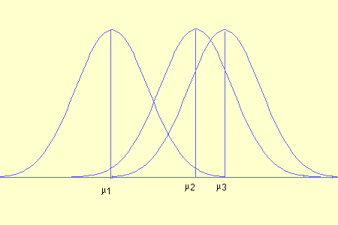
Analysis of Variance (ANOVA) Comparing means between three or more groups
Photo credit: http://www.stattucino.com/

Slide 3
Analysis of Variance
In its simplest form, it is used to compare means for three or more categories.
Examples:
Income (metric) and Marital Status (many categories)
Pain (metric) and Drug Type (several types, including a placebo).
Relies on the F-distribution
Just like the t-distribution and chi-square distribution, there are several sampling distributions for each possible value of df.

Slide 4
Why not just run a bunch of t-tests?
If we have a categorical variable with 3+ categories and a metric/interval/ratio variable, we could just run 3 t-tests.
So, we might look at group A compared to B, B to C, A to C…
One problem is that the 3 tests would not be independent of each other.
As number of comparisons grow, likelihood of finding some difference are expected– but do not necessarily indicate an overall difference.
Notes:
Individual t-tests result in an increased chance of a type I error (rejecting the null when we shouldn’t).

Slide 5
The problem with multiple t-tests
Consider comparing means between average incomes and all US States. For example:
California vs. Idaho
Idaho vs. Colorado
North Carolina vs. South Carolina
New York vs. Texas
….etc
How do you know that income actually varies by State? What is the basis for comparison?
Notes:
The point is that some of these are going to be significantly different…the more comparisons the more likely at least some will be significant.

Slide 6
Inflated error rates
The example we just discussed helps us understand why multiple t-tests would just not work if we have multiple comparisons (3 or more groups compared at a time). The actual problem can be further clarified by considering error:
We know that at an alpha value of .05, our standard, the probability of falsely rejecting the null hypothesis (Type I error) is just 5%.
Thus, the probability of NOT making a Type 1 error is 95%, which, again, is very reasonable for statisticians.

Slide 7
Inflated error rates (continued)
Let us suppose we are comparing 5 groups. In each case, the probability of NOT getting a Type 1 error is .95 (or 95%). (Remember, a Type I error is incorrect rejection of the null hypothesis by incorrectly accepting our alternative hypothesis).
Since we assume each test to be independent, we multiply those errors across all 5 groups (.95 to the 5th power), we get .77. So, there is a 77% chance of NOT getting a Type 1 error in any of our comparisons.
But, if there is now a 77% chance of NOT getting a Type 1 error, that means there is a 23% chance of getting at least one Type 1 error. This is way too high– remember that for only one test we only had a 5% chance of a Type 1 error!
This error rate across statistical tests from the same data is known as the familywise error rate, or the experimentwise error rate.

Slide 8
ANOVA as a solution to the multiple means comparison problem
A better approach: The variability within each group can tell us how much variability to expect between the groups (between the group means)
This is what ANOVA essentially does: it allows us to consider both types of variation (within and between groups).

Slide 9
ANOVA Intuition
Suppose we have groups with n members each. How much variance do we naturally expect between the group means?
Suppose we look within each group and find a variance of s_{wg}² (for each individual)
What variance would you predict for the mean of n individuals?
…

Slide 10
Calculating Variation: Sum of Squares and Mean Squares
The sum of squares is the sum of squared deviations (observed – expected)
We can apply this to measure three different types of variation:
(1) total sum of squares (difference between every observed data point and the grand mean).
(2) between-group sum of squares (difference between the mean of each group and the grand mean). This is sometimes called the “model sum of squares.”
(3) within-group sum of squares (difference between the score of a unit of analysis from a given group and the mean of that group). This is sometimes called the “residual sum of squares.”

Slide 11
From sum of squares to mean squares
Just as we did with the equation for variance, we need to account for the size of whatever type of group we are examining (e.g., between group variation or within group variation).
We resolve this by calculating the mean square, which is just the sum of squares divided by the appropriate degrees of freedom.

Slide 12
The F-ratio
MS = mean square
bg = between groups
wg = within groups
The numerator and denominator have their own degrees of freedom
Between groups df = the number of categories - 1, or (k-1)
Within groups df = N - # of categories (N – k)
Notes:
In the simplest terms, it is a ratio of the overall variance between the means of all groups, over the overall variance within the groups.
Named after R.A. Fisher

Slide 13
ANOVA and Regression
The ANOVA is also important for linear regression, where we investigate the linear relationship between one or more independent variables on a single dependent variable.
Thus, it is important to note that ANOVA is not only important for just looking at mean differences between groups. With regression, the ANOVA also allows us to test whether our overall regression model is significant– that is, whether there is no effect between any predictors and the dependent variable, or whether there are at least some significant differences in a given model.

Slide 14
F-Ratio framed as model divided by error
A different way to present the F-Ratio is to describe it as the Mean Square of the “model” divided by the Mean Square of the residual, or the “error”.
Note that either framing for the mean squares (“within-group variation divided by between-group variation” or “model divided by residual error”) is the same concept.

Slide 15
Interpreting the F-ratio
Generally, an F-ratio is a measure of how different the means are relative to the variability within each sample.
Thus, the F-ratio is the ratio of how good the model is against how bad it is (how much error there is).
Larger values of F → greater likelihood that the difference between means are not just due to chance alone.
We can also see why we are only looking for values of F that are greater than 1. If it is less than one, it means that their is more unsystematic variance than systematic variance. Or, to frame that differently, there is far more variation within the groups than there is variation between the groups.

Slide 16
Interpreting F
The overall F-test for an ANOVA is an omnibus test. That is, a significant F tells us that there is an overall effect– that there are some differences between means across all groups.
Importantly, the F does not tell us which means are significantly different from one another. We will have to do additional tests to find the individual group differences.

Slide 17
F-ratio
Remember: The F-ratio is just the mean square of the model divided by the mean square of the error. Put differently, F is the between-group variation divided by the within-group variation.

Slide 18
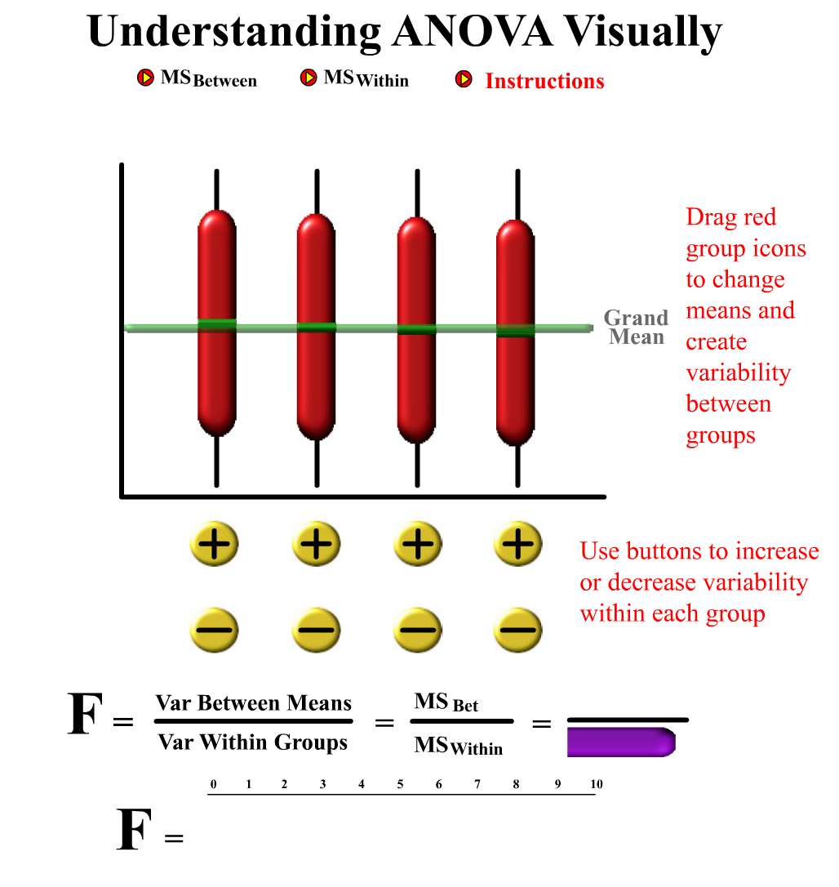
Example 1: No difference between means, and high within-group variation

Slide 19
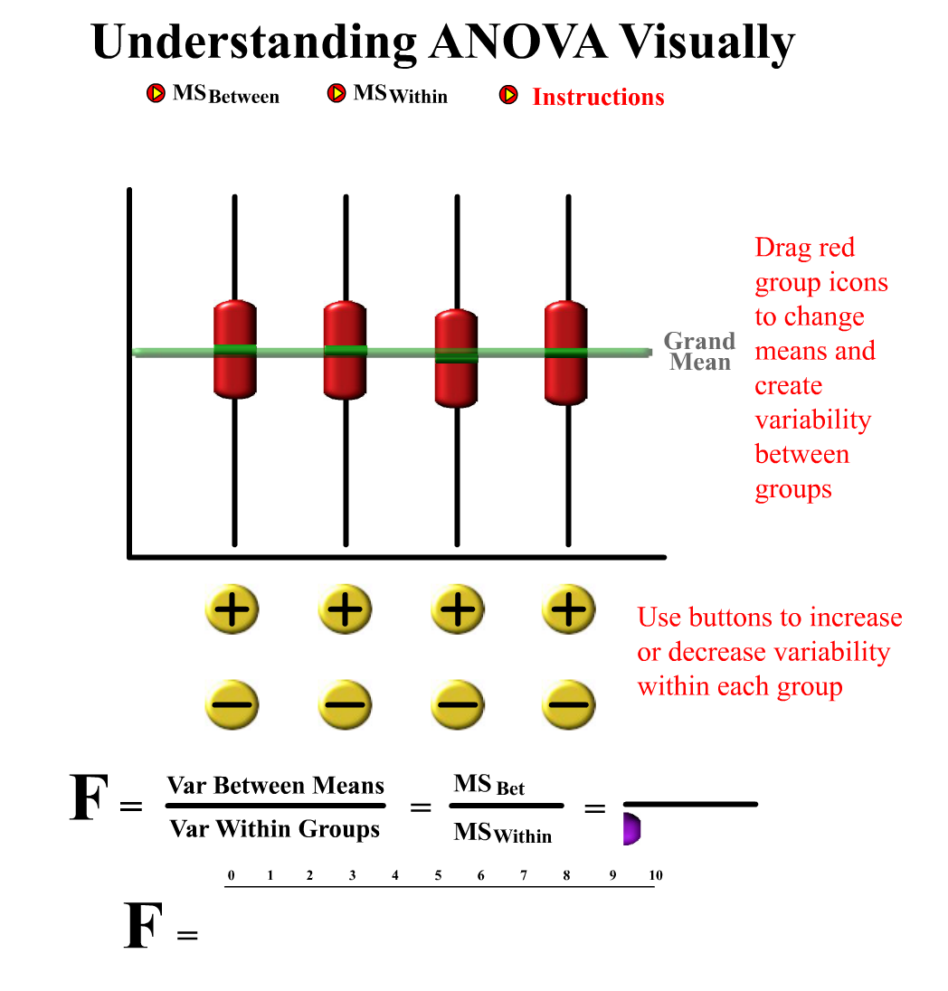
Example 2: No differences between means, low within-group variation

Slide 20
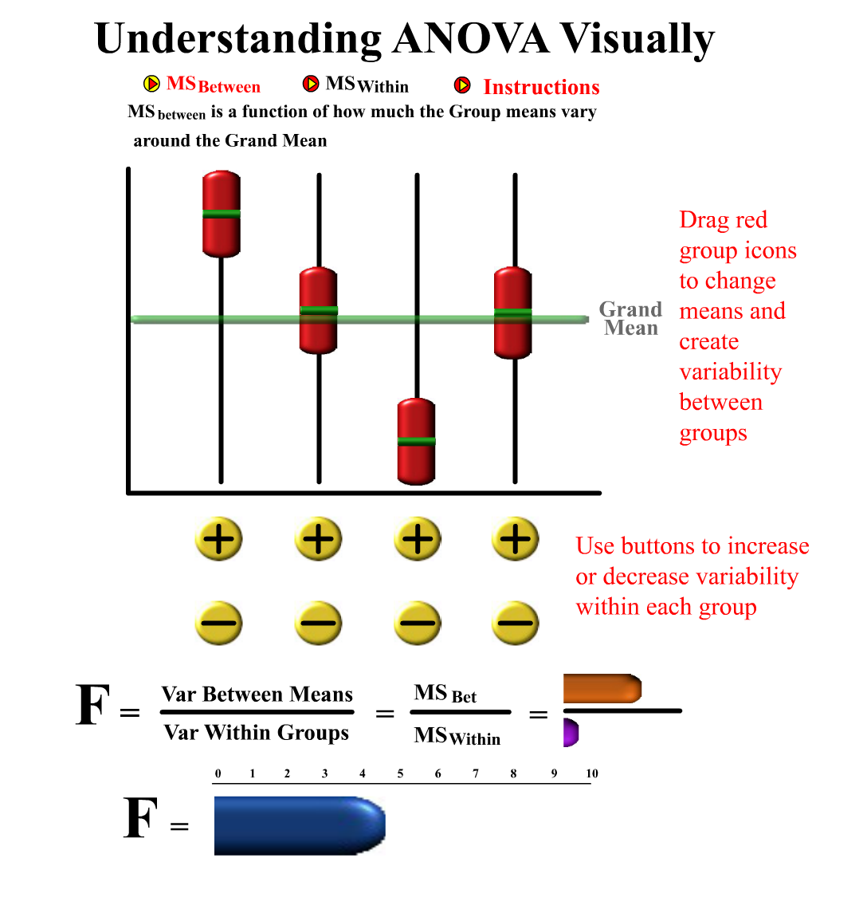
Example 3: Some between-group differences

Slide 21
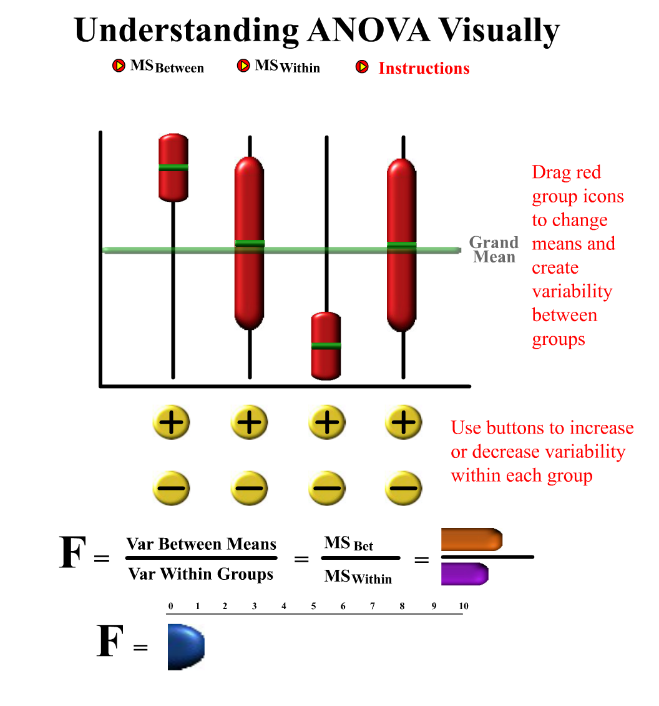
Example 4: between group differences with high within-group variation

Slide 22
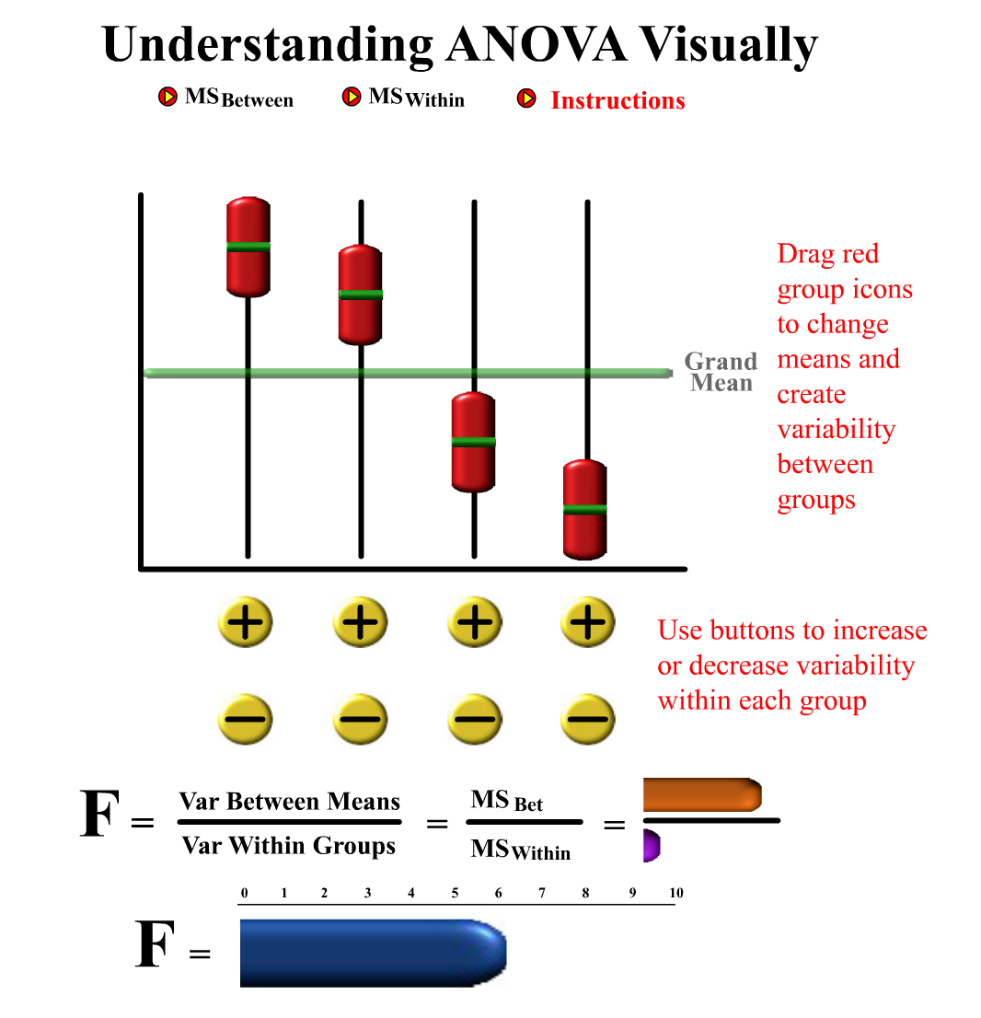
Example 5: Maximum difference between groups, with minimal within-group variation

Slide 23
Hypothesis testing with ANOVA
If there is little or no difference between the means, then the between-group sum of squares should be similar to the within-group sum of squares. (e.g., an F of 1 means the between-group variation is same as within-group variation)
Null Hypothesis: the means between all groups are equal.
Notes:
Why do we use the sum of squares?
Because…whenever we have three or more numerical values, the measure of their variability is equivalent to the measure of their aggregate differences. If this were a t-test we would have just taken mean differences.

Slide 25
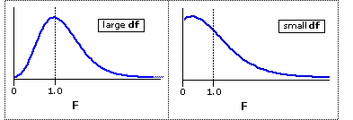
F-distribution
F-test for ANOVA is a one-tailed test.
A right-skewed distribution
It is a ratio of two chi-square distributions
Remember, Chi-square is the sum of squared deviates for randomly distributed variables…
So, the F-distribution is the ratio of two sum of squared deviates (or, one Chi-Square divided by another)
Notes:
Why is the ratio of two chi-square distributions an appropriate distribution to use?
Or, what does the F-ratio have to do with chi-square?
Remember, Chi-square is the sum of squared deviates for randomly distributed variables…
F-distribution is the ratio of two sum of squared deviates (or, one Chi-Square divided by another)

Slide 26
Assumptions of the ANOVA
Homogeneity of Variance:
We expect the variance within each group to be similar.
Just as we have done before, we can run Levene’s test to check this assumption.
Assumption of Normality
We expect our distributions to be mostly normally distributed
Just as we have done before, we could transform our variable if it non-normal.

Slide 27
Robustness of ANOVA
ANOVA is sometimes referred to as a “robust test”.
This simply means that even if we break some of the assumptions of the test, we still get a fairly accurate F-ratio.

Slide 28
Robustness of ANOVA
So, some deviation from normality or a lack of homogeneity of variance across our groups is not usually a problem.
The biggest exception is when you have very different group sizes and the variances are not equal across groups. In this type of situation that you might need to make corrections or even run a modified ANOVA that helps account for the problem (for example, Welch’s F test).

Slide 29
Effect Size
As with every test, we need to evaluate the practical significance of our result along with our statistical significance.
Once we know if our ANOVA is statistically significant, we can compute the effect size.
There is an effect size correlation for ANOVA, however, the effect size correlation is considered biased because it makes no adjustment for the fact that we are trying to estimate the effect size in the population.

Slide 30
Omega Squared as an effect size calculation for multiple groups
In order to get a better estimate for the effect size when comparing multiple groups, we use Omega Squared.
So, once we get the output from R, we can calculate it ourselves.
Again, please note that the “between-group sum of squares” is the same as the “model sum of squares”, and the “within-group mean square” is the same as “residual mean square”. This is important because the output in R or any other statistical software package may label the sums of squares differently.

Slide 31
Finding differences between groups after conducting the ANOVA
We know that the F-ratio tells us only whether the between-group variation is much larger than the within-group variation.
A large F-ratio only means that one or more of the differences between the means are statistically significant– but we don’t know which groups actually differ.
So, we need to do additional tests if we want to find out which groups differ from the others.

Slide 32
Planned Contrasts
If we actually have predictions about which groups (or categories) should be different than other groups (or categories), then we can run planned contrasts.
A planned contrast breaks down the variance accounted for in our model into its component parts.

Slide 33
Example: An experiment
Let’s imagine that we are working for a large health and education program and they want to do a huge national experiment on the effects of eating breakfast vs. not eating breakfast on academic achievement. In addition, they want to look at eating very little or eating a lot for breakfast.

Slide 34
Example of Planned Contrast
SS_{bg}
(Variance Explained by the Model, e.g the “Between-Group Variation”)
Eating More or Less Food for Breakfast
(Variance Explained by Experimental Conditions
Did Not Eat Breakfast
(Variance Explained by Control Condition)
Contrast 1
Eat More
Eat Less
Contrast 2

Slide 35
Post-hoc Tests
A completely different approach than planned contrasts is to just hunt for significant differences without any theory or hypothesis to guide us.
Post-hoc tests are a series of t-tests between all of our different groups or categories. These are called pairwise comparisons.
We already said that this was a bad way to look for overall variation between groups, but now we can use multiple t-tests to find specific difference between groups.
Post-hoc tests of this sort are a type of data mining and data exploration. This is because we have no a priori predictions about our data, but instead we are using statistical techniques to find significant differences.

Slide 36
ANOVA and t-test: Correcting for multiple comparisons
How do we know where the differences exist once we know that we have an overall difference between groups?
We still have the problem that as we compare more and more groups, *some* differences are expected just due to chance.

Slide 37
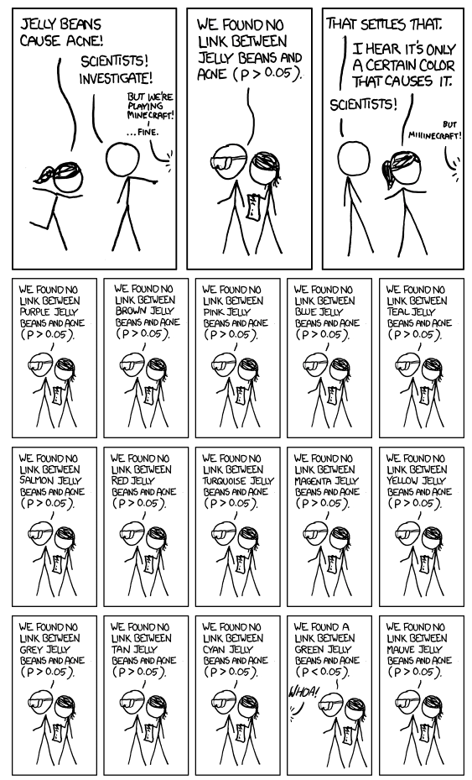
http://xkcd.com/882/

Slide 38
Correcting for Multiple Comparisons
Certain ‘corrections’ can be applied to post-hoc t-tests so that we account for multiple comparisons
Bonferroni correction: We divide the desired p-value by the number of comparisons being made). In essence, we are making our threshold for statistical significance much more conservative.

Slide 39
Bonferroni Correction
If we want to use our standard alpha of .05 and we have 3 comparisons, we divide .05 by 3.
In this example, we would need to get at least p=.017 (.05 / 3) to be confident in the statistical significance of the result. If we have 4 comparisons, each of our t-tests would need to have p-values = .0125 in order to be the equivalent of our standard alpha of .05.
It is worth noting that there are many different means comparisons test available (Tukey, Sidak, etc). The tests differ in how conservatively they estimate the p-value.

Slide 40
In Sum…
We use a basic ANOVA when we want to compare several means that come from independent groups.
As always, we should check to make sure we meet the assumptions of an ANOVA. However, ANOVA is a fairly robust test (we can obtain accurate estimates even when we violate some assumptions).
After we conduct an ANOVA and determine that it is significant, we can then run tests to see where the significant differences occur.
We use planned contrasts when we have specific hypotheses, and post-hoc tests when we do not have hypotheses.

Slide 41
ANOVA Example with some data:
We have data on three different types of cellphones (we will call them phones 1, 2, and 3.
We want to examine average battery life (in hours) for the three types of phones.
We can run a simple one-way ANOVA between phone type and battery life, as well as post-hoc tests since we don’t have a hypothesis about which phone has the best or worst battery life.
http://gadgetsteria.com/wp-content/uploads/2009/06/pile-o-cellphones-e1305282351881.jpg

Slide 42
Basic ANOVA output
Group Variable: Phones (1,2,3)
Quantitative Variable: Battery Life
> AnovaModel.2 <- aov(BatteryLife ~ Phone, data=Phones)
> summary(AnovaModel.2)
Df Sum Sq Mean Sq F value Pr(>F)
Phone 2 1549 774.5 5.349 0.0113 *
Residuals 26 3764 144.8
---
Signif. codes: 0 '***' 0.001 '**' 0.01 '*' 0.05 '.' 0.1 ' ' 1
> numSummary(Phones$BatteryLife , groups=Phones$Phone, statistics=c("mean", "sd"))
mean sd data:n
1 12.44444 2.505549 9
2 30.50000 9.980537 10
3 22.80000 17.693690 10

Slide 43
Effect Size
> AnovaModel.2 <- aov(BatteryLife ~ Phone, data=Phones)
> summary(AnovaModel.2)
Df Sum Sq Mean Sq F value Pr(>F)
Phone 2 1549 774.5 5.349 0.0113 *
Residuals 26 3764 144.8
ω² = 1549 – (2)144.8 / 5313 + 144.8
= 1549 – 289.6 / 5457.8 =
= 1259.4 / 5457.8
= .23
SS_{T} = SS_{BW} + SS_{W}
= 1549 + 3764
= 5313
Suggested interpretations for Omega Squared are small (.01), medium (.06), and large (.14 or higher)

Slide 44
Post-Hoc Tests
> pairwise.t.test(Phones$BatteryLife, Phones$Phone, p.adjust.method="bonferroni")
Pairwise comparisons using t tests with pooled SD
data: Phones$BatteryLife and Phones$Phone
1 2
2 0.0092 -
3 0.2170 0.4931
P value adjustment method: bonferroni

Slide 45
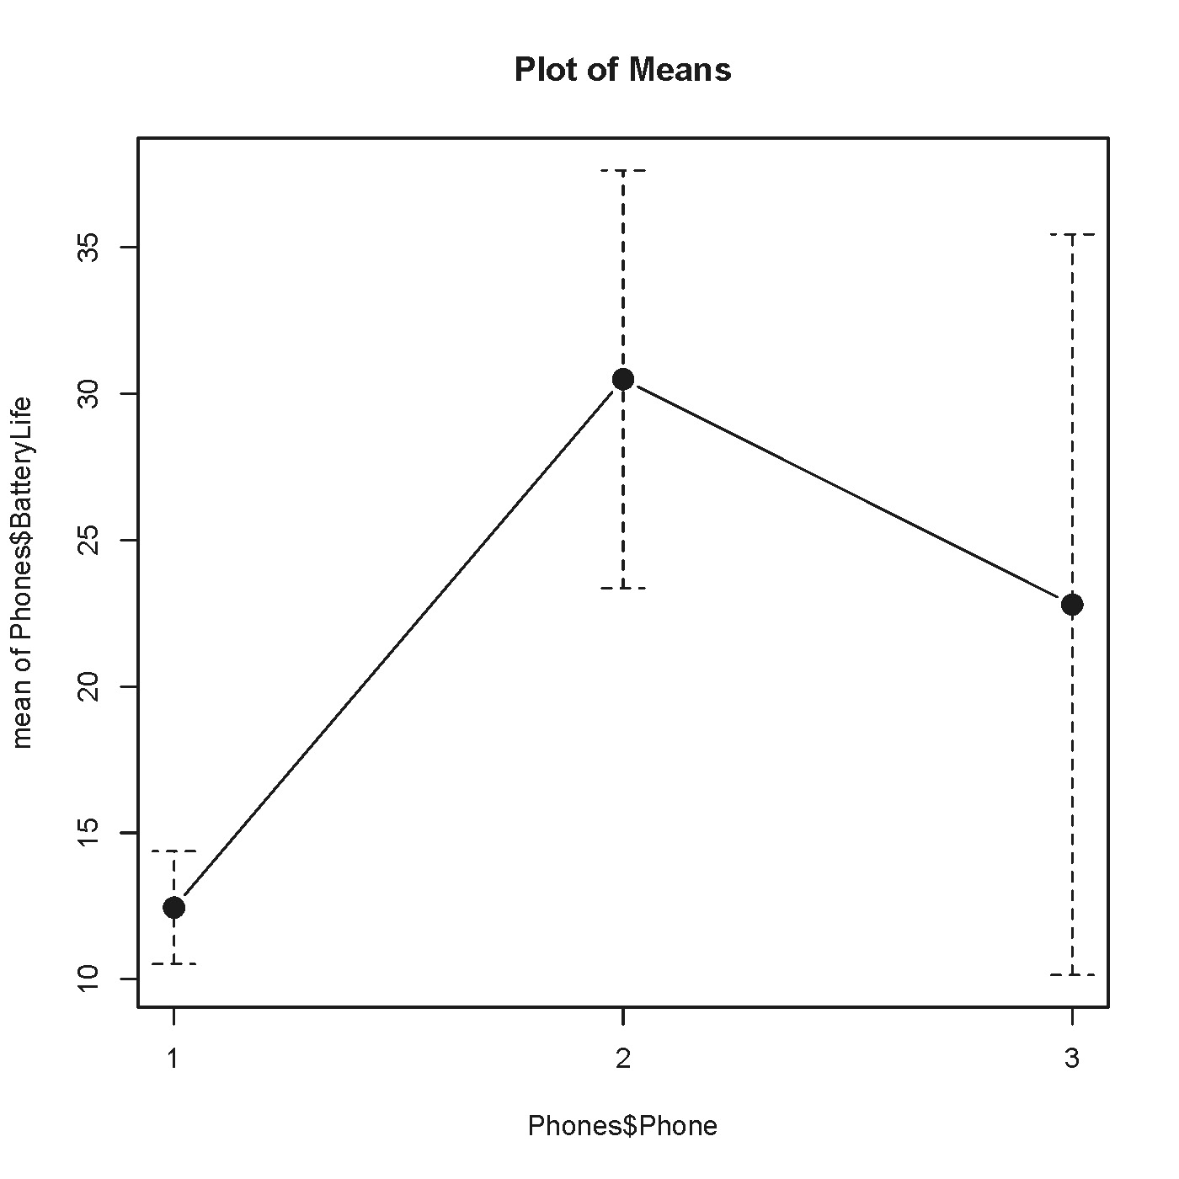
Line Chart of Mean Battery Life by Phone Type (with confidence intervals)

