Slide 1
MapReduce, HBase, Pig and Hive
University of California, Berkeley
School of Information
IS 257: Database Management

Slide 2
History of the World, Part 1
Relational Databases – mainstay of business
Web-based applications caused spikes
  Especially true for public-facing e-Commerce sites
Developers begin to front RDBMS with memcache or integrate other caching mechanisms within the application (ie. Ehcache)
Notes:
-> For the longest time (and still true today), the big relational database vendors such as Oracle, IBM, Sybase, and a lesser extent Microsoft were the mainstay of how data was stored.
-> During the Internet boom, startups looking for low-cost RDBMS alternatives turned to MySQL and PostgreSQL.
-> The ‘Slashdot Effect’ occurs when a popular website links to a smaller site, causing a massive increase in traffic.
-> Hooking your RDBMS to a web-based application was a recipe for headaches, they are OLTP in nature. Could have hundreds of thousands of visitors in a short-time span.
-> To mitigate, began to front the RDBMS with a read-only cache such as memcache to offload a considerable amount of the read traffic.
-> As datasets grew, the simple memcache/MySQL model (for lower-cost startups) started to become problematic.

Slide 3
Scaling Up
Issues with scaling up when the dataset is just too big
RDBMS were not designed to be distributed
Began to look at multi-node database solutions
Known as ‘scaling out’ or ‘horizontal scaling’
Different approaches include:
  Master-slave
  Sharding
Notes:
-> Best way to provide ACID and a rich query model is to have the dataset on a single machine.
-> However, there are limits to scaling up (Vertical Scaling).
-> Past a certain point, an organization will find it is cheaper and more feasible to scale out (horizontal scaling) by adding smaller, more inexpensive (relatively) servers rather than investing in a single larger server.
-> A number of different approaches to scaling out (Horizontal Scaling).
-> DBAs began to look at master-slave and sharding as a strategy to overcome some of these issues.

Slide 4
Scaling RDBMS – Master/Slave
Master-Slave
  All writes are written to the master. All reads performed against the replicated slave databases
  Critical reads may be incorrect as writes may not have been propagated down
  Large data sets can pose problems as master needs to duplicate data to slaves

Slide 5
Scaling RDBMS - Sharding
Partition or sharding
  Scales well for both reads and writes
  Not transparent, application needs to be partition-aware
  Can no longer have relationships/joins across partitions
  Loss of referential integrity across shards
Notes:
-> Different sharding approaches:
-> Vertical Partitioning: Have tables related to a specific feature sit on their own server. May have to rebalance or reshard if tables outgrow server.
-> Range-Based Partitioning: When single table cannot sit on a server, split table onto multiple servers. Split table based on some critical value range.
-> Key or Hash-Based partitioning: Use a key value in a hash and use the resulting value as entry into multiple servers.
-> Directory-Based Partitioning: Have a lookup service that has knowledge of the partitioning scheme . This allows for the adding of servers or
changing the partition scheme without changing the application.
-> http://adam.heroku.com/past/2009/7/6/sql_databases_dont_scale

Slide 6
Other ways to scale RDBMS
Multi-Master replication
INSERT only, not UPDATES/DELETES
No JOINs, thereby reducing query time
  This involves de-normalizing data
In-memory databases (like VoltDB)
Notes:
-> The multi-master replication system is responsible for propagating data modifications made by each member to the rest of the group, and resolving any conflicts that might arise between concurrent changes made by different members.
-> For INSERT-only, data is versioned upon update.
-> Data is never DELETED, only inactivated.
-> JOINs are expensive with large volumes and don’t work across partitions.
-> Denormalization leads to even larger databases, reduces query time.
-> Consistency is the responsibility of the application.
-> In-memory databases have not caught on mainstream and regular RDBMS are more disk-intensive that memory-intensive. Vendors looking to fix this.

Slide 7
NoSQL
NoSQL databases adopted these approaches to scaling, but lacked ACID transaction and SQL
At the same time, many Web-based services needed to deal with Big Data (the Three V’s we looked at last time) and created custom approaches to do this
In particular, MapReduce…

Slide 8
MapReduce and Hadoop
MapReduce developed at Google
MapReduce implemented in Nutch
  Doug Cutting at Yahoo!
  Became Hadoop (named for Doug’s child’s stuffed elephant toy)

Slide 9
Motivation
Large-Scale Data Processing
  Want to use 1000s of CPUs
    But don’t want hassle of managing things
MapReduce provides
  Automatic parallelization & distribution
  Fault tolerance
  I/O scheduling
  Monitoring & status updates
From “MapReduce…” by Dan Weld

Slide 10
Map/Reduce
Map/Reduce
  Programming model from Lisp
  (and other functional languages)
Many problems can be phrased this way
Easy to distribute across nodes
Nice retry/failure semantics
From “MapReduce…” by Dan Weld

Slide 11
Map in Lisp (Scheme)
(map f list [list₂ list₃ …])
(map square ‘(1 2 3 4))
  (1 4 9 16)
(reduce + ‘(1 4 9 16))
  (+ 16 (+ 9 (+ 4 1) ) )
  30
(reduce + (map square (map – l₁ l₂))))
Unary operator
Binary operator
From “MapReduce…” by Dan Weld

Slide 12
Map/Reduce ala Google
map(key, val) is run on each item in set
  emits new-key / new-val pairs
reduce(key, vals) is run for each unique key emitted by map()
  emits final output
From “MapReduce…” by Dan Weld

Slide 13
Programming model
Input & Output: each a set of key/value pairs
Programmer specifies two functions:
map (in_key, in_value) -> list(out_key, intermediate_value)
  Processes input key/value pair
  Produces set of intermediate pairs
reduce (out_key, list(intermediate_value)) -> list(out_value)
  Combines all intermediate values for a particular key
  Produces a set of merged output values (usually just one)
From “MapReduce: Simplified data Processing… ”, Jeffrey Dean and Sanjay Ghemawat

Slide 14
count words in docs
  Input consists of (url, contents) pairs
  map(key=url, val=contents):
    For each word w in contents, emit (w, “1”)
  reduce(key=word, values=uniq_counts):
    Sum all “1”s in values list
    Emit result “(word, sum)”
From “MapReduce…” by Dan Weld

Slide 15
Count, Illustrated
  map(key=url, val=contents):
    For each word w in contents, emit (w, “1”)
  reduce(key=word, values=uniq_counts):
    Sum all “1”s in values list
    Emit result “(word, sum)”
  see 1
  bob 1
  run 1
  see 1
  spot 1
  throw 1
  bob 1
  run 1
  see 2
  spot 1
  throw 1
  see bob throw
  see spot run
From “MapReduce…” by Dan Weld

Slide 16
Example
Page 1: the weather is good
Page 2: today is good
Page 3: good weather is good.
From “MapReduce: Simplified data Processing… ”, Jeffrey Dean and Sanjay Ghemawat

Slide 17
Map output
Worker 1:
  (the 1), (weather 1), (is 1), (good 1).
Worker 2:
  (today 1), (is 1), (good 1).
Worker 3:
  (good 1), (weather 1), (is 1), (good 1).
From “MapReduce: Simplified data Processing… ”, Jeffrey Dean and Sanjay Ghemawat

Slide 18
Reduce Input
Worker 1:
  (the 1)
Worker 2:
  (is 1), (is 1), (is 1)
Worker 3:
  (weather 1), (weather 1)
Worker 4:
  (today 1)
Worker 5:
  (good 1), (good 1), (good 1), (good 1)
From “MapReduce: Simplified data Processing… ”, Jeffrey Dean and Sanjay Ghemawat

Slide 19
Reduce Output
Worker 1:
  (the 1)
Worker 2:
  (is 3)
Worker 3:
  (weather 2)
Worker 4:
  (today 1)
Worker 5:
  (good 4)
From “MapReduce: Simplified data Processing… ”, Jeffrey Dean and Sanjay Ghemawat

Slide 20
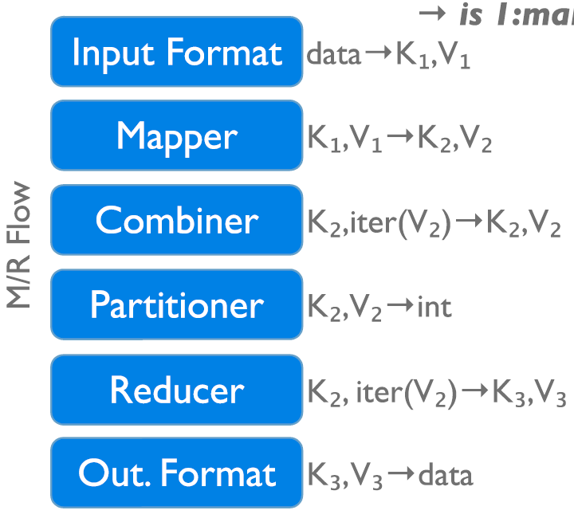
Data Flow in a MapReduce Program in Hadoop
→ 1:many
InputFormat
Map function
Partitioner
Sorting & Merging
Combiner
Shuffling
Merging
Reduce function
OutputFormat

Slide 21
Grep
  Input consists of (url+offset, single line)
  map(key=url+offset, val=line):
    If contents matches regexp, emit (line, “1”)
  reduce(key=line, values=uniq_counts):
    Don’t do anything; just emit line
From “MapReduce…” by Dan Weld

Slide 22
Reverse Web-Link Graph
Map
  For each URL linking to target, …
  Output <target, source> pairs
Reduce
  Concatenate list of all source URLs
  Outputs: <target, list (source)> pairs
From “MapReduce…” by Dan Weld

Slide 23
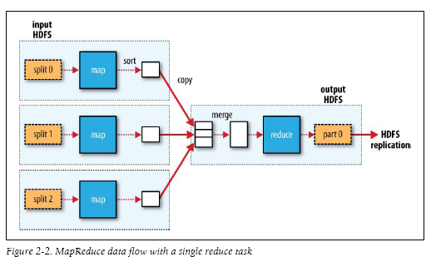
MapReduce in Hadoop (1)

Slide 24
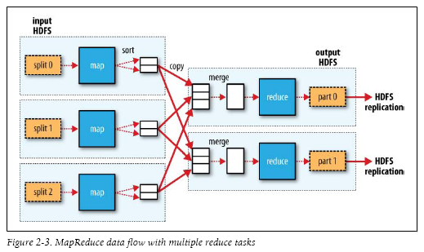
MapReduce in Hadoop (2)

Slide 25
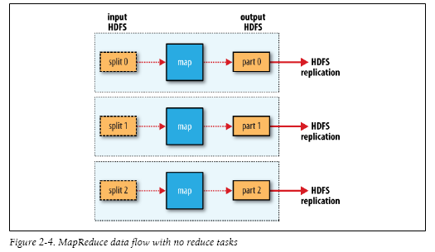
MapReduce in Hadoop (3)

Slide 26
Fault tolerance
On worker failure:
  Detect failure via periodic heartbeats
  Re-execute completed and in-progress map tasks
  Re-execute in progress reduce tasks
  Task completion committed through master
Master failure:
  Could handle, but don't yet (master failure unlikely)
From “MapReduce: Simplified data Processing… ”, Jeffrey Dean and Sanjay Ghemawat

Slide 27
Refinement
Different partitioning functions.
Combiner function.
Different input/output types.
Skipping bad records.
Local execution.
Status info.
Counters.
From “MapReduce: Simplified data Processing… ”, Jeffrey Dean and Sanjay Ghemawat

Slide 28
Performance
Scan 10^10 100-byte records to extract records matching a rare pattern (92K matching records) : 150 seconds.
Sort 10^10 100-byte records (modeled after TeraSort benchmark) : normal 839 seconds.
From “MapReduce: Simplified data Processing… ”, Jeffrey Dean and Sanjay Ghemawat

Slide 29
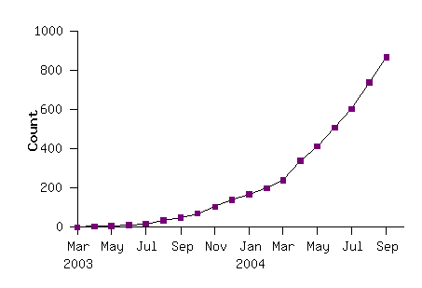
More and more mapreduce
From “MapReduce: Simplified data Processing… ”, Jeffrey Dean and Sanjay Ghemawat

Slide 30
Conclusion
MapReduce has proven to be a useful abstraction
Greatly simplifies large-scale computations at Google
Fun to use: focus on problem, let library deal w/ messy details
From “MapReduce: Simplified data Processing… ”, Jeffrey Dean and Sanjay Ghemawat

Slide 31
But – Raw Hadoop means code
Most people don’t want to write code if they don’t have to
Various tools layered on top of Hadoop give different, and more familiar, interfaces
Hbase – intended to be a NoSQL database abstraction for Hadoop
Hive and it’s SQL-like language

Slide 32
Hadoop Components
Hadoop Distributed File System (HDFS)
Hadoop Map-Reduce
Contributes
  Hadoop Streaming
  Pig / JAQL / Hive
  HBase
  Hama / Mahout

Slide 33
Hadoop Distributed File System
Notes:
33

Slide 34
Goals of HDFS
Very Large Distributed File System
  10K nodes, 100 million files, 10 PB
Convenient Cluster Management
  Load balancing
  Node failures
  Cluster expansion
Optimized for Batch Processing
  Allow move computation to data
  Maximize throughput
Notes:
Very Large Distributed File System
10K nodes, 100 million files, 10 PB
Assumes Commodity Hardware
Files are replicated to handle hardware failure
Detect failures and recovers from them
Optimized for Batch Processing
Data locations exposed so that computations can move to where data resides
Provides very high aggregate bandwidth

Slide 35
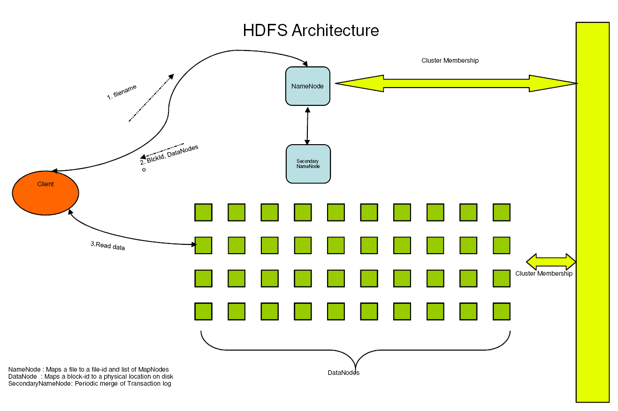
HDFS Architecture
Notes:
Name node: single point of failure, so we have secondary name node.
Secondary name node: read transaction log from name node, and upload FSImage to name node.
Single name node avoids metadata conflict etc.
Data node: easy to join and leave cluster.
Heartbeat protocol.

Slide 36
HDFS Details
Data Coherency
  Write-once-read-many access model
  Client can only append to existing files
Files are broken up into blocks
  Typically 128 MB block size
  Each block replicated on multiple DataNodes
Intelligent Client
  Client can find location of blocks
  Client accesses data directly from DataNode

Slide 37
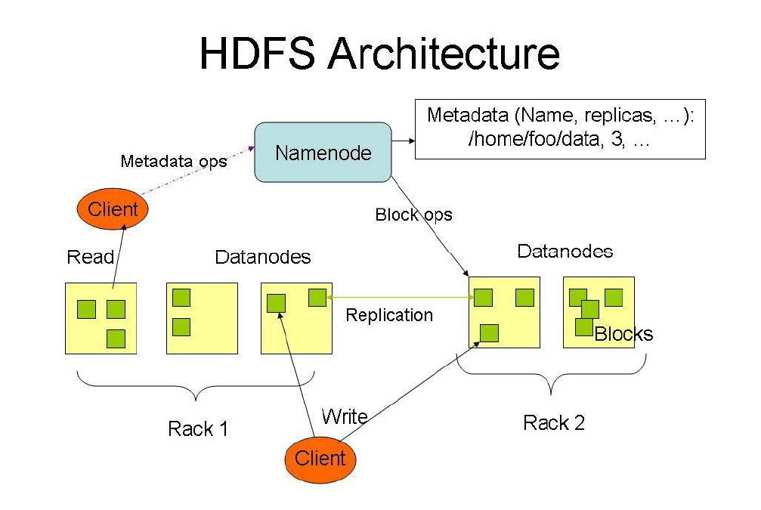
Notes:
Block placement policy
Block balancing
Block replication on node failure

Slide 38
HDFS User Interface
Java API
Command Line
  hadoop dfs -mkdir /foodir
  hadoop dfs -cat /foodir/myfile.txt
  hadoop dfs -rm /foodir myfile.txt
  hadoop dfsadmin -report
  hadoop dfsadmin -decommission datanodename
Web Interface
  http://host:port/dfshealth.jsp

Slide 39
HDFS
Very large-scale distributed storage with automatic backup (replication)
Processing can run at each node also
  Bring the computation to the data instead of vice-versa
Underlies all of the other Hadoop “menagie” of programs

Slide 40
Introduction to Pig
PIG – A data-flow language for MapReduce

Slide 41
MapReduce too complex?
Restrict programming model
  Only two phases
  Job chain for long data flow
Put the logic at the right phase
  In MR programmers are responsible for this
Too many lines of code even for simple logic
  How many lines do you have for word count?

Slide 42
Pig…
High level dataflow language (Pig Latin)
  Much simpler than Java
  Simplify the data processing
Put the operations at the apropriate phases (map, shuffle, etc.)
Chains multiple MapReduce jobs
Similar to relational algebra, but on files instead of relations

Slide 43
Pig Latin
Data flow language
  User specifies a sequence of operations to process data
  More control on the processing, compared with declarative language
Various data types are supported
”Schema”s are supported
User-defined functions are supported

Slide 44
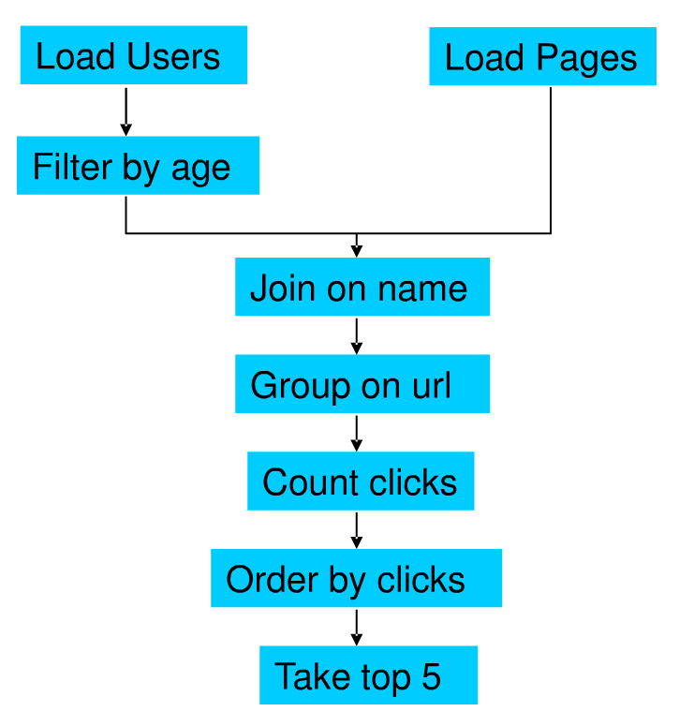
Motivation by Example
Suppose we have user data in one file, website data in another file.
We need to find the top 5 most visited pages by users aged 18-25

Slide 45
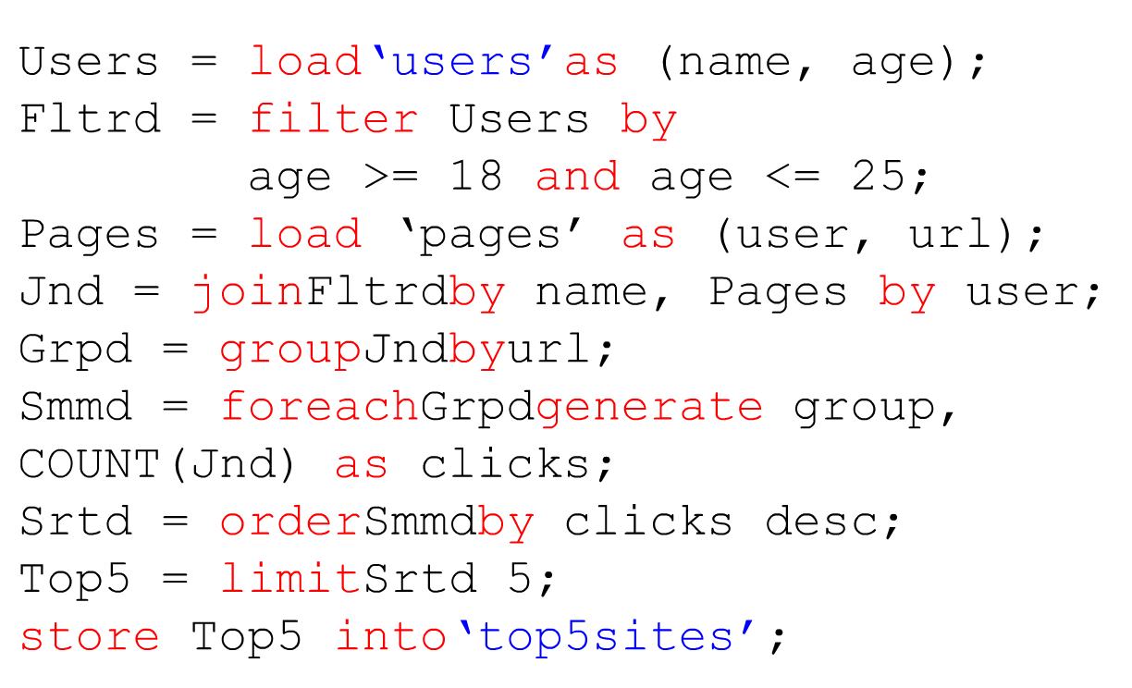
In Pig Latin

Slide 46
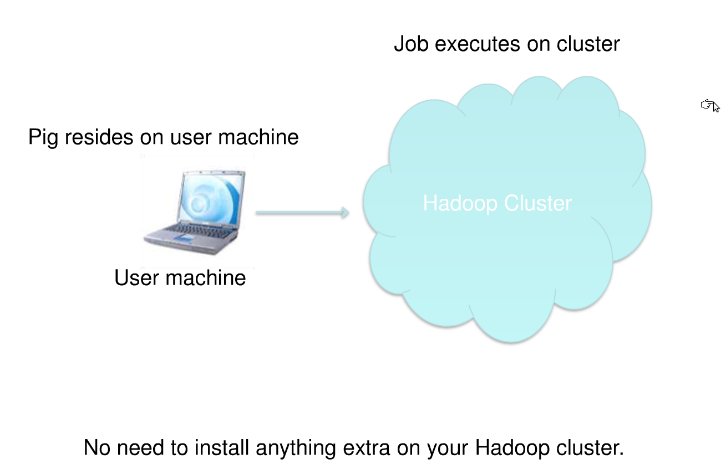
Pig runs over Hadoop

Slide 47
How Pig is used in Industry
At Yahoo!, 70% MapReduce jobs are written in Pig
Used to
  Process web log
  Build user behavior models
  Process images
  Data mining
Also used by Twitter, LinkedIn, Ebay, AOL, etc.

Slide 48
MapReduce vs. Pig
MaxTemperature
Year | Temperature | Air Quality | …
1998 | 87 | 2 | …
1983 | 93 | 4 | ..
2008 | 90 | 3 | …
2001 | 89 | 5 | …
1965 | 97 | 4 | …
SELECT Year, MAX(Temperature)
FROM Table1
WHERE AirQuality = 0|1|4|5|9
GROUPBY Year
Table1

Slide 49
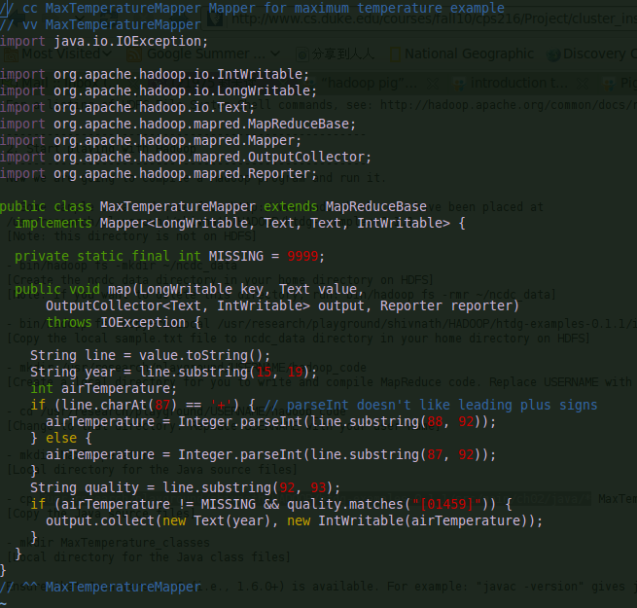
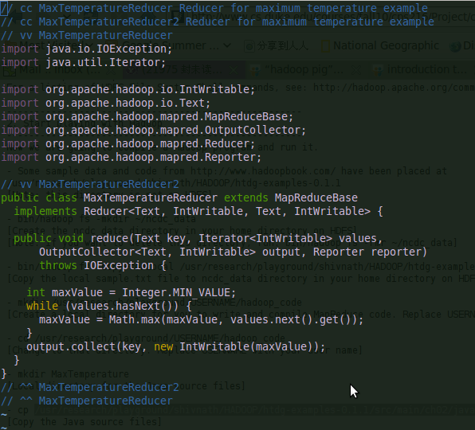
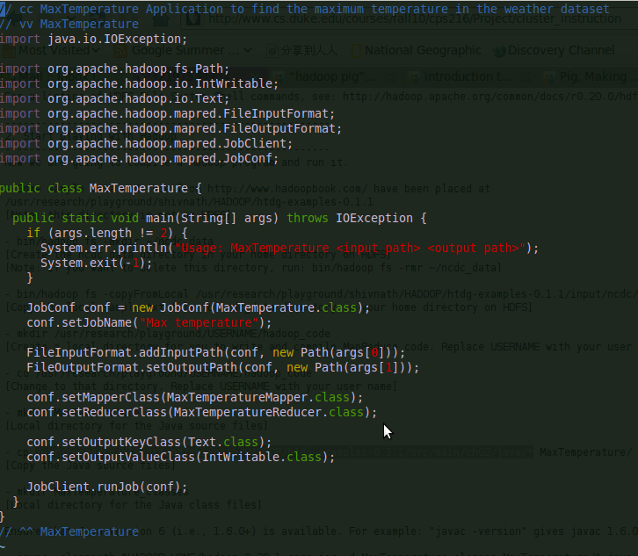
In MapReduce

Slide 50
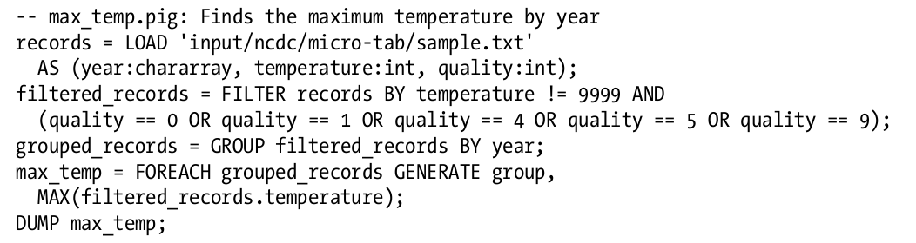
In Pig

Slide 51
Wait a mimute
How to map the data to records
  By default, one line → one record
  User can customize the loading process
How to identify attributes and map them to schema?
  Delimiters to separate different attributes
  By default tabs are used, but it can be customized

Slide 52
MapReduce vs. Pig cont.
Join in MapReduce
  Various algorithms. None of them are easy to implement in MapReduce
  Multi-way join more complicated

Slide 53
MapReduce vs. Pig cont.
Join in Pig
  Various algorithms already available.
  Some of them are generic to support multi-way join
  Simple to integrate into workflow…
  A = LOAD 'input/join/A’;
  B = LOAD 'input/join/B’;
  C = JOIN A BY $0, B BY $1;
  DUMP C;

Slide 54
Hive - SQL on top of Hadoop
Notes:
54

Slide 55
Map-Reduce and SQL
Map-Reduce is scalable
  SQL has a huge user base
  SQL is easy to code
Solution: Combine SQL and Map-Reduce
  Hive on top of Hadoop (open source)
  Aster Data (proprietary)
  Green Plum (proprietary)

Slide 56
Hive
A database/data warehouse on top of Hadoop
  Rich data types (structs, lists and maps)
  Efficient implementations of SQL filters, joins and group-by’s on top of mapreduce
Allow users to access Hadoop data without using Hadoop
Link:
  http://svn.apache.org/repos/asf/hadoop/hive/trunk/
Notes:
56

Slide 57
Hive Architecture
Map Reduce
HDFS
Web UI
Hive CLI
Mgmt, etc
Browsing
Queries
DDL
MetaStore
Hive QL
Parser
Planner
Planner
Execution
SerDe
Thrift
Jute
JSON
Thrift API

Slide 58
Hive QL – Join
SQL:
  INSERT INTO TABLE pv_users
  SELECT pv.pageid, u.age
  FROM page_view pv JOIN user u ON (pv.userid = u.userid);
page_view
pv_users
user
pageid | userid | time
1 | 111 | 9:08:01
2 | 111 | 9:08:13
1 | 222 | 9:08:14
pageid | age
1 | 25
2 | 25
1 | 32
userid | age | gender
111 | 25 | female
222 | 32 | male
X
=

Slide 59
Hive QL – Join in Map Reduce
page_view
pageid | userid | time
1 | 111 | 9:08:01
2 | 111 | 9:08:13
1 | 222 | 9:08:14
key | value
111 | <1,1>
111 | <1,2>
222 | <1,1>
key | value
111 | <1,1>
111 | <1,2>
111 | <2,25>
pv_users
pageid | age
1 | 25
2 | 25
Shuffle
Sort
key | value
111 | <2,25>
222 | <2,32>
Reduce
user
Map
userid | age | gender
111 | 25 | female
222 | 32 | male
key | value
222 | <1,1>
222 | <2,32>
pageid | age
1 | 32

Slide 60
Hive QL – Group By
SQL:
      INSERT INTO TABLE pageid_age_sum
      SELECT pageid, age, count(1)
      FROM pv_users
      GROUP BY pageid, age;
pv_users
pageid_age_sum
pageid | age
1 | 25
2 | 25
1 | 32
2 | 25
pageid | age | Count
1 | 25 | 1
2 | 25 | 2
1 | 32 | 1

Slide 61
Hive QL – Group By in Map Reduce
pv_users
pageid | age
1 | 25
2 | 25
key | value
<1,25> | 1
<2,25> | 1
key | value
<1,25> | 1
<1,32> | 1
pageid_age_sum
Shuffle
Sort
pageid | age | Count
1 | 25 | 1
1 | 32 | 1
Map
pageid | age
1 | 32
2 | 25
key | value
<1,32> | 1
<2,25> | 1
Reduce
key | value
<2,25> | 1
<2,25> | 1
pageid | age | Count
2 | 25 | 2

Slide 62
Beyond Hadoop – Spark

Slide 63
Spark
One problem with Hadoop/MapReduce is that it is fundamental batch oriented, and everything goes through a read/write on HDFS for every step in a dataflow
Spark was developed to leverage the main memory of distributed clusters and to, whenever possible, use only memory-to-memory data movement (with other optimizations
Can give up to 100fold speedup over MR

Slide 64
Spark
Developed at the AMP lab here at Berkeley
Open source version available from Apache
DataBrick was founded to commercialize Spark
Related software includes a very-high-speed Database – SparkDB
Next time we will hear a talk (recorded) from Michael Franklin about BDAS & Spark

