Slide 1
Data Warehouses, Decision Support and Data Mining
University of California, Berkeley
School of Information
IS 257: Database Management

Slide 2
Lecture Outline
Review
  Data Warehouses
    (Based on lecture notes from Joachim Hammer, University of Florida, and Joe Hellerstein and Mike Stonebraker of UCB)
Applications for Data Warehouses
  Decision Support Systems (DSS)
  OLAP (ROLAP, MOLAP)
  Data Mining
    Thanks again to lecture notes from Joachim Hammer of the University of Florida and others

Slide 3
Lecture Outline
Review
  Data Warehouses
    (Based on lecture notes from Joachim Hammer, University of Florida, and Joe Hellerstein and Mike Stonebraker of UCB)
Applications for Data Warehouses
  Decision Support Systems (DSS)
  OLAP (ROLAP, MOLAP)
  Data Mining
    Thanks again to lecture notes from Joachim Hammer of the University of Florida and others

Slide 4

Problem: Heterogeneous Information Sources
“Heterogeneities are everywhere”
Personal
Databases
World
Wide
Web
Scientific Databases
Digital Libraries
Different interfaces
Different data representations
Duplicate and inconsistent information
Slide credit: J. Hammer

Slide 5
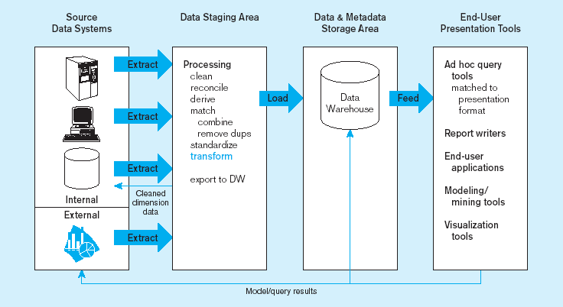
Generic two-level data warehousing architecture
L
One, company-wide warehouse
T
E
Periodic extraction ➔ data is not completely current in warehouse

Slide 6
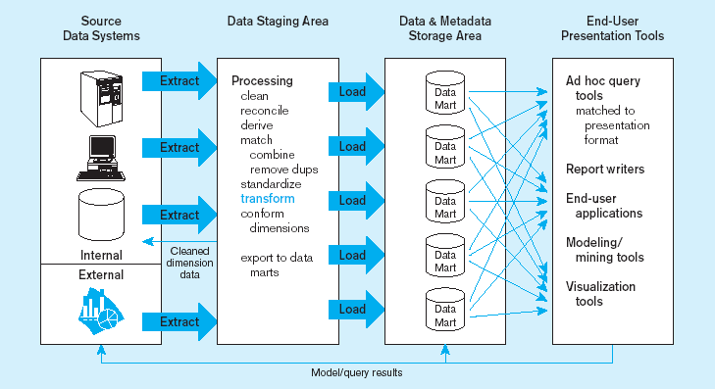
Independent data mart data warehousing architecture
Data marts:
Mini-warehouses, limited in scope
L
T
E
Separate ETL for each independent data mart
Data access complexity due to multiple data marts

Slide 7
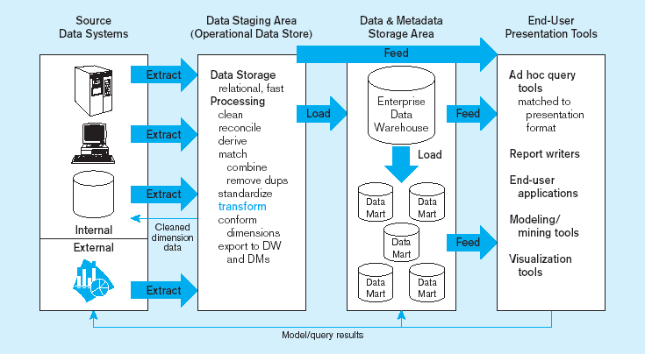
Dependent data mart with operational data store: a three-level architecture
ODS provides option for obtaining current data
L
T
E
Simpler data access
Single ETL for
enterprise data warehouse
(EDW)
Dependent data marts loaded from EDW

Slide 8
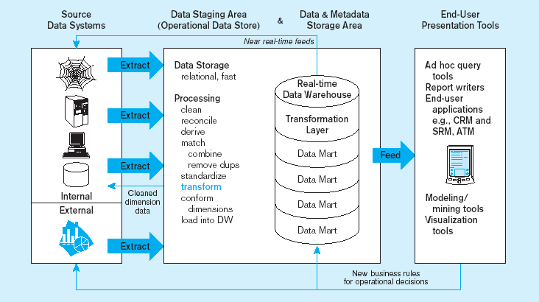
Logical data mart and real time warehouse architecture
ODS and data warehouse are one and the same
L
T
E
Near real-time ETL for
Data Warehouse
Data marts are NOT separate databases, but logical views of the data warehouse
➔ Easier to create new data marts

Slide 9
The ETL Process
Capture/Extract
Scrub or data cleansing
Transform
Load and Index
ETL = Extract, transform, and load

Slide 10
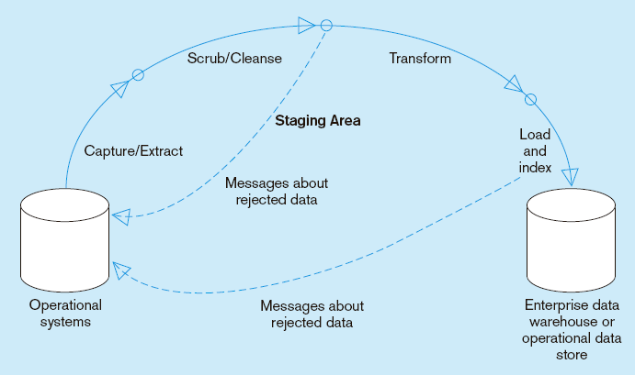
Capture/Extract…obtaining a snapshot of a chosen subset of the source data for loading into the data warehouse
Static extract = capturing a snapshot of the source data at a point in time
Incremental extract = capturing changes that have occurred since the last static extract

Slide 11
Scrub/Cleanse…uses pattern recognition and AI techniques to upgrade data quality
Figure 11-10: Steps in data reconciliation
(cont.)
Fixing errors: misspellings, erroneous dates, incorrect field usage, mismatched addresses, missing data, duplicate data, inconsistencies
Also: decoding, reformatting, time stamping, conversion, key generation, merging, error detection/logging, locating missing data

Slide 12
Transform = convert data from format of operational system to format of data warehouse
Figure 11-10: Steps in data reconciliation
(cont.)
Record-level:
Selection–data partitioning
Joining–data combining
Aggregation–data summarization
Field-level:
single-field–from one field to one field
multi-field–from many fields to one, or one field to many

Slide 13
Load/Index= place transformed data into the warehouse and create indexes
Figure 11-10: Steps in data reconciliation
(cont.)
Refresh mode: bulk rewriting of target data at periodic intervals
Update mode: only changes in source data are written to data warehouse

Slide 14
Lecture Outline
Review
  Data Warehouses
    (Based on lecture notes from Joachim Hammer, University of Florida, and Joe Hellerstein and Mike Stonebraker of UCB)
Applications for Data Warehouses
  Decision Support Systems (DSS)
  OLAP (ROLAP, MOLAP)
  Data Mining
    Thanks again to lecture notes from Joachim Hammer of the University of Florida and others

Slide 15
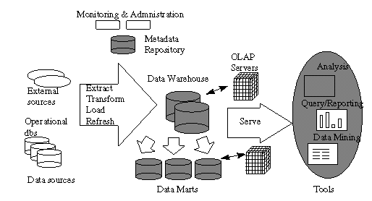
Data Warehousing Architecture

Slide 16
Today
Source: Gregory Piatetsky-Shapiro
Applications for Data Warehouses
  Decision Support Systems (DSS)
  OLAP (ROLAP, MOLAP)
  Data Mining
Thanks again to slides and lecture notes from Joachim Hammer of the University of Florida, and also to Laura Squier of SPSS, Gregory Piatetsky-Shapiro of KDNuggets and to the CRISP web site

Slide 17

Trends leading to Data Flood
More data is generated:
  Bank, telecom, other business transactions ...
  Scientific Data: astronomy, biology, etc
  Web, text, and e-commerce
More data is captured:
  Storage technology faster and cheaper
  DBMS capable of handling bigger DB
Source: Gregory Piatetsky-Shapiro

Slide 18
Examples
Europe's Very Long Baseline Interferometry (VLBI) has 16 telescopes, each of which produces 1 Gigabit/second of astronomical data over a 25-day observation session
  storage and analysis a big problem
Walmart reported to have 500 Terabyte DB
AT&T handles billions of calls per day
  data cannot be stored -- analysis is done on the fly
Source: Gregory Piatetsky-Shapiro

Slide 19
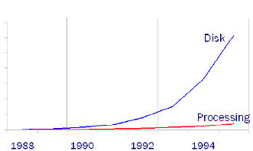
Growth Trends
Moore’s law
  Computer Speed doubles every 18 months
Storage law
  total storage doubles every 9 months
Consequence
  very little data will ever be looked at by a human
Knowledge Discovery is NEEDED to make sense and use of data.
Source: Gregory Piatetsky-Shapiro

Slide 20
Knowledge Discovery in Data (KDD)
Knowledge Discovery in Data is the non-trivial process of identifying
  valid
  novel
  potentially useful
  and ultimately understandable patterns in data.
    from Advances in Knowledge Discovery and Data Mining, Fayyad, Piatetsky-Shapiro, Smyth, and Uthurusamy, (Chapter 1), AAAI/MIT Press 1996
Source: Gregory Piatetsky-Shapiro

Slide 21
Related Fields
Machine
Learning
Visualization
Data Mining and
Knowledge Discovery
Statistics
Databases
Source: Gregory Piatetsky-Shapiro

Slide 22

Knowledge Discovery Process
Integration
Interpretation
& Evaluation
Knowledge
Data Mining
Knowledge
RawData
Transformation
__
____
__
____
__
____
Patterns
and
Rules
Selection
& Cleaning
Understanding
Transformed
Data
DATA
Ware
house
Target
Data
Source: Gregory Piatetsky-Shapiro

Slide 23
What is Decision Support?
Technology that will help managers and planners make decisions regarding the organization and its operations based on data in the Data Warehouse.
  What was the last two years of sales volume for each product by state and city?
  What effects will a 5% price discount have on our future income for product X?
Older DB-oriented term is KDD
  Knowledge Discovery in Databases
  Recent terms include “Big Data” & “Analytics”

Slide 24
Conventional Query Tools
Ad-hoc queries and reports using conventional database tools
  E.g. Access queries.
Typical database designs include fixed sets of reports and queries to support them
  The end-user is often not given the ability to do ad-hoc queries

Slide 25
On-Line Analytical Processing (OLAP)
The use of a set of graphical tools that provides users with multidimensional views of their data and allows them to analyze the data using simple windowing techniques
Relational OLAP (ROLAP)
  Traditional relational representation
Multidimensional OLAP (MOLAP)
  Cube structure
OLAP Operations
  Cube slicing – come up with 2-D view of data
  Drill-down – going from summary to more detailed views

Slide 26
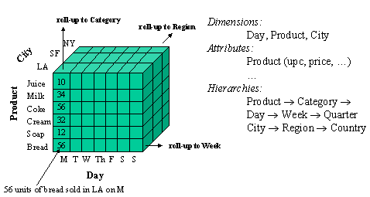
Data Cube

Slide 27
Operations on Data Cubes
Slicing the cube
  Extracts a 2d table from the multidimensional data cube
  Example…
Drill-Down
  Analyzing a given set of data at a finer level of detail

Slide 28
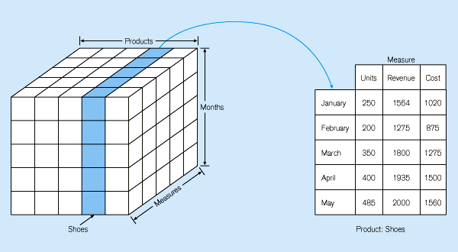
Figure 11-22: Slicing a data cube

Slide 29
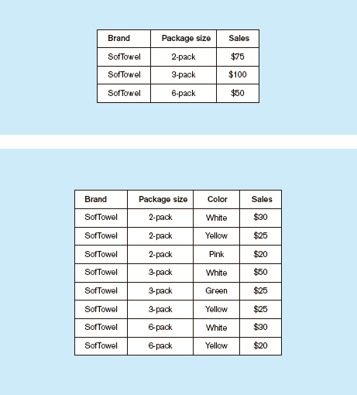
Summary report
Figure 11-24
Example of drill-down
Starting with summary data, users can obtain details for particular cells
Drill-down with color added

Slide 30
OLAP
Online Line Analytical Processing
  Intended to provide multidimensional views of the data
  I.e., the “Data Cube”
  The PivotTables in MS Excel are examples of OLAP tools

Slide 31
Star Schema
Typical design for the derived layer of a Data Warehouse or Mart for Decision Support
  Particularly suited to ad-hoc queries
  Dimensional data separate from fact or event data
Fact tables contain factual or quantitative data about the business
Dimension tables hold data about the subjects of the business
Typically there is one Fact table with multiple dimension tables

Slide 32
Star Schema for multidimensional data
Product
ProdNo
ProdName
Category
Description
…
Order
OrderNo
OrderDate
…
Fact Table
OrderNo
Salespersonid
Customerno
ProdNo
Datekey
Cityname
Quantity
TotalPrice
Customer
CustomerName
CustomerAddress
City
…
Date
DateKey
Day
Month
Year
…
Salesperson
SalespersonID
SalespersonName
City
Quota
City
CityName
State
Country
…

Slide 33
Data Mining and Visualization
Knowledge discovery using a blend of statistical, AI, and computer graphics techniques
Goals:
  Explain observed events or conditions
  Confirm hypotheses
  Explore data for new or unexpected relationships
Techniques
  Case-based reasoning
  Rule discovery
  Signal processing
  Neural nets
  Fractals
Data visualization – representing data in graphical/multimedia formats for analysis

Slide 34
Data Mining
Data mining is knowledge discovery rather than question answering
  May have no pre-formulated questions
  Derived from
    Traditional Statistics
    Artificial intelligence
    Computer graphics (visualization)
Another term used is “Analytics” which covers much of the same topics

Slide 35
Goals of Data Mining
Explanatory
  Explain some observed event or situation
    Why have the sales of SUVs increased in California but not in Oregon?
Confirmatory
  To confirm a hypothesis
    Whether 2-income families are more likely to buy family medical coverage
Exploratory
  To analyze data for new or unexpected relationships
    What spending patterns seem to indicate credit card fraud?

Slide 36
Data Mining Applications
Profiling Populations
Analysis of business trends
Target marketing
Usage Analysis
Campaign effectiveness
Product affinity
Customer Retention and Churn
Profitability Analysis
Customer Value Analysis
Up-Selling

Slide 37
How Can We Do Data Mining?
By Utilizing the CRISP-DM Methodology
  a standard process
  existing data
  software technologies
  situational expertise
Source: Laura Squier

Slide 38
Process Standardization
CRISP-DM:
CRoss Industry Standard Process for Data Mining
Initiative launched Sept.1996
SPSS/ISL, NCR, Daimler-Benz, OHRA
Funding from European commission
Over 200 members of the CRISP-DM SIG worldwide
  DM Vendors - SPSS, NCR, IBM, SAS, SGI, Data Distilleries, Syllogic, Magnify, ..
  System Suppliers / consultants - Cap Gemini, ICL Retail, Deloitte & Touche, …
  End Users - BT, ABB, Lloyds Bank, AirTouch, Experian, ...
Source: Laura Squier

Slide 39

CRISP-DM
Non-proprietary
Application/Industry neutral
Tool neutral
Focus on business issues
  As well as technical analysis
Framework for guidance
Experience base
  Templates for Analysis
Source: Laura Squier

Slide 40
The CRISP-DM Process Model
Source: Laura Squier

Slide 41
Why CRISP-DM?
The data mining process must be reliable and repeatable by people with little data mining skills
CRISP-DM provides a uniform framework for
  guidelines
  experience documentation
CRISP-DM is flexible to account for differences
  Different business/agency problems
  Different data
Source: Laura Squier

Slide 42
Phases and Tasks
Business
Understanding
Data
Understanding
Data
Preparation
Modeling
Evaluation
Deployment
Determine
Business Objectives
Background
Business Objectives
Business Success
Criteria
Situation Assessment
Inventory of Resources
Requirements,
Assumptions, and
Constraints
Risks and Contingencies
Terminology
Costs and Benefits
Determine
Data Mining Goal
Data Mining Goals
Data Mining Success
Criteria
Produce Project Plan
Project Plan
Initial Asessment of
Tools and Techniques
Collect Initial Data
Initial Data Collection
Report
Describe Data
Data Description Report
Explore Data
Data Exploration Report
Verify Data Quality
Data Quality Report
Data Set
Data Set Description
Select Data
Rationale for Inclusion /
Exclusion
Clean Data
Data Cleaning Report
Construct Data
Derived Attributes
Generated Records
Integrate Data
Merged Data
Format Data
Reformatted Data
Select Modeling
Technique
Modeling Technique
Modeling Assumptions
Generate Test Design
Test Design
Build Model
Parameter Settings
Models
Model Description
Assess Model
Model Assessment
Revised Parameter
Settings
Evaluate Results
Assessment of Data
Mining Results w.r.t.
Business Success
Criteria
Approved Models
Review Process
Review of Process
Determine Next Steps
List of Possible Actions
Decision
Plan Deployment
Deployment Plan
Plan Monitoring and
Maintenance
Monitoring and
Maintenance Plan
Produce Final Report
Final Report
Final Presentation
Review Project
Experience
Documentation
Source: Laura Squier

Slide 43
Phases in CRISP
Business Understanding
  This initial phase focuses on understanding the project objectives and requirements from a business perspective, and then converting this knowledge into a data mining problem definition, and a preliminary plan designed to achieve the objectives.
Data Understanding
  The data understanding phase starts with an initial data collection and proceeds with activities in order to get familiar with the data, to identify data quality problems, to discover first insights into the data, or to detect interesting subsets to form hypotheses for hidden information.
Data Preparation
  The data preparation phase covers all activities to construct the final dataset (data that will be fed into the modeling tool(s)) from the initial raw data. Data preparation tasks are likely to be performed multiple times, and not in any prescribed order. Tasks include table, record, and attribute selection as well as transformation and cleaning of data for modeling tools.
Modeling
  In this phase, various modeling techniques are selected and applied, and their parameters are calibrated to optimal values. Typically, there are several techniques for the same data mining problem type. Some techniques have specific requirements on the form of data. Therefore, stepping back to the data preparation phase is often needed.
Evaluation
  At this stage in the project you have built a model (or models) that appears to have high quality, from a data analysis perspective. Before proceeding to final deployment of the model, it is important to more thoroughly evaluate the model, and review the steps executed to construct the model, to be certain it properly achieves the business objectives. A key objective is to determine if there is some important business issue that has not been sufficiently considered. At the end of this phase, a decision on the use of the data mining results should be reached.
Deployment
  Creation of the model is generally not the end of the project. Even if the purpose of the model is to increase knowledge of the data, the knowledge gained will need to be organized and presented in a way that the customer can use it. Depending on the requirements, the deployment phase can be as simple as generating a report or as complex as implementing a repeatable data mining process. In many cases it will be the customer, not the data analyst, who will carry out the deployment steps. However, even if the analyst will not carry out the deployment effort it is important for the customer to understand up front what actions will need to be carried out in order to actually make use of the created models.

Slide 44
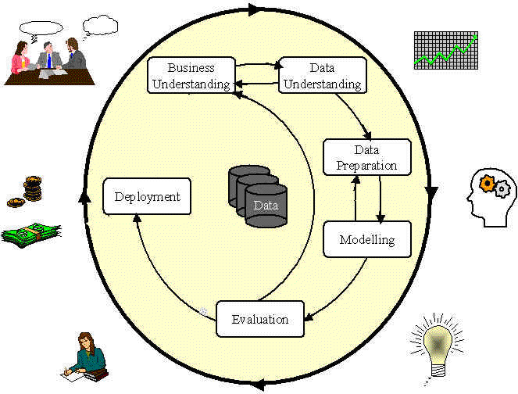
Phases in the DM Process: CRISP-DM
Source: Laura Squier

Slide 45
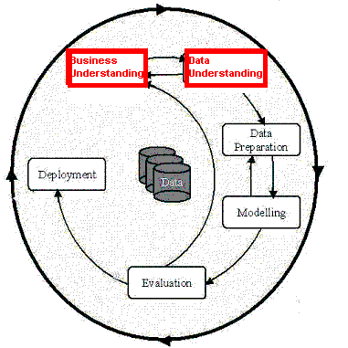
Phases in the DM Process (1 & 2)
Business Understanding:
  Statement of Business Objective
  Statement of Data Mining objective
  Statement of Success Criteria
Data Understanding
  Explore the data and verify the quality
  Find outliers
Source: Laura Squier

Slide 46
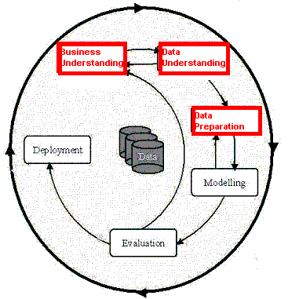
Phases in the DM Process (3)
Data preparation:
  Takes usually over 90% of our time
    Collection
    Assessment
    Consolidation and Cleaning
      table links, aggregation level, missing values, etc
    Data selection
      active role in ignoring non-contributory data?
      outliers?
      Use of samples
      visualization tools
    Transformations - create new variables
Source: Laura Squier

Slide 47
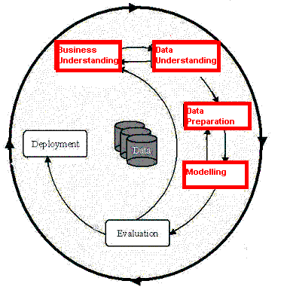
Phases in the DM Process (4)
Model building
  Selection of the modeling techniques is based upon the data mining objective
  Modeling is an iterative process - different for supervised and unsupervised learning
    May model for either description or prediction
Source: Laura Squier

Slide 48
Types of Models
Prediction Models for Predicting and Classifying
  Regression algorithms (predict numeric outcome): neural networks, rule induction, CART (OLS regression, GLM)
  Classification algorithm predict symbolic outcome): CHAID (CHi-squared Automatic Interaction Detection), C5.0 (discriminant analysis, logistic regression)
Descriptive Models for Grouping and Finding Associations
  Clustering/Grouping algorithms: K-means, Kohonen
  Association algorithms: apriori, GRI
Source: Laura Squier

Slide 49
Data Mining Algorithms
Market Basket Analysis
Memory-based reasoning
Cluster detection
Link analysis
Decision trees and rule induction algorithms
Neural Networks
Genetic algorithms

Slide 50
Market Basket Analysis
A type of clustering used to predict purchase patterns.
Identify the products likely to be purchased in conjunction with other products
  E.g., the famous (and apocryphal) story that men who buy diapers on Friday nights also buy beer.

Slide 51
Memory-based reasoning
Use known instances of a model to make predictions about unknown instances.
Could be used for sales forecasting or fraud detection by working from known cases to predict new cases

Slide 52
Cluster detection
Finds data records that are similar to each other.
K-nearest neighbors (where K represents the mathematical distance to the nearest similar record) is an example of one clustering algorithm

Slide 53
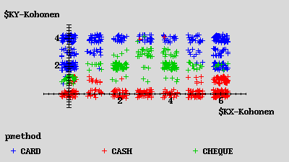
Kohonen Network
Description
unsupervised
seeks to describe dataset in terms of natural clusters of cases
Source: Laura Squier

Slide 54
Link analysis
Follows relationships between records to discover patterns
Link analysis can provide the basis for various affinity marketing programs
Similar to Markov transition analysis methods where probabilities are calculated for each observed transition.

Slide 55
Decision trees and rule induction algorithms
Pulls rules out of a mass of data using classification and regression trees (CART) or Chi-Square automatic interaction detectors (CHAID)
These algorithms produce explicit rules, which make understanding the results simpler

Slide 56
Rule Induction
Description
  Produces decision trees:
    income < $40K
      job > 5 yrs then good risk
      job < 5 yrs then bad risk
    income > $40K
      high debt then bad risk
      low debt then good risk
  Or Rule Sets:
    Rule #1 for good risk:
      if income > $40K
      if low debt
    Rule #2 for good risk:
      if income < $40K
      if job > 5 years
Source: Laura Squier

Slide 57
Rule Induction
Description
Intuitive output
Handles all forms of numeric data, as well as non-numeric (symbolic) data
C5 Algorithm a special case of rule induction
Target variable must be symbolic
Source: Laura Squier

Slide 58
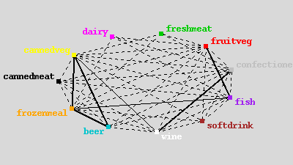
Apriori
Description
Seeks association rules in dataset
‘Market basket’ analysis
Sequence discovery
Source: Laura Squier
Notes:
Apriori^{[1]} is a classic algorithm for frequent item set mining and association rule learning over transactional databases. It proceeds by identifying the frequent individual items in the database and extending them to larger and larger item sets as long as those item sets appear sufficiently often in the database. The frequent item sets determined by Apriori can be used to determine association rules which highlight general trends in the database: this has applications in domains such as market basket analysis.

Slide 59
Neural Networks
Attempt to model neurons in the brain
Learn from a training set and then can be used to detect patterns inherent in that training set
Neural nets are effective when the data is shapeless and lacking any apparent patterns
May be hard to understand results

Slide 60
Neural Network
Input layer
Hidden layer
Output
Source: Laura Squier

Slide 61
Neural Networks
Description
  Difficult interpretation
  Tends to ‘overfit’ the data
  Extensive amount of training time
  A lot of data preparation
  Works with all data types
Source: Laura Squier

Slide 62
Genetic algorithms
Imitate natural selection processes to evolve models using
  Selection
  Crossover
  Mutation
Each new generation inherits traits from the previous ones until only the most predictive survive.

Slide 63
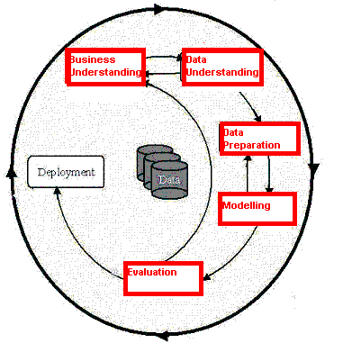
Phases in the DM Process (5)
Model Evaluation
  Evaluation of model: how well it performed on test data
  Methods and criteria depend on model type:
    e.g., coincidence matrix with classification models, mean error rate with regression models
  Interpretation of model: important or not, easy or hard depends on algorithm
Source: Laura Squier

Slide 64
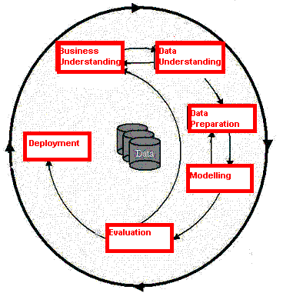
Phases in the DM Process (6)
Deployment
  Determine how the results need to be utilized
  Who needs to use them?
  How often do they need to be used
Deploy Data Mining results by:
  Scoring a database
  Utilizing results as business rules
  interactive scoring on-line
Source: Laura Squier

Slide 65

What data mining has done for...
The US Internal Revenue Service
needed to improve customer service and...
Scheduled its workforce
to provide faster, more accurate answers to questions.
Source: Laura Squier
Notes:
The US Internal Revenue Service is using data mining to improve customer service.
[Click] By analyzing incoming requests for help and information, the IRS hopes to schedule its workforce to provide faster, more accurate answers to questions.

Slide 66

What data mining has done for...
The US Drug Enforcement Agency needed to be more effective in their drug “busts” and
analyzed suspects’ cell phone usage to focus investigations.
Source: Laura Squier
Notes:
The US DFAS needs to search through 2.5 million financial transactions that may indicate inaccurate charges. Instead of relying on tips to point out fraud, the DFAS is mining the data to identify suspicious transactions.
[Click] Using Clementine, the agency examined credit card transactions and was able to identify purchases that did not match past patterns. Using this information, DFAS could focus investigations, finding fraud more costs effectively.

Slide 67

What data mining has done for...
HSBC need to cross-sell more
effectively by identifying profiles
that would be interested in higher
yielding investments and...
Reduced direct mail costs by 30% while garnering 95% of the campaign’s revenue.
Source: Laura Squier
Notes:
Retail banking is a highly competitive business. In addition to competition from other banks, banks also see intense competition from financial services companies of all kinds, from stockbrokers to mortgage companies.
With so many organizations working the same customer base, the value of customer retention is greater than ever before. As a result, HSBC Bank USA looks to enticing existing customers to "roll over" maturing products, or on cross-selling new ones.
[Click] Using SPSS products, HSBC found that it could reduce direct mail costs by 30% while still bringing in 95% of the campaign’s revenue. Because HSBC is sending out fewer mail pieces, customers are likely to be more loyal because they don’t receive junk mail from the bank.

Slide 68
Analytic technology can be effective
Combining multiple models and link analysis can reduce false positives
Today there are millions of false positives with manual analysis
Data Mining is just one additional tool to help analysts
Analytic Technology has the potential to reduce the current high rate of false positives
Source: Gregory Piatetsky-Shapiro

Slide 69
Data Mining with Privacy
Data Mining looks for patterns, not people!
Technical solutions can limit privacy invasion
  Replacing sensitive personal data with anon. ID
  Give randomized outputs
  Multi-party computation – distributed data
  …
    Bayardo & Srikant, Technological Solutions for Protecting Privacy, IEEE Computer, Sep 2003
Source: Gregory Piatetsky-Shapiro

Slide 70
The Hype Curve for
Data Mining and Knowledge Discovery
Over-inflated
expectations
Growing acceptance
and mainstreaming
rising
expectations
Disappointment
Source: Gregory Piatetsky-Shapiro

