Slide 1
NoSQL Databases
University of California, Berkeley
School of Information
IS 257: Database Management

Slide 2
Lecture Outline
Review
Object-Relational DBMS
OR features in Oracle
OR features in PostgreSQL
Extending OR databases (examples from PostgreSQL)
NoSQL Databases

Slide 3
Lecture Outline
Review
Object-Relational DBMS
OR features in Oracle
OR features in PostgreSQL
Extending OR databases (examples from PostgreSQL)
NoSQL Databases

Slide 4
Example
CREATE TYPE ANIMAL_TY AS OBJECT (Breed VARCHAR2(25), Name VARCHAR2(25), Birthdate DATE);
Creates a new type
CREATE TABLE Animal of Animal_ty;
Creates “Object Table”

Slide 5
Constructor Functions
INSERT INTO Animal values (ANIMAL_TY(‘Mule’, ‘Frances’, TO_DATE(‘01-APR-1997’, ‘DD-MM-YYYY’)));
Insert a new ANIMAL_TY object into the table

Slide 6
Selecting from an Object Table
Just use the columns in the object…
SELECT Name from Animal;

Slide 7
More Complex Objects
CREATE TYPE Address_TY as object (Street VARCHAR2(50), City VARCHAR2(25), State CHAR(2), zip NUMBER);
CREATE TYPE Person_TY as object (Name VARCHAR2(25), Address ADDRESS_TY);
CREATE TABLE CUSTOMER (Customer_ID NUMBER, Person PERSON_TY);

Slide 8
What Does the Table Look like?
DESCRIBE CUSTOMER;
NAME TYPE
-----------------------------------------------------
CUSTOMER_ID NUMBER
PERSON NAMED TYPE

Slide 9
Inserting
INSERT INTO CUSTOMER VALUES (1, PERSON_TY(‘John Smith’, ADDRESS_TY(‘57 Mt Pleasant St.’, ‘Finn’, ‘NH’, 111111)));

Slide 10
Selecting from Abstract Datatypes
SELECT Customer_ID from CUSTOMER;
SELECT * from CUSTOMER;
CUSTOMER_ID PERSON(NAME, ADDRESS(STREET, CITY, STATE ZIP))
---------------------------------------------------------------------------------------------------
1 PERSON_TY(‘JOHN SMITH’, ADDRESS_TY(‘57...

Slide 11
Selecting from Abstract Datatypes
SELECT Customer_id, person.name from Customer;
SELECT Customer_id, person.address.street from Customer;

Slide 12
Updating
UPDATE Customer SET person.address.city = ‘HART’ where person.address.city = ‘Briant’;

Slide 13
User-Defined Functions (Oracle)
CREATE [OR REPLACE] FUNCTION funcname (argname [IN | OUT | IN OUT] datatype …) RETURN datatype (IS | AS) {block | external body}

Slide 14
Example
Create Function BALANCE_CHECK (Person_name IN Varchar2) RETURN NUMBER is BALANCE NUMBER(10,2) BEGIN
SELECT sum(decode(Action, ‘BOUGHT’, Amount, 0)) - sum(decode(Action, ‘SOLD’, amount, 0)) INTO BALANCE FROM LEDGER where Person = PERSON_NAME;
RETURN BALANCE;
END;

Slide 15
Example
Select NAME, BALANCE_CHECK(NAME) from Worker;

Slide 16
Functions and Procedures - MySQL
CREATE [DEFINER = { user | CURRENT_USER }] PROCEDURE sp_name ([proc_parameter[,...]]) [characteristic ...] routine_body
CREATE [DEFINER = { user | CURRENT_USER }] FUNCTION sp_name ([func_parameter[,...]]) RETURNS type [characteristic ...] routine_body
proc_parameter: [ IN | OUT | INOUT ] param_name type
func_parameter: param_name type
type: Any valid MySQL data type
characteristic: LANGUAGE SQL | [NOT] DETERMINISTIC | { CONTAINS SQL | NO SQL | READS SQL DATA | MODIFIES SQL DATA } | SQL SECURITY { DEFINER | INVOKER } | COMMENT 'string'
routine_body: Valid SQL procedure statement

Slide 17
Defining a MySQL procedure
mysql> delimiter //
mysql> CREATE PROCEDURE simpleproc (OUT param1 INT)
-> BEGIN
-> SELECT COUNT(*) INTO param1 FROM t;
-> END//
Query OK, 0 rows affected (0.00 sec)
mysql> delimiter ;
mysql> CALL simpleproc(@a);
Query OK, 0 rows affected (0.00 sec)
mysql> SELECT @a;
+------+
| @a |
+------+
| 3 |
+------+
1 row in set (0.00 sec)

Slide 18
Defining a MySQL Function
mysql> CREATE FUNCTION hello (s CHAR(20))
RETURNS CHAR(50) DETERMINISTIC
-> RETURN CONCAT('Hello, ',s,'!');
Query OK, 0 rows affected (0.00 sec)
mysql> SELECT hello('world');
+----------------+
| hello('world') |
+----------------+
| Hello, world! |
+----------------+
1 row in set (0.00 sec)

Slide 19
TRIGGERS (Oracle)
Create TRIGGER UPDATE_LODGING INSTEAD OF UPDATE on WORKER_LODGING for each row BEGIN
if :old.name <> :new.name then update worker set name = :new.name where name = :old.name;
end if;
if :old.lodging <> … etc...

Slide 20
Triggers in MySQL
CREATE
[DEFINER = { user | CURRENT_USER }]
TRIGGER trigger_name trigger_time trigger_event
ON tbl_name FOR EACH ROW trigger_stmt
trigger_event can be INSERT, UPDATE, or DELETE
trigger_time can be BEFORE or AFTER.

Slide 21
Triggers in MySQL
CREATE TABLE test1(a1 INT);
CREATE TABLE test2(a2 INT);
CREATE TABLE test3(a3 INT NOT NULL AUTO_INCREMENT PRIMARY KEY);
CREATE TABLE test4( a4 INT NOT NULL AUTO_INCREMENT PRIMARY KEY, b4 INT DEFAULT 0 );
delimiter |
CREATE TRIGGER testref BEFORE INSERT ON test1 FOR EACH ROW
BEGIN
INSERT INTO test2 SET a2 = NEW.a1;
DELETE FROM test3 WHERE a3 = NEW.a1;
UPDATE test4 SET b4 = b4 + 1 WHERE a4 = NEW.a1;
END |
delimiter ;

Slide 22
Triggers in MySQL (cont)
mysql> INSERT INTO test3 (a3) VALUES
(NULL), (NULL), (NULL), (NULL), (NULL), (NULL), (NULL), (NULL), (NULL),
(NULL);
mysql> INSERT INTO test4 (a4) VALUES (0), (0), (0), (0), (0), (0), (0), (0),
(0), (0);
mysql> INSERT INTO test1 VALUES
-> (1), (3), (1), (7), (1), (8), (4), (4);
mysql> SELECT * FROM test1;
+------+
| a1 |
+------+
| 1 |
| 3 |
| 1 |
| 7 |
| 1 |
| 8 |
| 4 |
| 4 |
+------+

Slide 23
Triggers in MySQL (cont.)
mysql> SELECT * FROM test2;
+------+
| a2 |
+------+
| 1 |
| 3 |
| 1 |
| 7 |
| 1 |
| 8 |
| 4 |
| 4 |
+------+
mysql> SELECT * FROM test3;
+----+
| a3 |
+----+
| 2 |
| 5 |
| 6 |
| 9 |
| 10 |
+----+
mysql> SELECT * FROM test4;
+----+------+
| a4 | b4 |
+----+------+
| 1 | 3 |
| 2 | 0 |
| 3 | 1 |
| 4 | 2 |
| 5 | 0 |
| 6 | 0 |
| 7 | 1 |
| 8 | 1 |
| 9 | 0 |
| 10 | 0 |
+----+------+

Slide 24
PostgreSQL
Derived from POSTGRES
Developed at Berkeley by Mike Stonebraker and his students (EECS) starting in 1986
Postgres95
Andrew Yu and Jolly Chen adapted POSTGRES to SQL and greatly improved the code base
PostgreSQL
Name changed in 1996, and since that time the system has been expanded to support most SQL92 and many SQL99 features

Slide 25
PostgreSQL
All of the usual SQL commands for creation, searching and modifying classes (tables) are available. With some additions…
Inheritance
Non-Atomic Values
User defined functions and operators

Slide 26
Inheritance
In Postgres, a class can inherit from zero or more other classes.
A query can reference either
all instances of a class
or all instances of a class plus all of its descendants

Slide 27
Inheritance
ray=# create table cities (name varchar(50), population float,
altitude int);
CREATE TABLE
ray=# \d cities
Table "public.cities"
Column | Type | Modifiers
------------+-----------------------+-----------
name | character varying(50) |
population | double precision |
altitude | integer |
ray=# create table capitals (state char(2)) inherits (cities);
CREATE TABLE
ray=# \d capitals
Table "public.capitals"
Column | Type | Modifiers
------------+-----------------------+-----------
name | character varying(50) |
population | double precision |
altitude | integer |
state | character(2) |
Inherits: cities

Slide 28
Inheritance
For example, the following query finds all the cities that are situated at an attitude of 500ft or higher:
SELECT name, altitude
FROM cities
WHERE altitude > 500;
+----------+----------+
|name | altitude |
+----------+----------+
|Las Vegas | 2174 |
+----------+----------+
|Mariposa | 1953 |
+----------+----------+

Slide 29
Inheritance
On the other hand, to find the names of all cities, including state capitals, that are located at an altitude over 500ft, the query is:
SELECT c.name, c.altitude
FROM cities* c
WHERE c.altitude > 500;
which returns:
+----------+----------+
|name | altitude |
+----------+----------+
|Las Vegas | 2174 |
+----------+----------+
|Mariposa | 1953 |
+----------+----------+
|Madison | 845 |
+----------+----------+

Slide 30
Non-Atomic Values - Arrays
Postgres allows attributes of an instance to be defined as fixed-length or variable-length multi-dimensional arrays. Arrays of any base type or user-defined type can be created. To illustrate their use, we first create a class with arrays of base types.
CREATE TABLE SAL_EMP (
name text,
pay_by_quarter int4[],
schedule text[][]
);

Slide 31
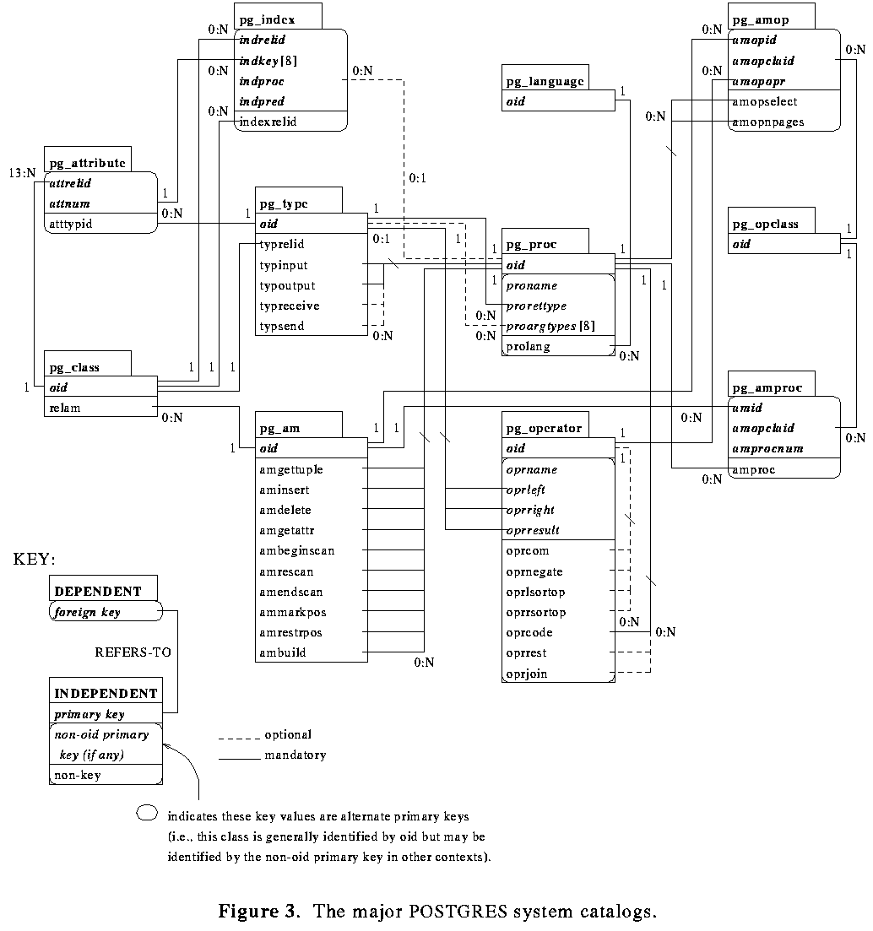
Postgres System Catalogs

Slide 32
NoSQL Introduction
Presentation from Keith Hare
NoSQL Database Architecture

Slide 33
NoSQL Database Architectures

Slide 34
NoSQL Database
NoSQL databases use a variety of file structures and access methods for their operation
There is very little commonality across the different NoSQL DBs in terms of file storage
We will look at a couple of examples
BerkeleyDB – the grand-daddy of NoSQL DBs
MongoDB – One of the best known NoSQL DBs

Slide 35
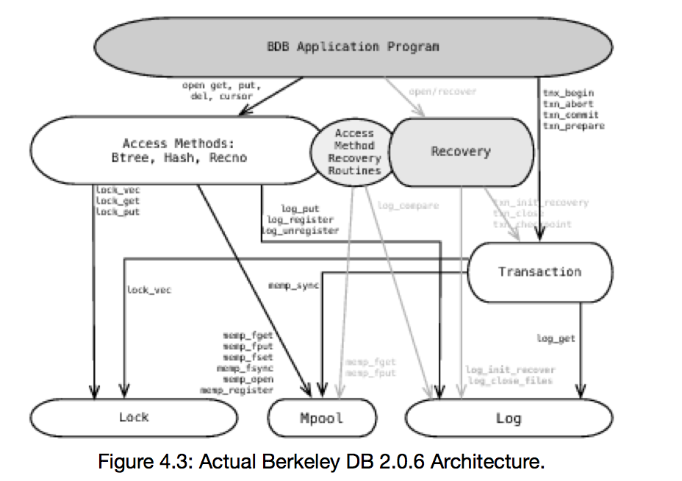
BerkeleyDB Architecture

Slide 36
BerkeleyDB
The system provides three types of underlying file DBMS access methods
RecordID
Btree
Hashed
RecordID is a simple numeric record lookup
Btree uses clever caching to keep the frequently used and higher tree levels in memory
Hash uses extensible hashing

Slide 37
MongoDB Storage
MongoDB uses memory-mapped files for data storage
A memory-mapped file is a file with data that the operating system places in memory by way of the mmap() system call. mmap() thus maps the file to a region of virtual memory.
Memory-mapped files are the critical piece of the storage engine in MongoDB.
By using memory mapped files MongoDB can treat the contents of its data files as if they were in memory.

Slide 38
MongoDB Storage
This provides MongoDB with an extremely fast and simple method for accessing and manipulating data.
Memory mapping assigns files to a block of virtual memory with a direct byte-for-byte correlation. Once mapped, the relationship between file and memory allows MongoDB to interact with the data in the file as if it were memory.

Slide 39
MongoDB Storage
How does MongoDB work with memory mapped files?
MongoDB uses memory mapped files for managing and interacting with all data.
MongoDB memory maps data files to memory as it accesses documents.
Data that isn’t accessed is not mapped to memory.

Slide 40
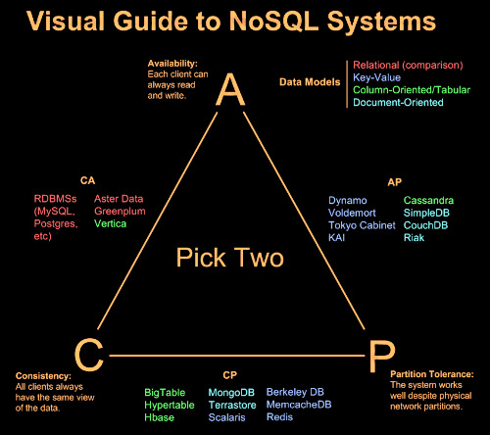
http://blog.nahurst.com/visual-guide-to-nosql-systems
Notes:
In theoretical computer science, the CAP theorem, also known as Brewer's theorem, states that it is impossible for a distributed computer system to simultaneously provide all three of the following guarantees:^{[1][2]}
Consistency (all nodes see the same data at the same time)
Availability (a guarantee that every request receives a response about whether it was successful or failed)
Partition tolerance (the system continues to operate despite arbitrary message loss or failure of part of the system)
According to the theorem, a distributed system cannot satisfy all three of these guarantees at the same time.
In May 2012 Brewer clarified some of his positions, including why the oft-used "two out of three" concept can be misleading or misapplied, and the different definition of consistency used in CAP relative to the one used in ACID.^{[4]}

