Slide 1
Data Mining and OLAP
University of California, Berkeley
School of Information
IS 257: Database Management

Slide 2
Lecture Outline
Review
Applications for Data Warehouses
Decision Support Systems (DSS)
OLAP (ROLAP, MOLAP)
Data Mining
Thanks again to lecture notes from Joachim Hammer of the University of Florida
More on OLAP and Data Mining Approaches

Slide 3
Knowledge Discovery in Data (KDD)
Knowledge Discovery in Data is the non-trivial process of identifying
valid
novel
potentially useful
and ultimately understandable patterns in data.
from Advances in Knowledge Discovery and Data Mining, Fayyad, Piatetsky-Shapiro, Smyth, and Uthurusamy, (Chapter 1), AAAI/MIT Press 1996
Source: Gregory Piatetsky-Shapiro

Slide 4
Related Fields
Machine
Learning
Visualization
Data Mining and
Knowledge Discovery
Statistics
Databases
Source: Gregory Piatetsky-Shapiro

Slide 5
Knowledge Discovery Process
Integration
Interpretation
& Evaluation
Knowledge
Data Mining
Knowledge
RawData
Transformation
__
____
__
____
__
____
Patterns
and
Rules
Selection
& Cleaning
Understanding
Transformed
Data
DATA
Ware
house
Target
Data
Source: Gregory Piatetsky-Shapiro

Slide 6
OLAP
Online Line Analytical Processing
Intended to provide multidimensional views of the data
I.e., the “Data Cube”
The PivotTables in MS Excel are examples of OLAP tools

Slide 7
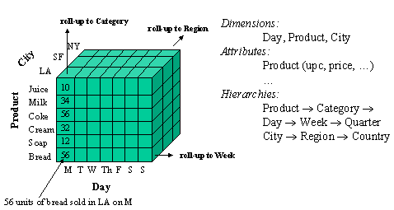
Data Cube

Slide 8
The CRISP-DM Process Model
Source: Laura Squier

Slide 9
Why CRISP-DM?
The data mining process must be reliable and repeatable by people with little data mining skills
CRISP-DM provides a uniform framework for
guidelines
experience documentation
CRISP-DM is flexible to account for differences
Different business/agency problems
Different data
Source: Laura Squier

Slide 10
Phases and Tasks
Business
Understanding
Data
Understanding
Data
Preparation
Modeling
Evaluation
Deployment
Determine
Business Objectives
Background
Business Objectives
Business Success
Criteria
Situation Assessment
Inventory of Resources
Requirements,
Assumptions, and
Constraints
Risks and Contingencies
Terminology
Costs and Benefits
Determine
Data Mining Goal
Data Mining Goals
Data Mining Success
Criteria
Produce Project Plan
Project Plan Initial Asessment of Tools and Techniques
Collect Initial Data
Initial Data Collection
Report
Describe Data
Data Description Report
Explore Data
Data Exploration Report Verify Data Quality
Data Quality Report
Data Set
Data Set Description
Select Data
Rationale for Inclusion /
Exclusion
Clean Data
Data Cleaning Report
Construct Data
Derived Attributes
Generated Records
Integrate Data
Merged Data
Format Data
Reformatted Data
Select Modeling
Technique
Modeling Technique
Modeling Assumptions
Generate Test Design
Test Design
Build Model
Parameter Settings
Models
Model Description
Assess Model
Model Assessment Revised Parameter Settings
Evaluate Results
Assessment of Data
Mining Results w.r.t.
Business Success
Criteria
Approved Models
Review Process
Review of Process
Determine Next Steps
List of Possible Actions
Decision
Plan Deployment
Deployment Plan
Plan Monitoring and
Maintenance
Monitoring and Maintenance Plan
Produce Final Report
Final Report
Final Presentation
Review Project
Experience
Documentation
Source: Laura Squier

Slide 11
Phases in CRISP
Business Understanding
This initial phase focuses on understanding the project objectives and requirements from a business perspective, and then converting this knowledge into a data mining problem definition, and a preliminary plan designed to achieve the objectives.
Data Understanding
The data understanding phase starts with an initial data collection and proceeds with activities in order to get familiar with the data, to identify data quality problems, to discover first insights into the data, or to detect interesting subsets to form hypotheses for hidden information.
Data Preparation
The data preparation phase covers all activities to construct the final dataset (data that will be fed into the modeling tool(s)) from the initial raw data. Data preparation tasks are likely to be performed multiple times, and not in any prescribed order. Tasks include table, record, and attribute selection as well as transformation and cleaning of data for modeling tools.
Modeling
In this phase, various modeling techniques are selected and applied, and their parameters are calibrated to optimal values. Typically, there are several techniques for the same data mining problem type. Some techniques have specific requirements on the form of data. Therefore, stepping back to the data preparation phase is often needed.
Evaluation
At this stage in the project you have built a model (or models) that appears to have high quality, from a data analysis perspective. Before proceeding to final deployment of the model, it is important to more thoroughly evaluate the model, and review the steps executed to construct the model, to be certain it properly achieves the business objectives. A key objective is to determine if there is some important business issue that has not been sufficiently considered. At the end of this phase, a decision on the use of the data mining results should be reached.
Deployment
Creation of the model is generally not the end of the project. Even if the purpose of the model is to increase knowledge of the data, the knowledge gained will need to be organized and presented in a way that the customer can use it. Depending on the requirements, the deployment phase can be as simple as generating a report or as complex as implementing a repeatable data mining process. In many cases it will be the customer, not the data analyst, who will carry out the deployment steps. However, even if the analyst will not carry out the deployment effort it is important for the customer to understand up front what actions will need to be carried out in order to actually make use of the created models.

Slide 12
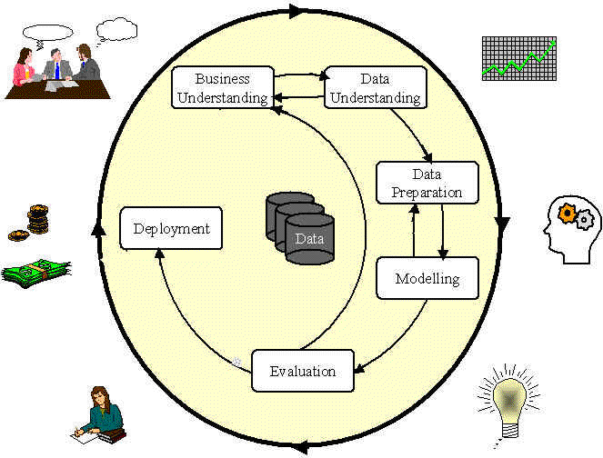
Phases in the DM Process: CRISP-DM
Source: Laura Squier

Slide 13
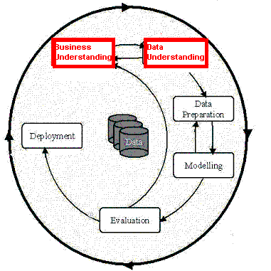
Phases in the DM Process (1 & 2)
Business Understanding:
Statement of Business Objective
Statement of Data Mining objective
Statement of Success Criteria
Data Understanding
Explore the data and verify the quality
Find outliers
Source: Laura Squier

Slide 14
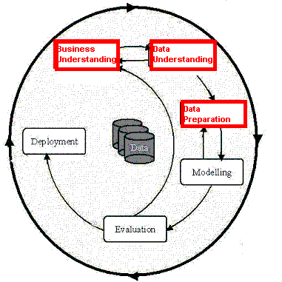
Phases in the DM Process (3)
Data preparation:
Takes usually over 90% of our time
Collection
Assessment
Consolidation and Cleaning
table links, aggregation level, missing values, etc
Data selection
active role in ignoring non-contributory data?
outliers?
Use of samples
visualization tools
Transformations - create new variables
Source: Laura Squier

Slide 15
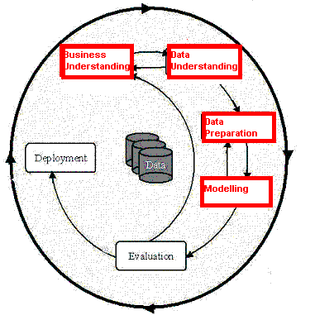
Phases in the DM Process (4)
Model building
Selection of the modeling techniques is based upon the data mining objective
Modeling is an iterative process - different for supervised and unsupervised learning
May model for either description or prediction
Source: Laura Squier

Slide 16
Types of Models
Prediction Models for Predicting and Classifying
Regression algorithms (predict numeric outcome): neural networks, rule induction, CART (OLS regression, GLM)
Classification algorithm predict symbolic outcome): CHAID (CHi-squared Automatic Interaction Detection), C5.0 (discriminant analysis, logistic regression)
Descriptive Models for Grouping and Finding Associations
Clustering/Grouping algorithms: K-means, Kohonen
Association algorithms: apriori, GRI
Source: Laura Squier

Slide 17
Data Mining Algorithms
Market Basket Analysis
Memory-based reasoning
Cluster detection
Link analysis
Decision trees and rule induction algorithms
Neural Networks
Genetic algorithms

Slide 18
Market Basket Analysis
A type of clustering used to predict purchase patterns.
Identify the products likely to be purchased in conjunction with other products
E.g., the famous (and apocryphal) story that men who buy diapers on Friday nights also buy beer.

Slide 19
Memory-based reasoning
Use known instances of a model to make predictions about unknown instances.
Could be used for sales forecasting or fraud detection by working from known cases to predict new cases

Slide 20
Cluster detection
Finds data records that are similar to each other.
K-nearest neighbors (where K represents the mathematical distance to the nearest similar record) is an example of one clustering algorithm

Slide 21
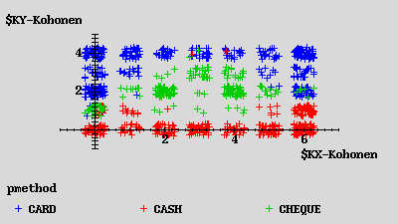
Kohonen Network
Description
unsupervised
seeks to describe dataset in terms of natural clusters of cases
Source: Laura Squier

Slide 22
Link analysis
Follows relationships between records to discover patterns
Link analysis can provide the basis for various affinity marketing programs
Similar to Markov transition analysis methods where probabilities are calculated for each observed transition.

Slide 23
Decision trees and rule induction algorithms
Pulls rules out of a mass of data using classification and regression trees (CART) or Chi-Square automatic interaction detectors (CHAID)
These algorithms produce explicit rules, which make understanding the results simpler

Slide 24
Rule Induction
Description
Produces decision trees:
income < $40K
job > 5 yrs then good risk
job < 5 yrs then bad risk
income > $40K
high debt then bad risk
low debt then good risk
Or Rule Sets:
Rule #1 for good risk:
if income > $40K
if low debt
Rule #2 for good risk:
if income < $40K
if job > 5 years
Source: Laura Squier

Slide 25
Rule Induction
Description
Intuitive output
Handles all forms of numeric data, as well as non-numeric (symbolic) data
C5 Algorithm a special case of rule induction
Target variable must be symbolic
Source: Laura Squier

Slide 26
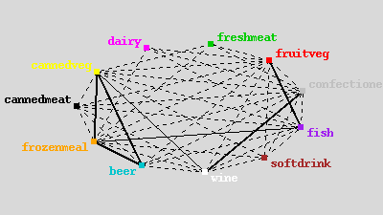
Apriori
Description
Seeks association rules in dataset
‘Market basket’ analysis
Sequence discovery
Source: Laura Squier

Slide 27
Neural Networks
Attempt to model neurons in the brain
Learn from a training set and then can be used to detect patterns inherent in that training set
Neural nets are effective when the data is shapeless and lacking any apparent patterns
May be hard to understand results

Slide 28
Neural Network
Input layer
Hidden layer
Output
Source: Laura Squier

Slide 29
Neural Networks
Description
Difficult interpretation
Tends to ‘overfit’ the data
Extensive amount of training time
A lot of data preparation
Works with all data types
Source: Laura Squier

Slide 30
Genetic algorithms
Imitate natural selection processes to evolve models using
Selection
Crossover
Mutation
Each new generation inherits traits from the previous ones until only the most predictive survive.

Slide 31
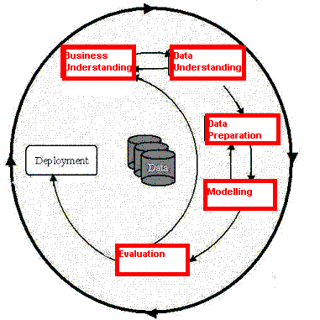
Phases in the DM Process (5)
Model Evaluation
Evaluation of model: how well it performed on test data
Methods and criteria depend on model type:
e.g., coincidence matrix with classification models, mean error rate with regression models
Interpretation of model: important or not, easy or hard depends on algorithm
Source: Laura Squier

Slide 32
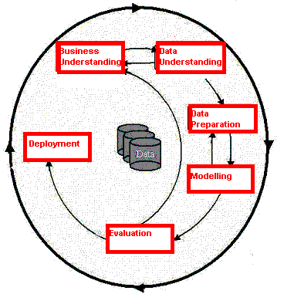
Phases in the DM Process (6)
Deployment
Determine how the results need to be utilized
Who needs to use them?
How often do they need to be used
Deploy Data Mining results by:
Scoring a database
Utilizing results as business rules
interactive scoring on-line
Source: Laura Squier

Slide 33
Specific Data Mining Applications:
Source: Laura Squier

Slide 34
What data mining has done for...
The US Internal Revenue Service
needed to improve customer service and...
Scheduled its workforce
to provide faster, more accurate answers to questions.
Source: Laura Squier
Notes:
The US Internal Revenue Service is using data mining to improve customer service.
[Click] By analyzing incoming requests for help and information, the IRS hopes to schedule its workforce to provide faster, more accurate answers to questions.

Slide 35
What data mining has done for...
The US Drug Enforcement Agency needed to be more effective in their drug “busts” and
analyzed suspects’ cell phone usage to focus investigations.
Source: Laura Squier
Notes:
The US DFAS needs to search through 2.5 million financial transactions that may indicate inaccurate charges. Instead of relying on tips to point out fraud, the DFAS is mining the data to identify suspicious transactions.
[Click] Using Clementine, the agency examined credit card transactions and was able to identify purchases that did not match past patterns. Using this information, DFAS could focus investigations, finding fraud more costs effectively.

Slide 36
What data mining has done for...
HSBC need to cross-sell more
effectively by identifying profiles
that would be interested in higher
yielding investments and...
Reduced direct mail costs by 30% while garnering 95% of the campaign’s revenue.
Source: Laura Squier
Notes:
Retail banking is a highly competitive business. In addition to competition from other banks, banks also see intense competition from financial services companies of all kinds, from stockbrokers to mortgage companies.
With so many organizations working the same customer base, the value of customer retention is greater than ever before. As a result, HSBC Bank USA looks to enticing existing customers to "roll over" maturing products, or on cross-selling new ones.
[Click] Using SPSS products, HSBC found that it could reduce direct mail costs by 30% while still bringing in 95% of the campaign’s revenue. Because HSBC is sending out fewer mail pieces, customers are likely to be more loyal because they don’t receive junk mail from the bank.

Slide 37
Analytic technology can be effective
Combining multiple models and link analysis can reduce false positives
Today there are millions of false positives with manual analysis
Data Mining is just one additional tool to help analysts
Analytic Technology has the potential to reduce the current high rate of false positives
Source: Gregory Piatetsky-Shapiro

Slide 38
Data Mining with Privacy
Data Mining looks for patterns, not people!
Technical solutions can limit privacy invasion
Replacing sensitive personal data with anon. ID
Give randomized outputs
Multi-party computation – distributed data
…
Bayardo & Srikant, Technological Solutions for Protecting Privacy, IEEE Computer, Sep 2003
Source: Gregory Piatetsky-Shapiro

Slide 39
The Hype Curve for Data Mining and Knowledge Discovery
Over-inflated
expectations
Growing acceptance
and mainstreaming
rising
expectations
Disappointment
Source: Gregory Piatetsky-Shapiro

Slide 40
More on OLAP and Data Mining
Nice set of slides with practical examples using SQL (by Jeff Ullman, Stanford – found via Google with no attribution)

