Slide 1
Lecture 13: Relevance Feedback
Principles of Information Retrieval
Prof. Ray Larson
University of California, Berkeley
School of Information

Slide 2
Overview
Review
Evaluation: Search length based measures
Relevance Feedback

Slide 3
Weak Ordering

Slide 4
Search Length
Rank
Relevant
1 | 2 | 3 | 4 | 5 | 6 | 7 | 8 | 9 | 10 | 11 | 12 | 13 | 14 | 15 | 16 | 17 | 18 | 19 | 20
n | y | n | y | y | y | y | n | y | n | n | n | n | y | n | y | n | n | n | n
Search Length = The number of NON-RELEVANT documents that
a user must examine before finding the number of documents that
they want (n)
If n=2 then search length is 2
If n=6 then search length is 3

Slide 5
Weak Ordering Search Length
Rank
Relevant
1 | 1 | 1 | 2 | 2 | 2 | 2 | 2 | 3 | 3 | 3 | 3 | 3 | 4 | 4 | 4 | 4 | 4 | 4 | 4
n | n | y | y | n | y | y | y | n | y | y | n | n | n | n | n | n | n | y | n
If we assume order within ranks is random…
If n=6 then we must go to level 3 of the ranking, but the
POSSIBLE search lengths are 3, 4, 5, or 6.
To compute Expected Search Length we need to know the
probability of each possible search length. to get this we need
to consider the number of different ways in which document
may be distributed in the ranks…

Slide 6
Expected Search Length
Rank
Relevant
1 | 1 | 1 | 2 | 2 | 2 | 2 | 2 | 3 | 3 | 3 | 3 | 3 | 4 | 4 | 4 | 4 | 4 | 4 | 4
n | n | y | y | n | y | y | y | n | y | y | n | n | n | n | n | n | n | y | n

Slide 7
Expected Search Length

Slide 8
Expected Search Length

Slide 9
Expected search length advantages
Instead of assuming that high recall is something that everyone wants, it lets the user determine what is wanted in terms of numbers relevant items retrieved
There are other measures that have been used recently that have something of the same idea
“Extended Cumulated Gain” used in INEX

Slide 10
XCG
XCG uses graded relevance scoring instead of binary
For XML retrieval takes into account “near misses” (like neighboring paragraphs, or paragraphs in a section when the section is considered relevant)

Slide 11
xCG
xCG is defined as a vector of accumulated gain in relevance scores. Given a ranked list of document components where the element IDs are replaced with their relevance scores, the cumulated gain at rank i, denoted as xCG[i], is computed as the sum of the relevance scores up to that rank:

Slide 12
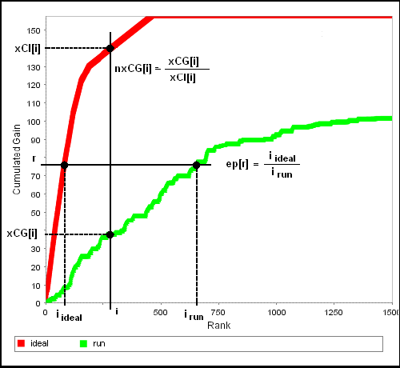
xCG

Slide 13
Today
Relevance Feedback
aka query modification
aka “more like this”

Slide 14
IR Components
A number of techniques have been shown to be potentially important or useful for effective IR (in TREC-like evaluations)
Today and over the next couple weeks we will look at these components of IR systems and their effects on retrieval
These include: Relevance Feedback, Latent Semantic Indexing, clustering, and application of NLP techniques in term extraction and normalization

Slide 15
Querying in IR System
Interest profiles
& Queries
Documents
& data
Storage
Line
Information Storage and Retrieval System
Rules of the game =
Rules for subject indexing +
Thesaurus (which consists of
Lead-In
Vocabulary
and
Indexing
Language
Formulating query in
terms of
descriptors
Indexing
(Descriptive and
Subject)
Storage of
profiles
Storage of
Documents
Store1: Profiles/
Search requests
Comparison/
Matching
Store2: Document
representations
Potentially
Relevant
Documents

Slide 16
Relevance Feedback in an IR System
Interest profiles
& Queries
Documents
& data
Storage
Line
Information Storage and Retrieval System
Rules of the game =
Rules for subject indexing +
Thesaurus (which consists of
Lead-In
Vocabulary
and
Indexing
Language
Formulating query in
terms of
descriptors
Indexing
(Descriptive and
Subject)
Storage of
profiles
Storage of
Documents
Store1: Profiles/
Search requests
Comparison/
Matching
Store2: Document
representations
Potentially
Relevant
Documents
Selected relevant docs

Slide 17
Query Modification
Changing or Expanding a query can lead to better results
Problem: how to reformulate the query?
Thesaurus expansion:
Suggest terms similar to query terms
Relevance feedback:
Suggest terms (and documents) similar to retrieved documents that have been judged to be relevant

Slide 18
Relevance Feedback
Main Idea:
Modify existing query based on relevance judgements
Extract terms from relevant documents and add them to the query
and/or re-weight the terms already in the query
Two main approaches:
Automatic (psuedo-relevance feedback)
Users select relevant documents
Users/system select terms from an automatically-generated list

Slide 19
Relevance Feedback
Usually do both:
Expand query with new terms
Re-weight terms in query
There are many variations
Usually positive weights for terms from relevant docs
Sometimes negative weights for terms from non-relevant docs
Remove terms ONLY in non-relevant documents

Slide 20
Rocchio Method

Slide 21
Rocchio/Vector Illustration
Information
1.0
Q₀ = retrieval of information = (0.7,0.3)
D₁ = information science = (0.2,0.8)
D₂ = retrieval systems = (0.9,0.1)
Q’ = ½*Q₀+ ½ * D₁ = (0.45,0.55)
Q” = ½*Q₀+ ½ * D₂ = (0.80,0.20)
D₁
Q’
0.5
Q₀
Q”
D₂
0
0.5
1.0
Retrieval

Slide 22
Example Rocchio Calculation
Relevant
docs
Non-rel doc
Original Query
Constants
Rocchio Calculation
Resulting feedback query

Slide 23
Rocchio Method
Rocchio automatically
re-weights terms
adds in new terms (from relevant docs)
have to be careful when using negative terms
Rocchio is not a machine learning algorithm
Most methods perform similarly
results heavily dependent on test collection
Machine learning methods are proving to work better than standard IR approaches like Rocchio

Slide 24
Probabilistic Relevance Feedback
Given a query term t
Document Relevance
+ -
+ r n-r n
- R-r N-n-R+r N-n
R N-R N
Document
indexing
Where N is the number of documents seen
Robertson & Sparck Jones

Slide 25
Robertson-Spark Jones Weights
Retrospective formulation --

Slide 26
Robertson-Sparck Jones Weights
Predictive formulation

Slide 27
Using Relevance Feedback
Known to improve results
in TREC-like conditions (no user involved)
So-called “Blind Relevance Feedback” typically uses the Rocchio algorithm with the assumption that the top N documents in an initial retrieval are relevant (more later)
What about with a user in the loop?
How might you measure this?
Let’s examine a user study of relevance feedback by Koenneman & Belkin 1996.

Slide 28
Questions being Investigated Koenemann & Belkin 96
How well do users work with statistical ranking on full text?
Does relevance feedback improve results?
Is user control over operation of relevance feedback helpful?
How do different levels of user control effect results?

Slide 29
How much of the guts should the user see?
Opaque (black box)
(like web search engines)
Transparent
(see available terms after the r.f. )
Penetrable
(see suggested terms before the r.f.)
Which do you think worked best?

Slide 30
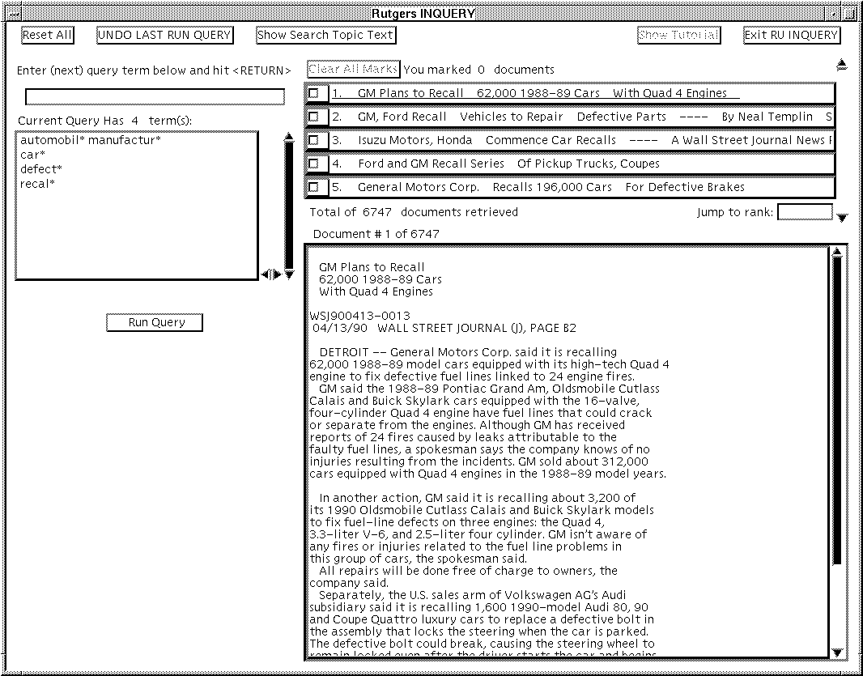

Slide 31
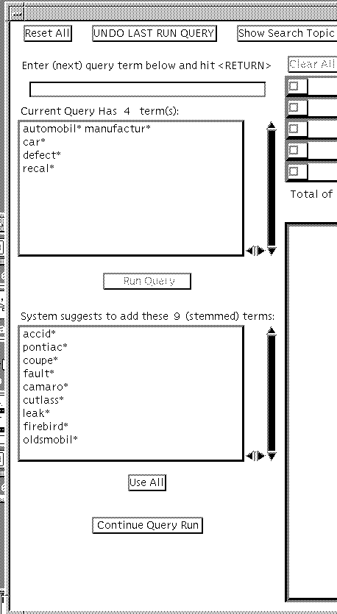
Penetrable…
Terms available for relevance
feedback made visible (from Koenemann & Belkin)

Slide 32
Details on User Study Koenemann & Belkin 96
Subjects have a tutorial session to learn the system
Their goal is to keep modifying the query until they’ve developed one that gets high precision
This is an example of a routing query (as opposed to ad hoc)
Reweighting:
They did not reweight query terms
Instead, only term expansion
pool all terms in rel docs
take top N terms, where
n = 3 + (number-marked-relevant-docs*2)
(the more marked docs, the more terms added to the query)

Slide 33
Details on User Study Koenemann & Belkin 96
64 novice searchers
43 female, 21 male, native English
TREC test bed
Wall Street Journal subset
Two search topics
Automobile Recalls
Tobacco Advertising and the Young
Relevance judgements from TREC and experimenter
System was INQUERY (Inference net system using (mostly) vector methods)

Slide 34
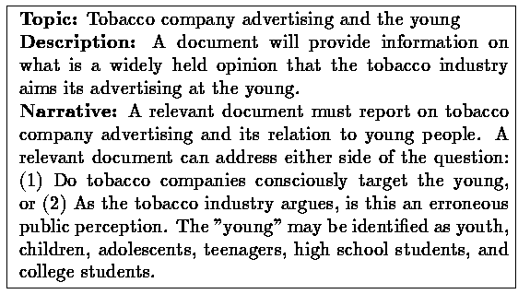
Sample TREC query

Slide 35
Evaluation
Precision at 30 documents
Baseline: (Trial 1)
How well does initial search go?
One topic has more relevant docs than the other
Experimental condition (Trial 2)
Subjects get tutorial on relevance feedback
Modify query in one of four modes
no r.f., opaque, transparent, penetration

Slide 36
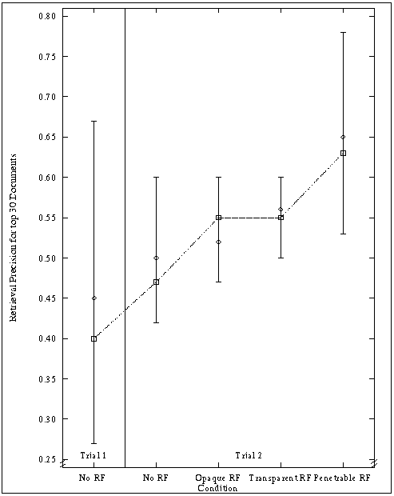
Precision vs. RF condition (from Koenemann & Belkin 96)

Slide 37
Effectiveness Results
Subjects with R.F. did 17-34% better performance than no R.F.
Subjects with penetration case did 15% better as a group than those in opaque and transparent cases.

Slide 38
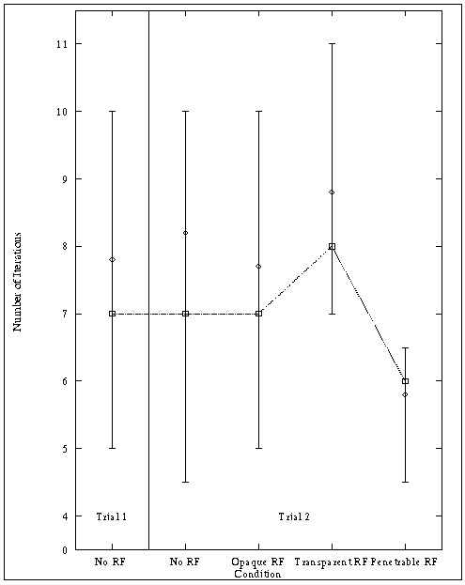
Number of iterations in formulating queries (from Koenemann & Belkin 96)

Slide 39
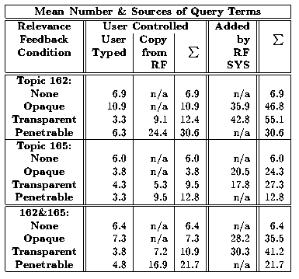
Number of terms in created queries (from Koenemann & Belkin 96)

Slide 40
Behavior Results
Search times approximately equal
Precision increased in first few iterations
Penetration case required fewer iterations to make a good query than transparent and opaque
R.F. queries much longer
but fewer terms in penetrable case -- users were more selective about which terms were added in.

Slide 41
Relevance Feedback Summary
Iterative query modification can improve precision and recall for a standing query
In at least one study, users were able to make good choices by seeing which terms were suggested for R.F. and selecting among them
So … “more like this” can be useful!

Slide 42
Pseudo Relevance Feedback
Pseudo (or Blind) Relevance Feedback performs the RF operation without any actual user feedback
Presumes that top-ranked documents are likely to be relevant (and low ranked documents are not)

Slide 43
Pseudo Relevance Feedback
Blind relevance feedback is typically performed in two stages.
First, an initial search is performed, after which some terms are selected from the top-ranked documents (which are presumed to be relevant).
The selected terms are weighted and then merged with the initial query to formulate a new query.
Finally the reweighted and expanded query is run against the same collection to produce a final ranked list of documents. It was a simple extension to adapt these document-level algorithms to document components for INEX.

Slide 44
Approaches to PRF
Use a vector method such as Rocchio
Use a probabilistic method like Robertson/Sparck Jones
As an example this is how PRF is implemented in Cheshire2 (not sure if it is there in C3)

Slide 45
Logistic Regression Ranking
Probability of relevance is based on Logistic regression from a sample set of documents to determine values of the coefficients.
At retrieval the probability estimate is obtained by:
For some set of m statistical measures, X_{i}, derived from the collection and query

Slide 46
Blind Feedback in Cheshire II
Perform initial search (using TREC2 Probabilistic Algorithm) next slide

Slide 47
TREC2 LR Algorithm
Term
Freq for:
Query
Document
Collection
Matching
Terms

Slide 48
TREC2 Algorithm
|Q_{c}| is the number of terms in common between the query and the component
qtf is the query term frequency
ql is the query length (number of tokens)
tf_{i} is the term frequency in the component/document
cl is the number of terms in the component/document
ctf_{i} is the collection term frequency (number of occurrences in collection)
N_{t} is the number of terms in the entire collection

Slide 49
Blind Relevance Feedback
Term selection from top-ranked documents is based on the classic Robertson/Sparck Jones probabilistic model:
Document Relevance
For each term t
+ -
+ R_{t} N_{t} -R_{t} N_{t}
- R-R_{t} N-N_{t}-R+R N-N_{t}
R N-R N
Document
indexing

Slide 50
Blind Feedback
Top x new terms taken from top y documents
For each term in the top y assumed relevant set…
Terms are ranked by termwt and the top x selected for inclusion in the query

Slide 51
Blind Feedback in Cheshire II
Take top N documents and get the term vectors for those documents
Calculate the Robertson/Sparck Jones weights for each term in the vectors
Note that collection stats are used for non-rel documents (i.e. n, n-m, etc)

Slide 52
Blind Feedback in Cheshire II
Rank the terms by w_{t} and take the top M terms (ignoring those that occur in less than 3 of the top ranked docs)
For the new query:
Use original freq weight * 0.5 as the weight for old terms
Add w_{t} to the new query length for old terms
Use 0.5 as the weight for new terms and add 0.5 to the query length for each term.
Perform the TREC2 ranking again using the new query with the new weights and length

Slide 53
Pseudo Relevance Feedback
Seems to work in most situations
Consider, though, without user judgement there is the potential to go far on-track
Attempts to do multiple cycles of PRF typically end up going off-topic
Some tests using massive expansion of initial queries (e.g., 1000 new words) also didn’t fare well in evaluations

Slide 54
Alternative Notions of Relevance Feedback
Find people whose taste is “similar” to yours. Will you like what they like?
Follow a users’ actions in the background. Can this be used to predict what the user will want to see next?
Track what lots of people are doing. Does this implicitly indicate what they think is good and not good?

Slide 55
Alternative Notions of Relevance Feedback
Sometimes called Social or Collaborative Filtering and Recommender Systems
Several different criteria to consider:
Implicit vs. Explicit judgements
Individual vs. Group judgements
Standing vs. Dynamic topics
Similarity of the items being judged vs. similarity of the judges themselves

Slide 56
Collaborative Filtering (social filtering)
If Pam liked the paper, I’ll like the paper
If you liked Star Wars, you’ll like Independence Day
Rating based on ratings of similar people
Ignores the text, so works on text, sound, pictures etc.
But: Initial users can bias ratings of future users

Slide 57
Ringo Collaborative Filtering (Shardanand & Maes 95)
Users rate musical artists from like to dislike
1 = detest - 7 = can’t live without : 4 = ambivalent
There is a normal distribution around 4
However, what matters are the extremes
Nearest Neighbors Strategy: Find similar users and predicted (weighted) average of user ratings
Pearson r algorithm: weight by degree of correlation between user U and user J
1 means very similar, 0 means no correlation, -1 dissimilar
Works better to compare against the ambivalent rating (4), rather than the individual’s average score

Slide 58
Social Filtering
Ignores the content, only looks at who judges things similarly
Works well on data relating to “taste”
something that people are good at predicting about each other too
Does it work for topic?
GroupLens results suggest otherwise (preliminary)
Perhaps for quality assessments
What about for assessing if a document is about a topic?

Slide 59
Learning interface agents
Add agents in the UI, delegate tasks to them
Use machine learning to improve performance
learn user behavior, preferences
Useful when:
1) past behavior is a useful predictor of the future
2) wide variety of behaviors amongst users
Examples:
mail clerk: sort incoming messages in right mailboxes
calendar manager: automatically schedule meeting times?

Slide 60
Example Systems
Example Systems
Newsweeder
Letizia
WebWatcher
Syskill and Webert
Vary according to
User states topic or not
User rates pages or not

Slide 61
NewsWeeder (Lang & Mitchell)
A netnews-filtering system
Allows the user to rate each article read from one to five
Learns a user profile based on these ratings
Use this profile to find unread news that interests the user.

Slide 62
Letizia (Lieberman 95)
user
letizia
heuristics
recommendations
user profile
Recommends web pages during browsing based on user profile
Learns user profile using simple heuristics
Passive observation, recommend on request
Provides relative ordering of link interestingness
Assumes recommendations “near” current page are more valuable than others

Slide 63
Letizia (Lieberman 95)
Infers user preferences from behavior
Interesting pages
record in hot list
save as a file
follow several links from pages
returning several times to a document
Not Interesting
spend a short time on document
return to previous document without following links
passing over a link to document (selecting links above and below document)

Slide 64
WebWatcher (Freitag et al.)
A "tour guide" agent for the WWW.
User tells it what kind of information is wanted
System tracks web actions
Highlights hyperlinks that it computes will be of interest.
Strategy for giving advice is learned from feedback from earlier tours.
Uses WINNOW as a learning algorithm

Slide 65
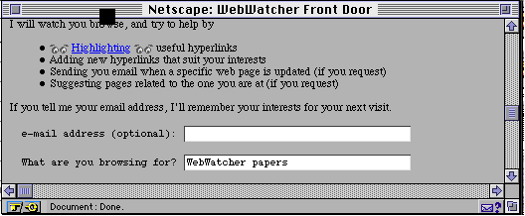
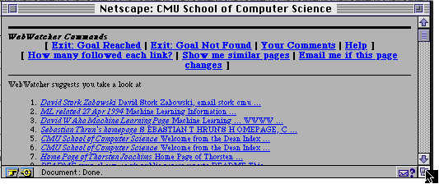

Slide 66
Syskill & Webert (Pazzani et al 96)
User defines topic page for each topic
User rates pages (cold or hot)
Syskill & Webert creates profile with Bayesian classifier
accurate
incremental
probabilities can be used for ranking of documents
operates on same data structure as picking informative features
Syskill & Webert rates unseen pages

Slide 67
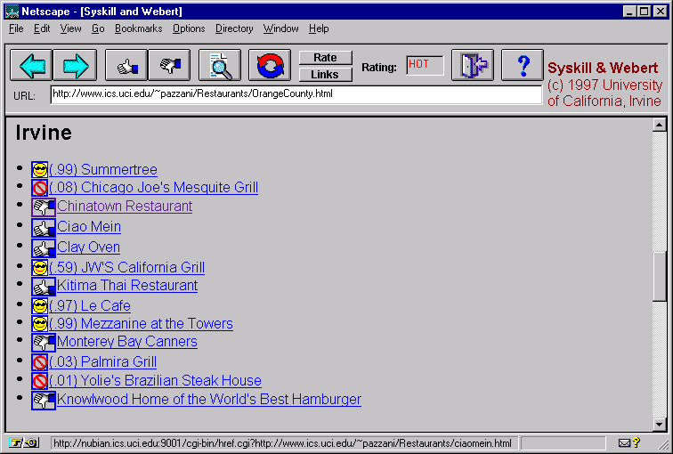
Rating Pages

Slide 68
Advantages
Less work for user and application writer
compare w/ other agent approaches
no user programming
significant a priori domain-specific and user knowledge not required
Adaptive behavior
agent learns user behavior, preferences over time
Model built gradually

Slide 69
Consequences of passiveness
Weak heuristics
click through multiple uninteresting pages en route to interestingness
user browses to uninteresting page, heads to nefeli for a coffee
hierarchies tend to get more hits near root
No ability to fine-tune profile or express interest without visiting “appropriate” pages

Slide 70
Open issues
How far can passive observation get you?
for what types of applications is passiveness sufficient?
Profiles are maintained internally and used only by the application. some possibilities:
expose to the user (e.g. fine tune profile) ?
expose to other applications (e.g. reinforce belief)?
expose to other users/agents (e.g. collaborative filtering)?
expose to web server (e.g. cnn.com custom news)?
Personalization vs. closed applications
Others?

Slide 71
Relevance Feedback on Non-Textual Information
Image Retrieval
Time-series Patterns

Slide 72
MARS (Riu et al. 97)
Relevance feedback based on image similarity

Slide 73
BlobWorld (Carson, et al.)

Slide 74
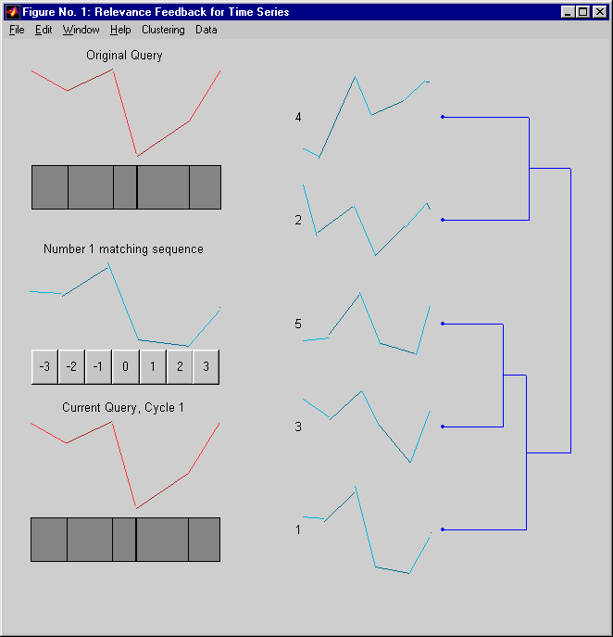
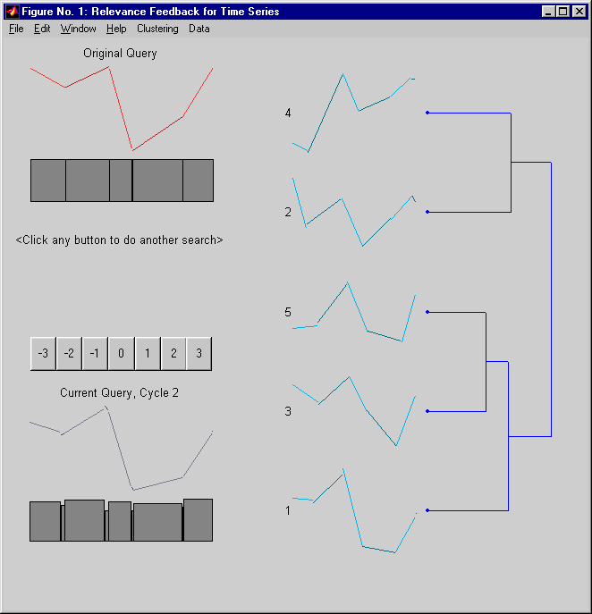
Time Series R.F. (Keogh & Pazzani 98)

Slide 75
Classifying R.F. Systems
Standard Relevance Feedback
Individual, explicit, dynamic, item comparison
Standard Filtering (NewsWeeder)
Individual, explicit, standing profile, item comparison
Standard Routing
“Community” (gold standard), explicit, standing profile, item comparison

Slide 76
Classifying R.F. Systems
Letizia and WebWatcher
Individual, implicit, dynamic, item comparison
Ringo and GroupLens:
Group, explicit, standing query, judge-based comparison

Slide 77
Classifying R.F. Systems
Syskill & Webert:
Individual, explicit, dynamic + standing, item comparison
Alexa: (?)
Community, implicit, standing, item comparison, similar items
Amazon (?):
Community, implicit, standing, judges + items, similar items

Slide 78
Summary
Relevance feedback is an effective means for user-directed query modification.
Modification can be done with either direct or indirect user input
Modification can be done based on an individual’s or a group’s past input.

