Slide 1
Session 17
Pew Internet and American Life Project – explore this resource
Deception, Reputation, Community

Slide 2
Context
The current state of national technology adoption – Introduction to the Pew Internet and American Life Project
Notes:
A good segue activity as we move to the new module where we’ll be looking at the Internet, network connectivity and related phenomena.
Just to start thinking beyond our own experiences…users of different ages, education levels, etc.

Slide 3
www.pewinternet.org
Ongoing research by non-partisan, non-profit “fact tank” on all matters connected to the Internet
Based upon national surveys (in US only) using probability sampling (random digit dialing)
Data available (import into SPSS, other statistical analysis packages)
Tracking technology adoption trends
Topics: health, politics, shopping, religion, etc.

Slide 4
X
X
X
X
X
X
Notes:
Remind ourselves of where we as a group stand in relation to the rest of the country:
http://www.pewinternet.org/Infographics/2011/Generations-and-gadgets.aspx
Pew Internet and American Life – latest statistics
(generations and gadgets survey carried out September 2010)
Generations and gadgets survey:
- Asks if you have a desktop computer, a laptop (but not how many?)

Slide 5
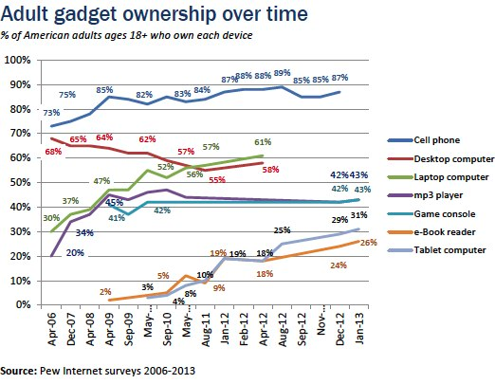

Slide 6
Identity, Deception, reputation, community
the Internet 1995 - present

Slide 7
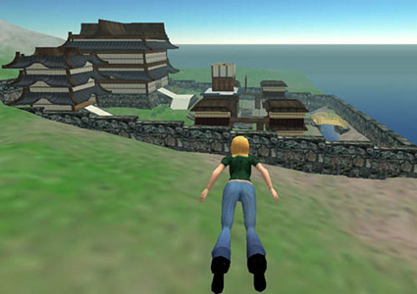
Focus of Section 3
Is sociability online different from face to face sociability?
What are the, “fundamental architectural differences that affect social interaction?” – boyd
How might the answers to the above questions shine some light on distinct challenges we face in designing or managing online social environments and (broadly) networked systems, services, applications that have a social, interactive component?

Slide 8
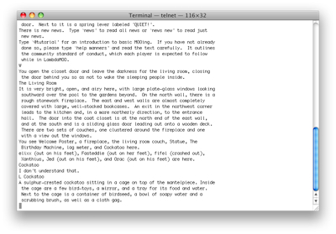
Platforms for Theory Exploration
These people are part of an unfolding role-playing game (circa 1991)
Same thing here (circa 2011)

Slide 9
How Social Interaction is Shaped Online
Architectural Elements:
Kill-files (block, ban function)
Anonymity/Pseudonymity configurations
etc
Social Conventions:
Administrative, Policy Level, Moderators
Peer to peer social enforcement – “plonk!”

Slide 10
Identity (Donath)
Sparseness(?) of identity cues online
Assessment signals - costly but reliable
Conventional signals – employed in deception
Resources for self-presentation online are different
Expressions given vs. expressions given off (Goffman)
No automatic bodily self-presentation
What signals are given by an e-mail address?

Slide 11
Reputation and Review Systems
Business considerations - security and predictability of transactions online:
Online buyers and sellers
Crowdsourcing vs. expert / professional evaluations:
Professionals – doctors, lawyers, etc.
Sex offenders
Restaurants, hotels
Movies

Slide 12
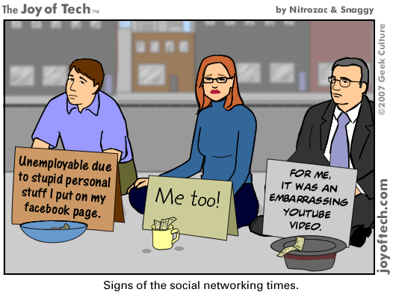
Consequences of a damaged reputation
Notes:
When people do it to themselves (without intending to) – some of this is invisible audiences and replicability coming together in a bad way.
Also, if we’re talking about deception, where people do it to others…next slide.

Slide 13
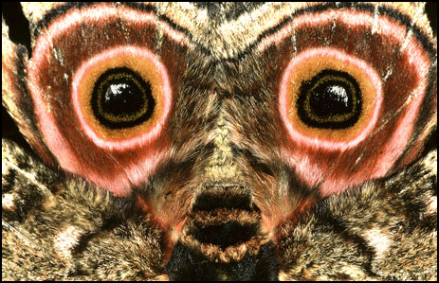
Deception
Trolls (online behavior intended to generate social discord conflict)
Sockpuppets
Impersonation
Concealment?
When is an online ‘deception’ regarded as a violation, a problem? When isn’t it? Examples?
Notes:
Is precipitated upon social norm of authentic self-representation. Can we speak about deception on 4chan? What would it take?
Deception as a betrayal. Deception on World of Warcraft? Is there such a thing?
Just as anonymity is regarded differently on different parts of the Internet.
Category deception – gender-swapping
Impersonation
Recent examples:
Impersonating someone on Twitter
Impersonation in Nigerian 419 scams
Networked publics – properties:
Identity cues are sparse
Spam is about replicability right?
Other problems (not deception):
Spam
Conflict, social discord

Slide 14
4chan and /b/
Anonymity (not just available but widely used – 90.07% of posts)
Ephemerality (contributions disappear quickly, no archive – 3.9 min avg lifespan of post)
Yet somehow users manage to do community-like things including signaling status and membership, invite ongoing participation, and inciting coordinated actions
Notes:
“rowdiness and lawlessness”
Archaic – does look incredibly dated – vintage web? Junky, cluttered, hard to parse aesthetic.
How does it have this ‘community’ effect – must move fast on anything you run across or it might disappear
Ways of resisting ephemerality – 4chanarchive.org, bump
Participation because no fear of failure, embarrassent, can disclose sensitive issues

Slide 15
Summary
anonymity vs. pseudonymity (not the same!) vs. authenticatable identity – When you say ‘anonymous’ do you really mean ‘psuedonymous?’
Architectural elements vs. social conventions (formal moderators, emergent user practices)
Deception – definition depends on the platform/context
Notes:
“rowdiness and lawlessness”
Archaic – does look incredibly dated – vintage web? Junky, cluttered, hard to parse aesthetic.
How does it have this ‘community’ effect – must move fast on anything you run across or it might disappear
Ways of resisting ephemerality – 4chanarchive.org, bump
Participation because no fear of failure, embarrassent, can disclose sensitive issues

Slide 16
For Thursday
Pick one…
Ackerman, The Intellectual Challenge of CSCW…
‘Do Artifacts Have Politics?’
Vineyard Computing
4chan and /b/
To prepare, revisit the reading, bring a copy of the reading to class:
What is the problem space this reading addresses?
What is its argument (or arguments)?

