Slide 1
Session 16
Networked Sociability – an introduction to some themes and concerns of section 3
Pew Internet and American Life Project – explore this resource

Slide 2
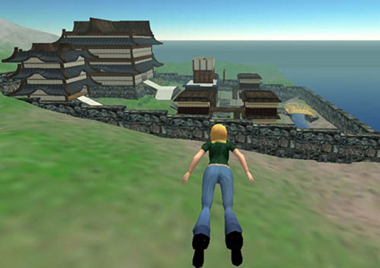
Focus of Section 3
Is sociability online different from face to face sociability?
What are the, “fundamental architectural differences that affect social interaction?” – boyd
How might the answers to the above questions shine some light on the distinct challenges in designing or managing online social environments and (broadly) networked systems, services, applications that have a social, interactive component?
Notes:
What do you think?
What do we mean by sociability – relating to and interacting with others, the skills involved and approaches to doing so?
“Why teens heart social networking sites: the role of networked publics in teenage social life” – call on someone.
As less constrained in certain ways (boyd argues) the requirement to ‘write self and community into being’ but also the flexibility of that. That in offline social existence we give off cues by our very existence which comes to be conventionalized…we have an appearance which signifies age, gender, race…that we have some ability (but limited) to manipulate through dress, speech, self-performance – more about this on Tuesday.
Another example of lesser constraint – the spatial, temporal span of our activities, nearly limitless potential audience (but at the same time audience attention – an issue raised in the other reading). We can be much more widely public than is possible in unmediated (face to face) publics. i.e. speaking in an auditorium is constrained by the room size and who can fit in that room, the projection of your voice. Limits of physics.
BTW – is this unique to the Internet? An extension of other mediating formats – radio/television, telephone, print & newspapers(!) and Imagined Communities. How is the Internet distinguishable? Interactivity, bidirectional communication? DiMaggio et al consider how “different modalities of communication” are integrated, combination of different kinds of content.
How things backfire, how we get in trouble online…some of it is sociotechnical gap related certainly.

Slide 3
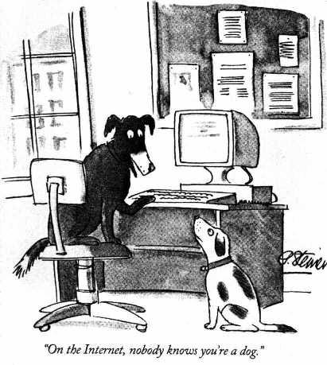
Notes:
What is the idea here? An old New Yorker cartoon.

Slide 4
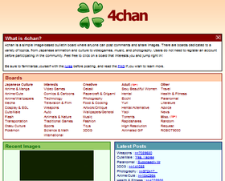
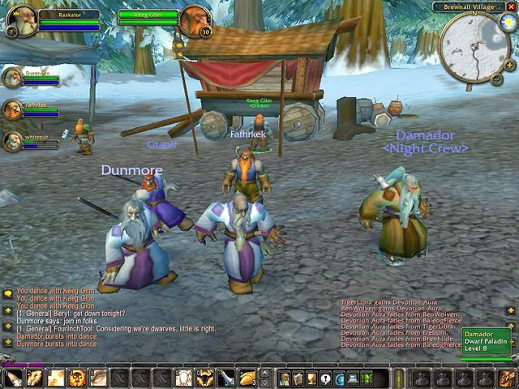
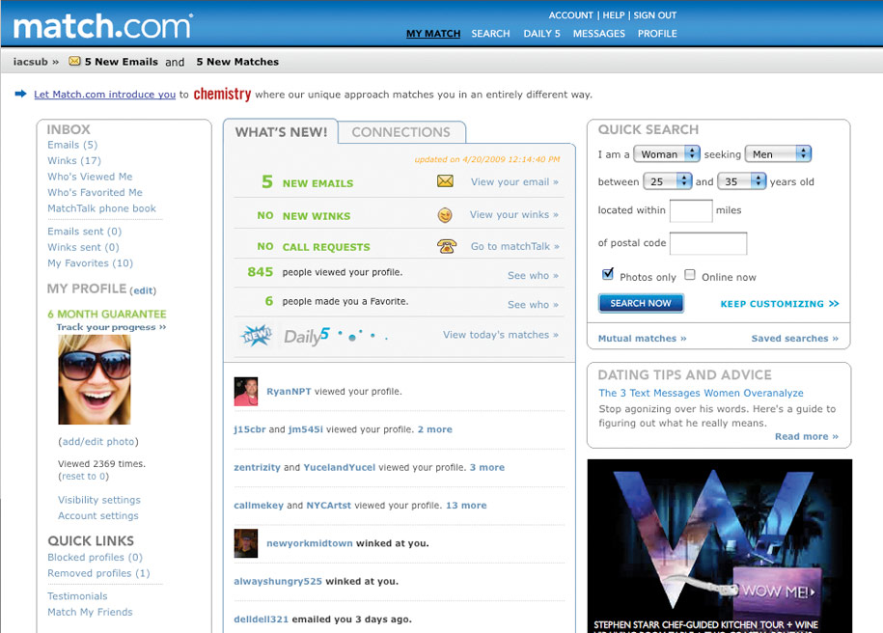
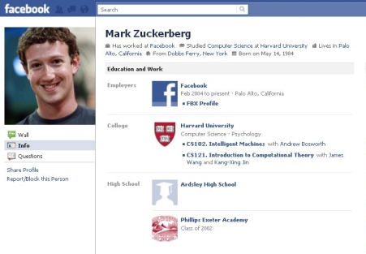
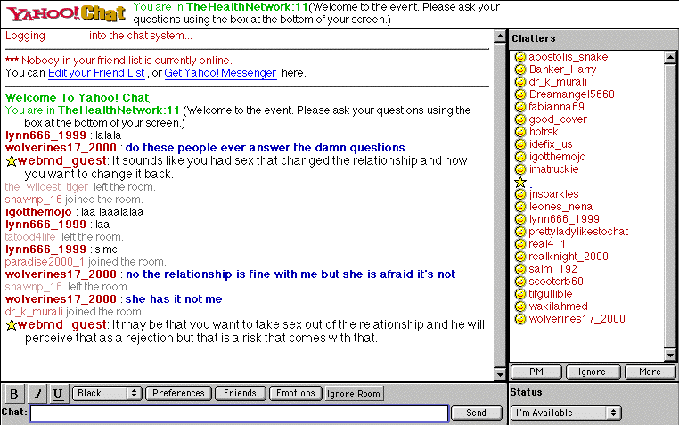
Discussion boards
MMORPG – networked gaming
Online dating sites
Thematic chat rooms
Social networking sites (SNS)
Pinterest?
Notes:
Online social environments come in many different flavors.
Different conventions, different challenges, etc.
There is not one Internet and I personally question the kind of broad gloss claims that try to encompass the Internet in its entirety -- about how virtual, online environments change our ways of interacting, identity formation, community which online environments.
This set of examples doesn’t even note the variants within category…all the various different versions of SNS – that draw different language communities. Orkut in Brazil, various Chinese SNSs. What is everyone using in China? How does it compare to Facebook?
SNS – profiles, friends, and comments as distinct features (different from these other kinds of environments)
What are some of the distinct practices emerging online and what do they perhaps point out as the distinct architecture that shapes social interaction that defines networked sociability:
Emoticons
Trolling
Lurkers
A very particular kind of self-made celebrity – the A-list blogger – a popularity, self-promotion that is emergent, less contained within the control and funding of media institutions
Flash mobs and crowdsourcing.
Internet memes
Cultural creation: the creation of vernacular culture, things “going viral” – extremely rapid spread
Farmville?
These are Internet-based examples, though in this section looking not just at the laptop computer based Internet, also a little bit at mobile devices, constant connectivity.

Slide 5
A (Non-Comprehensive) List of Distinctions
Temporality | Asynchronous | Synchronous
Identity | Role-playing, invention | Authentic self-presentation
Social connection | Strangers, social introductions | People from offline life
Other distinctions?
The point is this: there is considerable heterogeneity between different online social environments…the Internet is not one continuous space…not a single society or cyberculture
Notes:
Not a single online society or cyberculture – keep this in mind as you construct your final paper topic, identify problem space, and construct an argument

Slide 6
Thinking About Networked Sociability
Networked Individualism
Networked Publics
Focus on the individual in relation to others (across platforms)
The Social Network Revolution – as prior to Social Networking Apps (i.e. Facebook)
Social Network Analysis (in Sociology)
Focus on spaces and platforms (and their variation)
Architectural differences in the online
A Public - as collection of people and as space for speech (in Sociology)

Slide 7
“Publics” Mediated vs. Unmediated
Public / private distinction from a sociological perspective rather than a legal one
Properties of “networked publics:”
Persistence
Searchability
Replicability
Invisible audiences
Notes:
Some initial thoughts on this “architecture” within which we socialize, that “complicate” how we interact.
“networked publics” – the spaces and audiences bound together through technological networks. A type of mediated public, but not the same as tv, radio, newspapers … adds an additional feature “searchability” and “magnifying the other properties” – persistence, replicability, invisible audiences.
Privacy concerns – a topic of heavy discussion here at the ISchool…but we can consider this in more than one way.
There’s a legal debate around Internet privacy…in relation to business interests, against corporate power, in relation to the government, institutions.
Then there’s a more sociological reading of issues of private vs. public (as this piece on teens is aligned to)
Potential to be made hyperpublic.
Call on someone - what is the dilemma faced by teens – given their heavily monitored existence by a paranoid adult public they are trying to carve out space for the kind of socialization, experimentation process that is part of their stage of life. Doing so online (in networked publics), but more publicly than they would like. Ways of strategically managing that publicness, carving out privacy (from parents specifically) – deception (to evade searchability), configuring privacy settings (and developing workarounds), mirror accounts – the modern day equivalent of putting pillows in your bed and sneaking out the window (Ferris Bueller).
Persistence – speech is ephemeral, but what you put on the Internet is not – even where the modality appears to be one of informality and insignificance
(even in chat rooms, even discussions where comments scroll off screen eventually) – can be deceptively persistent - archives, visibility to bots, available to searching and indexing.
Searchability – ways of finding – not navigating through space, but instant. But does this crush serendipity, discovery?
Replicability – no distinction between original and copy – what are the implications? Mashups, things out of context. Internet memes. But also what about rumors? Wouldn’t rumors die on the Internet? One might expect that copy and paste would eliminate the imperfections that facilitate circulating stories that aren’t necessarily false. But see snopes.com
Invisible audiences – who is overhearing us – lurkers - this invisibility means its easy to make a mistake – presenting for a particular anticipated audience, but finding one has another audience entirely. Famous people saying stupid stuff on Twitter? Trolling as related to this – theory of reduced social cues.

Slide 8
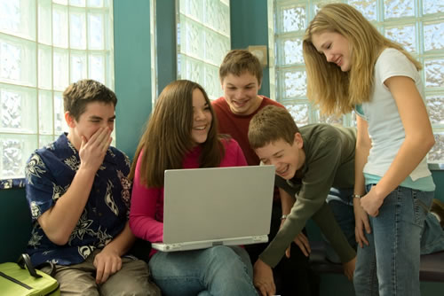
Special Populations
Teens: political and historical context
Origins of the term
Labor movement and child labor laws
Age segregation
Marketing to age groups
Spaces for teen socializing
Fear and moral panic
Notes:
“process of learning to read social cues and react accordingly” – for teens moving out of the home (where we begin to learn these cues as children) to “broader social settings”
The desire to be cool, validated by peers
“making mistakes and testing limits”
Exaggerated fears – “demonized” but also subject to protection. Surveilled in public space.

Slide 9
Context
The current state of national technology adoption – Introduction to the Pew Internet and American Life Project
Notes:
A good segue activity as we move to the new module where we’ll be looking at the Internet, network connectivity and related phenomena.
Just to start thinking beyond our own experiences…users of different ages, education levels, etc.

Slide 10
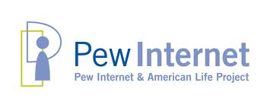
www.pewinternet.org
Ongoing research by non-partisan, non-profit “fact tank” on all matters connected to the Internet
Based upon national surveys (in US only) using probability sampling (random digit dialing)
Data available (import into SPSS, other statistical analysis packages)
Tracking technology adoption trends
Topics: health, politics, shopping, religion, etc.

Slide 11
X
X
X
X
X
X
Notes:
Remind ourselves of where we as a group stand in relation to the rest of the country:
http://www.pewinternet.org/Infographics/2011/Generations-and-gadgets.aspx
Just a reminder in what ways we are or are not perhaps typical.
Do a quick on the fly survey (white board – calculator):
Age range
Desktop computer
Laptop computer
Cell phone
E-book reader
iPad / tablet (10% in July 2011, 21% by September 2011!!)
Pew Internet and American Life – latest statistics
(generations and gadgets survey carried out September 2010)
Generations and gadgets survey:
- Asks if you have a desktop computer, a laptop (but not how many?)

Slide 12
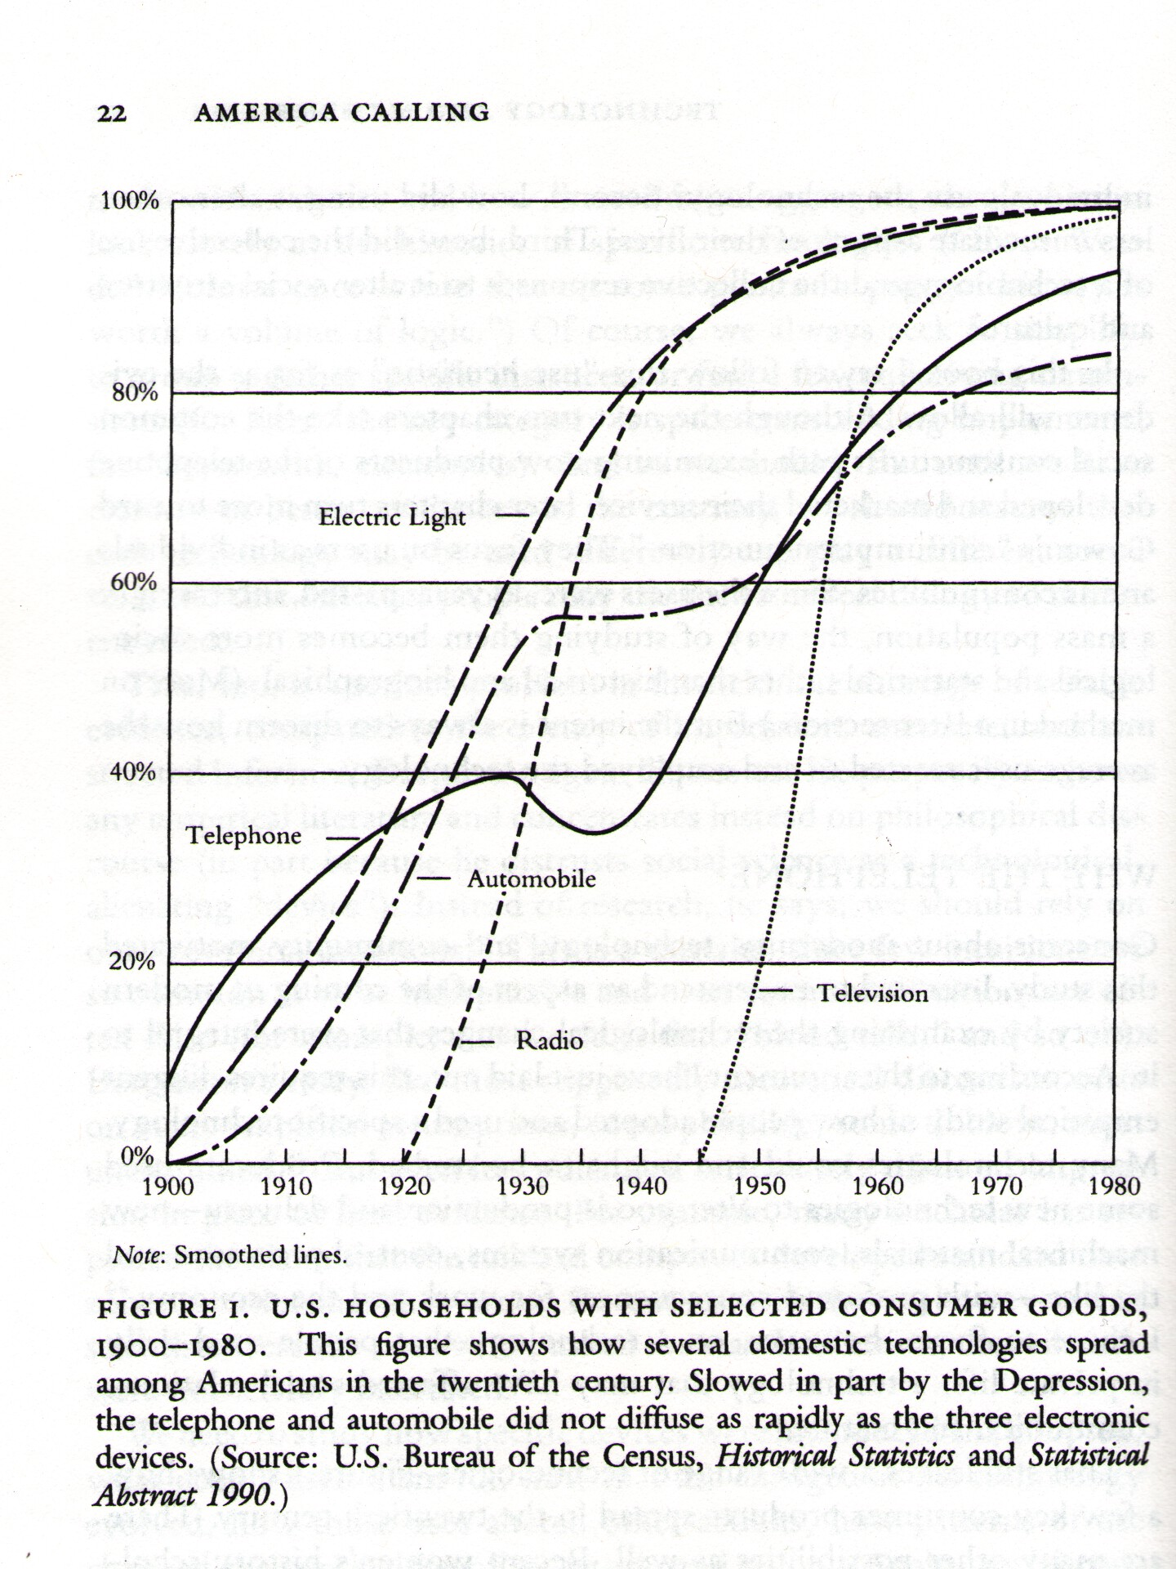

Slide 13
