Slide 1
Assignment 2
Don’t forget the Flickr assignment #2 (due end of day today)
Don’t forget the Work Practice Diary (to be used for assignment 2)
Assignment 2 was posted on the course website on Tuesday

Slide 2
Assignment 2
Two essay questions:
Updating the Myth of the Paperless Office
Yahoo! Ends All Work-From-Home Arrangements
Part II – further developing your
(1) topic area (2) specific problem (3) theoretical approach or concepts from class (4) justification

Slide 3
Assignment 2 – Part II
Provide 4 academic citations (can be some course readings, but start looking for some non course readings)
A document on resources for finding articles to cite is up on the course website.
A workshop with Elisa on using (free) bibliographic management software – Mendeley and on finding sources.

Slide 4
Session 14
Assignment 2
Professionalization, Values
Approaches to Design, Part II
Beyond Office Work
Notes:
In Myth of the Paperless Office issues considered at the interactional level. The way collaboration was considered in Myth of the Paperless Office about what we might refer to as group cognition or distributed cognition (as opposed to individual cognition)
Reading on the drug dispensing machine – a little bit more ‘down in the dirt’ issues of office politics, occupational groups and their professionalization efforts

Slide 5
So far…
Affordances (artifact-centric view, device comparisons)
Work practices (individual cognition vs. collaboration, tools employed in combination and in context)
Work roles (diversity within and across organizations)
TODAY…Values and Professionalization (specifically issues of status and power)

Slide 6
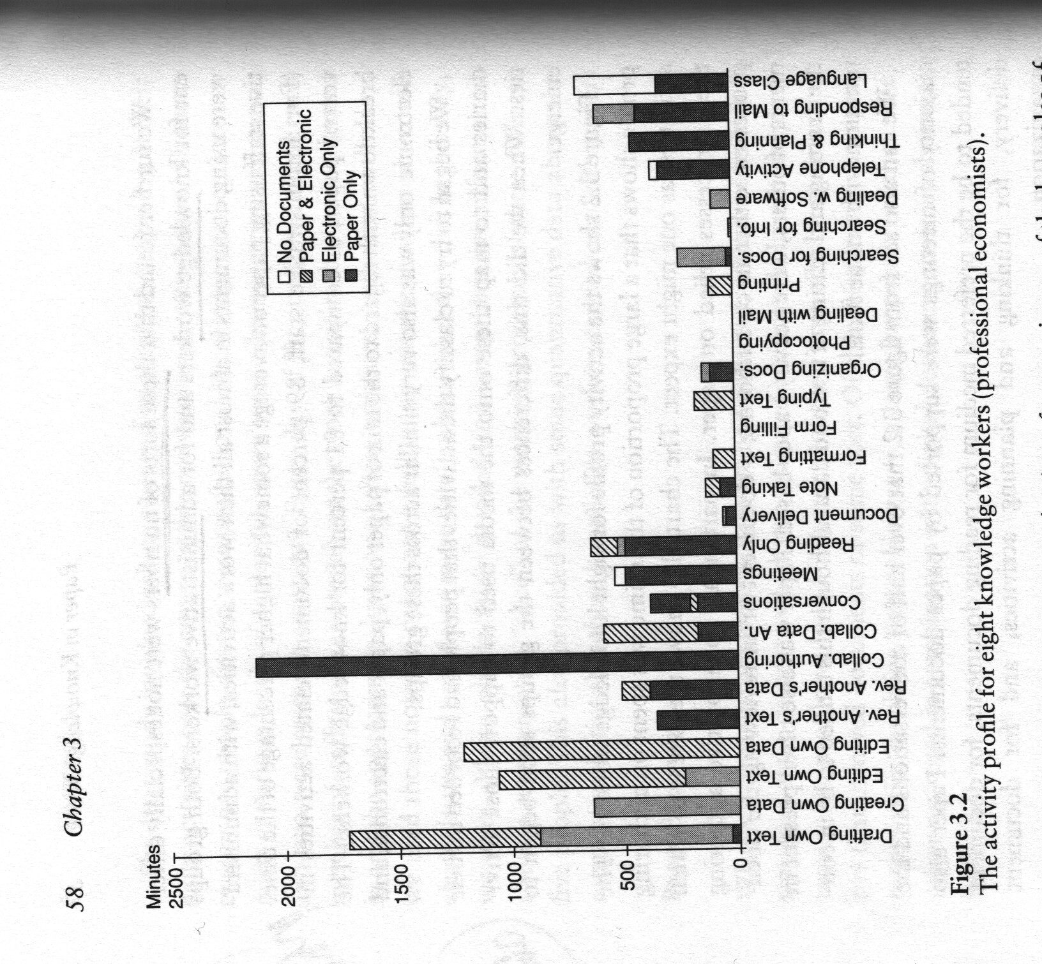
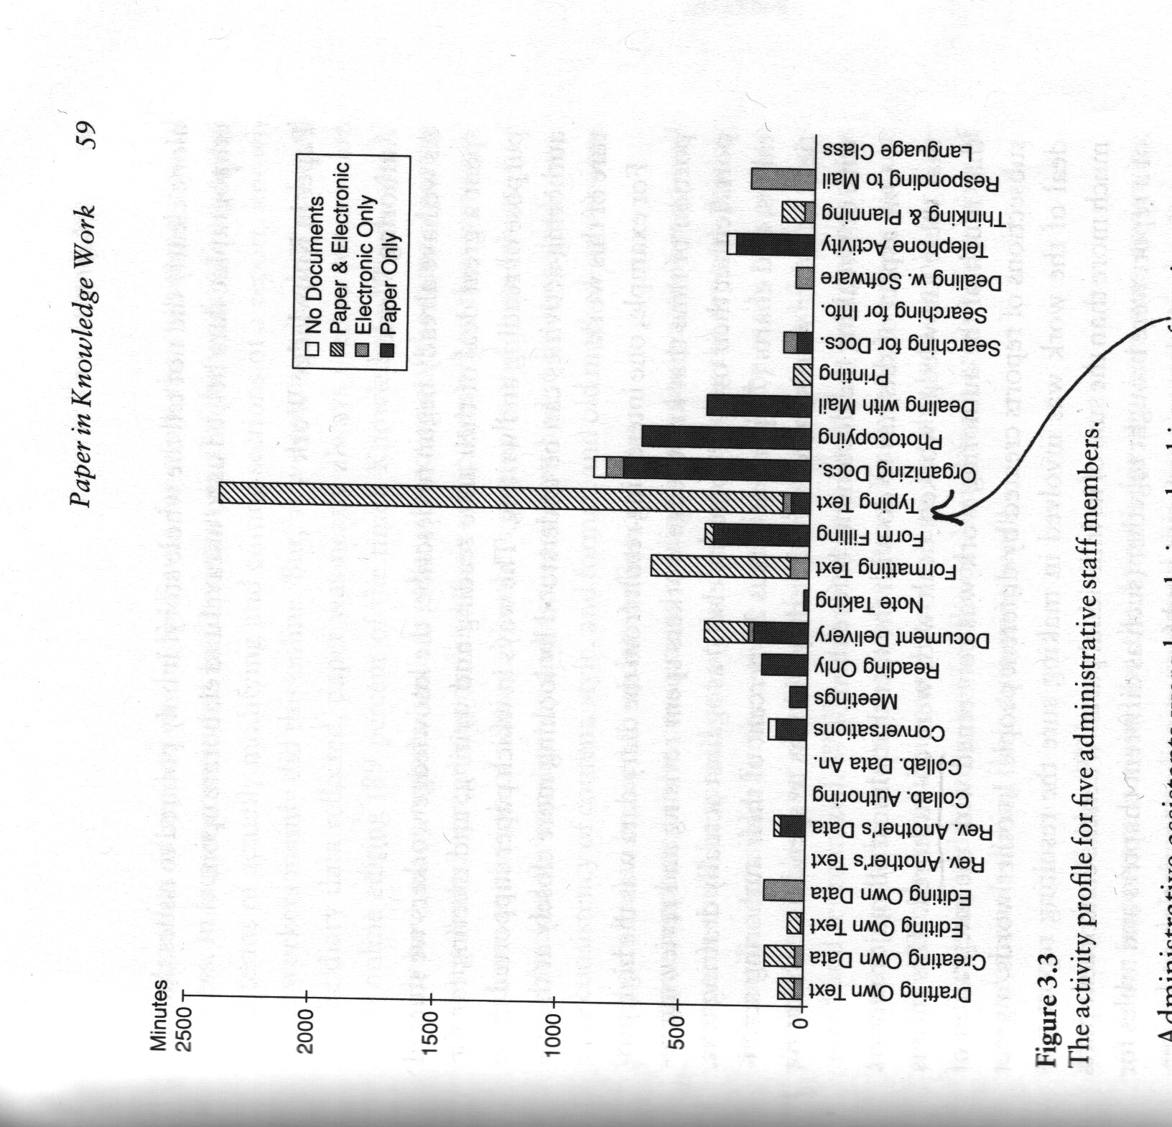
Differing Work Roles Within Organizations
Knowledge workers at the IMF
IMF administrators

Slide 7
Professionalization
About how we distinguish a job from a career
As an effort undertaken by an occupational group to ensure respect and job security
About “power struggles” and “status strivings” – Wilensky (American Journal of Sociology 1964)
Collaboration, coordination of work in relation to professional identity / values
Notes:
Professionalization is about how we distinguish a job from a career? Professionalization is an undertaking pursued by an occupational group… From a 1964 piece in the American Journal of Sociology “The professionalization of everyone?” - … professionalization is about establishing “professional authority” – and -- “any occupation wishing to exercise professional authority must find a technical basis for it, assert an exclusive jurisdiction [defending borders, boundaries], link both skill and jurisdiction to standards of training, and convince the public that its services are uniquely trustworthy.” [so partly about visibility too, recall Suchman] – can think of medical boards, professional licensing programs, the bar exam, etc.
In other words, its about how different occupational groups seek to ensure and protect the status of their profession and respect for it. Pragmatically about ensuring job security.
We can also talk about how change is negotiated through professionalization processes – for pharmacists…in the wake of certain aspects of their job shifting over to industrialization and automation processes [no longer mixing drugs, but trying to position themselves as “therapeutic advisors” sources of information, cross-checking, preventing deadly drug combinations, ensuring correct administering, etc. – a new role in an “information economy”].
Connecting to the broader history and context of a practitioner field (nursing, pharmacy) not just what happens within the walls of an organization. The challenge of plugging people into a task … they may debate the appropriateness of the role given to them in that new organizational structure and in relation to that new technology.
From Novek, idea or hope that “computer technology would enable pharmacy to reprofessionalize by defining its core tasks upward while automating and delegating its more routine tasks.” –pg. 382
Professionalization defined as:
specialization
transferability of skills [i.e. the concern among junior pharmacists about losing clinical skills]
certification, licensing, arrangements
Autonomy of expertise
From Widensky 1964, AJS

Slide 8
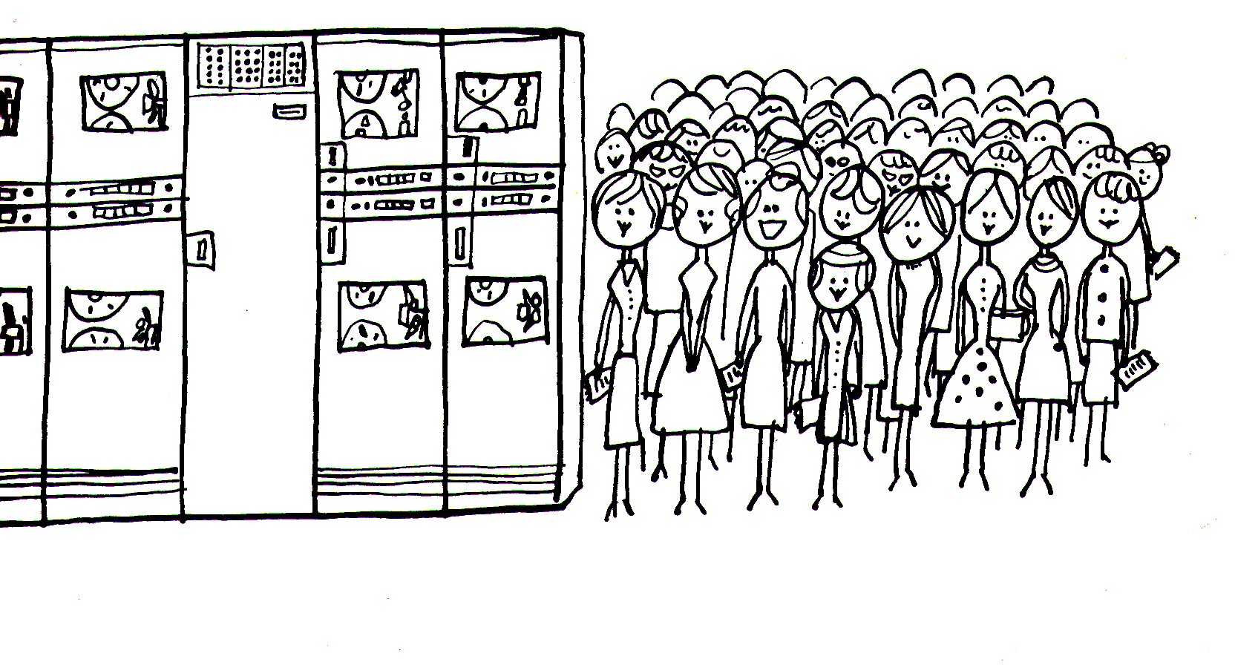
Why a Drug Dispensing Machine was Sent Back to the Manufacturer
Gender and “Resistance to Change”
Notes:
Issue raised in class -- what is “resistance to change?” when that “change” comes in the form of technology – Inexplicable? Irrational? … that it would be good/beneficial for them, but they refuse to use it because people are creatures of habit, risk-averse? Possibly generational?
gender/demographic – 90% women, 50% 40 and older, only 9% rate very good or excellent skills with technology.
A explanation for what is going on as tied to gender…nursing as a field then as now dominated by women, with certain occupational values that we associate with traditional femininity (caring, attentiveness to needs of others, being deferential)…by contrast to technology, engineering still dominantly an occupation taken up by men, and historically typically associated (in the popular imagination) with more masculine values – control.
In this case who was the tool built for -- “by and for pharmacy” – their professionalization interests (not those of nursing)
Of a group demographically with the least experience and confidence with technology (as self-reported), furthermore composed of part-timers – not stakeholders weighing in on decisions about automation -- ”nurses sense of vulnerability in the face of pervasive change reinforced their perception of the technology as imposed to meet others’ agendas.” – pg. 396…and contrary to their professional values

Slide 9
Why a Drug Dispensing Machine was Sent Back to the Manufacturer
“hospital work…is characterized by a complex division of labor requiring cooperation between occupational groups representing distinct interests and perspectives.” (Novek, p. 380)
“subordinate actors – users – whose work roles are subject to formalization are rarely consulted in the process of design and implementation of technology, except through training, where they are asked to adapt their work routines to a given system” (Novek, p. 399)

Slide 10
Why a Drug Dispensing Machine was Sent Back to the Manufacturer
“…There are two problems associated with this process of formalization and abstraction. The articulation work practiced by these diverse occupational groups, the nuanced knowledge and reflexive interpretation of local contingencies necessary to complete required tasks, is usually left out of the black boxes they are given to operate.” (Novek, p. 399)

Slide 11
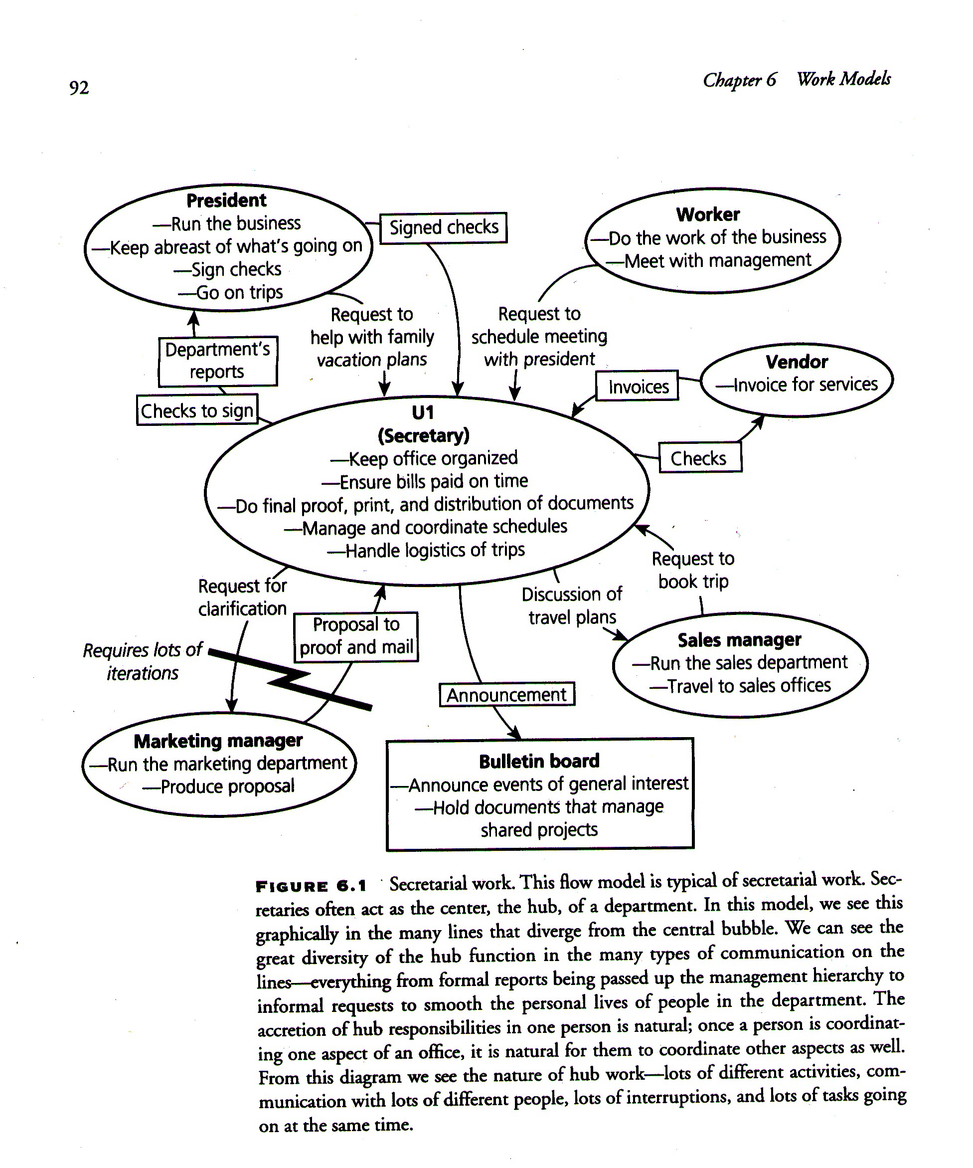
Contextual Inquiry: Flow Model
[from Contextual Design
(1997) Beyer and Holtzblatt]
Notes:
How might this look with the patient care managers, nursing managers, junior and senior pharmacists, pharmacy manager, and nurses? A way of thinking about those relationships, diagramming them. Handout from class.

Slide 12
DESIGN Approaches
Part II
Notes:
About designing user interfaces?

Slide 13
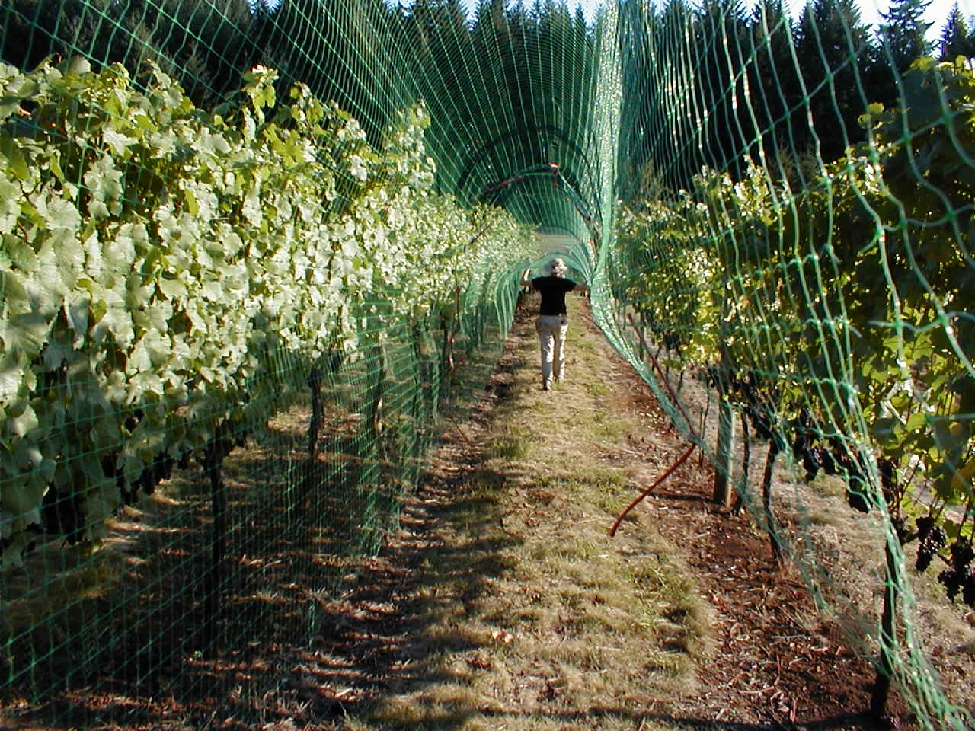
Vineyard Computing
Notes:
- This article was as much about understanding priorities and values in the vineyard workplace as it was about finding problems to fix.
We were concerned with critiquing a certain approach to sensor network system building and application (focused on pursuing deep computational problems) and the notion of proactive computing that aimed to take people out of the loop and to have computers automate decision-making

Slide 14
Research Questions
What data should we gather and how often?
What level of computational interpretation should we apply to the data?
How should we present the data to users?
Notes:
Could also frame this as a “problem space” – problem of efficient use of scarce computational and power resources (sensor network motes circa 2002) and how we might derive optimal configurations by drawing insights from actual work practices

Slide 15
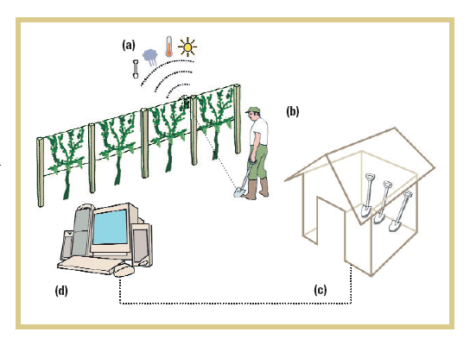
Findings: user interface level
Proactive computing (return of the socio-technical gap): Need to delegate btwn automatic and human-initiated decisions about data appropriately
UI matched to “work paradigm” – tangible UI (tagged tools) given diverse work roles in the field
Notes:
What makes sense to automate (again not because it can be or necessarily should be, but because it is in keeping with the observed work practices, in support of those practices)

Slide 16
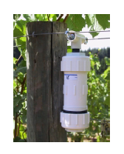
Findings: network configuration
Suggestions for sensor network configurations, system optimization driven by work practice.
Battery conservation (don’t need instant, live data)
In-network data processing
Data mules
Notes:
The main point of the article was that sensor network configuration decisions need not be based on the most efficient configuration of technology. Much of the effort in sensor network research was context-free, deeply into the computational challenges…yet social/work processes may be key sources of information for how technologies ought to be configured.

Slide 17
Beyond The OFFICE

Slide 18
Work Sites
Myth of the Paperless Office - how far do these findings ‘generalize?’
Characteristics of sites considered in MotPO:
  US / UK / Western
  ‘Clean,’ indoor, office environments
  Mobility – was it really considered?
What other issues around paperlessness (and general work practices) emerge in other kinds of sites?

Slide 19
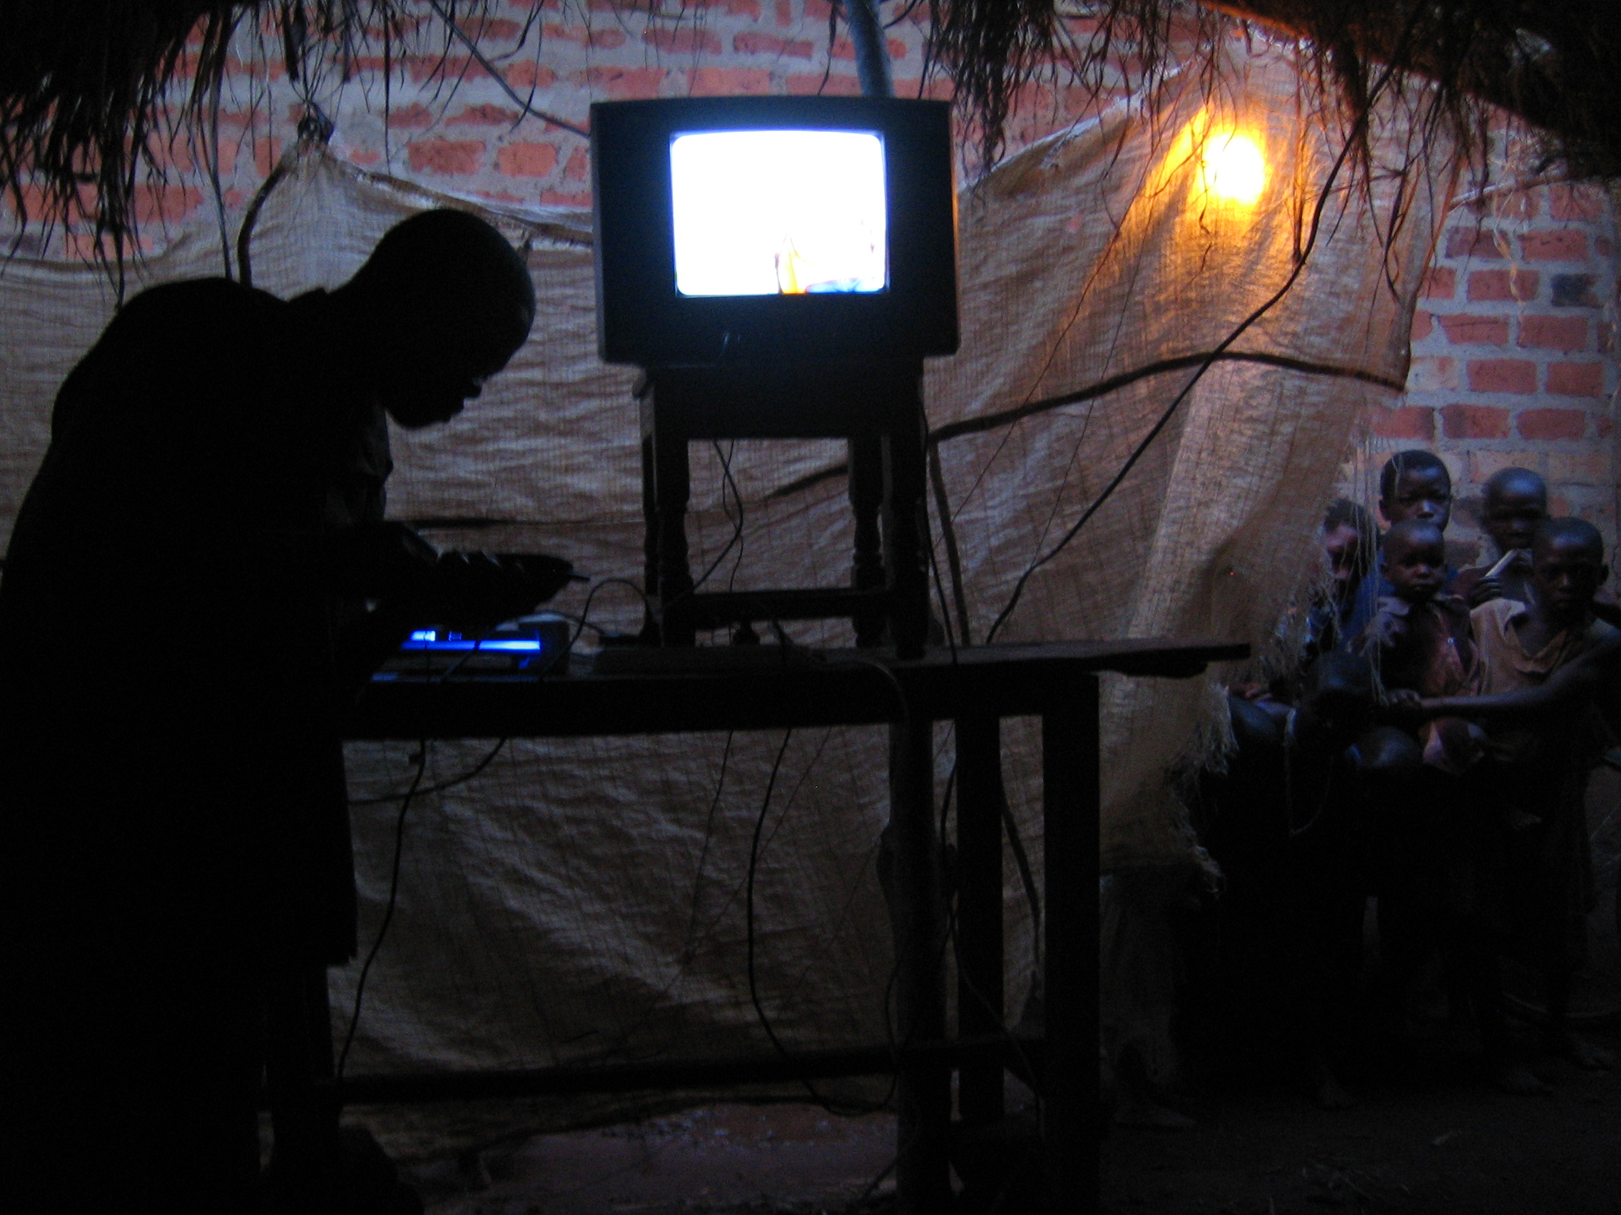
Beyond the Office:
Unreliable electricity infrastructure in many parts of the world and paper as critical back up

Slide 20

Beyond the Office:
What are the unique challenges of going paperless in the medical sector?
EMR – electronic medical records

Slide 21
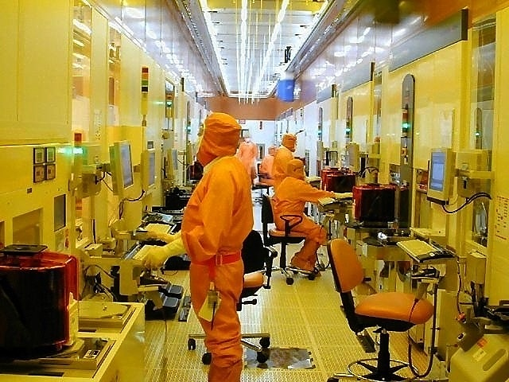
Beyond the Office:
Special constraints on paper in microprocessor manufacturing.
Notes:
Particle count – everything that crosses the barrier between the “clean room” and the outside office space has to be wiped down. Limits on paper, can only bring in 5 pieces…enforced paperlessness in relation to particle count. Perhaps predictably fab technician find workarounds

Slide 22
Summary
Topics to explore further: electronic medical records in the hospital setting,
Affordances, Work Activities and Roles, Work Values
Design Approaches
Work Beyond the Office Environment

