Slide 1
Session 12
Qualitative Research: Priorities, Process, Rigor
What is Ethnography?
Big Data: a debate on noise@ischool over OkCupid’s analysis of inter-racial dating

Slide 2
What are Some Qualitative Methods?
Interviews
Participant-Observation
Focus Groups
(Certain Forms of) Text and Image Analysis
Diary Studies
Any others?
Notes:
But recall Creswell piece…’qualitative approaches’ are not defined simply by methods.
Also ‘knowledge claims’ and ‘strategies of inquiry’

Slide 3
Qualitative Research Stereotypes
is not generalizable / is “anecdotal”
The sample is too small to say anything / is not a random sample / not representative
Very interesting, but can you show me some data that supports your claims?
the researcher’s presence in the setting biases the results
lacks rigor, procedure is unsystematic
Notes:
Population generalizability is but one way of talking about and thinking about generalizability. We can also think about generalizing to theory. Abstractions can be drawn from small samples, from the atypical to build, refine or critique theory.
Some research is about identifying what is typical, some research is not.
Interview transcripts, ethnographic field notes are data. Data does not equal numbers.
Lacks rigor? How are we defining rigor?

Slide 4
Qualitative Research – Distinctive Points of Emphasis, Priorities
Naturalistic Observation – how things unfold out in the real world (uncontrived)
Interested in Subjective Meanings (of Research Subjects) – ascertaining and analyzing the actor’s point of view (opinion, attitude, belief, value)
Inductive Analysis – on the side of theory discovery rather than theory testing
Notes:
We should evaluate qualitative research by criteria that match with these points of emphasis these priorities.
Not hold it to criteria from other research traditions.
So let’s talk about these priorities, what they demand, and what trade-offs are involved.
Trade offs of ‘naturalistic observation’:
lack of control over variables (as you would get in experimentation), (2) to get that close you have to be there which means you as a researcher can potentially disrupt, distort (sometimes that is actually very illuminating – people will explain the taken for granted to a stranger an outsider).
Trade offs of dealing with ‘subjective meanings of research subjects’
unavoidably face the limits of human communication and of ever knowing what is in someone’s mind.…also the flexibility of techniques required to invite that kind of self-expression creates some difficulty in doing comparisons – apples to oranges.
Trade offs of doing ‘inductive analysis’
not oriented to establishing causality, not well suited to generating precise measures of magnitude or distribution of a phenomenon

Slide 5
Qualitative Research – value in product /technology design specifically
Naturalistic Observation | More sound basis for feature prioritization exercises … beyond the focus group or big n marketing research surveys (de-contextualized, self-report)
Subjective Experience (of research subjects) | Getting a handle on ever more diverse user populations whose experiences and values are very different from our own
Inductive Analysis | Design innovation work…discovery process
[see Blomberg et al. 2003 for more]

Slide 6
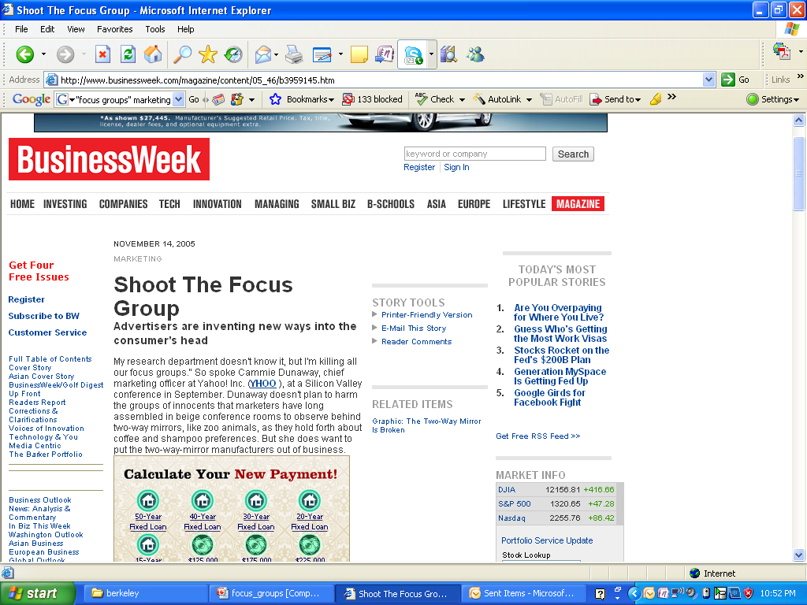
Notes:
How these priorities of qualitative research are translated into value within product and marketing research
http://www.businessweek.com/stories/2005-11-13/shoot-the-focus-group

Slide 7
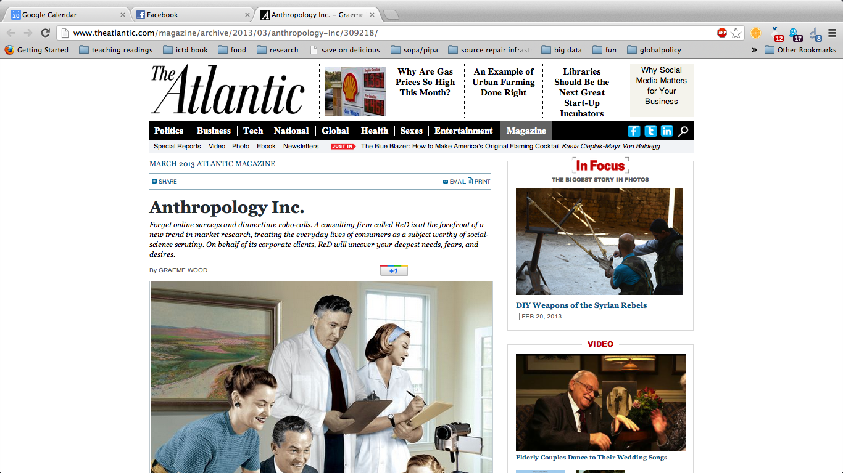
Notes:
How these priorities of qualitative research are translated into value within product and marketing research
http://www.theatlantic.com/magazine/archive/2013/03/anthropology-inc/309218/
“The corporate anthropology that ReD and a few others are pioneering is the most intense form of market research yet devised, a set of techniques that make surveys and dinnertime robo-calls (“This will take only 10 minutes of your time”) seem superficial by comparison.”
““The McKinseys and BCGs of the world will bring you heavy data. And I think those guys sometimes lack the human factor. What ReD brings is a deep understanding of consumers and the dynamics you find in a society.” That means finding out not only what consumers say they want in a liquor, but also what their actions reveal about the social effect they crave from bringing it to a party.”

Slide 8
Process
The Question of Rigor in Quantitative vs. Qualitative Approaches

Slide 9
Process: How Quantitative Research Really Works…
Problem
Method
Data Collection
Support or Reject
Hypotheses
Notes:
If we strip it all down, this is one of the ways in terms of an orderly sequence - we are taught (and teach others) to do user research in the traditional, positivist framework.
The reality should not prevent us from having a logic to our work, especially when we formulate our HYPOTHESES.

Slide 10
Process in Qualitative Research
1) research topic/questions
An Iterative Approach (Inductive Analysis)
2) sampling, site selection
3) data gathering
Field work
4) analysis
4) more analysis
Desk work
5) write-up
Notes:
Quantitative is less sequential, linear, and orderly than one might presume.
Likewise Qualitative Research has an underlying structure guiding such work…not sequential, but iterative

Slide 11
Ethnography?
What is it? Where did it come from?

Slide 12
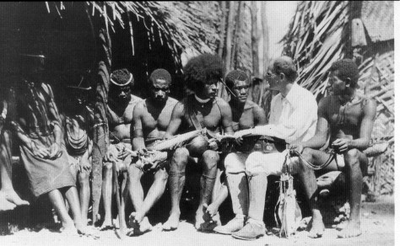
Ethnography
not a ‘method’ or ‘procedure’ rather a methodological approach: combination of subject matter, epistemology, and practice
ethno [nation] + graphy [writing]
Notes:
ethnography (simplest, clearest definition) – is the study of culture through the researcher’s immersion in that culture for a lengthy period of time.
ethno [nation] + graphy [writing] – writing a nation – does that illuminate the matter a bit? Maybe a little bit.
nation = defn 4 from the OED - “an aggregation of persons of the same ethnic family, often speaking the same language or cognate languages.”
Writing (description and argument) as a critical aspect (not just the transparent recording of findings).
If you are doing naturalistic observation are you doing ethnography? Not necessarily, but some observation and immersion is necessary but not sufficient.

Slide 13
Ethnography – characterized by…
subject: the holistic study of people, culture, societies, social relations, social processes, behaviour in situ
method: some component of participant-observation
analysis and writing style: inductive analysis, use of ‘thick description’ and narrative, emic accounts

Slide 14
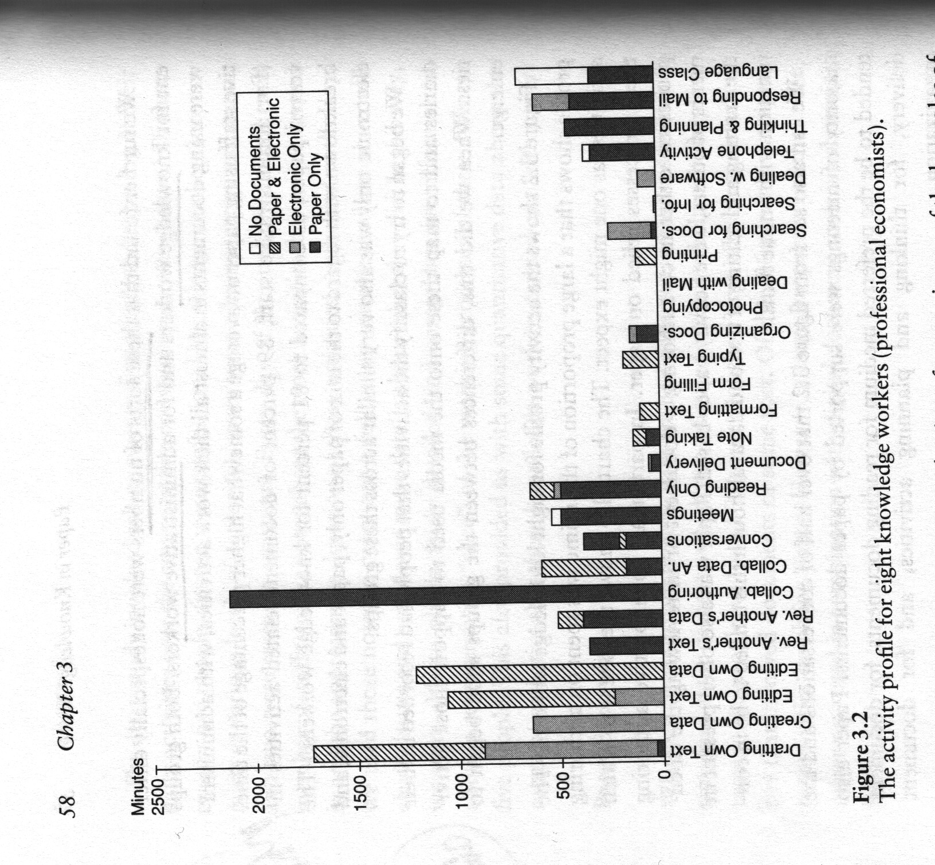
Ethnography – characterized by…
thick description
Keeping intact (holism)
‘You are there’ feeling
Not just observing action, understanding symbolic action
[time-use diary from naturalistic observation + self-observation – is this ethnography?]
[see Geertz, C. (1975). Thick Description: Toward and Interpretive Theory of Culture. In C. Geertz (Ed.), (pp. 3-30). London: Hutchinson, Basic Books.]
Notes:
Extensive use of unaltered data
Interpretation and meaning (wink vs. blink)

Slide 15
Advantages / disadvantages
rich data, non-reductive
direct observation of events, practice rather than reliance only on self-report
understanding behaviour, tacit knowledge
extraordinarily time consuming, unpredictable
extreme heterogeneity of data can be difficult to analyze, make sense of
commitment to inductive approach may lead to gaps in data

Slide 16
Becker – the epistemology of qualitative research (Criteria for Evaluation)
Quantitative Tradition | Qualitative Tradition
Reliability – reproducing the findings through the same procedures, same findings from multiple observers | Accuracy – based on close observation not remote indicators
Validity – whether and how well the researchers measured the phenomenon they claimed to be dealing with | Precision – captures a fine-grained account of the phenomenon including its dimensions and variation
 | Breadth – knowledge of a broad range of matters that touch on the topic
Notes:
On the qualitative side:
Embraces complexity, contradiction – goes along with precision

Slide 17
An ExaMPLE
Big Data and a relevant debate on noise@ischool

Slide 18
Mythology
“Big Data is a tagline for a process that has the potential to transform everything.” – Jon Kleinberg, CS Prof, Cornell U. – NY Times 8/11/12
“But faced with massive data, this approach to science — hypothesize, model, test — is becoming obsolete.” – Wired mag, 06/23/08
“'Big Data' can change the world” – headline, LA Times, 11/19/12
Notes:
http://www.nytimes.com/2012/08/12/business/how-big-data-became-so-big-unboxed.html
http://www.wired.com/science/discoveries/magazine/16-07/pb_theory
http://www.latimes.com/news/opinion/editorials/la-ed-data-privacy-20121119,0,7387282.story

Slide 19
What is new?
Type of data – log data, behavioral traces. “as the Internet has matured, the technologies for linking behavior with an identity have increased dramatically” (Lessig)
Quantity of data – terabytes, petabytes, yottabytes - more is better? New skills demanded for processing such data.
Range, Variety, Granularity of data – total enumeration

Slide 20
The Data Doesn’t Interpret Itself
Dubious Claim: that in online dating sites, people write more intelligently to people of certain ethnic groups than others…reflecting an implicit racial prejudice (in favor of white and asian people, against black and latino people)
Notes:
http://web.archive.org/web/20110327024741/
http://blog.okcupid.com/
“But ‘big data’ is still just as prone to misinterpretation as other kinds of captured data.”
Dubious claim from the piece:
“It seems that generally, people of all races write down to blacks and Latinos and up to Asians and whites. This is a pretty crazy result: proof that race not only affects the quantity of the contacts between people, but the quality as well. For example, the average black person writes at a level almost one full grade-level higher when writing to a white person than when writing to another black person.”

Slide 21
Interpreting Data
noise@ischool (Andrew Fiore, graduated PhD (now at Facebook):
“I enjoy reading the OkCupid blog, but I find their own interpretations of their data to be problematic at times…they make a big deal out of small differences and draw sometimes overstated conclusions from them “
“that discussion of grade level is a great example of how the analysis is mathematically OK but the interpretation is highly problematic (and, I would argue, legitimately offensive).”
Notes:
http://web.archive.org/web/20110327024741/
http://blog.okcupid.com/
“But ‘big data’ is still just as prone to misinterpretation as other kinds of captured data.”
Dubious claim from the piece:
“It seems that generally, people of all races write down to blacks and Latinos and up to Asians and whites. This is a pretty crazy result: proof that race not only affects the quantity of the contacts between people, but the quality as well. For example, the average black person writes at a level almost one full grade-level higher when writing to a white person than when writing to another black person.”

Slide 22
Interpreting Data: Mistaken Claim of Causality
noise@ischool:
“First, he asserts that race of sender and recipient is *affecting* the quality of writing.”
“These are not necessarily (or even probably) THE SAME PEOPLE writing grade-level 10 messages to blacks but grade-level 11 messages to whites. You can't assume that group-level patterns characterize individual behavior. There's no evidence that people are intentionally varying their writing quality for different targets anyway.”
“We know from Census data that mean educational attainment level differs by race.”

Slide 23
Interpreting Data: Exaggerating Differences
noise@ischool:
“The total swing in average grade level within any row (which is what matters, since it's relative to the sender-group's average) is 1.1 units. I'm sure it's statistically significant because their dataset is huge, but how practically important is the difference? We don't know. And you might presume from the bright, contrasting colors that they are VERY different.”

Slide 24
Small Data?
Small in terms of feasibility of non-algorithmic analysis (a human researcher being able to navigate through and recall of data)
Mixed methods and triangulation – check interpretations from big data with qualitative techniques – to get at motive, meanings directly research subjects
Big data as total enumeration (rather than sampling) permits identifying, characterizing outliers, extremes (which interests ethnographers and others doing qualitative research)

