Slide 1
Session 19
Mobile phones, constant connectivity

Slide 2
Outline
Mobile Phones – how do we get an accurate count of the number of phone users globally?
Networked Sociability vs. Constant Connectivity – what distinct issues are raised by the mobile phone in society, how applicable is existing theory?
Mobile Phone Etiquette
Notes:
Someone to summarize the reading?
From the

Slide 3
Mobile Phones
A Global View

Slide 4
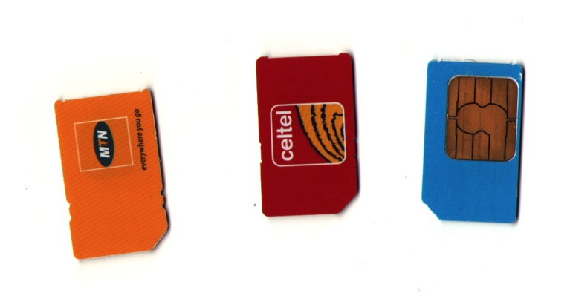
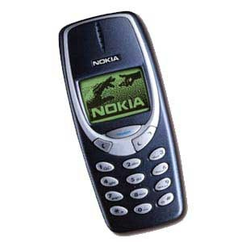
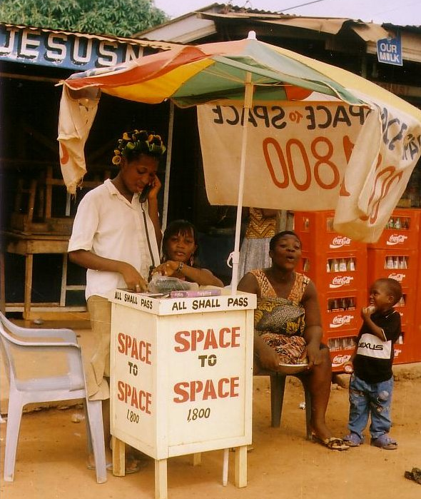
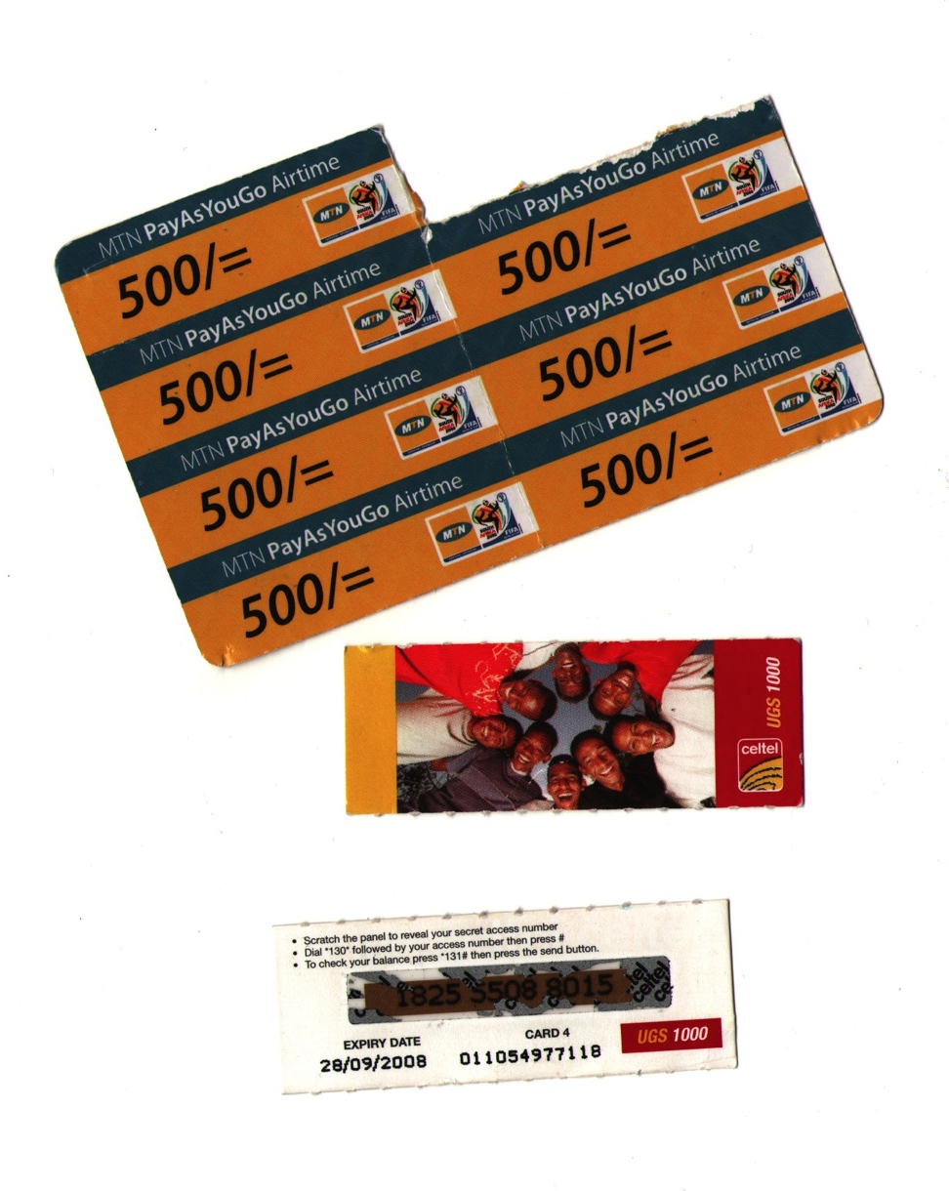
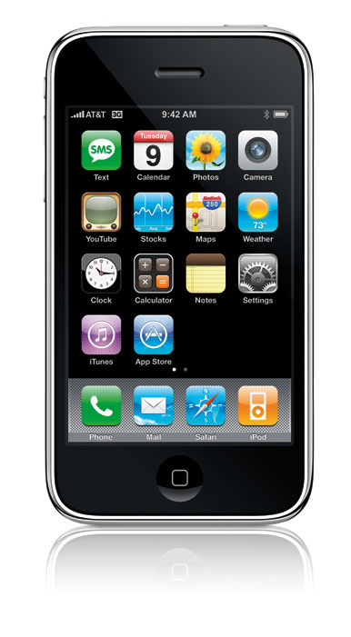
How to Count the Number of Phone Users Worldwide?
Notes:
Subscriptions (many people have multiple subscriptions, one on a different network so this likely yields overcounting) – (places with scarce coverage like Uganda)
Handsets (undercounts users – people share phones) – plus public phones. Also how long is a phone kept alive, what proportion break and what proportion go on to a second users (hand me down phones)
Along with shared phones should know about this pay-as-you-go model that predominates throughout almost the whole rest of the world (while here we are stuck with contract month-by-month service). The purchase of air time. Loading air time onto another person’s phone.
Location of sales – does not necessarily indicate country of use
Degrees of access and use (frequency, how distant the nearest phone is)
Land lines vs mobile phones (complements or substitutes) – in lower-income regions that had poor infrastructure to begin with – the mobile phone is the very first phone many have had access to.

Slide 5
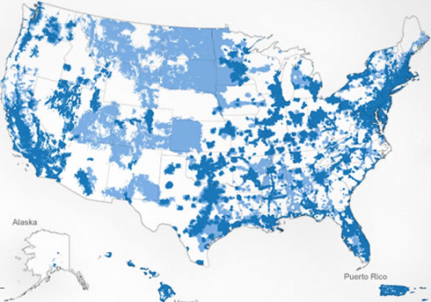
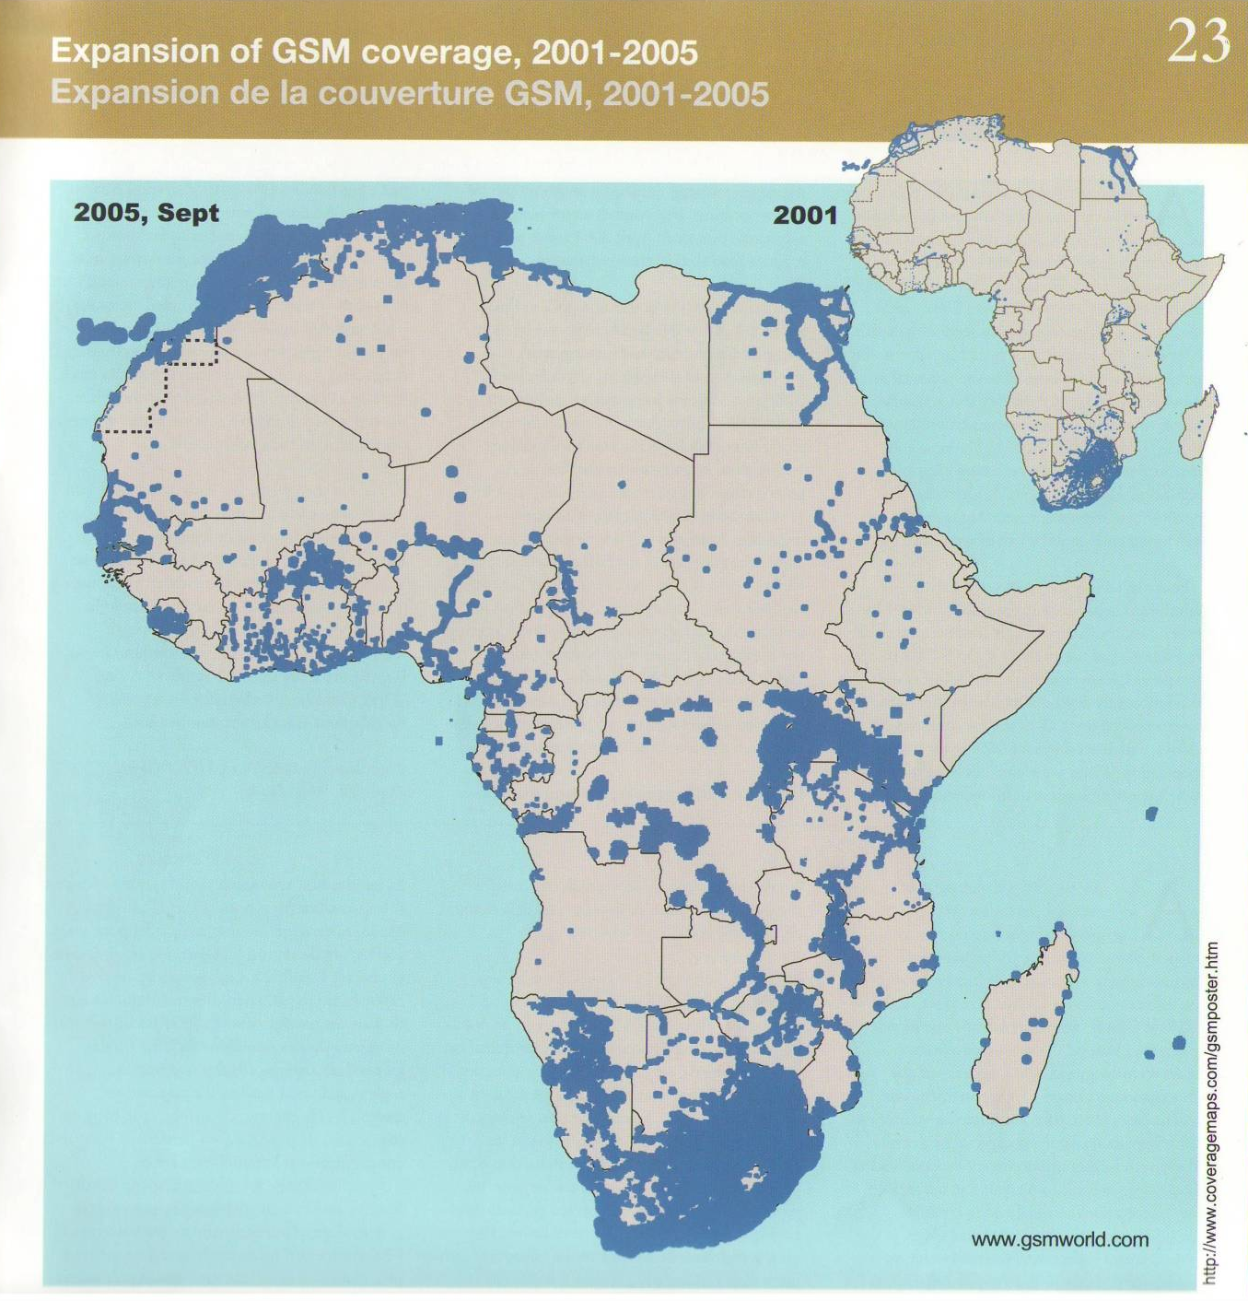
[AT&T 4G coverage]
[Acacia Atlas 2005, IDRC]
Notes:
Not just an ‘artifact’ but requires connectivity. Not just access to the phone, but also to the network.

Slide 6
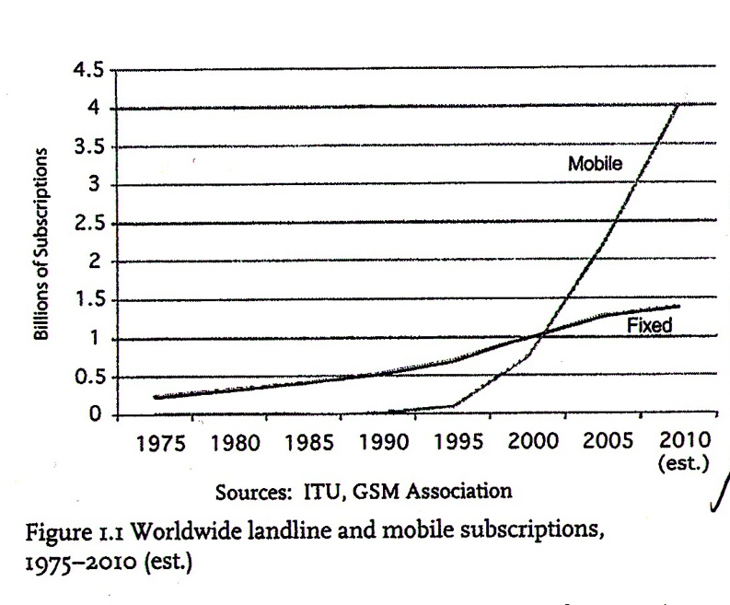
Fixed (Landline) vs. Mobile Phone

Slide 7
Networked sociability & Constant connectivity

Slide 8
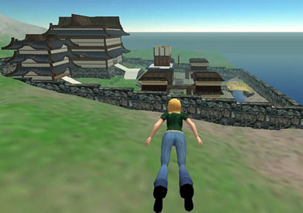
Online vs. Offline Interaction
Is sociability online different from face to face sociability?
Properties of Networked Publics:
* persistence * searchability * replicability * invisible audiences

Slide 9
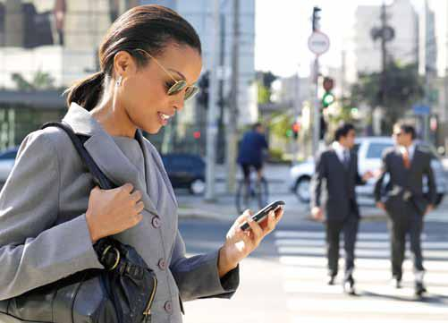
Online vs. Offline Interaction: overlap and convergence of these domains
‘Networked Sociability’ vs. ‘Constant Connectivity’
Interweaving of phone mediated communication and face-to-face interaction (this is where the etiquette issues emerge)
Portability of the phone (form factor) and its consequent use in public
Design for interruption
Notes:
Constant connectivity as a subcategory of networked sociability (perhaps)

Slide 10
Mobile Phones and Some Social Theoretical Perspectives On Technology
Technology Adoption / Diffusion Research | Communication technologies and the extra challenge to adoption of critical mass
Technological determinism / media effects (impact) | Bidirectionality of communication via phone technology complicates applicability of “media effects” literature (which posits active tech/content in relation to passive users)
Domestication | Diversity in the way a single artifact (the mobile phone) is made part of everyday life around the world

Slide 11
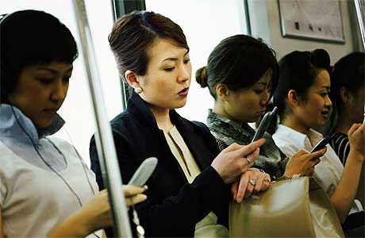
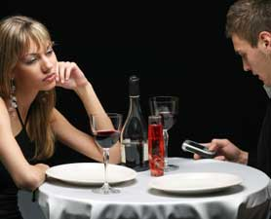
Mobile Phones: some distinct concepts/issues
Always On: connected presence, constant connectivity
Out in public: the phone as a symbolic device, as fashion
Just in Time: Micro-coordination work
Notes:
The distinctive white earphones – akin to clothing, an accessory.

Slide 12
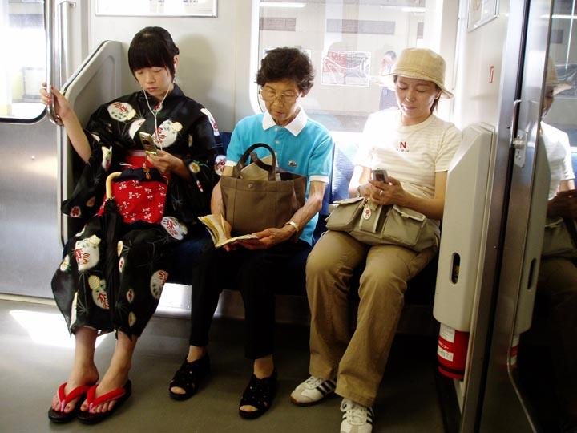
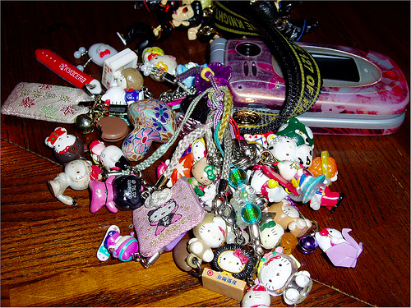
‘Kawaii’ and Phone Customization in Japan
Theories of technology domestication meet notion of phone as symbolic item, for personalization, as expression of cultural identity, for public display. Photo source: Larisa Hjorth
Notes:
Similarly – phone in Jamaica, in Ghana, in the Phillippines, in China, in South Africa, in India
No idea if this continues into the age of the smartphone.
Who participates? Young and old, men and women.
As a way of humanizing.
To cement personal ownership
Theory of domestication that the commodities we obtain are initially alien to use and through this process come to be a part of us, a reflection of self
Emphasizing global diversity and cultural specificity in the ways phones are used as far as functionality vs. its symbolic uses
About how it is “understood by communities in diverse ways”
Domestication doesn’t mean use in the home (sounds like it) but something more like localization.
How is this Japanese, what shapes the particular nature of Kawaii – “Kawaii culture draws from the Japanese tradition for gift giving, the symbolic value of animals in Buddhism, and as a means to overcome the Japanese proclivity for shyness in social interactions”
Kawaii culture is a final paper topic?

Slide 13
Mobile Phone Etiquette

Slide 14
Discuss
Think of an example of an egregious violation of mobile phone ‘etiquette’ that you have witnessed (or committed)? Think about what it was exactly that made this act such a violation?
What negotiations (if any) have you undertaken with a significant other or other family members or friends around phone use? What agreement or arrangement did you arrive at (if any)?
What do you think are (or ought to be) the rules of mobile phone use in public?
Notes:
Etiquette is emergent

Slide 15
How Social Interaction is Shaped by Mobile Phones
‘Architectural’ Elements:
Ring tone, volume, vibrate/silent function
Small size and portability
Caller ID
Voice Mail
Social Conventions:
Signs and announcements ‘please turn off your phone’
Emerging etiquette

Slide 16
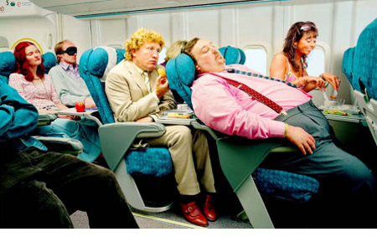
Etiquette
What is the problem?
The “problem space” outlined in chap. 5 of Ling & Donner
What does Humphrey’s observe about mobile phones, co-proximate individuals and body language?
Convergence of public and private
Opaqueness of context of your conversation partner

