Slide 1
Session 21
Peer Production and the Virtual Commons – How are resources like Wikipedia collectively constructed?
Methods and Big Data – how to study #1

Slide 2
Networked Sociability
An introduction

Slide 3
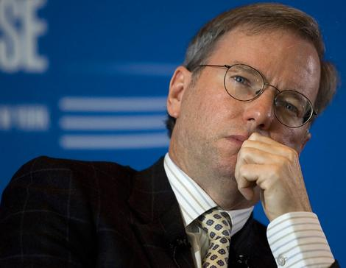
Anarchy?
“The Internet is the first thing that humanity has built that humanity doesn’t understand, the largest experiment in anarchy that we have ever had.”
- Eric Schmidt, Google CEO

Slide 4
Anarchy?
“The Internet is the first thing that humanity has built that humanity doesn’t understand, the largest experiment in anarchy that we have ever had.”
- Eric Schmidt, Google CEO
Do communities like Wikipedia and slashdot contradict this?

Slide 5
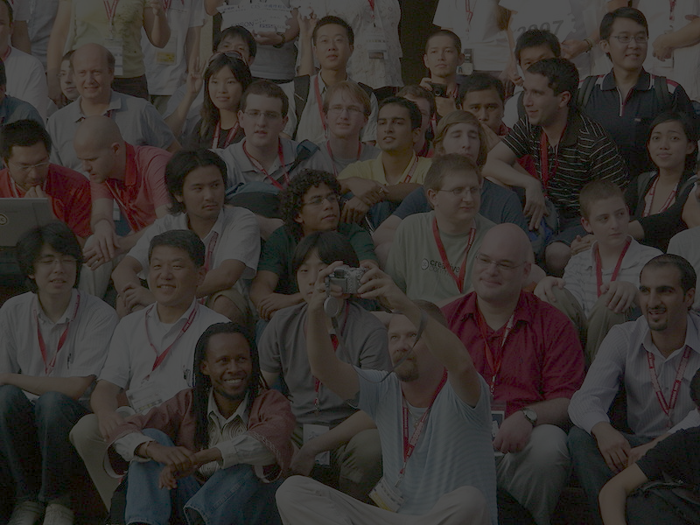
ORDER? morality?
What kinds of work are performed in order to govern online communities?
What is the role of technology in the governance of online communities?
What kinds of values are expressed in the design of social software?

Slide 6
Three studies
Slash(dot) and Burn: Distributed Moderation in a Large Online Conversation Space (Lampe and Resnick, 2004)
Articulations of WikiWork: Uncovering Valued Work in Wikipedia through Barnstars (Kriplean et al, 2008)
The Work of Sustaining Order in Wikipedia: The Banning of a Vandal (Geiger and Ribes 2010)

Slide 7
ONLINE vs. Offline DISCUSSION FORUMS
How are online discussions different from physical discussions?

Slide 8
ONLINE vs. Offline DISCUSSION FORUMS
How are online discussions different from physical discussions?
Properties of “networked publics:”
Persistence
Searchability
Replicability
Invisible audiences
What other unique challenges arise online?

Slide 9
ONLINE vs. Offline DISCUSSION FORUMS
There are many features built into slashdot’s discussion forum software:
No comments are deleted, only moderated
-1 to 5 scale for comment moderation
Meta-moderation to ‘watch the watchers’
Karma to reward good contributors
Anonymity possible, but with consequences

Slide 10
WHEN DOES MODERATION WORK?
Potential problems with moderation:
Which comments receive moderation?
Are ‘buried treasures’ uncovered?
Do moderation reversals happen?
Too much importance on ‘first posts’?
How have newer discussion platforms handled this issue differently?

Slide 11
WIKIPEDIA AS A WORKPLACE?
The different kinds of tasks that Wikipedians are rewarded for performing show us what kind of roles editors play in building the encyclopedia:
editing encyclopedia articles
mentorship and leadership
border patrol
administration
conflict resolution
meta-content tasks

Slide 12
HOW TECHNOLOGY SUPPORTS WORK
“Successful online communities have complex cooperative arrangements, articulations of work, and integration practices. They require technical infrastructure to support a broad division of labor.” – Kriplean, Beschastnikh, and McDonald (2008)
What kinds of work do barnstars support, and how do barnstars as a technical feature support this?
Notes:
There is a subtle difference here between:
What Kriplean et al’s study of barnstars tell us about work practices generally in Wikipedia, namely that they exist and are diverse; and
What their study of barnstars tells us about how specific technological features support work practices, namely the work of rewarding good workers and articulating work practices

Slide 13
Wikipedia’s gatekeepers
Wikipedians routinely patrol content according to pre-established rules, principles, and procedures.
Malicious contributors can be blocked from editing.
Administrators exist, and are explicitly granted more authority than ordinary users

Slide 14
HOW TECHNOLOGY supports work
“the blocking of a vandal [is] a cognitive process made possible by a complex network of interactions between humans, encyclopedia articles, software systems, and databases.”
– Geiger and Ribes (2010)
What kinds of work do vandal fighting tools support, and how do they as technical features support this?

Slide 15
BIG DATA
Methods, concepts, and techniques

Slide 16
Large-scale Statistical Analyses
Lampe and Resnick (2004):
“Our primary method of inquiry was to look for patterns in the usage logs.”
“Because there are so many observations in our datasets, the differences we report are all strongly statistically significant, and we omit reporting measures of significance in most cases.”

Slide 17
Large-scale Statistical Analyses
Lampe and Resnick (2004):
“Our primary method of inquiry was to look for patterns in the usage logs.”
“Because there are so many observations in our datasets, the differences we report are all strongly statistically significant, and we omit reporting measures of significance in most cases.”
“We also conducted interviews with three Slashdot editors, reviewing early findings and asking for clarification and explication of certain phenomena.”
Notes:
Be wary of statistical significance – it does not always mean ‘actual’ significance.
There is a lot of invisible qualitative and ethnographic work that goes into ‘purely’ statistical analyses.

Slide 18
Tracing Articulation Work
Concept from Anselm Strauss, Susan Leigh Star, and Lucy Suchman
Focusing on how people talk about work practices as a way of making work visible to others.
“Barnstars are observations of the activities of others, but they do not explicate how tasks are divided, scoped, and recomposed. On the other hand, barnstars – as a practice – are articulations of the work of recognizing the contributions of others.” (Kriplean et al. 2008, p. 49)
Notes:
Articulation work has long been used in the study of organizations and workplaces, with sociologists focusing on how people talk about and plan the work they do. This kind of articulation work is often structured and metadata friendly in online environments, which means you can trace it quite easily.

Slide 19
Tracing Distributed Cognition
Concept from Ed Hutchins, Bruno Latour, and Diane Vaughn
Tracing how groups collectively make decisions and judgments based on segmented tasks and information flows.
“because the cognitive activity is distributed across a social network, many of these internal processes and internal communications are directly observable (Hutchins, p. 128)

