Slide 1
Session 17
Deception, Reputation, Community

Slide 2
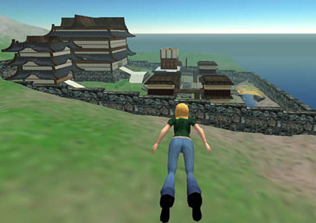
Focus of Section 3
Is sociability online different from face to face sociability?
What are the, “fundamental architectural differences that affect social interaction?” – boyd
How might the answers to the above questions shine some light on distinct challenges we face in designing or managing online social environments and (broadly) networked systems, services, applications that have a social, interactive component?

Slide 3
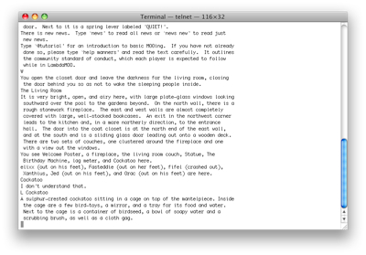
Platforms for Theory Exploration
These people are part of an unfolding role-playing game (circa 1991)
Same thing here (circa 2011)

Slide 4
How Social Interaction is Shaped Online
Architectural Elements:
Kill-files (block, ban function)
Anonymity/Pseudonymity configurations
etc
Social Conventions:
Administrative, Policy Level, Moderators
Peer to peer social enforcement – “plonk!”

Slide 5
Identity (Donath)
Sparseness(?) of identity cues online
Assessment signals - costly but reliable
Conventional signals – employed in deception
Resources for self-presentation online are different
Expressions given vs. expressions given off (Goffman)
No automatic bodily self-presentation
What signals are given by an e-mail address?

Slide 6
Reputation and Review Systems
Business considerations - security and predictability of transactions online:
Online buyers and sellers
Crowdsourcing vs. expert / professional evaluations:
Professionals – doctors, lawyers, etc.
Sex offenders
Restaurants, hotels
Movies

Slide 7
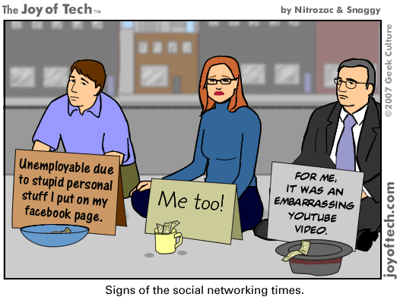
Consequences of a damaged reputation
Notes:
When people do it to themselves (without intending to) – some of this is invisible audiences and replicability coming together in a bad way.
Also, if we’re talking about deception, where people do it to others…next slide.

Slide 8
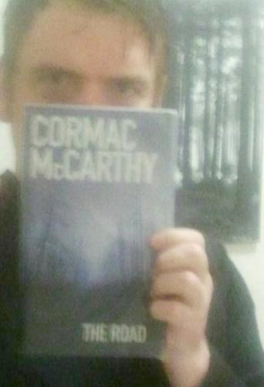
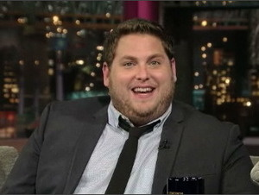
Two Cases of Twitter Impersonators
The Actor Jonah Hill
This guy from Scotland
Notes:
Someone posing as the actor Jonah Hill (created a twitter account) and then saying insulting things to other celebrities:
AW: So what inspired you to do the McCarthy Twitter feed? MC: My idea was to join Twitter as myself and follow news in the literary world. Then I did a search for Cormac McCarthy. I realized the chance of Cormac having a Twitter feed were remote. Cormac is religiously private. Of course there was no Cormac on Twitter. The idea flashed to create a parody Cormac feed. I created the account and did a search of the Twitter literati. I came across Margaret Atwood's tweets. I had read and admired her novel The Handmaid’s Tale. As Cormac I tweeted her as I imagined he would do. I think Cormac is noble and sincere and blunt. I tweeted Margaret -- “Please excuse my intrusion” -- and it escalated from there.
McCarthy - notoriously private, granted only one interview.
MC: Margaret Atwood welcomed me with a gregarious and kind introduction to three of her followers. I was instantly flooded with tweets and got swept away in the spate. A few people queried my authenticity from the start. Mostly people were carried along in the rapid tide with me. Cormac has a renowned reclusive nature. I think people wished it real and went with the wish.

Slide 9
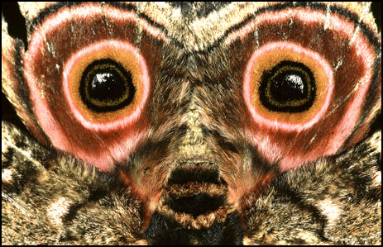
Deception
Trolls (online behavior intended to generate social discord conflict)
Sockpuppets
Impersonation
Concealment?
When is an online ‘deception’ regarded as a violation, a problem? When isn’t it? Examples?
Notes:
Is precipitated upon social norm of authentic self-representation. Can we speak about deception on 4chan? What would it take?
Deception as a betrayal. Deception on World of Warcraft? Is there such a thing?
Just as anonymity is regarded differently on different parts of the Internet.
Category deception – gender-swapping
Impersonation
Recent examples:
Impersonating someone on Twitter
Impersonation in Nigerian 419 scams
Networked publics – properties:
Identity cues are sparse
Spam is about replicability right?
Other problems (not deception):
Spam
Conflict, social discord
Draw properties of networked publics on the board?
Persistence
Searchability
Replicability
Invisible audiences

Slide 10
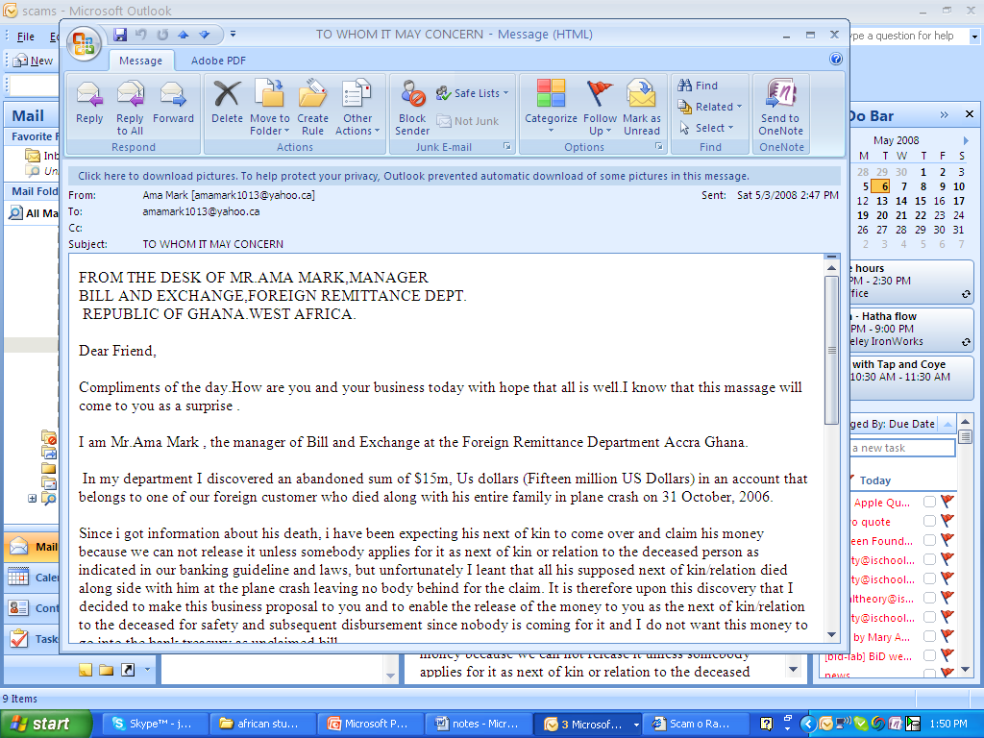
Notes:
They do work, all the time.

Slide 11
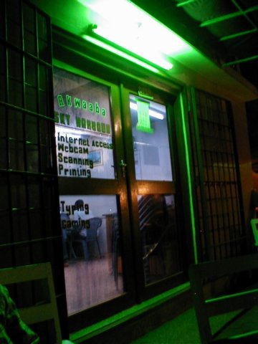
Nigerian 419 Internet Scams as Deception
Meant to be Persuasive
A ‘Re-mix’ of Western Depictions, Westerners Expectations about Africa
Playing on Greed, Lust, Altruism
Notes:
None of these narratives of deception gets at any of the cultural, global, political aspects. Looking at biology and social psych.

Slide 12
Internet Scammers in Ghana
“You see Africa is never printed as it is out of the continent Africa…if you are not in Africa all the pictures you see in Africa are diseases…. These nice, nice places will not be broadcasted....”
“… if I put my real picture or if I tell you this…my family background, my status, my financial background you will not even want to talk to me.”
Resentment over migration policy – ‘because they can’t go to America they will take money from Americans’
Notes:
Desire to interview trolls.
We can interview Internet scammers and this is what they have to say.

Slide 13
4chan and /b/
Anonymity (not just available but widely used – 90.07% of posts)
Ephemerality (contributions disappear quickly, no archive – 3.9 min avg lifespan of post)
Yet somehow users manage to do community-like things including signaling status and membership, invite ongoing participation, and inciting coordinated actions
Notes:
“rowdiness and lawlessness”
Archaic – does look incredibly dated – vintage web? Junky, cluttered, hard to parse aesthetic.
How does it have this ‘community’ effect – must move fast on anything you run across or it might disappear
Ways of resisting ephemerality – 4chanarchive.org, bump
Participation because no fear of failure, embarrassent, can disclose sensitive issues

Slide 14
For Thursday
Pick one (sign up Google doc on website)
Ackerman
Vineyard computing
Heilbroner
4chan and /b/
To prepare, revisit the reading:
What is the problem space this reading addresses?
What is its argument (or arguments)?

