Slide 1
Session 15
CSCW 2012
Flickr photos – How Do We Actually Work?

Slide 2
Work: macro to micro focus
macro
National Economy
.
Occupational Groups
micro
Interactional, Work Process Focus
IT adoption within firms and productivity gains?
Trans-firm groups, professionalization efforts
Within the firm: working alone or in a group
Notes:
We can (and we have) examined this question of information technology and the social and organizational issues of work at different levels – from very broad macro-level to the micro-level
(1) Started at the macro-level – Brynjolfsson article on the productivity paradox – which made the argument that some firms get more productive gain out of IT than others…the reason being that productivity is an outcome simply of adopting and investing in IT, but also making necessary organizational changes. The gains in productivity can take time to surface as organizations adjust, as workers learn.
(2) at the occupational level (got a taste of this last Thursday) considering how workers don’t just see themselves as members of a firm, or workers with a task, but as part of a profession/occupation, orient their work not just toward accomplishing tasks, but in relation to the values of their profession and larger professionalization efforts (see this in the negotiation over technology which is often brought in to automate certain activities) – Novek piece on a drug dispensing machine in a hospital touches on it, my article on vineyard computing does too, but only a little bit.
Between the occupational level and interactional level you might have a consideration of things like organizational culture, firm-level issues (rather than just groups and individuals within firms)
(3) Interactional level – Myth of the Paperless Office delves mostly into this level, Suchman, Grudin. Most of our effort and attention went into examining work at this level.

Slide 3
How do we Really work?

Slide 4
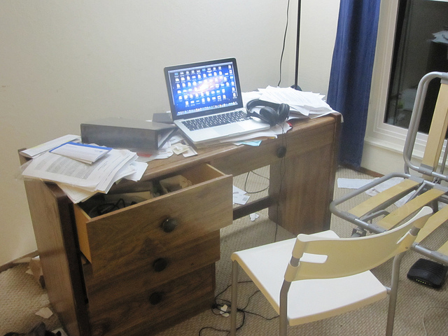
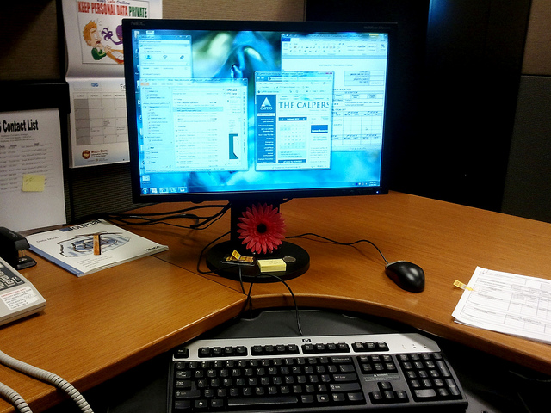
Work Styles
Photo: Natarajan
Arthur: “My desk is littered with a variety of things that aren't directly related to the task at hand, but are leftover from miscellaneous tasks in the past week…There are also a few business cards from an event I went to over the weekend. On the right, there is a stack of random papers and mail that I haven't cleaned up yet.”
“Yes, my desk always look like this – no clutter.” - Mary

Slide 5
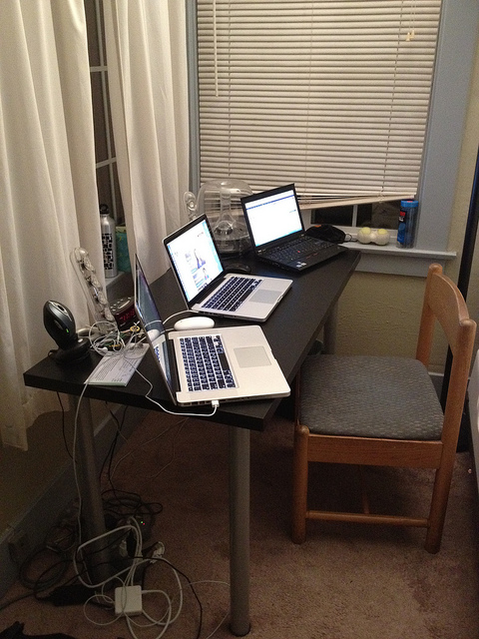
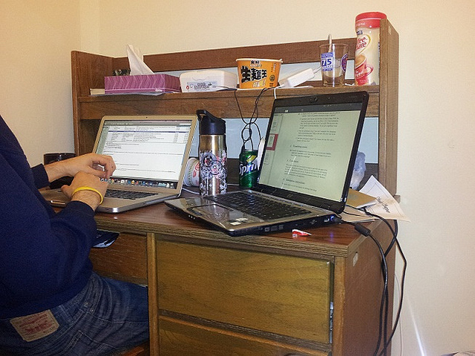
Notes:
Multiple screens:
A solution for issues raised in MotPO – spatial arrangements – broadening the territory used (beyond the dimensions of a single screen) -- certain kinds of activities cross-referencing…here also the need for dynamic displays.

Slide 6
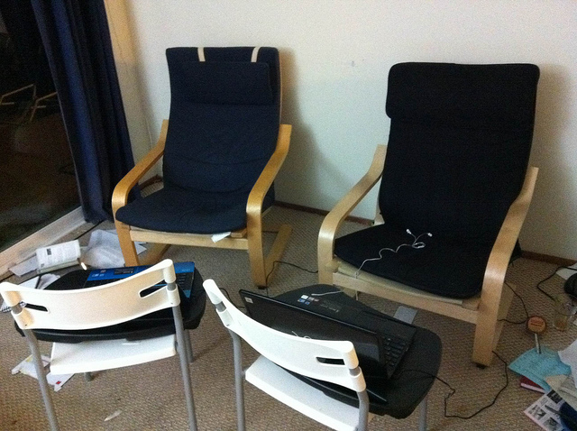
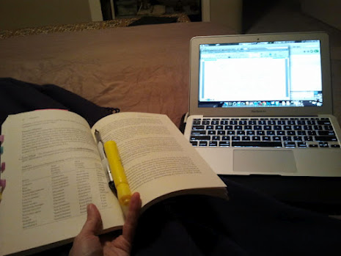
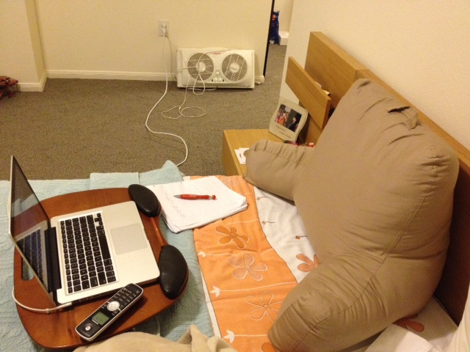
Comfort

Slide 7
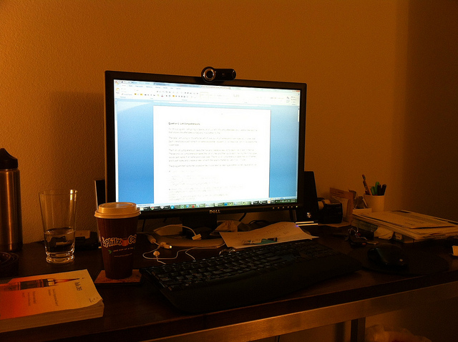
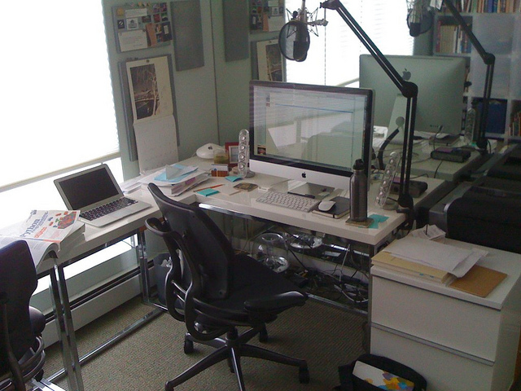
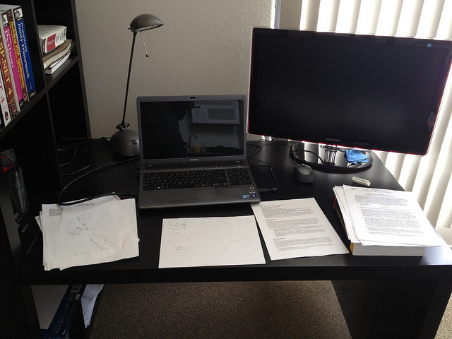
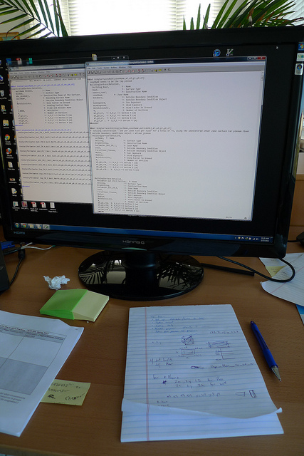
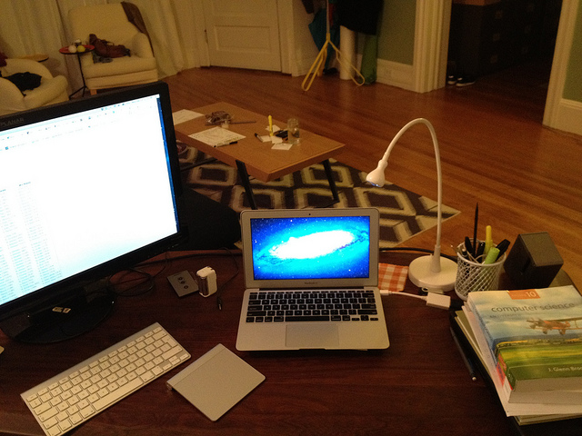
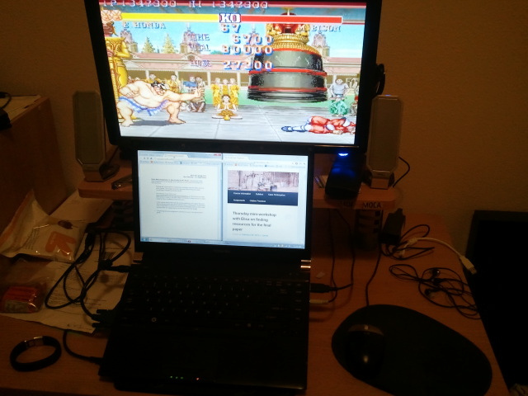
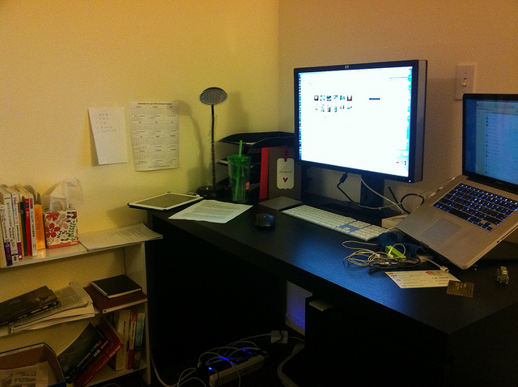
Notes:
Lawish 10 – middle right – “I use the big screen monitor to do most of my work as the extra screen space allows me to enlarge text and spatially lay out documents I am using“
Curtis says -- Bottom left image - “I also always use dual screens b/c the extra real estate allows me to multi-task. I almost never do one thing at a time, instead spending a few minutes on a specific task then rotating.”
Suhani – “I never do one task at a time. I am always handling multiple tasks simultaneously and switching between tasks. Hence, my desk, my prime location for work, is always at least as filled as shown.”

Slide 8
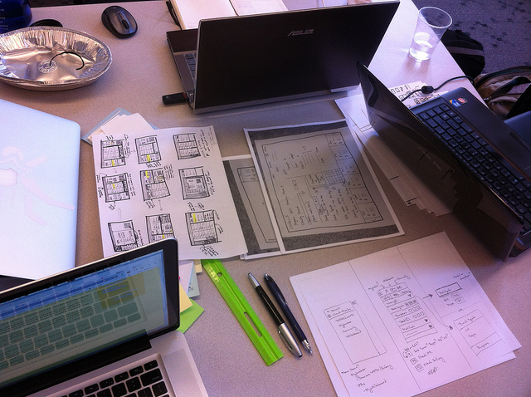
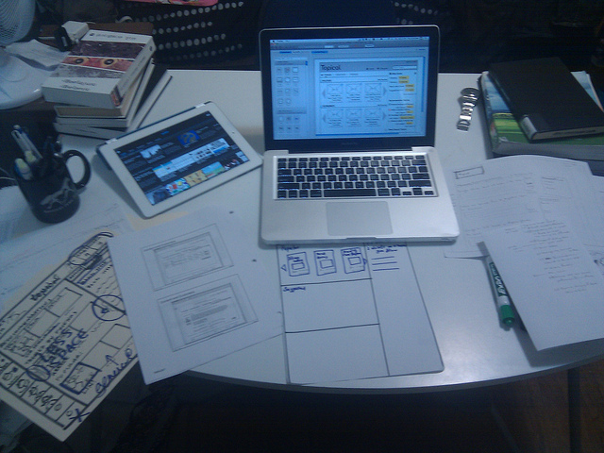
Collaboration,
Visual Creation Work
Notes:
Magiclandia: “we also used the white board to help us delineate our tasks and to make sure we don't deviate from our plan…working on paper prototyping for Info 213. It is much easier to do so by hand instead of using digital tools at this stage because these are only fast iterations of early phase prototype ideas. Getting ideas down fast by hand is a lot more efficient and also, I find, focuses my attention on the tasks the app needs to fulfill and not get bogged down by digital processes.” – say more about
Gilbert: “Paper is being used to collaborate and quickly iterate through different prototypes. Paper was a useful means to quickly visualize, markup, and annotate prototypes collaboratively. Laptops were used to display static information about assignment requirements.”
“Our group began prototyping on paper, since it was very easy to sketch out ideas” – Taeil
“The paper is especially good for brainstorming, and it didn't give us any constraints on imagination…Post-it gave us flexibility in generating affinity diagrams, but computer did not support this functionality…Though design software on a laptop created more polished designs, we had to use the built-in plugins and designs which constrained our creativity.” - Aijia

Slide 9
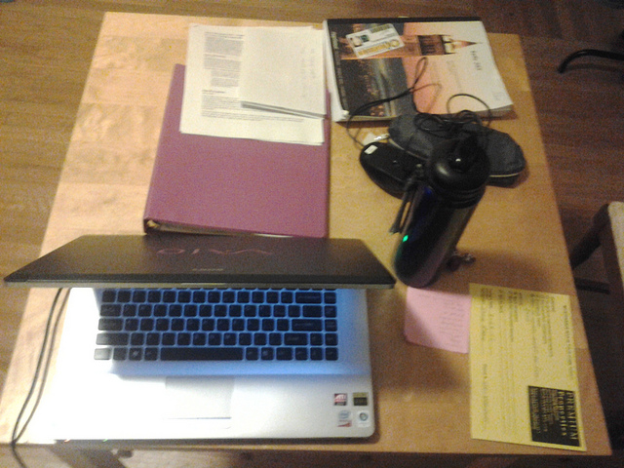
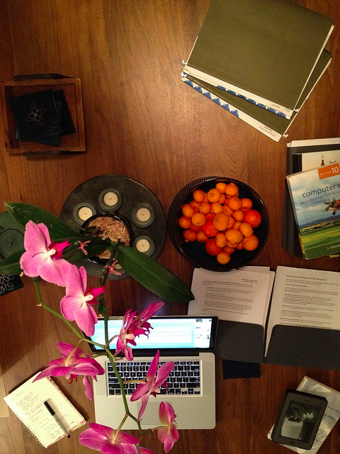
Memory Work

Slide 10
Memory Work
“Lastly, I've placed two folders with my 2011 and 2012 taxes, mostly so that I don't forget about them.” – Philip
“The pink slip is my "Things to do" list. I keep it on the table in paper format so that it is always seen by me and I am reminded of doing the pending tasks. If I store the list in my laptop, there are 2 problems: either I forget to open and file and check, or my laptop is shut since I am doing some paper reading…Having the slip on my table reminds me of the task simply by looking at the pink color and not even reading the list.” – Suhani
“I stick two pieces of papers on the wall left to my desk, a yearly calendar and a list of my long term goals. They are at that place so that I can frequently see them as reminders but won't distract me if I'm focusing at my screen.” – Sean

Slide 11
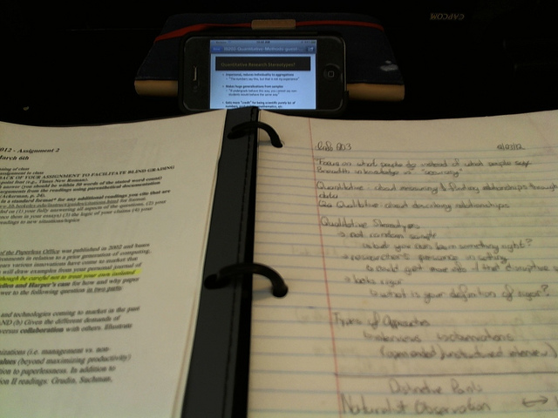
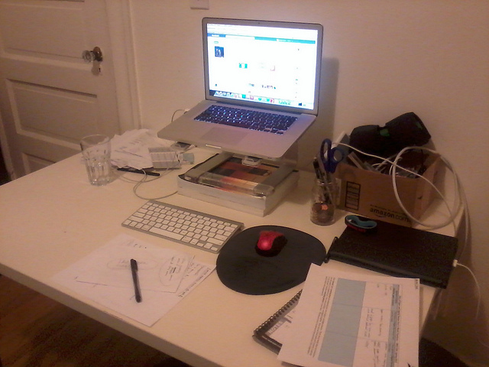
Notes:
phones, ipads, kindles…not in widespread use…not totally integrated into work. Why not?
Kay: “While using paper as a note taking tool, I prop up my iPhone which contains scanned versions of all of my notes and any lecture slides.”
Sean: “I usually don't use my iPad for work. It's there because sometimes the computer takes time when restarting or performing a large task… Then I'll check out stuff by iPad while waiting for the computer to respond.”

