Slide 1
Session 12
Qualitative Research: Priorities, Process, Rigor
What is Ethnography?
Assignment 1 – looking back
Assignment 2 – looking forward

Slide 2
Qualitative Research Stereotypes
is not generalizable / is “anecdotal”
The sample is too small to say anything / is not a random sample / not representative
Very interesting, but can you show me some data that supports your claims?
the researcher’s presence in the setting biases the results
lacks rigor, procedure is unsystematic
Notes:
Population generalizability is but one way of talking about and thinking about generalizability. We can also think about generalizing to theory. Abstractions can be drawn from small samples, from the atypical to build, refine or critique theory.
Some research is about identifying what is typical, some research is not.
Interview transcripts, ethnographic field notes are data. Data does not equal numbers.
Lacks rigor? How are we defining rigor?

Slide 3
Qualitative Research – Distinctive Points of Emphasis, Priorities
Naturalistic Observation – how things unfold out in the real world (uncontrived)
Emic Accounts – ascertaining and analyzing the actor’s point of view (opinion, attitude, belief, value)
Inductive Analysis – more on the side of theory discovery than theory testing
Notes:
We should evaluate qualitative research by criteria that match with these points of emphasis these priorities.
Not hold it to criteria from other research traditions.
So let’s talk about these priorities, what they demand, and what trade-offs are involved.

Slide 4
Qualitative Research – value in product /technology design specifically
Naturalistic Observation | More sound basis for feature prioritization exercises … beyond the focus group or big n marketing research surveys (de-contextualized, self-report)
Emic Accounts | Getting a handle on ever more diverse user populations whose experiences and values are very different from our own
Inductive Analysis | Design innovation work…discovery process
[see Blomberg et al. 2003 for more]

Slide 5
Process
The Question of Rigor in Quantitative vs. Qualitative Approaches

Slide 6
Process: How Quantitative Research Really Works…
Problem
Method
Data Collection
Support or Reject
Hypotheses
Notes:
If we strip it all down, this is one of the ways in terms of an orderly sequence - we are taught (and teach others) to do user research in the traditional, positivist framework.
The reality should not prevent us from having a logic to our work, especially when we formulate our HYPOTHESES.

Slide 7
Process in Qualitative Research
1) research topic/questions
An Iterative Approach (Inductive Analysis)
2) sampling, site selection
3) data gathering
Field work
4) analysis
4) more analysis
Desk work
5) write-up
Notes:
Quantitative is less sequential, linear, and orderly than one might presume.

Slide 8
Ethnography?
What is it? Where did it come from?

Slide 9
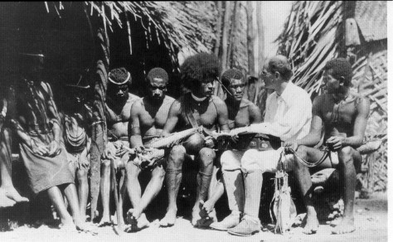
Ethnography
not a ‘method’ or ‘procedure’ rather a methodological approach: combination of subject matter, epistemology, and practice
ethno [nation] + graphy [writing]
Notes:
ethnography (simplest, clearest definition) – is the study of culture through the researcher’s immersion in that culture for a lengthy period of time.
ethno [nation] + graphy [writing] – writing a nation – does that illuminate the matter a bit? Maybe a little bit.
nation = defn 4 from the OED - “an aggregation of persons of the same ethnic family, often speaking the same language or cognate languages.”
Writing (description and argument) as a critical aspect (not just the transparent recording of findings).
If you are doing naturalistic observation are you doing ethnography? Not necessarily, but some observation and immersion is necessary but not sufficient.

Slide 10
Ethnography – characterized by…
subject: the holistic study of people, culture, societies, social relations, social processes, behaviour in situ
method: some component of participant-observation
analysis and writing style: inductive analysis, use of ‘thick description’ and narrative, emic accounts

Slide 11
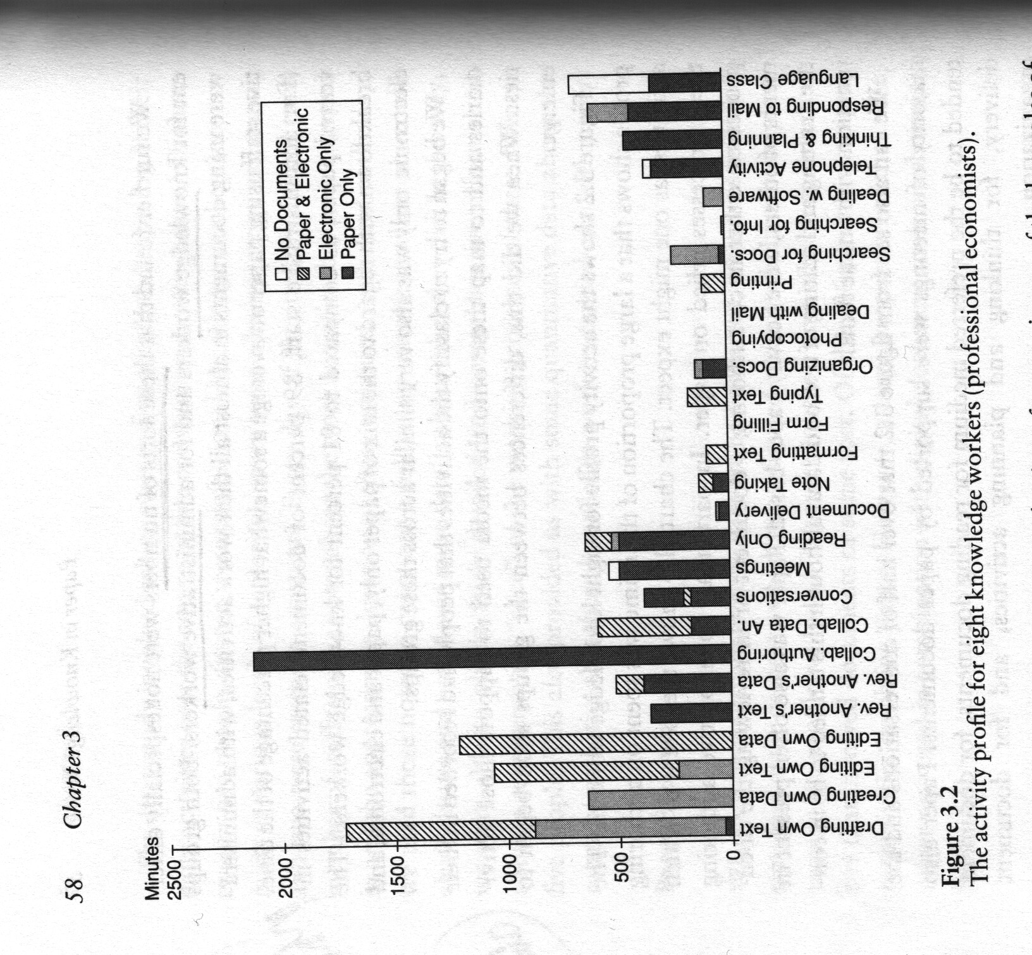
Ethnography – characterized by…
thick description
Keeping intact (holism)
‘You are there’ feeling
Not just observing action, understanding symbolic action
[time-use diary from naturalistic observation + self-observation – is this ethnography?]
[see Geertz, C. (1975). Thick Description: Toward and Interpretive Theory of Culture. In C. Geertz (Ed.), (pp. 3-30). London: Hutchinson, Basic Books.]
Notes:
Extensive use of unaltered data
Interpretation and meaning (wink vs. blink)

Slide 12
When is ‘ethnography’ NOT ethnography
When there’s no context (holistic)
When there’s no empathetic understanding (emic)
When there is no symbolic understanding of action (thick description)
When there’s no situated participation (experience)
When you’re not prepared to be surprised (inductive analysis)
When there’s no interpretation/framework (models)

Slide 13
Advantages / disadvantages
rich data, non-reductive
direct observation of events, practice rather than reliance only on self-report
understanding behaviour, tacit knowledge
extraordinarily time consuming, unpredictable
extreme heterogeneity of data can be difficult to analyze, make sense of
commitment to inductive approach may lead to gaps in data

Slide 14
Becker – the epistemology of qualitative research (Criteria for Evaluation)
Quantitative Tradition | Qualitative Tradition
Reliability – reproducing the findings through the same procedures, same findings from multiple observers | Accuracy – based on close observation not remote indicators
Validity – whether and how well the researchers measured the phenomenon they claimed to be dealing with | Precision – captures a fine-grained account of the phenomenon including its dimensions and variation
 | Breadth – knowledge of a broad range of matters that touch on the topic
Notes:
On the qualitative side:
Embraces complexity, contradiction – goes along with precision

Slide 15
Assignment 1

Slide 16
Assignment 1 – looking back
General Feedback
Questions not read carefully or answered completely
Reifying theories / concepts
Captured the details, but missed the big picture
Organization, logic, clarity
“Extension of Course Concepts”

Slide 17
Assignment 1 – looking back
Issues with specific readings
The socio-technical gap ≠ the gap between what we want a technology to do for us and what it is able to do for us.
Bijker’s social construction of technology framework (SCOT) – often referenced in question 3 – “relevant social group” ≠ users vs. non-users
Question 4 and Latour - written with some obvious clues to Actor-Network Theory (“non-humans” and “delegation”)
Notes:
What defines a relevant social group is a shared interpretation of a technology (not automatically the case that users = one relevant social group and non-users = another relevant social group)

Slide 18
Assignment 1 – looking back
Final Paper Topic
Scope - should be a topic you can examine without collecting primary data (i.e. relying on existing published accounts) [data collection and analysis requires a whole separate set of skills – see qual or quant research courses or needs and usability assessment]
Novelty – make it your own
Relevance to 203 – brings in issues and concepts from this course
3 Pages of Detailed Notes Will Be Posted on Course Website

Slide 19
Assignment 2 – looking forward
Similar format to the previous assignment (but covering new concepts and readings of course)
Work practice journal/diary (keep track for 1 or 2 days your own use of paper and digital devices) – for your reference, not turned in
Expect a Flickr mini-assignment (photographing work spaces) in the next week

Slide 20
Assignment 2 – looking forward

