Slide 1
Session 8
Flickr mini-assignment
Reconsidering the OLPC
Big Themes and Takeaways

Slide 2
Flickr Mini-Assignment
Examples of repurposed items (in ANT terms many examples could be called anti-programs) …though is ANT just about how things are repurposed?
How is this new ‘identity’ produced through assemblages of humans and non-humans? What else is enrolled to produce it? Is this enrollment successful? Is it stable? Or not?

Slide 3
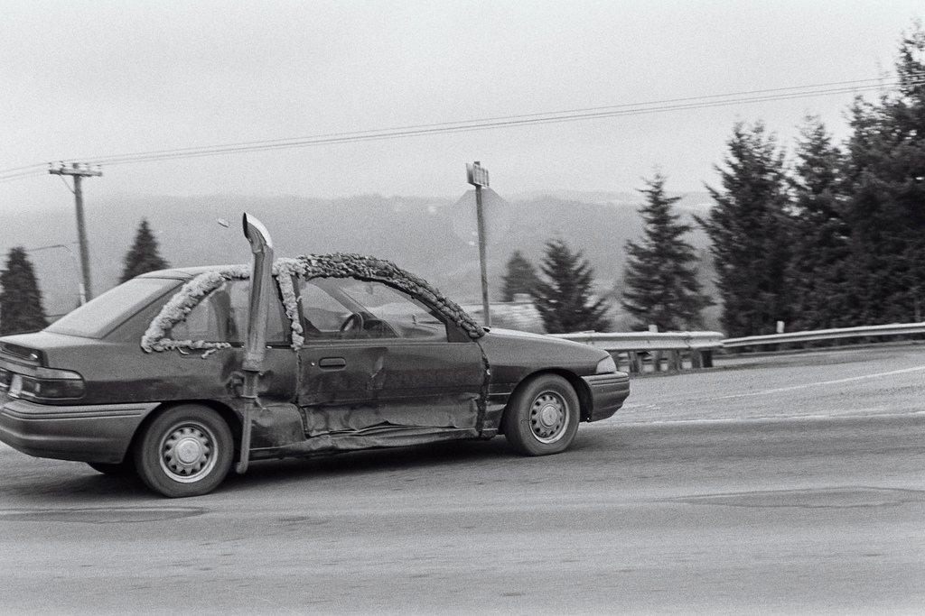
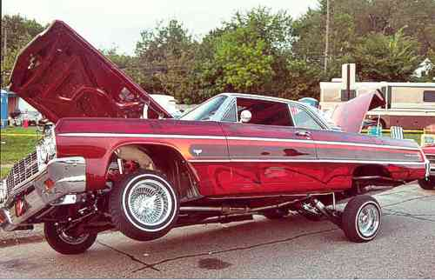
Notes:
This gives us an opportunity to talk a bit more about programs and anti-programs…ANT considers the way orderings between humans and non-humans are constantly enacted (just as we maneuver around cars every day without this happening) but depending upon how secure and firmly delegated and enrolled are also prone to disruption. The car that smashed into the side of this car had a very consequential anti-program, presumably beyond the intentions of the car owner who was driving the car that did this damage. The result was a new and unstable state, now operating this car leads to exhaust filling the interior and possibly poisoning the inhabitants of the car. A new effort at enrollment on the part of this car’s owner acting as heterogeneous engineer, installing (or persuading someone to install) this giant exhaust pipe and sealing up the windows. Can see that this is a car owner who is able to enroll certain resources, but not others (most apparently here – does not seem to be able to enroll the money to do proper autobody repair).
Breakdowns make things visible. With a more stable re-ordering we wouldn’t be able to see all of this. The broken down car is a more quintessentially ANT example then the low-rider car … in the way that car accidents in general reflect a pretty powerful role played by nonhumans, they way they may operate in ways that are counter to human intention.
A number of photos in the Flickr set that offered the repurposing of functional items for decorative purposes. As a kind of style. ANT generally doesn’t care about style, fashion, symbolic display, cares about how the things brought together into an actor-network have certain material consequences.

Slide 4
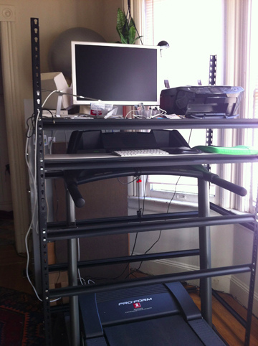
Notes:
A failed effort at enrollment (or not quite successful)…if it was meant to persuade you to walk.
How to complete this failed enrollment?
What if you set up the computer so that it is powered by the treadmill.

Slide 5
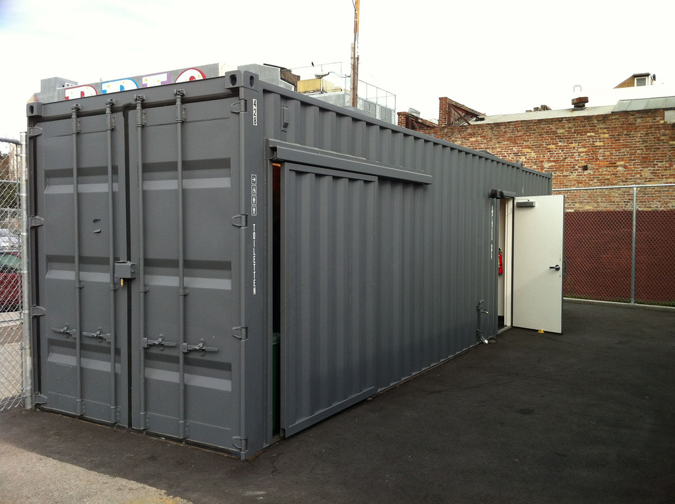
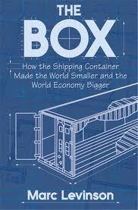
Notes:
Something called containerization… “a system of freight transport based on these steel containers” … containerization is a very, very strong and pervasive global enrollment that is by now extremely stable.
There’s even a book about it that states, “The container is at the core of a highly automated system for moving goods from anywhere, to anywhere, with a minimum of cost and complication on the way.”
This story about the shipping container told in this way with the box itself at the center of that universe (the mundane – or perhaps not so mundane – artifact, this very consequential non-human) is very much in the spirit of an ANT approach.

Slide 6
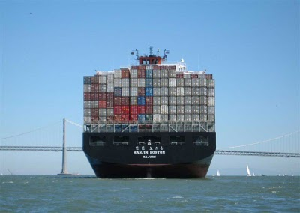
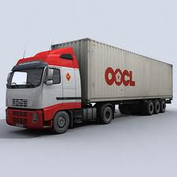
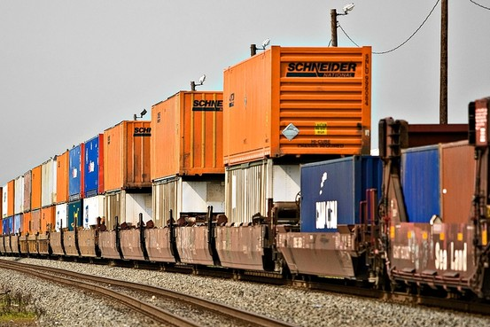
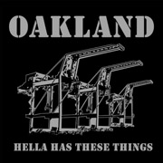
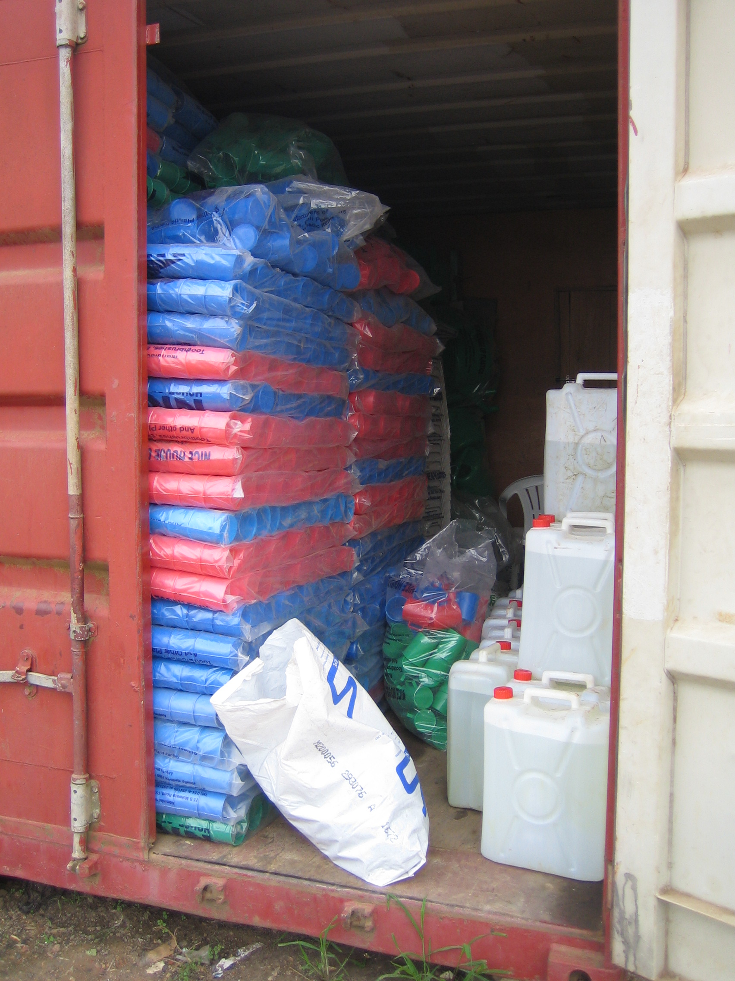
ISO Standards
Transportation vehicles and infrastructure
Things stored in it
More infrastructure
Notes:
What would we see if we followed it along its course as it is enacted as a shipping container, see how it is enrolled with all kinds of other things along the way…along those whole path from its point of origins to its destination?
Not just that putting stuff in a steel shipping container makes it a container, but the whole interconnected system is what compels people to keep putting lots of things, all kinds of things in this container.
What was new and important about containerization about this system whereby this container can be transferred between transportation networks without being opened.
(1) a story of delegation to nonhumans…much smaller army of port workers than before this standardized system of automation.
(2) a story of standards - the ISO standards are so critical to this system that the containers are also sometimes referred to as “ISO containers.” The standards specify size, etc. Setting and agreeing on these global standards and building containers to those standards set off a whole chain reaction whereby the railroad cars, etc were adjusted to match these container standards.
The effect of this enrollment, “the container made shipping cheap” … and according to this book, through such means the global economy was profoundly altered.

Slide 7
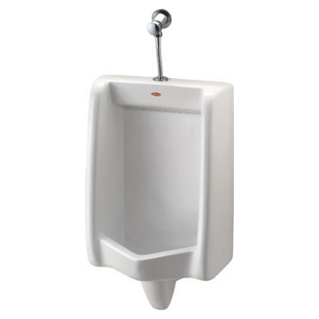
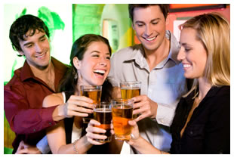
Municipal regulations
Regular system for emptying receptacles
Walls and partitions for privacy
Receptacles for human waste
When is a shipping container not a shipping container?
When it’s a public restroom.
Proximity to population consuming alcohol
Notes:
So what entities is it enrolled with to make it what it is (a bathroom) instead of an ISO standard global shipping container?
Ceci n’est pas une pipe

Slide 8
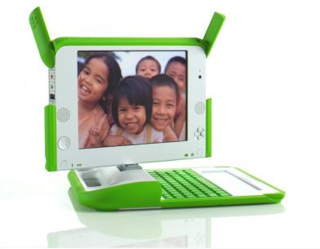
The One Laptop Per Child Project

Slide 9
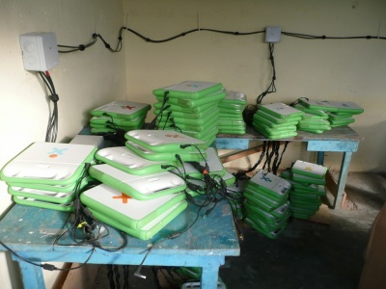
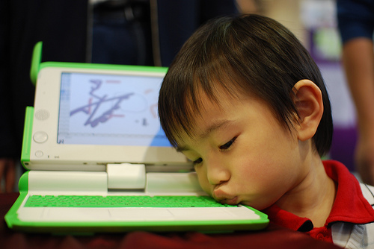
In Defense of Pilot Projects
Notes:
The Ames and Warschauer reading.

Slide 10
Negroponte’s Herculean Effort to Enroll the Governments of the Global South

Slide 11
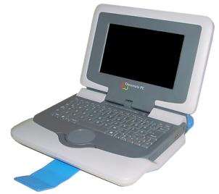
Distribution
Intel’s classmate PC
Aiming at Economies of Scale
Distributed through governments (ministry of education) to bypass markups from the supply chain.
In the end no country committed to the 1 million minimum
OLPC

Slide 12
Distribution Woes
India opts out – ministry spokesperson says - “India must not allow itself to be used for experimentation with children in this area… It would be impossible to justify an expenditure of this scale on a debatable scheme when public funds continue to be in inadequate supply for well-established needs listed in different policy documents.”
Still plagued by weak sales (much lower than planned)
Notes:
Negroponte fails to enroll

Slide 13
Distribution: New Tactics
Americans can purchase OLPC devices for $399, keep one and the other is given to a child in a developing region (80,000 distributed)
OLPC Corps in Africa – not only distribute but guide and train
OLPC as part of curriculum / classroom

Slide 14
MAJOR Themes and takeaways FROM MODULE 1

Slide 15
A Range of Processes/Practices
Technology Development – the work of giving form to a new technological artifact or system
Technology Adoption – the decision (on the part of users) to accept a technology by taking possession of and (presumably) using it
Technology Diffusion – “the process by which an innovation is communicated through certain channels over time among the members of a social system” (Rogers)
Technology Use – the application of a technology to a human practice.
Technology Appropriation – incorporating (and in the process altering) a technology to fit with users practices

Slide 16
What have we learned about users?
Ackerman – the sociotechnical gap
Fischer – a social history of the telephone in America
Bijker – the history of the development of the bicycle
Latour – where are the missing masses? A history of a few mundane artifacts
Cowan – the consumption junction, history of home heating
Rogers – Diffusion of Innovations
Eglash – Appropriating Technology
Warschauer and Ames on the OLPC
Notes:
What comes to be the dominant use of a technology, may not be the one anticipated or condoned by its inventors.
Two people may both be users of a technology, but may use it in completely different ways (different circumstances of users - gender, rural vs. urban, etc).
Users make decisions not as isolated individuals, but within social systems where other users (and non-users) may influence them, place pressure for or against the tech….women and the bicycle – issue of propriety. Boiling water in a Peruvian village (Rogers)
High-power users are often part of a constant flow of conversation with inventors/developers and in this way influence the form a technology eventually takes. (Bijker)
Low-power users may still have influence through more independent means, finding novel and unintended uses, altering the form of the technology directly, etc.(Eglash)
Non-users can also have influence, for example as vocal concerned community members – yelling threats at bicyclists, writing letters to the editor, pushing legislation, etc.

Slide 17
… a cautionary tale

Slide 18
Why do new technologies (even seemingly superior ones) fail to be adopted?
Notes:
Rogers: relative advantage, compatibility, complexity, trialability, observability
The technological artifact/object may be in some sense an obvious advantage over what is currently in use while the necessary infrastructure, support system is not in place (Cowan).
Entrenched standards that are hard/impossible to dislodge – the QWERTY keyboard

