Slide 1
Session 3
Technological Determinism (and critiques of), The history of the telephone in America

Slide 2
From Thursday
The responsibility and power of design/building That many of our most popular social media tools are not especially in line with insights from social research
“Having two identities for yourself is an example of a lack of integrity” – Mark Zuckerberg
“people have very nuanced behavior concerning how and with whom they wish to share information. People are concerned about whether to release this piece of information to that person at this time, and they have very complex understanding of people’s views of themselves, the current situation, and the effects of disclosure.”
– Mark Ackerman (citing Erving Goffman)
Notes:
Zuckberg’s normative stance about how we “should” be vs. the weight of social research that suggests we do not present one face, one identity. Opportunities to tweak the social network format

Slide 3
Technological Determinism
(HARD) technological determinism: science develops according to an internal and purely rational process and technology is the application of science. Technological inventions enter into society, are taken up according to an economic rationality and consequently produce a social impact.
R&D
Science
Tech
Society

Slide 4
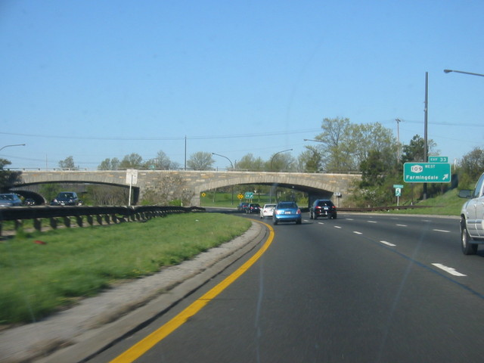
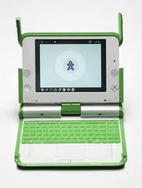
Can a bridge be prejudiced?
How artifacts matter:
Consequences beyond the intended
Fixedness of form

Slide 5
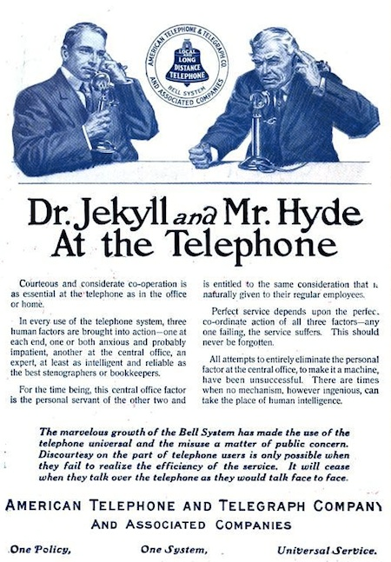
Social History of the Telephone
Claude Fischer, America Calling
Chapter 1 “Technology and Modern Life”
Chapter 3 “Educating the Public”

Slide 6
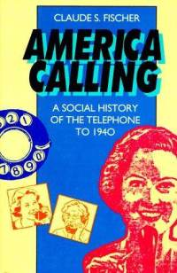
Readings / How to Read
Empirical
Academic Publications
Statistical analysis
Qualitative – ethnographic, interviews, case study
Non-empirical
Summative Evaluation (of a research field, perspective)
Present a Concept / Vision
Present a Design Solution
Argumentative Essay

Slide 7
Technological Determinism(s)
‘Billiard-ball’ model (Ogburn 1950s)
Comparing national trajectories – consequences are socially conditioned -- i.e. different trajectories for the trolley in different countries
‘Impact—imprint’ model – an essence or style to technology, technology transfers its qualities to users

Slide 8
Alternatives to Tech Determinism
Symptomatic approaches – tech as expression of culture, Geist – spirit of the age (rationalization in the industrial age)
Social Constructivism – struggle, negotiation over development and invention (see Bjiker bicycle next week)
Fischer’s “User Heuristic” – emphasizing user agency in realizing the unfolding consequences of technology

Slide 9
Why look back at historical cases?
We know how the story ends
View more dispassionately than present-day technologies
See the full scope of this recurring pattern over time: invention → marketing → adoption → adaptation → eventual, settled role.
Notes:
What is there to learn from the history, especially that period just after the introduction of a now commonplace technology?

Slide 10
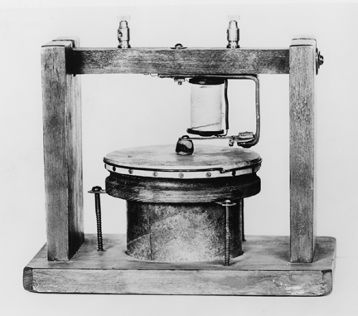
Inevitability, Uncertainty
“This ‘telephone’ has too many shortcomings to be seriously considered as a means of communication. The device is inherently of no value to us.” – Western Union, internal memo, 1876

Slide 11
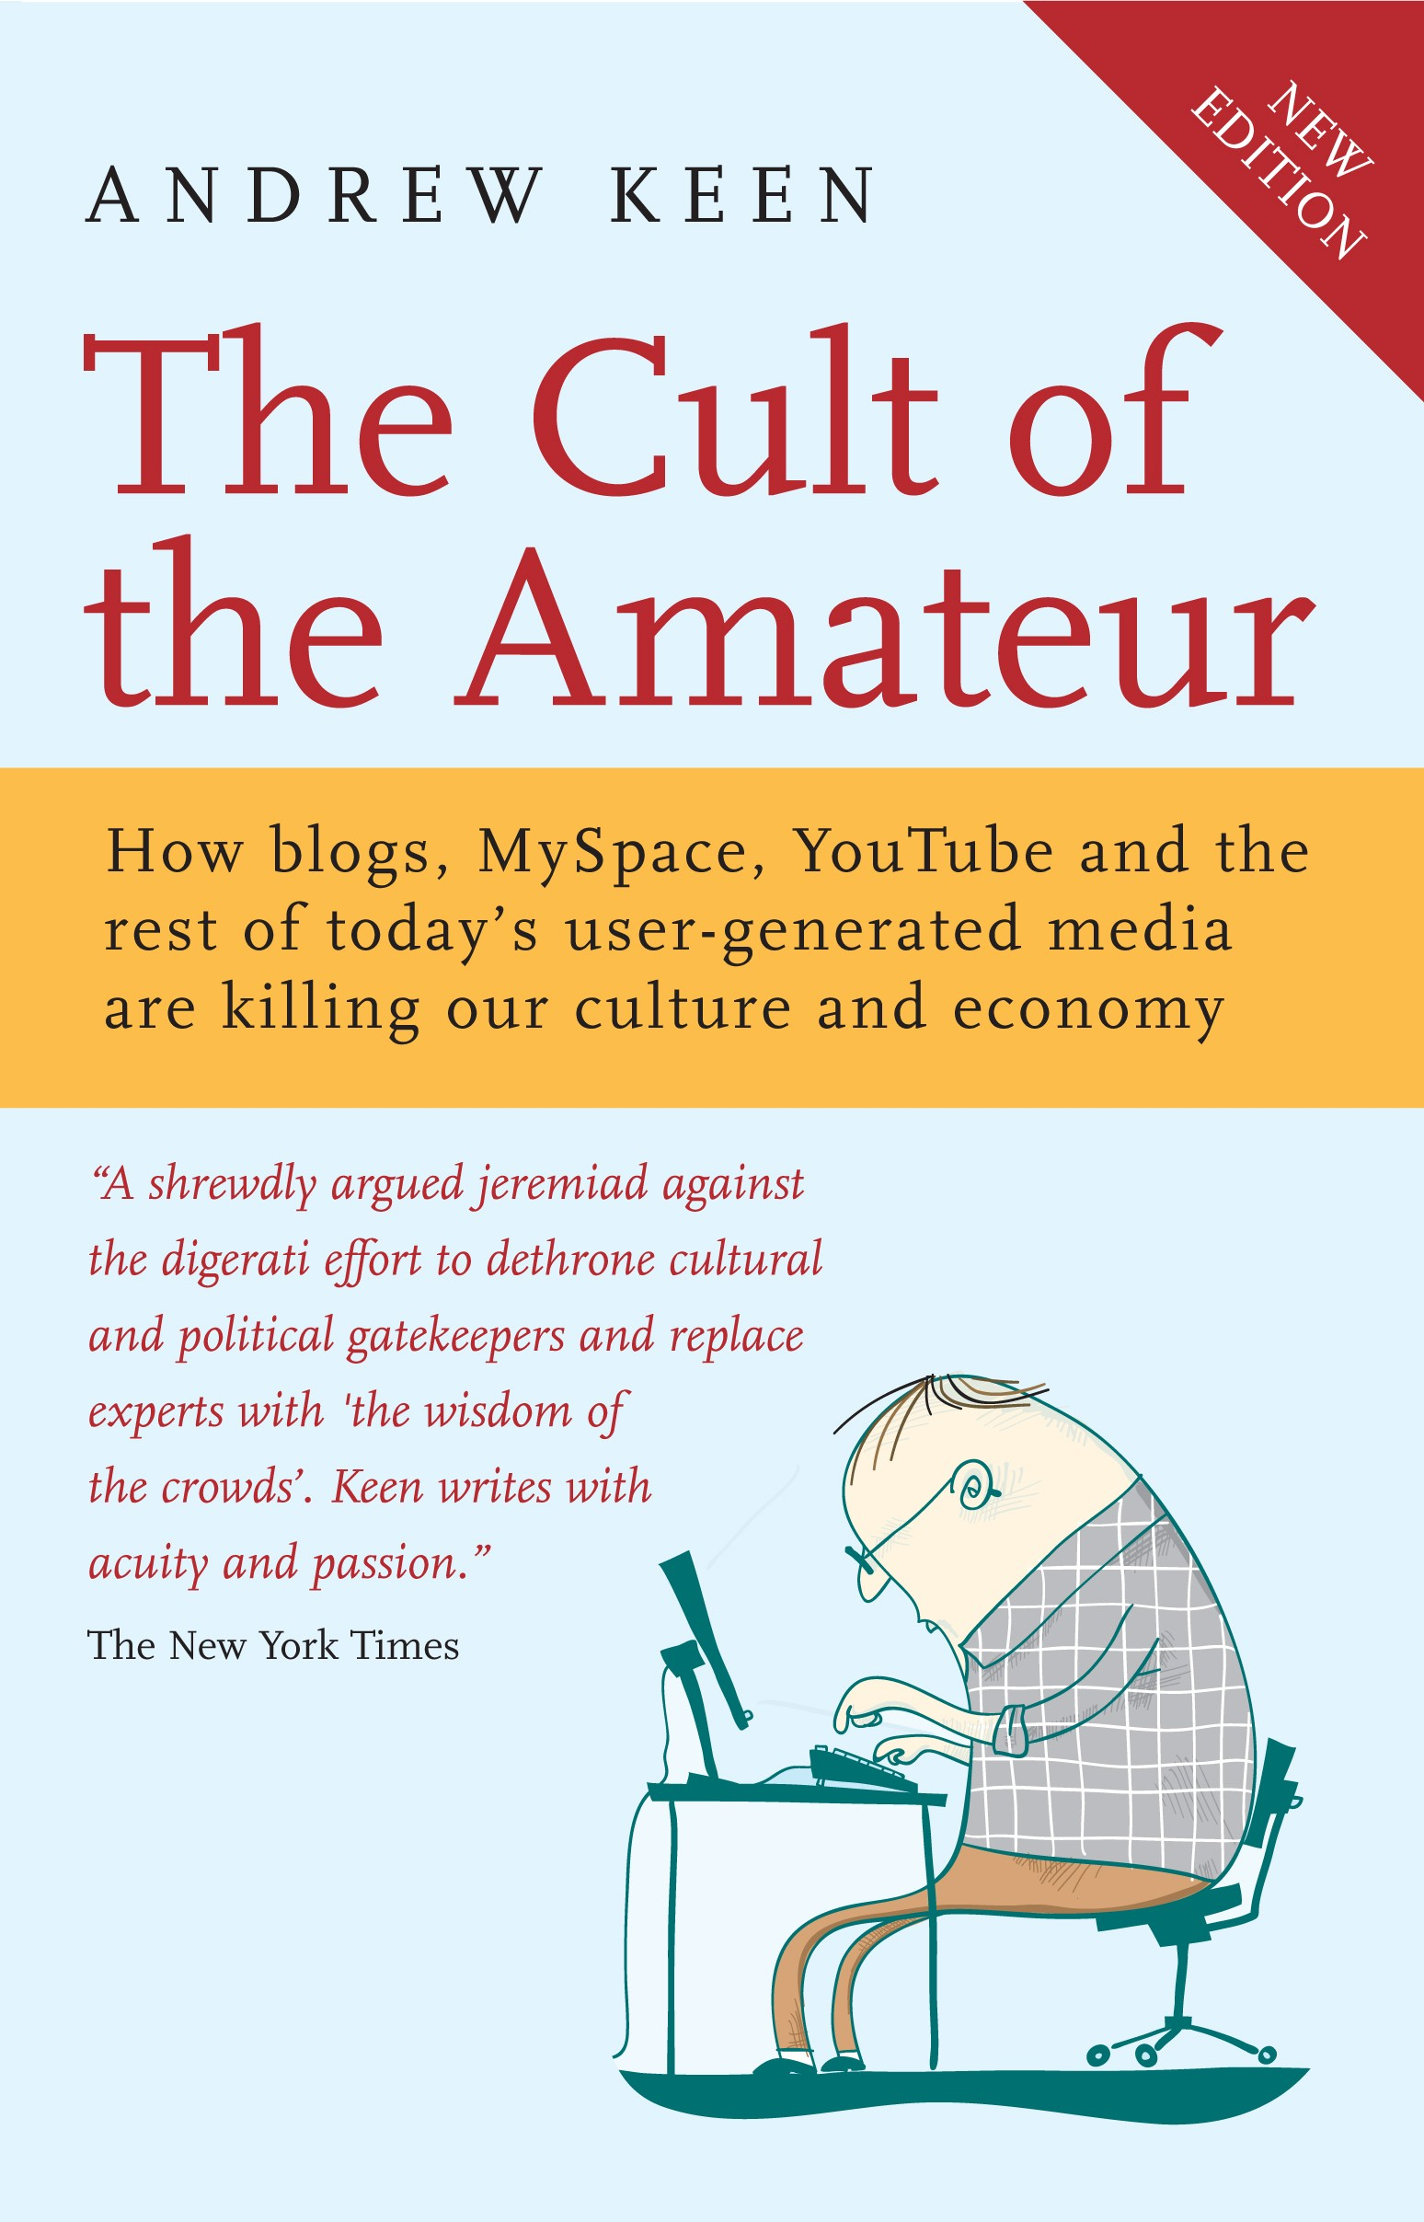
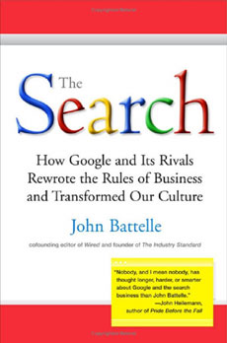
Promise and Threat

Slide 12
Promise and Threat
On the telegraph and its use after the assassination of President James Garfield: “It was the touch of the telegraph key…that welded human sympathy and made possible its manifestation in a common, universal, simultaneous heart throb…the nations stand in sympathetic mourning: a spectacle unequalled in history…indicative of a day when science shall have so blended, interwoven, and unified human thoughts and interests that the feeling of universal kinship shall be…constant and controlling.”
- 1881, Scientific American
Notes:
The idea that the telegraph will bring us a constant sense of “universal kinship”

Slide 13
Guess the Technology
"Children in the public schools will be taught practically everything by X. Certainly they will never be obliged to read history again.”

Slide 14
Guess the Technology
"Children in the public schools will be taught practically everything by moving pictures. Certainly they will never be obliged to read history again.” - D.W. Griffith
Notes:
panaceas

Slide 15
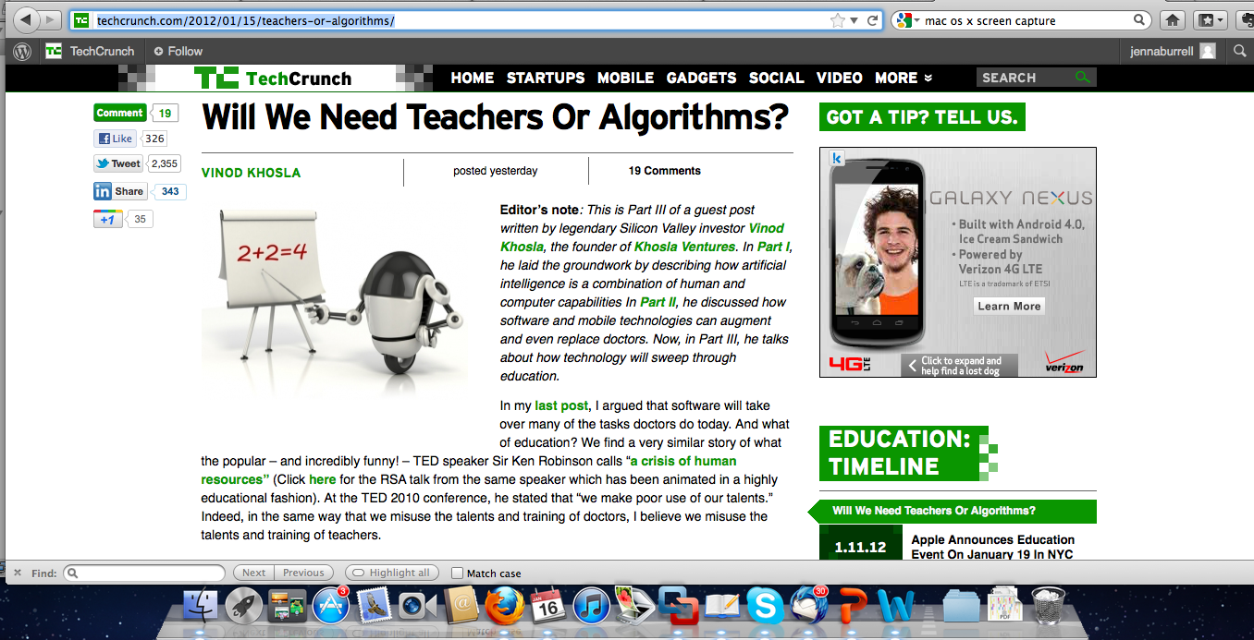
Notes:
Similar tone in this article

Slide 16
Guess the Technology
"Those who acquire X will cease to exercise their memory and become forgetful; they will rely on X to bring things to their remembrance by external signs instead of on their own internal resources.”
Notes:
What is X? What kinds of tools and aids can you imagine people of today or of prior generations.
Calculator?
Calendar? PDA?

Slide 17
Guess the Technology
"Those who acquire writing will cease to exercise their memory and become forgetful; they will rely on writing to bring things to their remembrance by external signs instead of on their own internal resources.”
- Plato, Phaedrus, c. 370 bc
Notes:
What is X?

Slide 18
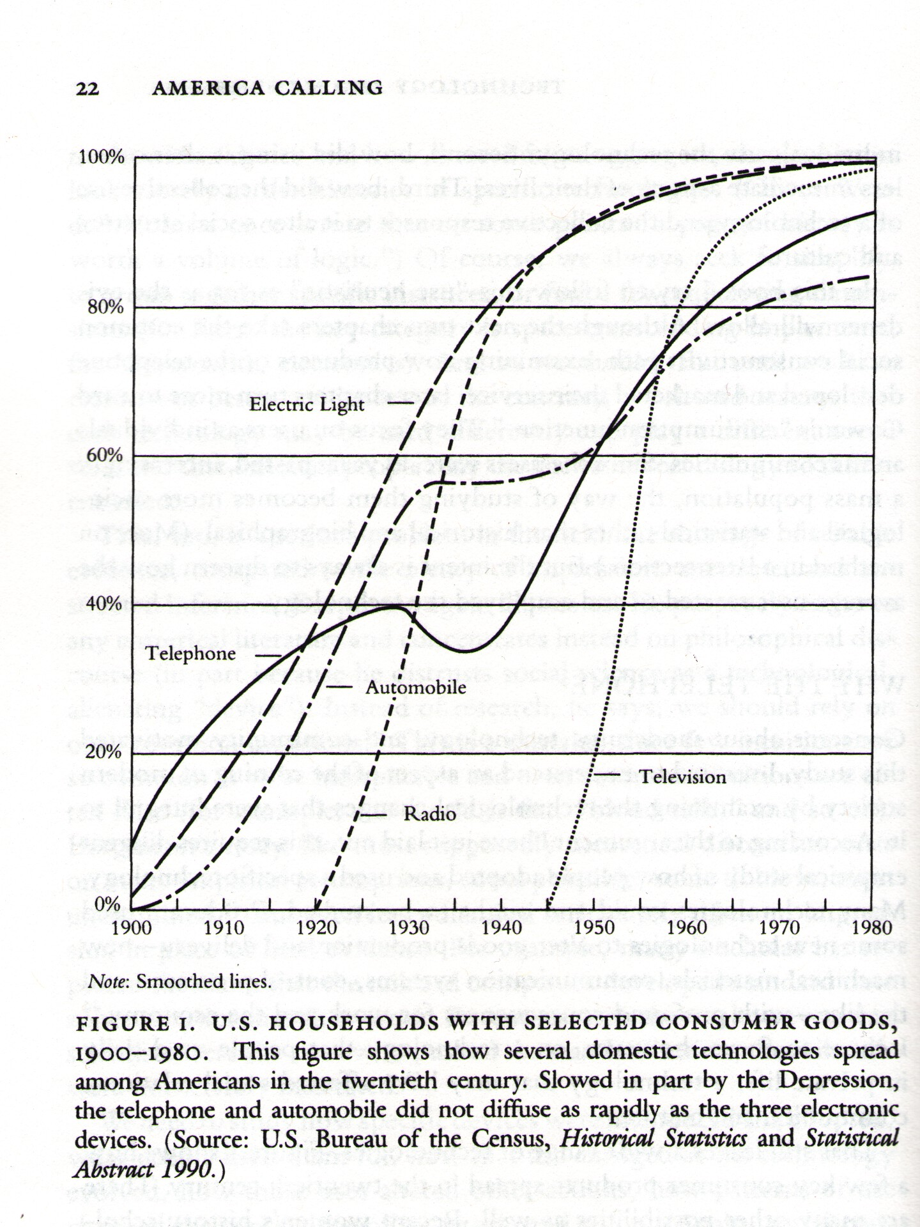
What questions for further investigation can you extract from this graph? Support or call into question a technological determinist view?

