Slide 1
Data Science and Analytics
Xuhui Shao
VP Engineering

Slide 2
Topics
Intro of Yahoo
Intro of online display advertising business
Data-driven products and user modeling needs
”Big data” and the tools
Future challenges
Open questions

Slide 3
Yahoo Intro
Eleven #1 online properties
Finance, Flickr, Mail, Messenger, My Yahoo!, News, omg!, Real Estate, Shopping, Sports, TV.
Business model
The main revenue source is advertising: display and search
Main data-driven products
Content personalization – to drive user engagement
Advertising targeting – better marketing results, and more relevant ads to users
Very different business considerations, but learning problems are fairly similar
Yahoo! The Premium Digital Media Company
Yahoo! Presentation, Confidential
3

Slide 4
Content Personalization
Objective: increase user engagement
1st-order model: optimize for clicks
2nd-order model: optimize for multiple objectives
Clicks, but also time spent
Downstream impact on engagement
Lift on advertising revenue
Higher-order model: optimize complex objectives with biz constraints
Example: fairness to different properties
Future problem
Optimize across multiple recommendations – social, editorial, and ML
Notes:
Disclaimer: I know almost nothing about Yahoo’s content personalization. So mostly speculation here.

Slide 5
Online Advertising
Display vs search
Display is demand generation, search is demand fulfillment
Search is user seeking an ad, display is ad seeking a user
Search is still the most successful online advertising format
Defined by monetization / user minute.
Display is much more complex
Different objectives: branding, click, different actions;
Creative formats: graphics, animation, video, interactive;
Content, demographics, behavioral, social targeting
User action is not given: for ex, far fewer people click on ads than before

Slide 6
User Modeling Applications
Risk Management
Model derogatory behavior and contrast with normal behavior
Data-driven credit/application approval, transaction processing decisions
Personalization
Recommend products and web contents based on collaborative filtering
Personalize products and contents based on user profiling
Advertising
User response predictive modeling
Look-alike modeling and “Act-alike” modeling
Notes:
Derogatory behavior: fraud, spam, abusive traffic

Slide 7
Modeling Techniques
Predictive modeling – classic approach
Supervised learning: Regression, classification
Unsupervised learning: clustering, collaborative filtering
Experimentation & optimization
Observational modeling vs experimentation
Explore/exploit problem: slot machines, yield maximization
Interpretive modeling
Attribution: “why” does it happen instead of “what” will happen

Slide 8
The Big Picture of Modeling
Data is 90% of the success
90% resource spent is in the collection and processing of data
The importance of data pre-processing - “garbage in, garbage out”
Simple algorithm + order-of-magnitude-of-data > most sophisticated algorithm
There is no universally good modeling technique
The “No-Free-Lunch” theorem (David Wolpert)
For practical problems, combination of simple approaches often win
As demonstrated statistically in Netflix competition and several KDD cups

Slide 9
The Small Picture of Modeling
Counting numbers is often the hardest problem
Our current challenge
Counting unique users in any given location, site, and time period
Thousands of combinations on a very large, unsorted data set that changes over t
Accuracy can be relaxed but controlled
The basic approach: hash-based approximate counting
String -> hash value (0,1)
Count ~ 1 / smallest value
A small buffer of n smallest values can increase accuracy
The challenge: how to count thousands of combinations efficiently

Slide 10
The Importance of Metric
If you can’t measure (correctly), you can’t improve
Problem 1: no baseline
Problem 2: wrong baseline
A/B test
Ad creative optimization
Ad targeting tactic optimization
Landing / home page optimization
Web content optmization
Multi-variate attribution

Slide 11
The Policy Issue on User Modeling
Privacy and Regulation
Healthcare industry is highly regulated (HIPAA) but ineffective
Financial industry: some want more regulation, some want much less
Online industry: hotly debated in the last 12 months
What’s the balance [discussion topic]
Privacy vs. Research access
Anonymization, de-identification, re-identification
Opt-in vs. opt-out
Control: government, browser tool, or individual service provider
Who really owns the data: advertiser/merchants, online service, or consumer
Notes:
Privacy: how much protection and control you give to each consumer
Regulation: how much protection and control you give to the government

Slide 12
Big Data
Big Data vs Large-scale Data
Data size beyond typical database tools - McKinsey’s big data report
Data growth catches up to Moore's Law, while economic value is largely flat.
IDC estimate: data growth at 50%/year, or getting close to Moore's Law
Conclusion: value density goes down, sparser, need to do it cheaper
Big Data is our ability to mine sparse and unstructured data assets in the face of escalading data dilution of social and economic value.
Notes:
1. How big is big data: McKinsey’s definition

Slide 13
Big Data Tool – Hadoop
Hadoop: open-source version of Google’s MapReduce
Batch processing of very large scale data
Built-in parallel processing on commodity hardware
Users can focus on writing algorithm in the forms of mapper and reducer methods
Higher level languages:
PIG: a workflow language that generates a series of MapReduce jobs for execution
Hive: a SQL-like query language that is complied into MapReduce jobs
Hadoop deployment at Yahoo
42K machines
200+ Petabytes
5M jobs/month
Personalizing ads, pages, anti-spams on 289MM mailboxes, ...
Notes:
2. Hadoop – How do our scientist crunch this data and run their experiments and test their inventions? They do it on Hadoop. Hadoop is the open source technology at the epicenter of big data and cloud computing. Yahoo! pioneered Hadoop in 2005 since then has helped drive large scale adoption of the technology which lets companies get value from their data and better manage their businesses. At Yahoo! we use Hadoop to manage our big data. Hadoop manages 5 million jobs per month and one of these is protecting our 289m mailboxes from receiving too much spam. Hadoop and the Cloud enables Yahoo! Labs to carry out core research at colossal scale based around machine learning. Yahoo! was rated best mail provider at filtering spam (ahead of gmail and hotmail) in an independent study by Fraunhofer Institute for Secure Information Technology (SIT) based in Germany. (Source: Fraunhofer Institute for Secure Information Technology (SIT), ‘Examination of spam characteristics of cost-free email services study’ – March 25, 2010)
4. Based on these core ingredients, we’ve developed many secret recipes for building sophisticated ad systems right into our business. Take C.O.R.E., a suite of technologies, first developed in Yahoo! Labs, based on deep-science, delivers personalization, optimization and user control to all our apps and services. It is Yahoo!’s technology for selecting the most meaningful, personally relevant content (e.g., news articles on Yahoo!’s Home Page) to show users. With CORE, Yahoo has achieved more than 270% improvement in click through rates. It helps editors create 13 million combinations of stories a day and results in over 45,000 variations of the homepage every 5 minutes. It has been instrumental in helping us reach 1 Billion clicks on the Yahoo! Today module in January 2011 and averaging this amount every month since.

Slide 15
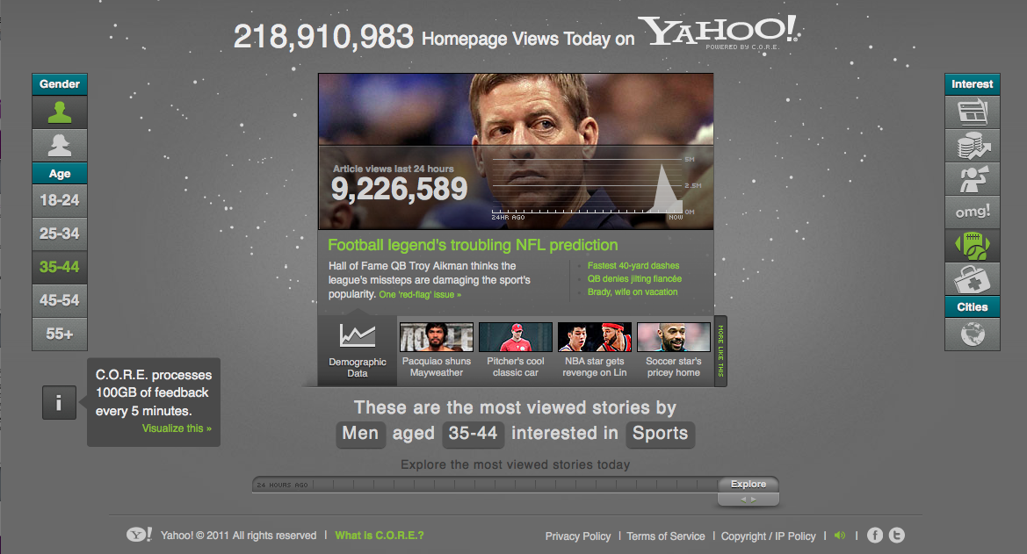

Slide 16
Bid Data Tools Challenges
Hadoop as a computation platform needs more maturing
Performance, stability, a rich collection of utility tools
Fully reconcile SQL MPP and NoSQL
Alternative computation models on grid
Real-time, streaming computation, iterative computation and modeling

Slide 17
Big Data Modeling Challenges
Sparsity and Generalization
“Curse of dimensionality”: more data won’t solve the problem.
Reject-inference problem
The placebo effect
A/B test and experimentation
Noise, data quality and concept drift
Use data to innovate new business models and products
Notes:
100 variables can overfit the universe

Slide 18
Open discussion
Yahoo! Presentation, Confidential
18
Notes:
Brian Lent Story about Yahoo.

