Slide 1
Looking at differences: parametric and non-parametric tests
Sealy Gossett, chemist working for Guinness brewery– published work on the t-distribution under the name “student”

Slide 2
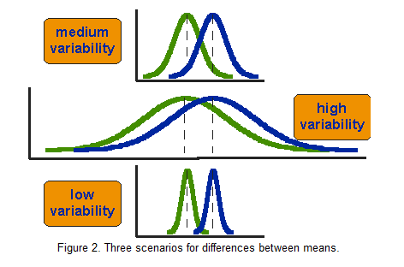
Comparing mean difference while accounting for variability in samples
Mean Number of Friends
People with a hot tub
People without a hot tub
(D-51 with aluminum tubes)
Image: http://www.socialresearchmethods.net/kb/stat_t.php

Slide 3
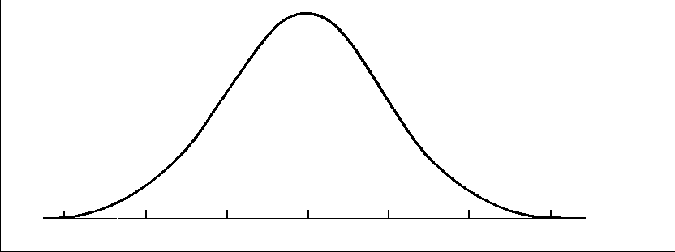
Why can’t we use a z-test
A z-test compares a sample against a hypothesized population mean and standard deviation
σ
μ₀
When we have two samples, we don’t know the population standard deviation, but have to estimate it from our samples.
This adds variability and widens the expected sampling distribution
s
μ₀

Slide 4
t distribution
Because N plays such a prominent role in the calculation of the t-statistic, note that for very large N’s, the sample standard deviation (s) begins to closely approximate the population standard deviation (σ), so the uncertainty in σ disappears
As the degrees of freedom increase (towards infinity), the t distribution approaches the z distribution (i.e., a normal distribution)
That is, as degrees of freedom increase (as a function of the sample size as we will discuss in a moment), the actual curve itself becomes more peaked and less dispersed– just like the normal distribution.

Slide 5
Why use the t distribution (and the t-test) instead of the z-test?
t-test is useful for testing mean differences when the N is not very large
In very large samples, a t-test is the same as a z-test.

Slide 6
Z-distribution versus t-distribution

Slide 7
t-test Null and Alternative Hypotheses
Null Hypothesis:
H₀: μ₁ = μ_{c}
Alternative Hypotheses:
H₁: μ₁ < μ_{c}
H₂: μ₁ > μ_{c}
H₃: μ₁ ≠ μ_{c}

Slide 8
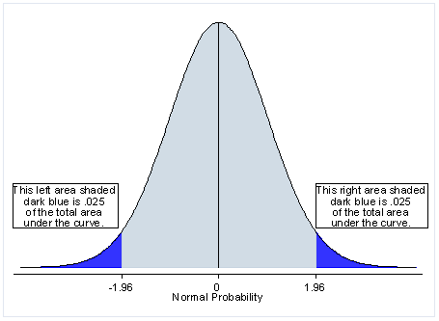
One and Two-Tailed Tests: Defining Critical Regions
Step 1: form your hypothesis
Step 2: calculate your t-statistic
Step 3: plot your t-value on the appropriate curve to get the p-value.
Notes:
Step 1: form your hypothesis
Step 2: calculate your t-statistic
Step 3: plot your t-value on the appropriate curve to get the p-value.

Slide 9
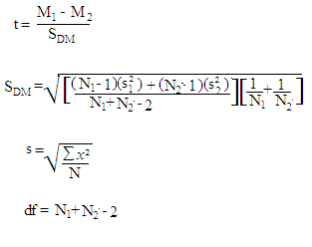
The independent sample t-test
Where: M = mean of one group S_{DM} = Standard error of the difference between means N = number of subjects in group s = Standard Deviation of group df = degrees of freedom
Essentially, the t-value is the difference between group means (mean difference), divided by the variability of the two groups (standard error of difference).

Slide 10
Degrees of freedom
d.f. = the number of independent pieces of information from the data collected in a study.
In the independent sample t-test, we deal with two means (thus, two known quantities); our degrees of freedom are reduced by two (df = n₁ + n₂ – 2)
We can also conduct a one-sample t-test. In a one-sample t-test the degrees of freedom = number of measurements – 1. (only one known quantity). A one sample t-test is useful when we want to test whether one sample is significantly different from some hypothesized value.

Slide 11
Assumptions Underlying the Independent Sample t-test
Assumption of Normality
Variables are normally distributed within each group
If we don’t meet this, we could transform our variable, or, consider a non-parametric test.
Can use the Central-Limit Theorem to get normality for large samples
Rule of thumb: at least 30 observations
Assumption of Homogeneity of Variance
Variation of scores in the two groups should not be very different.
There is a simple correction if this assumption is not met, automatically applied in R
Notes:
Normality: we could transform the variables (e.g. take the log, or some other transformation)
Homogeneity of Variance: we can test to see if we meet this assumption

Slide 12
What if the Variances are not equal?
We can test to see if the variances are significantly different between groups (equality of variance test such as Levene’s test)
If they *are* significantly different, we should use a modified t-test that corrects for this problem (Welch’s t-test).
Welch’s test is the default in R, so we usually don’t have to worry about this.
The key is that the denominator uses a different estimate of the variance (since we cannot just assume that both distributions are equal now), and the degrees of freedom are reduced– making this a highly conservative test.
Notes:
Uses Welch-Satterthwaite equation.
The key is that the denominator uses a different estimate of the variance (since we cannot just assume that both distributions are equal now), and the degrees of freedom are reduced– making this test highly conservative.

Slide 13
Conducting an independent sample t-test
1) State your hypothesis (1 or 2-tailed?)
2) Check the assumption of normality
3) Check the assumption of equal variances
4) if unequal, make sure to use a modified (Welch’s) t-test

Slide 14
Interpretation: Levene’s test for homogeneity of variance
> leveneTest(survey$Height, survey$Sex, center=median)
Levene's Test for Homogeneity of Variance (center = median)
Df F value Pr(>F)
group 1 6.5688 0.01109 *
206
---
Signif. codes: 0 '***' 0.001 '**' 0.01 '*' 0.05 '.' 0.1 ' ' 1

Slide 15
Interpretation: two-tailed t-test
> t.test(Height~Sex, alternative='two.sided', conf.level=.95, var.equal=FALSE, data=survey)
Welch Two Sample t-test
data: Height by Sex
t = -12.9243, df = 192.703, p-value < 2.2e-16
alternative hypothesis: true difference in means is not equal to 0
95 percent confidence interval:
-15.14454 -11.13420
sample estimates:
mean in group Female mean in group Male
165.6867 178.8260

Slide 16
Calculating Effect Size
One common effect size standard is called Cohen’s d
Effect size allows you to compare relative effect of one test to another.
Note that the SD in the effect size calculation is the pooled (combined) standard deviation for both groups
Values of .8 or greater are usually large effects, .5 medium, .2 small.
As always, effect size is a measure of practical significance, not statistical significance.

Slide 17
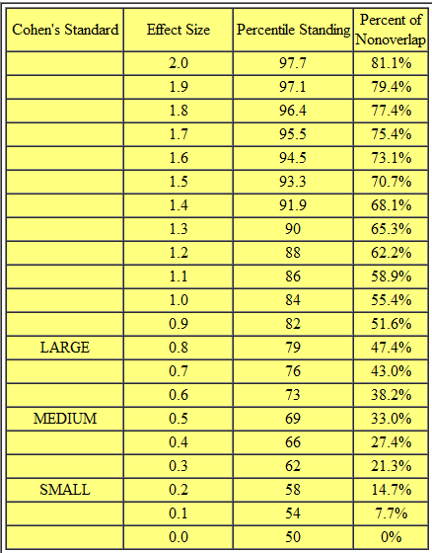

Slide 18
Effect size correlation, r
The effect size correlation, r, is also a very popular way to measure practical significance
The effect size correlation is interpreted just like any other correlation.
Effect size | r
Small | 0.10
Medium | 0.30
Large | 0.50

Slide 19
Effect Size Example
Sample of 2,000,000 participants.
Average “skill with computers”
Women = 6.5 (S.D. = 3.3) on a 10-point scale.
Men = 5.9 (S.D. =3)
The t-test is highly statistically sig (p < .001)
Cohen’s d effect size = .19
r effect size = .094
Thus, this statistically significant difference is not very practically significant. This is a small effect size.
Notes:
What if we have a fairly large effect size, but its just not statistically significant?
Perhaps we just need more data– but how much??

Slide 20
Another example: Interpretation of Effect Size
data: Height by Sex
t = -12.9243, df = 192.703, p-value < 2.2e-16
alternative hypothesis: true difference in means is not equal to 0
95 percent confidence interval:
-15.14454 -11.13420
sample estimates:
mean in group Female mean in group Male
165.6867 178.8260
Standard deviations:
6.15 8.38
Cohen’s d = -1.78
r = -.67
(interpretation: this is a very large effect size)

Slide 21
The dependent t-test
We have already seen that the independent sample t-test allows us to compare means between two different groups.
The dependent t-test allows us to compare the two means (of the same variable) taken at two different time points for the same group of cases.
For example, we could use the dependent t-test to examine how the same class of students performed on the same quiz during the first week and the last week of class.

Slide 22
Equation for dependent t-test
Note that the equation is very similar to the independent t-test.
Also, note that we are essentially examining observed – expected. X-bar is the difference in the sample means, and we subtract the difference that we would expect from the population means.
However, just like the independent samples t-test, we expect the population difference to be zero (our null hypothesis). Thus, the equation is reduced to the form:
Mean of group A at time 1 – Mean of group A at time 2
----------------------------------------------------------------
Standard error of the differences

Slide 23
Assumptions for the dependent t-test
We still assume normality of the sampling distribution, just as we do with other parametric tests.
However, unlike the independent sample t-test, we are actually only concerned with one distribution rather than two. In the dependent t-test, we want to check the normality of the difference between scores.
Note that it is entirely possible to have two measures that are non-normal, but their differences can be normally distributed.
We can also apply the Central Limit Theorem to get normality for large samples.

Slide 24
Example:
Here I just created some fake data, assigning values for two groups.
> value <- c (1,2,2,4,4,4,8,8,8,9,5,5,7,7,10,10,12,12,16,16)
> group <- c (0,0,0,0,0,0,0,0,0,0,1,1,1,1,1,1,1,1,1,1)
> data <- data.frame(group,value)
> dep.t.test<-t.test(value ~ group, data = data, paired = TRUE)
> dep.t.test
Paired t-test
data: value by group
t = -9.3026, df = 9, p-value = 6.509e-06
alternative hypothesis: true difference in means is not equal to 0
95 percent confidence interval:
-6.215873 -3.784127
sample estimates:
mean of the differences
-5

Slide 25
Effect size for dependent t-test
We can then calculate the effect size correlation just as we have done before.
> t<-dep.t.test$statistic[[1]]
> df<-dep.t.test$parameter[[1]]
> r<- sqrt(t^2/(t^2+df))
> round(r,3)
[1] 0.952

Slide 26
Non-parametric tests
As we have already discussed, sometimes we do not meet key assumptions, such as the assumption of normality.
We can try to address such problems by transforming variables, but sometimes it might just be best to not make big assumptions in the first place.
Also, non-parametric tests are useful when our key outcome variable is an ordinal variable rather than an interval or ratio variable.
Non-parametric tests, or “assumption-free” tests tend to be much less restrictive.

Slide 27
What do non-parametric tests actually do?
Many non-parametric tests use the principle of ranking data.
For example, data are listed from lowest scores to highest scores. Each score receives a potential rank …1, 2, 3, etc.
Thus, higher scores end up with higher ranks and lower scores have lower ranks.
Advantage: we get around the normal distribution assumption of parametric tests.
Disadvantage: we lose some information about the magnitude of differences between scores. Non-parametric tests often have less power than parametric ones
If our sampling distribution is not normally distributed (which we can only infer from our sample), then a non-parametric test is still a better option than parametric tests (such as t-tests).

Slide 28
Parametric and non-parametric tests for comparing only two groups
Type of Design | Parametric Tests | Non-Parametric Tests
Two independent samples | Independent samples t-test | Wilcoxon Rank Sums test (aka, Mann-Whitney test)
Two dependent samples | Dependent samples t-test | Wilcoxon signed-rank test

Slide 29
Comparing two independent conditions: Wilcoxon rank-sum test
Our data are ranked from lowest to highest across all groups. This provides potential rank scores.
If the same score occurs more than once, then all scores of the same value receive the average of the potential ranks for those scores (the values highlighted with a different color in the table)
When we are done, we have the final rank scores.
 | Group | Score | Potential Rank | Final Rank
1 | A | 10 | 1 | 1
2 | A | 11 | 2 | 2.5
3 | B | 11 | 3 | 2.5
4 | B | 12 | 4 | 4
5 | A | 20 | 5 | 6
6 | B | 20 | 6 | 6
7 | B | 20 | 7 | 6
8 | A | 33 | 8 | 8

Slide 30
Calculating the Wilcoxon rank-sum test
We can then add up all of the ranks for the two groups (in our case, Group A and Group B).
We then subtract the minimum rank sum for a group of the same size as ours. If we have a group size of 4, then this would be:
1 + 2 + 3 + 4 = 10.
Our final calculation is therefore:
W = sum of ranks – minimum rank sum
From my example data that I just showed in the table, group A would be:
Sum of ranks (17.5) – minimum rank sum (10) = 7.5

Slide 31
Interpretation of Wilcoxon rank-sum test
Just as with a t-test, the default is a two-sided test (where our null hypothesis is that there is no difference in ranks, and the alternative hypothesis is that there is a difference in ranks)
You can also declare a one-directional test if you actually hypothesize that one group will have higher ranks than the other.
There are always two values for W (one for each group), but typically the lowest score for W is used as the test statistic.

Slide 32
Interpretation of Wilcoxon rank-sum test:
Our p-value is calculated with Monte Carlo methods (where simulated data are used to estimate a statistic) if we have a small N (under 40).
For larger samples, R will use a normal approximation method (where we only assume that the sampling distribution of the W statistic is normal– it does not assume that our data are normal).
The normal approximation method is helpful because it also calculates a z-statistic that is used to calculate the p-value.

Slide 33
Effect size for Wilcoxon rank-sum test
We can calculate the effect size correlation after conducting our statistical test.
Since our Wilcoxon rank-sum output also calculates a z-statistic, we can simply compute the effect size correlation by dividing it by the square root of the total sample size.
Effect size | r
Small | 0.10
Medium | 0.30
Large | 0.50

Slide 34
Comparing two related conditions: Wilcoxon signed-rank test
The Wilcoxon signed-rank test is the non-parametric equivalent of the dependent t-test.
We actually use a very similar procedure as the dependent t-test, as we are looking at the difference in scores among the same cases (rather than two separate groups).
But, unlike the dependent t-test, we examine the ranking of the differences in scores, rather than the scores themselves

Slide 35
Calculating the Wilcoxon signed-rank test
The calculation of ranks has a similar logic to the rank-sum test, except now we focus on the rank of the difference between the first scores and the second scores. These differences can be positive or negative. If they are zero (that is, there is no difference between the first and second scores, then we exclude those cases altogether). The scores are ranked from their absolute value (so we ignore their sign for the ranking).
After we create the ranks, the positive and negative ranks are summed separately.
Between the positive and the negative sum of ranks, whichever value is smaller is used as the test statistic.
ID | Score 1 | Score 2 | Diff | Rank | Neg Rank | Pos Rank
1 | 9 | 12 | -3 | 2 | 2
2 | 6 | 11 | -5 | 4 | 4
3 | 12 | 11 | 1 | 1 |  | 1
4 | 7 | 3 | 4 | 3 |  | 3
Sum of negative ranks = 6
Sum of positive ranks = 4

Slide 36
Effect size for Wilcoxon signed-rank test
We calculate the effect size correlation after conducting our statistical test.
The calculation for the effect size correlation is the same as the Wilcoxon rank-sum test.
We obtain the z-statistic and divide by the square root of the sample size.
In R, we can use the qnorm() function to find the z-statistic from our p-value.
Effect size | r
Small | 0.10
Medium | 0.30
Large | 0.50

Slide 37
In Sum…
Non-parametric tests offer a way to examine differences between different groups or among groups with multiple measures, while avoiding some of the assumptions that are necessary in parametric tests.
Which test you choose (parametric or non-parametric) depends on:
(1) the variables and data that you have (e.g., do you have a continuous variable of interest, or is it an ordinal variable?)
(2) Whether you meet the necessary assumptions for parametric tests, such as the assumption of normality.

