Slide 1
This Week: Testing relationships between two metric variables: Correlation Testing relationships between two nominal variables: Chi-Squared

Slide 2
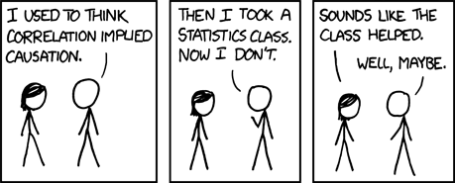
Correlation and Causality
Correlation is a precondition for causality– but by itself it is not sufficient to show causality
Notes:
Highly correlated variables help us predict what one variable will be based on the other, but this ability has nothing to do with establishing which one causes the other (if at all).

Slide 3
Conditions of Causality
Covariation/Correlation
No confounding covariates
Logical time ordering
Mechanism to explain how X causes Y
X
Y
Notes:
Spurious relationships…home power consumption causes ice cream sales to go up….

Slide 4
Causation and Causal Paths
Direct causal paths
Reciprocal causation
Indirect causation
X
Y
X
Y
X
Z
Y
Notes:
Reciprocal causation is not especially common, but it shows up when time order issue (earlier slide) is not clear. For example, effect of Government foreign policy (X) on Government popularity (Y). It is entirely reasonable to believe that X→Y as well as Y→X.

Slide 5
Just having more data does not address the problem of causality.
There are pundits in the fields of big data and data science that argue that having enough data solves the problem of causality because we are collecting so much information.
Correlations are a way of catching a scientist's attention. Models and mechanisms that explain relationships are how we make the predictions that not only advance science, but generate practical applications.

Slide 6
Scatterplots
Notes:
Three ways to summarize this data:
point of averages
Horizontal SD
Vertical SD

Slide 7
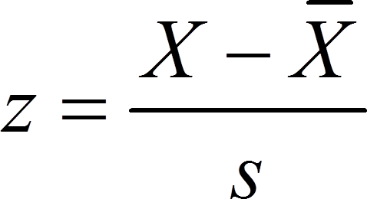
The z-score (review)
Standardizing a group of scores changes the scale to one of standard deviation units.
Allows for comparisons with scores that were originally on a different scale.
Tells us where a score is located within a distribution– specifically, how many standard deviation units the score is above or below the mean.
Notes:
The z-score is important for thinking about individual scores on any distribution. Observed value minus mean, over standard deviation.

Slide 8
Correlation: Checking for simple linear relationships using standard units (z-scores)
Pearson’s correlation coefficient
Measures the extent to which two metric or interval-type variables are linearly related
Statistic is Pearson r
The correlation coefficient is the average of the products of the corresponding z-scores.

Slide 9
The correlation coefficient
r = average of (x in standard units) x (y in standard units)
The correlation coefficient is a pure number without units. It ranges from -1 to 1. Zero means no correlation.
Notes:
Thus, the correlation coefficient is not affected by:
Change in scale
Interchanging variables
Adding the same number to one of the variables
Multiplying all values of one variable by a positive number

Slide 10
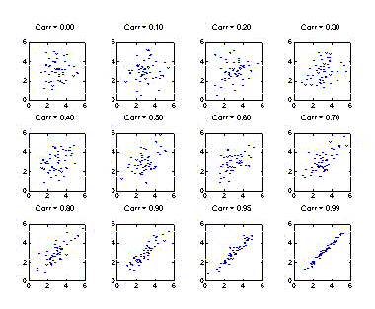
Correlations
Ranges from z-1 to 1, where 1 = perfect linear relationship between the two variables. 0 = no linear relationship between variables
Positive relations
Negative relations
The correlation coefficient is a measure of clustering around a single line, relative to the standard deviations.
Remember: correlation ONLY measures linear relationships, not all relationships.
This is why the scatterplot is essential; you can get a coefficient even if there is not a good linear fit.

Slide 11
Interpretation
Correlation is a proportional measure; does not depend on specific measurements
Correlation interpretation:
Direction (+/-)
Magnitude of Effect (-1 to 1); shown as r
Horizontal line means no correlation.
Statistical Significance (p<.05, p<.01, p<.001)
Interpretation of p in this context: what is null hypothesis (no correlation), alt hypothesis is *any* correlation.

Slide 12
Reading Correlation Output
Often shown in table form with 2 or more variables at a time. Correlation coefficient is shown along with the p-value.
price mpg
price 1.0000
mpg -0.4686 1.0000
0.0000
Correlation between price of car (price) and miles per gallon (mpg)

Slide 13
Is my Correlation practically significant?
Correlation | Negative | Positive
None | −0.09 to 0.0 | 0.0 to 0.09
Small | −0.3 to −0.1 | 0.1 to 0.3
Medium | −0.5 to −0.3 | 0.3 to 0.5
Strong | −1.0 to −0.5 | 0.5 to 1.0

Slide 14
Factors which limit Correlation coefficient
Homogeneity of sample group
Non-linear relationships
Censored or limited scales
Unreliable measurement instrument
Outliers
Ecological Correlations

Slide 15
Homogenous Groups

Slide 16
Homogenous Groups: Adding Groups

Slide 17
Homogenous Groups: Adding More Groups

Slide 18
Separate Groups (non-homogeneous)

Slide 19
Non-Linear Relationships

Slide 20
Censored or Limited Scales…

Slide 21
Censored or Limited Scales

Slide 22
Unreliable Instrument

Slide 23
Unreliable Instrument

Slide 24
Outliers

Slide 25
Outliers
Outlier

Slide 26
Ecological Correlations

Slide 27
Ecological Correlations
Average by Classroom
Notes:
The ecological correlation overstate the association because they eliminate the variance in the units of analysis (eg., the classroom).
Thus, the correlation looks stronger simply because we have averaged groups of responses that now appear to be less varied (but in fact the raw data is varied).

Slide 28
In Sum:
The correlation is one of the statistical tools we use constantly.
However, there are many things that can affect the correlation, so we must be careful to look for things that would affect our interpretation (including non-linear relationships, limited samples, outliers, and so on).
Bottom line with correlation: know your data, and always look at the scatterplot for your correlation.

Slide 29
The coefficient of determination
We know that Pearson’s r is the correlation coefficient, and it tells us how closely our points cluster around a single line.
By taking the square of r, know as R² , we can measure the amount of variability in one variable that is shared by another.

Slide 30
Example interpretation of R²
Suppose we have a correlation between “number of friends” and “life happiness”, r = .46, p < .001
R² = (.46)² = .21
In other words, number of friends shares 21% of the variation in life happiness.
Remember, even though we often talk about R² in terms of “how much variation in Y is explained by X”, this still does not mean we can infer a causal relationship. We know how much variation is shared by the two variables, but as we know, there are many more factors that are necessary to establish a causal relationship between the two.

Slide 31
Partial Correlations
How do we handle situations where more than one variable likely explain the variation in some other variable?
For example, we might believe that the number of friends that you have is correlated with life happiness, but income is also likely correlated with life happiness.
Partial correlations are correlations between only two variables, but the effects of other variables are held constant.

Slide 32
Example of Partial Correlation
Life Happiness
Number of Friends

Slide 33
Example of Partial Correlation
Life Happiness
Income

Slide 34
Example of Partial Correlation
Unique variance accounted for by number of friends
Life Happiness
Number of Friends
Income
Unique variance accounted for by income

Slide 35
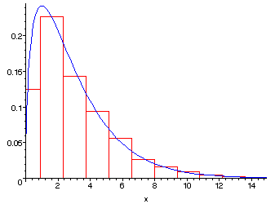
The Chi-Square Distribution and Test for Independence
Hypothesis testing between two categorical variables

Slide 36
Requirements for Chi-Square test
Must be a random sample from population
Data must be in raw frequencies
Observations must be independent
Categories for each independent variable must be mutually exclusive and exhaustive

Slide 37
Application of the Chi-Square
Question: is there a relationship in this table? Why? How would you know?
Used with two categorical variables. This will produce a crosstabulation (crosstab table) of cells.
How do you know if the cell counts are different than what would be expected by chance alone?
Or, are the observed cell counts in the cells independent from one another?
 | Student | Not Student | Total
Males | 46 | 71 | 117
Females | 37 | 83 | 120
Total | 83 | 154 | 237

Slide 38
Chance process with more than 2 categories:
The Chi-square statistic is just the sum of the observed minus the expected frequencies squared, divided by the expected frequency
Chi-square is just a numeric way to indicate the difference between observed and expected frequencies. Large Chi-square values = big differences between observed and expected.
http://www.flickr.com/photos/kirstea/4884298267/
Notes:
Chi-square is just a numeric way to indicate the difference between observed and expected frequencies. Large values = big differences between observed and expected.
This can be done for something like dice (is it a fair die?): roll it many times, for each roll square diff between expected and observed, divide by expected.
Big values = observed is very different from expected values.

Slide 39
Example Crosstabulation:
 | Student | Not Student | Total
Males | 46 (40.97) | 71 (76.02) | 117
Females | 37 (42.03) | 83 (77.97) | 120
Total | 83 | 154 | N=237
Observed
Expected
Notes:
Each cell has its own chi-square value, telling you how different the expected is from observed. We add them up to get an overall chi-square test for the table.

Slide 40
Many tests use “degrees of freedom”. These include Chi-square, t-tests, Analysis of Variance, etc. So, what are degrees of freedom?
d.f. = the number of values in the final calculation of a statistic that are free to vary.
Example: Choose 3 numbers that add up to 100.
We have 3 choices, but in reality our choices are reduced to N-1 because once we choose any 2 numbers, the 3rd is decided for us.
In statistics, further restrictions reduce the degrees of freedom.
X + Y + Z = 100
20 + 70 + Z = 100
Z must be 10; it cannot vary.

Slide 41
Using the Chi-Square Test
The chi-square test of independence tests whether the columns are contingent on the rows in the table.
In this case, the null hypothesis is that there is no relationship between row and column frequencies.
H₀: The 2 variables are independent.
Our alternative hypothesis is that the two variables are not independent.
Notes:
So, what is the alternative hypothesis?
Note that there is no direction here– even though it is a one-tailed test, we are only testing on one end of the curve.

Slide 42
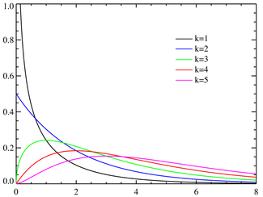
Chi-Square Distribution
The logic of why we test with a particular distribution curve is related to how we calculate the statistic. In essence, if the calculation is based on summing and squaring several normally distributed independent variables, we should know what the curve looks like when we do just that…
The chi-square distribution results when independent variables with standard normal distributions are squared and summed.
Notes:
The logic of why we must use this curve is related to how we calculate the statistic. In essence, if the calculation is based on summing and squaring several normally distributed independent variables, we should know what the curve looks like when we do just that…

Slide 43
Chi-square Degrees of freedom
df = (r-1) (c-1)
Where r = # of rows, c = # of columns
Thus, in any 2x2 contingency table, the degrees of freedom = 1.
As the degrees of freedom increase, the distribution shifts to the right and the critical values of chi-square become larger.
 | Q | E | Totals
X | a | b | 10
Y | c | d | 20
Total | 5 | 25 | N = 30
Note that if we know the value in any one cell, we can calculate all other cells. If a = 5, then b = n3-5, and so on.

Slide 44
Chi-Square Test of Independence (k = various degrees of freedom)

Slide 45
Interpretation of Chi-Square
First, we look at the overall chi-square value and whether it is significant (p-value)
We can also look at the individual chi-square for each cell, to see how much of a contribution that cell made to the overall chi-square.
You can also look at the residuals for each cell. Remember that a residual is just the error between what the model predicts (expected frequency) and the actual observations (observed frequencies). Larger residuals indicate significant differences.
Standardized residuals can be interpreted as z-scores. So, just as we have seen in the past with the z-test and the table of z-scores, a value outside of around +/- 1.96 will be statistically significant.

Slide 46
Special Cases
Fisher’s Exact Test
When you have a 2 x 2 table with expected frequencies less than 5. You do not use Fischer’s exact test just because the observed frequencies are low.
Fisher’s exact test is really most important for small data; when we are working with fairly large data it is rarely an issue.

Slide 47
Practical Significance in Chi-Square
Strength of Association: Practical Significance
Cramer’s V gives a value of association between the variables.
Cramer’s V is interpreted much like a correlation. Values range from 0-1, where under .2 is weak, .2 to .4 is strong, and values greater than .4 are very strong.
For 2 x 2 tables, the odds ratio is also a useful way to look at practical significance.

