Slide 1
Graphs and Plots in R

Slide 2
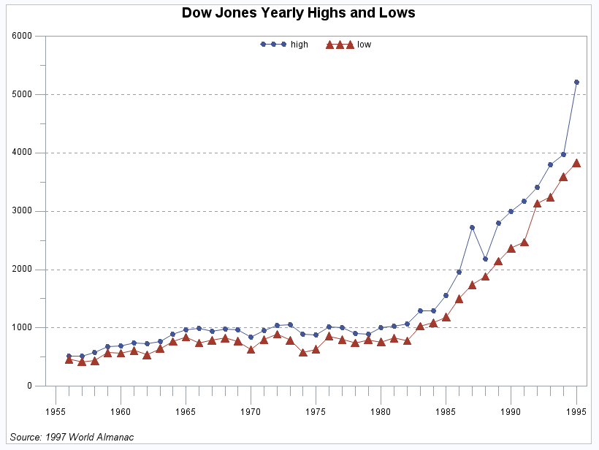
Graphs
Graphs capture much more detail than numerical summaries, so very useful for learning about data and communicating its features.
At the same time, graphical interpretation isn’t standard in the way that numerical summaries are, and our eyes can fool us.

Slide 3
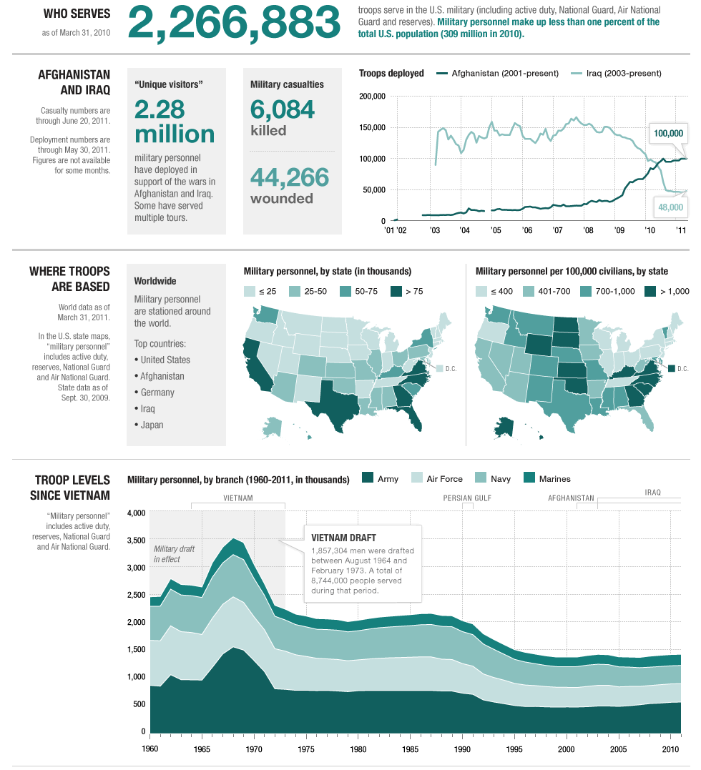
Some General Rules
Insights from Edward Tufte (2001)
show the data
Induce the reader to think about the data being presented
Avoid distorting the data
http://www.npr.org/2011/07/03/137536111/by-the-numbers-todays-military

Slide 4
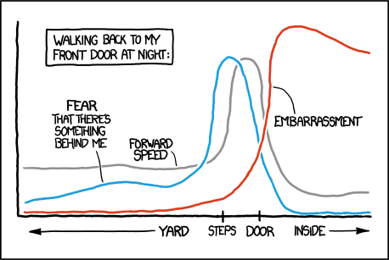
More Insights from Tufte
Present many numbers with minimum ink
Try to make large data sets coherent
Encourage the reader to compare different pieces of data
“Reveal” Data at different levels of detail
The visualization should serve a reasonably clear purpose
http://xkcd.com/1064/

Slide 5
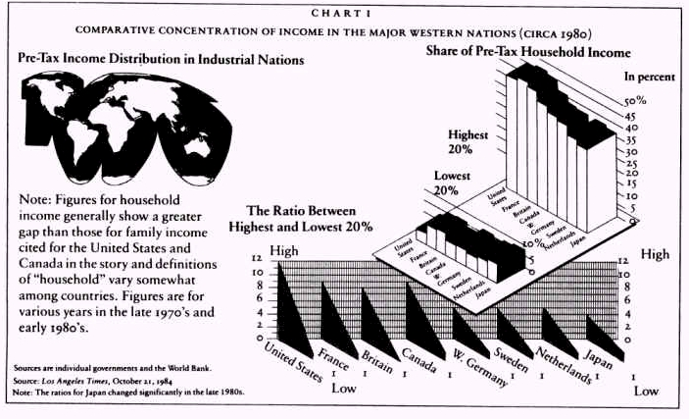
Things to Avoid Whenever Possible:
Avoid distractions, chart junk, and distorting data.
Phillips (1991)

Slide 6
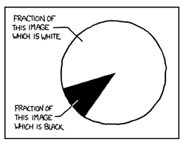
Why Pie Charts are Usually Terrible.
http://xkcd.com/688/

Slide 7
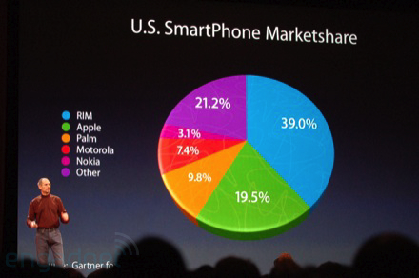
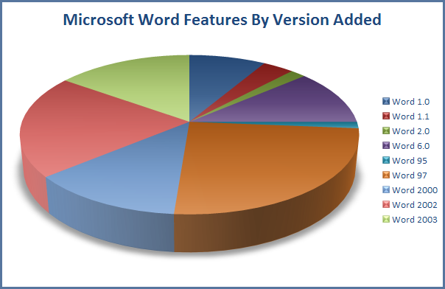
Pie Charts in the Wild
http://www.engadget.com/2008/01/15/live-from-macworld-2008-steve-jobs-keynote/
http://www.jgc.org/blog/uploaded_images/FeaturesByVersion-777059.png

Slide 8
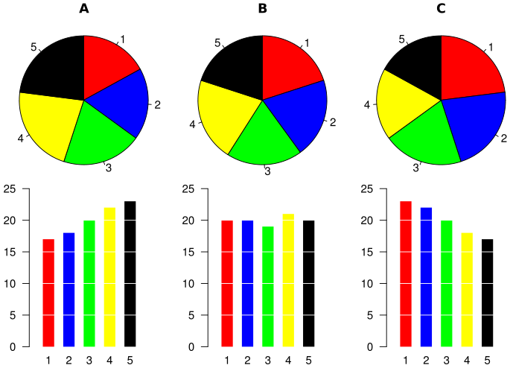
Why Pie Charts are Usually Terrible.
(Source: Wikipedia user Schutz)

