Slide 1
Review: Estimating a Mean
Suppose we want to know the mean of a variable in a population, but we can only take the mean over a sample.
Law of Large Numbers: The sample mean is a consistent estimator for the population mean.
But the sample mean would be different each time we collected a sample – it varies according to some sampling distribution (which we don’t know)
To find out how good an estimate we have, can compute standard error as
Central Limit Theorem: If the sample is large (~30+) the sampling distribution will be approximately normal, and we can compute probabilities of finding the true mean within ranges of our estimate.

Slide 2
Research Problems and Questions
Problem
Justification
Research Question
Testable Hypothesis 1
Testable Hypothesis 2
Research Question
Testable Hypothesis 1
Testable Hypothesis 2
Notes:
This is ultimately why we care about all of this– we want to be able to formulate good research problems, turn them into questions and then test specific predictions.

Slide 3
Three Criteria for a Research Problem
What are we going to learn as the result of the proposed project that we do not know now?
(Will this tell us something new?)
Why is it worth knowing?
(What is so important about the problem?)
How will we know that the conclusions are valid?
(Only this one really deals with methods– other 2 are achieved through argumentation)
Photo credit: http://www.qualtrics.com/blog/
Notes:
Might seem obvious to you, but it isnt always clear what is “problematic” and why we should bother.
Only the 3rd actually involves our methodology. The other two are achieved through our arguments.

Slide 4
Justifying Research Problems
Explain what is not known about the problem.
Why does the problem matter?
Provide documentation that this is actually a problem.
Available statistics?
Available literature that shows that this is a needed area of inquiry?
Discrepancies in the literature
What would convince *you* that something is actually problematic and worthy of further study?

Slide 5
What is not usually good enough for a full Justification?
“No one has looked at it or studied it before”
But institutional blind spots could hide important results
“The issue or problem is not discussed in the literature, media, etc.”
Notes:
e.g., research has failed to examine the effect of shirt color on food preference.

Slide 6
Research Problem
Some examples from my own work:
What would the internet look like if we could build it from scratch, knowing everything we know about networking today?
NSF 100x100 Clean-Slate Design Project
How can the resistance to new technologies in the network layer be addressed?
My Ischool thesis
How does the graph-structure of supply chains influence market outcomes?
Ongoing work with Pedro Ferreira

Slide 7
Defining Research Questions
Forming a research question:
“an interrogative sentence or statement that asks: What relation exists between two or more concepts?”
A good problem can produce many research questions
Some may be oriented to quantitative or qualitative investigation; we are focusing on the former.
The research question(s) can be restated in one or more ways to produce testable hypotheses.

Slide 8
Testable Hypotheses
Once a research problem has been identified and one or more research questions emerge, specific hypotheses are used to relate specific variables
Note the significant role of operationalization at this point!
Research problem → questions → hypotheses → variables.

Slide 9
Hypothesis
“hypothesis statements contain two or more variables that are measurable or potentially measurable and that specify how the variables are related” (Kerlinger 1986)
A good research question will produce one or more testable hypotheses.
Testable hypotheses predict a relationship between variables (not concepts).
Notes:
A good research question will produce one or more testable hypotheses.
Testable hypotheses predict a relationship between variables (not concepts).

Slide 10
Propositions and Hypotheses
Propositions link concepts together with specific relationships
Hypotheses link variables together with specific relationships
Wikipedia Editing
Online Leadership
Total Number of
Edits by
Category during
Time X
Total Number of
Observed Activities in
Organizational Wiki
Pages

Slide 11
Null and Alternative Hypotheses
Null Hypothesis, H₀: The default, specific assumption. Usually that there is no effect.
Alternative Hypothesis, H_{A}: A prediction that comes from our expectation, theory, etc. Often that some relationship exists.
We cannot prove our alternative hypothesis. All we can do is reject the null hypothesis or not.

Slide 12
Statistics
Observation
⬇
Probability(Model)
Specific Model
⬇
Probability(Observations)
How we wish it worked
How it actually works
Space of models is too unstructured to assign probabilities:
Given a sample mean, what is the probability that the average height of humans is exactly 5.5 feet?
Um, probably zero?
Given that the sun has come up for each of the last 10 days, what is the probability that it comes up at least 90% of the time?
One question we can answer: Given null hypothesis, how unlikely are the observations?
Notes:
Why do we focus our investigation on the null hypothesis?
This relates to the capabilities of statistics. We can’t find the probability that a model is true. We certainly can never prove a point-estimate. No amount of data will ever prove that the average height is exactly 5.5 feet.
In fact, we really can’t even prove that a model is within a range with any probability.
(ok, sometimes we want the probability that a parameter is within a confidence interval, but this requires many more assumptions. We’re saying, what is the probability we’re within a confidence interval, assuming that one of a family of models is true, and they all have equal probability before any evidence.)
One thing we can do is take a point estimate, and find the probability for a set of observations.

Slide 13
Example
Suppose that students in the US read an average of 6 hours a week, with a standard deviation of 2 hours.
We want to know if Berkeley students are different than the national average
Our null hypothesis should be that Berkeley student’s reading habits are exactly the same as the national average (drawn from the same distribution)
Given the null hypothesis, we can compute how likely we are to find any average number of reading hours in our Berkeley sample.

Slide 14
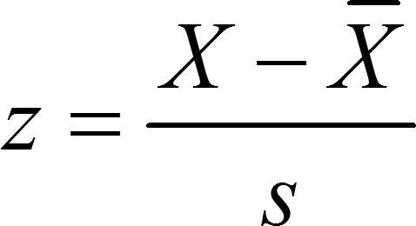
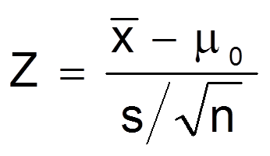
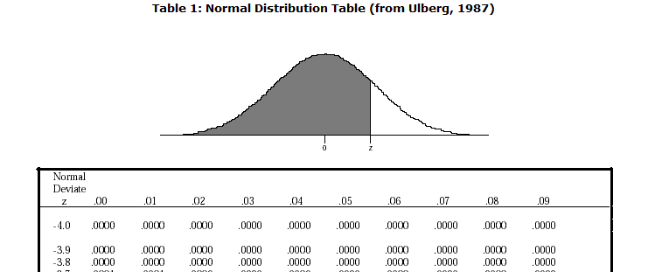
The Z-test as a hypothesis test
z is a test statistic
More generally:
Z tells us how many standard errors an observed value is from its expected value.
Finding a z-score for a single variable
Using a z-score as a statistical test
z = observed – expected
SE
Notes:
Note that we are now using observed and expected values, along with standard errors
So, specifically, we are using the spread of a chance process.

Slide 15
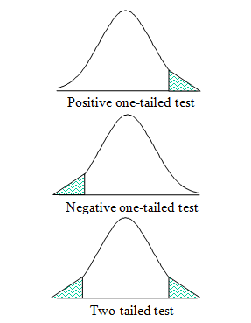
One and two-tailed hypothesis testing
One-tailed test
Directional Hypothesis
Probability at one end of the curve
Two-tailed test
Non-directional Hypothesis
Probability is both ends of the curve

Slide 16
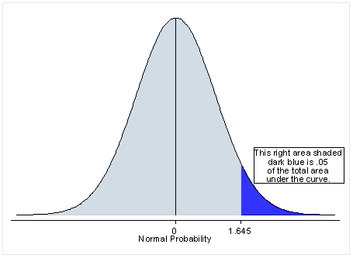
Logic of Hypothesis Testing: One-tailed tests
Null Hypothesis:
H₀: μ₁ = μ₂
μ₁ and μ₂ are the two population means
Alternative Hypotheses:
H₁: μ₁ < μ₂
H₁: μ₁ > μ₂

Slide 17
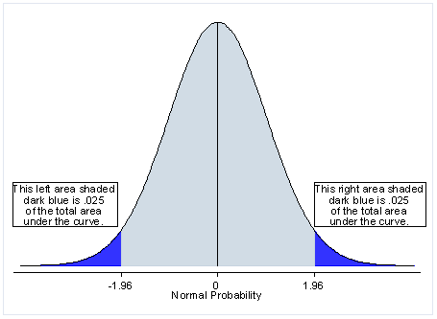
Logic of Hypothesis Testing: two-tailed test
Null Hypothesis:
H₀: μ₁ = μ₂
μ₁ and μ₂ are the two population means
Alternative Hypothesis:
H₁: μ₁ ≠ μ₂

Slide 18
Example 1
Do Berkeley Information students read either more or less than the national average of 6 hours a week?
H₀: μ = 6 The mean for Berkeley students is equal to 6
H₁: μ ≠ 6 The mean for Berkeley students is not equal to 6

Slide 19
Example 2
Do Berkeley Information students read more than the national average of 6 hours a week?
H₀: μ = 6 There is no difference between Berkeley students and other students
H₁: μ > 6 The mean for Berkeley students is higher than the mean for all students

Slide 20
Statistical Significance
http://xkcd.com/539/

Slide 21
The meaning of p-value
“The P-value of a test is the chance of getting a big test statistic– assuming the null hypothesis to be right. P is not the chance of the null hypothesis being right.
-David Freedman (Statistics, 4th Edition)
Notes:
This is subtle, important, and constantly misunderstood.

Slide 22
The meaning of p-value
Put differently: The p-value is the probability of obtaining a test statistic at least as extreme as the one that was actually observed, assuming that the null hypothesis is true.

Slide 23
“Cheating” in Hypothesis Testing
The entire point of hypothesis testing is that we want to evaluate an outcome given our hypothesis (our prediction).
If we change our hypothesis in light of the data and results, it becomes increasingly likely that we will report irreproducible results. This is cheating in research.
Remember: the p-value does not tell you if something is right or not. It only tells you the chance of getting a big test statistic, assuming the null hypothesis is true.

Slide 24
Common Evaluation of p-values
When p value > .10 → the observed difference is “not significant”
When p value ≤ .10 → the observed difference is “marginally significant” or “borderline significant”
When p value ≤ .05 → the observed difference is “statistically significant”
When p value ≤ .01 → the observed difference is “highly significant”

Slide 25
More on Evaluating Statistical Hypothesis Testing
Recall that of our two hypotheses—null and alternative– only one can be supported (the cannot both be supported at the same time).
Our decision to retain or reject our null hypothesis leaves an opportunity to commit two different types of error.
Null Hypothesis:
H₀: μ₁ = μ₂
Alt Hypothesis:
H₁: μ₁ ≠ μ₂

Slide 26
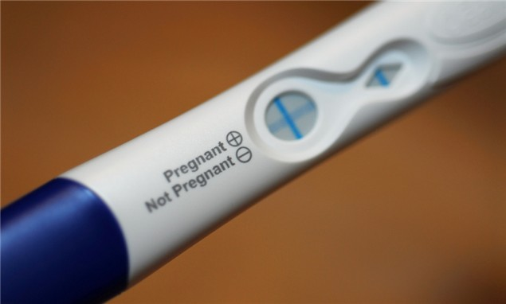
Type I Error in Statistical Hypothesis Testing
Type I Error: Falsely rejecting a null hypothesis (false positive)
Occurs when we think we are supporting our alternative hypothesis but the effect is not real.
Denoted by alpha: α
Our alpha value is our statistical significance level, such as the standard .05 level (critical value must fall within 5% region of one tail, or within 2.5% of either tail)
Notes:
Might help to think of a pregnancy test…Null = not pregnant. (or not guilty)
In much social science work, Type I is a bit more dangerous than Type II.

Slide 27
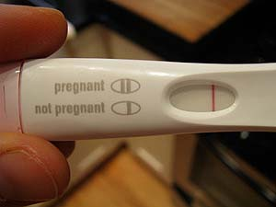
Type II Error in Statistical Hypothesis Testing
Type II Error: Failing to reject the null hypothesis when it is false (false negative)
Can occur with very conservative estimates.
Denoted by beta: β
If we reduce α in a given test, we will increase β, and vice versa

Slide 28
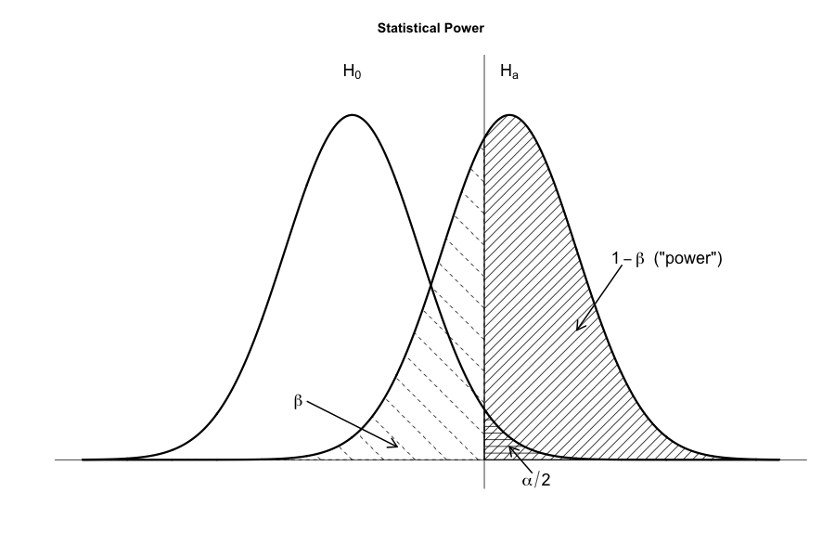
Statistical Power
We know that the probability of a Type II error (β) is the probability to miss a potentially important finding by retaining the null when it is actually false.
1 – β is known as statistical power, or just power.
It is the probability of rejecting the null hypothesis when it is, in reality, false.
Image: http://rpsychologist.com/

Slide 29
More on Statistical Power
Sample size is one of the most common ways that we increase our statistical power.
As sample size increases, the sample becomes more and more like the population.
The criterion used for statistical significance as well as the magnitude of the effect that we hope to observe also affect power.
http://what-if.xkcd.com/

Slide 30
Can we “prove” the null or alternative hypothesis?
We cannot support the null hypothesis
It’s a point estimate
As odd as it may seem at first, we reject or do not reject the null; a traditional hypothesis test is evaluated against the null.
Again– this is very important– we never use the word “prove” with hypothesis testing and statistics, we reject or fail to reject.
We always run the risk of a Type I or Type II error because we are making optimal use of available data. We minimize error, but we are always making a choice in the presence of uncertainty.

Slide 31
What your p-value won’t tell you
Statistical significance (the p-value of our statistical hypothesis test) only tells us if we should reject or accept our null hypothesis.
Statistical significance does not tell us if a difference or an effect is actually large, small, useful or not practically useful.

Slide 32
Effect Size
After we conduct a statistical test, we look at the size of an effect– the effect size.
Different effect size calculations exist for different types of tests
Include: r coefficient for correlations, Cohen’s d for difference in means, regression coefficients.

Slide 33
Some Examples
Example 1
Example 2
Hypothesis: approval ratings of the US president will be higher among group X compared to group Y.
Measure: Approval scale from 1-10 (where 10 = highest approval)
We get a random sample, N=30
Result: Mean for group X is 4, mean for group Y is 7
We get a p-value of .06 (marginally statistically significant)
Hypothesis: approval ratings of the US president will be higher among group X compared to group Y.
Measure: Approval scale from 1-10 (where 10 = highest approval)
We get a random sample, N=10,000
Result: Mean for group X is 7, mean for group Y is 7.2
We get a p-value of .001 (highly statistically significant)

Slide 34
Practical vs. Statistical Significance
Statistical Significance: Tells us if we should accept or reject our null hypothesis. This is determined by probability.
Practical Significance: Tells us the magnitude of a given effect; whether the observed effect is meaningful or important.

