Slide 1
Models

Slide 2
Administrative Stuff:
Anna’s Office Hours
  Tuesday after class: in the Co-lab
  Friday 10-11am: rm 107

Slide 3
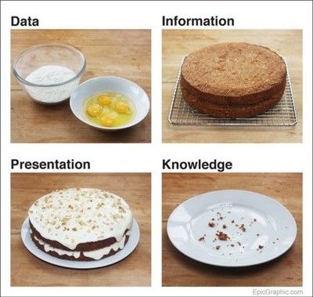
Notes:
Or, data by itself doesn’t give you knowledge. We shouldn’t be talking about Big Data. We should be talking about Big Information. Usable stuff…ways to build knowledge through the accumulation of usable, accurate, reliable information.
What is a statistical model? We’re representing data as information, repackaging, build a model

Slide 4








Making Sense of Overwhelming Data
“Today companies like Google, which have grown up in an era of massively abundant data, don't have to settle for wrong models. Indeed, they don't have to settle for models at all.
–Chris Anderson”
Notes:
So again, this is the big issue…all this “data” is so overwhelming that I think many just believe it has to be telling us something…
And it can! But we need to think carefully about what we think we are learning.

Slide 5
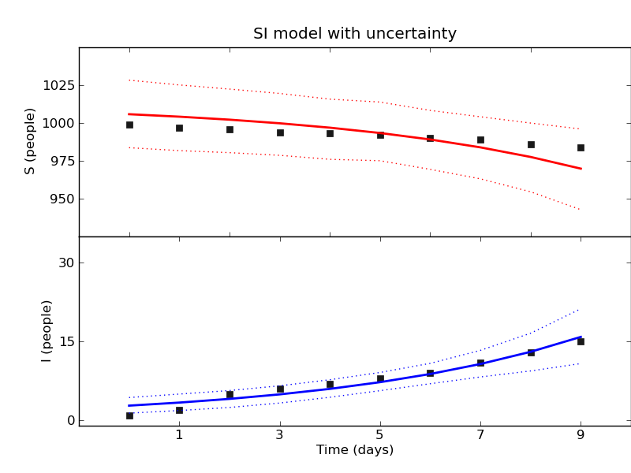
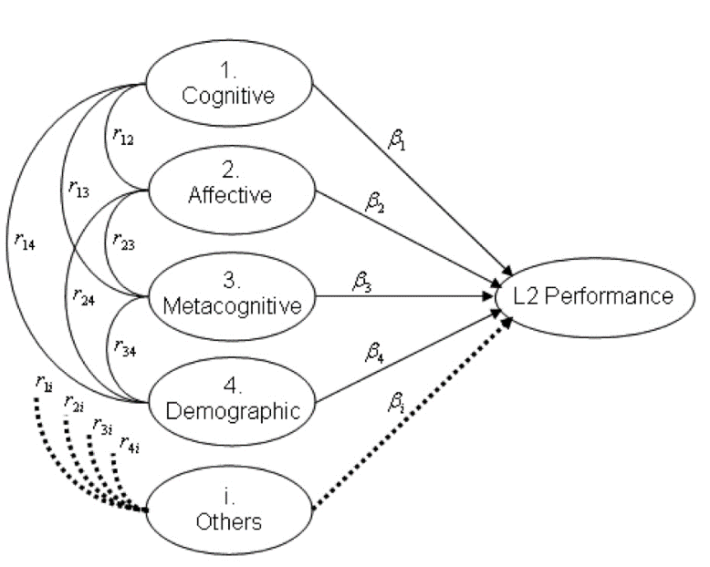
The Scientific Method is Built Around the Idea of Constructing and Testing Models…So What is a Model?
X ~ N(0,1)

Slide 6
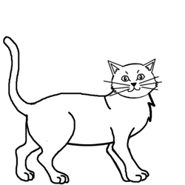

A Simple Model…

Slide 7
George Box, a famous statistician, on “worrying selectively”:
“
Since all models are wrong the scientist must be alert to what is importantly wrong. It is inappropriate to be concerned about mice when there are tigers abroad.
”
Notes:
In other words, lets not get caught up in smaller matters of variance here and there…lets try to figure out if we understand the key mechanism(s) or not!

Slide 8
George Box on parsimony:
“
Since all models are wrong the scientist cannot obtain a “correct” one by excessive elaboration. On the contrary following William of Occam he should seek an economical description of natural phenomena. Just as the ability to devise simple but evocative models is the signature of the great scientist so overelaboration and overparameterization is often the mark of mediocrity.
”
Notes:
William of Occam: 14th century English philosopher and theologian. Occam’s razor: “entia non sunt multiplicanda praeter necessitatem” -- "entities must not be multiplied beyond necessity.”

Slide 9
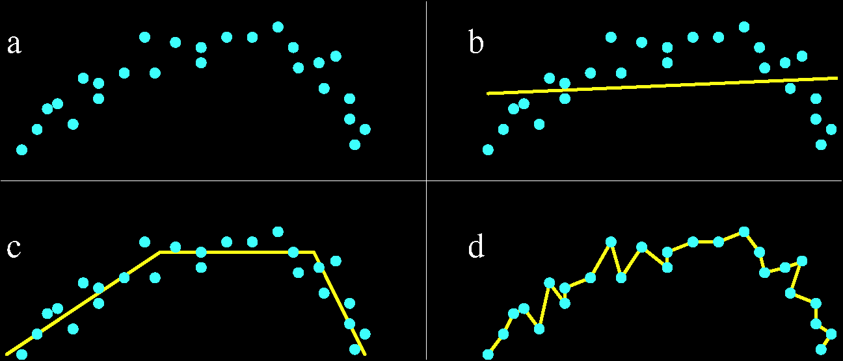
Simple Example of a Type of Overelaboration: Overfitting…or “memorizing the data”
(From Lee et al. 2006, “Overfitting Control for Surface Reconstruction”)
Notes:
Consider the yellow line in b, c, d. Which is the “best” way to describe the data in a? Why?

Slide 10
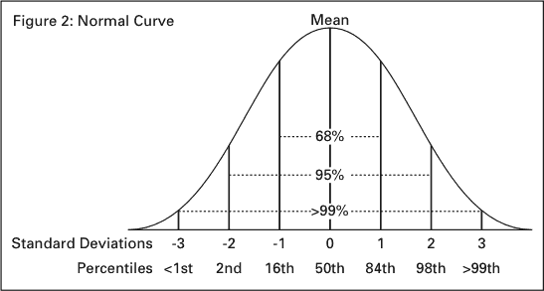
The Normal Curve
Notes:
Several properties:
Unimodal
Mean = median = mode
Curve is symmetric
Range is infinite

Slide 11
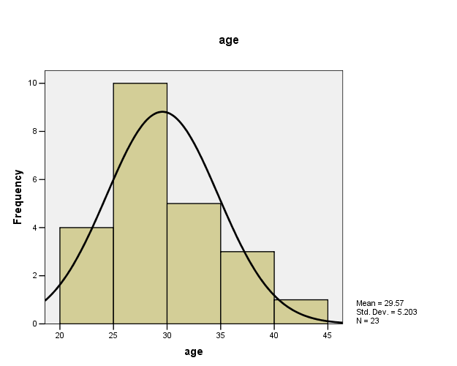
Notes:
Simple frequency histogram…. quick and dirty way to see if you should even care about a “variable”
Example in GSS data: use tabulate and histogram (tab attend, hist attend; tab age, hist age)

Slide 12
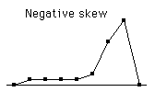

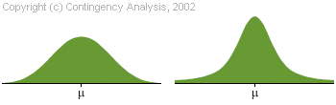
Non Normal Distributions
Skewness
Kurtosis
Notes:
Skewness in a normal distribution = 0
Kurtosis = 3
A distribution is platykurtic if it is flatter than the corresponding normal curve and leptokurtic if it is more peaked than the normal curve.

Slide 13
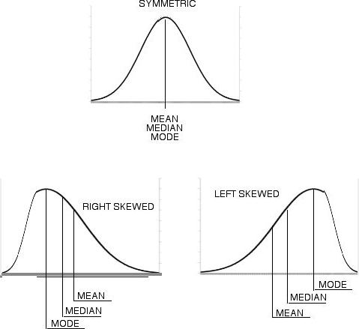
Describing Distributions
Central Tendency
  Some way of “typifying” a distribution of values, scores, etc.
    Mean
      sum of scores divided by number of scores
    Median
      middle score, as found by rank
    Mode
      most common value from set of values
  In a normal distribution, all 3 measures are equal.
Image: http://thenormalgenius.blogspot.com
Notes:
What are relative advantages of mean, median and mode?
Mode = good for qualitative descriptions when mean value is not a good descriptive
Median = don’t want those big outliers to have an effect…just want to know what lies in the middle
Mean = ‘best’ overall value for the middle value, all values have equal weight in computing value

Slide 14
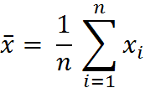
Special Features of the Mean
Sum of the deviations from the mean of all scores = zero.
It is the point in a distribution where the two halves are balanced.

Slide 15
Using Central Tendencies in Recoding Variables
“splitting” metric variables into binary variables
  High/Low (mean or median)
  Most common, least common (mode)
“collapsing” variables (less from more)
  Groups of scores in different ranges above and below the mean

Slide 16
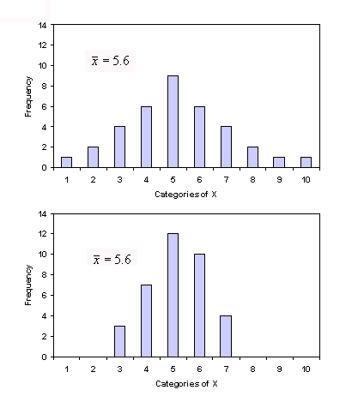
Dispersion
Range
  Overall measure of distance between all values in a variable.
Variance
  Computed as the average squared deviation of each value from its mean
Standard Deviation
  A statistic that describes how tightly the values are clustered around the mean.
Both of these distributions have same mean, but top figure has greater dispersion.
Notes:
Variance is just the standard deviation squared; or, SD is the square root of the variance.
We often use SD in regular univariate stats b/c its in same units as the variable of interest. Variance is more useful when calculating certain statistics as the values are oriented around difference from the mean.

Slide 17

Sum of Squares and Variance
Consider this example: number of words in a sample of your own emails.
  We can use the mean as a statistical model– it is a hypothetical value that describes something of interest.
  The word count in each individual email will likely differ a little from the mean. This is error.
  By squaring the errors and then taking the sum, we get the sum of squared errors, or SS.
  We can divide the SS by N-1 to account for the sample size. This value is the variance.
Equation for variance

Slide 18
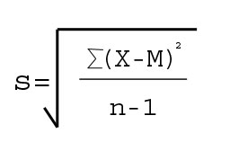
Standard Deviation (S.D.)
S.D is the square root of the variance.
S.D. is in same units as the original measure.
If a constant is added to all scores, it has no impact on S.D.
If a constant is multiplied to all scores, it will affect the dispersion (S.D. and variance)
S = standard deviation
X = individual score
M = mean of all scores
n = sample size (number of scores)

Slide 19
Notes:
What is the practical meaning if I say that a given value is 1 standard deviations from the mean?
What if it is 3 standard deviations?

Slide 20
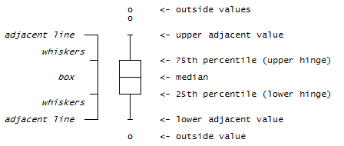
Common Data Representations
Histograms
  Simple graphs of the density or frequency
    With density, area comes out in percent and total area = 100%
Box Plots
  Yet another way of displaying dispersion. Provides a lot of information in one graphic.

Slide 21
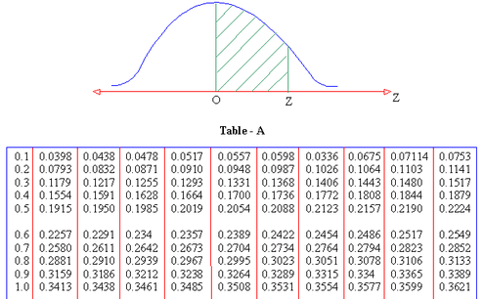
The Normal Distribution and using standard units (z-scores)

Slide 22
Why Sum of Squares?
Say that we want to minimize the sum of squares error about an estimate, x
To minimize this, we use the first order condition:
In other words, the sum of squares is the error that is minimized by the mean

Slide 23
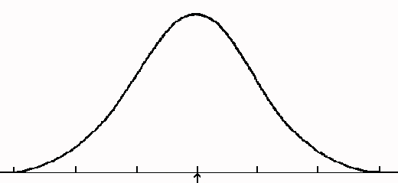
Why N-1?
Variance is the average squared error
For a whole population, we would simply compute
For a sample, the sample mean is shifted towards our sampled data points, which lowers our calculation of variance.
To correct this, we compute
mean
sample mean

Slide 24
Frequency Distributions and Probability
Probability corresponds to area under frequency distribution
Often, we don’t know the frequency distribution, but have reason to believe it’s approximately normal

Slide 25
The Normal Distribution: A Common, Idealized Distribution
Notes:
What is the practical meaning if I say that a given value is 1 standard deviations from the mean?
What if it is 3 standard deviations?

Slide 26

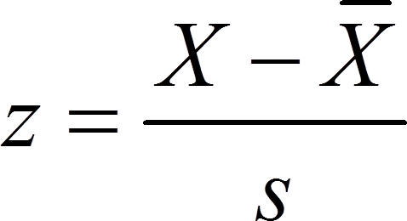
The z-score and the normal distribution
(z-scores are also called standard units)
Standardizing a group of scores changes the scale to one of standard deviation units.
Allows for comparisons with scores that were originally on a different scale.
Or…
Notes:
The z-score is important for thinking about individual scores on any distribution. Observed value minus mean, over standard deviation.

Slide 27
z-scores (continued)
Tells us where a score is located within a distribution.
Properties
  The mean of a set of z-scores = zero
  The variance and standard deviation of a set of z-scores = 1.

Slide 28
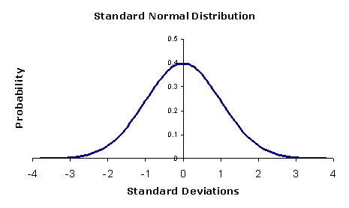
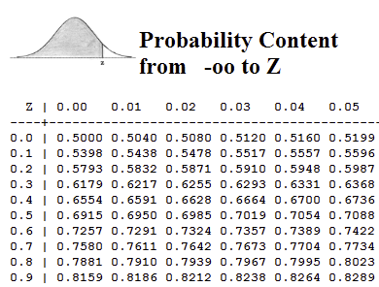
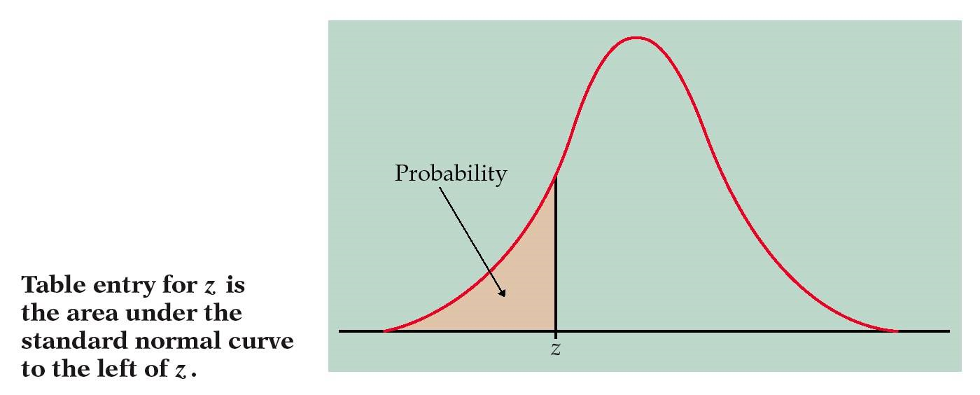
Notes:
We can plot any z-score and figure out the probability associated with it.
This probability (the area under curve) can then be attached to a specific criteria (p-value).

Slide 29
Using z-scores: Area under the normal curve
Example, you have a variable x with mean of 500 and S.D. of 15. How common is a score of 525?
  Z = 525-500/15 = 1.67
  A z-statistic of 1.67 (as found in a z-score table), we find that the proportion of scores less than our value is .9525.
  Or, a score of 525 is very rare. In very specific terms, our specified score is larger than .9525 of the population.
Notes:
This is just an example using one score out of single variable distribution. But, we can use the same process on a sample *mean* in a sampling distribution.

Slide 30
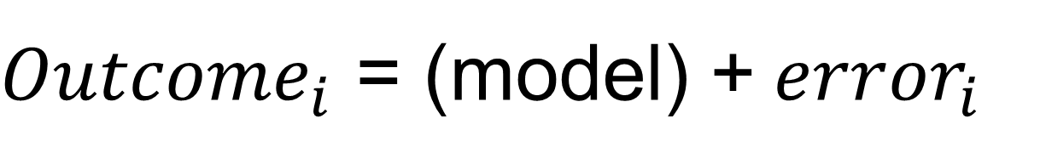
One Equation to Rule them All

Slide 31
Other sources of error
3 Major Sources of Error
Chance: expected error from random fluctuation, factors outside model
  Individual measurement = exact value + chance error
Bias: systematic error, net positive or negative expected value
Recording: isolated errors
  Can cause outliers - extreme measures far outside the normal curve
Notes:
Bias changes our scores in exactly the same w

Slide 32
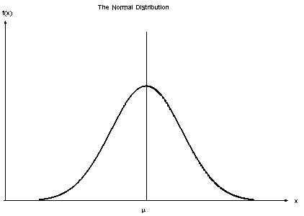
Why spend so much time on the normal distribution?
For some statistical tests, our variables may need to meet the assumption of normality.
A key assumption for many variables is that the means of samples are normally distributed.
We are especially interested in the normal distribution as it relates to sampling distributions.

Slide 33
Sampling Variation and Sampling Distributions
Sampling Variation
  If we take different samples from the same population, the means for each sample will likely be different.
Sampling Distribution
  This is the frequency distribution of sample means (or any statistic that we want to estimate for that matter) obtained from the same population.
  In general, we don’t actually know the sampling distribution, but may have reason to think it’s normal
Notes:
Sampling distribution is all of the individual samples if we brought them together– but of course we usually have just one, but b/c of the central limit theorem we can still calculate estimates of mean, and standard deviation for the population.
Good time for a class experiment.

Slide 34
Two Big Laws of Asymptotics
The Law of Large Numbers:
  For a population with mean μ, the sample mean
  approaches the population mean
  Technically, the sample mean is a consistent estimator of μ: Prob(|Y – μ| > ε ) -> 0 as n -> ∞ for any ε
  This means that we can use the sample mean as a sensible estimator for the population mean.
_
1
n
Y_{n}
=
_
∑
Y_{i}
Notes:
So, Y might be your score on the SAT…which can be represented as the population average plus some error, positive and negative (test taking ability, knowledge, etc).
The central limit theorem helps us approximate 3 key things: 1) the location of the mean, 2) the width of the distribution, and 3) how it is distributed.
Remember our sample exercise where we averaged groups of responses to the question, “pick a number between 1-10”? This was a demonstration of the central limit theorem.

Slide 35

How Good an Estimator is the Sample Mean?
In other words, how spread out is the sampling distribution about the true population mean?
We can compute the standard deviation of the sampling distribution – this is called the standard error.
Large samples give us more accuracy
  In other words, small samples only allow us to uncover large effects

Slide 36


The Difference between Standard Deviation and Standard Error
Standard Deviation
  Measures spread of any distribution
  Especially spread of population parameters
Standard Error
  Standard deviation of a sampling distribution
    more commonly, estimates of that standard deviation
  Applies when we want to know how good our sample parameter is an an estimate for a population parameter
Graphics: Wikipedia

Slide 37
Two Big Laws of Asymptotics
Central Limit Theorem
    Even for small samples, if errors can be viewed as a sum of many independent random effects, individual scores will tend to be normally distributed.
      This assumption is often questionable
    The mean of a large number of independent and identically-distributed random variables will be approximately normally distributed
Notes:
So, Y might be your score on the SAT…which can be represented as the population average plus some error, positive and negative (test taking ability, knowledge, etc).
The central limit theorem helps us approximate 3 key things: 1) the location of the mean, 2) the width of the distribution, and 3) how it is distributed.
Remember our sample exercise where we averaged groups of responses to the question, “pick a number between 1-10”? This was a demonstration of the central limit theorem.

Slide 38
What does the Central Limit Theorem Imply?
We are using a sample to estimate the mean for an entire population. The Central Limit Theorem tells us about how that estimate is distributed.
  This lets us to figure out how confident we should be in our estimate, or how close the actual value is likely to be.
  In other words, it allows us to do statistics on statistics
    Or at least statistics on estimators
The LLN and the Central Limit Theorem rely on properties of the sample mean, but they often apply to estimators in general.

Slide 39
An example*
Note: reproduced from Karl Whelan’s class notes

Slide 41
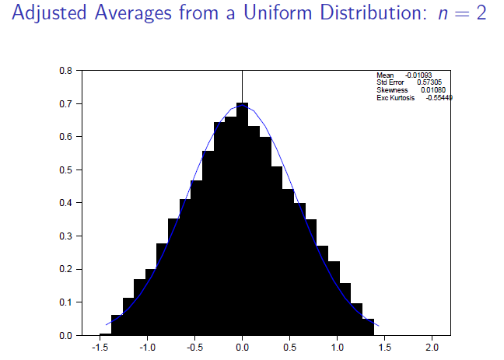

Slide 43
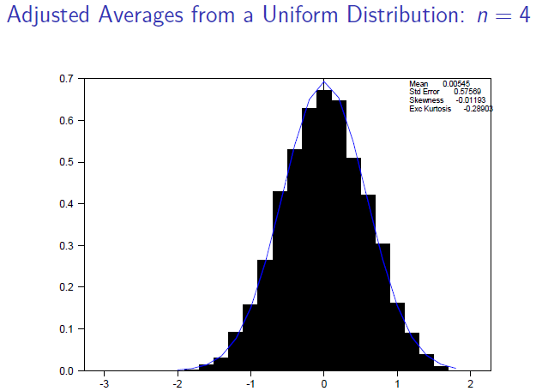

Slide 46
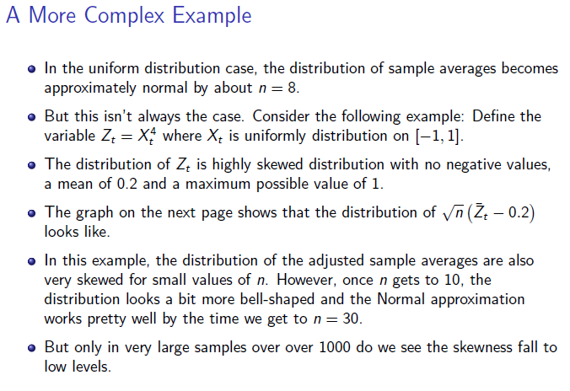

Slide 48
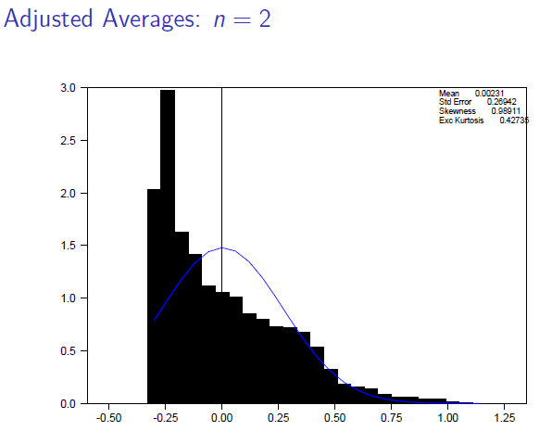

Slide 51
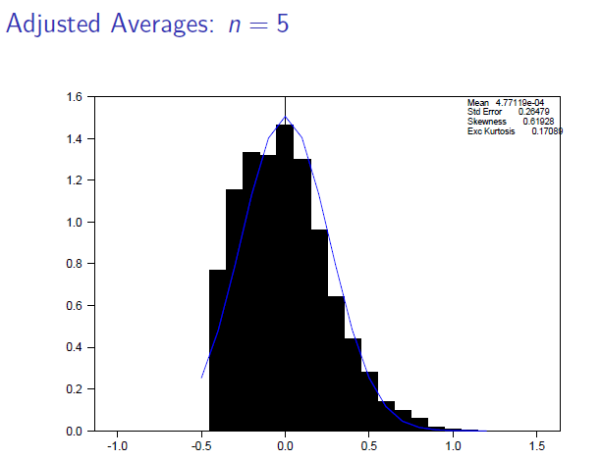

Slide 54
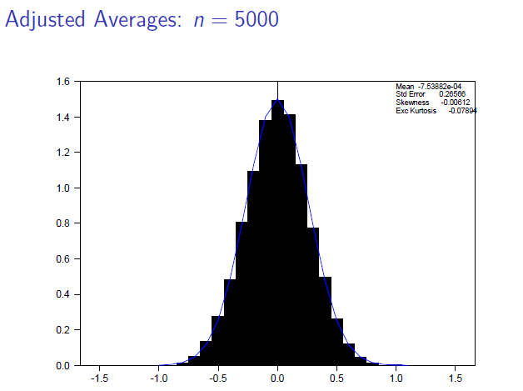

Slide 55
How Large is Large Enough?
In general, no easy way to know when a sampling distribution becomes normal
  N = 30 is often used as a rule of thumb
May be able to use bootstrapping to infer properties of sampling distribution.

