Slide 1
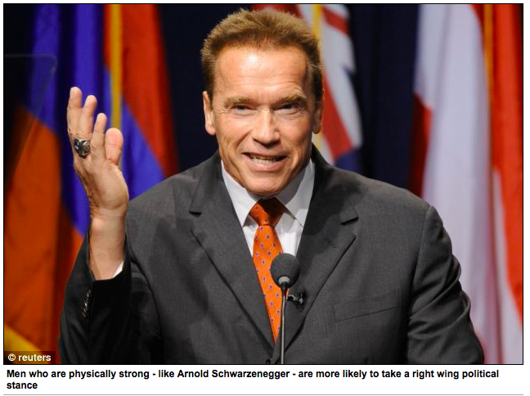
Review: Improper Identification
Men who are physically strong are more likely to have right wing political views
Weaker men more likely to support welfare state and wealth redistribution
Link may reflect psychological traits that evolved in our ancestors
Strength was a proxy for ability to defend or acquire resources
There is no link between women's physical strength and political views
By DAILY MAIL REPORTER PUBLISHED: 05:21 EST, 16 May 2013
http://www.dailymail.co.uk/health/article-2325414/Men-physically-strong-likely-right-wing-political-views.html#ixzz2lmUITJhE

Slide 2
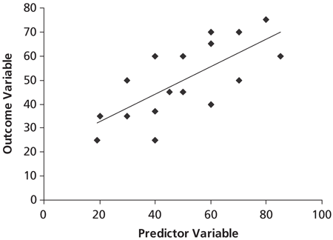
Intro to Multiple Regression

Slide 3
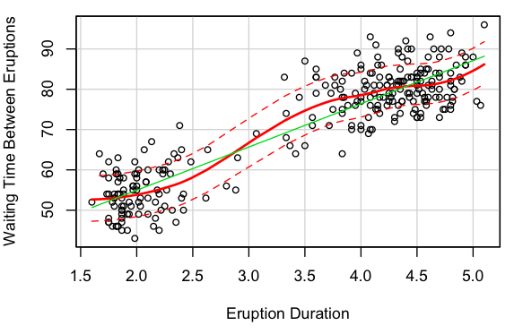
We can Learn a Lot from Simple Regression…
Old Faithful Eruptions
Y = 33.5 + 10.7 X
Azzalini, A. and Bowman, A. W. (1990). A look at some data on the Old Faithful geyser. Applied Statistics 39, 357–365.

Slide 4
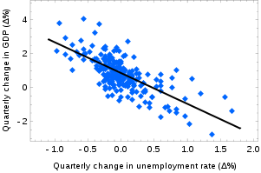
We can Learn a Lot from Simple Regression…
% Δ GDP = .856 - 1.827 * Δ Unemployment
Okun, Arthur, M, Potential GNP, its measurement and significance (1962), Cowles Foundation, Yale University,

Slide 5
But the World is a Complex Place
Multiple Regression: Predicting an outcome from multiple explanatory variables
Each predictor has its own coefficient.
This denotes its effect on the outcome, after removing the effects of the other predictors
As always, outcome_{i} = (model) + error_{i}
Y_{i} = (b₀ + b₁x_{i} + b₂x_{2i} + b₃x_{3i} ) + e_{i}.
Notes:
What is the null hypothesis in a regression?
What test do we use to check if it is significant?
What test do we use to see if each IV is significant?

Slide 6
Why Add More Independent Variables?
Control Variables
Does it make sense to remove effects of some variables?
For example, if we want to study the wage gap between men and women, we may want to control for education

Slide 7
Why Add More Independent Variables (continued)?
Alternate predictor variables
We could be interested in the effects of several predictors
E.g. we want to chose between two policy levers that could improve broadband penetration
Improving prediction accuracy
More variables increases R²
Complex functional forms
Interactions between predictors
Contributions from squares of predictors, etc…

Slide 8
Hypothesis Testing and Multiple Regression
Y_{i} = b₀ + b₁x_{i} + b₂x_{2i} + b₃x_{3i} + e_{i}
What is the null hypothesis?
What statistical test do we use to assess the overall model?
How do we test each coefficient?

Slide 9
ANOVA and F-test in Regression
The overall model can be tested with ANOVA. Why?
We have several independent variables in our model, and we want to know if at least some of them are not equal to zero.
ANOVA test the null hypothesis that b₁ = b₂ = 0
So, we can use the F-ratio to measure how much the model improves our prediction of a given outcome, compared to how much is left unexplained.
Formally, the F-ratio compares the model mean square to the residual mean square.

Slide 10
Testing coefficients
As in simple regression, we can use a t-test to check the significance of each coefficient.
For coefficient b_{i} we are testing the null hypothesis that b_{i} = 0.
We will have a separate p-value for each coefficient

Slide 11
Influential Cases
Could one or two datapoints be throwing off our regression – leading to very different coefficients?
Put differently: If we were to delete a certain case, would we obtain very different regression coefficients and a different line of best fit?
This issue can be broken into two parts:
First, Leverage: how much potential does each datapoint have to change our regression.
Second, Influence: how much does each datapoint actually change our regression.

Slide 12
Leverage
Leverage (hat values), written h_{ii,} is a measure of how sensitive our regression is to a particular datapoint i.
Imagine moving a datapoint up and down on the y-axis and observing how much the regression line follows it.
Roughly speaking, h_{ii} is the ratio of how much the regression line moves compared to how much you move the datapoint.
Ranges from zero to 1, where 0 = no influence, and 1= complete influence.
However, just because a point has high leverage doesn’t mean it’s influencing our regression, because it could be in line with the rest of the data anyway.

Slide 13
Influence
To substantially change our regression coefficients, a datapoint needs leverage, but also a large residual.
This means it lies far from the trend of the rest of the data.
Cook’s distance:
Measures the actual effect of deleting a given observation. If points have large Cook’s distance, they should be examined and potentially eliminated from the analysis.
General rule is that Cook’s distances > 1 are potentially problematic.

Slide 14
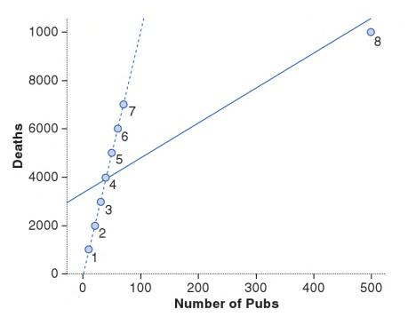
Residuals versus Influence
Consider this example where 8 different regions (boroughs) of London are examined in terms of deaths and number of pubs.
The last case (8) changes the line of best fit– but what is interesting is that the residual for case 8 is not that large.
But, if we look at measures of influence (e.g., Cook’s Distance or Hat Value), we would fine enormous values for case 8.
Thus, sometimes a case can exert a huge influence and still produce a small residual. This is why it is good to look at both.
Example from Field et al. 2012, “Discovering Statistics with R”

Slide 15
Measuring Residuals
Unstandardized residuals
Measured in the same units as our outcome variable. Useful for looking at a single model, but doesn’t tell us what residual is “too large.”
So we often want to standardize residuals.
To compare across different regression models
To identify outliers
There’s a rough way to standardize residuals and a more precise way.

Slide 16
The Rough Approach: Standardized Residuals
residual
Leverage
(points with high leverage pull the regression with them, so they tend to have smaller residuals)
Standard error
Standardized residuals
Take the normal residuals and divide by their standard error.
The results look a lot like z-scores, and they are distributed close to a normal curve
But not exactly a normal curve!
Just as with z-scores, once we standardize the residuals we can compare them across different models and use a consistent rule for large residuals (again, analogy would be z-scores at the tail end of a z-distribution with critical values above 2).

Slide 17
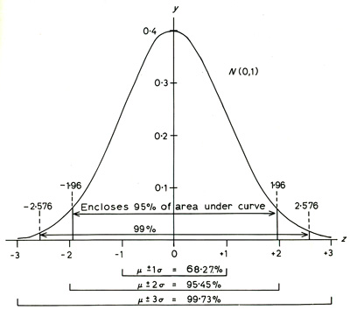
How big of a standardized residual?
Just like with z-scores, we know that about 95% of z-scores fall between -1.96 and 1.96 standard units. About 99% are between -2.58 and 2.58, and about 99.9% are between -3.29 and 3.29.
Thus, Standardized Residuals can give us a rough estimate of what scores are outliers
> 3 are very large and unlikely due to chance.
If 1% or more cases have residuals greater than about 2.5, then we have too much error in our model.
If more than 5% of cases have residuals greater than 2, then our model has too much error and is a poor representation of our data.

Slide 18
The Precise Approach: Studentized Residuals
New standard error
Studentized Residual
The Studentized residual looks almost like the Standardized residual. The only difference is that before we compute the standard error, we remove the given datapoint. (this is called jackknifing)
This makes the numerator and denominator independent
The important thing though, is that the studentized residual now follows a Student’s t-distribution.
So we can apply precise tests to identify significant outliers.

Slide 19
Different Approaches to Building Multiple Regression Models
Forward Method
Backward Method
Composite Stepwise Method
Hierarchical Regression
Forced Entry
Statistical Methods (stepwise Methods)
Non-Statistical Methods (Theoretical)

Slide 20
Theory-Driven Methods
Hierarchical Regression
Forced Entry
Non-Statistical Methods (Theoretical)

Slide 21
Hierarchical Models
Hierarchical (e.g, Nested) Models
We may want to examine more than one model by adding variables in a theoretically meaningful way and see which model is a better fit.
Model 1: (X₁ + X₂) → Y
Model 2: (X₁ + X₂)+ (X₃) → Y
Models are “nested” in the sense that simpler models are contained within models with more independent variables (Model 1 is ‘nested’ in Model 2 in our example). We can compare the different models to see if additional variables improve our goodness of fit.

Slide 22
Conducting Hierarchical Regression
Relies on the researcher knowing what the “known predictors” are from prior research, which are then entered into the model first.
We then add new predictors into separate steps (sometimes called blocks).
The important point is that the researcher is making all of the key decisions about which variables go into each regression model, and in what order.

Slide 23
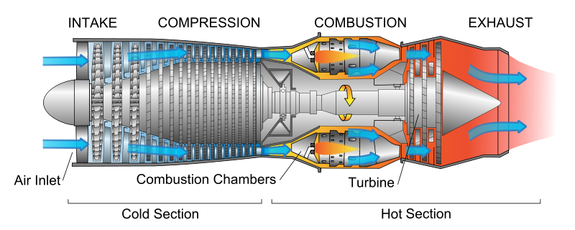
Example:
An engineer may be interested in lifespan of a jet engines. She may already know that engine type and hours of use are predictors of lifespan in years, but she also wants to add several new predictors (e.g., type of metal used in construction, type of fuel used in the engine, etc).
Each model would add an additional predictor variable, and then each models can be compared to the last model to understand the relative improvement at each step.

Slide 24
Hierarchical Regression (continued)
Hierarchical regression makes the most sense when you are testing theory (e.g., you have clear hypotheses and you know what you want to test).
Hierarchical regression allows the researcher to easily see the unique predictive influence of each new variable on the outcome of interest (since the known predictors are held constant across the models).

Slide 25
Hierarchical Regression: Example
Model 1
Model 2
Model 3
Known Predictor 1
Known Predictor 1
Known Predictor 2
Known Predictor 1
Known Predictor 2
Explanatory Variable 1
Known Predictor 2
Explanatory Variable 1
Explanatory Variable 2

Slide 26
Forced Entry Regression
All independent variables are entered into one model at the same time.
Thus, no decisions are made about the order of variable entry, since– again-- only one model is used.
Like hierarchical regression, this method is used to test theory. You must have a solid theoretical rationale for including every variable.

Slide 27
Example:
We know from prior work that education, age and occupational prestige are strong predictors of income. So we would run a single regression with all three predictors (rather than stepping through multiple models with different combinations or orders of variables).

Slide 28
Forced Regression
No matter how many variables we have, we only use one model with all variables at once.
One Model:
Known Predictor 1
Known Predictor 2
Explanatory Variable 1
Explanatory Variable 2

Slide 29
Statistical Methods for Multiple Regression
Forward Method
Add independent variables to the equation one variable or step at a time.
Backward Method
Remove non-significant predictors one at a time.
Composite Stepwise Method
Uses both forward and backward methods.
Statistical Methods (stepwise Methods)

Slide 30
Forward Method
constant only; no predictors
Only One Final Model Produced:
Best Predictor Added (by correlation)
Additional Predictors Added Until Model No Longer Improves
Predictor 1
Predictor 5
Predictor 8
Predictor 10

Slide 31
Backward Method
All Predictors Added to Model
Predictors Each Removed One at a Time Until Model Fit Decreases
One Final Model Produced:
Best Predictor
Second Best Predictor
Third Best Predictor

Slide 32
Composite Stepwise Method
One Model Produced:
Constant Only; No Predictors
Best Predictor Added (by correlation)
Second Best Predictor
Third Best Predictor
Additional Predictors Added, then a Removal Test for the Least Useful Predictor; Continues Until Model No Longer Improves
Best Predictor

Slide 33
Measures of Fit: Multiple R²
Since we have several predictors, we cannot just look at a simple R², since there is one for every independent variable.
Instead, we use multiple R², which is the square of the correlation between the observed values of Y and the values of Y predicted by the multiple regression model.
The interpretation of multiple R² is the same as for simple R²: it is the amount of variation in the outcome variable that is accounted for by the model.
As before, R² = model sum squares / total sum squares

Slide 34
The Problem with R²
R2 will go up as you add more variables to the model, even if the variables do not really add very much to the overall model.
So a model with more predictor variables will appear to fit better, even though it may be less parsimonious than a simpler model with fewer, strong predictors.

Slide 35
AIC: Akaike information criterion (Parsimony-adjusted measure of fit)
AIC is a measure of fit that penalizes the model as the number of variables increases.
AIC is useful only for models with the same data and same dependent variable. Basically, larger AIC values means a worse fit.
Thus, you can use AIC to look at several models of the same data and same dependent variable to find the most parsimonious model with good fit.
AIC does not tell you about the quality of the model. It is only a way to assess relative fit between models.

Slide 36
Comparing Models
We can directly compare model improvement with a statistical test if we use hierarchical regression (where model 2 contains all of the variables from model 1, and model 3 contains all of the variables from model 2, etc).
Model 1
Model 2
Model 3
Known Predictor 1
Known Predictor 1
Known Predictor 2
Known Predictor 1
Known Predictor 2
Explanatory Variable 1
Known Predictor 2
Explanatory Variable 1
Explanatory Variable 2

Slide 37
Comparing Models
We can use ANOVA and the F-test to compare model improvement between each new model.
Interpretation of the results is straightforward: If we conduct an ANOVA tests between model 1 and model 2, then a statistically significant F indicates that model 2 improved the fit from model 1.

Slide 38
Comparing Models
The F-test between models allows us to test whether the improvement is statistically significant or not.
Note that we can also look at the difference between R² in Model 1 and Model 2. Looking at the different R² values allows us to examine the change in the amount of variance explained by the model.

Slide 39
Multicollinearity
Multicollinearity occurs when an IV is very highly correlated with one or more other IV’s
To find the coefficient for a variable, we need to vary it while holding the other variables constant. But we can’t do this unless the variable has some unique variation in the dataset.
If we have perfect collinearity (two predictors have perfect correlation), then the coefficients for each variable are essentially interchangeable. So, we cannot get unique estimates for our regression coefficients.
If we have high collinearity, our errors will be huge

Slide 40
Causes of Multicollinearity?
Caused by various things:
Computing different predictor variables from the same set of original variables, and then using the predictor variables in the same model.
Using multiple operationalizations of same concept in more than one predictor variable (e.g. two different questions in a survey, but they ask about exact same concept)
Constraints in the population. Suppose you use annual income and price of home to predict life happiness. The problem is that those with more income, by definition, can afford more expensive homes. This problem can exist regardless of how good your sampling procedure is because it is a real constraint in the population.

Slide 41
Consequences of Multicollinearity
For OLS regression, it does not violate any core assumptions, but…
Standard errors will be much, much larger than normal. (Confidence intervals become wider, t-statistics become smaller). So, our coefficients are untrustworthy.
We cannot assess the importance of our predictors because they both account for similar variance in the outcome.

Slide 42
Issue with Multiple Independent Variables: Multicollinearity
You can start with a simple correlation matrix before you run a regression– looking at all correlations between predictor variables (where big correlations > .7 or so are potentially problematic).
We can use VIF (variance inflation factors) scores to detect multicollinearity, including more subtle forms of multicollinearity that exist with more predictor variables.
Generally, VIF > 10 means there is likely a real problem. (Though, a VIV > 5 is high enough that you should pay attention and look for issues).

Slide 43
Finding and Solving Multicollinearity Problems
VIF tells you that you have a problem, but it doesn’t tell you where the problem exits. typically, regressing each IV on the other IV’s is a way to find the problem variable(s).
Once we find IV’s that are collinear, we should eliminate one of them from the analysis.

