Slide 1
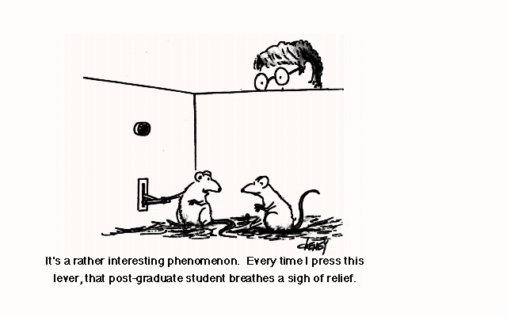
Quantitative Research Methods for Information Systems and Management (Info 271B)
Course Introduction: Preface to Social Research and Quantitative Methods

Slide 2
Administrative Stuff:
Paul Laskowski
paul at ischool dot berkeley dot edu
Office 211
Office Hours: Tuesday 2:30-3:30pm
TA: Anna Swigart
annagswigart at gmail dot com
Office Hours: TBA
Course Website:
http://courses.ischool.berkeley.edu/i271b/f13/

Slide 3
Course Design
Part lecture, part skills development
Usually one major topic per week
Some time devoted to working in groups on research design and data analysis (labs)
Three major course sections
Basics of research and statistics (weeks 1-5)
Simple data manipulation in R (weeks 7-12)
Regression and advanced topics (weeks 13-15)

Slide 4
Course Textbook
George Marcoulides and Tenko Raykov. Basic Statistics: An Introduction with R. Rowman and Littlefield, 2012.
Other readings distributed as pdfs.

Slide 5
Statistical Software
All course examples and exercises will use the R Language
R is open source, and can be downloaded from www.r-project.org
We will also use the R Commander graphical user interface in early weeks.
On most systems, this can be installed by entering the following command into R:
install.packages(“Rcmdr”, dependencies = TRUE)
You will need R and R Commander installed on your machine by week 5
Notes:
Has anyone used a statistical package? R, SPSS, Minitab, STATA, SAS..?

Slide 6
Software and Computers
Bring your laptop to class.
We will devote class time in many sessions (starting in week 6) to work with R.
If you choose not to bring a laptop to class, I encourage you to sit with anyone who has a statistical software package when we begin to use it in class.

Slide 7
Course Assignments and Grading
Several “lab assignments” (30%)
Most are group assignments, but some require individual deliverables from your group work.
Final Exam (60%)
Will cover major topics in class
Challenging, but will be a take-home exam allowing plenty of time to complete.
Participation and Instructor Discretion (10%)

Slide 8
Overall Course Goals: Or, what you can expect to get out of this course
You will understand the properties of a good quantitative research design.
You will be able to prepare, recode and error-check numeric data.
You will be able to use a general purpose statistical package to conduct and interpret statistical analyses, and to visualize data.
You will understand and know when to use a variety of statistical tests, covering basic univariate statistics, bivariate statistics and linear regression.

Slide 9
Measurement, Inference and Foundations of Research

Slide 10
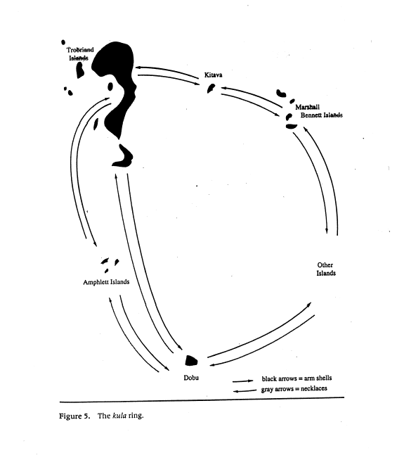
Different Strategies of Inquiry
Qualitative
Emergent methods
Open-ended questions
Interviews, Case Studies, Ethnographies
Quantitative
Instrument-based questions
Statistical analysis
Surveys, Experiments
Notes:
For a given problem or issue, there are different strategies of inquiry that we can take.
… as Creswell argues, the strategy is tied up in the nature of the problem!

Slide 11
Why quantitative research?
Standardized methodologies
Statistical techniques are public
Like any science, the methods of research can (and should be) disclosed so that anyone can duplicate your findings
Forces the investigator to think about the measurement of key factors (i.e., variables) and whether they actually measure intended concepts.
Tools that lets us draw conclusions from samples, small numbers of variables
Comparable results
Isolate effects of one or two variables, argue cause and effect
Nice looking graphs
Era of big data
Confirm or deny theoretical assertions / anectodes
Gives us structure to help us avoid our bias

Slide 12
Problems and Justifications: Induction and Deduction

Slide 13
Inductive Logic of Research in Qualitative Studies
Generalizations are made, or Theories to Past Experience
And Literature
Researcher Looks for Broad Patterns, Generalizations, or
Theories from Themes or Categories
Researcher Analyzes Data to Form Themes
Or Categories
Researcher Asks Open-Ended Questions of Participants
Or Records Field Notes
Researcher Gathers Information

Slide 14
The Deductive Approach in Typical Quantitative Research
Researcher Tests or Verifies a Theory
Researcher Tests Hypotheses or Research Questions
From the Theory
Researcher Defines and Operationalizes
Variables Derived from the Theory
Researcher Measures or Observes Variables Using an
Instrument to Obtain Scores

Slide 15
Elements of Inquiry
Knowledge Claims
Strategies of Inquiry
Methods
Approaches to Research
Design Process
Questions
Data collection
Data analysis
Qualitative
Quantitative
Mixed Methods
Adapted from (Creswell 2003)

Slide 16
How Research is Supposed to Work
Problem
Method
Data Collection
Support or Reject
Hypotheses
Notes:
If we strip it all down, this is one of the ways we are taught (and teach others) to do user research in the traditional, positivist framework.
The reality should not prevent us from having a logic to our work, especially when we formulate our HYPOTHESES.

Slide 17
How Research Really Works…
Problem
Method
Data Collection
Support or Reject
Hypotheses
Notes:
If we strip it all down, this is one of the ways we are taught (and teach others) to do user research in the traditional, positivist framework.
The reality should not prevent us from having a logic to our work, especially when we formulate our HYPOTHESES.

Slide 18
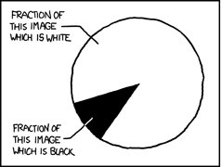
Foundations of Quantitative Research: Variables and Measurement
Source: XKCD

Slide 19
Constructs and Variables
Variables
Something we can directly measure
Concrete measured expressions to which we can assign numeric values
Constructs
Concepts, often complex
Not directly measurable
Also called ‘theoretical variables’
Notes:
Example of a construct? What about 2 different variables for measuring that construct?

Slide 20
Linking Constructs and Variables
Success
Life Happiness
S1?
S2?
L1?
L2?
Notes:
So, what are variables that might be indicative of “Success” and “Life Happiness”? What would you use to prove that your variables measure the intended construct? How do you justify your definition over someone else’s?

Slide 21
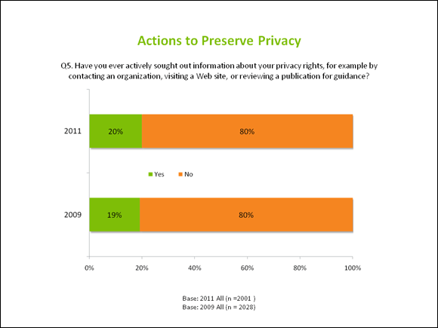
Conceptual and Operational Definitions
Conceptual Definitions
Abstractions that facilitate understanding
Operational Definitions
How to measure a conceptual variable
Notes:
Other examples… ?

Slide 22
Multidimensionality and Measurement
Multidimensionality:
No single variable does a very good job of measuring the intended concept.
?
?
Info Privacy
?
?

Slide 23
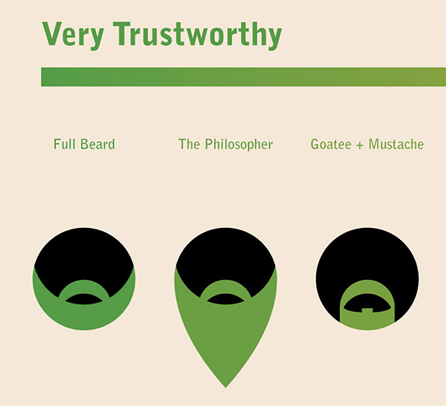
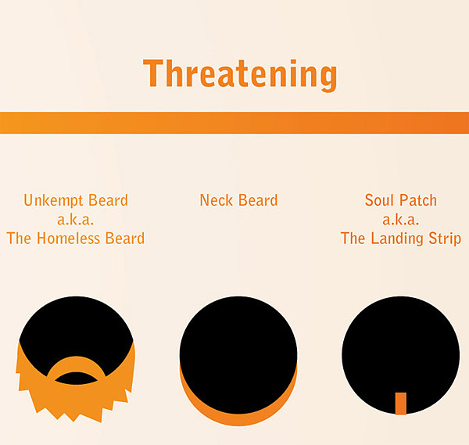
Operationalization
“If the content of an operational definition is bad, then so are all conclusions you draw from using it to measure something.”
Concept: “Trustworthiness”
Notes:
While a humorous example, this is not so different from how real operationalizations take place… often some measure is a proxy for the intended concept.

Slide 24
Administrative Stuff:
Paul Laskowski
paul at ischool dot berkeley dot edu
Office 211
Office Hours: Tuesday 2:30-3:30pm
TA: Anna Swigart
agswigart at ischool dot berkeley dot edu
Office Hours: Tuesday 5-6, Friday 10-11
Course Website:
http://courses.ischool.berkeley.edu/i271b/f13/

Slide 25
Actual Beard Study
Men’s Facial Hair as a Mate Signal: An Evolutionary Perspective
Abstract: Through the lens of evolutionary based theories, this study examined differences and associations among men's facial hair styles (i.e., clean-shaven men and men with mustaches, soul patches, goatees, and beards), what they communicate (e.g., assessments of social status, attractiveness, and trustworthiness), and judgments about the possibility of forming relationships with men (e.g., befriending, dating, engaging in casual sex, and marrying). Photographs of men at a college campus were collected and their perspective on opportunities to form relationships with women were assessed. Then, different sets of women rated the pictures and made judgments about the likelihood of forming a relationship with the men. The findings revealed that men with facial hair were seen as less trustworthy and less task attractive than clean-shaven men…
Thanks Xavier!

Slide 26
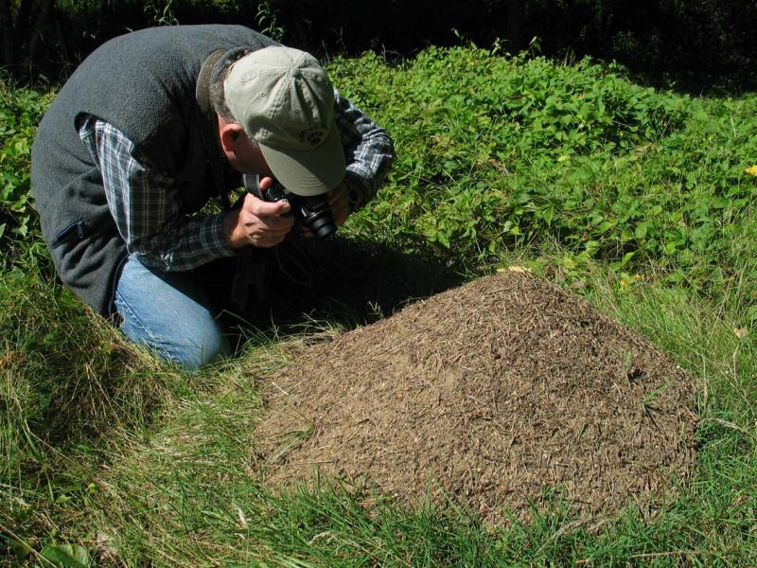
Operationalization
For any operational definition, there are a few important things to keep in mind:
What is the unit of analysis?
Be able to justify your operational definition (i.e., don’t make arbitrary decisions)
An entire study and the conclusions you draw can be undone (invalidated) by an insufficient operationalization.
Notes:
Are we going to measure social status of a neighborhood, of individuals, etc?
Same point as before– but it cannot be said enough. Your justification for an operationalization is one of the most important things in a study.
Note Bernard’s example (p. 39-40) of parental aspirations and children's career aspirations (the measure didn’t take into account that parents didn’t want to give kids a false sense of hope).
Reframed question would ask, “suppose nothing stood in the way of you child becoming anything they wanted to be..what would you like them to be doing 10 years from now”.

Slide 27
Measurement: Variables
Independent Variable (X)
Also called predictor variables, or right-hand side variables (RHS)
Those that the researcher manipulates
Attributes or potential causes under investigation in a given study
Dependent Variable (Y)
Also called outcome variable, or left-hand side variables (LHS)
Y
X
y = mx + b
Notes:
Why are LHS and RHS seemingly reversed? Its because of the order/notation in a standard equation such as a linear relationship.

Slide 28
Types of Variables
Categorical
(Factor)
Quantitative (Metric)
Nominal
Ordinal (Rank)
Interval
(arbitrary zero)
Ratio
Binary
Binary
Polytomous
Polytomous

Slide 29
Nominal Variables
Binary/dichotomous
Example: Gender, event occurred or did not occur, etc.
When coded as 0/1, also called ‘dummy variables’
Polytomous
Examples: State of Residence, hair color, one’s name, employment status.
Consider Employment Status:
1= Employed
2= Unemployed
3= Retired
Why would we ‘dummy code’ a binary variable? Consider taking the average of gender if it is coded 1= male, 2= female…
On the other hand, if we recode gender into a new variable called ‘female’ where 1= female, 0=male…the average is now an interpretable proportion.
Three New Dummy Variables:
Employed (0,1)
Unemployed (0,1)
Retired (0,1)
Notes:
Why would we want to make a binary variable into a “dummy code” of zero and one?
Value indicates proportion of true state, e.g. .6 Female.
(Also, can multiple dummy variables to get proportion of intersection)
How could we make our non-ordered variable into dummy variables? Why might we do this?

Slide 30
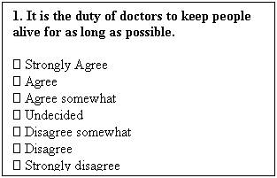
Ordinal Variables
Ordered polytomous
Example: Likert scales
Any ordered, categorical variable where the distance between categories may not be equal and meaningful
Other examples include ordered categories of degree (high, medium, low)
Notes:
These are very popular types of questions– what are the strengths and weaknesses here?
-Malleable to very different concepts
-Simple answers for respondents
But…
-Limited range
-Assumes a distribution where midpoint is ‘undecided’ or ‘neither agree or disagree’.
-You might actually want a single direction

Slide 31
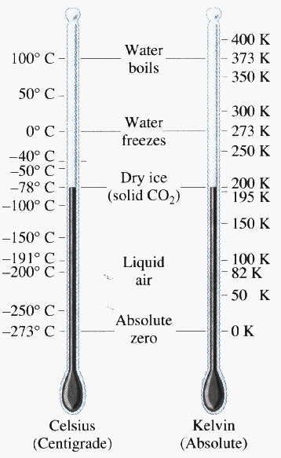
Metric Variables
Interval Variables
Distance between attributes has meaning
Example: Celsius temperature
Ratio Variables
Distance between attributes has meaning, and there can be a meaningful bottom point = zero.
Example: Kelvin temperature, Count variables

Slide 32
Variable Types Matter
Time spent
exercising between
time 1 and time 2
Difference in
weight scores between
time1and time 2
(Correlation)
Gender
(Male =1,
Female =2)
Scale 1-5 of attitude
about President
(t-test)
Ethnic Identity
(10 Racial Types)
Career Types
(categories)
(Chi-Square test)
Notes:
So, The variables matter– Even for the type of test. Correlation, T-test, and Chi-Square in this case.

Slide 33
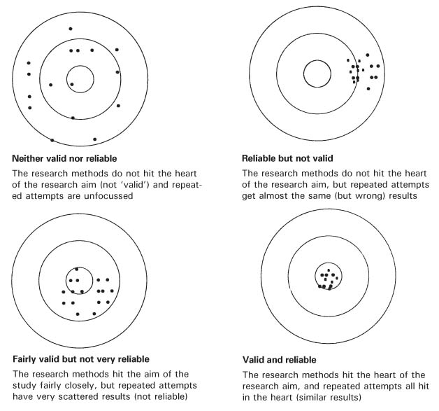
Validity and Reliability
Validity:
Accuracy and trustworthiness of instruments, data and findings.
Reliability:
Do you get the same answer using the same instrument to measure the same thing more than once.
Notes:
Think of the analogy as a bullseye– where the center is the “target concept” and the dots are attempts to measure the target concept.
Validity: accuracy and trustworthiness of your instrument, data and findings
Reliability: Does it work if you do it more than once?

Slide 34
Testing for Reliability
Reliability: How consistent is the instrument when you use it more than once?
Interobserver reliability
Many different researchers try to get consistent results
Test-retest reliability
Same results on same person over time
Notes:
Interobserver: many different researchers try to get consistent results
Test-retest: same results on same person over time

Slide 35
Determining Validity
Validity: Accuracy of our instrument at measuring the intended concept
Face Validity: ‘face value’ of researcher interpretation
Construct Validity: the closeness of the fit between the observations made and the construct. Does it behave like the construct should?
Content Validity: appropriate type and amount of content to get at intended concept (lots of vars to get at one concept)
Criterion Validity: the closeness of fit between measures of an instrument and some other, well-established instrument of known validity (e.g., diff measures of height). “gold standard” test.
Notes:
Face validity – e.g. a survey that directly asks people whether they are trustworthy
Content validity – is the beard enough to understand trustworthiness
Construct – actually getting at the concept.

Slide 36
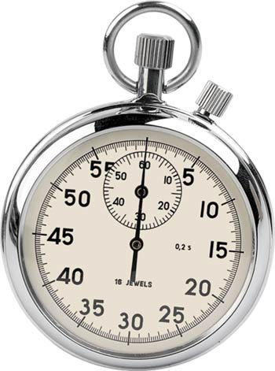
Precision
The precision of an instrument is the magnitude of the smallest unit of measure (e.g., how many decimals in the measurement).
For example: Consider the tradeoff between using an attitudinal scale of “attractiveness” on a 4 point scale (very attractive to not very attractive) versus 1-1000 scale of attractiveness.
Notes:
Big problem in social science– many over-estimate the importance of ‘precision’ in their measures. What is the potential problem here?
What do you gain from an attitudinal scale of “attractiveness” on a 4 point scale (very attractive to not very attractive) versus 1-1000 scale of attractiveness?

Slide 37
Research Design
Correlational
Experimental
Variation comes from nature
Researcher draws conclusions from hands-off observation
Researcher manipulates variables directly
In a pure experiment, conditions are randomly assigned

Slide 38
Correlational Research
Observation of natural events by taking “snapshot” of many variables at points in time.
Cross-sectional surveys of individuals (again, snapshot at one point in time).
Longitudinal observations over time
Panel data of multiple subjects at multiple times
Establishing causality is difficult

Slide 39
Experimental Research
Allows us to directly investigate causal claims: does variable X actually cause a change in variable Y?
Experiments involve treatments or conditions, allowing us to examine one or more key factors
Includes both between-subjects and within-subjects designs

Slide 40
Statistical Tests, Causality, and Types of Research
Causality depends on several things, including time order, absence of confounding variables, among others.
A statistical test does not, by itself, imply a causal relationship.
E.g., we can conduct a t-test in a correlational study or in an experiment. The design of the study and how the data are collected are essential for testing causality– not the statistical test.

