Slide 1
Probability Rules

Slide 2
Back to Basics: Probability Concepts and Rules
Basic Concepts in Probability
Basic Probability Rules
Connecting Probability to Sampling

Slide 3
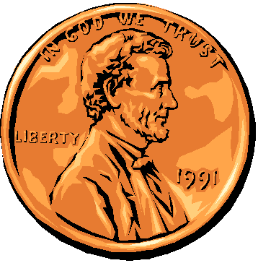
Basic Concepts in Elementary Probability
Sample Space
The complete set of possible outcomes
E.g., one roll of a die: {1,2,3,4,5,6}
Probability
A proportion assigned to each possible outcome, corresponding to its frequency of occurrence.
E.g., 1/6 for each possible die roll.
Event
A Subset of the Sample Space
If it includes just one outcome, it is an elementary event
E.g., an even roll, roll at least 4, etc.
Independence
The probability of an event does not depend on the occurrence of another event
E.g., Rolling an even number and rolling at least 5 (but not 4)
Notes:
Independence: think of your responses to the question “how many animals do you own”. We assume that each response is independent b/c one persons response has no influence on another. Lots of situations do not work that way… such as??

Slide 4
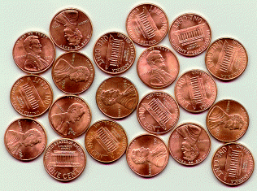
Mutually exclusive, exhaustive events
Mutually exclusive events
Two or more events that cannot occur at the same time because one prevents the other from occurring or being true.
Exhaustive events
A set of events that accounts for all of the elementary events in the sample space.
What happens to probability when your sample space is not exhaustive?
Why might this happen?
Note: the elementary events are mutually exclusive and exhaustive.
Notes:
This should be familiar– same concepts we talked about with categorical variables. Same logic applies– in order to talk about proportions, percentages or probabilities, they have to be mutually exclusive and exhaustive.
*Note, how is Mutually Exclusive different than *independent* events?
-mutual exclusive if occurrence *prevents another from happening*. If your primary residence is in CA, it cannot also be in Florida.
-independent if occurrence does not change the chances of the other. Living in CA does not affect liklihood that you are male.

Slide 5
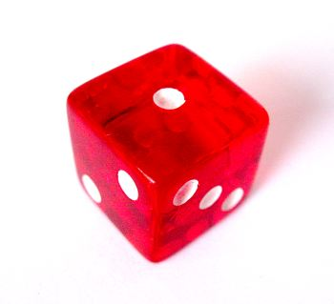
Basic Rules of Probability
The addition rule for mutually-exclusive events
Example: Rolling die and getting a 1 or a 6?
When two or more events can happen at the same time, and the events are mutually exclusive, then: P(X or Y) = P(X) + P(Y)

Slide 6
Addition Rule and Non-Mutually Exclusive Events
When two or more events can happen at the same time, and the events are not mutually exclusive, then: P(X or Y) = P(X) + P(Y) - P(X and Y)
For example, what is the probability that a card chosen at random from a deck of cards will either be a king or a heart?
P(King or Heart) = P(X or Y) = 4/52 + 13/52 - 1/52 = 30.77%
S
Y
X
Notes:
Remember: multiplication rule is for “X and Y” while addition rule is for “X or Y”

Slide 7
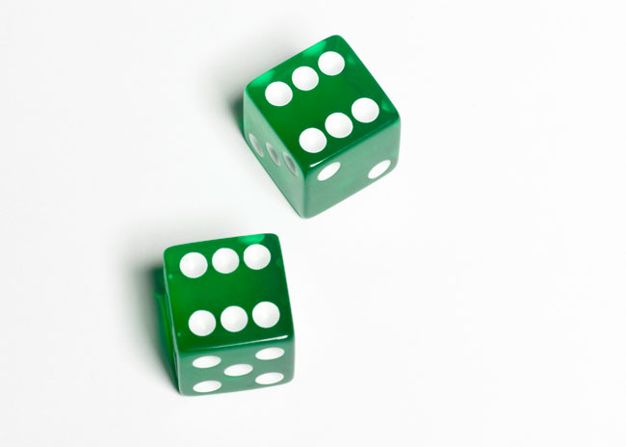
Basic rules of probability
Multiplication Rule
Example: Probability of rolling a die twice and getting 6 on both rolls?
But what happens if the events are not independent?
Example: probability of selecting a club from a deck of cards, then selecting another club (without replacement)?
Notes:
Dice rolls are Independent: Dice are easy example: rolling 2 dice and getting a pair of 6’s? (1/36)

Slide 8
Multiplication Rule
When two or more events will happen at the same time, and the events are independent, then the special rule of multiplication law is used to find the joint probability: P(X and Y) = P(X) x P(Y)
When two or more events will happen at the same time, and the events are dependent, then the general rule of multiplication law is used to find the joint probability: P(X and Y) = P(X) x P(Y|X)
S
Y
X
Notes:
Dependent: Cards are favorite example: Probability of drawing 2 aces? 4/52 * 3/51 = 1/221

Slide 9
Bayes’ Law
Compute the probability of X and Y two ways:
P(Y) x P(X|Y) = P(X and Y) = P(X) x P(Y|X)
Divide to get:
P(X|Y) = P(X) x P(Y|X) / P(Y)
Could also rewrite this by expanding P(Y) as
P(Y) = P(Y and X) + P(Y and X^{C})
= P(X)P(Y|X) + P(X^{C})P(Y|X^{C})
Then
P(X|Y) = P(X) x P(Y|X) / [ P(X)P(Y|X) + P(X^{C})P(Y|X^{C}) ]
S
Y
X
Notes:
Dependent: Cards are favorite example: Probability of drawing 2 aces? 4/52 * 3/51 = 1/221

Slide 10
Exercise
Assume that a rare disease A affects 2 out of 10,000 people. P(A) = 0.0002.
The best test gives the wrong result 1% of the time for healthy people, but is always right for affected people.
Suppose a random person receives a positive result from the test – Call this event B. What is the probability he suffers from the disease?

Slide 11
Exercise
P(B|A)=1 Positive test for ill person
P(A|A^{C})=0.01 Positive test for healthy person
Want P(A|B). By Bayes’ Theorem,

Slide 12
Pitfalls of Probability Rules: The Collins Case
A famous trial in 1968 in Los Angeles, California, that used probability to help determine guilt or innocence.
A black man and a white woman were charged with robbery. Bystanders said that perpetrators were a black male with a beard and mustache, and a Caucasian female with blonde hair in a ponytail. They were driving yellow car.
Probabilities of various characteristics were multiplied (being in a yellow car, 1/10; man with mustache ¼; Interracial couple in car 1/1000…and so on)
The basis for multiplying is *independence*…but, there was no evidence of this (to the contrary, actually)
But, also a second fallacy: conflating probability of a *match* with probability of *being guilty or innocent*.
“Assuming the prosecution's 1 in 12 million result, what is the probability that somewhere in the Los Angeles area there are at least two couples that have the six characteristics as the witnesses described for the robbers? The justices calculated that probability to be over 40 percent. Hence, it was not at all reasonable to conclude that the defendants must be guilty simply because they have the six characteristics in the witnesses' descriptions.”
Notes:
The basis for multiplying is *independence*…but, there was no evidence of this (to the contrary, actually)
But, also a second fallacy: conflating probability of a *match* with probability of *being guilty or innocent*.
A rough calculation (even given the 1 in 12 mil result)
Let G be event of guilt, C be the event of all those characteristics.
P(G|C) = P(C|G) P(G) / P(C) = P(G) /P(C) = guilty people in LA / number of people with characteristics in LA (given there’s at least 1) = 1 / 1.32 = .76…

Slide 13
Bayes vs Frequentist Stats
We have a Null hypothesis, H₀, and our data provides evidence, E.
We are interested in P(H₀|E)
We can actually compute P(E|H₀)
If we assume priors, P(E) and P(H₀), we can also compute P(H₀|E)
This is the idea behind a field known as Bayesian Statistics

Slide 14
