Slide 1
Database Applications and
Web-Enabled Databases
University of California, Berkeley
School of Information
IS 257: Database Management

Slide 2
Lecture Outline
Review
  Database design review
  Introduction to SQL and MySQL
Application Development in Access
Databases for Web Applications – Overview

Slide 3
Lecture Outline
Review
  Database design review
  Introduction to SQL & MySQL
Databases for Web Applications – Overview

Slide 4
Database Design Process
Application 1
Application 2
Application 3
Application 4
External
Model
External
Model
External
Model
External
Model
Application 1
Conceptual
requirements
Application 2
Conceptual
requirements
Conceptual
Model
Logical
Model
Internal Model
Application 3
Conceptual
requirements
Application 4
Conceptual
requirements

Slide 5
Cookie ER Diagram
pubid
accno
BIBFILE
CALLFILE
LIBFILE
accno
accno
libid
AU_BIB
AU ID
libid
PUBFILE
pubid
INDXFILE
SUBFILE
Note: diagram
contains only
attributes used
for linking
AUTHORS
accno
subcode
subcode
AU_ID
Author

Slide 6
Logical Model: Mapping to Relations
Take each entity
  Authors
  BIBFILE
  LIBFILE
  CALLFILE
  SUBFILE
  PUBFILE
  INDXFILE
  AU_BIB
And make it a table...

Slide 7
Physical Model: SQL for Creation
We looked at how an SQL “script” could be created that would create each of the relational tables, define primary keys and indexes and load data into the database

Slide 8
MySQL Data Types
MySQL supports all of the standard SQL numeric data types. These types include the exact numeric data types (INTEGER, SMALLINT, DECIMAL, and NUMERIC), as well as the approximate numeric data types (FLOAT, REAL, and DOUBLE PRECISION). The keyword INT is a synonym for INTEGER, and the keyword DEC is a synonym for DECIMAL
Numeric (can also be declared as UNSIGNED)
  BIT(n) (variable field of n bits)
  BOOL or BOOLEAN (internally is TINYINT with value of 0 for FALSE)
  TINYINT (1 byte)
  SMALLINT (2 bytes)
  MEDIUMINT (3 bytes)
  INTEGER (4 bytes)
  INT (4 bytes - Synonym)
  BIGINT (8 bytes)
  NUMERIC or DECIMAL (Packed - up to 65 digits - DEC, FIXED synonyms)
  FLOAT
  DOUBLE (or DOUBLE PRECISION)
  SERIAL = BIGINT UNSIGNED NOT NULL AUTO_INCREMENT UNIQUE

Slide 9
MySQL Data Types
The date and time types for representing temporal values are DATETIME, DATE, TIMESTAMP, TIME, and YEAR. Each temporal type has a range of legal values, as well as a “zero” value that is used when you specify an illegal value that MySQL cannot represent
  DATETIME '0000-00-00 00:00:00'
  DATE '0000-00-00'
  TIMESTAMP (4.1 and up) '0000-00-00 00:00:00'
  TIMESTAMP (before 4.1) 00000000000000
  TIME '00:00:00'
  YEAR 0000

Slide 10
MySQL Data Types
The string types are CHAR, VARCHAR, BINARY, VARBINARY, BLOB, TEXT, ENUM, and SET
Maximum length for CHAR is 255 and VARCHAR is 65,535 (limited by row size)
For longer things there is BLOB and TEXT

Slide 11
MySQL Data Types
A BLOB is a binary large object that can hold a variable amount of data.
The four BLOB types are TINYBLOB, BLOB, MEDIUMBLOB, and LONGBLOB. These differ only in the maximum length of the values they can hold
The four TEXT types are TINYTEXT, TEXT, MEDIUMTEXT, and LONGTEXT. These correspond to the four BLOB types and have the same maximum lengths and storage requirements
TINY=1byte, BLOB and TEXT=2bytes, MEDIUM=3bytes, LONG=4bytes

Slide 12
MySQL Data Types
BINARY and VARBINARY are like CHAR and VARCHAR but are intended for binary data of 255 bytes or less
ENUM is a list of values that are stored as their addresses in the list
  For example, a column specified as ENUM('one', 'two', 'three') can have any of the values shown here. The index of each value is also shown:
    Value = Index
    NULL = NULL
    ‘’ = 0
    'one’ = 1
    ‘two’ = 2
    ‘three’ = 3
  An enumeration can have a maximum of 65,535 elements.

Slide 13
MySQL Data Types
The final string type (for this version) is a SET
A SET is a string object that can have zero or more values, each of which must be chosen from a list of allowed values specified when the table is created.
SET column values that consist of multiple set members are specified with members separated by commas (‘,’)
For example, a column specified as SET('one', 'two') NOT NULL can have any of these values:
  ''
  'one'
  'two'
  'one,two‘
A set can have up to 64 member values and is stored as an 8byte number

Slide 14
ALTER Table
ALTER TABLE table-name ADD COLUMN col_name col_definition;
… DROP COLUMN col_name;
… CHANGE col_name new_col_definition;
Adds/removes a new column from an existing database table
Many other options for adding constraints (like NOT NULL, or PRIMARY KEY), etc.

Slide 15
INSERT
INSERT INTO table-name (attr1, attr4, attr5,…, attrK) VALUES (“val1”, val4, val5,…, “valK”);
Adds a new row(s) to a table.
INSERT INTO table-name (attr1, attr4, attr5,…, attrK) VALUES SELECT ...

Slide 16
Creating a new table data from existing tables
Syntax:
  INSERT INTO tablename (attr1, attr2, attr3)
  SELECT [DISTINCT] xattr1, xattr2, xattr3 FROM rel1 r1, rel2 r2,… rel3 r3 WHERE condition1 {AND | OR} condition2 ORDER BY attr1 [DESC], attr3 [DESC]
  tablename has to previously exist for this to work in MySQL…

Slide 17
DELETE
DELETE FROM table-name WHERE <where clause>;
Removes rows from a table.

Slide 18
UPDATE
UPDATE tablename SET attr1=newval, attr2 = newval2 WHERE <where clause>;
changes values in existing rows in a table (those that match the WHERE clause).

Slide 19
DROP Table
DROP TABLE tablename;
Removes a table from the database.

Slide 20
Lecture Outline
Review
  Introduction to SQL
Databases for Web Applications – Overview

Slide 21
Overview
Why use a database system for Web design and e-commerce?
What systems are available?
Pros and Cons of different web database systems?
Text retrieval in database systems
Search Engines for Intranet and Intrasite searching

Slide 22
Why Use a Database System?
Simple Web sites with only a few pages don’t need much more than static HTML files

Slide 23
Simple Web Applications
Files
Web
Server
Internet
Server
Clients

Slide 24
Adding Dynamic Content to the Site
Small sites can often use HTML and JavaScript to access data files to create dynamic content for small sites.

Slide 25
Issues For Scaling Up Web Applications
Performance
Scalability
Maintenance
Data Integrity
Transaction support

Slide 26
Performance Issues
Problems arise as both the data to be managed and usage of the site grows.
  Interpreted scripts are inherently slower than compiled native programs
  Startup time for each connection slows down the application
  Load on the system compounds the problem
  Tied to other scalability issues

Slide 27
Scalability Issues
Well-designed database systems will permit the applications to scale to accommodate very large databases
  A script that works fine scanning a small data file may become unusable when the file becomes large.
  Issues of transaction workload on the site
    Starting a separate copy of a python program for each user is NOT a scalable solution as the workload grows

Slide 28
Maintenance Issues
Dealing with multiple data files (customer list, product list, customer orders, etc.) using Python means:
  If any data element in one of the files changes, all scripts that access that file must be rewritten
  If files are linked, the programs must insure that data in all the files remains synchronized
  A large part of maintenance will involve dealing with data integrity issues
  Unanticipated requirements may require rewriting scripts

Slide 29
Data Integrity Constraint Issues
These are constraints we wish to impose in order to protect the database from becoming inconsistent.
Five basic types
  Required data
  attribute domain constraints
  entity integrity
  referential integrity
  enterprise constraints

Slide 30
Transaction support
Concurrency control (ensuring the validity of database updates in a shared multiuser environment).

Slide 31
No Concurrency Control: Lost updates
John
Marsha
Read account balance (balance = $1000)
Withdraw $200 (balance = $800)
Write account balance (balance = $800)
Read account balance (balance = $1000)
Withdraw $300 (balance = $700)
Write account balance (balance = $700)
ERROR!

Slide 32
Concurrency Control: Locking
Locking levels
  Database
  Table
  Block or page
  Record
  Field
Types
  Shared (S locks)
  Exclusive (X locks)

Slide 33
Concurrency Control: Updates with X locking
John
Marsha
Lock account balance
Read account balance (balance = $1000)
Withdraw $200 (balance = $800)
Write account balance (balance = $800)
Unlock account balance
Read account balance (DENIED)
Lock account balance
Read account balance (balance = $800)
etc...

Slide 34
Concurrency Control: Deadlocks
John
Marsha
Place S lock
Read account balance (balance = $1000)
Request X lock (denied)
wait ...
Place S lock
Read account balance (balance = $1000)
Request X lock (denied)
wait...
Deadlock!

Slide 35
Transaction Processing
Transactions should be ACID:
  Atomic – Results of transaction are either all committed or all rolled back
  Consistent – Data is transformed from one consistent state to another
  Isolated – The results of a transaction are invisible to other transactions
  Durable – Once committed the results of a transaction are permanent and survive system or media failures

Slide 36
Why Use a Database System?
Database systems have concentrated on providing solutions for all of these issues for scaling up Web applications
  Performance
  Scalability
  Maintenance
  Data Integrity
  Transaction support
While systems differ in their support, most offer some support for all of these.

Slide 37
Dynamic Web Applications 2
Files
Web
Server
database
DBMS
Internet
database
database
Server
Clients

Slide 38
Server Interfaces
Web Server
Database
HTML
SQL
Native
DB
Interfaces
DHTML
Web Application
Server
JavaScript
Web DB
App
CGI
Web Server
API’s
ODBC
Native DB
interfaces
JDBC
ColdFusion PhP Perl
Java ASP
Adapted from
John P Ashenfelter,
Choosing a Database for Your Web Site

Slide 39
What Database systems are available?
Choices depend on:
  Size (current and projected) of the application
  Hardware and OS Platforms to be used in the application
  Features required
    E.g.: SQL? Upgrade path? Full-text indexing? Attribute size limitations? Locking protocols? Direct Web Server access? Security?
  Staff support for DBA, etc.
  Programming support (or lack thereof)
  Cost/complexity of administration
  Budget

Slide 40
Desktop Database Systems
Individuals or very small enterprises can create DBMS-enabled Web applications relatively inexpensively
Some systems will require an application server (such as Python/Flask) to provide the access path between the Web server and the DBMS

Slide 41
Pros and Cons of Database Options
Desktop databases
  usually simple to set up and administer
  inexpensive
  often will not scale to a very large number of users or very large database size
  May lack locking management appropriate for multiuser access
  Poor handling for full-text search
  Well supported by application software (Python, PHP, etc.)

Slide 42
Enterprise Database Systems
Enterprise servers are powerful and available in many different configurations
They also tend to be VERY expensive
Pricing is usually based on users, or CPU’s

Slide 43
Pros and Cons of Database Options
Enterprise databases
  Can be very complex to set up and administer
    Oracle, for example recommends RAID-1 with 7x2 disk configuration as a bare minimum, more recommended
  Expensive
  Will scale to a very large number of users
  Will scale to very large databases
  Incorporate good transaction control and lock management
  Native handling of Text search is poor, but most DBMS have add-on text search options
  Support for applications software (Python, PHP, etc.)

Slide 44
Free Database Servers
System is free, but there is also no help line.
Include many of the features of Enterprise systems, but tend to be lighter weight
Versions may vary in support for different systems
Open Source -- So programmers can add features

Slide 45
Pros and Cons of Database Options
Free databases
  Can be complex to set up and administer
  Inexpensive (FREE!)
  usually will scale to a large number of users
  Incorporate good transaction control and lock management
  Native handling of Text search has improved, and there are IR-like capabilities in MySQL and PostgreSQL
  Support for applications software (ColdFusion, Python, etc.)

Slide 46
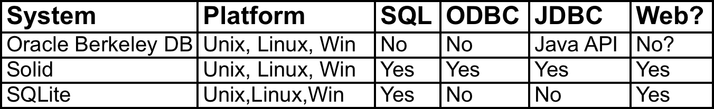
Embedded Database Servers
May require programming experience to install
Tend to be fast and economical in space requirements
Includes many NOSQL databases

Slide 47
Pros and Cons of Database Options
Embedded databases
  Must be embedded in a program
  Can be incorporated in a scripting language
  inexpensive (for non-commercial application)
  May not scale to a very large number of users (depends on how it is used)
  (May) Incorporate good transaction control and lock management
  Text search support is minimal
  May not support SQL

Slide 48
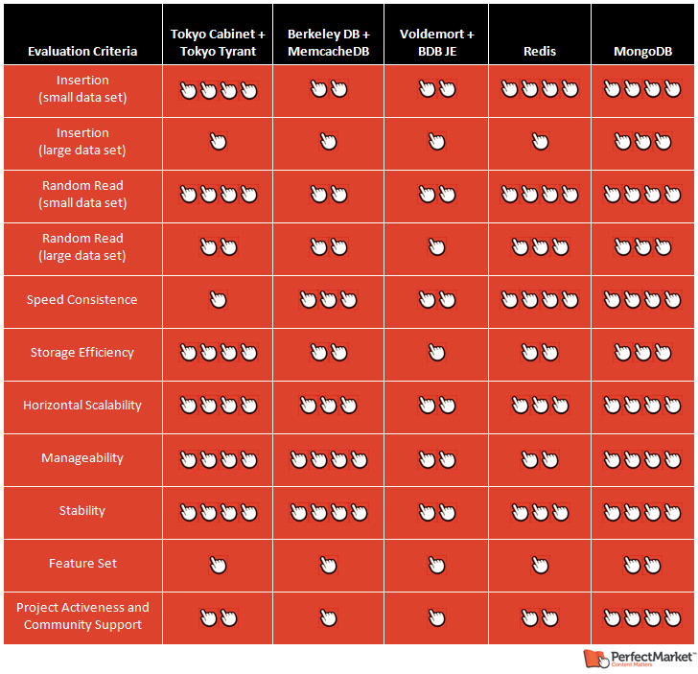
NOSQL Databases

Slide 49
Database Security
Different systems vary in security support:
  Views or restricted subschemas
  Authorization rules to identify users and the actions they can perform
  User-defined procedures (and rule systems) to define additional constraints or limitations in using the database
  Encryption to encode sensitive data
  Authentication schemes to positively identify a person attempting to gain access to the database

Slide 50
Views
A subset of the database presented to some set of users.
  SQL: CREATE VIEW viewname AS SELECT field1, field2, field3,…, FROM table1, table2 WHERE <where clause>;
  Note: “queries” in Access function as views.

Slide 51
Authorization Rules
Most current DBMS permit the DBA to define “access permissions” on a table by table basis (at least) using the GRANT and REVOKE SQL commands.
Some systems permit finer grained authorization (most use GRANT and REVOKE on variant views.
Some desktop systems have poor authorization support.

Slide 52
Database Backup and Recovery
Backup
Journaling (audit trail)
Checkpoint facility
Recovery manager

Slide 53
Web Application Server Software
Python + Flask
Java/Spring Structs
Ruby on Rails
PHP
ASP
JSP

