Slide 1
Data Security, Data Administration and Database Administration
University of California, Berkeley
School of Information
IS 257: Database Management

Slide 2
Lecture Outline
Review
  Database Administration: Security
Database Administration: Disasters, Backup and Recovery
Database Administration: Roles

Slide 3
Lecture Outline
Database Administration: Data Integrity and Security
Database Administration: Disasters, Backup and Recovery
Database Administration: Roles

Slide 4
Data Integrity
Intrarecord integrity (enforcing constraints on contents of fields, etc.)
Referential Integrity (enforcing the validity of references between records in the database)
Concurrency control (ensuring the validity of database updates in a shared multiuser environment)

Slide 5
Integrity Constraints (review)
The constraints we wish to impose in order to protect the database from becoming inconsistent.
Five types
  Required data
  attribute domain constraints
  entity integrity
  referential integrity
  enterprise constraints

Slide 6
Referential Integrity
Ensures that dependent relationships in the data are maintained. In Oracle, for example:
CREATE TABLE table-name (
attr1 attr-type PRIMARY KEY,
attr2 attr-type NOT NULL,
…, attrM attr-type REFERENCES owner.tablename(attrname) ON DELETE CASCADE, …

Slide 7
Concurrency Control
The goal is to support access by multiple users to the same data, at the same time
It must assure that the transactions are serializable and that they are isolated
It is intended to handle several problems in an uncontrolled system
Specifically:
  Lost updates
  Inconsistent data states during access
  Uncompleted (or committed) changes to data

Slide 8
Concurrency Control: Locking
Locking levels
  Database
  Table
  Block or page
  Record
  Field
Types
  Shared (S locks)
  Exclusive (X locks)

Slide 9
Transaction Control in ORACLE
Transactions are sequences of SQL statements that ORACLE treats as a unit
  From the user’s point of view a private copy of the database is created for the duration of the transaction
Transactions are started with SET TRANSACTION, followed by the SQL statements
Any changes made by the SQL are made permanent by COMMIT
Part or all of a transaction can be undone using ROLLBACK

Slide 10
Transactions in MySQL
START TRANSACTION or BEGIN starts a transaction block (disables autocommit)
COMMIT or ROLLBACK will commit the transaction block or return to state before the block was started
MySQL may use different underlying database engines – the InnoDB engine also supports SAVEPOINT and ROLLBACK TO SAVEPOINT
NOTE: This syntax can be used in any of MySQL’s database engines - but it only WORKS when using the InnoDB engine (which can be set up when the tables are created)

Slide 11
Transactions in MySQL (5.0+)
START TRANSACTION [WITH CONSISTENT SNAPSHOT] | BEGIN [WORK]
COMMIT [WORK] [AND [NO] CHAIN] [[NO] RELEASE]
ROLLBACK [WORK] [AND [NO] CHAIN] [[NO] RELEASE]
SET AUTOCOMMIT = {0 | 1}
The START TRANSACTION and BEGIN statement begin a new transaction. COMMIT commits the current transaction, making its changes permanent. ROLLBACK rolls back the current transaction, canceling its changes. The SET AUTOCOMMIT statement disables or enables the default autocommit mode for the current connection

Slide 12
Versioning
Newer optimistic approach to concurrency control
Instead of locking
Assumption is that simultaneous updates will be infrequent
Each transaction can attempt an update as it wishes
The system will reject an update when it senses a conflict
Use of rollback and commit for this

Slide 13
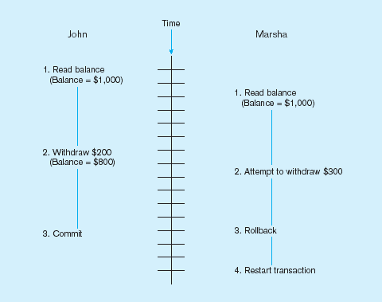
Use of Versioning…
Better performance than locking

Slide 14
Database Security
Views or restricted subschemas
Authorization rules to identify users and the actions they can perform
User-defined procedures (with rule systems or triggers) to define additional constraints or limitations in using the database
Encryption to encode sensitive data
Authentication schemes to positively identify a person attempting to gain access to the database

Slide 15
Views
A subset of the database presented to some set of users
  SQL:
  CREATE VIEW viewname AS SELECT field1, field2, field3,…, FROM table1, table2 WHERE <where clause>;
  Note: “queries” in Access function as views

Slide 16
Restricted Views
Main relation has the form:
Name | C_name | Dept | C_dept | Prof | C_prof | TC
J Smith | S | Dept1 | S | Cryptography | TS | TS
M Doe | U | Dept2 | S | IT Security | S | S
R Jones | U | Dept3 | U | Secretary | U | U
U = unclassified : S = Secret : TS = Top Secret

Slide 17
Restricted Views
S-view of the data
NAME | Dept | Prof
J Smith | Dept1 | ---
M Doe | Dept2 | IT Security
R Jones | Dept3 | Secretary
U-view of the data
NAME | Dept | Prof
M Doe | --- | ---
R Jones | Dept3 | Secretary

Slide 18
Authorization Rules
Most current DBMS permit the DBA to define “access permissions” on a table by table basis (at least) using the GRANT and REVOKE SQL commands
Some systems permit finer grained authorization (most use GRANT and REVOKE on variant views

Slide 19
MySQL Backup Types
Physical (Raw) Versus Logical Backups
  Physical (or Raw) Backups
    Physical backups consist of raw copies of the directories and files that store database contents. This type of backup is suitable for large, important databases that need to be recovered quickly when problems occur.
  Logical Backups
    Logical backups save information represented as logical database structure (CREATE DATABASE, CREATE TABLE statements) and content (INSERT statements or delimited-text files). This type of backup is suitable for smaller amounts of data where you might edit the data values or table structure, or recreate the data on a different machine architecture.
From: http://dev.mysql.com/doc/refman/5.1/en/backup-types.html

Slide 20
Logical Backups
Logical backup tools include the mysqldump program and the SELECT ... INTO OUTFILE statement. These work for any storage engine, even MEMORY.
To restore logical backups, SQL-format dump files can be processed using the mysql client. To load delimited-text files, use the LOAD DATA INFILE statement or the mysqlimport client.

Slide 21
Physical Backups
Physical backup tools include file system-level commands (such as cp, scp, tar, rsync), mysqlhotcopy for MyISAM tables, ibbackup for InnoDB tables, or START BACKUP for NDB tables.
For restore, files copied at the file system level or with mysqlhotcopy can be copied back to their original locations with file system commands; ibbackup restores InnoDB tables, and ndb_restore restores NDB tables.

Slide 22
Lecture Outline
Review
  Database Administration: Security
Database Administration: Disasters, Backup and Recovery
Database Administration: Roles and Functions

Slide 23

Disasters come in many forms…

Slide 24

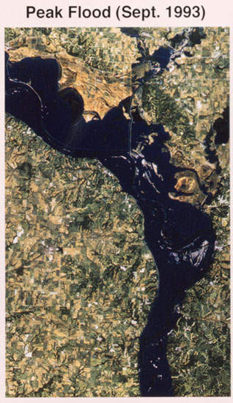


Slide 25

La Crosse, Wisc 2001

Slide 26

Katrina

Slide 27

Katrina

Slide 28

Katrina

Slide 29

Katrina

Slide 30
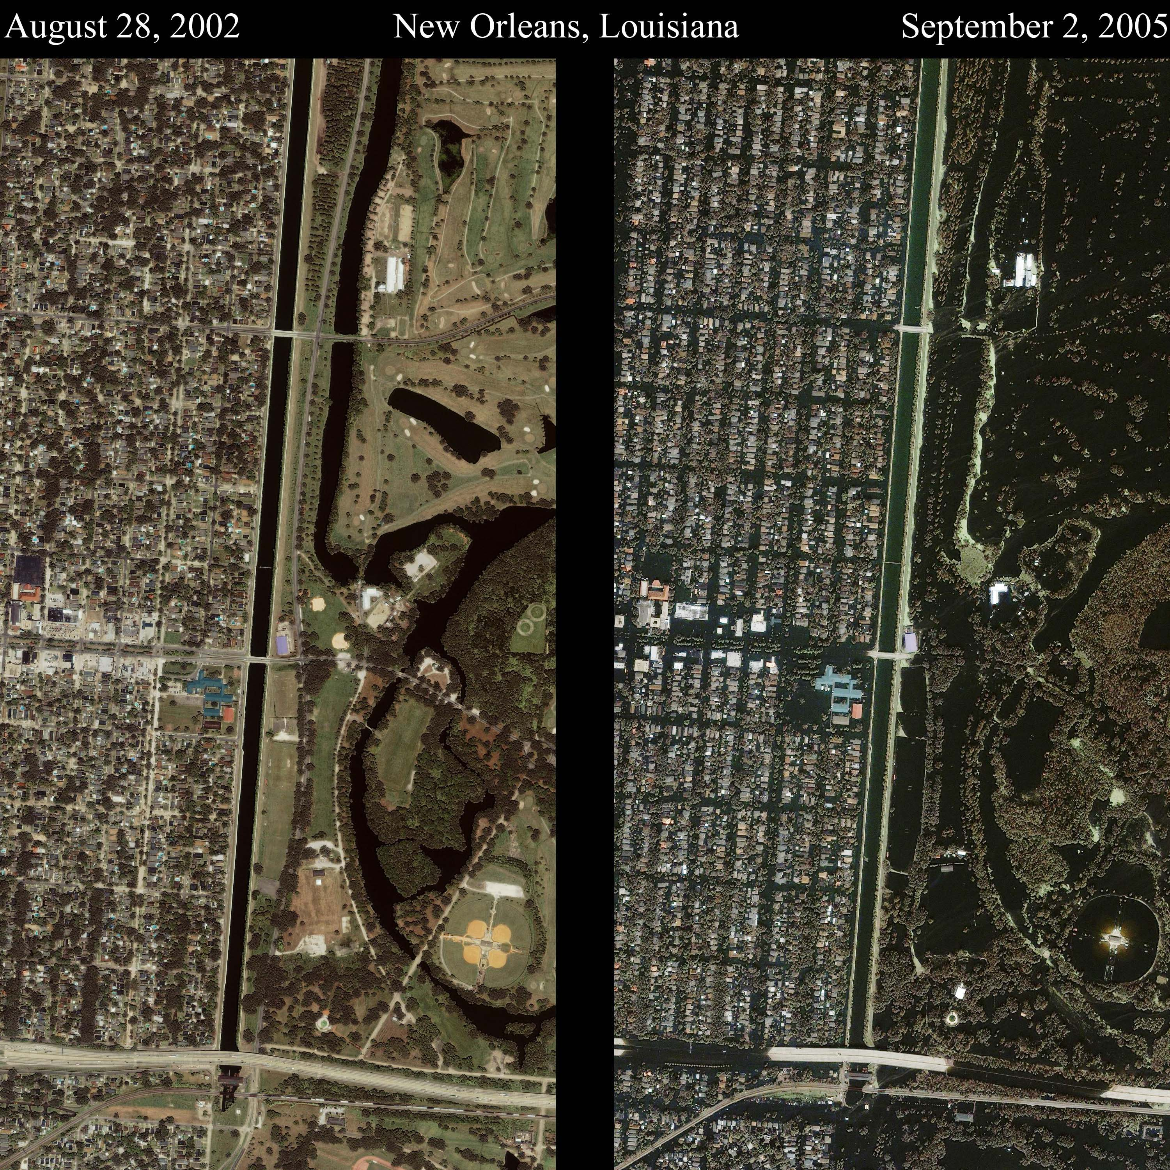
Katrina

Slide 31

Katrina

Slide 32


Hurricane Sandy in N.J. & N.Y.

Slide 33
Disaster Recovery Planning
Risk
Analysis
Plan
Maintenance
Recovery
Strategies
Testing and
Training
Budget &
Implement
Procedures
Development
From Toigo “Disaster Recovery Planning”

Slide 34
Threats to Assets and Functions
Water
Fire
Power Failure
Mechanical breakdown or software failure
Accidental or deliberate destruction of hardware or software
  By hackers, disgruntled employees, industrial saboteurs, terrorists, or others

Slide 35
Threats
Between 1967 and 1978 fire and water damage accounted for 62% of all data processing disasters in the U.S.
The water damage was sometimes caused by fighting fires
More recently improvements in fire suppression (e.g., Halon) for DP centers has meant that water is the primary danger to DP centers

Slide 36
Kinds of Records
Class I: VITAL
  Essential, irreplaceable or necessary to recovery
Class II: IMPORTANT
  Essential or important, but reproducible with difficulty or at extra expense
Class III: USEFUL
  Records whose loss would be inconvenient, but which are replaceable
Class IV: NONESSENTIAL
  Records which upon examination are found to be no longer necessary

Slide 37

Offsite Storage of Data
Early offsite storage facilities were often intended to survive atomic explosions
PRISM International directory
  PRISM = Professional Records and Information Services Management
  http://www.prismintl.org/
Mirror sites (Hot sites)
Agility “Hotsuite”

Slide 38

Offsite Storage Providers
Iron Mountain

Slide 39
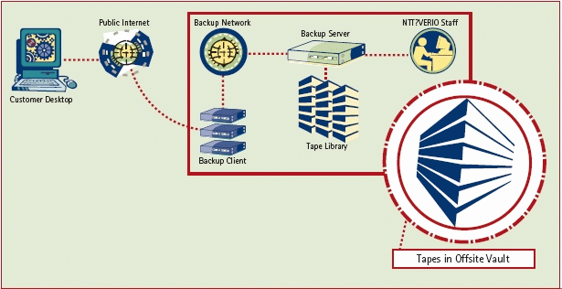
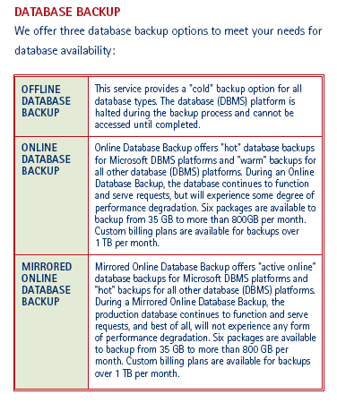
Offsite backup providers
Verio

Slide 40
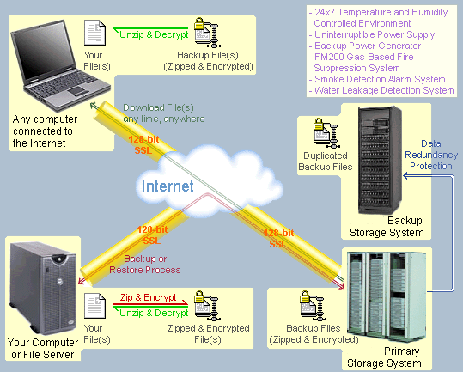
Backup and Offsite Backup
Found on the Web…
This is typical
of services that provide offsite backup for computers or DP centers

Slide 41
Lecture Outline
Review
  Database Administration: Security
Database Administration: Disasters, Backup and Recovery
Database Administration: Roles

Slide 42
Today
Traditional and Current Data Administration
Traditional and Current Database Administration
Review of Security, Integrity, etc.

Slide 43
Changes in Traditional Roles
This is being driven by rapid changes in
  Technology
  Platforms (e.g., Micro vs. Mainframe vs. Server vs. Cloud)
  Organizational Structure
We will focus on the core functions and tasks of these roles (traditional or current)

Slide 44
Traditional Administration Definitions
Data Administration: A high-level function that is responsible for the overall management of data resources in an organization, including maintaining corporate-wide definitions and standards
Database Administration: A technical function that is responsible for physical database design and for dealing with technical issues such as security enforcement, database performance, and backup and recovery

Slide 45
Traditional Data Administration Functions
Data policies, procedures, standards
Planning
Data conflict (ownership) resolution
Managing the information repository
Internal marketing of DA concepts

Slide 46
Traditional Database Administration Functions
Selection of DBMS and software tools
Installing/upgrading DBMS
Tuning database performance
Improving query processing performance
Managing data security, privacy, and integrity
Data backup and recovery

Slide 47
Evolving Approaches to Data Administration
Blend data and database administration into one role
Fast-track development – monitoring development process (analysis, design, implementation, maintenance)
Procedural DBAs–managing quality of triggers and stored procedures
eDBA–managing Internet-enabled database applications
PDA DBA–data synchronization and personal database management
Data warehouse administration

Slide 48
Database System Life Cycle
Database
Planning
Growth &
Change
Database
Analysis
Operation &
Maintenance
Database
Design
Database
Implementation
Note: this is a different version of this
life cycle than discussed previously

Slide 49
Database Planning
Development of a strategic plan for database development that supports the overall organization’s business plan
DA supports top management in development of this plan
The result of this stage is an enterprise data model

Slide 50
Database Design
Purpose of the design phase is the development of the logical database design that will serve the needs of the organization and the physical design implementing the logical design
In relational systems the outcome is normalized relations, and the data definition for a particular database systems (including indexes, etc.)

Slide 51
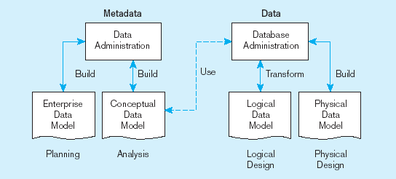
Roles for design process

Slide 52
Database Implementation
Database design gives you an empty database
Load data into the database structure
Convert existing data sets and applications to use the new database
  May need programs, conversion utilities to convert old data to new formats.
Outcome is the actual database with its data

Slide 53
Database Implementation DA & DBA functions
Specify database access policies (DA & DBA)
Establish Security controls (DBA)
Supervise Database loading (DBA)
Specify test procedures (DBA)
Develop application programming standards (DBA)
Establish procedures for backup and recovery (DBA)
Conduct User training (DA & DBA)

Slide 54
Operation and Maintenance 1: Operations
Users are responsible for updating the database, DA and DBA are responsible for developing procedures that ensure the integrity and security of the database during the update process.
Specific responsibility for data collection, editing and verification must be assigned
Quality assurance must be practiced to protect and audit the database quality.

Slide 55
Operation and Maintenance 2: Maintenance
The ongoing process of updating the database to keep it current
  adding new records
  deleting obsolete records
  changing data values in particular records
  modifying relation structures (e.g. adding new fields)
Privacy, security, access control must be in place.
Recovery and Backup procedures must be established and used

Slide 56
Operation and Maintenance: DA & DBA functions
Monitor database performance (DBA)
Tune and reorganize databases (DBA)
Enforce standards and procedures (DBA)
Support users (DA & DBA)

Slide 57
Data Warehouse Administration
New role, coming with the growth in data warehouses
Similar to DA/DBA roles
Emphasis on integration and coordination of metadata/data across many data sources
Specific roles:
  Support DSS applications
  Manage data warehouse growth
  Establish service level agreements regarding data warehouses and data marts

Slide 58
Growth & Change
Change is a way of life
  Applications, data requirements, reports, etc. will all change as new needs and requirements are found
  The Database and applications and will need to be modified to meet the needs of changes to the organization and the environment
  Database performance should be monitored to maintain a high level of system performance

Slide 59
Database Performance Tuning
DBMS Installation
  Setting installation parameters
Memory Usage
  Set cache levels
  Choose background processes
Input/Output (I/O) Contention
  Use striping
  Distribution of heavily accessed files
CPU Usage
  Monitor CPU load
Application tuning
  Modification of SQL code in applications

Slide 60
Data Availability
Downtime is expensive
How to ensure availability
  Hardware failures–provide redundancy for fault tolerance
  Loss of data–database mirroring
  Maintenance downtime–automated and nondisruptive maintenance utilities
  Network problems–careful traffic monitoring, firewalls, and routers

