Slide 1
Future of Database Systems
University of California, Berkeley
School of Information
IS 257: Database Management

Slide 2
Lecture Outline
Future of Database Systems
Predicting the future…
Quotes from Leon Kappelman “The future is ours” CACM, March 2001
Accomplishments of database research over the past 30 years
Next-Generation Databases and the Future

Slide 3
Radio has no future, Heavier-than-air flying machines are impossible. X-rays will prove to be a hoax.
William Thompson (Lord Kelvin), 1899

Slide 4
This “Telephone” has too many shortcomings to be seriously considered as a means of communication. The device is inherently of no value to us.
Western Union, Internal Memo, 1876

Slide 5
I think there is a world market for maybe five computers
Thomas Watson, Chair of IBM, 1943

Slide 6
The problem with television is that the people must sit and keep their eyes glued on the screen; the average American family hasn’t time for it.
New York Times, 1949

Slide 7
Where … the ENIAC is equipped with 18,000 vacuum tubes and weighs 30 tons, computers in the future may have only 1000 vacuum tubes and weigh only 1.5 tons
Popular Mechanics, 1949

Slide 8
There is no reason anyone would want a computer in their home.
Ken Olson, president and chair of Digital Equipment Corp., 1977.

Slide 9
640K ought to be enough for anybody.
Attributed to Bill Gates, 1981

Slide 10
By the turn of this century, we will live in a paperless society.
Roger Smith, Chair of GM, 1986

Slide 11
I predict the internet… will go spectacularly supernova and in 1996 catastrophically collapse.
Bob Metcalfe (3-Com founder and inventor of ethernet), 1995

Slide 12
Lecture Outline
Review
Object-Oriented Database Development
Future of Database Systems
Predicting the future…
Quotes from Leon Kappelman “The future is ours” CACM, March 2001
Accomplishments of database research over the past 30 years
Next-Generation Databases and the Future

Slide 13
Database Research
Database research community less than 40 years old
Has been concerned with business type applications that have the following demands:
Efficiency in access and modification of very large amounts of data
Resilience in surviving hardware and software errors without losing data
Access control to support simultaneous access by multiple users and ensure consistency
Persistence of the data over long time periods regardless of the programs that access the data
Research has centered on methods for designing systems with efficiency, resilience, access control, and persistence and on the languages and conceptual tools to help users to access, manipulate and design databases.

Slide 14
Accomplishments of DBMS Research
DBMS are now used in almost every computing environment to create, organize and maintain large collections of information, and this is largely due to the results of the DBMS research community’s efforts, in particular:
Relational DBMS
Transaction management
Distributed DBMS

Slide 15
Relational DBMS
The relational data model proposed by E.F. Codd in papers (1970-1972) was a breakthrough for simplicity in the conceptual model of DBMS.
However, it took much research to actually turn RDBMS into realities.

Slide 16
Relational DBMS
During the 1970’s database researchers:
Invented high-level relational query languages to ease the use of the DBMS for end users and applications programmers.
Developed Theory and algorithms needed to optimize queries into execution plans as efficient and sophisticated as a programmer might have custom designed for an earlier DBMS

Slide 17
Relational DBMS
Developed Normalization theory to help with database design by eliminating redundancy
Developed clustering algorithms to improve retrieval efficiency.
Developed buffer management algorithms to exploit knowledge of access patterns
Constructed indexing methods for fast access to single records or sets of records by values
Implemented prototype RDBMS that formed the core of many current commercial RDBMS

Slide 18
Relational DBMS
The result of this DBMS research was the development of commercial RDBMS in the 1980’s
When Codd first proposed RDBMS it was considered theoretically elegant, but it was assumed only toy RDBMS could ever be implemented due to the problems and complexities involved. Research changed that.

Slide 19
Transaction Management
Research on transaction management has dealt with the basic problems of maintaining consistency in multi-user high transaction database systems

Slide 20
Transaction Management
To guarantee that a transaction transforms the database from one consistent state to another requires:
The concurrent execution of transactions must be such that they appear to execute in isolation.
System failures must not result in inconsistent database states. Recovery is the technique used to provide this.

Slide 21
Distributed Databases
The ability to have a single “logical database” reside in two or more locations on different computers, yet to keep querying, updates and transactions all working as if it were a single database on a single machine
How do you manage such a system?
It has to become part of the DBMS itself, not left to the application layer

Slide 22
Lecture Outline
Review
Object-Oriented Database Development
Future of Database Systems
Predicting the future…
Quotes from Leon Kappelman “The future is ours” CACM, March 2001
Accomplishments of database research over the past 30 years
“Next-Generation Databases” and the Future

Slide 23
Next Generation Database Systems
Where are we going from here?
Hardware is getting faster and cheaper
DBMS technology continues to improve and change
OODBMS
ORDBMS
NoSQL
NewSQL
Bigger challenges for DBMS technology
Medicine, design, manufacturing, digital libraries, sciences, environment, planning, etc...
Sensor networks, streams, etc…
The Claremont Report on DB Research
Sigmod Record, v. 37, no. 3 (Sept 2008)

Slide 24
Examples
NASA EOSDIS
Estimated 10¹⁶ Bytes (Exabyte)
Computer-Aided design
The Human Genome
Department Store tracking
Mining non-transactional data (e.g. Scientific data, text data?)
Insurance Company
Multimedia DBMS support

Slide 25
New Features
New Data types
Rule Processing
New concepts and data models
Problems of Scale
Parallelism/Cloud-based DB
Tertiary Storage vs Very Large-Scale Disk Storage vs Large-Scale semiconductor Storage
Heterogeneous Databases
Memory Only DBMS

Slide 26
Coming to a Database Near You…
Browsibility
User-defined access methods
Security
Steering Long processes
Federated Databases
IR capabilities
XML
The Semantic Web(?)

Slide 27
The next-generation DBMS
What can we expect for a next generation of DBMS?
Look at the DB research community – their research leads to the “new features” in DBMS
The “Claremont Report” (2008) on DB research was a report of meeting of top researchers and what they thought were the interesting and fruitful research topics for the future

Slide 28
But will it be a RDBMS?
Recently, Mike Stonebraker (one of the people who helped invent Relational DBMS) has suggested that the “One Size Fits All” model for DBMS is an idea whose time has come – and gone
This was also a theme of the Claremont Report
RDBMS technology, as noted previously, has optimized on transactional business type processing
But many other applications do not follow that model

Slide 29
Will it be an RDBMS?
Stonebraker predicted that the DBMS market will fracture into many more specialized database engines
Although some may have a shared common frontend
Examples are Data Warehouses, Stream processing engines, Text and unstructured data processing systems
We are seeing this with NoSQL, NewSQL and Stream processors

Slide 30
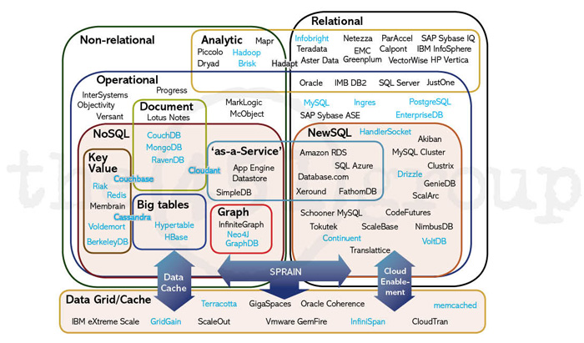
The Database Universe 2013

Slide 31
Will it be an RDBMS?
Data Warehouses currently use (mostly) conventional DBMS technology
But they are NOT the type of data those are optimized for
Storage usually puts all elements of a row together, but that is an optimization for updating and not searching, summarizing, and reading individual attributes
A better solution is to store the data by column instead of by row – vastly more efficient for typical Data Warehouse Applications

Slide 32
Will it be an RDBMS?
Streaming data, such as Wall St. stock trade information is badly suited to conventional RDBMS (other than as historical data)
The data arrives in a continuous real-time stream
But, data in old-school RDBMS has to be stored before it can be read and actions taken on it
This is too slow for real-time actions on that data
Stream processors function by running “queries” on the live data stream instead
May be orders of magnitude faster
Some NewSQL systems also play in this space, like VoltDB that we looked at last time, by reducing RDBMS overhead and running in memory

Slide 33
Will it be an RDBMS?
Sensor networks provide another massive stream input and analysis problem
Text Search: No current text search engines use RDBMS, they too need to be optimized for searching, and tend to use inverted file structures instead of RDBMS storage
Scientific databases are another typical example of streamed data from sensor networks or instruments

Slide 34
XML Databases
XML data is still not a first-class citizen of RDBMS, and there are reasons to believe that specialized database engines are needed
Some XML Databases are also billed as NoSQL
MarkLogic – which has gotten part of the blame for the implementation fiasco surrounding HealthCare.gov :
“Another sore point was the Medicare agency’s decision to use database software, from a company called MarkLogic, that managed the data differently from systems by companies like IBM, Microsoft and Oracle. CGI officials argued that it would slow work because it was too unfamiliar. Government officials disagreed, and its configuration remains a serious problem.” New York Times, 11/22/2013

Slide 35
Will it be an RDBMS
RDBMS will still be used for what they are best at – business-type high transaction data
But specialized DBMS will be used for many other applications
Consider Oracle’s acquisions of SleepyCat (BerkeleyDB) embedded database engine, and TimesTen main memory database engine
specialized database engines for specific applications

Slide 36
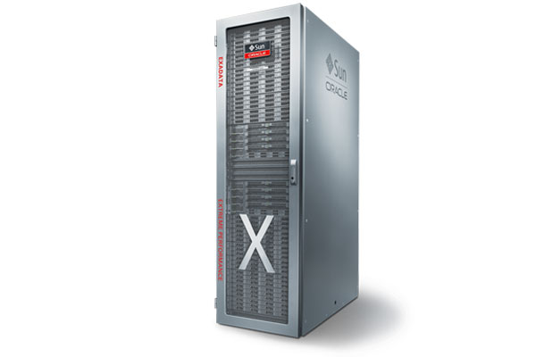
You can buy Big Data…
Oracle will be happy to sell you systems (hardware and software) to manage your exabytes…
Oracle Exadata Database Machine X3-8

Slide 37
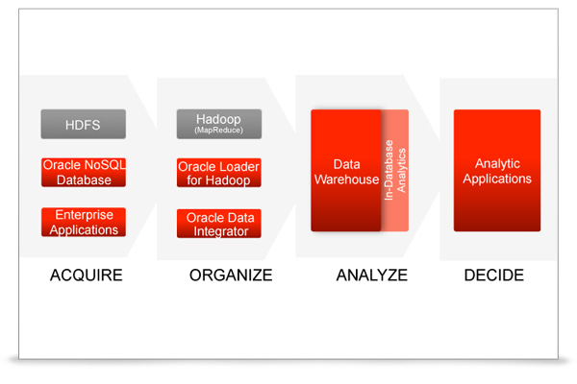
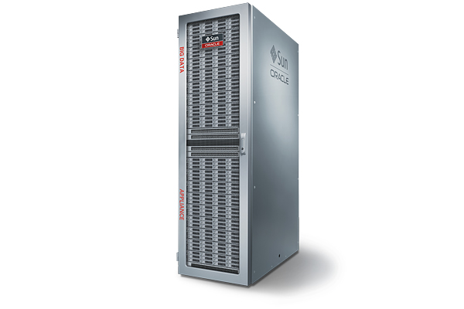
And NoSQL too…
Oracle Big Data Appliance
With Oracle NoSQL Database (BerkeleyDB)

Slide 38
The Claremont Report 2008
The group saw a “Turning Point in Database Research”
Current Environment
Research Opportunities
Moving Forward

Slide 39
Current Environment
“Big Data” is becoming ubiquitous in many fields
enterprise applications
Web tasks
E-Science
Digital entertainment
Natural Language Processing (esp. for Humanities applications)
Social Network analysis
Etc.

Slide 40
Current Environment
Data Analysis as a profit center
No longer just a cost – may be the entire business as in Business Intelligence

Slide 41
Current Environment
Ubiquity of Structured and Unstructured data
Text
XML
Web Data
Crawling the Deep Web
How to extract useful information from “noisy” text and structured corpora?

Slide 42
Current Environment
Expanded developer demands
Wider use means broader requirements, and less interest from developers in the details of traditional DBMS interactions
Architectural Shifts in Computing
The move to parallel architectures both internally (on individual chips)
And externally – Cloud Computing/Grid Computing

Slide 43
Research Opportunities
Revisiting Database Engines
Do DBMS need a redesign from the ground up to accommodate the new demands of the current environment?

Slide 44
Research Opportunities-DB engines
Designing systems for clusters of many-core processors
Exploiting RAM and Flash as persistent media, rather than relying on magnetic disk
Continuous self-tuning of DBMS systems
Encryption and Compression
Supporting non-relation data models
instead of “shoe-horning” them into tables

Slide 45
Research Opportunities-DB engines
Trading off consistency and availability for better performance and scaleout to thousands of machines
Designing power-aware DBMS that limit energy costs without sacrificing scalability

Slide 46
Research Opportunities-Programming
Declarative Programming for Emerging Platforms
MapReduce
Ruby on Rails
Workflows

Slide 47
Research Opportunities-Data
The Interplay of Structured and Unstructured Data
Extracting Structure automatically
Contextual awareness
Combining with IR research and Machine Learning

Slide 48
Research Opportunities - Cloud
Cloud Data Services
New models for “shared data” servers
Learning from Grid Computing
SRB/IRODS, etc.
Hadoop - as mentioned earlier - is open source and freely available software from Apache for running massively parallel computation (and distributed storage)

Slide 49
Research Opportunities - Mobile
Mobile Applications and Virtual Worlds
Need for real-time services combining massive amounts of user-generated data

Slide 50
Moving forward
Establishing large-scale collaborative projects to address these research opportunities
What will be the result?

Slide 51
Some things to consider
Bandwidth will keep increasing and getting cheaper (and go wireless) (?)
Processing power will keep increasing (?)
Moore’s law: Number of circuits on the most advanced semiconductors doubling every 18 months
With multicore chips, all computing is becoming parallel computing
Memory and Storage will keep getting cheaper (and probably smaller) (?)
“Storage law” or Kryder’s Law: Worldwide digital data storage capacity has doubled every 9 months for the past couple of decades

Slide 52
Put it all together and what do you have?
“The ideal database machine would have a single infinitely fast processor with infinite memory with infinite bandwidth – and it would be infinitely cheap (free)” : David DeWitt and Jim Gray, 1992
Today it is more likely to be thousands of commodity machines running in parallel (using Hadoop or Spark, for example) with very fast networking between them (but it is definitely not free)
But will these assumptions hold into the future?

Slide 53
Is the future all roses?
Most future predictions start with the assumption that:
Moores Law will continue double chip complexity or density every 18 months
Disk will follow the same path by “Kryder’s Law” which says that the capacity doubles about every two years
Consider the following analysis, thanks to David Rosenthal of LOCKSS on the issues with archival storage systems (remember Walmart’s Data Warehouse?)

Slide 54
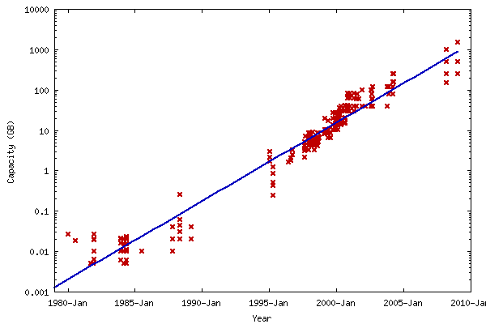
Kryder’s “Law”
Source: David Rosenthal - LOCKSS
Notes:
There is a 30 year history of disk prices dropping about 40% per year.
SDSC has figures showing that media is only about 1/3 of the total storage cost – the rest is power, cooling, space, staff, etc.
But the costs are per-drive, not per byte, so total per-byte cost drops in line with media costs. Meaning customers get double the capacity every two years for the same price.
This has held for 30 years, implying the the difference between storing something temporarily vs. forever rapidly becomes negligible.

Slide 55
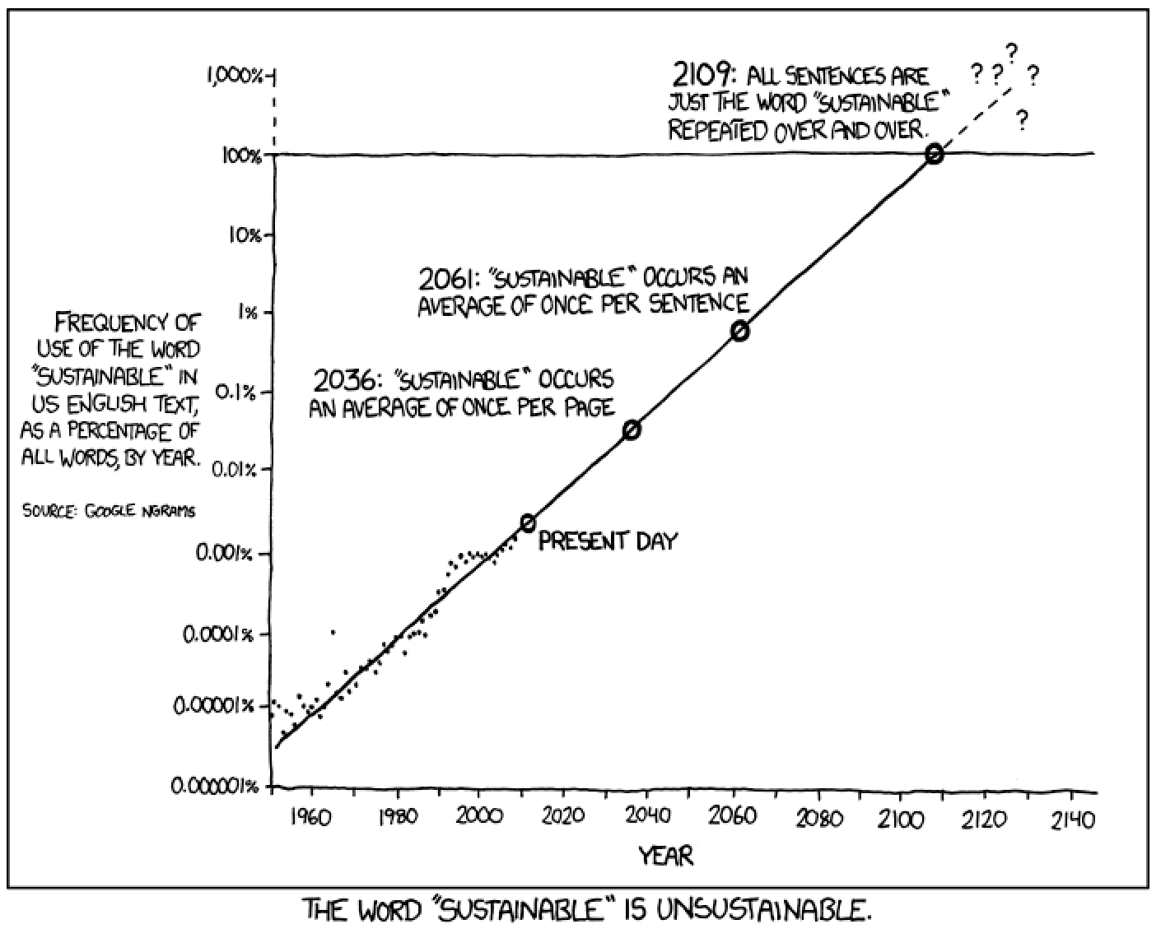
But is it sustainable?
From XKCD : http://xkcd.com/1007/

Slide 56
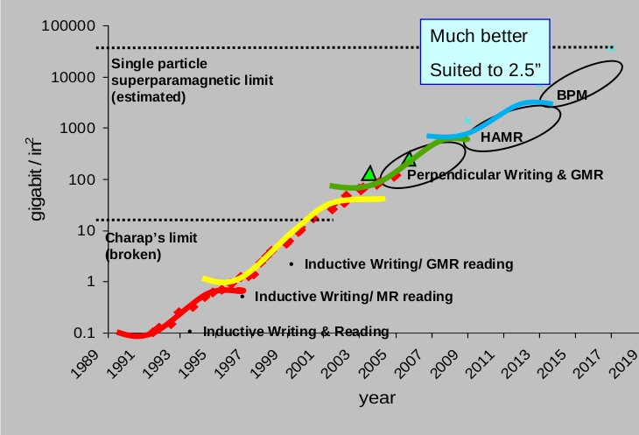
Disk Technologies and Scale
Source: Dave Anderson of Seagate - via David Rosenthal - LOCKSS
Notes:
Development is not linear, but a sequence of S curves
Note how PMR was supposed to be replaced by HAMR around 2009 – but nobody has shipped a HAMR drive yet and 4TB drives should have arrived in 2010 – not 2012.

Slide 57
Kryder’s Law?
It was pretty clear by 2011 that the storage industry had fallen off the Kryder curve
That was BEFORE the floods in Thailand destroyed 40% of the world’s disk manufacturing capacity and doubled disk prices overnight
Prices are still about 60% more than they were before the floods and were not expected to return to pre-flood levels until 2014
Source: David Rosenthal - LOCKSS

Slide 58
The Crisis in three numbers
According to IDC demand for storage grows about 60% per year
Bit density on disk platters is expected to grow no more than 20% per year for the next 5 years
Meanwhile IT budgets in recent years have only grown between 0% and 2% per year
The graph on the next slide projects these numbers for 10 years…

Slide 59
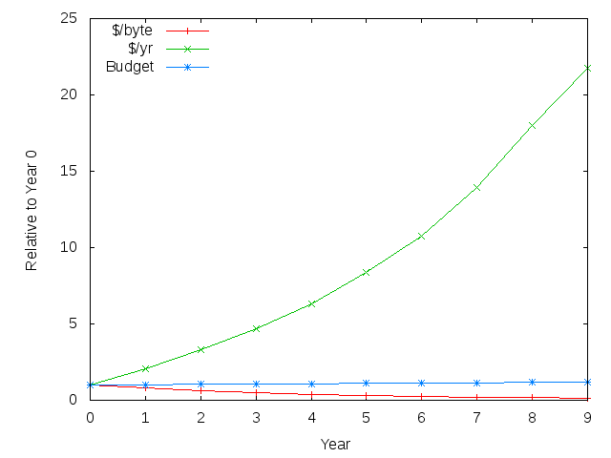
Three Numbers
Red = Kryder
@ 20%
Blue = IT
Budget
Green = Cost
of storage
with 60%
growth
Source: David Rosenthal - LOCKSS
Notes:
The red line is Kryder’s Law at 20% per year
The Green line is the annual cost of storing the data accumulated since year 0 at the 60% growth rate
10 years from now the cost of storing all the accumulated data would cost over 20 TIMES as much as it does this year.
If storage is 5% of your IT budget this year, in 10 years it will be over 100%

Slide 60
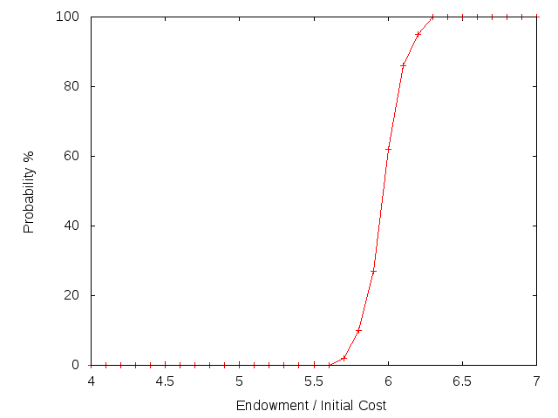
Source: David Rosenthal - LOCKSS
Notes:
Suppose you use an endowment to pay for future storage – a model simulating 100 years of storage and the probability of success – if your initial endowment is too low
You are almost guaranteed to fail, if large enough it is certain to survive

Slide 61
Future DBMS
What kinds of things can we expect to be incorporated in future DBMS?
One way to look at it is to see what we are doing now – and just scale it up in size and speed
Another is to consider what kinds of features would be useful for current “problem areas” or desired applications…

Slide 62
Future trends
Integration (multiple formats, multiple databases)
Accessibility (anytime, anywhere)
Reliability (no data loss - ever)
Proper display of data (advanced graphics methods dynamically applied)
Real-time access
Able to handle the 3 Vs – Volume, Velocity and Variety
Based on slides from Marina L. Gavrilova

Slide 63
Future trends in use
Real-time decision support
Information visualization and 3D modeling
Tracking DB development on-line
Data exchange between different applications/vendors
Virtual and augmented reality
Intelligent Decision support and cognitive methods for data analysis
Based on slides from Marina L. Gavrilova

Slide 64
Future Interfaces
Scientific visualization tools
Automated vision tools
Fourth dimension
Advanced spatial analysis tools (e.g. S+)
Beyond the WIMP (windows, icons, menus and pointers) Desktop
High Interactivity
Multisensory input
Multisensory output
Touch free displays
Virtual and Augmented Reality
Based on slides from Marina L. Gavrilova

Slide 65
Revisiting the Assumptions
Bandwidth will keep increasing and getting cheaper (and go wireless)
Processing power will keep increasing
Moore’s law: Number of circuits on the most advanced semiconductors doubling every 18 months
With multicore chips, all computing is becoming parallel computing
Memory and Storage will keep getting cheaper (and probably smaller)
“Kryder’s law”: Worldwide digital data storage capacity has doubled every 18-24 months for the past decade
E.g. Resistive Random Access Memory "RRAM” – 20 times faster and 10 x lower power – but persistent like flash
So what will the database environment of the future look like?

Slide 66
?

