Slide 1
Data Mining and Introduction to Big Data
University of California, Berkeley
School of Information
IS 257: Database Management

Slide 2
Lecture Outline
Announcements
  Final Project Reports
Review
  OLAP (ROLAP, MOLAP)
  OLAP with SQL
Big Data (introduction)

Slide 3
Final Project Reports
Final project is the completed version of your personal project with an enhanced version of Assignment 4
Optional in-class presentation on the database design and interface – this not required, but gives extra credit
Detailed description and elements to be considered in grading are available by following the links on the Assignments page or the main page of the class site

Slide 4
Lecture Outline
Announcements
  Final Project Reports
Review
  OLAP (ROLAP, MOLAP)
  OLAP with SQL
Big Data (introduction)

Slide 5
Related Fields
Machine
Learning
Visualization
Data Mining and
Knowledge Discovery
Statistics
Databases
Source: Gregory Piatetsky-Shapiro

Slide 6
OLAP
Online Line Analytical Processing
  Intended to provide multidimensional views of the data
  I.e., the “Data Cube”
  The PivotTables in MS Excel are examples of OLAP tools

Slide 7
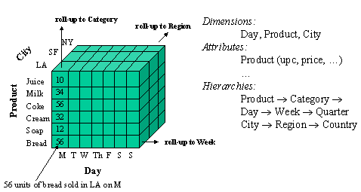
Data Cube

Slide 8
Star Schemas
A star schema is a common organization for data at a warehouse. It consists of:
  Fact table : a very large accumulation of facts such as sales.
    Often “insert-only.”
  Dimension tables : smaller, generally static information about the entities involved in the facts.

Slide 9
Example: Star Schema
Suppose we want to record in a warehouse information about every beer sale: the bar, the brand of beer, the drinker who bought the beer, the day, the time, and the price charged.
The fact table is a relation:
Sales(bar, beer, drinker, day, time, price)

Slide 10
Example, Continued
The dimension tables include information about the bar, beer, and drinker “dimensions”:
Bars(bar, addr, license)
Beers(beer, manf)
Drinkers(drinker, addr, phone)

Slide 11
Visualization – Star Schema
Dimension Table (Bars)
Dimension Table (Drinkers)
Dimension Attrs.
Dependent Attrs.
Fact Table - Sales
Dimension Table (Beers)
Dimension Table (etc.)
From anonymous “olap.ppt” found on Google

Slide 12
Typical OLAP Queries
Often, OLAP queries begin with a “star join”: the natural join of the fact table with all or most of the dimension tables.
Example:
SELECT *
FROM Sales, Bars, Beers, Drinkers
WHERE Sales.bar = Bars.bar AND
Sales.beer = Beers.beer AND
Sales.drinker = Drinkers.drinker;
From anonymous “olap.ppt” found on Google

Slide 13
Example: OLAP Query
For each bar in Palo Alto, find the total sale of each beer manufactured by Anheuser-Busch.
Filter: addr = “Palo Alto” and manf = “Anheuser-Busch”.
Grouping: by bar and beer.
Aggregation: Sum of price.

Slide 14
Example: In SQL
SELECT bar, beer, SUM(price)
FROM Sales NATURAL JOIN Bars
NATURAL JOIN Beers
WHERE addr = ’Palo Alto’ AND
manf = ’Anheuser-Busch’
GROUP BY bar, beer;
From anonymous “olap.ppt” found on Google

Slide 15
Using Materialized Views
A direct execution of this query from Sales and the dimension tables could take too long.
If we create a materialized view that contains enough information, we may be able to answer our query much faster.

Slide 16
Example: Materialized View
Which views could help with our query?
Key issues:
  It must join Sales, Bars, and Beers, at least.
  It must group by at least bar and beer.
  It must not select out Palo-Alto bars or Anheuser-Busch beers.
  It must not project out addr or manf.
From anonymous “olap.ppt” found on Google

Slide 17
Example --- Continued
Here is a materialized view that could help:
CREATE VIEW BABMS(bar, addr,
beer, manf, sales) AS
SELECT bar, addr, beer, manf,
SUM(price) sales
FROM Sales NATURAL JOIN Bars
NATURAL JOIN Beers
GROUP BY bar, addr, beer, manf;
Since bar -> addr and beer -> manf, there is no real
grouping. We need addr and manf in the SELECT.
From anonymous “olap.ppt” found on Google

Slide 18
Example --- Concluded
Here’s our query using the materialized view BABMS:
SELECT bar, beer, sales
FROM BABMS
WHERE addr = ’Palo Alto’ AND
manf = ’Anheuser-Busch’;
From anonymous “olap.ppt” found on Google

Slide 19
Visualization - Data Cubes
beer
price
bar
drinker

Slide 20
Marginals
The data cube also includes aggregation (typically SUM) along the margins of the cube.
The marginals include aggregations over one dimension, two dimensions,…

Slide 21
Visualization - Data Cube w/ Aggregation
beer
SUM over
all Drinkers
price
bar
drinker

Slide 22
Example: Marginals
Our 4-dimensional Sales cube includes the sum of price over each bar, each beer, each drinker, and each time unit (perhaps days).
It would also have the sum of price over all bar-beer pairs, all bar-drinker-day triples,…

Slide 23
Structure of the Cube
Think of each dimension as having an additional value *.
A point with one or more *’s in its coordinates aggregates over the dimensions with the *’s.
Example: Sales(“Joe’s Bar”, “Bud”, *, *) holds the sum over all drinkers and all time of the Bud consumed at Joe’s.

Slide 24
Drill-Down
Drill-down = “de-aggregate” = break an aggregate into its constituents.
Example: having determined that Joe’s Bar sells very few Anheuser-Busch beers, break down his sales by particular A.-B. beer.

Slide 25
Roll-Up
Roll-up = aggregate along one or more dimensions.
Example: given a table of how much Bud each drinker consumes at each bar, roll it up into a table giving total amount of Bud consumed for each drinker.

Slide 26
Roll Up and Drill Down
$ of Anheuser-Busch by drinker/bar
$ of A-B / drinker
 | Jim | Bob | Mary
Joe’s Bar | 45 | 33 | 30
Nut- House | 50 | 36 | 42
Blue Chalk | 38 | 31 | 40
Jim | Bob | Mary
133 | 100 | 112
Roll up
by Bar
Drill down
by Beer
$ of A-B Beers / drinker
 | Jim | Bob | Mary
Bud | 40 | 29 | 40
M’lob | 45 | 31 | 37
Bud Light | 48 | 40 | 35

Slide 27
Materialized Data-Cube Views
Data cubes invite materialized views that are aggregations in one or more dimensions.
Dimensions may not be completely aggregated --- an option is to group by an attribute of the dimension table.

Slide 28
Example
A materialized view for our Sales data cube might:
  Aggregate by drinker completely.
  Not aggregate at all by beer.
  Aggregate by time according to the week.
  Aggregate according to the city of the bar.

Slide 29
Data Mining
Data mining is a popular term for queries that summarize big data sets in useful ways.
Examples:
  Clustering all Web pages by topic.
  Finding characteristics of fraudulent credit-card use.

Slide 30
Market-Basket Data
An important form of mining from relational data involves market baskets = sets of “items” that are purchased together as a customer leaves a store.
Summary of basket data is frequent itemsets = sets of items that often appear together in baskets.

Slide 31
Example: Market Baskets
If people often buy hamburger and ketchup together, the store can:
  Put hamburger and ketchup near each other and put potato chips between.
  Run a sale on hamburger and raise the price of ketchup.

Slide 32
Example: Market Baskets
If people often buy hamburger and ketchup together, the store can:
  Put hamburger and ketchup near each other and put potato chips between.
  Run a sale on hamburger and raise the price of ketchup.
From anonymous “olap.ppt” found on Google

Slide 33
Finding Frequent Pairs
The simplest case is when we only want to find “frequent pairs” of items.
Assume data is in a relation Baskets(basket, item).
The support threshold s is the minimum number of baskets in which a pair appears before we are interested.
From anonymous “olap.ppt” found on Google

Slide 34
Frequent Pairs in SQL
Look for two
Basket tuples
with the same
basket and
different items.
First item must
precede second,
so we don’t
count the same
pair twice.
SELECT b1.item, b2.item
FROM Baskets b1, Baskets b2
WHERE b1.basket = b2.basket
AND b1.item < b2.item
GROUP BY b1.item, b2.item
HAVING COUNT(*) >= s;
Create a group for
each pair of items
that appears in at
least one basket.
Throw away pairs of items
that do not appear at least
s times.
From anonymous “olap.ppt” found on Google

Slide 35
A-Priori Trick --- (1)
Straightforward implementation involves a join of a huge Baskets relation with itself.
The a-priori algorithm speeds the query by recognizing that a pair of items {i, j } cannot have support s unless both {i } and {j } do.

Slide 36
A-Priori Trick --- (2)
Use a materialized view to hold only information about frequent items.
INSERT INTO Baskets1(basket, item)
SELECT * FROM Baskets
WHERE item IN (
SELECT item FROM Baskets
GROUP BY item
HAVING COUNT(*) >= s
);
Items that
appear in at
least s baskets.

Slide 37
A-Priori Algorithm
Materialize the view Baskets1.
Run the obvious query, but on Baskets1 instead of Baskets.
Computing Baskets1 is cheap, since it doesn’t involve a join.
Baskets1 probably has many fewer tuples than Baskets.
  Running time shrinks with the square of the number of tuples involved in the join.

Slide 38
Example: A-Priori
Suppose:
  A supermarket sells 10,000 items.
  The average basket has 10 items.
  The support threshold is 1% of the baskets.
At most 1/10 of the items can be frequent.
Probably, the minority of items in one basket are frequent -> factor 4 speedup.

Slide 39
Lecture Outline
Announcements
  Final Project Reports
Review
  OLAP (ROLAP, MOLAP)
  OLAP with SQL
Big Data (introduction)

Slide 40
Big Data and Databases
“640K ought to be enough for anybody.”
  Attributed to Bill Gates, 1981

Slide 41
Big Data and Databases
We have already mentioned some Big Data
  The Walmart Data Warehouse
  Information collected by Amazon on users and sales and used to make recommendations
Most modern web-based companies capture EVERYTHING that their customers do
  Does that go into a Warehouse or someplace else?

Slide 42
Other Examples
NASA EOSDIS
  Estimated 10¹⁸ Bytes (Exabyte)
Computer-Aided design
The Human Genome
Department Store tracking
  Mining non-transactional data (e.g. Scientific data, text data?)
Insurance Company
  Multimedia DBMS support

Slide 43
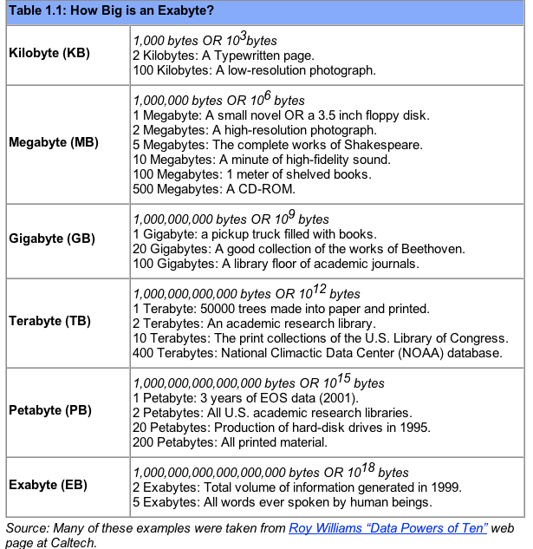

Slide 44
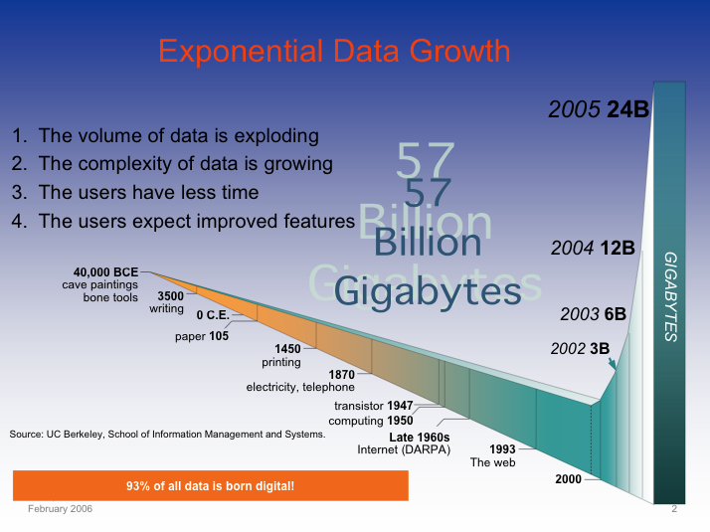
Digitization of Everything: the Zettabytes are coming
Soon most everything will be recorded and indexed
Much will remain local
Most bytes will never be seen by humans.
Search, data summarization, trend detection, information and knowledge extraction and discovery are key technologies
So will be infrastructure to manage this.

Slide 45
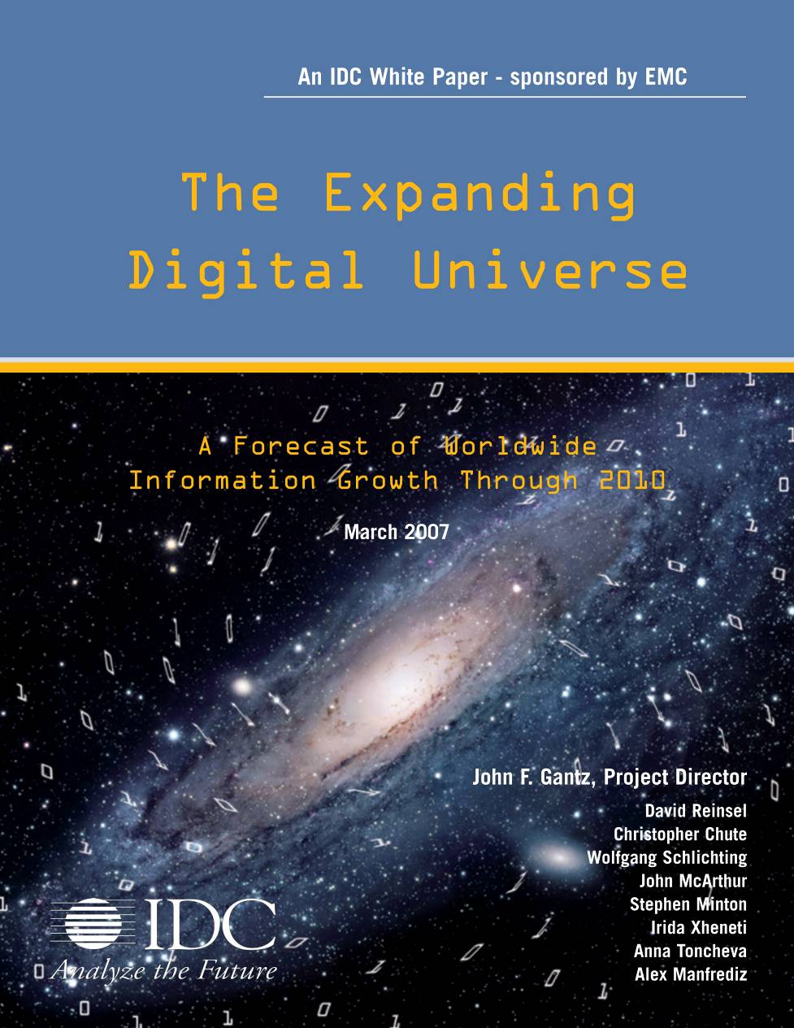
Digital Information
Created, Captured, Replicated Worldwide
Exabytes
10-fold Growth in 5 Years!
DVD
RFID
Digital TV
MP3 players
Digital cameras
Camera phones, VoIP
Medical imaging, Laptops,
Data center applications, Games
Satellite images, GPS, ATMs, Scanners
Sensors, Digital radio, DLP theaters, Telematics
Peer-to-peer, Email, Instant messaging, Videoconferencing,
CAD/CAM, Toys, Industrial machines, Security systems, Appliances
Source: IDC, 2008

Slide 46
Before the Cloud there was the Grid
So what’s this Grid thing anyhow?
Data Grids and Distributed Storage
Grid vs “Cloud”
The following borrows heavily from presentations by Ian Foster (Argonne National Laboratory & University of Chicago), Reagan Moore and others from San Diego Supercomputer Center

Slide 47

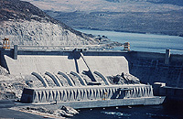
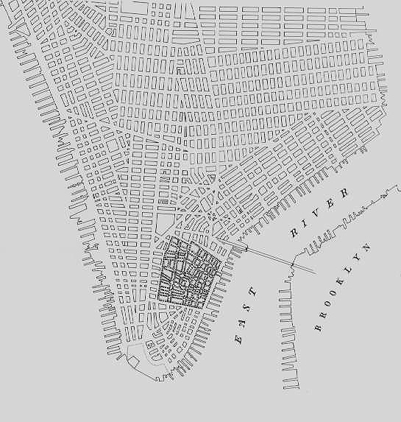
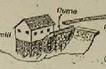
The Grid: On-Demand Access to Electricity
Quality, economies of scale
Time
Source: Ian Foster

Slide 48
By Analogy, A Computing Grid
Decouples production and consumption
  Enable on-demand access
  Achieve economies of scale
  Enhance consumer flexibility
  Enable new devices
On a variety of scales
  Department
  Campus
  Enterprise
  Internet
Source: Ian Foster

Slide 49
What is the Grid?
“The short answer is that, whereas the Web is a service for sharing information over the Internet, the Grid is a service for sharing computer power and data storage capacity over the Internet. The Grid goes well beyond simple communication between computers, and aims ultimately to turn the global network of computers into one vast computational resource.”
Source: The Global Grid Forum

Slide 50
Not Exactly a New Idea …
“The time-sharing computer system can unite a group of investigators …. one can conceive of such a facility as an … intellectual public utility.”
  Fernando Corbato and Robert Fano , 1966
“We will perhaps see the spread of ‘computer utilities’, which, like present electric and telephone utilities, will service individual homes and offices across the country.” Len Kleinrock, 1967
Source: Ian Foster

Slide 51
But, Things are Different Now
Networks are far faster (and cheaper)
  Faster than computer backplanes
“Computing” is very different than pre-Net
  Our “computers” have already disintegrated
  E-commerce increases size of demand peaks
  Entirely new applications & social structures
We’ve learned a few things about software
But, the needs are changing too…
Source: Ian Foster

Slide 52
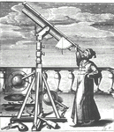
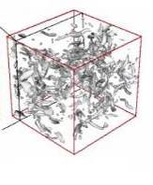


Progress of Science
Thousand years ago:
science was empirical
  describing natural phenomena
Last few hundred years:
theoretical branch
  using models, generalizations
Last few decades:
a computational branch
  simulating complex phenomena
Today: (big data/information)
data and information exploration (eScience)
  unify theory, experiment, and simulation - information driven
  Data captured by sensors, instruments
  or generated by simulator
  Processed/searched by software
  Information/Knowledge stored in computer
  Scientist analyzes database / files
  using data management and statistics
  Network Science
  Cyberinfrastructure
Source: Jim Gray
Notes:
52

Slide 53

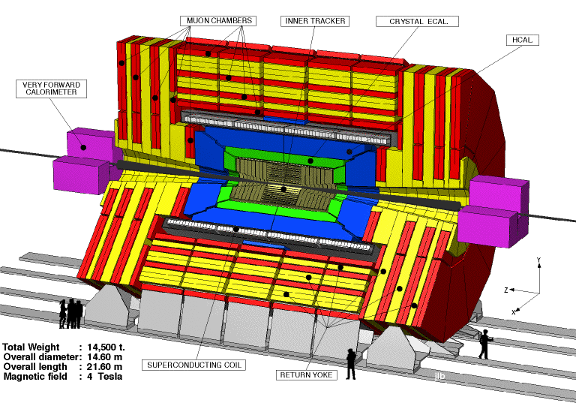
Why the Grid?
(1) Revolution in Science
Pre-Internet
  Theorize &/or experiment, alone
  or in small teams; publish paper
Post-Internet
  Construct and mine large databases of observational or simulation data
  Develop simulations & analyses
  Access specialized devices remotely
  Exchange information within
  distributed multidisciplinary teams
Source: Ian Foster

Slide 54
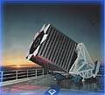

Computational Science
Traditional Empirical Science
  Scientist gathers data by direct observation
  Scientist analyzes data
Computational Science
  Data captured by instruments
  Or data generated by simulator
  Processed by software
  Placed in a database
  Scientist analyzes database
  tcl scripts
    or C programs
      on ASCII files

Slide 55
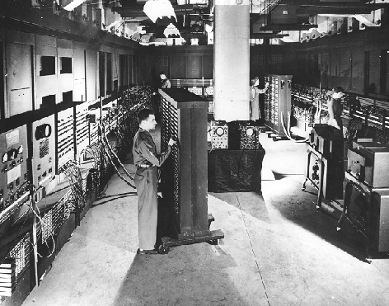
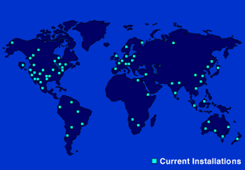
Why the Grid?
(2) Revolution in Business
Pre-Internet
  Central data processing facility
Post-Internet
  Enterprise computing is highly distributed, heterogeneous, inter-enterprise (B2B)
  Business processes increasingly
  computing- & data-rich
  Outsourcing becomes feasible =>
  service providers of various sorts
Source: Ian Foster

Slide 56
The Information Grid
Imagine a web of data
Machine Readable
  Search, Aggregate, Transform, Report On, Mine Data – using more computers, and less humans
Scalable
  Machines are cheap – can buy 50 machines with 100Gb or memory and 100 TB disk for under $100K, and dropping
  Network is now faster than disk
Flexible
  Move data around without breaking the apps
Source: S. Banerjee, O. Alonso, M. Drake - ORACLE

Slide 57


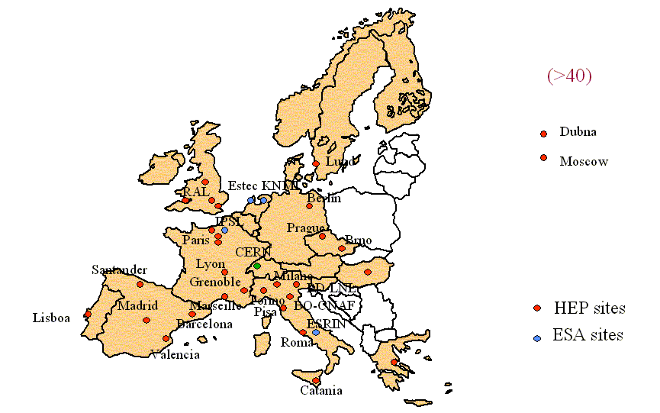


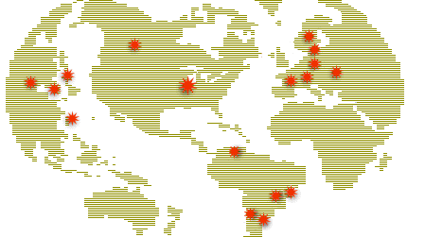

The Foundations are Being Laid
Edinburgh
Glasgow
DL
Newcastle
Belfast
Manchester
Oxford
Cambridge
Cardiff
RAL
London
Hinxton
Soton
Tier0/1 facility
Tier2 facility
Tier3 facility
10 Gbps link
2.5 Gbps link
622 Mbps link
Other link

Slide 58
Current Environment
“Big Data” is becoming ubiquitous in many fields
  enterprise applications
  Web tasks
  E-Science
  Digital entertainment
  Natural Language Processing (esp. for Humanities applications)
  Social Network analysis
  Etc.
Berkeley Institute for Data Science (BIDS)

Slide 59
Current Environment
Data Analysis as a profit center
  No longer just a cost – may be the entire business as in Business Intelligence

Slide 60
Current Environment
Ubiquity of Structured and Unstructured data
  Text
  XML
  Web Data
  Crawling the Deep Web
How to extract useful information from “noisy” text and structured corpora?

Slide 61
Current Environment
Expanded developer demands
  Wider use means broader requirements, and less interest from developers in the details of traditional DBMS interactions
Architectural Shifts in Computing
  The move to parallel architectures both internally (on individual chips)
  And externally – Cloud Computing

Slide 62
The 3V’s of Big Data
Volume – how much(?)
Velocity – how fast(?)
Variety – how diverse(?)
Volume
Big Data
Velocity
Variety

Slide 63
High Velocity Data
Examples:
  Harvesting hot topics from the Twitter “firehose”
  Collecting “clickstream” data from websites
  System logs and Web logs
  High frequency stock trading (HFT)
  Real-time credit card fraud detection
  Text-in voting for TV competitions
  Sensor data
  Adwords auctions for ad pricing
    http://www.youtube.com/watch?v=a8qQXLby4PY

Slide 64
High Velocity Requirements
Ingest at very high speeds and rates
  E.g. Millions of read/write operations per second
Scale easily to meet growth and demand peaks
Support integrated fault tolerance
Support a wide range of real-time (or “near-time”) analytics
Integrate easily with high volume analytic datastores (Data Warehouses)

Slide 65

Put Differently
High velocity and you
You need to ingest a firehose in real time
You need to process, validate, enrich and respond in real-time (i.e. update)
You often need real-time analytics (i.e. query)
Notes:
----- Meeting Notes (6/2/11 13:18) -----
scale: not just now, but at peak and in future
adapt: move processing to data.

Slide 66
High Volume Data
“Big Data” in the sense of large volume is becoming ubiquitous in many fields
  enterprise applications
  Web tasks
  E-Science
  Digital entertainment
  Natural Language Processing (esp. for Humanities applications – e.g. Hathi Trust)
  Social Network analysis
  Etc.

Slide 67
High Volume Data Examples
The Walmart Data Warehouse
  Often cited as one of, if not the largest data warehouse
The Google Web database
  Current web
The Internet Archive
  Historic web
Flickr and YouTube
Social Networks (E.g.: Facebook)
NASA EOSDIS
  Estimated 10¹⁶ Bytes (Exabyte)
Other E-Science databases
  E.g. Large Hadron Collider, Sloan Digital Sky Survey, Large Synoptic Survey Telescope (2016)
Notes:
The Large Hadron Collider experiments represent about 150 million sensors delivering data 40 million times per second. There are nearly 600 million collisions per second. After filtering and refraining from recording more than 99.999% of these streams, there are 100 collisions of interest per second.^{[27][28][29]}
As a result, only working with less than 0.001% of the sensor stream data, the data flow from all four LHC experiments represents 25 petabytes annual rate before replication (as of 2012). This becomes nearly 200 petabytes after replication.
When the Sloan Digital Sky Survey (SDSS) began collecting astronomical data in 2000, it amassed more in its first few weeks than all data collected in the history of astronomy. Continuing at a rate of about 200 GB per night, SDSS has amassed more than 140 terabytes of information. When the Large Synoptic Survey Telescope, successor to SDSS, comes online in 2016 it is anticipated to acquire that amount of data every five days.^{[5]}
If all sensor data were to be recorded in LHC, the data flow would be extremely hard to work with. The data flow would exceed 150 million petabytes annual rate, or nearly 500 exabytes per day, before replication. To put the number in perspective, this is equivalent to 500 quintillion (5×10²⁰) bytes per day, almost 200 times higher than all the other sources combined in the world.

Slide 68
Difficulties with High Volume Data
Browsibility
Very long running analyses
Steering Long processes
Federated/Distributed Databases
IR and item search capabilities
Updating and normalizing data
Changing requirements and structure

Slide 69
High Variety
Big data can come from a variety of sources, for example:
  Equipment sensors: Medical, manufacturing, transportation, and other machine sensor transmissions
  Machine generated: Call detail records, web logs, smart meter readings, Global Positioning System (GPS) transmissions, and trading systems records
  Social media: Data streams from social media sites like Facebook and miniblog sites like Twitter

Slide 70
High Variety
The problem of high variety comes when these different sources must be combined and integrated to provide the information of interest
Problems of:
  Different structures
  Different identifiers
  Different scales for variables
Often need to combine unstructured or semi-structured text (XML/JSON) with structured data

Slide 71
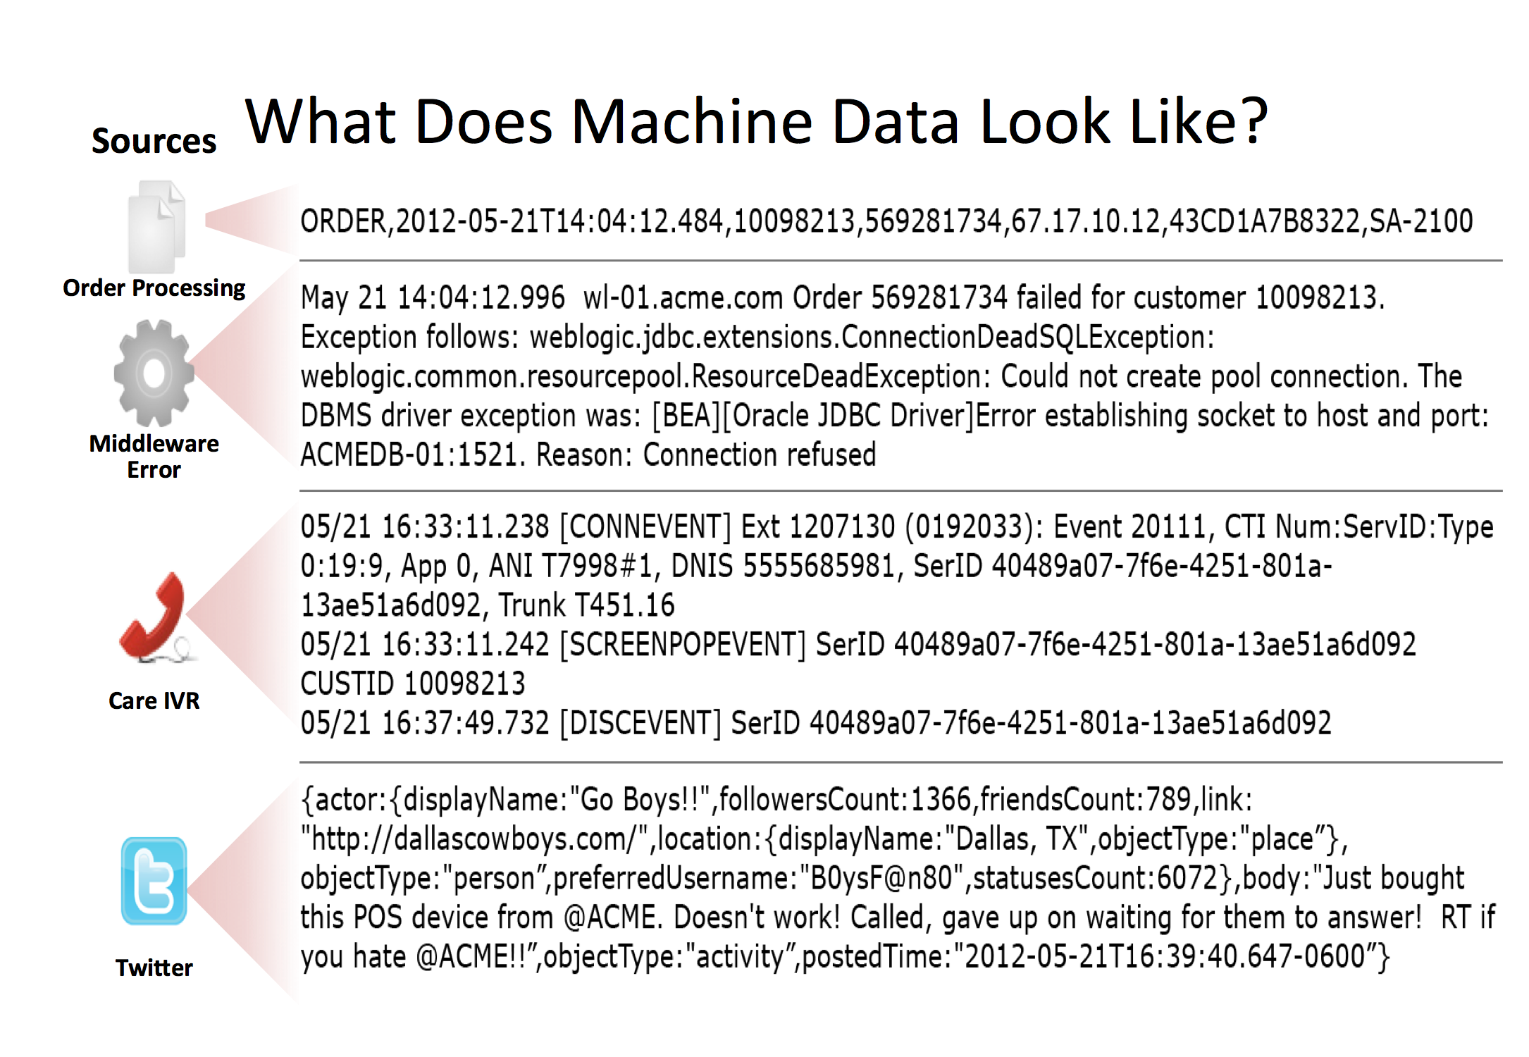
Various data sources
From Stephen Sorkin of Splunk

Slide 72
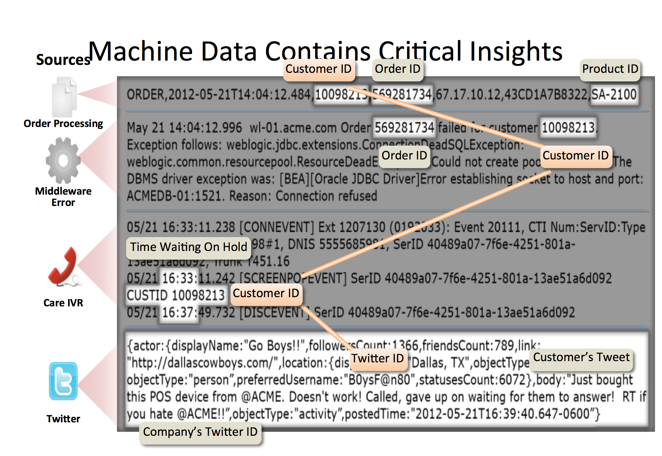
Integration of Variety
From Stephen Sorkin of Splunk

