Slide 1
Data Warehousing
University of California, Berkeley
School of Information
IS 257: Database Management

Slide 2
Lecture Outline
Data Warehouses
Introduction to Data Warehouses
Data Warehousing
(Based on lecture notes from Modern Database Management Text (Hoffer, Ramesh, Topi); Joachim Hammer, University of Florida, and Joe Hellerstein and Mike Stonebraker of UCB)

Slide 3
Overview
Data Warehouses and Merging Information Resources
What is a Data Warehouse?
History of Data Warehousing
Types of Data and Their Uses
Data Warehouse Architectures
Data Warehousing Problems and Issues

Slide 4
Problem: Heterogeneous Information Sources
“Heterogeneities are everywhere”
Personal
Databases
World
Wide
Web
Scientific Databases
Digital Libraries
Different interfaces
Different data representations
Duplicate and inconsistent information
Slide credit: J. Hammer

Slide 5
Problem: Data Management in Large Enterprises
Vertical fragmentation of informational systems (vertical stove pipes)
Result of application (user)-driven development of operational systems
Sales Planning
Suppliers
Num. Control
Stock Mngmt
Debt Mngmt
Inventory
...
...
...
Sales Administration
Finance
Manufacturing
...
Slide credit: J. Hammer

Slide 6
Goal: Unified Access to Data
Integration System
World
Wide
Web
Personal
Databases
Digital Libraries
Scientific Databases
Collects and combines information
Provides integrated view, uniform user interface
Supports sharing
Slide credit: J. Hammer

Slide 7
The Traditional Research Approach
Query-driven (lazy, on-demand)
Clients
Integration System
Metadata
. . .
Wrapper
Wrapper
Wrapper
. . .
Source
Source
Source
Slide credit: J. Hammer

Slide 8
Disadvantages of Query-Driven Approach
Delay in query processing
Slow or unavailable information sources
Complex filtering and integration
Inefficient and potentially expensive for frequent queries
Competes with local processing at sources
Hasn’t caught on in industry
Slide credit: J. Hammer

Slide 9
The Warehousing Approach
Information integrated in advance
Stored in WH for direct querying and analysis
Clients
Data
Warehouse
Integration System
Metadata
. . .
Extractor/
Monitor
Extractor/
Monitor
Extractor/
Monitor
. . .
Source
Source
Source
Slide credit: J. Hammer

Slide 10
Advantages of Warehousing Approach
High query performance
But not necessarily most current information
Doesn’t interfere with local processing at sources
Complex queries at warehouse
OLTP at information sources
Information copied at warehouse
Can modify, annotate, summarize, restructure, etc.
Can store historical information
Security, no auditing
Has caught on in industry
Slide credit: J. Hammer

Slide 11
Not Either-Or Decision
Query-driven approach still better for
Rapidly changing information
Rapidly changing information sources
Truly vast amounts of data from large numbers of sources
Clients with unpredictable needs
Slide credit: J. Hammer

Slide 12
Data Warehouse Evolution
“Building the
DW”
Inmon (1992)
Relational
Databases
Company
DWs
Data Replication
Tools
1960
1975
1980
1985
1990
1995
2000
Information-
Based
Management
“Prehistoric
Times”
“Middle
Ages”
Data
Revolution
TIME
PC’s and
Spreadsheets
End-user
Interfaces
1st DW
Article
DW
Confs.
Vendor DW
Frameworks
Slide credit: J. Hammer

Slide 13
What is a Data Warehouse?
“A Data Warehouse is a
subject-oriented,
integrated,
time-variant,
non-volatile
collection of data used in support of management decision making processes.”
-- Inmon & Hackathorn, 1994: viz. Hoffer, Chap 11

Slide 14
DW Definition…
Subject-Oriented:
The data warehouse is organized around the key subjects (or high-level entities) of the enterprise. Major subjects include
Customers
Patients
Students
Products
Etc.

Slide 15
DW Definition…
Integrated
The data housed in the data warehouse are defined using consistent
Naming conventions
Formats
Encoding Structures
Related Characteristics

Slide 16
DW Definition…
Time-variant
The data in the warehouse contain a time dimension so that they may be used as a historical record of the business

Slide 17
DW Definition…
Non-volatile
Data in the data warehouse are loaded and refreshed from operational systems, but cannot be updated by end-users

Slide 18
What is a Data Warehouse? A Practitioners Viewpoint
“A data warehouse is simply a single, complete, and consistent store of data obtained from a variety of sources and made available to end users in a way they can understand and use it in a business context.”
-- Barry Devlin, IBM Consultant
Slide credit: J. Hammer

Slide 19
A Data Warehouse is...
Stored collection of diverse data
A solution to data integration problem
Single repository of information
Subject-oriented
Organized by subject, not by application
Used for analysis, data mining, etc.
Optimized differently from transaction-oriented db
User interface aimed at executive decision makers and analysts

Slide 20
… Cont’d
Large volume of data (Gb, Tb)
Non-volatile
Historical
Time attributes are important
Updates infrequent
May be append-only
Examples
All transactions ever at WalMart
Complete client histories at insurance firm
Stockbroker financial information and portfolios
Slide credit: J. Hammer

Slide 21
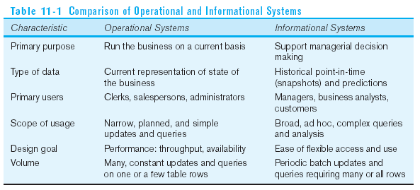
Need for Data Warehousing
Integrated, company-wide view of high-quality information (from disparate databases)
Separation of operational and informational systems and data (for improved performance)

Slide 22
Warehouse is a Specialized DB
Standard (Operational) DB
Mostly updates
Many small transactions
Mb - Gb of data
Current snapshot
Index/hash on p.k.
Raw data
Thousands of users (e.g., clerical users)
Warehouse (Informational)
Mostly reads
Queries are long and complex
Gb - Tb of data
History
Lots of scans
Summarized, reconciled data
Hundreds of users (e.g., decision-makers, analysts)
Slide credit: J. Hammer

Slide 23
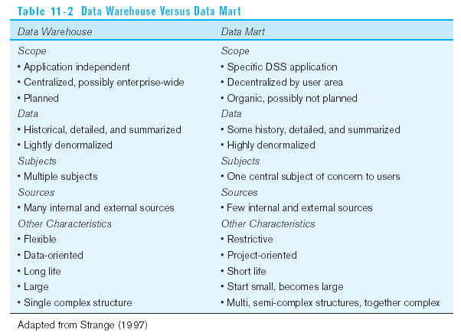
Warehouse vs. Data Mart

Slide 24
Data Warehouse Architectures
Generic Two-Level Architecture
Independent Data Mart
Dependent Data Mart and Operational Data Store
Logical Data Mart and @ctive Warehouse
Three-Layer architecture
All involve some form of extraction, transformation and loading (ETL)

Slide 25
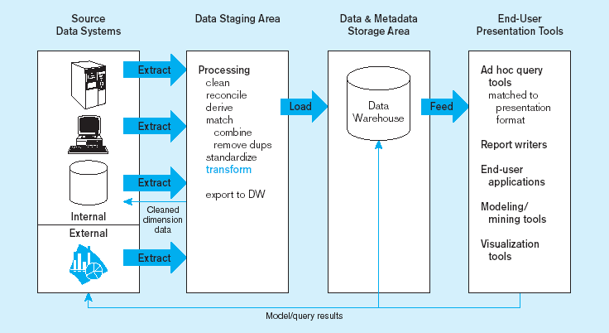
Generic two-level data warehousing architecture
L
One, company-wide warehouse
T
E
Periodic extraction ➔ data is not completely current in warehouse

Slide 26
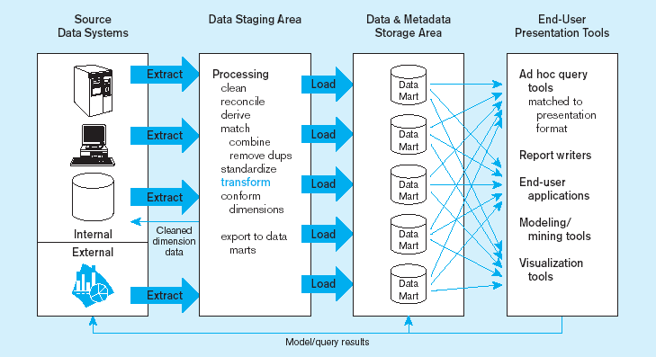
Independent data mart data warehousing architecture
Data marts:
Mini-warehouses, limited in scope
L
T
E
Separate ETL for each independent data mart
Data access complexity due to multiple data marts

Slide 27
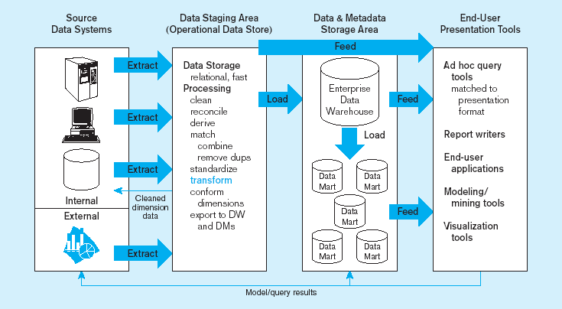
Dependent data mart with operational data store: a three-level architecture
ODS provides option for obtaining current data
L
T
E
Simpler data access
Single ETL for
enterprise data warehouse
(EDW)
Dependent data marts loaded from EDW

Slide 28
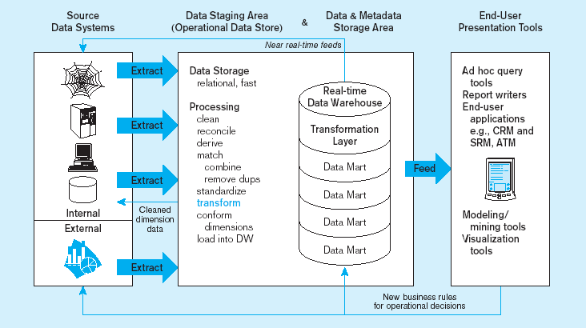
Logical data mart and real time warehouse architecture
ODS and data warehouse are one and the same
L
T
E
Near real-time ETL for
Data Warehouse
Data marts are NOT separate databases, but logical views of the data warehouse
➔ Easier to create new data marts

Slide 29
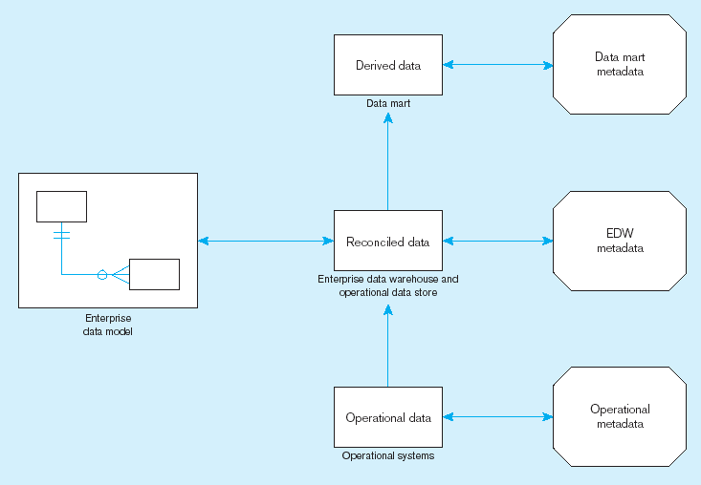
Three-layer data architecture for a data warehouse

Slide 30
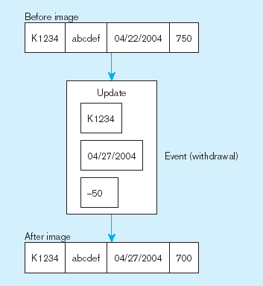
Data Characteristics Status vs. Event Data
Status
Event = a database action (create/update/delete) that results from a transaction
Status

Slide 31
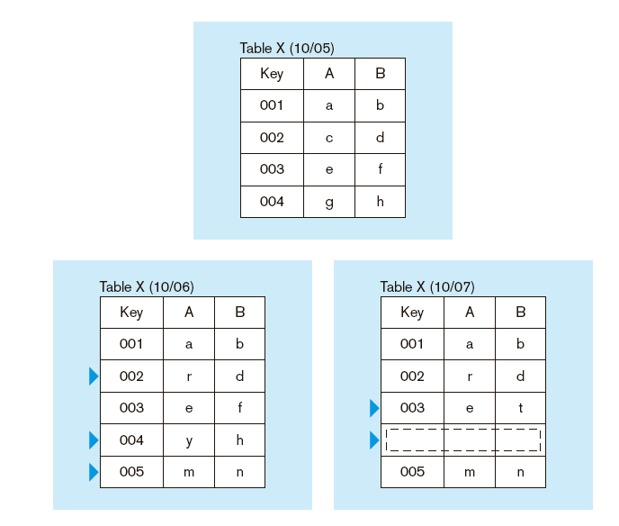
Data Characteristics Transient vs. Periodic Data
With transient data, changes to existing records are written over previous records, thus destroying the previous data content

Slide 32
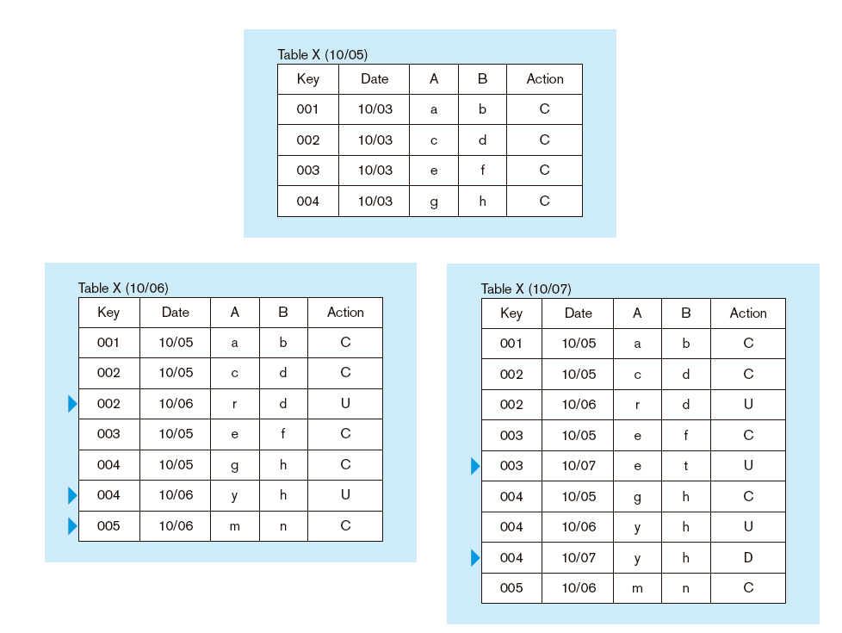
Data Characteristics Transient vs. Periodic Data
Periodic data are never physically altered or deleted once they have been added to the store

Slide 33
Other Data Warehouse Changes
New descriptive attributes
New business activity attributes
New classes of descriptive attributes
Descriptive attributes become more refined
Descriptive data are related to one another
New source of data

Slide 34
The Reconciled Data Layer
Typical operational data is:
Transient–not historical
Not normalized (perhaps due to denormalization for performance)
Restricted in scope–not comprehensive
Sometimes poor quality–inconsistencies and errors
After ETL, data should be:
Detailed–not summarized yet
Historical–periodic
Normalized–3rd normal form or higher
Comprehensive–enterprise-wide perspective
Timely–data should be current enough to assist decision-making
Quality controlled–accurate with full integrity

Slide 35
Types of Data
Business Data - represents meaning
Real-time data (ultimate source of all business data)
Reconciled data
Derived data
Metadata - describes meaning
Build-time metadata
Control metadata
Usage metadata
Data as a product* - intrinsic meaning
Produced and stored for its own intrinsic value
e.g., the contents of a text-book
Slide credit: J. Hammer

Slide 36
Data Warehousing: Two Distinct Issues
(1) How to get information into warehouse
“Data warehousing”
(2) What to do with data once it’s in warehouse
“Warehouse DBMS”
Both rich research areas
Industry has focused on (2)
Slide credit: J. Hammer

Slide 37
The ETL Process
Capture/Extract
Scrub or data cleansing
Transform
Load and Index
ETL = Extract, transform, and load

Slide 38
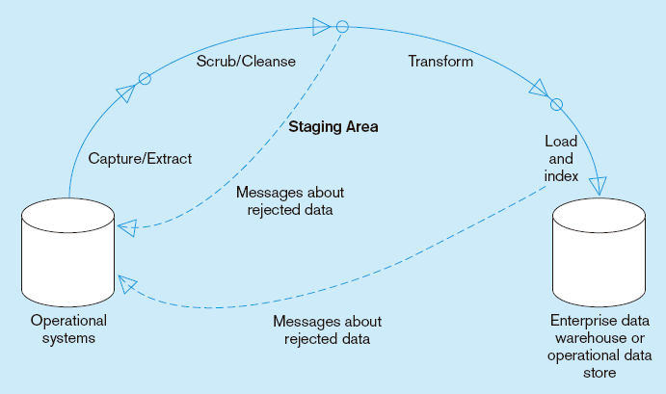
Capture/Extract…obtaining a snapshot of a chosen subset of the source data for loading into the data warehouse
Static extract = capturing a snapshot of the source data at a point in time
Incremental extract = capturing changes that have occurred since the last static extract

Slide 39
Data Extraction
Source types
Relational, flat file, WWW, etc.
How to get data out?
Replication tool
Dump file
Create report
ODBC or third-party “wrappers”
Slide credit: J. Hammer

Slide 40
Wrapper
Converts data and queries from one data model to another
Data
Model
A
Queries
Data
Model
B
Data
Extends query capabilities for sources with limited capabilities
Queries
Wrapper
Source
Slide credit: J. Hammer

Slide 41
Wrapper Generation
Solution 1: Hard code for each source
Solution 2: Automatic wrapper generation
Wrapper
Wrapper
Generator
Definition
Slide credit: J. Hammer

Slide 42
Monitors
Goal: Detect changes of interest and propagate to integrator
How?
Triggers
Replication server
Log sniffer
Compare query results
Compare snapshots/dumps
Slide credit: J. Hammer

Slide 43
Scrub/Cleanse…uses pattern recognition and AI techniques to upgrade data quality
Figure 11-10: Steps in data reconciliation
(cont.)
Fixing errors: misspellings, erroneous dates, incorrect field usage, mismatched addresses, missing data, duplicate data, inconsistencies
Also: decoding, reformatting, time stamping, conversion, key generation, merging, error detection/logging, locating missing data

Slide 44
New approaches for Data Cleansing
It is generally been found that 70-90 percent of the time and effort in large data management and analysis tasks is taken up with data cleansing
New tool “Data Wrangler” from Stanford and Berkeley CS folks
http://vis.stanford.edu/wrangler/

Slide 45
Data Cleansing
Find (& remove) duplicate tuples
e.g., Jane Doe vs. Jane Q. Doe
Detect inconsistent, wrong data
Attribute values that don’t match
Patch missing, unreadable data
Notify sources of errors found
Slide credit: J. Hammer

Slide 46
Transform = convert data from format of operational system to format of data warehouse
Figure 11-10: Steps in data reconciliation
(cont.)
Record-level:
Selection–data partitioning
Joining–data combining
Aggregation–data summarization
Field-level:
single-field–from one field to one field
multi-field–from many fields to one, or one field to many

Slide 47
Data Transformations
Convert data to uniform format
Byte ordering, string termination
Internal layout
Remove, add & reorder attributes
Add key
Add data to get history
Sort tuples
Slide credit: J. Hammer

Slide 48
Load/Index= place transformed data into the warehouse and create indexes
Figure 11-10: Steps in data reconciliation
(cont.)
Refresh mode: bulk rewriting of target data at periodic intervals
Update mode: only changes in source data are written to data warehouse

Slide 49
Data Integration
Receive data (changes) from multiple wrappers/monitors and integrate into warehouse
Rule-based
Actions
Resolve inconsistencies
Eliminate duplicates
Integrate into warehouse (may not be empty)
Summarize data
Fetch more data from sources (wh updates)
etc.
Slide credit: J. Hammer

Slide 50
Warehouse Maintenance
Warehouse data ≈ materialized view
Initial loading
View maintenance
View maintenance
Slide credit: J. Hammer

Slide 51
Differs from Conventional View Maintenance...
Warehouses may be highly aggregated and summarized
Warehouse views may be over history of base data
Process large batch updates
Schema may evolve
Slide credit: J. Hammer

Slide 52
Differs from Conventional View Maintenance...
Base data doesn’t participate in view maintenance
Simply reports changes
Loosely coupled
Absence of locking, global transactions
May not be queriable
Slide credit: J. Hammer

Slide 53
Warehouse Maintenance Anomalies
Materialized view maintenance in loosely coupled, non-transactional environment
Simple example
Data
Warehouse
Sold (item,clerk,age)
Sold = Sale Emp
Integrator
Sales
Comp.
Sale(item,clerk)
Emp(clerk,age)
Slide credit: J. Hammer

Slide 54
Warehouse Maintenance Anomalies
Data
Warehouse
Sold (item,clerk,age)
Integrator
Sales
Comp.
Sale(item,clerk)
Emp(clerk,age)
1. Insert into Emp(Mary,25), notify integrator
2. Insert into Sale (Computer,Mary), notify integrator
3. (1) → integrator adds Sale (Mary,25)
4. (2) → integrator adds (Computer,Mary) Emp
5. View incorrect (duplicate tuple)
Slide credit: J. Hammer

Slide 55
Warehouse Specification (ideally)
View Definitions
Warehouse
Configuration
Module
Warehouse
Integration
rules
Change
Detection
Requirements
Integrator
Metadata
Extractor/
Monitor
Extractor/
Monitor
Extractor/
Monitor
...
Slide credit: J. Hammer

Slide 56
Additional Research Issues
Historical views of non-historical data
Expiring outdated information
Crash recovery
Addition and removal of information sources
Schema evolution
Slide credit: J. Hammer

Slide 57
Warehousing and Industry
Data Warehousing is big business
$2 billion in 1995
$3.5 billion in early 1997
Predicted: $8 billion in 1998 [Metagroup]
Wal-Mart said to have the largest warehouse
1000-CPU, 583 Terabyte, Teradata system (InformationWeek, Jan 9, 2006)
“Half a Petabyte” in warehouse (Ziff Davis Internet, October 13, 2004)
1 billion rows of data or more are updated every day (InformationWeek, Jan 9, 2006)
Reported to be 2.5 Petabytes in 2008
http://gigaom.com/2013/03/27/why-apple-ebay-and-walmart-have-some-of-the-biggest-data-warehouses-youve-ever-seen

Slide 58
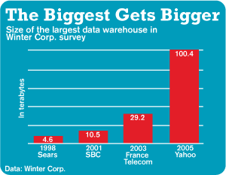
Other Large Data Warehouses
(InformationWeek, Jan 9, 2006)

Slide 59
Those are small change today…
Some databases are larger, however…
eBay: has two Teradata systems. Its primary data warehouse is 9.2 petabyes; its “singularity system” that stores web clicks and other “big” data is more than 40 petabytes. It includes a single table that’s 1 trillion rows. (2013)
http://gigaom.com/2013/03/27/why-apple-ebay-and-walmart-have-some-of-the-biggest-data-warehouses-youve-ever-seen
Apple: “Multiple Petabytes” in 2013
Yahoo! for web user behavioral analysis, storing two petabytes and claimed to be the largest data warehouse using a heavily modified version of PostgreSQL (Wikipedia 2012)

Slide 60
More Information on DW
Agosta, Lou, The Essential Guide to Data Warehousing. Prentise Hall PTR, 1999.
Devlin, Barry, Data Warehouse, from Architecture to Implementation. Addison-Wesley, 1997.
Inmon, W.H., Building the Data Warehouse. John Wiley, 1992.
Widom, J., “Research Problems in Data Warehousing.” Proc. of the 4th Intl. CIKM Conf., 1995.
Chaudhuri, S., Dayal, U., “An Overview of Data Warehousing and OLAP Technology.” ACM SIGMOD Record, March 1997.

