Slide 1
Database Management: Introduction
Ray R. Larson
University of California, Berkeley
School of Information
IS 257: Database Management

Slide 2
Overview
Announcements
Course Description
Database Concepts and Terminology
Database Models
Database Life Cycle

Slide 3
Overview
Announcements
Course Description
Database Concepts and Terminology
Database Models
Database Life Cycle

Slide 4
Course Overview
Description of the Course
Assignments
Readings
Grading
Schedule
Web site: http://courses.ischool.berkeley.edu/i257/f13

Slide 5
Course Description
This course is concerned with the design of the database itself -- not with the design of database system software.
We will discuss DBMS internals only as they relate to the database and its design and structure
We will spend a fair amount time on database application design, especially on options for Web application database support -- but this will not be primary focus.

Slide 6
Assignments
Two kinds of assignments
Using a pre-built database for search and retrieval and database modification queries
Designing, populating, and running queries against your own personal (or group) database
Types of database project
Individual
Work related
Course only
Projects from around campus that need doing…
Group
Course related
Final Master’s project

Slide 7
Readings
Textbook is:
Jeffrey A. Hoffer, Ramesh Venkataraman and Heikki Topi. Modern Database Management (Eleventh Edition). Prentice Hall (Pearson Educational) : Upper Saddle River, NJ, 2011.
ISBN 0132662256 or 978-0132662253
10th, Ninth (or even earlier) editions are OK too

Slide 8
Grading
Grades will be based on:
Assignments (30%)
Personal/Group Database project (60%)
Class participation (10%)
(No midterm or final)

Slide 9
Schedule
On website:
http://courses.ischool.berkeley.edu/i257/f14

Slide 10
Overview
Announcements
Course Description
Database Concepts and Terminology
Database Models
Database Life Cycle

Slide 11
Overview
What’s a database?
What’s a DataBase Management System?
Why use a database & DBMS?
How can you use a DBMS?

Slide 12
What is a Database?
?
How many have used a database today?

Slide 13
What is a database?
Broadly speaking – any collection of data might be called a database
Normally, though, certain characteristics of the data and how it is stored distinguish a database from any collection of data

Slide 14
What is a database?
Wikipedia tells us:
“A database is an organized collection of data. The data is typically organized to model relevant aspects of reality (for example, the availability of rooms in hotels), in a way that supports processes requiring this information (for example, finding a hotel with vacancies).”

Slide 15
What is a Database?
A Database is a collection of stored operational data used by the application systems of some particular enterprise. (C.J. Date)
Paper “Databases”
Still contain a large portion of the world’s knowledge
Changing as, for example, book scanning projects like Google Books and the Open Content Alliance convert paper docs
File-Based Data Processing Systems
Early batch processing of (primarily) business data
Still with us – in fact the entire MapReduce suite used in Big Data processing is primarily file-based
Database Management Systems (DBMS)
Some old ones still in use, but most modern DBMS are relational, object or object-relational, but there is increasing use of so-called “noSQL” key/object databases

Slide 16
What is a DataBase Management System?
Wikipedia again:
“A general-purpose database management system (DBMS) is a software system designed to allow the definition, creation, querying, update, and administration of databases.
Well-known DBMSs include MySQL, PostgreSQL, SQLite, Microsoft SQL Server, Microsoft Access, Oracle, Sybase, dBASE, FoxPro, and IBM DB2.”

Slide 17
What’s a DBMS
It maintains Metadata about the database
Data about data
In DBMS this means all of the characteristics describing the attributes of an entity, E.G.:
name of attributes
data type of attributes
size of the attributes
format or special characteristics
Characteristics of tables or ‘relations’
Name, content, notes, etc.
Associated elements in other tables

Slide 18
Why Databases and DBMS
In programming courses you have learned about data and file structures and how they can be used in your programs to help you accomplish various goals
Let’s say you want to create a program to keep a list of names and addresses
How would you write a program to do it?
Suppose the list got REALLY big – what kind of file structures might you use in searching it?

Slide 19
Why Use a DBMS?
History
50’s and 60’s all applications were custom built for particular needs
File based
Many similar/duplicative applications dealing with collections of business data
Early DBMS were extensions of programming languages
1970 - E.F. Codd and the Relational Model
1979 - Ashton-Tate & first Microcomputer DBMS

Slide 20
From File Systems to DBMS
Problems with File Processing systems
Inconsistent Data
Inflexibility
Limited Data Sharing
Poor enforcement of standards
Excessive program maintenance

Slide 21
DBMS Benefits
Minimal Data Redundancy
Consistency of Data
Integration of Data
Sharing of Data
Ease of Application Development
Uniform Security, Privacy, and Integrity Controls
Data Accessibility and Responsiveness
Data Independence
Reduced Program Maintenance

Slide 22
Why use a DBMS?
You don’t need to write all the code to manage your data
It will gracefully scale to VERY large collections of data
It will support transactions that are
Atomic (all or nothing)
Consistent (from valid state to valid state)
Isolated (no interference from concurrent use)
Durable (once committed is part of DB)
Easy to port data to other DBMS or files

Slide 23
Terms and Concepts
Database activities:
Create
Add new data to the database
Read
Read current data from the database
Update
Update or modify current database data
Delete
Remove current data from the database

Slide 24
Terms and Concepts
Data Independence
Physical representation and location of data and the use of that data are separated
The application doesn’t need to know how or where the database has stored the data, but just how to ask for it.
Moving a database from one DBMS to another should not have a material effect on application programs
Recoding, adding fields, etc. in the database should not affect applications

Slide 25
Database Environment
CASE
Tools
User
Interface
Application
Programs
Repository
DBMS
Database

Slide 26
Database Components
DBMS
===============
Design tools
Table Creation
Form Creation
Query Creation
Report Creation
Procedural
language
compiler (4GL)
=============
Run time
Form processor
Query processor
Report Writer
Language Run time
Database
Application
Programs
Database contains:
User’s Data
Metadata
Indexes
Application Metadata
User
Interface
Applications

Slide 27
Types of Database Systems
Local Databases
Centralized Database
Client/Server Databases
Distributed Databases
Cloud-Based Databases
Database Models

Slide 28
Local Databases
E.G.,
Access
SQLite
Etc.

Slide 29
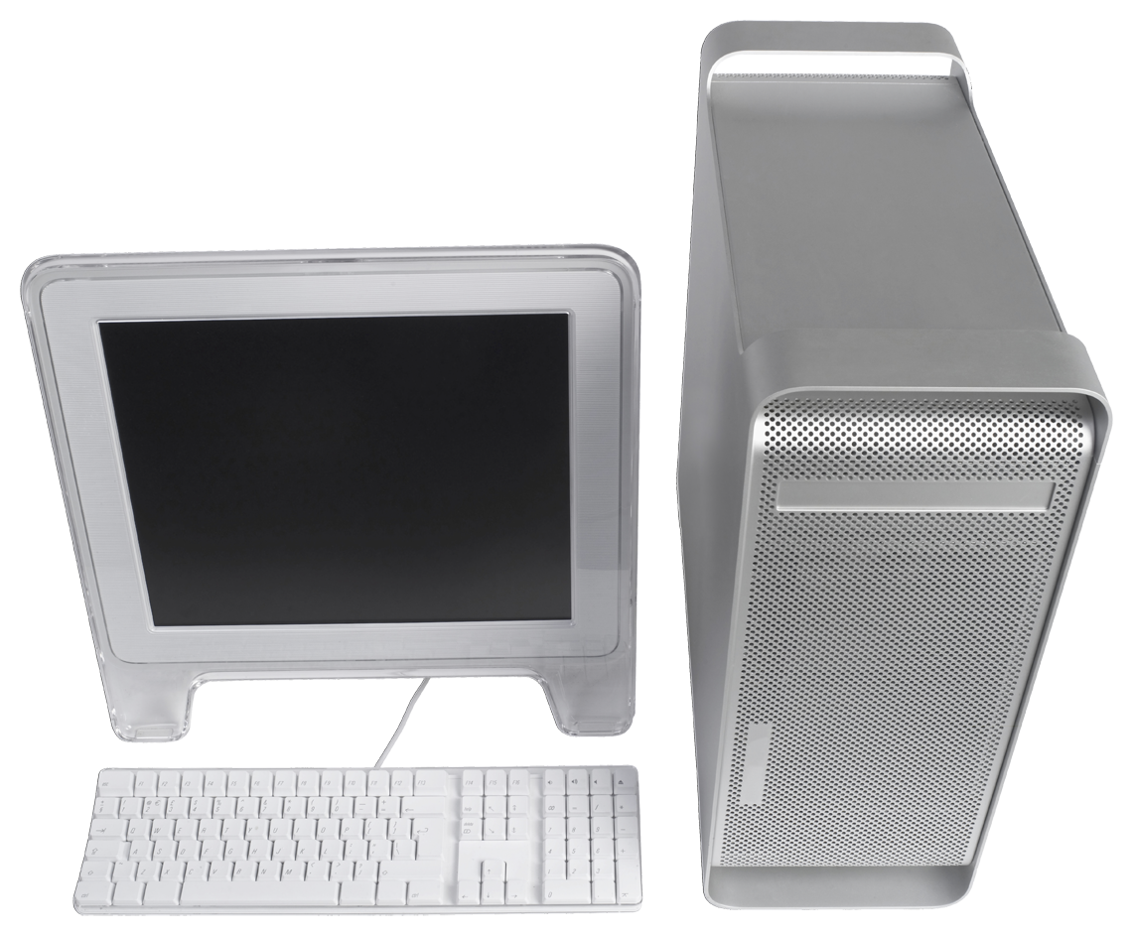
Centralized Databases
Cental
Computer

Slide 30
Client Server Databases
Client
Network/ Internet
Client
Database
Server
Client

Slide 31
Distributed Databases
Location B
Location C
computer
computer
computer
Homogeneous
Databases
Location A

Slide 32
Distributed Databases
Client
Heterogeneous
Or Federated
Databases
Remote
Comp.
Local Network
Or Internet
Database
Server
Comm
Server
Remote
Comp.
Client

Slide 33
Cloud-Based Databases
Server may be one or more remote machines, depending on task demands
Remote
Server
Remote
Server
Remote
Server
Client
Client
Remote
Servers
Client

Slide 34
Terms and Concepts
Database Application
An application program (or set of related programs) that is used to perform a series of database activities:
Create
Read
Update
Delete
On behalf of database users

Slide 35
Range of Database Applications
Local databases
Usually for individual user applications
E.g. SQLite is used by many iPhone Apps including IOS itself
WorkGroup databases
Small group use where everyone has access to the database over a LAN (or internet)
Departmental databases
Larger than a workgroup – but similar
Enterprise databases
For the entire organization over an intranet or the internet

Slide 36
Terms and Concepts
Enterprise
Organization
Entity
Person, Place, Thing, Event, Concept...
Attributes
Data elements (facts) about some entity
Also sometimes called fields or items or domains
Data values
instances of a particular attribute for a particular entity

Slide 37
Terms and Concepts
Records
The set of values for all attributes of a particular entity
AKA “tuples” or “rows” in relational DBMS
File
Collection of records
AKA “Relation” or “Table” in relational DBMS

Slide 38
Terms and Concepts
Key
an attribute or set of attributes used to identify or locate rows in a table
Primary Key
an attribute or set of attributes that uniquely identifies each row in a table

Slide 39
Terms and Concepts
DA
Data adminstrator - person responsible for the Data Administration function in an organization
Sometimes may be the CIO -- Chief Information Officer
DBA
Database Administrator - person responsible for the Database Administration Function

Slide 40
Terms and Concepts
Models
(1) Levels or views of the Database
Conceptual, logical, physical
(2) DBMS types
Relational, Hierarchic, Network, Object-Oriented, Object-Relational

Slide 41
Overview
Announcements
Course Description
Database Concepts and Terminology
Database Models
Database Life Cycle

Slide 42
Models (1)
Application 1
Application 2
Application 3
Application 4
External
Model
External
Model
External
Model
External
Model
Application 1
Conceptual
requirements
Application 2
Conceptual
requirements
Conceptual
Model
Logical
Model
Internal Model
Application 3
Conceptual
requirements
Application 4
Conceptual
requirements

Slide 43
Data Models(2): History
Hierarchical Model (1960’s and 1970’s)
Similar to data structures in programming languages.
Books
(id, title)
Authors
(first, last)
Publisher
Subjects

Slide 44
Data Models(2): History
Network Model (1970’s)
Provides for single entries of data and navigational “links” through chains of data.
Authors
Subjects
Books
Publishers

Slide 45
Data Models(2): History
Relational Model (1980’s)
Provides a conceptually simple model for data as relations (typically considered “tables”) with all data visible.

Slide 46
Data Models(2): History
Object Oriented Data Model (1990’s)
Encapsulates data and operations as “Objects”
Books
(id, title)
Authors
(first, last)
Publisher
Subjects

Slide 47
Data Models(2): History
Object-Relational Model (1990’s)
Combines the well-known properties of the Relational Model with such OO features as:
User-defined datatypes
User-defined functions
Inheritance and sub-classing

Slide 48
NoSQL Databases
Usually very simple key/value search operations
Usually very fast, with low storage overhead, but often lack security, consistency and other features of RDBMS
May use distributed parallel processing (grid/cloud, e.g. MongoDB + Hadoop)
Semantic Web “TripleStores” are one type

Slide 49
Overview
Announcements
Course Description
Database Concepts and Terminology
Database Models
Database Life Cycle

Slide 50
Database System Life Cycle
Physical
Creation
2
Design
1
Conversion
3
Growth,
Change, &
Maintenance
6
Integration
4
Operations
5

Slide 51
The “Cascade” View
Project
Identifcation
and Selection
Project
Initiation
and Planning
Analysis
Logical
Design
Physical
Design
Implementation
Maintenance
See Hoffer, p. 41

Slide 52
Design
Determination of the needs of the organization
Development of the Conceptual Model of the database
Typically using Entity-Relationship diagramming techniques
Construction of a Data Dictionary
Development of the Logical Model

Slide 53
Physical Creation
Development of the Physical Model of the Database
data formats and types
determination of indexes, etc.
Load a prototype database and test
Determine and implement security, privacy and access controls
Determine and implement integrity constraints

Slide 54
Conversion
Convert existing data sets and applications to use the new database
May need programs, conversion utilities to convert old data to new formats.

Slide 55
Integration
Overlaps with Phase 3
Integration of converted applications and new applications into the new database

Slide 56
Operations
All applications run full-scale
Privacy, security, access control must be in place.
Recovery and Backup procedures must be established and used

Slide 57
Growth, Change & Maintenance
Change is a way of life
Applications, data requirements, reports, etc. will all change as new needs and requirements are found
The Database and applications and will need to be modified to meet the needs of changes

Slide 58
Another View of the Life Cycle
Integration
4
Operations
5
Design
1
Physical
Creation
2
Conversion
3
Growth,
Change
6

Slide 59
Next Time
Introduction to the Diveshop database
Introduction to Database Design

