Slide 1
Data Mining and the Weka Toolkit and Intro for Big Data
University of California, Berkeley
School of Information
IS 257: Database Management

Slide 2
Lecture Outline
Announcements
  Final Project Reports
Review
  OLAP (ROLAP, MOLAP)
Data Mining with the WEKA toolkit
Big Data (introduction)

Slide 3
Final project
Final project is the completed version of your personal project with an enhanced version of Assignment 4
AND an in-class presentation on the database design and interface
Detailed description and elements to be considered in grading are available by following the links on the Assignments page or the main page of the class site

Slide 4
Lecture Outline
Announcements
  Final Project Reports
Review
  OLAP (ROLAP, MOLAP)
Data Mining with the WEKA toolkit
Big Data (introduction)

Slide 5
Related Fields
Machine
Learning
Visualization
Data Mining and
Knowledge Discovery
Statistics
Databases
Source: Gregory Piatetsky-Shapiro

Slide 6
The Hype Curve for
Data Mining and Knowledge Discovery
Over-inflated
expectations
Growing acceptance
and mainstreaming
rising
expectations
Disappointment
Source: Gregory Piatetsky-Shapiro

Slide 7
OLAP
Online Line Analytical Processing
  Intended to provide multidimensional views of the data
  I.e., the “Data Cube”
  The PivotTables in MS Excel are examples of OLAP tools

Slide 8
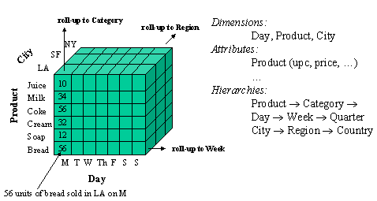
Data Cube

Slide 9
Visualization – Star Schema
Dimension Table (Bars)
Dimension Table (Drinkers)
Dimension Attrs.
Dependent Attrs.
Fact Table - Sales
Dimension Table (Beers)
Dimension Table (etc.)
From anonymous “olap.ppt” found on Google

Slide 10
Typical OLAP Queries
Often, OLAP queries begin with a “star join”: the natural join of the fact table with all or most of the dimension tables.
Example:
SELECT *
FROM Sales, Bars, Beers, Drinkers
WHERE Sales.bar = Bars.bar AND
Sales.beer = Beers.beer AND
Sales.drinker = Drinkers.drinker;
From anonymous “olap.ppt” found on Google

Slide 11
Example: In SQL
SELECT bar, beer, SUM(price)
FROM Sales NATURAL JOIN Bars
NATURAL JOIN Beers
WHERE addr = ’Palo Alto’ AND
manf = ’Anheuser-Busch’
GROUP BY bar, beer;
From anonymous “olap.ppt” found on Google

Slide 12
Example: Materialized View
Which views could help with our query?
Key issues:
  It must join Sales, Bars, and Beers, at least.
  It must group by at least bar and beer.
  It must not select out Palo-Alto bars or Anheuser-Busch beers.
  It must not project out addr or manf.
From anonymous “olap.ppt” found on Google

Slide 13
Example --- Continued
Here is a materialized view that could help:
CREATE VIEW BABMS(bar, addr,
beer, manf, sales) AS
SELECT bar, addr, beer, manf,
SUM(price) sales
FROM Sales NATURAL JOIN Bars
NATURAL JOIN Beers
GROUP BY bar, addr, beer, manf;
Since bar -> addr and beer -> manf, there is no real
grouping. We need addr and manf in the SELECT.
From anonymous “olap.ppt” found on Google

Slide 14
Example --- Concluded
Here’s our query using the materialized view BABMS:
SELECT bar, beer, sales
FROM BABMS
WHERE addr = ’Palo Alto’ AND
manf = ’Anheuser-Busch’;
From anonymous “olap.ppt” found on Google

Slide 15
Example: Market Baskets
If people often buy hamburger and ketchup together, the store can:
  Put hamburger and ketchup near each other and put potato chips between.
  Run a sale on hamburger and raise the price of ketchup.
From anonymous “olap.ppt” found on Google

Slide 16
Finding Frequent Pairs
The simplest case is when we only want to find “frequent pairs” of items.
Assume data is in a relation Baskets(basket, item).
The support threshold s is the minimum number of baskets in which a pair appears before we are interested.
From anonymous “olap.ppt” found on Google

Slide 17
Frequent Pairs in SQL
Look for two
Basket tuples
with the same
basket and
different items.
First item must
precede second,
so we don’t
count the same
pair twice.
SELECT b1.item, b2.item
FROM Baskets b1, Baskets b2
WHERE b1.basket = b2.basket
AND b1.item < b2.item
GROUP BY b1.item, b2.item
HAVING COUNT(*) >= s;
Create a group for
each pair of items
that appears in at
least one basket.
Throw away pairs of items
that do not appear at least
s times.
From anonymous “olap.ppt” found on Google

Slide 18
Lecture Outline
Announcements
  Final Project Reports
Review
  OLAP (ROLAP, MOLAP)
Data Mining with the WEKA toolkit
Big Data (introduction)

Slide 19
More on Data Mining using Weka
Slides from Eibe Frank, Waikato Univ. NZ

Slide 20
Lecture Outline
Announcements
  Final Project Reports
Review
  OLAP (ROLAP, MOLAP)
Data Mining with the WEKA toolkit
Big Data (introduction)

Slide 21
Big Data and Databases
“640K ought to be enough for anybody.”
  Attributed to Bill Gates, 1981

Slide 22
Big Data and Databases
We have already mentioned some Big Data
  The Walmart Data Warehouse
  Information collected by Amazon on users and sales and used to make recommendations
Most modern web-based companies capture EVERYTHING that their customers do
  Does that go into a Warehouse or someplace else?

Slide 23
Other Examples
NASA EOSDIS
  Estimated 10¹⁸ Bytes (Exabyte)
Computer-Aided design
The Human Genome
Department Store tracking
  Mining non-transactional data (e.g. Scientific data, text data?)
Insurance Company
  Multimedia DBMS support

Slide 24
Before the Cloud there was the Grid
So what’s this Grid thing anyhow?
Data Grids and Distributed Storage
Grid vs “Cloud”
This lecture borrows heavily from presentations by Ian Foster (Argonne National Laboratory & University of Chicago), Reagan Moore and others from San Diego Supercomputer Center

Slide 25
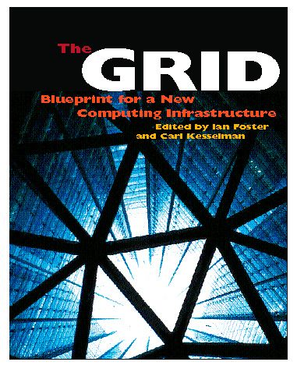
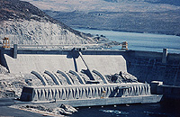
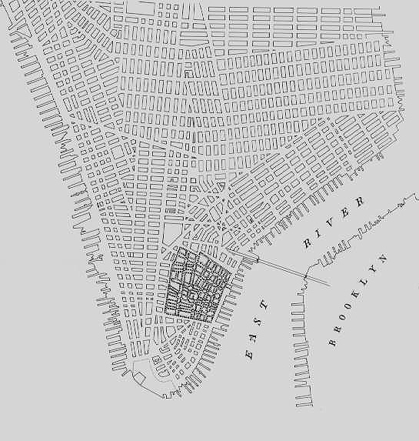
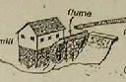
The Grid: On-Demand Access to Electricity
Quality, economies of scale
Time
Source: Ian Foster

Slide 26
By Analogy, A Computing Grid
Decouples production and consumption
  Enable on-demand access
  Achieve economies of scale
  Enhance consumer flexibility
  Enable new devices
On a variety of scales
  Department
  Campus
  Enterprise
  Internet
Source: Ian Foster

Slide 27
What is the Grid?
“The short answer is that, whereas the Web is a service for sharing information over the Internet, the Grid is a service for sharing computer power and data storage capacity over the Internet. The Grid goes well beyond simple communication between computers, and aims ultimately to turn the global network of computers into one vast computational resource.”
Source: The Global Grid Forum

Slide 28
Not Exactly a New Idea …
“The time-sharing computer system can unite a group of investigators …. one can conceive of such a facility as an … intellectual public utility.”
  Fernando Corbato and Robert Fano , 1966
“We will perhaps see the spread of ‘computer utilities’, which, like present electric and telephone utilities, will service individual homes and offices across the country.” Len Kleinrock, 1967
Source: Ian Foster

Slide 29
But, Things are Different Now
Networks are far faster (and cheaper)
  Faster than computer backplanes
“Computing” is very different than pre-Net
  Our “computers” have already disintegrated
  E-commerce increases size of demand peaks
  Entirely new applications & social structures
We’ve learned a few things about software
Source: Ian Foster

Slide 30
Computing isn’t Really Like Electricity
I import electricity but must export data
“Computing” is not interchangeable but highly heterogeneous: data, sensors, services, …
This complicates things; but also means that the sum can be greater than the parts
  Real opportunity: Construct new capabilities dynamically from distributed services
Raises three fundamental questions
  Can I really achieve economies of scale?
  Can I achieve QoS across distributed services?
  Can I identify apps that exploit synergies?
Source: Ian Foster

Slide 31

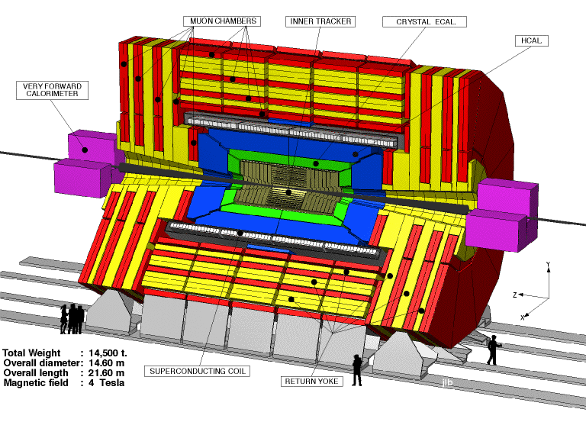
Why the Grid?
(1) Revolution in Science
Pre-Internet
  Theorize &/or experiment, alone
  or in small teams; publish paper
Post-Internet
  Construct and mine large databases of observational or simulation data
  Develop simulations & analyses
  Access specialized devices remotely
  Exchange information within
  distributed multidisciplinary teams
Source: Ian Foster

Slide 32
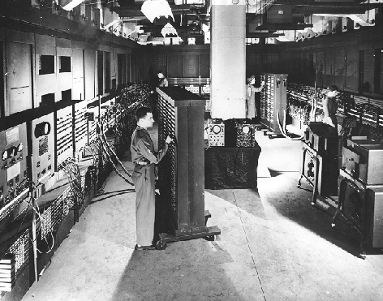
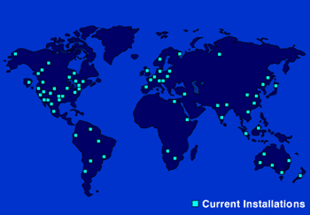
Why the Grid?
(2) Revolution in Business
Pre-Internet
  Central data processing facility
Post-Internet
  Enterprise computing is highly distributed, heterogeneous, inter-enterprise (B2B)
  Business processes increasingly
  computing- & data-rich
  Outsourcing becomes feasible =>
  service providers of various sorts
Source: Ian Foster

Slide 33
The Information Grid
Imagine a web of data
Machine Readable
  Search, Aggregate, Transform, Report On, Mine Data – using more computers, and less humans
Scalable
  Machines are cheap – can buy 50 machines with 100Gb or memory and 100 TB disk for under $100K, and dropping
  Network is now faster than disk
Flexible
  Move data around without breaking the apps
Source: S. Banerjee, O. Alonso, M. Drake - ORACLE

Slide 34
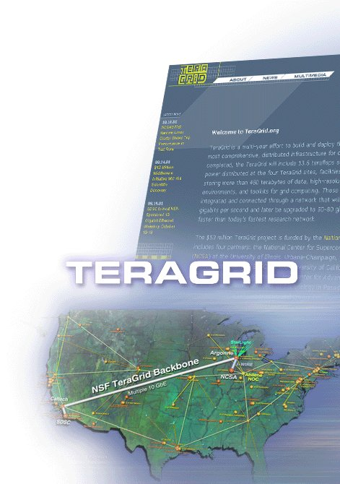

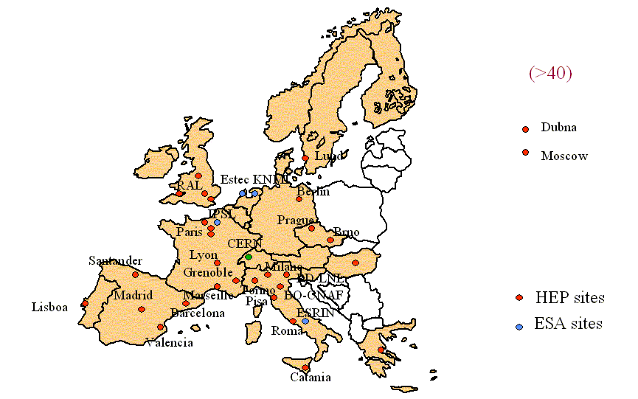


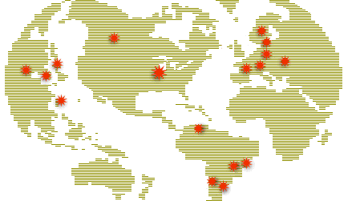

The Foundations are Being Laid
Edinburgh
Glasgow
DL
Newcastle
Belfast
Manchester
Oxford
Cambridge
Cardiff
RAL
London
Hinxton
Soton
Tier0/1 facility
Tier2 facility
Tier3 facility
10 Gbps link
2.5 Gbps link
622 Mbps link
Other link

Slide 35
Current Environment
“Big Data” is becoming ubiquitous in many fields
  enterprise applications
  Web tasks
  E-Science
  Digital entertainment
  Natural Language Processing (esp. for Humanities applications)
  Social Network analysis
  Etc.

Slide 36
Current Environment
Data Analysis as a profit center
  No longer just a cost – may be the entire business as in Business Intelligence

Slide 37
Current Environment
Ubiquity of Structured and Unstructured data
  Text
  XML
  Web Data
  Crawling the Deep Web
How to extract useful information from “noisy” text and structured corpora?

Slide 38
Current Environment
Expanded developer demands
  Wider use means broader requirements, and less interest from developers in the details of traditional DBMS interactions
Architectural Shifts in Computing
  The move to parallel architectures both internally (on individual chips)
  And externally – Cloud Computing

Slide 39
The Semantic Web
The basic structure of the Semantic Web is based on RDF triples (as XML or some other form)
Conventional DBMS are very bad at doing some of the things that the Semantic Web is supposed to do… (.e.g., spreading activation searching)
“Triple Stores” are being developed that are intended to optimize for the types of search and access needed for the Semantic Web

Slide 40
Research Opportunities
Revisiting Database Engines
  Do DBMS need a redesign from the ground up to accommodate the new demands of the current environment?

Slide 41
The next-generation DBMS
What can we expect for a next generation of DBMS?
Look at the DB research community – their research leads to the “new features” in DBMS
The “Claremont Report” on DB research is the report of meeting of top researchers and what they think are the interesting and fruitful research topics for the future

Slide 42
But will it be a RDBMS?
Recently, Mike Stonebraker (one of the people who helped invent Relational DBMS) has suggested that the “One Size Fits All” model for DBMS is an idea whose time has come – and gone
  This was also a theme of the Claremont Report
RDBMS technology, as noted previously, has optimized on transactional business type processing
But many other applications do not follow that model

Slide 43
Will it be an RDBMS?
Stonebraker predicts that the DBMS market will fracture into many more specialized database engines
  Although some may have a shared common frontend
Examples are Data Warehouses, Stream processing engines, Text and unstructured data processing systems

Slide 44
Will it be an RDBMS?
Data Warehouses currently use (mostly) conventional DBMS technology
  But they are NOT the type of data those are optimized for
  Storage usually puts all elements of a row together, but that is an optimization for updating and not searching, summarizing, and reading individual attributes
  A better solution is to store the data by column instead of by row – vastly more efficient for typical Data Warehouse Applications

Slide 45
Will it be an RDBMS?
Streaming data, such as Wall St. stock trade information is badly suited to conventional RDBMS (other than as historical data)
  The data arrives in a continuous real-time stream
  But, data in RDBMS has to be stored before it can be read and actions taken on it
    This is too slow for real-time actions on that data
  Stream processors function by running “queries” on the live data stream instead
    May be orders of magnitude faster

Slide 46
Will it be an RDBMS?
Sensor networks provide another massive stream input and analysis problem
Text Search: No current text search engines use RDBMS, they too need to be optimized for searching, and tend to use inverted file structures instead of RDBMS storage
Scientific databases are another typical example of streamed data from sensor networks or instruments
XML data is still not a first-class citizen of RDBMS, and there are reasons to believe that specialized database engines are needed

Slide 47
Will it be an RDBMS
RDBMS will still be used for what they are best at – business-type high transaction data
But specialized DBMS will be used for many other applications
Consider Oracle’s acquisions of SleepyCat (BerkeleyDB) embedded database engine, and TimesTen main memory database engine
  specialized database engines for specific applications

Slide 48
Some things to consider
Bandwidth will keep increasing and getting cheaper (and go wireless)
Processing power will keep increasing
  Moore’s law: Number of circuits on the most advanced semiconductors doubling every 18 months
  With multicore chips, all computing is becoming parallel computing
Memory and Storage will keep getting cheaper (and probably smaller)
  “Storage law”: Worldwide digital data storage capacity has doubled every 9 months for the past decade

Slide 49
Research Opportunities-DB engines
Designing systems for clusters of many-core processors
Exploiting RAM and Flash as persistent media, rather than relying on magnetic disk
Continuous self-tuning of DBMS systems
Encryption and Compression
Supporting non-relation data models
  instead of “shoe-horning” them into tables

Slide 50
Research Opportunities-DB engines
Trading off consistency and availability for better performance and scaleout to thousands of machines
Designing power-aware DBMS that limit energy costs without sacrificing scalability

Slide 51
Research Opportunities-Programming
Declarative Programming for Emerging Platforms
  MapReduce (esp. Hadoop and tools like Pig)
  Ruby on Rails
  Workflows

Slide 52
Research Opportunities-Data
The Interplay of Structured and Unstructured Data
  Extracting Structure automatically
  Contextual awareness
  Combining with IR research and Machine Learning

Slide 53
Research Opportunities - Cloud
Cloud Data Services
  New models for “shared data” servers
  Learning from Grid Computing
    SRB/IRODS, etc.
  Hadoop - as mentioned earlier - is open source and freely available software from Apache for running massively parallel computation (and distributed storage)

Slide 54
Research Opportunities - Mobile
Mobile Applications and Virtual Worlds
  Need for real-time services combining massive amounts of user-generated data

Slide 55
Moving forward
Much of this is already happening
Big Data is the new normal
  Terabytes are common Petabytes are Big
Hadoop and software based on it (Pig, Hive, Impala, etc.) are becoming standard and well supported (e.g. Cloudera)
Next Week we go for a deeper dive into Big Data and how it can be used
  Tuesday – Tom Lento of Facebook
  Thursday - ???

