Slide 1
Data Warehouses, Decision Support and Data Mining
University of California, Berkeley
School of Information
IS 257: Database Management

Slide 2
Lecture Outline
Review
  Data Warehouses
    (Based on lecture notes from Joachim Hammer, University of Florida, and Joe Hellerstein and Mike Stonebraker of UCB)
Views and View Maintenance
Applications for Data Warehouses
  Decision Support Systems (DSS)
  OLAP (ROLAP, MOLAP)
  Data Mining
    Thanks again to lecture notes from Joachim Hammer of the University of Florida
A new architecture – SAP HANA

Slide 3
Lecture Outline
Review
  Data Warehouses
    (Based on lecture notes from Joachim Hammer, University of Florida, and Joe Hellerstein and Mike Stonebraker of UCB)
Views and View Maintenance
Applications for Data Warehouses
  Decision Support Systems (DSS)
  OLAP (ROLAP, MOLAP)
  Data Mining
    Thanks again to lecture notes from Joachim Hammer of the University of Florida

Slide 4

Problem: Heterogeneous Information Sources
“Heterogeneities are everywhere”
Personal
Databases
World
Wide
Web
Scientific Databases
Digital Libraries
Different interfaces
Different data representations
Duplicate and inconsistent information
Slide credit: J. Hammer

Slide 5
Problem: Data Management in Large Enterprises
Vertical fragmentation of informational systems (vertical stove pipes)
Result of application (user)-driven development of operational systems
Sales Planning
Suppliers
Num. Control
Stock Mngmt
Debt Mngmt
Inventory
...
...
...
Sales Administration
Finance
Manufacturing
...
Slide credit: J. Hammer

Slide 6
Goal: Unified Access to Data
Integration System
World
Wide
Web
Personal
Databases
Digital Libraries
Scientific Databases
Collects and combines information
Provides integrated view, uniform user interface
Supports sharing
Slide credit: J. Hammer

Slide 7
The Traditional Research Approach
Query-driven (lazy, on-demand)
Clients
Integration System
Metadata
. . .
Wrapper
Wrapper
Wrapper
. . .
Source
Source
Source
Slide credit: J. Hammer

Slide 8
The Warehousing Approach
Information integrated in advance
Stored in WH for direct querying and analysis
Clients
Data
Warehouse
Integration System
Metadata
. . .
Extractor/
Monitor
Extractor/
Monitor
Extractor/
Monitor
. . .
Source
Source
Source
Slide credit: J. Hammer

Slide 9
What is a Data Warehouse?
“A Data Warehouse is a
  subject-oriented,
  integrated,
  time-variant,
  non-volatile
collection of data used in support of management decision making processes.”
-- Inmon & Hackathorn, 1994: viz. Hoffer, Chap 11

Slide 10
A Data Warehouse is...
Stored collection of diverse data
  A solution to data integration problem
  Single repository of information
Subject-oriented
  Organized by subject, not by application
  Used for analysis, data mining, etc.
Optimized differently from transaction-oriented db
User interface aimed at executive decision makers and analysts

Slide 11
… Cont’d
Large volume of data (Gb, Tb)
Non-volatile
  Historical
  Time attributes are important
Updates infrequent
May be append-only
Examples
  All transactions ever at WalMart
  Complete client histories at insurance firm
  Stockbroker financial information and portfolios
Slide credit: J. Hammer

Slide 12
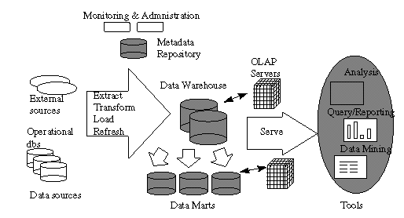
Data Warehousing Architecture

Slide 13
“Ingest”
Clients
Data
Warehouse
Integration System
Metadata
. . .
Extractor/
Monitor
Extractor/
Monitor
Extractor/
Monitor
. . .
Source/ File
Source / DB
Source / External

Slide 14
Lecture Outline
Review
  Data Warehouses
    (Based on lecture notes from Joachim Hammer, University of Florida, and Joe Hellerstein and Mike Stonebraker of UCB)
Views and View Maintenance
Applications for Data Warehouses
  Decision Support Systems (DSS)
  OLAP (ROLAP, MOLAP)
  Data Mining
    Thanks again to lecture notes from Joachim Hammer of the University of Florida

Slide 15
Warehouse Maintenance
Warehouse data ≈ materialized view
  Initial loading
  View maintenance
View maintenance
Slide credit: J. Hammer

Slide 16
Differs from Conventional View Maintenance...
Warehouses may be highly aggregated and summarized
Warehouse views may be over history of base data
Process large batch updates
Schema may evolve
Slide credit: J. Hammer

Slide 17
Differs from Conventional View Maintenance...
Base data doesn’t participate in view maintenance
  Simply reports changes
  Loosely coupled
  Absence of locking, global transactions
  May not be queriable
Slide credit: J. Hammer

Slide 18
Warehouse Maintenance Anomalies
Materialized view maintenance in loosely coupled, non-transactional environment
Simple example
Data
Warehouse
Sold (item,clerk,age)
Sold = Sale Emp
Integrator
Sales
Comp.
Sale(item,clerk)
Emp(clerk,age)
Slide credit: J. Hammer

Slide 19
Warehouse Maintenance Anomalies
Data
Warehouse
Sold (item,clerk,age)
Integrator
Sales
Comp.
Sale(item,clerk)
Emp(clerk,age)
1. Insert into Emp(Mary,25), notify integrator
2. Insert into Sale (Computer,Mary), notify integrator
3. (1) → integrator adds Sale (Mary,25)
4. (2) → integrator adds (Computer,Mary) Emp
5. View incorrect (duplicate tuple)
Slide credit: J. Hammer

Slide 20
Maintenance Anomaly - Solutions
Incremental update algorithms (ECA, Strobe, etc.)
  ECA (Eager Compensating Algorithm) is “an incremental view maintenance algorithm. It is a method for fixing the view maintenance problem that occurs due to the decoupling between base data and the view maintenance manager at the warehouse”
Research issues: Self-maintainable views
  What views are self-maintainable
  Store auxiliary views so original + auxiliary views are self-maintainable

Slide 21
Self-Maintainability: Examples
Sold(item,clerk,age) =
Sale(item,clerk) Emp(clerk,age)
Inserts into Emp
  If Emp.clerk is key and Sale.clerk is foreign key (with ref. int.) then no effect
Inserts into Sale
  Maintain auxiliary view:
  Emp-Π_{clerk,age}(Sold)
Deletes from Emp
  Delete from Sold based on clerk
Slide credit: J. Hammer

Slide 22
Self-Maintainability: Examples
Deletes from Sale
  Delete from Sold based on {item,clerk}
  Unless age at time of sale is relevant
Auxiliary views for self-maintainability
  Must themselves be self-maintainable
  One solution: all source data
  But want minimal set
Slide credit: J. Hammer

Slide 23
Partial Self-Maintainability
Avoid (but don’t prohibit) going to sources
Sold=Sale(item,clerk) Emp(clerk,age)
Inserts into Sale
  Check if clerk already in Sold, go to source if not
  Or replicate all clerks over age 30
  Or ...
Slide credit: J. Hammer

Slide 24
Warehouse Specification (ideally)
View Definitions
Warehouse
Configuration
Module
Warehouse
Integration
rules
Change
Detection
Requirements
Integrator
Metadata
Extractor/
Monitor
Extractor/
Monitor
Extractor/
Monitor
...
Slide credit: J. Hammer

Slide 25
Optimization
Update filtering at extractor
  Similar to irrelevant updates in constraint and view maintenance
Multiple view maintenance
  If warehouse contains several views
  Exploit shared sub-views
Slide credit: J. Hammer

Slide 26
Additional Research Issues
Historical views of non-historical data
Expiring outdated information
Crash recovery
Addition and removal of information sources
  Schema evolution
Slide credit: J. Hammer

Slide 27
More Information on DW
Agosta, Lou, The Essential Guide to Data Warehousing. Prentise Hall PTR, 1999.
Devlin, Barry, Data Warehouse, from Architecture to Implementation. Addison-Wesley, 1997.
Inmon, W.H., Building the Data Warehouse. John Wiley, 1992.
Widom, J., “Research Problems in Data Warehousing.” Proc. of the 4th Intl. CIKM Conf., 1995.
Chaudhuri, S., Dayal, U., “An Overview of Data Warehousing and OLAP Technology.” ACM SIGMOD Record, March 1997.

Slide 28
Lecture Outline
Review
  Data Warehouses
    (Based on lecture notes from Joachim Hammer, University of Florida, and Joe Hellerstein and Mike Stonebraker of UCB)
Views and View Maintenance
Applications for Data Warehouses
  Decision Support Systems (DSS)
  OLAP (ROLAP, MOLAP)
  Data Mining
    Thanks again to lecture notes from Joachim Hammer of the University of Florida

Slide 29
Today
Source: Gregory Piatetsky-Shapiro
Applications for Data Warehouses
  Decision Support Systems (DSS)
  OLAP (ROLAP, MOLAP)
  Data Mining
Thanks again to slides and lecture notes from Joachim Hammer of the University of Florida, and also to Laura Squier of SPSS, Gregory Piatetsky-Shapiro of KDNuggets and to the CRISP web site

Slide 30

Trends leading to Data Flood
More data is generated:
  Bank, telecom, other business transactions ...
  Scientific Data: astronomy, biology, etc
  Web, text, and e-commerce
More data is captured:
  Storage technology faster and cheaper
  DBMS capable of handling bigger DB
Source: Gregory Piatetsky-Shapiro

Slide 31
Examples
Europe's Very Long Baseline Interferometry (VLBI) has 16 telescopes, each of which produces 1 Gigabit/second of astronomical data over a 25-day observation session
  storage and analysis a big problem
Walmart reported to have 500 Terabyte DB
AT&T handles billions of calls per day
  data cannot be stored -- analysis is done on the fly
Source: Gregory Piatetsky-Shapiro

Slide 32
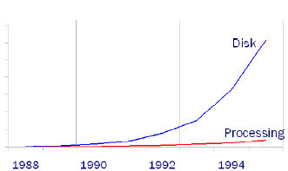
Growth Trends
Moore’s law
  Computer Speed doubles every 18 months
Storage law
  total storage doubles every 9 months
Consequence
  very little data will ever be looked at by a human
Knowledge Discovery is NEEDED to make sense and use of data.
Source: Gregory Piatetsky-Shapiro

Slide 33
Knowledge Discovery in Data (KDD)
Knowledge Discovery in Data is the non-trivial process of identifying
  valid
  novel
  potentially useful
  and ultimately understandable patterns in data.
    from Advances in Knowledge Discovery and Data Mining, Fayyad, Piatetsky-Shapiro, Smyth, and Uthurusamy, (Chapter 1), AAAI/MIT Press 1996
Source: Gregory Piatetsky-Shapiro

Slide 34
Related Fields
Machine
Learning
Visualization
Data Mining and
Knowledge Discovery
Statistics
Databases
Source: Gregory Piatetsky-Shapiro

Slide 35

Knowledge Discovery Process
Integration
Interpretation
& Evaluation
Knowledge
Data Mining
Knowledge
RawData
Transformation
__
____
__
____
__
____
Patterns
and
Rules
Selection
& Cleaning
Understanding
Transformed
Data
DATA
Ware
house
Target
Data
Source: Gregory Piatetsky-Shapiro

Slide 36
What is Decision Support?
Technology that will help managers and planners make decisions regarding the organization and its operations based on data in the Data Warehouse.
  What was the last two years of sales volume for each product by state and city?
  What effects will a 5% price discount have on our future income for product X?
Increasing common term is KDD
  Knowledge Discovery in Databases

Slide 37
Conventional Query Tools
Ad-hoc queries and reports using conventional database tools
  E.g. Access queries.
Typical database designs include fixed sets of reports and queries to support them
  The end-user is often not given the ability to do ad-hoc queries

Slide 38
OLAP
Online Line Analytical Processing
  Intended to provide multidimensional views of the data
  I.e., the “Data Cube”
  The PivotTables in MS Excel are examples of OLAP tools

Slide 39
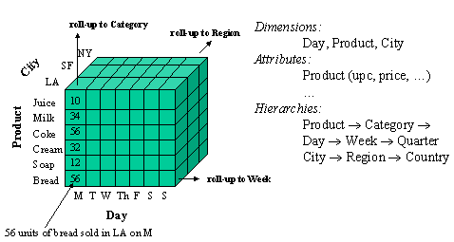
Data Cube

Slide 40
Operations on Data Cubes
Slicing the cube
  Extracts a 2d table from the multidimensional data cube
  Example…
Drill-Down
  Analyzing a given set of data at a finer level of detail

Slide 41
Star Schema
Typical design for the derived layer of a Data Warehouse or Mart for Decision Support
  Particularly suited to ad-hoc queries
  Dimensional data separate from fact or event data
Fact tables contain factual or quantitative data about the business
Dimension tables hold data about the subjects of the business
Typically there is one Fact table with multiple dimension tables

Slide 42
Star Schema for multidimensional data
Product
ProdNo
ProdName
Category
Description
…
Order
OrderNo
OrderDate
…
Fact Table
OrderNo
Salespersonid
Customerno
ProdNo
Datekey
Cityname
Quantity
TotalPrice
Customer
CustomerName
CustomerAddress
City
…
Date
DateKey
Day
Month
Year
…
Salesperson
SalespersonID
SalespersonName
City
Quota
City
CityName
State
Country
…

Slide 43
Data Mining
Data mining is knowledge discovery rather than question answering
  May have no pre-formulated questions
  Derived from
    Traditional Statistics
    Artificial intelligence
    Computer graphics (visualization)
Another term used is “Analytics” which covers much of the same topics

Slide 44
Goals of Data Mining
Explanatory
  Explain some observed event or situation
    Why have the sales of SUVs increased in California but not in Oregon?
Confirmatory
  To confirm a hypothesis
    Whether 2-income families are more likely to buy family medical coverage
Exploratory
  To analyze data for new or unexpected relationships
    What spending patterns seem to indicate credit card fraud?

Slide 45
Data Mining Applications
Profiling Populations
Analysis of business trends
Target marketing
Usage Analysis
Campaign effectiveness
Product affinity
Customer Retention and Churn
Profitability Analysis
Customer Value Analysis
Up-Selling

Slide 46
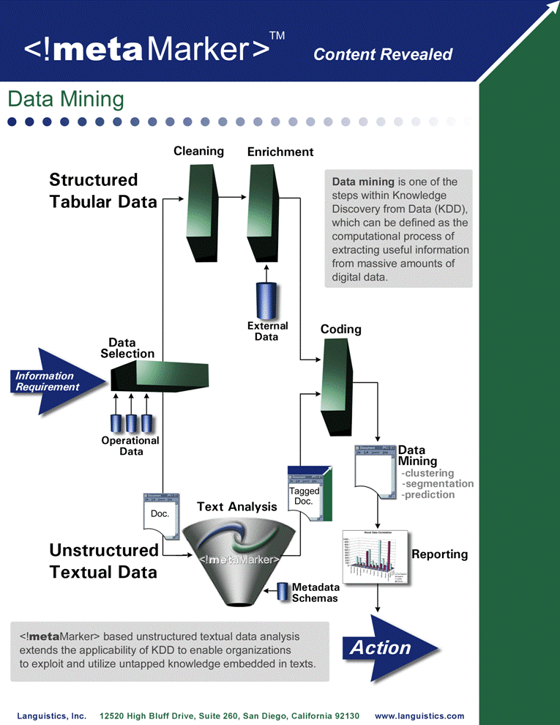
Data + Text Mining Process
Source: Languistics
via Google Images

Slide 47
How Can We Do Data Mining?
By Utilizing the CRISP-DM Methodology
  a standard process
  existing data
  software technologies
  situational expertise
Source: Laura Squier

Slide 48
Why Should There be a Standard Process?
Framework for recording experience
  Allows projects to be replicated
Aid to project planning and management
“Comfort factor” for new adopters
  Demonstrates maturity of Data Mining
  Reduces dependency on “stars”
The data mining process must be reliable and repeatable by people with little data mining background.
Source: Laura Squier

Slide 49
Process Standardization
CRISP-DM:
CRoss Industry Standard Process for Data Mining
Initiative launched Sept.1996
SPSS/ISL, NCR, Daimler-Benz, OHRA
Funding from European commission
Over 200 members of the CRISP-DM SIG worldwide
  DM Vendors - SPSS, NCR, IBM, SAS, SGI, Data Distilleries, Syllogic, Magnify, ..
  System Suppliers / consultants - Cap Gemini, ICL Retail, Deloitte & Touche, …
  End Users - BT, ABB, Lloyds Bank, AirTouch, Experian, ...
Source: Laura Squier

Slide 50

CRISP-DM
Non-proprietary
Application/Industry neutral
Tool neutral
Focus on business issues
  As well as technical analysis
Framework for guidance
Experience base
  Templates for Analysis
Source: Laura Squier

Slide 51
The CRISP-DM Process Model
Source: Laura Squier

Slide 52
Why CRISP-DM?
The data mining process must be reliable and repeatable by people with little data mining skills
CRISP-DM provides a uniform framework for
  guidelines
  experience documentation
CRISP-DM is flexible to account for differences
  Different business/agency problems
  Different data
Source: Laura Squier

Slide 53
Phases and Tasks
Business
Understanding
Data
Understanding
Data
Preparation
Modeling
Evaluation
Deployment
Determine
Business Objectives
Background
Business Objectives
Business Success
Criteria
Situation Assessment
Inventory of Resources
Requirements,
Assumptions, and
Constraints
Risks and Contingencies
Terminology
Costs and Benefits
Determine
Data Mining Goal
Data Mining Goals
Data Mining Success
Criteria
Produce Project Plan
Project Plan
Initial Asessment of
Tools and Techniques
Collect Initial Data
Initial Data Collection
Report
Describe Data
Data Description Report
Explore Data
Data Exploration Report
Verify Data Quality
Data Quality Report
Data Set
Data Set Description
Select Data
Rationale for Inclusion /
Exclusion
Clean Data
Data Cleaning Report
Construct Data
Derived Attributes
Generated Records
Integrate Data
Merged Data
Format Data
Reformatted Data
Select Modeling
Technique
Modeling Technique
Modeling Assumptions
Generate Test Design
Test Design
Build Model
Parameter Settings
Models
Model Description
Assess Model
Model Assessment
Revised Parameter
Settings
Evaluate Results
Assessment of Data
Mining Results w.r.t.
Business Success
Criteria
Approved Models
Review Process
Review of Process
Determine Next Steps
List of Possible Actions
Decision
Plan Deployment
Deployment Plan
Plan Monitoring and
Maintenance
Monitoring and
Maintenance Plan
Produce Final Report
Final Report
Final Presentation
Review Project
Experience
Documentation
Source: Laura Squier

Slide 54
Phases in CRISP
Business Understanding
  This initial phase focuses on understanding the project objectives and requirements from a business perspective, and then converting this knowledge into a data mining problem definition, and a preliminary plan designed to achieve the objectives.
Data Understanding
  The data understanding phase starts with an initial data collection and proceeds with activities in order to get familiar with the data, to identify data quality problems, to discover first insights into the data, or to detect interesting subsets to form hypotheses for hidden information.
Data Preparation
  The data preparation phase covers all activities to construct the final dataset (data that will be fed into the modeling tool(s)) from the initial raw data. Data preparation tasks are likely to be performed multiple times, and not in any prescribed order. Tasks include table, record, and attribute selection as well as transformation and cleaning of data for modeling tools.
Modeling
  In this phase, various modeling techniques are selected and applied, and their parameters are calibrated to optimal values. Typically, there are several techniques for the same data mining problem type. Some techniques have specific requirements on the form of data. Therefore, stepping back to the data preparation phase is often needed.
Evaluation
  At this stage in the project you have built a model (or models) that appears to have high quality, from a data analysis perspective. Before proceeding to final deployment of the model, it is important to more thoroughly evaluate the model, and review the steps executed to construct the model, to be certain it properly achieves the business objectives. A key objective is to determine if there is some important business issue that has not been sufficiently considered. At the end of this phase, a decision on the use of the data mining results should be reached.
Deployment
  Creation of the model is generally not the end of the project. Even if the purpose of the model is to increase knowledge of the data, the knowledge gained will need to be organized and presented in a way that the customer can use it. Depending on the requirements, the deployment phase can be as simple as generating a report or as complex as implementing a repeatable data mining process. In many cases it will be the customer, not the data analyst, who will carry out the deployment steps. However, even if the analyst will not carry out the deployment effort it is important for the customer to understand up front what actions will need to be carried out in order to actually make use of the created models.

Slide 55
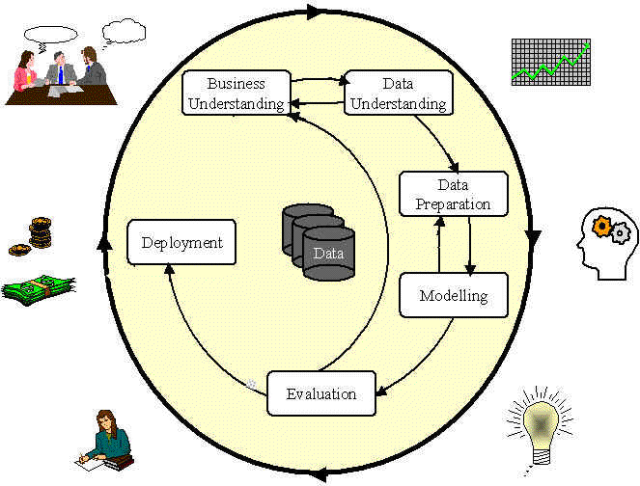
Phases in the DM Process: CRISP-DM
Source: Laura Squier

Slide 56
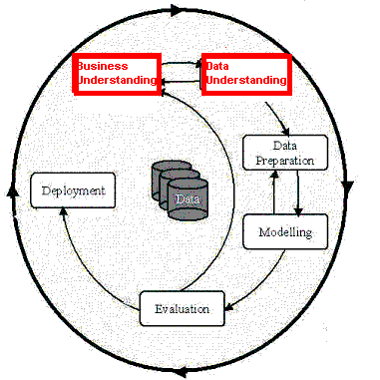
Phases in the DM Process (1 & 2)
Business Understanding:
  Statement of Business Objective
  Statement of Data Mining objective
  Statement of Success Criteria
Data Understanding
  Explore the data and verify the quality
  Find outliers
Source: Laura Squier

Slide 57
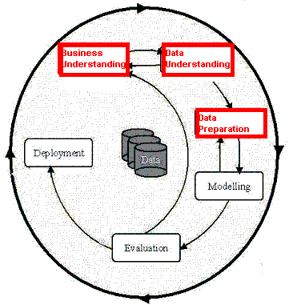
Phases in the DM Process (3)
Data preparation:
  Takes usually over 90% of our time
    Collection
    Assessment
    Consolidation and Cleaning
      table links, aggregation level, missing values, etc
    Data selection
      active role in ignoring non-contributory data?
      outliers?
      Use of samples
      visualization tools
    Transformations - create new variables
Source: Laura Squier

Slide 58
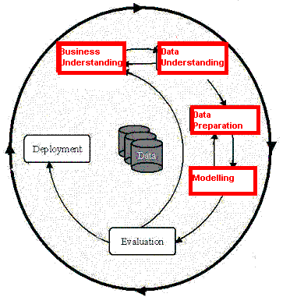
Phases in the DM Process (4)
Model building
  Selection of the modeling techniques is based upon the data mining objective
  Modeling is an iterative process - different for supervised and unsupervised learning
    May model for either description or prediction
Source: Laura Squier

Slide 59
Types of Models
Prediction Models for Predicting and Classifying
  Regression algorithms (predict numeric outcome): neural networks, rule induction, CART (OLS regression, GLM)
  Classification algorithm predict symbolic outcome): CHAID (CHi-squared Automatic Interaction Detection), C5.0 (discriminant analysis, logistic regression)
Descriptive Models for Grouping and Finding Associations
  Clustering/Grouping algorithms: K-means, Kohonen
  Association algorithms: apriori, GRI
Source: Laura Squier

Slide 60
Data Mining Algorithms
Market Basket Analysis
Memory-based reasoning
Cluster detection
Link analysis
Decision trees and rule induction algorithms
Neural Networks
Genetic algorithms

Slide 61
Market Basket Analysis
A type of clustering used to predict purchase patterns.
Identify the products likely to be purchased in conjunction with other products
  E.g., the famous (and apocryphal) story that men who buy diapers on Friday nights also buy beer.

Slide 62
Memory-based reasoning
Use known instances of a model to make predictions about unknown instances.
Could be used for sales forecasting or fraud detection by working from known cases to predict new cases

Slide 63
Cluster detection
Finds data records that are similar to each other.
K-nearest neighbors (where K represents the mathematical distance to the nearest similar record) is an example of one clustering algorithm

Slide 64
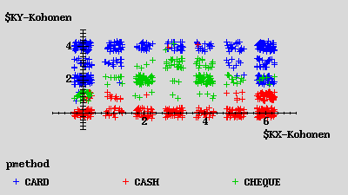
Kohonen Network
Description
unsupervised
seeks to describe dataset in terms of natural clusters of cases
Source: Laura Squier

Slide 65
Link analysis
Follows relationships between records to discover patterns
Link analysis can provide the basis for various affinity marketing programs
Similar to Markov transition analysis methods where probabilities are calculated for each observed transition.

Slide 66
Decision trees and rule induction algorithms
Pulls rules out of a mass of data using classification and regression trees (CART) or Chi-Square automatic interaction detectors (CHAID)
These algorithms produce explicit rules, which make understanding the results simpler

Slide 67
Rule Induction
Description
  Produces decision trees:
    income < $40K
      job > 5 yrs then good risk
      job < 5 yrs then bad risk
    income > $40K
      high debt then bad risk
      low debt then good risk
  Or Rule Sets:
    Rule #1 for good risk:
      if income > $40K
      if low debt
    Rule #2 for good risk:
      if income < $40K
      if job > 5 years
Source: Laura Squier

Slide 68
Rule Induction
Description
Intuitive output
Handles all forms of numeric data, as well as non-numeric (symbolic) data
C5 Algorithm a special case of rule induction
Target variable must be symbolic
Source: Laura Squier

Slide 69
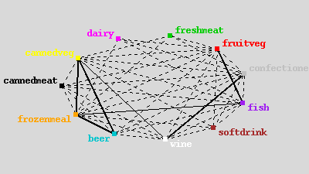
Apriori
Description
Seeks association rules in dataset
‘Market basket’ analysis
Sequence discovery
Source: Laura Squier

Slide 70
Neural Networks
Attempt to model neurons in the brain
Learn from a training set and then can be used to detect patterns inherent in that training set
Neural nets are effective when the data is shapeless and lacking any apparent patterns
May be hard to understand results

Slide 71
Neural Network
Input layer
Hidden layer
Output
Source: Laura Squier

Slide 72
Neural Networks
Description
  Difficult interpretation
  Tends to ‘overfit’ the data
  Extensive amount of training time
  A lot of data preparation
  Works with all data types
Source: Laura Squier

Slide 73
Genetic algorithms
Imitate natural selection processes to evolve models using
  Selection
  Crossover
  Mutation
Each new generation inherits traits from the previous ones until only the most predictive survive.

Slide 74
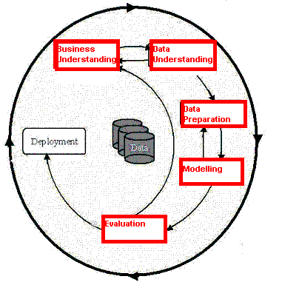
Phases in the DM Process (5)
Model Evaluation
  Evaluation of model: how well it performed on test data
  Methods and criteria depend on model type:
    e.g., coincidence matrix with classification models, mean error rate with regression models
  Interpretation of model: important or not, easy or hard depends on algorithm
Source: Laura Squier

Slide 75
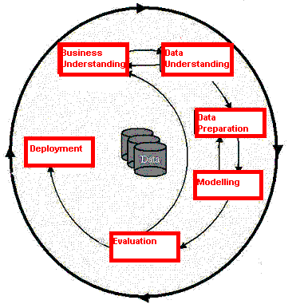
Phases in the DM Process (6)
Deployment
  Determine how the results need to be utilized
  Who needs to use them?
  How often do they need to be used
Deploy Data Mining results by:
  Scoring a database
  Utilizing results as business rules
  interactive scoring on-line
Source: Laura Squier

Slide 76
Specific Data Mining Applications:
Source: Laura Squier

Slide 77

What data mining has done for...
The US Internal Revenue Service
needed to improve customer service and...
Scheduled its workforce
to provide faster, more accurate answers to questions.
Source: Laura Squier
Notes:
The US Internal Revenue Service is using data mining to improve customer service.
[Click] By analyzing incoming requests for help and information, the IRS hopes to schedule its workforce to provide faster, more accurate answers to questions.

Slide 78

What data mining has done for...
The US Drug Enforcement Agency needed to be more effective in their drug “busts” and
analyzed suspects’ cell phone usage to focus investigations.
Source: Laura Squier
Notes:
The US DFAS needs to search through 2.5 million financial transactions that may indicate inaccurate charges. Instead of relying on tips to point out fraud, the DFAS is mining the data to identify suspicious transactions.
[Click] Using Clementine, the agency examined credit card transactions and was able to identify purchases that did not match past patterns. Using this information, DFAS could focus investigations, finding fraud more costs effectively.

Slide 79

What data mining has done for...
HSBC need to cross-sell more
effectively by identifying profiles
that would be interested in higher
yielding investments and...
Reduced direct mail costs by 30% while garnering 95% of the campaign’s revenue.
Source: Laura Squier
Notes:
Retail banking is a highly competitive business. In addition to competition from other banks, banks also see intense competition from financial services companies of all kinds, from stockbrokers to mortgage companies.
With so many organizations working the same customer base, the value of customer retention is greater than ever before. As a result, HSBC Bank USA looks to enticing existing customers to "roll over" maturing products, or on cross-selling new ones.
[Click] Using SPSS products, HSBC found that it could reduce direct mail costs by 30% while still bringing in 95% of the campaign’s revenue. Because HSBC is sending out fewer mail pieces, customers are likely to be more loyal because they don’t receive junk mail from the bank.

Slide 80
Analytic technology can be effective
Combining multiple models and link analysis can reduce false positives
Today there are millions of false positives with manual analysis
Data Mining is just one additional tool to help analysts
Analytic Technology has the potential to reduce the current high rate of false positives
Source: Gregory Piatetsky-Shapiro

Slide 81
Data Mining with Privacy
Data Mining looks for patterns, not people!
Technical solutions can limit privacy invasion
  Replacing sensitive personal data with anon. ID
  Give randomized outputs
  Multi-party computation – distributed data
  …
    Bayardo & Srikant, Technological Solutions for Protecting Privacy, IEEE Computer, Sep 2003
Source: Gregory Piatetsky-Shapiro

Slide 82
The Hype Curve for
Data Mining and Knowledge Discovery
Over-inflated
expectations
Growing acceptance
and mainstreaming
rising
expectations
Disappointment
Source: Gregory Piatetsky-Shapiro

