Slide 1
Object-Relational Databases and OR Extensions
University of California, Berkeley
School of Information
IS 257: Database Management

Slide 2
Lecture Outline
Object-Relational DBMS
OR features in Oracle
OR features in PostgreSQL
Extending OR databases (examples from PostgreSQL)

Slide 3
Lecture Outline
Object-Relational DBMS
OR features in Oracle
OR features in PostgreSQL
Extending OR databases (examples from PostgreSQL)

Slide 4
Object Relational Databases
Background
Object Definitions
inheritance
User-defined datatypes
User-defined functions

Slide 5
Object Relational Databases
Began with UniSQL/X unified object-oriented and relational system
Some systems (like OpenODB from HP) were Object systems built on top of Relational databases.
Miro/Montage/Illustra built on Postgres.
Informix Buys Illustra. (DataBlades)
Oracle Hires away Informix Programmers. (Cartridges)

Slide 6
Object Relational Data Model
Class, instance, attribute, method, and integrity constraints
OID per instance
Encapsulation
Multiple inheritance hierarchy of classes
Class references via OID object references
Set-Valued attributes
Abstract Data Types

Slide 7
Object Relational Extended SQL (Illustra)
CREATE TABLE tablename {OF TYPE Typename}|{OF NEW TYPE typename} (attr1 type1, attr2 type2,…,attrn typen) {UNDER parent_table_name};
CREATE TYPE typename (attribute_name type_desc, attribute2 type2, …, attrn typen);
CREATE FUNCTION functionname (type_name, type_name) RETURNS type_name AS sql_statement

Slide 8
Object-Relational SQL in ORACLE
CREATE (OR REPLACE) TYPE typename AS OBJECT (attr_name, attr_type, …);
CREATE TABLE OF typename;

Slide 9
Example
CREATE TYPE ANIMAL_TY AS OBJECT (Breed VARCHAR2(25), Name VARCHAR2(25), Birthdate DATE);
Creates a new type
CREATE TABLE Animal of Animal_ty;
Creates “Object Table”

Slide 10
Constructor Functions
INSERT INTO Animal values (ANIMAL_TY(‘Mule’, ‘Frances’, TO_DATE(‘01-APR-1997’, ‘DD-MM-YYYY’)));
Insert a new ANIMAL_TY object into the table

Slide 11
Selecting from an Object Table
Just use the columns in the object…
SELECT Name from Animal;

Slide 12
More Complex Objects
CREATE TYPE Address_TY as object (Street VARCHAR2(50), City VARCHAR2(25), State CHAR(2), zip NUMBER);
CREATE TYPE Person_TY as object (Name VARCHAR2(25), Address ADDRESS_TY);
CREATE TABLE CUSTOMER (Customer_ID NUMBER, Person PERSON_TY);

Slide 13
What Does the Table Look like?
DESCRIBE CUSTOMER;
NAME TYPE
-----------------------------------------------------
CUSTOMER_ID NUMBER
PERSON NAMED TYPE

Slide 14
Inserting
INSERT INTO CUSTOMER VALUES (1, PERSON_TY(‘John Smith’, ADDRESS_TY(‘57 Mt Pleasant St.’, ‘Finn’, ‘NH’, 111111)));

Slide 15
Selecting from Abstract Datatypes
SELECT Customer_ID from CUSTOMER;
SELECT * from CUSTOMER;
CUSTOMER_ID PERSON(NAME, ADDRESS(STREET, CITY, STATE ZIP))
---------------------------------------------------------------------------------------------------
1 PERSON_TY(‘JOHN SMITH’, ADDRESS_TY(‘57...

Slide 16
Selecting from Abstract Datatypes
SELECT Customer_id, person.name from Customer;
SELECT Customer_id, person.address.street from Customer;

Slide 17
Updating
UPDATE Customer SET person.address.city = ‘HART’ where person.address.city = ‘Briant’;

Slide 18
MySQL
So far, no data type definitions in MySQL
But would not be surprised to see them before too long
User-defined data types are in the current SQL standard, so they will probably make it into MySQL eventually
They are available in Oracle and PostgreSQL

Slide 19
User-Defined Functions (Oracle)
CREATE [OR REPLACE] FUNCTION funcname (argname [IN | OUT | IN OUT] datatype …) RETURN datatype (IS | AS) {block | external body}

Slide 20
Example
Create Function BALANCE_CHECK (Person_name IN Varchar2) RETURN NUMBER is BALANCE NUMBER(10,2) BEGIN
SELECT sum(decode(Action, ‘BOUGHT’, Amount, 0)) - sum(decode(Action, ‘SOLD’, amount, 0)) INTO BALANCE FROM LEDGER where Person = PERSON_NAME;
RETURN BALANCE;
END;

Slide 21
Example
Select NAME, BALANCE_CHECK(NAME) from Worker;

Slide 22
Functions and Procedures - MySQL
CREATE [DEFINER = { user | CURRENT_USER }] PROCEDURE sp_name ([proc_parameter[,...]]) [characteristic ...] routine_body
CREATE [DEFINER = { user | CURRENT_USER }] FUNCTION sp_name ([func_parameter[,...]]) RETURNS type [characteristic ...] routine_body
proc_parameter: [ IN | OUT | INOUT ] param_name type
func_parameter: param_name type
type: Any valid MySQL data type
characteristic: LANGUAGE SQL | [NOT] DETERMINISTIC | { CONTAINS SQL | NO SQL | READS SQL DATA | MODIFIES SQL DATA } | SQL SECURITY { DEFINER | INVOKER } | COMMENT 'string'
routine_body: Valid SQL procedure statement

Slide 23
Defining a MySQL procedure
mysql> delimiter //
mysql> CREATE PROCEDURE simpleproc (OUT param1 INT)
-> BEGIN
-> SELECT COUNT(*) INTO param1 FROM t;
-> END//
Query OK, 0 rows affected (0.00 sec)
mysql> delimiter ;
mysql> CALL simpleproc(@a);
Query OK, 0 rows affected (0.00 sec)
mysql> SELECT @a;
+------+
| @a |
+------+
| 3 |
+------+
1 row in set (0.00 sec)

Slide 24
Defining a MySQL Function
mysql> CREATE FUNCTION hello (s CHAR(20))
RETURNS CHAR(50) DETERMINISTIC
-> RETURN CONCAT('Hello, ',s,'!');
Query OK, 0 rows affected (0.00 sec)
mysql> SELECT hello('world');
+----------------+
| hello('world') |
+----------------+
| Hello, world! |
+----------------+
1 row in set (0.00 sec)

Slide 25
TRIGGERS (Oracle)
Create TRIGGER UPDATE_LODGING INSTEAD OF UPDATE on WORKER_LODGING for each row BEGIN
if :old.name <> :new.name then update worker set name = :new.name where name = :old.name;
end if;
if :old.lodging <> … etc...

Slide 26
Triggers in MySQL
CREATE
[DEFINER = { user | CURRENT_USER }]
TRIGGER trigger_name trigger_time trigger_event
ON tbl_name FOR EACH ROW trigger_stmt
trigger_event can be INSERT, UPDATE, or DELETE
trigger_time can be BEFORE or AFTER.

Slide 27
Triggers in MySQL
CREATE TABLE test1(a1 INT);
CREATE TABLE test2(a2 INT);
CREATE TABLE test3(a3 INT NOT NULL AUTO_INCREMENT PRIMARY KEY);
CREATE TABLE test4( a4 INT NOT NULL AUTO_INCREMENT PRIMARY KEY, b4 INT DEFAULT 0 );
delimiter |
CREATE TRIGGER testref BEFORE INSERT ON test1 FOR EACH ROW
BEGIN
INSERT INTO test2 SET a2 = NEW.a1;
DELETE FROM test3 WHERE a3 = NEW.a1;
UPDATE test4 SET b4 = b4 + 1 WHERE a4 = NEW.a1;
END |
delimiter ;

Slide 28
Triggers in MySQL (cont)
mysql> INSERT INTO test3 (a3) VALUES
(NULL), (NULL), (NULL), (NULL), (NULL), (NULL), (NULL), (NULL), (NULL),
(NULL);
mysql> INSERT INTO test4 (a4) VALUES (0), (0), (0), (0), (0), (0), (0), (0),
(0), (0);
mysql> INSERT INTO test1 VALUES
-> (1), (3), (1), (7), (1), (8), (4), (4);
mysql> SELECT * FROM test1;
+------+
| a1 |
+------+
| 1 |
| 3 |
| 1 |
| 7 |
| 1 |
| 8 |
| 4 |
| 4 |
+------+

Slide 29
Triggers in MySQL (cont
mysql> SELECT * FROM test2;
+------+
| a2 |
+------+
| 1 |
| 3 |
| 1 |
| 7 |
| 1 |
| 8 |
| 4 |
| 4 |
+------+
mysql> SELECT * FROM test3;
+----+
| a3 |
+----+
| 2 |
| 5 |
| 6 |
| 9 |
| 10 |
+----+
mysql> SELECT * FROM test4;
+----+------+
| a4 | b4 |
+----+------+
| 1 | 3 |
| 2 | 0 |
| 3 | 1 |
| 4 | 2 |
| 5 | 0 |
| 6 | 0 |
| 7 | 1 |
| 8 | 1 |
| 9 | 0 |
| 10 | 0 |
+----+------+

Slide 30
Lecture Outline
Object-Relational DBMS
OR features in Oracle
OR features in PostgreSQL
Extending OR databases (examples from PostgreSQL)

Slide 31
PostgreSQL
Derived from POSTGRES
Developed at Berkeley by Mike Stonebraker and his students (EECS) starting in 1986
Postgres95
Andrew Yu and Jolly Chen adapted POSTGRES to SQL and greatly improved the code base
PostgreSQL
Name changed in 1996, and since that time the system has been expanded to support most SQL92 and many SQL99 features

Slide 32
PostgreSQL Classes
The fundamental notion in Postgres is that of a class, which is a named collection of object instances. Each instance has the same collection of named attributes, and each attribute is of a specific type. Furthermore, each instance has a permanent object identifier (OID) that is unique throughout the installation. Because SQL syntax refers to tables, we will use the terms table and class interchangeably. Likewise, an SQL row is an instance and SQL columns are attributes.

Slide 33
Creating a Class
You can create a new class by specifying the class name, along with all attribute names and their types:
CREATE TABLE weather (
city varchar(80),
temp_lo int, -- low temperature
temp_hi int, -- high temperature
prcp real, -- precipitation
date date
);

Slide 34
PostgreSQL
Postgres can be customized with an arbitrary number of user-defined data types. Consequently, type names are not syntactical keywords, except where required to support special cases in the SQL92 standard.
So far, the Postgres CREATE command looks exactly like the command used to create a table in a traditional relational system. However, we will presently see that classes have properties that are extensions of the relational model.

Slide 35
PostgreSQL
All of the usual SQL commands for creation, searching and modifying classes (tables) are available. With some additions…
Inheritance
Non-Atomic Values
User defined functions and operators

Slide 36
Inheritance
CREATE TABLE cities (
name text,
population float,
altitude int -- (in ft)
);
CREATE TABLE capitals (
state char(2)
) INHERITS (cities);

Slide 37
Inheritance
ray=# create table cities (name varchar(50), population float,
altitude int);
CREATE TABLE
ray=# \d cities
Table "public.cities"
Column | Type | Modifiers
------------+-----------------------+-----------
name | character varying(50) |
population | double precision |
altitude | integer |
ray=# create table capitals (state char(2)) inherits (cities);
CREATE TABLE
ray=# \d capitals
Table "public.capitals"
Column | Type | Modifiers
------------+-----------------------+-----------
name | character varying(50) |
population | double precision |
altitude | integer |
state | character(2) |
Inherits: cities

Slide 38
Inheritance
In Postgres, a class can inherit from zero or more other classes.
A query can reference either
all instances of a class
or all instances of a class plus all of its descendants

Slide 39
Inheritance
For example, the following query finds all the cities that are situated at an attitude of 500ft or higher:
SELECT name, altitude
FROM cities
WHERE altitude > 500;
+----------+----------+
|name | altitude |
+----------+----------+
|Las Vegas | 2174 |
+----------+----------+
|Mariposa | 1953 |
+----------+----------+

Slide 40
Inheritance
On the other hand, to find the names of all cities, including state capitals, that are located at an altitude over 500ft, the query is:
SELECT c.name, c.altitude
FROM cities* c
WHERE c.altitude > 500;
which returns:
+----------+----------+
|name | altitude |
+----------+----------+
|Las Vegas | 2174 |
+----------+----------+
|Mariposa | 1953 |
+----------+----------+
|Madison | 845 |
+----------+----------+

Slide 41
Inheritance
The "*" after cities in the preceding query indicates that the query should be run over cities and all classes below cities in the inheritance hierarchy
Many of the PostgreSQL commands (SELECT, UPDATE and DELETE, etc.) support this inheritance notation using "*"

Slide 42
Non-Atomic Values
One of the tenets of the relational model is that the attributes of a relation are atomic
I.e. only a single value for a given row and column (I.e., 1st Normal Form)
Postgres does not have this restriction: attributes can themselves contain sub-values that can be accessed from the query language
Examples include arrays and other complex data types.

Slide 43
Non-Atomic Values - Arrays
Postgres allows attributes of an instance to be defined as fixed-length or variable-length multi-dimensional arrays. Arrays of any base type or user-defined type can be created. To illustrate their use, we first create a class with arrays of base types.
CREATE TABLE SAL_EMP (
name text,
pay_by_quarter int4[],
schedule text[][]
);

Slide 44
Non-Atomic Values - Arrays
The preceding SQL command will create a class named SAL_EMP with a text string (name), a one-dimensional array of int4 (pay_by_quarter), which represents the employee's salary by quarter and a two-dimensional array of text (schedule), which represents the employee's weekly schedule
Now we do some INSERTSs; note that when appending to an array, we enclose the values within braces and separate them by commas.

Slide 45
Inserting into Arrays
INSERT INTO SAL_EMP
VALUES ('Bill',
'{10000, 10000, 10000, 10000}',
'{{"meeting", "lunch"}, {}}');
INSERT INTO SAL_EMP
VALUES ('Carol',
'{20000, 25000, 25000, 25000}',
'{{"talk", "consult"}, {"meeting"}}');

Slide 46
Querying Arrays
This query retrieves the names of the employees whose pay changed in the second quarter:
SELECT name
FROM SAL_EMP
WHERE SAL_EMP.pay_by_quarter[1] <>
SAL_EMP.pay_by_quarter[2];
+------+
|name |
+------+
|Carol |
+------+

Slide 47
Querying Arrays
This query retrieves the third quarter pay of all employees:
SELECT SAL_EMP.pay_by_quarter[3] FROM SAL_EMP;
+---------------+
|pay_by_quarter |
+---------------+
|10000 |
+---------------+
|25000 |
+---------------+

Slide 48
Querying Arrays
We can also access arbitrary slices of an array, or subarrays. This query retrieves the first item on Bill's schedule for the first two days of the week.
SELECT SAL_EMP.schedule[1:2][1:1]
FROM SAL_EMP
WHERE SAL_EMP.name = 'Bill';
+-------------------+
|schedule |
+-------------------+
|{{"meeting"},{""}} |
+-------------------+

Slide 49
Lecture Outline
Object-Relational DBMS
OR features in Oracle
OR features in PostgreSQL
Extending OR databases (examples from PostgreSQL)

Slide 50
PostgreSQL Extensibility
Postgres is extensible because its operation is catalog-driven
RDBMS store information about databases, tables, columns, etc., in what are commonly known as system catalogs. (Some systems call this the data dictionary).
One key difference between Postgres and standard RDBMS is that Postgres stores much more information in its catalogs
not only information about tables and columns, but also information about its types, functions, access methods, etc.
These classes can be modified by the user, and since Postgres bases its internal operation on these classes, this means that Postgres can be extended by users
By comparison, conventional database systems can only be extended by changing hardcoded procedures within the DBMS or by loading modules specially-written by the DBMS vendor.

Slide 51
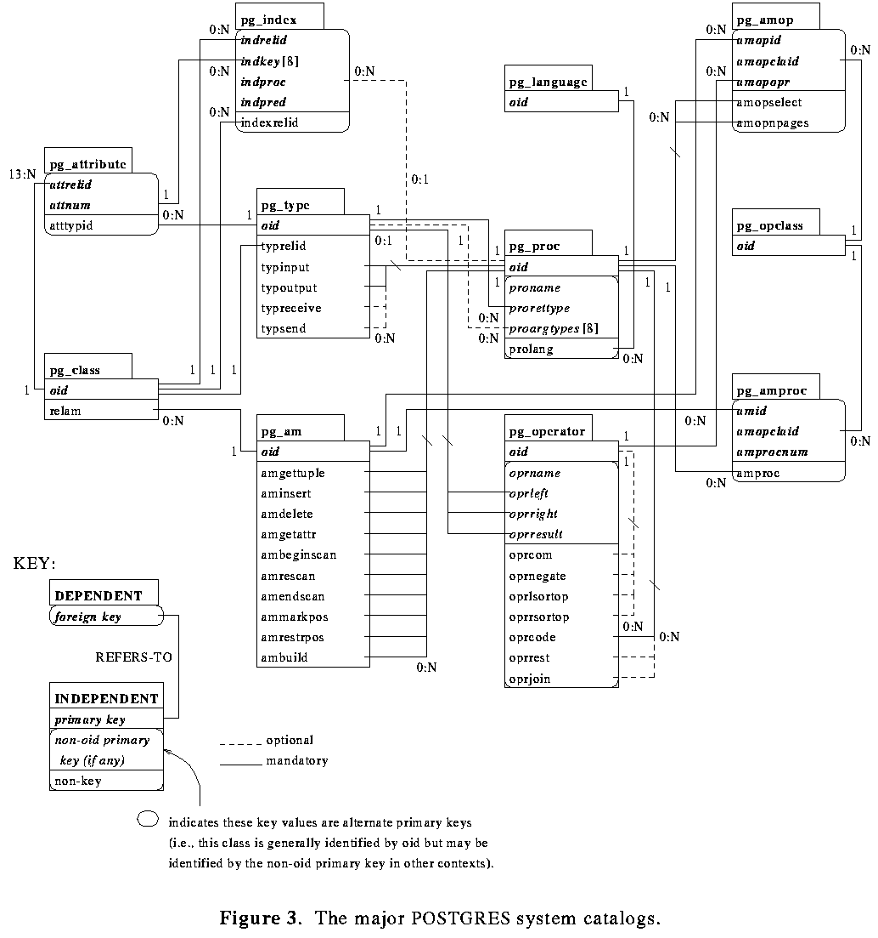
Postgres System Catalogs

Slide 52
User Defined Functions
CREATE FUNCTION allows a Postgres user to register a function with a database. Subsequently, this user is considered the owner of the function
CREATE FUNCTION name ( [ ftype [, ...] ] )
RETURNS rtype
AS {SQLdefinition}
LANGUAGE 'langname'
[ WITH ( attribute [, ...] ) ]
CREATE FUNCTION name ( [ ftype [, ...] ] )
RETURNS rtype
AS obj_file , link_symbol
LANGUAGE 'C'
[ WITH ( attribute [, ...] ) ]

Slide 53
Simple SQL Function
CREATE FUNCTION one() RETURNS int4
AS 'SELECT 1 AS RESULT'
LANGUAGE 'sql';
SELECT one() AS answer;
answer
--------
1

Slide 54
A more complex function
To illustrate a simple SQL function, consider the following, which might be used to debit a bank account:
create function TP1 (int4, float8) returns int4
as ‘update BANK set balance = BANK.balance - $2
where BANK.acctountno = $1;
select balance from bank
where accountno = $1; ‘ language 'sql';
A user could execute this function to debit account 17 by $100.00 as follows:
select (x = TP1( 17,100.0));

Slide 55
SQL Functions on Composite Types
When creating functions with composite types, you have to include the attributes of that argument. If EMP is a table containing employee data, (therefore also the name of the composite type for each row of the table) a function to double salary might be…
CREATE FUNCTION double_salary(EMP) RETURNS integer
AS ' SELECT $1.salary * 2 AS salary; ' LANGUAGE SQL;
SELECT name, double_salary(EMP) AS dream FROM EMP WHERE EMP.cubicle ~= point '(2,1)';
name | dream
------+-------
Sam | 2400
Notice the use of the syntax $1.salary to select one field of the argument row value. Also notice how the calling SELECT command uses a table name to denote the entire current row of that table as a composite value.

Slide 56
SQL Functions on Composite Types
It is also possible to build a function that returns a composite type. This is an example of a function that returns a single EMP row:
CREATE FUNCTION new_emp() RETURNS EMP
AS ' SELECT text ''None'' AS name,
1000 AS salary,
25 AS age,
point ''(2,2)'' AS cubicle; ' LANGUAGE SQL;

Slide 57
External Functions
This example creates a C function by calling a routine from a user-created shared library. This particular routine calculates a check digit and returns TRUE if the check digit in the function parameters is correct. It is intended for use in a CHECK contraint.
CREATE FUNCTION ean_checkdigit(bpchar, bpchar) RETURNS bool
AS '/usr1/proj/bray/sql/funcs.so' LANGUAGE 'c';
CREATE TABLE product (
id char(8) PRIMARY KEY,
eanprefix char(8) CHECK (eanprefix ~ '[0-9]{2} [0-9]{5}')
REFERENCES brandname(ean_prefix),
eancode char(6) CHECK (eancode ~ '[0-9]{6}'),
CONSTRAINT ean CHECK (ean_checkdigit(eanprefix, eancode)));

Slide 58
Creating new Types
CREATE TYPE allows the user to register a new user data type with Postgres for use in the current data base. The user who defines a type becomes its owner. typename is the name of the new type and must be unique within the types defined for this database.
CREATE TYPE typename ( INPUT = input_function, OUTPUT = output_function
, INTERNALLENGTH = { internallength | VARIABLE } [ , EXTERNALLENGTH = { externallength | VARIABLE } ]
[ , DEFAULT = "default" ]
[ , ELEMENT = element ] [ , DELIMITER = delimiter ]
[ , SEND = send_function ] [ , RECEIVE = receive_function ]
[ , PASSEDBYVALUE ] )

Slide 59
New Type Definition
This command creates the box data type and then uses the type in a class definition:
CREATE TYPE box (INTERNALLENGTH = 8,
INPUT = my_procedure_1, OUTPUT = my_procedure_2);
CREATE TABLE myboxes (id INT4, description box);

Slide 60
New Type Definition
In the external language (usually C) functions are written for
Type input
From a text representation to the internal representation
Type output
From the internal represenation to a text representation
Can also define function and operators to manipulate the new type

Slide 61
New Type Definition Example
A C data structure is defined for the new type:
typedef struct Complex {
double x;
double y;
} Complex;

Slide 62
New Type Definition Example
Complex *
complex_in(char *str)
{
double x, y;
Complex *result;
if (sscanf(str, " ( %lf , %lf )", &x, &y) != 2) {
elog(WARN, "complex_in: error in parsing”);
return NULL;
}
result = (Complex *)palloc(sizeof(Complex));
result->x = x;
result->y = y;
return (result);
}

Slide 63
New Type Definition Example
char *
complex_out(Complex *complex)
{
char *result;
if (complex == NULL)
return(NULL);
result = (char *) palloc(60);
sprintf(result, "(%g,%g)", complex->x,
complex->y);
return(result);
}

Slide 64
New Type Definition Example
Now tell the system about the new type…
CREATE FUNCTION complex_in(opaque)
RETURNS complex
AS 'PGROOT/tutorial/obj/complex.so'
LANGUAGE 'c';
CREATE FUNCTION complex_out(opaque)
RETURNS opaque
AS 'PGROOT/tutorial/obj/complex.so'
LANGUAGE 'c';
CREATE TYPE complex (
internallength = 16,
input = complex_in,
output = complex_out);

Slide 65
Operator extensions
CREATE FUNCTION complex_add(complex, complex)
RETURNS complex
AS '$PWD/obj/complex.so'
LANGUAGE 'c';
CREATE OPERATOR + (
leftarg = complex,
rightarg = complex,
procedure = complex_add,
commutator = + );

Slide 66
Create tables using the type
CREATE TABLE test_complex (a complex, b complex);
INSERT INTO test_complex (a,b) values (….);

Slide 67
Now we can do…
SELECT (a + b) AS c FROM test_complex;
+----------------+
|c |
+----------------+
|(5.2,6.05) |
+----------------+
|(133.42,144.95) |
+----------------+

Slide 68
Creating new Aggregates
CREATE AGGREGATE complex_sum (
sfunc1 = complex_add,
basetype = complex,
stype1 = complex,
initcond1 = '(0,0)');
SELECT complex_sum(a) FROM test_complex;
+------------+
|complex_sum |
+------------+
|(34,53.9) |
+------------+

Slide 69
Rules System
CREATE RULE name AS ON event
TO object [ WHERE condition ]
DO [ INSTEAD ] [ action | NOTHING ]
Rules can be triggered by any event (select, update, delete, etc.)

Slide 70
Views as Rules
Views in Postgres are implemented using the rule system. In fact there is absolutely no difference between a
CREATE VIEW myview AS SELECT * FROM mytab;
compared against the two commands
CREATE TABLE myview (same attribute list as for mytab);
CREATE RULE "_RETmyview" AS ON SELECT TO myview DO INSTEAD
SELECT * FROM mytab;

Slide 71
Extensions to Indexing
Access Method extensions in Postgres
GiST: A Generalized Search Trees
Joe Hellerstein, UC Berkeley

Slide 72
Indexing in OO/OR Systems
Quick access to user-defined objects
Support queries natural to the objects
Two previous approaches
Specialized Indices (“ABCDEFG-trees”)
redundant code: most trees are very similar
concurrency control, etc. tricky!
Extensible B-trees & R-trees (Postgres/Illustra)
B-tree or R-tree lookups only!
E.g. ‘WHERE movie.video < ‘Terminator 2’

Slide 73
GiST Approach
A generalized search tree. Must be:
Extensible in terms of queries
General (B+-tree, R-tree, etc.)
Easy to extend
Efficient (match specialized trees)
Highly concurrent, recoverable, etc.

Slide 74
GiST Applications
New indexes needed for new apps...
find all supersets of S
find all molecules that bind to M
your favorite query here (multimedia?)
...and for new queries over old domains:
find all points in region from 12 to 2 o’clock
find all text elements estimated relevant to a query string

