Slide 1
New Generation Database Systems: XML Databases
University of California, Berkeley
School of Information
IS 257: Database Management

Slide 2
Lecture Outline
XML and RDBMS
Xpath and Native XML Databases

Slide 3
Lecture Outline
XML and DBMS
Xpath and Native XML Databases

Slide 4
Standards: XML/SQL
As part of SQL3 an extension providing a mapping from XML to DBMS is being created called XML/SQL
The (draft) standard is very complex, but the ideas are actually pretty simple
Suppose we have a table called EMPLOYEE that has columns EMPNO, FIRSTNAME, LASTNAME, BIRTHDATE, SALARY

Slide 5
Standards: XML/SQL
That table can be mapped to: <EMPLOYEE> <row><EMPNO>000020</EMPNO> <FIRSTNAME>John</FIRSTNAME> <LASTNAME>Smith</LASTNAME> <BIRTHDATE>1955-08-21</BIRTHDATE> <SALARY>52300.00</SALARY> </row>
<row> … etc. …

Slide 6
Standards: XML/SQL
In addition the standard says that XMLSchemas must be generated for each table, and also allows relations to be managed by nesting records from tables in the XML.
Variants of this are incorporated into the latest versions of ORACLE
But what if you want to deal with more complex XML schemas (beyond “flat” structures)?

Slide 7
XML and MySQL
MySQL supports XML output of results:
Specify the “--xml” option when starting the mysql client…
mysql> select * from DIVECUST;
<?xml version="1.0"?>
<resultset statement="select * from DIVECUST;"
xmlns:xsi="http://www.w3.org/2001/XMLSchema-instance">
<row>
<field name="Customer_No">1480</field>
<field name="Name">Louis Jazdzewski</field>
<field name="Street">2501 O'Connor</field>
<field name="City">New Orleans</field>
<field name="State_Prov">LA</field>
<field name="Zip_Postal_Code">60332</field>
<field name="Country">U.S.A.</field>
… etc…

Slide 8
XML and MySQL
The mysqldump command can also use the “--xml” option, in which case the entire dump is phrased in XML…
harbinger:~ --> mysqldump --xml -p ray DIVECUST …
<?xml version="1.0"?>
<mysqldump xmlns:xsi="http://www.w3.org/2001/XMLSchema-instance">
<database name="ray">
<table_structure name="DIVECUST">
<field Field="Customer_No" Type="int(11)" Null="NO" Key="PRI"
Extra="" Comment="" />
<field Field="Name" Type="varchar(255)" Null="YES" Key="" Extra=""
Comment="" />…
<options Name="DIVECUST" Engine="MyISAM" Version="10"
Row_format="Dynamic" Rows="26" Avg_row_length="92"
Data_length="2412" … Check_time="2011-09-02 15:49:22"
Collation="latin1_swedish_ci" Create_options="" Comment="" />
</table_structure>

Slide 9
XML and MySQL
… <table_data name="DIVECUST"> <row> <field name="Customer_No">1480</field> <field name="Name">Louis Jazdzewski</field> <field name="Street">2501 O'Connor</field> <field name="City">New Orleans</field> <field name="State_Prov">LA</field> <field name="Zip_Postal_Code">60332</field> <field name="Country">U.S.A.</field> <field name="Phone">(902) 555-8888</field> <field name="First_Contact">1991-01-29 00:00:00</field> </row> <row> <field name="Customer_No">1481</field> <field name="Name">Barbara Wright</field> <field name="Street">6344 W. Freeway</field> <field name="City">San Francisco</field> <field name="State_Prov">CA</field> <field name="Zip_Postal_Code">95031</field> <field name="Country">U.S.A.</field> …

Slide 10
XML to Relational Database Mapping
The following slides are adapted from:
Bhavin Kansara
Slide from Bhavin Kansara

Slide 11
Introduction
XML/relational mapping means data transformation between XML and relational data models
XML documents can be transformed to relational data models or vice versa.
Mapping method is the way the mapping is done
Slide from Bhavin Kansara

Slide 12
XML
XML: Extensible Markup Language
Documents have tags giving extra information about sections of the document
E.g. <title> XML </title>
<slide> Introduction </slide>
XML has emerged as the standard for representing and exchanging data on the World Wide Web.
The increasing amount of XML documents requires the need to store and query XML documents efficiently.
Slide from Bhavin Kansara

Slide 13
XML vs. HTML
<name>
<first> abc </first>
<middle> xyz </middle>
<last> def </last>
</name>
<html>
<head>
<title>Title of page</title>
</head>
<body>
abc <br>
xyz <br>
def <br>
</body>
</html>
HTML tags describe how to render things on the screen, while XML tags describe what thing are.
HTML tags are designed for the interaction between humans and computers, while XML tags are designed for the interactions between two computers.
Unlike HTML, XML tags tell you what the data means, rather than how to display it
Slide from Bhavin Kansara

Slide 14
XML Technologies
<bib>
{
for $b in doc("http://bstore1.example.com/bib.xml")/bib/book
where $b/publisher = "Addison-Wesley" and $b/@year > 1991
return
<book year="{ $b/@year }">
{ $b/title }
</book>
}
</bib>
Schema Languages
DTDs
XML Schemas
Query Languages
XPath
XQuery
XSLT
Programming APIs
DOM
SAX
<?xml version="1.0" encoding="ISO-8859-1"?>
<?xml-stylesheet type="text/xsl" href="simple.xsl"?>
<breakfast_menu>
<food>
<name>Belgian Waffles</name>
<price>$5.95</price>
<description>
two of our famous Belgian Waffles
</description>
<calories>650</calories>
</food>
</breakfast_menu>
Slide from Bhavin Kansara

Slide 15
DTD ( Document Type Definition )
Slide from Bhavin Kansara
DTD stands for Document Type Definition
The purpose of a Document Type Definition is to define the legal building blocks of an XML document.
It formally defines relationship between the various elements that form the documents.
DTD allows computers to check that each component of document occurs in a valid place within the document.

Slide 16
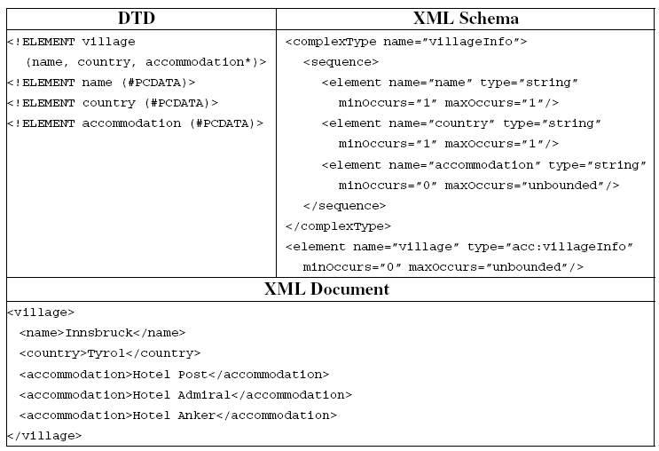
DTD ( Document Type Definition )
Slide from Bhavin Kansara

Slide 17
XML vs. Relational Database
CUSTOMER
Name | Age
ABC | 30
XYZ | 40
<customers>
<custRec>
<Name type=“String”>ABC</Name>
<Age type=“Integer”>30</Age>
</custRec>
<custRec>
<Name type=“String”>XYZ</Name>
<Age type=“Integer”>40</Age>
</custRec>
</customers>
Slide from Bhavin Kansara

Slide 18
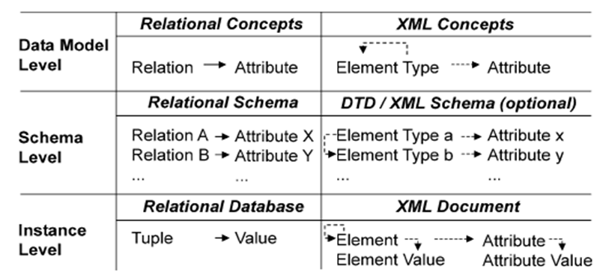
XML vs. Relational Database
Slide from Bhavin Kansara

Slide 19
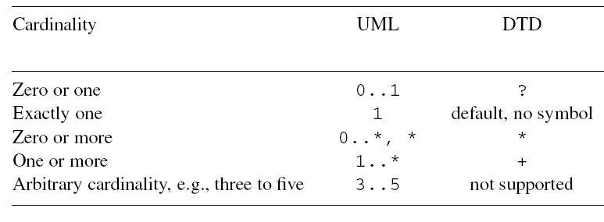
XML vs. Relational Database
<!ELEMENT note (to+, from, header, message*, #PCDATA)>
Slide from Bhavin Kansara

Slide 20
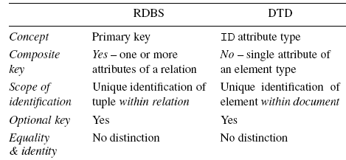
XML vs. Relational Database
Slide from Bhavin Kansara

Slide 21
When XML representation is not beneficial
Slide from Bhavin Kansara
When downstream processing of the data is relational
When the highest possible performance is required
When any normalized data components have value outside the XML representation or the data need not be retained in XML form to have value
When the data is naturally tabular

Slide 22
When XML representation is beneficial
Slide from Bhavin Kansara
When schema is volatile
When data is inherently hierarchical in nature
When data represents business objects in which the component parts do not make sense when removed from the context of that business object
When applications have sparse attributes
When low-volume data is highly structured

Slide 23
XML-to-Relational mapping
Slide from Bhavin Kansara
Schema mapping
Database schema is generated from an XML schema or DTD for the storage of XML documents.
Data mapping
Shreds an input XML document into relational tuples and inserts them into the relational database whose schema is generated in the schema mapping phase

Slide 24
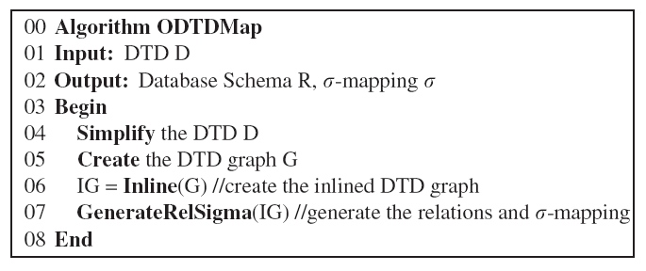
Schema Mapping
Slide from Bhavin Kansara

Slide 25
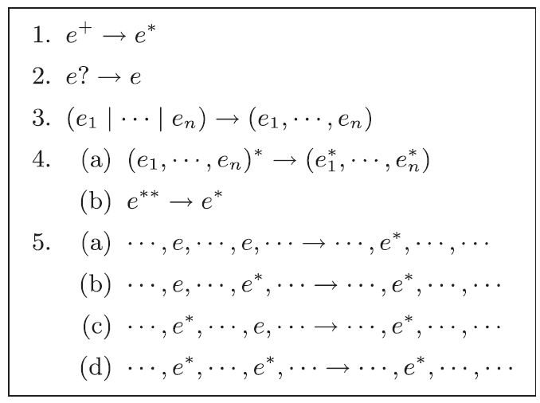
Simplifying DTD
Slide from Bhavin Kansara

Slide 26
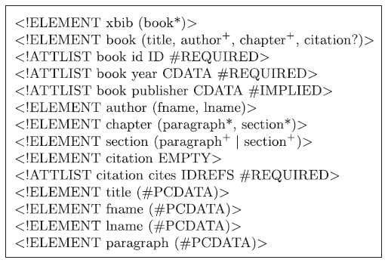
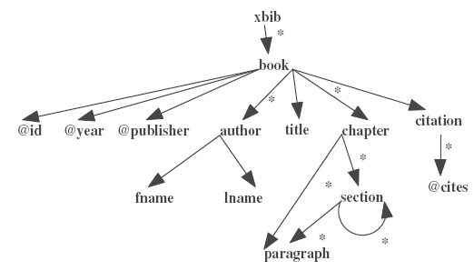
DTD graph
Slide from Bhavin Kansara
Notes:
26

Slide 27
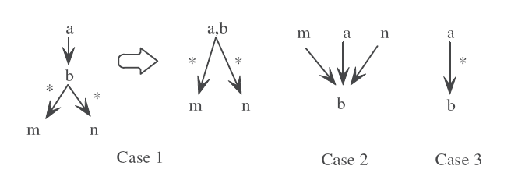
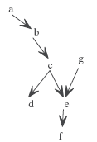
Inlined DTD graph
Given a DTD graph, a node is inlinable if and only if it has exactly one incoming edge and that edge is a normal edge.
Slide from Bhavin Kansara
Notes:
27

Slide 28
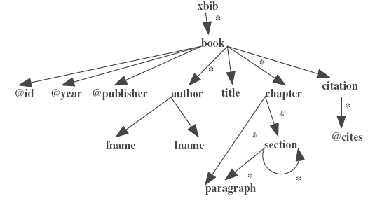
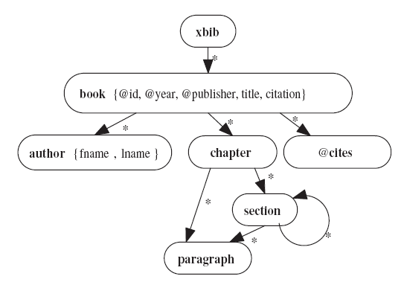
Inlined DTD graph
Slide from Bhavin Kansara

Slide 29
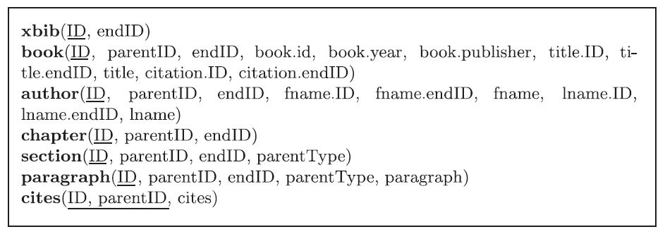
Generated Database Schema
Slide from Bhavin Kansara

Slide 30
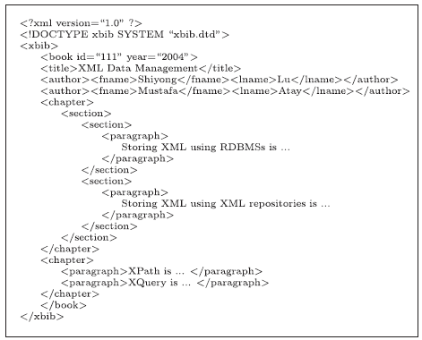
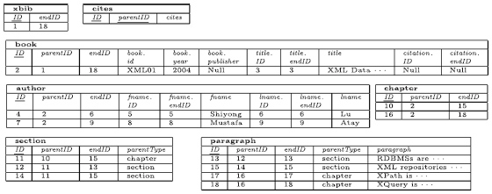
Data Mapping
XML file is used to insert data into generated database schema
Parser is used to fetch data from XML file.
Slide from Bhavin Kansara

Slide 31
Summary
Slide from Bhavin Kansara
Simplify DTD
Create DTD graph from simplified DTD
Create inlined DTD graph from DTD graph
Use inlined DTD graph to generate database schema
Insert values from XML file into generated tables

Slide 32
Issues
So, we can convert the XML to a relational database, but can we then export as an XML document?
This is equally challenging
But MOSTLY involves just re-joining the tables
How do you store and put back the wrapping tags for sets of subelements?
Since the decomposition of the DTD was approximate, the output MAY not be identical to the input

Slide 33
Lecture Outline
XML and RDBMS
Native XML Databases

Slide 34
Native XML Database (NXD)
Native XML databases have an XML-based internal model
That is, their fundamental unit of storage is XML
However, different native XML databases differ in What they consider the fundamental unit of storage
Document vs element or segment
And how that information or its subelements are accessed, indexed and queried
E.g., SQL vs. Xquery or a special query language

Slide 35
Why XML Databases?
The advantages of using an XML repository over an RDBMS come from the reduced mismatch between the application-programming model and the data storage model.
In particular applications that deal with document content or non-tabular information benefit from using an XML database.
Any information that has no schema, conforms only loosely to a schema, or conforms to a schema that is extensible, or changes frequently is a good candidate.
From: http://www.oracle.com/technetwork/products/berkeleydb/xml-faq-088319.html#General

Slide 36
Database Systems supporting XQuery
The following database systems offer XQuery support:
Native XML Databases:
Berkeley DB XML
eXist
MarkLogic
Software AG Tamino
Raining Data TigerLogic
Documentum xDb (X-Hive/DB) (now EMC)
Relational Databases (also support SQL):
IBM DB2
Microsoft SQL Server
Oracle

Slide 37
Further comments on NXD
Native XML databases are most often used for storing “document-centric” XML document
I.e. the unit of retrieval would typically be the entire document and not a particular node or subelement
This supports query languages like Xquery
Able to ask for “all documents where the third chapter contains a page that has boldfaced word”
Very difficult to do that kind of query in SQL

Slide 38
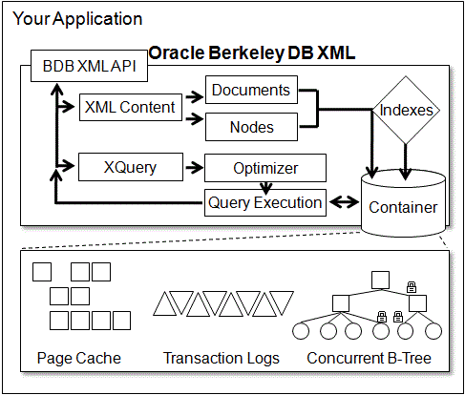
Anatomy of a Native XML database
ORACLE Berkeley DB XML
Berkeley DB XML supports XQuery 1.0 and XPath 2.0, XML Namespaces, schema validation, naming and cross-container operations and document streaming.
From: http://www.oracle.com/technetwork/products/berkeleydb/overview/index-083851.html

Slide 39
OBDBXML
The XQuery engine uses a sophisticated cost-based query optimizer and supports pre-compiled query execution with embedded variables.
Large documents can be stored intact or broken up into nodes, enabling more efficient retrieval and partial document updates.
Berkeley DB XML supports flexible indexing of XML nodes, elements, attributes and meta-data to enable the fastest, most efficient retrieval of data.
From: http://www.oracle.com/technetwork/products/berkeleydb/overview/index-083851.html

Slide 40
OBDBXML
XML Document Storage
Fast, scalable, transactional storage
Flexible storage control - nodes or whole document
Group content into containers
Schema and method validation, per-document
Key/value meta-data support
XML namespace support
XQuery debugging support
White space preservation when whole document storage is used
From: http://www.oracle.com/technetwork/products/berkeleydb/overview/index-083851.html

Slide 41
OBDBXML
XML Document Indexing
Berkeley DB XML's unique dynamic indexing system enables optimized retrieval of XML content. XQuery statements are optimized based on statistical, cost-based query planning engine combine to deliver results quickly even when processing complex XQuery statements across large datasets.
Flexible indexing of XML nodes, elements, attributes and meta-data
Node level indexes which improve query performance, especially for large XML documents
Complex index creation and removal at runtime
Indexes targeted at specific hot spots
Type and existence-specific indexes
Interactive query planning and index optimization
Partial document re-indexing
From: http://www.oracle.com/technetwork/products/berkeleydb/overview/index-083851.html

Slide 42
OBDBXML
XML Document Query Access
The XQuery language brings to XML databases what SQL brings to relational databases. With XQuery it is easy to express complex relationships, joins, conditions and result sets in statements that can be optimized and executed quickly over huge data sets. Berkeley DB XML closely tracks the XQuery and related XML standards.
XQuery 1.0 and XPath 2.0
Queries within a single container or across many
Queries across containers and network sources of XML data
Permanent document identifiers for direct access
Query optimization via cost-based query engine
Streamlined path expression evaluation and predicate evaluation
Pre-compiled queries containing variables for even more efficient repeated execution
Document streaming from URI, memory or file
DOM-like navigation of XML result sets
From: http://www.oracle.com/technetwork/products/berkeleydb/overview/index-083851.html

Slide 43
OBDBXML
XML Document Modification
Berkeley DB XML provides a full modification API allowing for very efficient updates. XML document modification is not yet part of the XQuery standard, but as the standards are approved, Berkeley DB XML will support them.
XQuery Update 1.0
Partial document updates
In-place document modification within transactions
Concurrent modification of different sections of content
From: http://www.oracle.com/technetwork/products/berkeleydb/overview/index-083851.html

Slide 44
OBDBXML
Deployment
Berkeley DB XML is very flexible, easy to deploy and easy to integrate. As a set of C and C++ libraries, it can be installed and configured along with your application. It was designed to operate without the need for administrative oversight, no DBA required, all administrative functions are controlled programmatically. It supports a wide variety of programming languages and operating system platforms.
Programmatic administration and management - zero human administration
Command line tools to load, backup, dump and interact with the XML databases
Language support (C++, Java, Perl, Python, PHP, Tcl, Ruby, etc.)
Operating system support (Windows, Linux, BSD UNIX, Mac OS/X and any POSIX-compliant operating system)
Installer for Microsoft Windows
Apache integration
Documents up to 256TB
Source code, test suite included
From: http://www.oracle.com/technetwork/products/berkeleydb/overview/index-083851.html

