Slide 1
Lecture 22: Future Search
Principles of Information Retrieval
Prof. Ray Larson
University of California, Berkeley
School of Information
Credit for several of the slides in this presentation goes to Chris Manning (Stanford) and Joel Farrell (IBM)

Slide 2
Why IR? (or Why not?)
IR is not the only approach to managing and accessing information
There are several problems and issues that have better addressed by other technologies, e.g.:
  DBMS
  NLP
  Web services
In the following we will examine some of these issues and consider what we might see in the future

Slide 3
“Databases” in 1992
Database systems (mostly relational) are the pervasive form of information technology providing efficient access to structured, tabular data primarily for governments and corporations: Oracle, Sybase, Informix, etc.
(Text) Information Retrieval systems is a small market dominated by a few large systems providing information to specialized markets (legal, news, medical, corporate info): Westlaw, Medline, Lexis/Nexis
Commercial NLP market basically nonexistent
    mainly DARPA work
Slide from Christopher Manning - Stanford

Slide 4
“Databases” in 2002
A lot of new things seem important:
  Internet, Web search, Portals, Peer­to­Peer, Agents, Collaborative Filtering, XML/Metadata, Data mining
Is everything the same, different, or just a mess?
There is more of everything, it’s more distributed, and it’s less structured.
Large textbases and information retrieval are a crucial component of modern information systems, and have a big impact on everyday people (web search, portals, email)
Slide from Christopher Manning - Stanford

Slide 5
“Databases” in 2012
IR is the dominant technology (in terms of the number of users)
Most e-commerce depends on relational DBMS for managing everything from inventory to customer preferences (but often uses IR approaches for product search)
NLP methods are used for everything from mining Social network sites to spam filters
Grid/Cloud-based databases growing rapidly
Mobile applications also growing rapidly

Slide 6
“Databases” in 2013
Search now ubiquitous, massive social networks with new search capabilities
New kinds and scales of data, even less structure in the traditional sense, but enabling complex analysis with tools like MapReduce
Things are even more distributed
Large collections of data of various kinds effect people’s lives

Slide 7
Linguistic data is ubiquitous
Most of the information in most companies, organizations, etc. is material in human languages (reports, customer email, web pages, discussion papers, text, sound, video) – not stuff in traditional databases
  Estimates: 70%, 90% ?? [all depends how you measure]. Most of it.
Most of that information is now available in digital form:
  Estimate for companies in 1998: about 60% [CAP Ventures/Fuji Xerox]. More like 90% now?
Slide from Christopher Manning - Stanford

Slide 8
The problem
When people see text, they understand its meaning (by and large)
When computers see text, they get only character strings (and perhaps HTML tags)
We'd like computer agents to see meanings and be able to intelligently process text
These desires have led to many proposals for structured, semantically marked up formats
But often human beings still resolutely make use of text in human languages
This problem isn’t likely to just go away.
Slide from Christopher Manning - Stanford

Slide 9
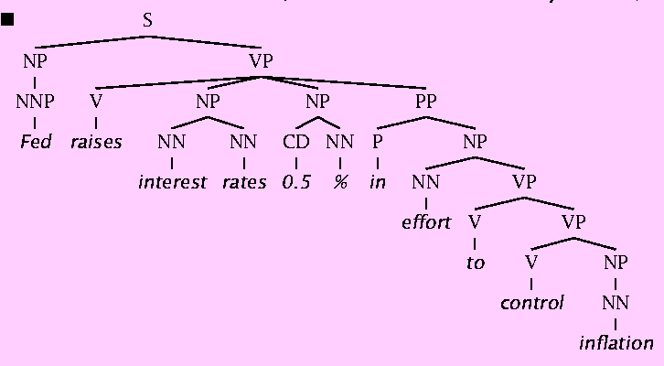
Why is Natural Language Understanding difficult?
The hidden structure of language is highly ambiguous
Structures for: Fed raises interest rates 0.5% in effort to control inflation (NYT headline 5/17/00)
Slide from Christopher Manning - Stanford

Slide 10
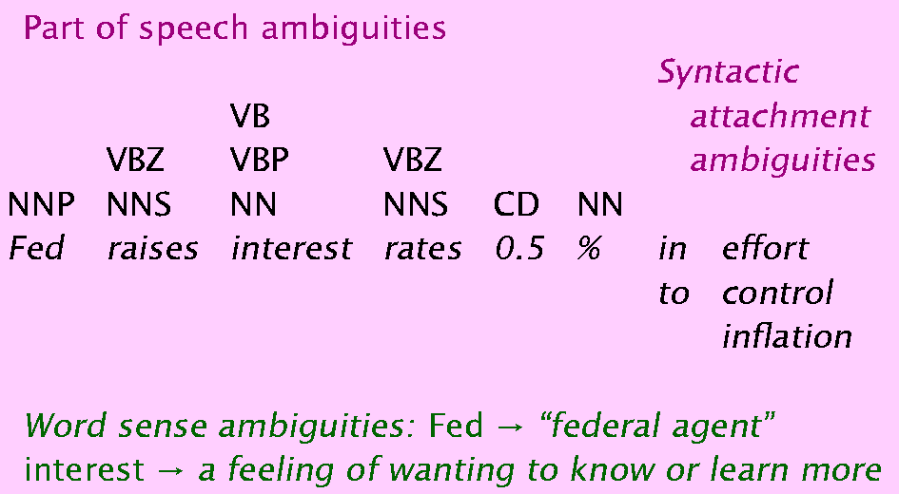
Where are the ambiguities?
Slide from Christopher Manning - Stanford

Slide 11
Translating user needs
User need
User query
Results
For RDB, a lot
of people know
how to do this
correctly, using
SQL or a GUI tool
The answers
coming out here
will then be
precisely what the
user wanted (or rather,
what was asked for)
Slide from Christopher Manning - Stanford

Slide 12
Translating user needs
User need
User query
Results
For meanings in text,
no IR-style query
gives one exactly
what one wants;
it only hints at it
The answers
coming out may
be roughly what
was wanted, or
can be refined
Sometimes!
Slide from Christopher Manning - Stanford

Slide 13
Translating user needs
User need
NLP query
Results
For a deeper NLP
analysis system,
the system subtly
translates the
user’s language
If the answers coming
back aren’t what was
wanted, the user
frequently has no idea
how to fix the problem
Risky!
Slide from Christopher Manning - Stanford

Slide 14
Aim: Practical applied NLP goals
Use language technology to add value to data by:
interpretation
transformation
value filtering
augmentation (providing metadata)
Two motivations:
The amount of information in textual form
Information integration needs NLP methods for coping with ambiguity and context
Slide from Christopher Manning - Stanford

Slide 15
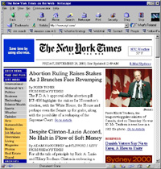
Knowledge Extraction Vision
Multi-dimensional Meta-data Extraction
Slide from Christopher Manning - Stanford

Slide 16
Natural Language Interfaces to Databases
This was going to be the big application of NLP in the 1980s
  > How many service calls did we receive from Europe last month?
  I am listing the total service calls from Europe for November 2001.
  The total for November 2001 was 1756.
It has been recently integrated into MS SQL Server (English Query)
Problems: need largely hand-built custom semantic support (improved wizards in new version!)
  GUIs more tangible and effective?
Slide from Christopher Manning - Stanford

Slide 17
NLP for IR/web search?
It’s a no-brainer that NLP should be useful and used for web search (and IR in general):
  Search for ‘Jaguar’
    the computer should know or ask whether you’re interested in big cats [scarce on the web], cars, or, perhaps a molecule geometry and solvation energy package, or a package for fast network I/O in Java
  Search for ‘Michael Jordan’
    The basketballer or the machine learning guy?
  Search for laptop, don’t find notebook
  Google doesn’t even stem:
    Search for probabilistic model, and you don’t even match pages with probabilistic models.
Slide from Christopher Manning - Stanford

Slide 18
NLP for IR/web search?
Word sense disambiguation technology generally works well (like text categorization)
Synonyms can be found or listed
Lots of people have been into fixing this
  e-Cyc had a beta version with Hotbot that disambiguated senses, and was going to go live in 2 months … 14 months ago
  Lots of startups:
    LingoMotors
    iPhrase “Traditional keyword search technology is hopelessly outdated”
Slide from Christopher Manning - Stanford

Slide 19
NLP for IR/web search?
But in practice it’s an idea that hasn’t gotten much traction
  Correctly finding linguistic base forms is straightforward, but produces little advantage over crude stemming which just slightly over equivalence classes words
  Word sense disambiguation only helps on average in IR if over 90% accurate (Sanderson 1994), and that’s about where we are
  Syntactic phrases should help, but people have been able to get most of the mileage with “statistical phrases” – which have been aggressively integrated into systems recently
Slide from Christopher Manning - Stanford

Slide 20
NLP for IR/web search?
People can easily scan among results (on their 21” monitor) … if you’re above the fold
Much more progress has been made in link analysis, and use of anchor text, etc.
Anchor text gives human-provided synonyms
Link or click stream analysis gives a form of pragmatics: what do people find correct or important (in a default context)
Focus on short, popular queries, news, etc.
Using human intelligence always beats artificial intelligence (Does it still, viz. Watson?)
Slide from Christopher Manning - Stanford

Slide 21
NLP for IR/web search?
Methods which use of rich ontologies, etc., can work very well for intranet search within a customer’s site (where anchor-text, link, and click patterns are much less relevant)
  But don’t really scale to the whole web
Moral: it’s hard to beat keyword search for the task of general ad hoc document retrieval
Conclusion: one should move up the food chain to tasks where finer grained understanding of meaning is needed
Slide from Christopher Manning - Stanford

Slide 22
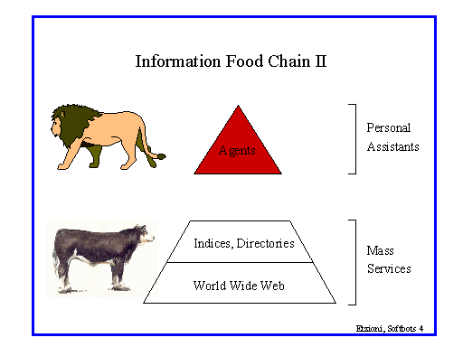
Slide from Christopher Manning - Stanford

Slide 23
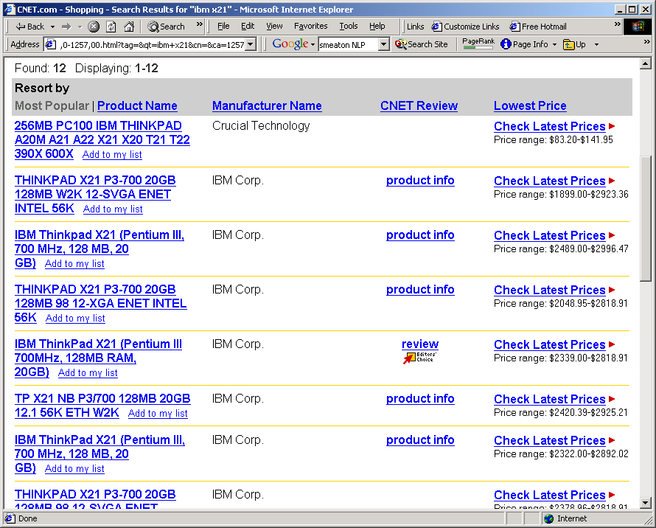
Product information
Slide from Christopher Manning - Stanford

Slide 24
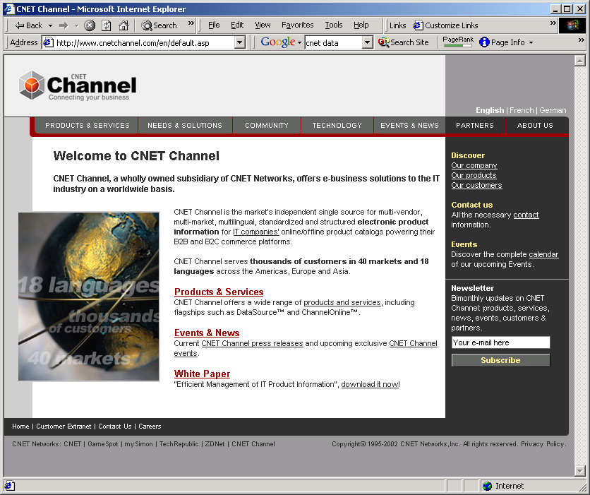
Product info
C-net markets this information
How do they get most of it?
  Phone calls
  Typing.
Slide from Christopher Manning - Stanford

Slide 25

Inconsistency: digital cameras
Image Capture Device: 1.68 million pixel 1/2-inch CCD sensor
Image Capture Device Total Pixels Approx. 3.34 million Effective Pixels Approx. 3.24 million
Image sensor Total Pixels: Approx. 2.11 million-pixel
Imaging sensor Total Pixels: Approx. 2.11 million 1,688 (H) x 1,248 (V)
CCD Total Pixels: Approx. 3,340,000 (2,140[H] x 1,560 [V] )
  Effective Pixels: Approx. 3,240,000 (2,088 [H] x 1,550 [V] )
  Recording Pixels: Approx. 3,145,000 (2,048 [H] x 1,536 [V] )
These all came off the same manufacturer’s website!!
And this is a very technical domain. Try sofa beds.
Slide from Christopher Manning - Stanford

Slide 26
Product information/ Comparison shopping, etc.
Need to learn to extract info from online vendors
Can exploit uniformity of layout, and (partial) knowledge of domain by querying with known products
E.g., Jango Shopbot (Etzioni and Weld)
  Gives convenient aggregation of online content
Bug: not popular with vendors
  A partial solution is for these tools to be personal agents rather than web services
Slide from Christopher Manning - Stanford

Slide 27
Email handling
Big point of pain for many people
There just aren’t enough hours in the day
  even if you’re not a customer service rep
What kind of tools are there to provide an electronic secretary?
  Negotiating routine correspondence
  Scheduling meetings
  Filtering junk
  Summarizing content
“The web’s okay to use; it’s my email that is out of control”
Slide from Christopher Manning - Stanford

Slide 28
Text Categorization is a task with many potential uses
Take a document and assign it a label representing its content (MeSH heading, ACM keyword, Yahoo category)
Classic example: decide if a newspaper article is about politics, business, or sports?
There are many other uses for the same technology:
  Is this page a laser printer product page?
  Does this company accept overseas orders?
  What kind of job does this job posting describe?
  What kind of position does this list of responsibilities describe?
  What position does this this list of skills best fit?
  Is this the “computer” or “harbor” sense of port?
Slide from Christopher Manning - Stanford

Slide 29
Text Categorization
Usually, simple machine learning algorithms are used.
Examples: Naïve Bayes models, decision trees.
Very robust, very re-usable, very fast.
Recently, slightly better performance from better algorithms
  e.g., use of support vector machines, nearest neighbor methods, boosting
Accuracy is more dependent on:
  Naturalness of classes.
  Quality of features extracted and amount of training data available.
Accuracy typically ranges from 65% to 97% depending on the situation
  Note particularly performance on rare classes
Slide from Christopher Manning - Stanford

Slide 30
Financial markets
Quantitative data are (relatively) easily and rapidly processed by computer systems, and consequently many numerical tools are available to stock market analysts
  However, a lot of these are in the form of (widely derided) technical analysis
  It’s meant to be information that moves markets
Financial market players are overloaded with qualitative information – mainly news articles – with few tools to help them (beyond people)
  Need tools to identify, summarize, and partition information, and to generate meaningful links
Slide from Christopher Manning - Stanford

Slide 31
Citeseer/ResearchIndex
An online repository of papers, with citations, etc. Specialized search with semantics in it
Great product; research people love it
However it’s fairly low tech. NLP could improve on it:
  Better parsing of bibliographic entries
  Better linking from author names to web pages
  Better resolution of cases of name identity
    E.g., by also using the paper content
    Cf. Cora, which did some of these tasks better
Slide from Christopher Manning - Stanford

Slide 32
Chat rooms/groups/discussion forums/usenet
Many of these are public on the web
The signal to noise ratio is very low
But there’s still lots of good information there
Some of it has commercial value
  What problems have users had with your product?
  Why did people end up buying product X rather than your product Y
Some of it is time sensitive
  Rumors on chat rooms can affect stockprice
    Regardless of whether they are factual or not
Slide from Christopher Manning - Stanford

Slide 33
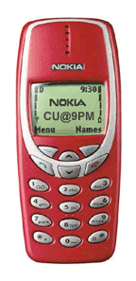
Small devices
With a big monitor, humans can scan for the right information
On a small screen, there’s hugely more value from a system that can show you what you want:
  phone number
  business hours
  email summary
    “Call me at 11 to finalize this”
Slide from Christopher Manning - Stanford

Slide 34
Machine translation
High quality MT is still a distant goal
But MT is effective for scanning content
And for machine-assisted human translation
Dictionary use accounts for about half of a traditional translator's time.
Printed lexical resources are not up-to-date
Electronic lexical resources ease access to terminological data.
“Translation memory” systems: remember previously translated documents, allowing automatic recycling of translations
Slide from Christopher Manning - Stanford

Slide 35
Online technical publishing
Natural Language Processing for Online Applications: Text Retrieval, Extraction & Categorization
Peter Jackson & Isabelle Moulinier (Benjamins, 2002)
“The Web really changed everything, because there was suddenly a pressing need to process large amounts of text, and there was also a ready-made vehicle for delivering it to the world. Technologies such as information retrieval (IR), information extraction, and text categorization no longer seemed quite so arcane to upper management. The applications were, in some cases, obvious to anyone with half a brain; all one needed to do was demonstrate that they could be built and made to work, which we proceeded to do.”
Slide from Christopher Manning - Stanford

Slide 36
Task: Information Extraction
Suppositions:
A lot of information that could be represented in a structured semantically clear format isn’t
It may be costly, not desired, or not in one’s control (screen scraping) to change this.
Goal: being able to answer semantic queries using “unstructured” natural language sources
Slide from Christopher Manning - Stanford

Slide 37
Information Extraction
Information extraction systems
  Find and understand relevant parts of texts.
  Produce a structured representation of the relevant information: relations (in the DB sense)
  Combine knowledge about language and the application domain
  Automatically extract the desired information
When is IE appropriate?
  Clear, factual information (who did what to whom and when?)
  Only a small portion of the text is relevant.
  Some errors can be tolerated
Slide from Christopher Manning - Stanford

Slide 38
Name Extraction via HMMs
The delegation, which included the commander of the U.N. troops in Bosnia, Lt. Gen. Sir Michael Rose, went to the Serb stronghold of Pale, near Sarajevo, for talks with Bosnian Serb leader Radovan Karadzic.
The delegation, which included the commander of the U.N. troops in Bosnia, Lt. Gen. Sir Michael Rose, went to the Serb stronghold of Pale, near Sarajevo, for talks with Bosnian Serb leader Radovan Karadzic.
training
sentences
Training
Program
answers
NE
Models
Speech
Speech
Recognition
Entities
Extractor
Text
Prior to 1997 - no learning approach competitive with hand-built rule systems
Since 1997 - Statistical approaches (BBN, NYU, MITRE, CMU/JustSystems) achieve state-of-the-art performance
Locations
Persons
Organizations
Slide from Christopher Manning - Stanford

Slide 39
Classified Advertisements (Real Estate)
Background:
Advertisements are plain text
Lowest common denominator: only thing that 70+ newspapers with 20+ publishing systems can all handle
<ADNUM>2067206v1</ADNUM>
<DATE>March 02, 1998</DATE>
<ADTITLE>MADDINGTON $89,000</ADTITLE>
<ADTEXT>
OPEN 1.00 - 1.45<BR>
U 11 / 10 BERTRAM ST<BR>
NEW TO MARKET Beautiful<BR>
3 brm freestanding<BR>
villa, close to shops & bus<BR>
Owner moved to Melbourne<BR>
ideally suit 1st home buyer,<BR>
investor & 55 and over.<BR>
Brian Hazelden 0418 958 996<BR>
R WHITE LEEMING 9332 3477
</ADTEXT>
Slide from Christopher Manning - Stanford

Slide 40
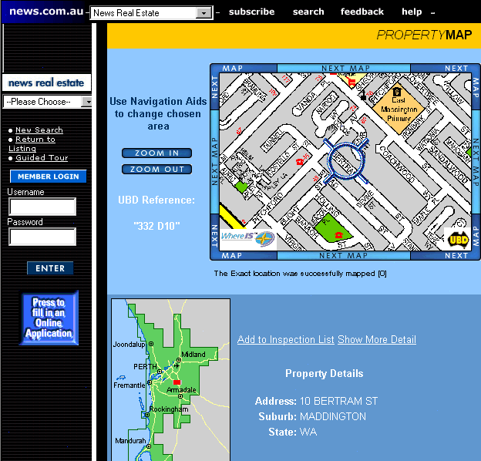

Slide 41
Why doesn’t text search (IR) work?
What you search for in real estate advertisements:
Suburbs. You might think easy, but:
  Real estate agents: Coldwell Banker, Mosman
  Phrases: Only 45 minutes from Parramatta
  Multiple property ads have different suburbs
Money: want a range not a textual match
  Multiple amounts: was $155K, now $145K
  Variations: offers in the high 700s [but not rents for $270]
Bedrooms: similar issues (br, bdr, beds, B/R)
Slide from Christopher Manning - Stanford

Slide 42
Machine learning
To keep up with and exploit the web, you need to be able to learn
  Discovery: How do you find new information sources S?
  Extraction: How can you access and parse the information in S?
  Semantics: How does one understand and link up the information in contained in S?
  Pragmatics: What is the accuracy, reliability, and scope of information in S?
Hand-coding just doesn’t scale
Slide from Christopher Manning - Stanford

Slide 43
Question answering from text
TREC 8/9 QA competition: an idea originating from the IR community
With massive collections of on-line documents, manual translation of knowledge is impractical: we want answers from textbases [cf. bioinformatics]
Evaluated output is 5 answers of 50/250 byte snippets of text drawn from a 3 Gb text collection, and required to contain at least one concept of the semantic category of the expected answer type. (IR think. Suggests the use of named entity recognizers.)
Get reciprocal points for highest correct answer.
Slide from Christopher Manning - Stanford

Slide 44
Pasca and Harabagiu (2001) show value of sophisticated NLP
Good IR is needed: paragraph retrieval based on SMART
Large taxonomy of question types and expected answer types is crucial
Statistical parser (modeled on Collins 1997) used to parse questions and relevant text for answers, and to build knowledge base
Controlled query expansion loops (morphological, lexical synonyms, and semantic relations) are all important
Answer ranking by simple ML method
Slide from Christopher Manning - Stanford

Slide 45
Question Answering Example
How hot does the inside of an active volcano get?
get(TEMPERATURE, inside(volcano(active)))
“lava fragments belched out of the mountain were as hot as 300 degrees Fahrenheit”
fragments(lava, TEMPERATURE(degrees(300)),
  belched(out, mountain))
  volcano ISA mountain
  lava ISPARTOF volcano • lava inside volcano
  fragments of lava HAVEPROPERTIESOF lava
The needed semantic information is in WordNet definitions, and was successfully translated into a form that can be used for rough ‘proofs’
Slide from Christopher Manning - Stanford

Slide 46
IBM Watson
A Brief Overview and Thoughts for Healthcare Education and Performance Improvement
Watson Team
Presenter: Joel Farrell
IBM
Notes:
46

Slide 47
Informed Decision Making: Search vs. Expert Q&A
Decision Maker
Has Question
Search Engine
Distills to 2-3 Keywords
Finds Documents containing Keywords
Reads Documents, Finds Answers
Delivers Documents based on Popularity
Expert
Finds & Analyzes Evidence
Decision Maker
Understands Question
Asks NL Question
Produces Possible Answers & Evidence
Considers Answer & Evidence
Analyzes Evidence, Computes Confidence
Delivers Response, Evidence & Confidence

Slide 48
Automatic Open-Domain Question Answering
A Long-Standing Challenge in Artificial Intelligence to emulate human expertise
Given
  Rich Natural Language Questions
  Over a Broad Domain of Knowledge
Deliver
  Precise Answers: Determine what is being asked & give precise response
  Accurate Confidences: Determine likelihood answer is correct
  Consumable Justifications: Explain why the answer is right
  Fast Response Time: Precision & Confidence in <3 seconds
48
Notes:
Automatic Open-Domain Question Answering is represents a very long standing challenge in Computer Science, specifically in the areas of NLP, Information Retrieval and AI.
<go through slide>
48

Slide 49
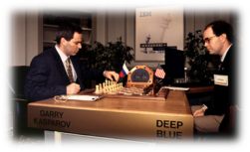
A Grand Challenge Opportunity
Capture the imagination
  The Next Deep Blue
Engage the scientific community
  Envision new ways for computers to impact society & science
  Drive important and measurable scientific advances
Be Relevant to Important Problems
  Enable better, faster decision making over unstructured and structured content
  Business Intelligence, Knowledge Discovery and Management, Government, Compliance, Publishing, Legal, Healthcare, Business Integrity, Customer Relationship Management, Web Self-Service, Product Support, etc.
49
Notes:
Among many things, IBM Research is interested in pursuing exploratory research and Grand Challenges. Consider Deep Blue, the first computer to win against a grand master chess player.
The goals are for a Grand Challenge Project are to engage and inspire the scientific community to have broader impact on science and society.
To push the limits of computer technology and ultimately to drive innovation into business applications relevant to IBM customers. Like, as we will see, in the case of the Jeopardy! Challenge, to have impact on Business Intelligence, Knowledge Discovery and Knowledge Management Compliance, Legal, Healthcare, Business Integrity, Customer Relationship Management, Web Self-Service , Product Support and National Intelligence.
49

Slide 50
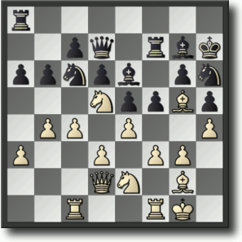

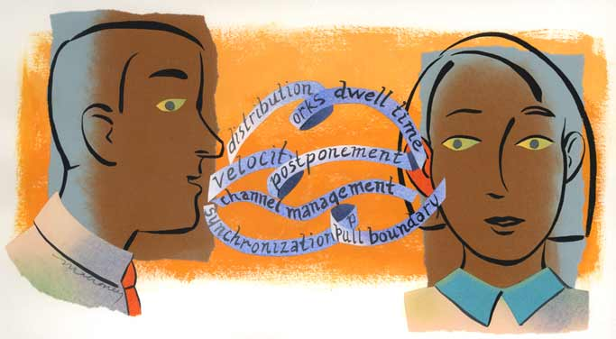
Real Language is Real Hard
Chess
  A finite, mathematically well-defined search space
  Limited number of moves and states
  Grounded in explicit, unambiguous mathematical rules
Human Language
  Ambiguous, contextual and implicit
  Grounded only in human cognition
  Seemingly infinite number of ways to express the same meaning

Slide 51
What Computers Find Easier (and Hard)
ln((12,546,798 * π) ^ 2) / 34,567.46 =
0.00885
Select Payment where Owner=“David Jones” and Type(Product)=“Laptop”,
Owner | Serial Number
David Jones | 45322190-AK
Invoice # | Vendor | Payment
INV10895 | MyBuy | $104.56
Serial Number | Type | Invoice #
45322190-AK | LapTop | INV10895
David Jones
Dave Jones
≠
=
David Jones
David Jones
Notes:
Consider first what computers are good at.
Here is a equation – the natural long of 12 million 546 thousand, 7 hundred and nintey-eight * Pi / 34,567.46
Anyone?
Anyone know if its greater or less than 1?
Comptuter?
<click>
The answer is 0.00885
How about this?
Select the payment where the owner is David Jones and the type of the product owned is a laptop.
<click>
The computer can easily traverse this information in tables or “structured databases” and go from row to column to row and find its way to the Payment field and get the answer.
It does this sort of stuff really, really well storing just the information it needs to answer these database queries
How about matching keywords does that real well too.
Here to figure out that David Jones is the same as David Jones it compares each letter and knows they are the same so it concludes they are equal.
<click>
In the next example based on that simple letter matching algorithm it does not think “Dave Jones” is the same as “David Jones”
To make that very simple leap it would have to know that that Dave is nickname for David and some likelihood they are the same.
As far as the computer is concerned with no additional knowledge David and Dave are as different as Mary and Mauri.

Slide 52
What Computers Find Hard
Computer programs are natively explicit, fast and exacting in their calculation over numbers and symbols….But Natural Language is implicit, highly contextual, ambiguous and often imprecise.
Structured
Person | Birth Place
Einstein | ULM
Unstructured
Where was X born?
  One day, from among his city views of Ulm, Otto chose a water color to send to Albert Einstein as a remembrance of Einstein´s birthplace.
X ran this?
  If leadership is an art then surely Jack Welch has proved himself a master painter during his tenure at GE.
Person | Organization
J. Welch | GE
Notes:
Computer programs are natively explicit and exacting in their calculations over numbers and symbols.
But Natural Language - -the words and phrases we humans use to communicate with one another -- is implicit -- the exact meaning is not completely and exactly indicated -- but instead is highly dependent on the context -- what has been said before, the topic, how it is being discussed -- factually, figuratively, fictionally etc.
Moreover, natural language is often imprecise – it does not have to treat a subject with numerical precision…humans naturally interact and operate all the time with different degrees of uncertainty and fuzzy associations between words and concepts. We use huge amounts of background knowledge to reconcile and interpret what we read.
Consider these examples….it is one thing to build a database table to exactly answer the question “Where is someone born?”. The computer looks up the name in one column and is programmed to know that the other column contains the birth place. STRUCUTRED information, like this database table, is designed for computers to make simple comparisons and to be exactly as accurate as the data entered into the database.
Natural language is created and used by humans for humans. A reason we call natural language “Unstructured” is because it lacks the exact structure and meaning that computer programs typically use to answer questions. Understanding what is being represented is a whole other challenge for computer programs .
Consider this sentence <read>
It implies that Albert Einstein was born in Ulm – but there is a whole lot the computer has to do to figure that out any degree of certainty - it has to understand sentence structure, parts of speech, the possible meaning of words and phrases and how they related to the words and phrases in the question. What does a remembrance, a water color and an Otto have to do with where someone was born.
Consider another question in the Jeopardy Style … X ran this? And this potentially answer-bearing sentence. Read the Sentence…
Does this sentence answer the question for Jack Welch - -what does “ran” have to do with leadership or painting. How would a computer confidently infer from this sentence that Jack Welch ran GE – might be easer to deduce that he was at least a painter there.

Slide 53
Some Basic Jeopardy! Clues
The type of thing being asked for is often indicated but can go from specific to very vague
This fish was thought to be extinct millions of years ago
until one was found off South Africa in 1938
Category: ENDS IN "TH"
Answer:
When hit by electrons, a phosphor gives off electromagnetic energy in this form
Category: General Science
Answer:
Secy. Chase just submitted this to me for the third time--guess what, pal. This time I'm accepting it
Category: Lincoln Blogs
Answer:
coelacanth
light (or photons)
his resignation
53
Notes:
Lets look at some examples of what we call Basic Factiods.
_{<Read the fish example>}
Notice that the type of thing being asked for is often indicated,
but can go from specific to very vague.
If you are starting
to think -- we can just build a database of fish, think again.
_{<Read the form example>}
imagine building a database of everything that can be a form
Or consider this example
_{<read the Lincoln example>}
There are many questions that do not indicate the type at all.
53

Slide 54
Broad Domain
We do NOT attempt to anticipate all questions and build databases.
We do NOT try to build a formal
model of the world
In a random sample of 20,000 questions we found
2,500 distinct types*. The most frequent occurring <3% of the time. The distribution has a very long tail.
And for each these types 1000’s of different things may be asked.
Even going for the head of the tail will
barely make a dent
*13% are non-distinct (e.g, it, this, these or NA)
Our Focus is on reusable NLP technology for analyzing vast volumes of as-is text.
Structured sources (DBs and KBs) provide background knowledge for interpreting the text.
54
Notes:
We do NOT approach the Jeopardy Challenge by trying to anticipate all questions and building databases of answers.
In fact, in a random sample of 20,000 Jeopardy Clues we automatically identified the main subject or type being asked about.
We found that in 13% of the sampled questions, there was no clear indication at all for the type of answer and the players must rely almost entirely on the context to figure out what sort of answer is required.
The remaining 87% is what you see is this graph. It shows, what we call, a very long tail. There is no small-enough set of topics to focus on that covers enough ground. Even focusing on the most frequent few (The head of the tail to the left) will cover less-than 10% of the content.
1000’s of topics from hats to insects to writers to diseases to vegetables are all equally fair game.
And FOR these 1000’s of types, 1000’s of different questions may be asked and then phrased in an huge variety of different of ways.
So, our primary approach and research interest is not to collect and organize databases. Rather it is ON reusable Natural Language Processing (NLP) technology for automatically understanding naturally occurring human-language text.
AS-IS, pre=existing structured knowledge in the form of DBs or KBs is used to help to bridge meaning and interpret multiple NL texts. But because of the broad domain and the expressive language used in the questions and in content, pre-built databases have very limited use of answering any significant number of questions. The focus rather is on NL understanding.

Slide 55

Automatic Learning for “Reading”
Generalization &
Statistical Aggregation
Sentence
Parsing
Volumes of Text
Syntactic Frames
Semantic Frames
subject
verb
object
Inventors patent inventions (.8)
Officials Submit Resignations (.7)
People earn degrees at schools (0.9)
Fluid is a liquid (.6)
Liquid is a fluid (.5)
Vessels Sink (0.7)
People sink 8-balls (0.5) (in pool/0.8)

Slide 56
Evaluating Possibilities and Their Evidence
In cell division, mitosis splits the nucleus & cytokinesis splits this liquid cushioning the nucleus.
Organelle
Vacuole
Cytoplasm
Plasma
Mitochondria
Blood …
Many candidate answers (CAs) are generated from many different searches
Each possibility is evaluated according to different dimensions of evidence.
Just One piece of evidence is if the CA is of the right type. In this case a “liquid”.
“Cytoplasm is a fluid surrounding the nucleus…”
↑
Is(“Cytoplasm”, “liquid”) = 0.2
Is(“organelle”, “liquid”) = 0.1
Wordnet → Is_a(Fluid, Liquid) → ?
Is(“vacuole”, “liquid”) = 0.2
Is(“plasma”, “liquid”) = 0.7
Learned → Is_a(Fluid, Liquid) → yes.
Notes:
Note that the “Text Mining” inference is very different from the Wordnet Tycor – mining ordinary language as we find that people consider a FLUID a type of LIQUID, when a strict taxonomy like Wordnet, correctly does not. However, for this domain, Jeopardy!, ML techniques learn to trust the relations mined from natural language text which allows the system to boost Cytoplasm’ Tycor score.

Slide 57


















Different Types of Evidence: Keyword Evidence
In May 1898 Portugal celebrated the 400th anniversary of this explorer’s arrival in India.
In May, Gary arrived in India after he celebrated his anniversary in Portugal.
arrived in
celebrated
Keyword Matching
celebrated
In May 1898
Keyword Matching
In May
400th anniversary
Keyword Matching
anniversary
Evidence suggests “Gary” is the answer BUT the system must learn that keyword matching may be weak relative to other types of evidence
Portugal
Keyword Matching
in Portugal
arrival in
India
Keyword Matching
India
explorer
Gary
57
Notes:
RSDC 2009
4/29/13 10:57
D3_Ferrucci
57
We faced a lot of technical challenges but at the heart of the algorithm challenge is dealing with the many was you can express the same meaning. NL is often very sensitive to context and is often incomplete, tacit and ambiguous. Simplified approaches can lead you astray.
These next two examples should help motivate our approach.
Consider this question. <Read it>
The systems parses it into is logical structure – things centered around the predicate celebrated etc.
Now consider that based on keywords it would be straight-forward to pick up this potentially answer-bearing passage. <read green passage>
This is a great hit from a Keyword search perspective and by that score gives good evidence that Joe is the answer.
And it might be – of course in this case – Joe is not the answer, -- Vasco De Gama is the answer.
The system must learn that of all sorts of evidence different algorithms might produce, some evidence under some conditions is stronger than other evidence.
Using probabilistic machine learning algorithms, it has to learn this automatically.
Consider this…<next slide>

Slide 58
































Different Types of Evidence: Deeper Evidence
In May 1898 Portugal celebrated the 400th anniversary of this explorer’s arrival in India.
On 27th May 1498, Vasco da Gama landed in Kappad Beach
On 27th May 1498, Vasco da Gama landed in Kappad Beach
On 27th May 1498, Vasco da Gama landed in Kappad Beach
On the 27th of May 1498, Vasco da Gama landed in Kappad Beach
Search Far and Wide
Explore many hypotheses
Find Judge Evidence
Many inference algorithms
celebrated
landed in
Portugal
Temporal Reasoning
May 1898
400th anniversary
27th May 1498
Statistical Paraphrasing
Date
Math
Stronger evidence can be much harder to find and score.
arrival in
GeoSpatial Reasoning
Para-phrases
India
Kappad Beach
Geo-KB
explorer
Vasco da Gama
The evidence is still not 100% certain.
58
Notes:
Here we see the same question, the same parse, but on the other side we see that there exists a passage containing the RIGHT answer BUT with only one key word in common.
<read the green passage>
The system must consider in parallel and in detail a huge amount of content just to get a SHOT at this evidence and then must find and weigh the right inferences that will allow it to match and score with an accurate confidence, for example in this case
<click>
Date Math, Statistical Paraphrasing and Geospatial reasoning.
And its still not 100% certain
What if, for example, the passage said “considered landing in” rather than “landed in” or what if there was just a preponderance of weaker evidence for another answer.
Question Answering Technology tries to understand what the user is really asking for and to deliver precise and correct responses. But Natural language is hard.
Meaning can be expressed in so many different ways and to achieve high levels of precision and confidence you must consider much more information and analyze it much more deeply.
We is needed is a radically different approach that explores many different plaussive interpretations in parallel and collects and evaluates all sorts of evidence in support or in refutation of those possibilities.
58

Slide 59
Not Just for Fun
Some Questions require Decomposition and Synthesis
Category: Edible Rhyme Time
A long, tiresome speech delivered by a frothy pie topping
.
Diatribe
.
Whipped Cream
.
.
Harangue
Meringue
.
.
.
.
.
.
  Answer:
Meringue
Harangue
59
Notes:
RSDC09
4/29/13 10:57
D3_Ferrucci_v02
59
Many Jeopardy! clues are designed to be FUN or entertaining, but it turns out that they require an important and general question analysis capability – to detect and then decompose a question unto meaningful subparts, solve those and put the pieces back to together into a coherent answer.
Go through the clue
In this case the computer must understand enough about the language to compose the final answer but putting the modifier in front of the object, even though they are reversed in the question.

Slide 60
Missing Links
Buttons
Category: Common Bonds
Shirts,
TV remote controls,
Telephones
Mt Everest
Edmund
Hillary
He was first
On hearing of the discovery of George Mallory's body, he told reporters he still thinks he was first.

Slide 61


DeepQA: The Technology Behind Watson
Massively Parallel Probabilistic Evidence-Based Architecture
DeepQA generates and scores many hypotheses using an extensible collection of Natural Language Processing, Machine Learning and Reasoning Algorithms. These gather and weigh evidence over both unstructured and structured content to determine the answer with the best confidence.
Learned Models
help combine and weigh the Evidence
Evidence Sources
Answer Sources
Models
Models
Question
Answer Scoring
Evidence
Retrieval
Deep Evidence Scoring
Models
Models
Primary
Search
Candidate
Answer
Generation
Models
Models
Question & Topic Analysis
Question
Decomposition
Hypothesis
Generation
Hypothesis and Evidence Scoring
Synthesis
Final Confidence Merging & Ranking
Hypothesis
Generation
Hypothesis and Evidence Scoring
Answer & Confidence
61
. . .
Notes:
_{<click>}
Watson – the computer system we developed to play Jeopardy! is based on the DeepQA softate archtiecture.Here is a look at the DeepQA architecture. This is like looking inside the brain of the Watson system from about 30,000 feet high.
Remember, the intended meaning of natural language is ambiguous, tacit and highly contextual. The computer needs to consider many possible meanings, attempting to find the evidence and inference paths that are most confidently supported by the data.
So, the primary computational principle supported by the DeepQA architecture is to assume and pursue multiple interpretations of the question, to generate many plausible answers or hypotheses and to collect and evaluate many different competing evidence paths that might support or refute those hypotheses.
Each component in the system adds assumptions about what the question might means or what the content means or what the answer might be or why it might be correct.
DeepQA is implemented as an extensible architecture and was designed at the outset to support interoperability.
<UIMA Mention>
For this reason it was implemented using UIMA, a framework and OASIS standard for interoperable text and multi-modal analysis contributed by IBM to the open-source community.
Over 100 different algorithms, implemented as UIMA components, were integrated into this architecture to build Watson.
In the first step, Question and Category analysis, parsing algorithms decompose the question into its grammatical components. Other algorithms here will identify and tag specific semantic entities like names, places or dates. In particular the type of thing being asked for, if is indicated at all, will be identified. We call this the LAT or Lexical Answer Type, like this “FISH”, this “CHARACTER” or “COUNTRY”.
In Query Decomposition, different assumptions are made about if and how the question might be decomposed into sub questions. The original and each identified sub part follow parallel paths through the system.
In Hypothesis Generation, DeepQA does a variety of very broad searches for each of several interpretations of the question. Note that Watson, to compete on Jeopardy! is not connected to the internet.
These searches are performed over a combination of unstructured data, natural language documents, and structured data, available data bases and knowledge bases fed to Watson during training.
The goal of this step is to generate possible answers to the question and/or its sub parts. At this point there is very little confidence in these possible answers since little intelligence has been applied to understanding the content that might relate to the question. The focus at this point on generating a broad set of hypotheses, – or for this application what we call them “Candidate Answers”.
To implement this step for Watson we integrated and advanced multiple open-source text and KB search components.
After candidate generation DeepQA also performs Soft Filtering where it makes parameterized judgments about which and how many candidate answers are most likely worth investing more computation given specific constrains on time and available hardware. Based on a trained threshold for optimizing the tradeoff between accuracy and speed, Soft Filtering uses different light-weight algorithms to judge which candidates are worth gathering evidence for and which should get less attention and continue through the computation as-is. In contrast, if this were a hard-filter those candidates falling below the threshold would be eliminated from consideration entirely at this point.
In Hypothesis & Evidence Scoring the candidate answers are first scored independently of any additional evidence by deeper analysis algorithms. This may for example include Typing Algorithms. These are algorithms that produce a score indicating how likely it is that a candidate answer is an instance of the Lexical Answer Type determined in the first step – for example Country, Agent, Character, City, Slogan, Book etc.
Many of these algorithms may fire using different resources and techniques to come up with a score. What is the likelihood that “Washington” for example, refers to a “General” or a “Capital” or a “State” or a “Mountain” or a “Father” or a “Founder”?
For each candidate answer many pieces of additional Evidence are search for. Each of these pieces of evidence are subjected to more algorithms that deeply analyze the evidentiary passages and score the likelihood that the passage supports or refutes the correctness of the candidate answer. These algorithms may consider variations in grammatical structure, word usage, and meaning.
In the Synthesis step, if the question had been decomposed into sub-parts, one or more synthesis algorithms will fire. They will apply methods for inferring a coherent final answer from the constituent elements derived from the questions sub-parts.
Finally, arriving at the last step, Final Merging and Ranking, are many possible answers, each paired with many pieces of evidence and each of these scored by many algorithms to produce hundreds of feature scores. All giving some evidence for the correctness of each candidate answer.
Trained models are applied to weigh the relative importance of these feature scores. These models are trained with ML methods to predict, based on past performance, how best to combine all this scores to produce final, single confidence numbers for each candidate answer and to produce the final ranking of all candidates.
The answer with the strongest confidence would be Watson’s final answer. And Watson would try to buzz-in provided that top answer’s confidence was above a certain threshold.
----
The DeepQA system defers commitments and carries possibilities through the entire process while searching for increasing broader contextual evidence and more credible inferences to support the most likely candidate answers.
All the algorithms used to interpret questions, generate candidate answers, score answers, collection evidence and score evidence are loosely coupled but work holistically by virtue of DeepQA’s pervasive machine learning infrastructure.
No one component could realize its impact on end-to-end performance without being integrated and trained with the other components AND they are all evolving simultaneously. In fact what had 10% impact on some metric one day, might 1 month later, only contribute 2% to overall performance due to evolving component algorithms and interactions. This is why the system as it develops in regularly trained and retrained.
DeepQA is a complex system architecture designed to extensibly deal with the challenges of natural language processing applications and to adapt to new domains of knowledge.
The Jeopardy! Challenge has greatly inspired its design and implementation for the Watson system.
61

Slide 62
Grouping features to produce Evidence Profiles
Clue: Chile shares its longest land border with this country.
Bolivia is more Popular due to a commonly discussed border dispute. But Watson learns that Argentina has better evidence.
Positive Evidence
Negative Evidence

Slide 63
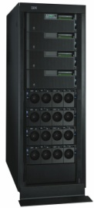

One Jeopardy! question can take 2 hours on a single 2.6Ghz Core
Optimized & Scaled out on 2880-Core IBM workload optimized POWER7 HPC using UIMA-AS,
Watson answers in 2-6 seconds.
Question
1000’s of
Pieces of Evidence
100s Possible Answers
100,000’s scores from many simultaneous Text Analysis Algorithms
100s sources
built on UIMA for interoperability
Multiple Interpretations
Question & Topic Analysis
Question
Decomposition
Hypothesis
Generation
Hypothesis and Evidence Scoring
Synthesis
Final Confidence Merging & Ranking
built on UIMA-AS for scale-out and speed
Hypothesis
Generation
Hypothesis and Evidence Scoring
Answer & Confidence
. . .
Notes:
_{<click>}
Here is a look at the DeepQA architecture. This is like looking inside the brain of the Watson system from about 30,000 feet high.
Remember, natural language is ambiguous, polysemous, tacit and its meaning is often highly contextual. Bottom line -- the computer needs to consider many possible meanings, attempting to find the inference paths that are most confidently supported by the data.
So, the primary computational principle supported by the DeepQA architecture is to assume and maintain multiple interpretations of the question, to generate many plausible answers or hypotheses and to collect and process many different evidence streams that might support or refute those hypotheses.
Each component in the system adds assumptions about what the question means or what the content means or what the answer might be or why it might be correct.
DeepQA is implemented as an extensible architecture and was designed at the outset to support interoperability.
<UIMA Mention>
For this reason it was implemented using UIMA, a framework and OASIS standard for interoperable text and multi-modal analysis contributed by IBM to the open-source community.
Over 100 different algorithms, implemented as UIMA components, were integrated into this architecture to build Watson.
In the first step, Question and Category analysis, parsing algorithms decompose the question into its grammatical or syntactic components. Other algorithms here will identify and tag specific semantic entities like names, places or dates. In particular the type of thing being asked for, if is indicated at all, will be identified. We call this the LAT or Lexical Answer Type, like this “FISH”, this “CHARACTER” or “COUNTRY”.
In Query Decomposition, different assumptions are made about if and how the question might be decomposed into sub questions. The original and each identified sub part follow parallel paths through the system.
In Hypothesis Generation, DeepQA does a variety of very broad searches for each of several interpretations of the question.
These searches are performed over a combination of unstructured data, natural language documents, and structured data, available knowledge bases.
--
The goal of this step is to generate possible answers to the question and/or its sub parts. At this point there is not a lot of confidence in these possible answers since little intelligence has been applied to understanding the content that might relate to the question. The focus is on generating a broad set of hypotheses, – or for this application what we call “Candidate Answers”.
To implement this step for Watson we used multiple open-source text and KB search components.
The Soft Filtering step in DeepQA, acknowledges that resources are ultimately limited. And some parameterized judgment about which candidate answers are worth pursuing further must be made given constrains on time and available hardware.
Based on a trained threshold for optimizing the tradeoff between accuracy and latency, Soft Filtering uses different light-weight algorithms to judge which candidates are worth gathering evidence for and which should get less attention and continue through the computation as-is. In contrast, if this were a hard-filter those candidates falling below the filter would be eliminated from consideration entirely at this point.
In Hypothesis & Evidence Scoring the candidate answers are scored independently of any additional evidence by deeper analysis algorithms. This may for example include Typing Algorithms. These are algorithms that produce a score indicating how likely it is that a candidate answer is an instance of the Lexical Answer Type determined in the first step – for example Country, Agent, Character, City, Slogan, Book etc.
Many of these algorithms may fire using different resources and techniques to come up with a score. What is the likelihood that “Washington” for example, refers to a “General” or a “Capital” or a “State” or a “Mountain” or a “Father” or a “Founder”?
Evidence, in this case, more documents and or more structured facts, is collected for the many candidate answers. Each of these pieces of evidence are subjected to more algorithms that deeply analyze the evidentiary passages, for example, and score the likelihood that the passage supports or refutes the correctness of the candidate answer.
In the Synthesis step, if the question had been decomposed into sub-parts, one or more synthesis algorithms will fire, with varying levels of certainty, They will apply methods for inferring a coherent final answer from the constituent elements derived from the questions sub-parts.
Finally, arriving at the last step, Final Merging and Ranking, are many possible answers, each paired with many pieces of evidence and each of these scored by many algorithms to produce hundreds of feature scores. All giving some evidence for the correctness of each candidate answer.
Trained models are applied to weigh the relative importance of these feature scores. These models are trained with ML methods to predict, based on past performance, how best to combine all this scores to produce final, single confidence numbers for each candidate answer and to produce the final ranking of all candidates.
The answer with the strongest confidence would be Watson’s final answer. And Watson would try to buzz-in provided that top answer’s confidence was above a certain threshold.
----
The DeepQA system defers commitments and carries possibilities through the entire process while searching for increasing broader contextual evidence and more credible inferences to support the most likely candidate answers.
All the algorithms used to interpret questions, generate candidate answers, score answers, collection evidence and score evidence are loosely coupled but work holistically by virtue of DeepQA’s pervasive machine learning infrastructure.
No one component could realize its impact on end-to-end performance without being integrated and trained with the other components AND they are all evolving simultaneously. In fact what had 10% impact on some metric one day, might 1 month later, only contribute 2% to overall performance due to evolving component algorithms and interactions. This is why the system as it develops in regularly trained and retrained.
DeepQA is a complex system architecture designed to extensibly deal with the challenges of natural language processing applications and to adapt to new domains of knowledge.
The Jeopardy! Challenge has greatly inspired its design and implementation for the Watson system.
63

Slide 64
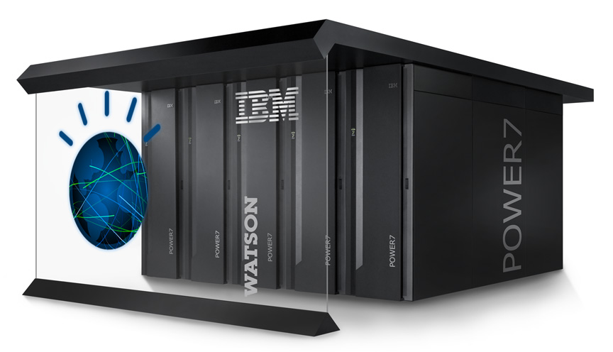


Watson – a Workload Optimized System
90 x IBM Power 750¹ servers
2880 POWER7 cores
POWER7 3.55 GHz chip
500 GB per sec on-chip bandwidth
10 Gb Ethernet network
15 Terabytes of memory
20 Terabytes of disk, clustered
Can operate at 80 Teraflops
Runs IBM DeepQA software
Scales out with and searches vast amounts of unstructured information with UIMA & Hadoop open source components
Linux provides a scalable, open platform, optimized
to exploit POWER7 performance
10 racks include servers, networking, shared disk system, cluster controllers
¹ Note that the Power 750 featuring POWER7 is a commercially available
server that runs AIX, IBM i and Linux and has been in market since Feb 2010

Slide 65
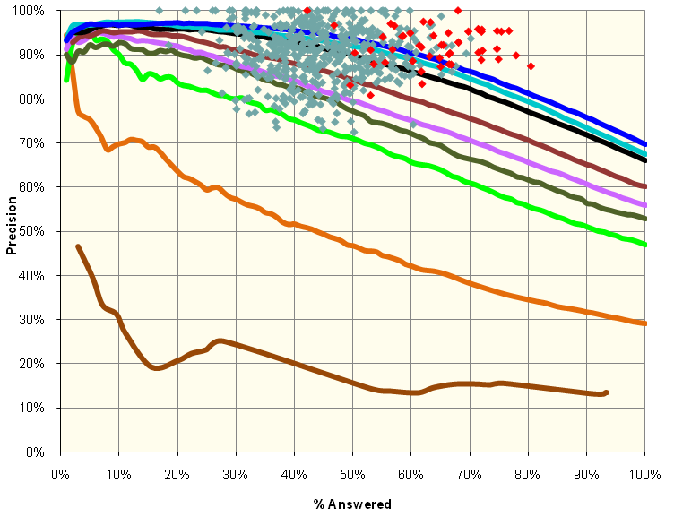

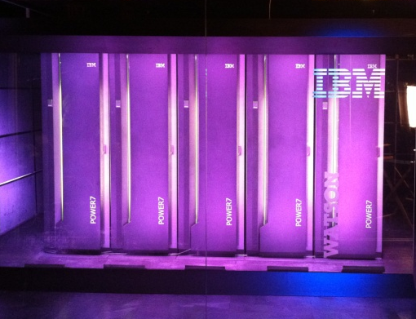
Watson: Precision, Confidence & Speed
Deep Analytics – We achieved champion-levels of Precision and Confidence over a huge variety of expression
Speed – By optimizing Watson’s computation for Jeopardy! on 2,880 POWER7 processing cores we went from 2 hours per question on a single CPU to an average of just 3 seconds – fast enough to compete with the best.
Results – in 55 real-time sparring against former Tournament of Champion Players last year, Watson put on a very competitive performance, winning 71%. In the final Exhibition Match against Ken Jennings and Brad Rutter, Watson won!

Slide 66


Potential Business Applications
Healthcare / Life Sciences: Diagnostic Assistance, Evidenced-Based, Collaborative Medicine
Tech Support: Help-desk, Contact Centers
Enterprise Knowledge Management and Business Intelligence
Government: Improved Information Sharing and Security

Slide 67
Watson and the MedBiquitous Community
Medical Education is based on a huge amount of mostly natural language information
  Reference Texts
  Scientific Literature
  Online class material
  Evaluations
We keep a large amount of information associated with Health Care professionals
  Reviews
  C.V.’s
  Clinical information
Can we glean more insight from this information?

Slide 68
We can start now
Text Analytics
Tools are available today
Semantic Modeling
Is(“Cytoplasm”, “liquid”) = 0.2
Is(“organelle”, “liquid”) = 0.1
Machine Learning
Is(“vacuole”, “liquid”) = 0.2
Is(“plasma”, “liquid”) = 0.7

Slide 69

With a Full Watson-Like Solution
Verify Hypotheses
Find or compare evidence for alternatives
Supplement tutoring systems
Enhance Just-in-time or Point-of-Care learning
Clarify or synthesize prevailing opinion
Speed up literature research
Perhaps Watson’s greatest contribution will be to make us rethink the possibilities

