Slide 1
Lecture 21: Web Searching
Principles of Information Retrieval
Prof. Ray Larson
University of California, Berkeley
School of Information

Slide 2
Today
MiniTREC initial results…
Review
Web Search Engines and Algorithms
Web indexes and Ranking – PageRank
Hadoop/Nutch Processing
Web Search Processing
Parallel Architectures (Inktomi - Brewer)
Cheshire III Design
Credit for some of the slides in this lecture goes to Marti Hearst and Eric Brewer

Slide 3
Mini-TREC
Proposed Schedule
February 11 – Database and previous Queries
March 4 – report on system acquisition and setup
March 6, New Queries for testing…
April 22, Results due
April 24, Results and system rankings
April 29 Group reports and discussion

Slide 4
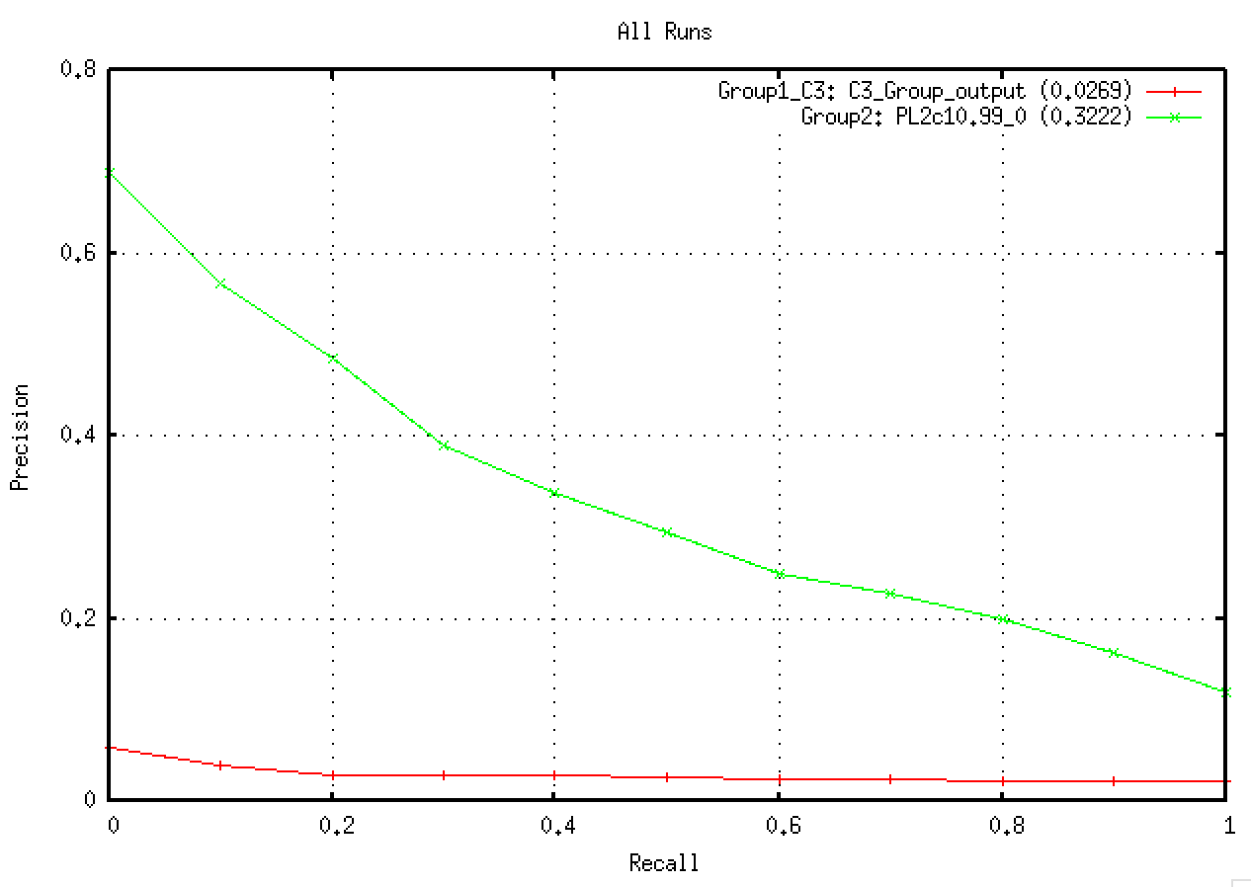
MiniTREC Results 2013

Slide 5
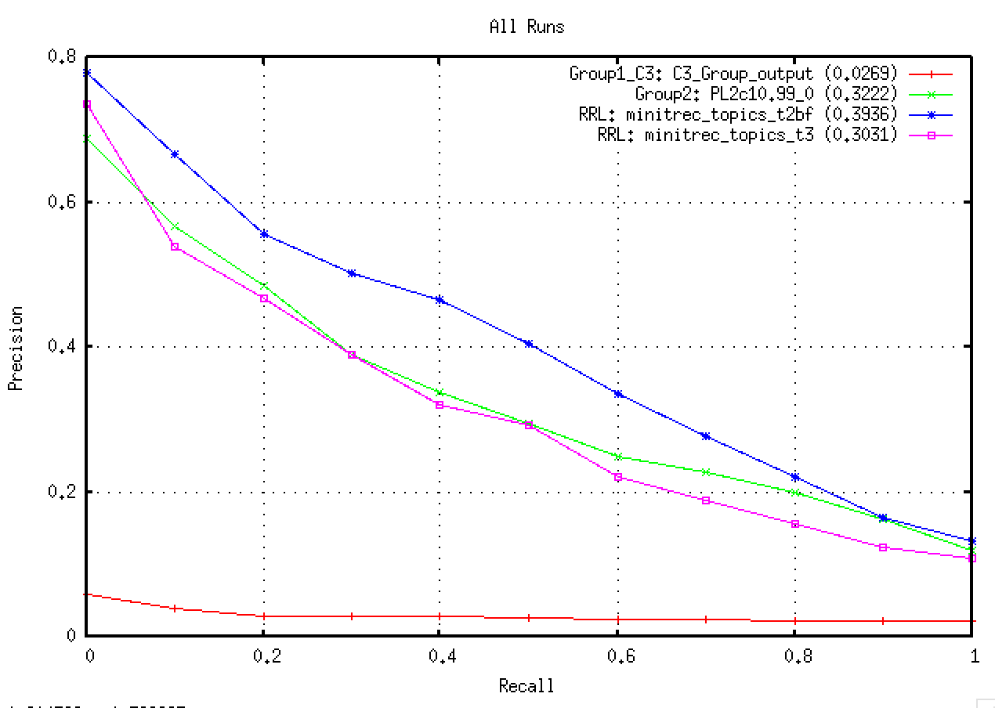
With my runs…

Slide 6
Mini-TREC Reports
In-Class Presentations April 29th
No class during RRR week
Written report due by or before May 15th (During Final Exam week) – 5-10 pages
Content
System description
What approach/modifications were taken?
results of official submissions (see RESULTS)
results of “post-runs” – new runs with results using MINI_TREC_QRELS and trec_eval

Slide 7
Final Term Paper
Should be about 8-15 pages on:
some area of IR research (or practice) that you are interested in and want to study further
Experimental tests of systems or IR algorithms
Build an IR system, test it, and describe the system and its performance
Due May 15th (Final exam Week)

Slide 8
Today
Review
Web Search Engines and Algorithms
Web indexes and Ranking – PageRank
Hadoop/Nutch Processing
Web Search Processing
Parallel Architectures (Inktomi - Brewer)
Cheshire III Design
Credit for some of the slides in this lecture goes to Marti Hearst and Eric Brewer

Slide 9
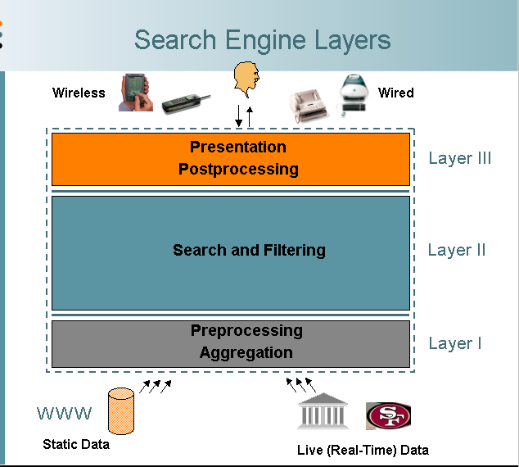
Web Search Engine Layers
From description of the FAST search engine, by Knut Risvik http://www.infonortics.com/searchengines/sh00/risvik_files/frame.htm

Slide 10
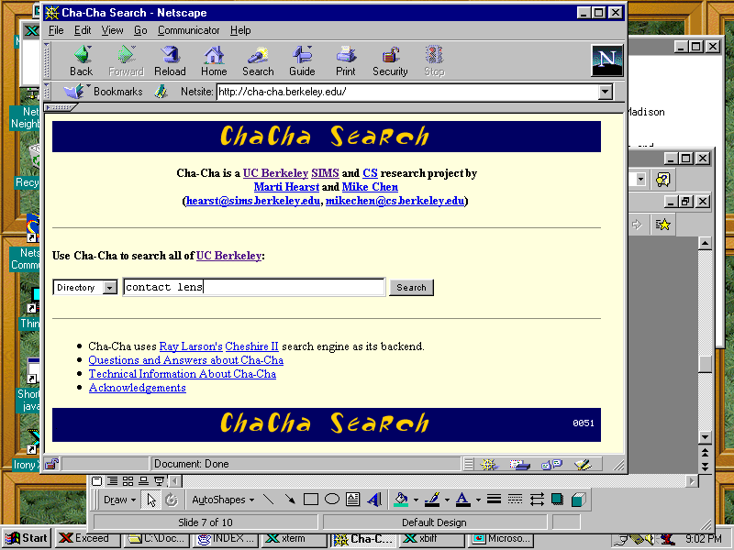
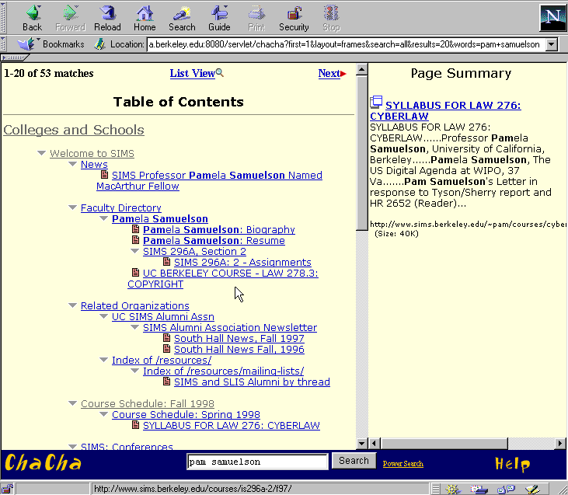
Standard Web Search Engine Architecture
Check for duplicates,
store the
documents
DocIds
crawl the
web
user
query
create an
inverted
index
Inverted
index
Search
engine
servers
Show results
To user

Slide 11
More detailed architecture, from Brin & Page 98. Only covers the preprocessing in detail, not the query serving.

Slide 12
Indexes for Web Search Engines
Inverted indexes are still used, even though the web is so huge
Most current web search systems partition the indexes across different machines
Each machine handles different parts of the data (Google uses thousands of PC-class processors and keeps most things in main memory)
Other systems duplicate the data across many machines
Queries are distributed among the machines
Most do a combination of these

Slide 13
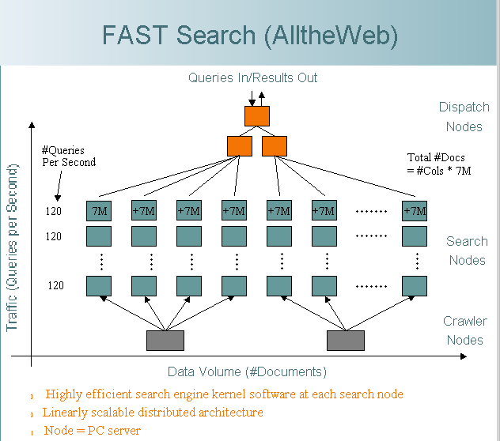
Search Engine Querying
In this example, the data for the pages is partitioned across machines. Additionally, each partition is allocated multiple machines to handle the queries.
Each row can handle 120 queries per second
Each column can handle 7M pages
To handle more queries, add another row.
From description of the FAST search engine, by Knut Risvik http://www.infonortics.com/searchengines/sh00/risvik_files/frame.htm

Slide 14
Querying: Cascading Allocation of CPUs
A variation on this that produces a cost-savings:
Put high-quality/common pages on many machines
Put lower quality/less common pages on fewer machines
Query goes to high quality machines first
If no hits found there, go to other machines

Slide 15
Today
Review
Web Search Engines and Algorithms
Web indexes and Ranking – PageRank
Hadoop/Nutch Processing
Web Search Processing
Parallel Architectures (Inktomi - Brewer)
Cheshire III Design
Credit for some of the slides in this lecture goes to Marti Hearst and Eric Brewer

Slide 16
Ranking: Link Analysis
Why does this work?
The official Toyota site will be linked to by lots of other official (or high-quality) sites
The best Toyota fan-club site probably also has many links pointing to it
Less high-quality sites do not have as many high-quality sites linking to them

Slide 17
Ranking: PageRank
Google uses the PageRank for ranking docs:
We assume page p_{i} has pages p_{j}...p_{N} which point to it (i.e., are citations). The parameter d is a damping factor which can be set between 0 and 1. d is usually set to 0.85. L(p_{i}) is defined as the number of links going out of page p_{i}. The PageRank (PR) of a page p_{i} is given as follows:
Note that the PageRanks form a probability distribution over web pages, so the sum of all web pages' PageRanks will be one

Slide 18
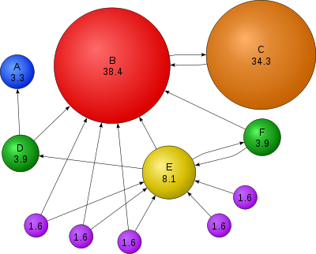
PageRank (from Wikipedia)

Slide 19
Today
Review
Web Search Engines and Algorithms
Web indexes and Ranking – PageRank
Hadoop/Nutch Processing
Web Search Processing
Parallel Architectures (Inktomi - Brewer)
Cheshire III Design
Credit for some of the slides in this lecture goes to Marti Hearst and Eric Brewer

Slide 20
MapReduce for search processing
As we have heard from our guest speakers, Mapreduce is widely used for search processing
ANNOUNCEMENT - 155 Kroeber from 9:30 to 11 this Thursday (tommorrow) Doug Cutting – the developer of Hadoop, Lucene and Nutch will talk on Big Data
As a short review…

Slide 21
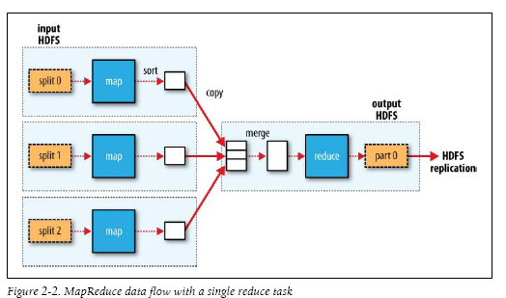
MapReduce in Hadoop (1)

Slide 22
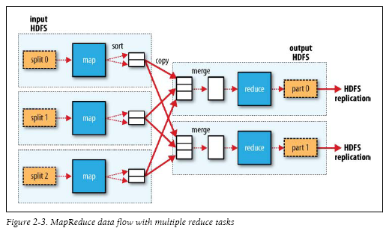
MapReduce in Hadoop (2)

Slide 23
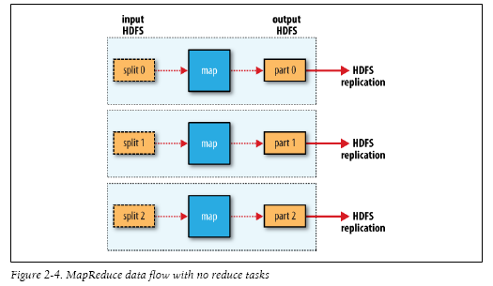
MapReduce in Hadoop (3)

Slide 24
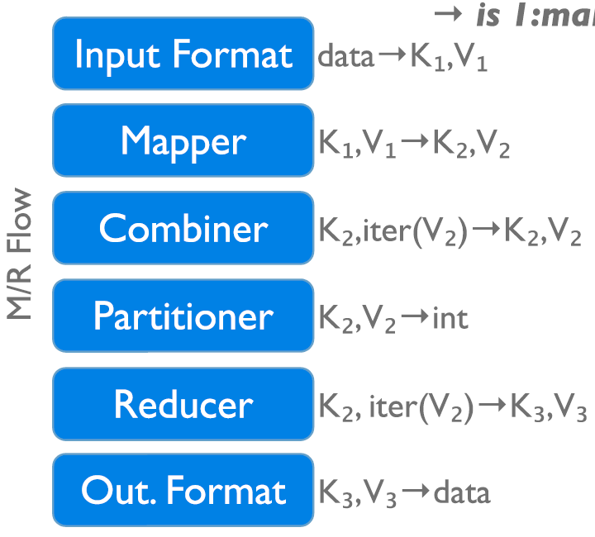
Data Flow in a MapReduce Program in Hadoop
→ 1:many
InputFormat
Map function
Partitioner
Sorting & Merging
Combiner
Shuffling
Merging
Reduce function
OutputFormat

Slide 25
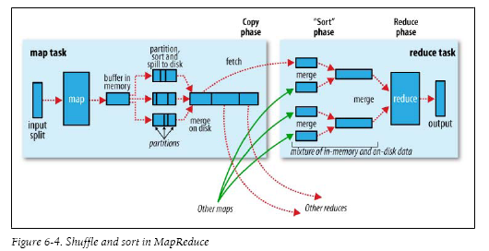

Slide 46
Today
Review
Web Search Engines and Algorithms
Web indexes and Ranking – PageRank
Hadoop/Nutch Processing
Web Search Processing
Parallel Architectures (Inktomi - Brewer)
Cheshire III Design
Credit for some of the slides in this lecture goes to Marti Hearst and Eric Brewer

Slide 47
Introduction
Cheshire History:
Developed at UC Berkeley originally
Solution for library data (C1), then SGML (C2), then XML
Monolithic applications for indexing and retrieval server in C + TCL scripting
Cheshire3:
Developed at Liverpool, plus Berkeley
XML, Unicode, Grid scalable: Standards based
Object Oriented Framework
Easy to develop and extend in Python

Slide 48
Introduction
Today:
Version 1.0
Mostly stable, but needs thorough QA and docs
Grid, NLP and Classification algorithms integrated

Slide 49
Context
Environmental Requirements:
Very Large scale information systems
Terabyte scale (Data Grid)
Computationally expensive processes (Comp. Grid)
Digital Preservation
Analysis of data, not just retrieval (Data/Text Mining)
Ease of Extensibility, Customizability (Python)
Open Source
Integrate not Re-implement
"Web 2.0" – interactivity and dynamic interfaces

Slide 50
Context
Application
Layer
Digital Library Layer
Data Grid
Layer
User Interface
Data Mining Tools
Text Mining Tools
User Interface
Web Browser Multivalent
Dedicated Client
Orange, Weka, ...
Tsujii Labs, ...
MySRB
PAWN
Classification
Clustering
Natural
Language
Processing
Information
Extraction
Query
Results
Information System
Data Grid
Protocol Handler
Cheshire3
Apache+
Mod_Python+
Cheshire3
Query
Store
SRB
iRODS
Search /
Retrieve
Index /
Store
Results
Query
Results
Term Management
Document Parsers
Process Management
Process Management
Multivalent,...
Kepler
Cheshire3
Termine
WordNet
...
Kepler
iRODS rules
Export
Parse

Slide 51
Cheshire3 Object Model
Protocol
Handler
Ingest Process
Documents
Object
Document
Group
ConfigStore
Transformer
Server
User
Records
Query
Document
UserStore
Database
PreParser
ResultSet
PreParser
PreParser
Query
Index
Document
Extracter
RecordStore
Parser
Normaliser
Terms
Record
IndexStore
DocumentStore

Slide 52
Object Configuration
One XML 'record' per non-data object
Very simple base schema, with extensions as needed
Identifiers for objects unique within a context (e.g., unique at individual database level, but not necessarily between all databases)
Allows workflows to reference by identifier but act appropriately within different contexts.
Allows multiple administrators to define objects without reference to each other

Slide 53
Grid
Focus on ingest, not discovery (yet)
Instantiate architecture on every node
Assign one node as master, rest as slaves. Master then divides the processing as appropriate.
Calls between slaves possible
Calls as small, simple as possible: (objectIdentifier, functionName, *arguments)
Typically: ('workflow-id', 'process', 'document-id')

Slide 54
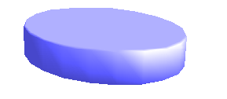
Grid Architecture
Master Task
(workflow, process, document)
(workflow, process, document)
fetch document
fetch document
Data Grid
document
document
Slave Task 1
Slave Task N
extracted data
extracted data
GPFS Temporary Storage

Slide 55
Grid Architecture - Phase 2
Master Task
(index, load)
(index, load)
store index
store index
Data Grid
Slave Task 1
Slave Task N
fetch extracted data
fetch extracted data
GPFS Temporary Storage

Slide 56
Workflow Objects
Written as XML within the configuration record.
Rewrites and compiles to Python code on object instantiation
Current instructions:
object
assign
fork
for-each
break/continue
try/except/raise
return
log (= send text to default logger object)
Yes, no if!

Slide 57
Workflow example
<subConfig id=“buildSingleWorkflow”>
<objectType>workflow.SimpleWorkflow</objectType>
<workflow>
<object type=“workflow” ref=“PreParserWorkflow”/>
<try>
<object type=“parser” ref=“NsSaxParser”/>
</try>
<except>
<log>Unparsable Record</log>
<raise/>
</except>
<object type=“recordStore” function=“create_record”/>
<object type=“database” function=“add_record”/>
<object type=“database” function=“index_record”/>
<log>”Loaded Record:” + input.id</log>
</workflow>
</subConfig>

Slide 58
Text Mining
Integration of Natural Language Processing tools
Including:
Part of Speech taggers (noun, verb, adjective,...)
Phrase Extraction
Deep Parsing (subject, verb, object, preposition,...)
Linguistic Stemming (is/be fairy/fairy vs is/is fairy/fairi)
Planned: Information Extraction tools

Slide 59
Data Mining
Integration of toolkits difficult unless they support sparse vectors as input - text is high dimensional, but has lots of zeroes
Focus on automatic classification for predefined categories rather than clustering
Algorithms integrated/implemented:
Perceptron, Neural Network (pure python)
Naïve Bayes (pure python)
SVM (libsvm integrated with python wrapper)
Classification Association Rule Mining (Java)

Slide 60
Data Mining
Modelled as multi-stage PreParser object (training phase, prediction phase)
Plus need for AccumulatingDocumentFactory to merge document vectors together into single output for training some algorithms (e.g., SVM)
Prediction phase attaches metadata (predicted class) to document object, which can be stored in DocumentStore
Document vectors generated per index per document, so integrated NLP document normalization for free

Slide 61
Data Mining + Text Mining
Testing integrated environment with 500,000 medline abstracts, using various NLP tools, classification algorithms, and evaluation strategies.
Computational grid for distributing expensive NLP analysis
Results show better accuracy with fewer attributes:

Slide 62
Applications (1)
Automated Collection Strength Analysis
Primary aim: Test if data mining techniques could be used to develop a coverage map of items available in the London libraries.
The strengths within the library collections were automatically determined through enrichment and analysis of bibliographic level metadata records.
This involved very large scale processing of records to:
Deduplicate millions of records
Enrich deduplicated records against database of 45 million
Automatically reclassify enriched records using machine learning processes (Naïve Bayes)

Slide 63
Applications (1)
Data mining enhances collection mapping strategies by making a larger proportion of the data usable, by discovering hidden relationships between textual subjects and hierarchically based classification systems.
The graph shows the comparison of numbers of books classified in the domain of Psychology originally and after enhancement using data mining

Slide 64
Applications (2)
Assessing the Grade Level of NSDL Education Material
The National Science Digital Library has assembled a collection of URLs that point to educational material for scientific disciplines for all grade levels. These are harvested into the SRB data grid.
Working with SDSC we assessed the grade-level relevance by examining the vocabulary used in the material present at each registered URL.
We determined the vocabulary-based grade-level with the Flesch-Kincaid grade level assessment. The domain of each website was then determined using data mining techniques (TF-IDF derived fast domain classifier).
This processing was done on the Teragrid cluster at SDSC.

Slide 65
Cheshire3 Grid Tests
Running on an 30 processor cluster in Liverpool using PVM (parallel virtual machine)
Using 16 processors with one “master” and 22 “slave” processes we were able to parse and index MARC data at about 13000 records per second
On a similar setup 610 Mb of TEI data can be parsed and indexed in seconds

Slide 66
SRB and SDSC Experiments
We worked with SDSC to include SRB support
We are planning to continue working with SDSC and to run further evaluations using the TeraGrid server(s) through a “small” grant for 30000 CPU hours
SDSC's TeraGrid cluster currently consists of 256 IBM cluster nodes, each with dual 1.5 GHz Intel® Itanium® 2 processors, for a peak performance of 3.1 teraflops. The nodes are equipped with four gigabytes (GBs) of physical memory per node. The cluster is running SuSE Linux and is using Myricom's Myrinet cluster interconnect network.
Planned large-scale test collections include NSDL, the NARA repository, CiteSeer and the “million books” collections of the Internet Archive

Slide 67
Conclusions
Scalable Grid-Based digital library services can be created and provide support for very large collections with improved efficiency
The Cheshire3 IR and DL architecture can provide Grid (or single processor) services for next-generation DLs
Available as open source via:
http://www.cheshire3.org/

