Slide 1
Lecture 18: GIR and MMM3
GIR and Location-Based Search:
Access to Geo-Referenced Information Resources
Ray R. Larson
University of California, Berkeley
School of Information
(Original version presented at Kyoto University, March 23, 2010)

Slide 2
Mini-TREC
Proposed Schedule
February 11 – Database and previous Queries
March 4 – report on system acquisition and setup
March 6, New Queries for testing…
April 22, Results due
April 24, Results and system rankings
April 29 Group reports and discussion

Slide 3
Overview
What is GIR?
Logistic Regression Algorithms for GIR
GIR and Location-Based Search
Mobile Location-Based Services
Reviving MMM (Mobile Media Metadata)

Slide 4
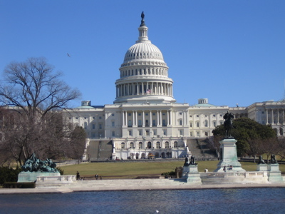
Geographic Information Retrieval (GIR)
Geographic information retrieval (GIR) is concerned with spatial approaches to the retrieval of geographically referenced, or georeferenced, information objects (GIOs)
about specific regions or features on or near the surface of the Earth.
Geospatial data are a special type of GIO that encodes a specific geographic feature or set of features along with associated attributes
maps, air photos, satellite imagery, digital geographic data, photos, text documents, etc.
Source: USGS

Slide 5
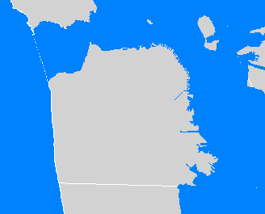
Georeferencing and GIR
Within a GIR system, e.g., a geographic digital library, information objects can be georeferenced by place names or by geographic coordinates (i.e. longitude & latitude)
San Francisco Bay Area
-122.418, 37.775

Slide 6
Geometric Approximations
The decomposition of spatial objects into approximate representations is a common approach to simplifying complex and often multi-part coordinate representations
Types of Geometric Approximations
Conservative: superset
Progressive: subset
Generalizing: could be either
Concave or Convex
Geometric operations on convex polygons much faster

Slide 7
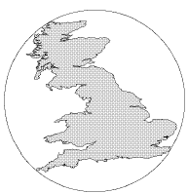
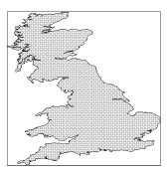
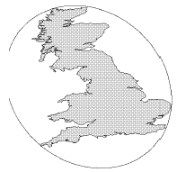
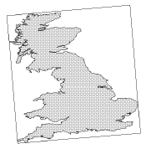
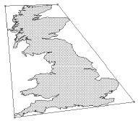
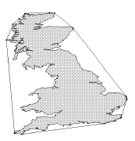
Other convex, conservative Approximations
1) Minimum Bounding Circle (3)
2) MBR: Minimum aligned Bounding rectangle (4)
3) Minimum Bounding Ellipse (5)
4) Rotated minimum bounding rectangle (5)
5) 4-corner convex polygon (8)
6) Convex hull (varies)
After Brinkhoff et al, 1993b
Presented in order of increasing quality. Number in parentheses denotes number of parameters needed to store representation

Slide 8
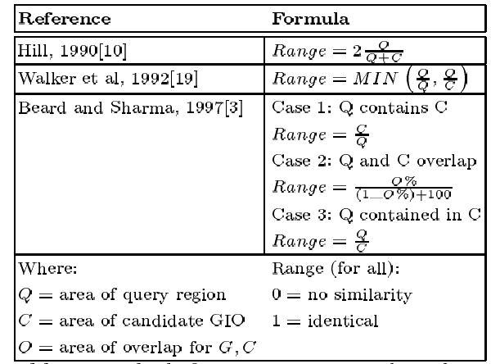
Spatial Ranking: Methods for computing spatial similarity

Slide 9
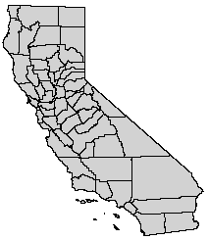
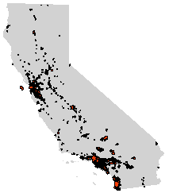
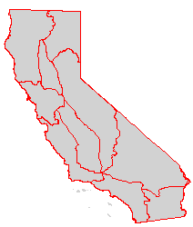
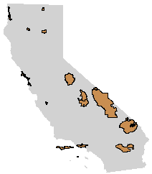
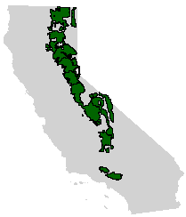
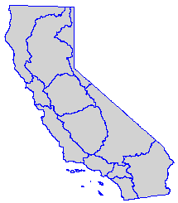
CA Named Places in the Test Collection – complex polygons
Counties
Cities
Bioregions
National
Parks
National
Forests
Water QCB
Regions

Slide 10
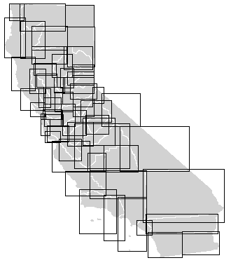
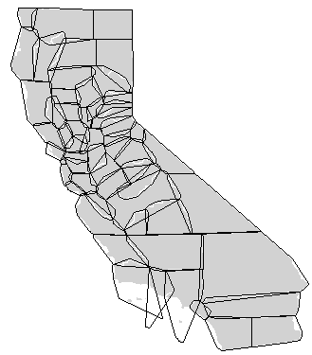
CA Counties – Geometric Approximations
MBRs
Convex Hulls
Ave. False Area of Approximation:
MBRs: 94.61% Convex Hulls: 26.73%

Slide 11
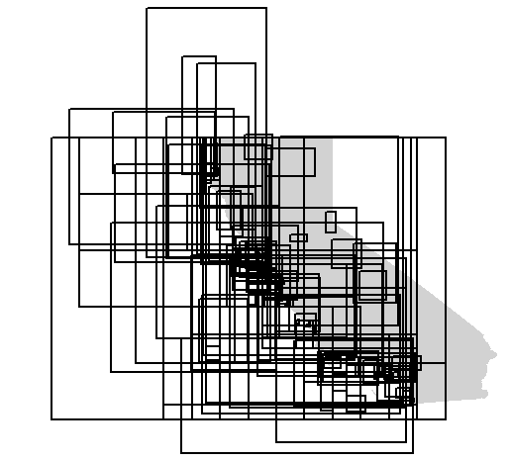
CA User Defined Areas (UDAs) in the Test Collection

Slide 12
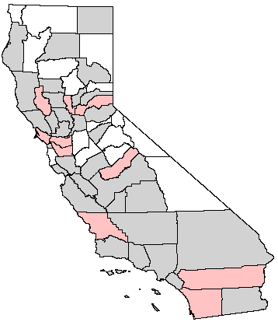
Test Collection Query Regions: CA Counties
42 of 58 counties referenced in the test collection metadata
10 counties randomly selected as query regions to train LR model
32 counties used as query regions to test model

Slide 13
Results for MBR - Named data
Precision
Recall

Slide 14
Results for Convex Hulls -Named
Precision
Recall

Slide 15
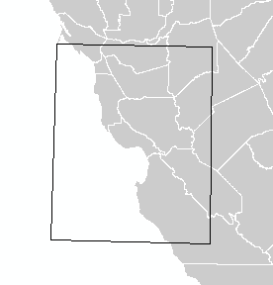
Offshore / Coastal Problem
California EEZ Sonar Imagery Map – GLORIA Quad 13
PROBLEM: the MBR for GLORIA Quad 13 overlaps with several counties that area completely inland.

Slide 16
Results for All Data - MBRs
Precision
Recall

Slide 17
Results for All Data - Convex Hull
Precision
Recall

Slide 18
GIR Examples
The following screen captures are from a GIR application using the algorithms (2 variable logistic regression model) and data (the CIEC database data)
Uses a Google Earth network link to provide a GIR search interface

Slide 19
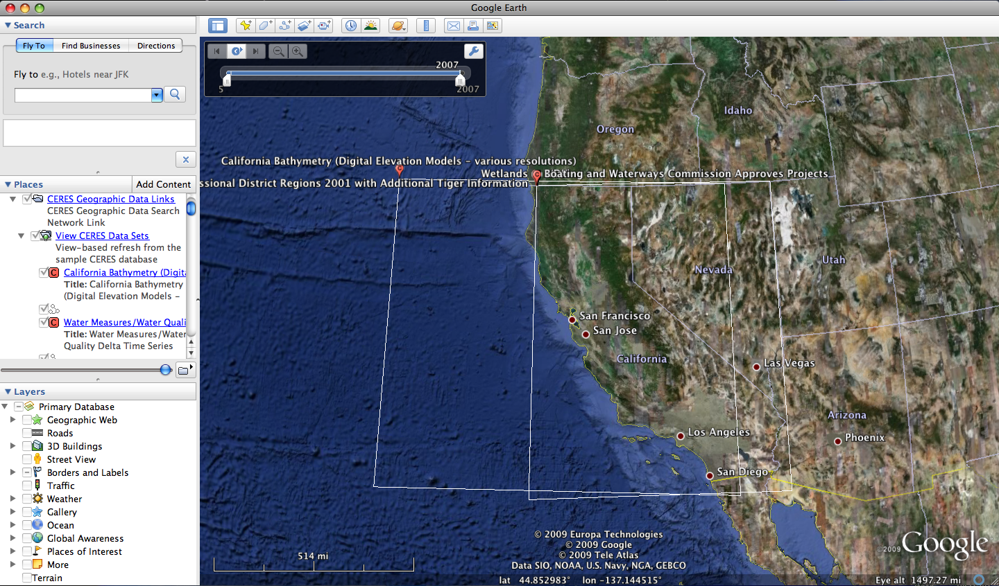

Slide 20
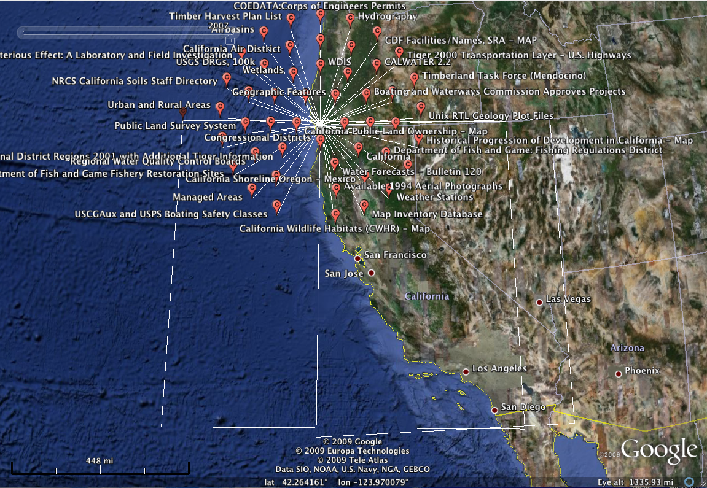

Slide 21
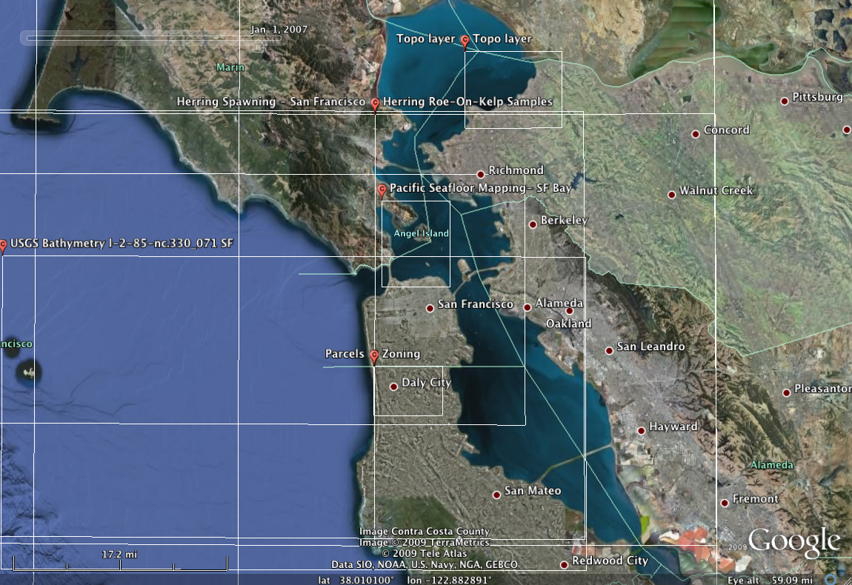

Slide 22
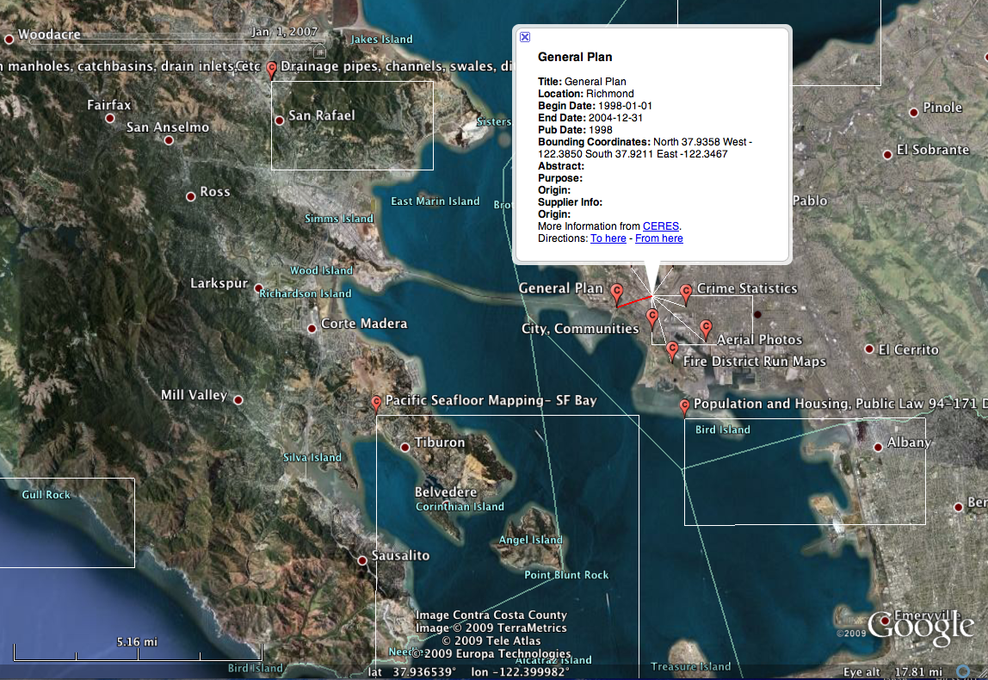

Slide 23
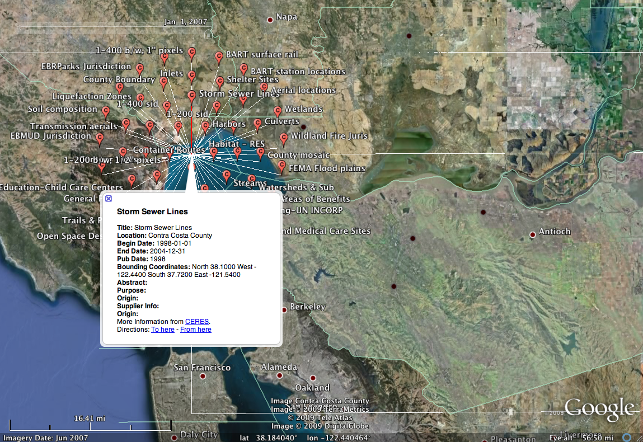

Slide 24
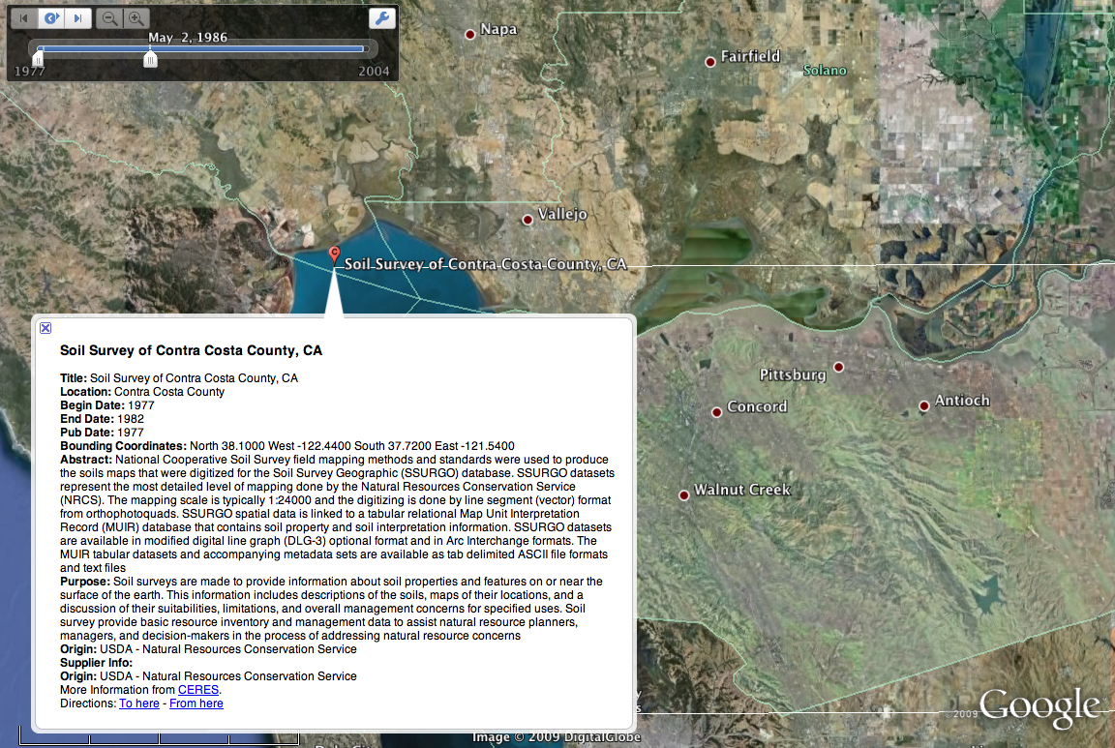

Slide 25
GIR Evaluations
The GeoCLEF track of CLEF conducted evaluations of GIR systems using text-based queries
One finding was that good text retrieval methods may work as well, or better, than more complex geographic modeling and query expansion approaches
The GikiCLEF track of CLEF
New NTCIR-GEOTIME track focuses GeoTemporal Information starting -- see http://metadata.berkeley.edu/NTCIR-GeoTime/

Slide 26
GeoCLEF Overview
Geographical Information Retrieval (GIR) concerns the retrieval of information involving some kind of spatial awareness. Given that many documents (and queries) contain some kind of spatial reference, there are examples where geographical references (geo-references) may be important for IR.
In addition to this, many documents contain geo-references expressed in multiple languages which may or may not be the same as the query language. This would require an additional translation step to enable successful retrieval.
Existing evaluation campaigns such as TREC and CLEF do not explicitly evaluate geographical IR relevance.
The aim of GeoCLEF was to provide the necessary framework in which to evaluate GIR systems for search tasks involving both spatial and multilingual aspects.

Slide 27
Organizers of GeoCLEF
Fred Gey and Ray Larson, University of California, Berkeley, USA (gey@berkeley.edu, ray@sims.berkeley.edu)
Mark Sanderson, Department of Information Studies, University of Sheffield, UK (m.sanderson@sheffield.ac.uk)
Hideo Joho, University of Glasgow, UK (hideo@dcs.gla.ac.uk)
Thomas Mandl and Christa Womser-Hacker of U. Hildesheim Germany (German language coordinators)
Diana Santos and Paulo Rocha of Linguateca (Portuguese coordinators)
Andrés Montoyo of U. Alicante (Spanish coordinator)

Slide 28
GeoCLEF
Proposed 2004, first evaluation 2005
The last GeoCLEF was held in 2008, but a new “GikiCLEF” task took its place in 2009

Slide 29
Topic for GeoCLEF 2005
Topics translated for both English and German
<top> <num> GC001 </num> <orignum> C084 </orignum> <EN-title>Shark Attacks off Australia and
California</EN-title> <EN-desc> Documents will report any information
relating to shark attacks on humans. </EN-desc> <EN-narr> Identify instances where a human was
attacked by a shark, including where the attack
took place and the circumstances surrounding the
attack. Only documents concerning specific attacks
are relevant; unconfirmed shark attacks or
suspected bites are not relevant. </EN-narr> <!-- NOTE: This topic has added tags for GeoCLEF --> <EN-concept> Shark attacks </EN-concept> <EN-spatialrelation>near</EN-spatialrelation> <EN-location> Australia </EN-location> <EN-location> California </EN-location> </top>

Slide 30
GeoCLEF 2005 Collections
The document collections for GeoCLEF 2005 are all newswire stories from the years 1994 and 1995 used in previous CLEF competitions.
The English document collection consists of 169,477 documents from the Glasgow Herald (1995) and the Los Angeles Times (1994).
The German document collection consists of 294,809 documents from Der Spiegel (1994/95), the Frankfurter Rundschau (1994) and the Swiss news agency SDA (1994/95)
The same collections were used for all GeoCLEF evaluations 2005-2008

Slide 31
GeoCLEF 2005 Documents
In both collections, the documents have a common structure:
newspaper-specific information like:
date
page
issue
special filing numbers
one or more titles
a byline
the actual text.
The document collections were not explicitly geographically tagged or contained any other location-specific information.

Slide 32
GeoCLEF 2005 Runs
† Linguateca helped with evaluation, but did not submit runs

Slide 33
GeoCLEF 2006 Topics
Topics in English, German, Spanish and Portuguese
<top>
<num>GC026</num>
<EN-title>Wine regions around rivers in Europe</EN-title>
<EN-desc>Documents about wine regions along the banks of European
rivers</EN-desc>
<EN-narr>Relevant documents describe a wine region along a major river in
European countries. To be relevant the document must name the region and the
river.</EN-narr>
</top>
<top>
<num>GC027</num>
<EN-title>Cities within 100km of Frankfurt</EN-title>
<EN-desc>Documents about cities within 100 kilometers of the city of Frankfurt
in Western Germany</EN-desc>
<EN-narr>Relevant documents discuss cities within 100 kilometers of Frankfurt
am Main Germany, latitude 50.11222, longitude 8.68194. To be relevant the
document must describe the city or an event in that city. Stories about Frankfurt
itself are not relevant</EN-narr>
</top>
<top>

Slide 34
GeoCLEF 2006 Topics
<top>
<num> GC034 </num>
<EN-title> Malaria in the tropics </EN-title>
<EN-desc> Malaria outbreaks in tropical regions and preventive
vaccination </EN-desc>
<EN-narr> Relevant documents state cases of malaria in tropical regions
and possible preventive measures like chances to vaccinate against the
disease. Outbreaks must be of epidemic scope. Tropics are defined as the region
between the Tropic of Capricorn, latitude 23.5 degrees South and the Tropic of
Cancer, latitude 23.5 degrees North. Not relevant are documents about a single
person's infection. </EN-narr> </top>
<top>
<num>GC042</num>
<EN-title>Regional elections in Northern Germany</EN-title>
<EN-desc>Documents about regional elections in Northern Germany</EN-desc>
<EN-narr>Relevant documents are those reporting the campaign or results for the
state parliaments of any of the regions of Northern Germany. The states of north
ern Germany are commonly Bremen, Hamburg, Lower Saxony, Mecklenburg-Western
Pomerania and Schleswig-Holstein. Only regional elections are relevant; municipal,
national and European elections are not.</EN-narr></top>

Slide 35
GeoCLEF 2006 Collections
Same English and German documents as 2005
Added Spanish and Portuguese collections
Spanish: EFE 1994-1995
Portuguese: Público 1994-1995, Folha de São Paulo 1994-1995
For 2007 and 2008 the Spanish collection was dropped

Slide 36
GeoCLEF 2006 Runs
NAME | DE | EN | ES | PT | X2DE | X2EN | X2ES | X2PT | Total
alicante |  | 4 | 3 |  |  |  |  |  | 7
berkeley | 2 | 4 | 2 | 4 | 2 |  | 2 | 2 | 18
daedalus | 5 | 5 | 5 |  |  |  |  |  | 15
hagen | 5 |  |  |  | 5 |  |  |  | 10
hildesheim | 4 | 5 |  |  | 4 |  |  |  | 13
imp-coll |  | 2 |  |  |  |  |  |  | 2
jaen |  | 5 |  |  |  |  |  |  | 5
ms-china |  | 5 |  |  |  |  |  |  | 5
nicta |  | 5 |  |  |  |  |  |  | 5
rfia-upv |  | 4 |  |  |  |  |  |  | 4
sanmarcos |  | 5 | 5 | 4 |  |  | 3 | 2 | 19
talp |  | 5 |  |  |  |  |  |  | 5
u.buffalo |  | 4 |  |  |  |  |  |  | 4
u.groningen |  | 5 |  |  |  |  |  |  | 5
u.twente |  | 5 |  |  |  |  |  |  | 5
unsw |  | 5 |  |  |  |  |  |  | 5
xldb |  | 5 |  | 5 |  |  |  |  | 10
TOTALS (17) | 16 | 73 | 15 | 13 | 11 | 0 | 5 | 4 | 137

Slide 37
Techniques used by various groups in 2005 and 2006
Ad-hoc text retrieval techniques (blind feedback, German word de-compounding, etc.)
Question-answering modules
Gazetteer construction (GNIS, World Gazetteer)
Toponym Named Entity Extraction
Term expansion using Wordnet, geographic thesauri
Toponym resolution
NLP – Geofiltering predicates
Latitude-longitude assignment
Gazetteer-based query expansion

Slide 38
Best-Performing Monolingual Runs: GeoCLEF 2005

Slide 39
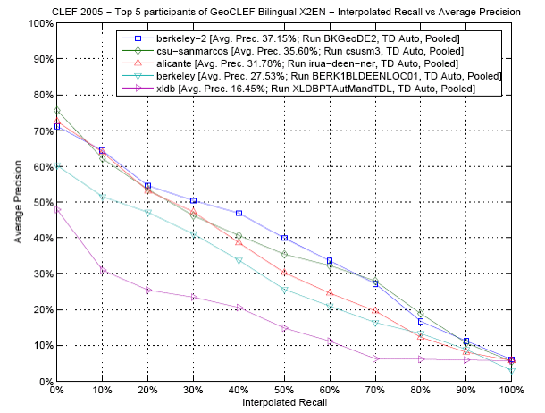
Bilingual English Performance

Slide 40
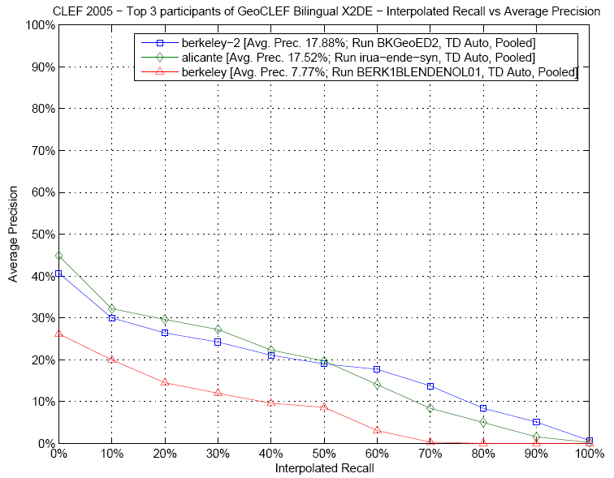
Bilingual German Performance

Slide 41
GeoCLEF 2006 Top Mono. Runs

Slide 42
Monolingual English 2006

Slide 43
Monolingual German 2006

Slide 44
Monolingual Portuguese 2006

Slide 45
Monolingual Spanish 2006

Slide 46
GeoCLEF 2006 Top Biling. Runs

Slide 47
Bilingual English 2006

Slide 48
Bilingual German 2006

Slide 49
Bilingual Portuguese 2006

Slide 50
Bilingual Spanish 2006

Slide 51
GeoCLEF Collections 2007

Slide 52
Example Topics 2007

Slide 53
Participant Approaches 2007
Ad-hoc techniques (weighting, probabilistic retrieval, language model, blind relevance feedback )
Semantic analysis (annotation and inference)
Geographic knowledge bases (Gazetteers, thesauri, ontologies)
Text mining
Query expansion techniques (e.g. geographic feedback)
Geographic Named Entity Extraction (LingPipe, GATE, etc.)
Geographic disambiguation
Geographic scope and relevance models
Geographic relation analysis
Geographic entity type analysis
Term expansion using WordNet
Part-of-speech tagging

Slide 54
Monolingual Results 2007

Slide 55
Monolingual English 2007

Slide 56
Monolingual German 2007

Slide 57
Monolingual Portuguese 2007

Slide 58
Bilingual results 2007

Slide 59
Bilingual English 2007

Slide 60
Bilingual German 2007

Slide 61
Bilingual Portuguese 2007

Slide 62
GeoCLEF 2008
The 2008 evaluation continued the same basic approach to topics and results with the same test collections
In 2008 more of the topics were originally formulated in Portuguese, and then translated to English and German

Slide 63
Example Topics 2008

Slide 64
Monolingual English 2008

Slide 65
Monolingual German 2008

Slide 66
Monolingual Portuguese 2008

Slide 67
Bilingual English 2008

Slide 68
Bilingual German 2008

Slide 69
Bilingual Portuguese 2008

Slide 70
Cheshire Results 2007-2008
The good results obtained in 2007 and 2008 by our system were not due to explicit geographic processing (such as explicit geographic query expansion or geometric approaches)
We used only text retrieval methods as used in other text retrieval tasks
Logistic regression text retrieval with psuedo relevance feedback
For GeoCLEF type queries, place names searched as text appears to perform as well or better than more complex geographic processing (but good machine translation software is essential)

Slide 71
Comparison of Cheshire Runs
Cheshire Runs 2006-2008

Slide 72
GikiCLEF 2009
GikiCLEF has replaced GeoCLEF for GIR-related retrieval in the 2009 CLEF Evaluation
GikiCLEF uses the Wikipedia database in 10 different languages
Bulgarian, Dutch, English, German, Italian, Norwegian (Bokmål and Nynorsk), Portuguese, Romanian and Spanish

Slide 73
GikiCLEF 2009
For GikiCLEF, systems need to answer or address geographically challenging topics, on the Wikipedia collections, returning Wikipedia document titles as list of answers
The user model for which GikiCLEF systems intend to cater for is anyone who is interested in knowing something that might be already included in Wikipedia, but has not enough time or imagination to browse it manually

Slide 74
GikiCLEF 2009 Example Topics
<topic id="GC-2009-01">List the Italian places where Ernest Hemingway visited during his life.</topic>
<topic id="GC-2009-07"> What capitals of Dutch provinces received their town privileges before the fourteenth century? </topic>
<topic id="GC-2009-21"> List the left side tributaries of the Po river. </topic>

Slide 75
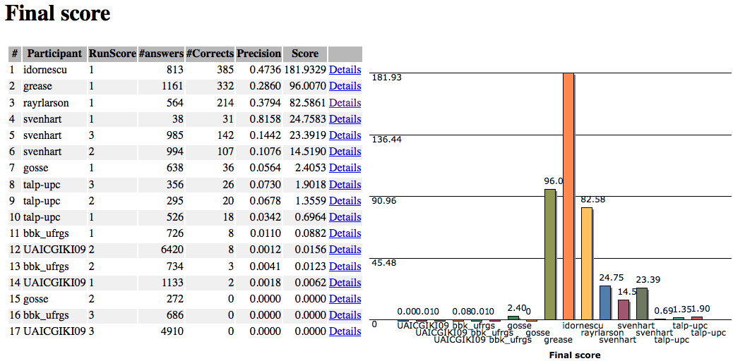
GikiCLEF Results (just released)

Slide 76
NTCIR GeoTime 2010
The introductory NTCIR GeoTime track will explore GIR with the added complexity of temporal (time-based) elements
Will use both English and Japanese collections
Still open for participation

Slide 77
NTCIR GeoTime Example Topics
NTCIR GeoTime Web Site: http://metadata.berkeley.edu/NTCIR-GeoTime/

Slide 78
Results (preview)
runID | mean AP | mean Q | mean nDCG
BRKLY-JA-EN-01-DN | 0.42 | 0.43 | 0.62
BRKLY-EN-EN-02-DN | 0.4 | 0.42 | 0.61
UIOWA-EN-01-D | 0.4 | 0.42 | 0.62
INESC-EN-EN-05-DN | 0.39 | 0.41 | 0.62
UIOWA-EN-03-DN | 0.38 | 0.39 | 0.62
BRKLY-JA-EN-02-D | 0.38 | 0.39 | 0.56
UIOWA-EN-05-DN | 0.37 | 0.38 | 0.58
BRKLY-EN-EN-03-D | 0.36 | 0.38 | 0.56
UIOWA-EN-02-D | 0.36 | 0.38 | 0.58
INESC-EN-EN-03-DN | 0.35 | 0.36 | 0.56
UIOWA-EN-04-DN | 0.35 | 0.37 | 0.59
BRKLY-EN-EN-04-DN | 0.34 | 0.36 | 0.58
XLDB-EN-EN-02-T | 0.34 | 0.36 | 0.57
XLDB-EN-EN-01-T | 0.33 | 0.35 | 0.57
XLDB-EN-EN-03-T | 0.33 | 0.35 | 0.56
DCU-EN-EN-02-D | 0.32 | 0.34 | 0.55
DCU-EN-EN-01-D | 0.32 | 0.34 | 0.55
XLDB-EN-EN-04-T | 0.3 | 0.32 | 0.53
DCU-EN-EN-03-D | 0.28 | 0.3 | 0.51
DCU-EN-EN-04-D | 0.25 | 0.26 | 0.48
DCU-EN-EN-05-D | 0.24 | 0.26 | 0.5
INESC-EN-EN-02-DN | 0.23 | 0.23 | 0.41
INESC-EN-EN-04-DN | 0.21 | 0.22 | 0.42
IIIT-H | 0.15 | 0.14 | 0.22
INESC-EN-EN-01-DN | 0.14 | 0.15 | 0.3

Slide 79
What can we do with GIR?
Consider some earlier work on Mobile Media Metadata
Experimental development with Marc Davis during course I202 in 2003 and 2004
Several of the doctoral students currently in the program were participants in this course during that period
The following slides and video from Marc…
Please recall that this was in 2002-2004 so many of today’s web-based media technologies were still in early stages (or not developed, such as you-tube and Flickr)

Slide 80
What is the Problem?
Today people cannot easily find, edit, share, and reuse media
Computers don’t understand media content
Media is opaque and data rich
We lack structured representations
Without content representation (metadata), manipulating digital media will remain like word-processing with bitmaps
Notes:
State of denial of researchers and developers in the areas of multimedia and interactive television
wthout content representation,
no scaling
no control at multiple levels of granularity

Slide 81
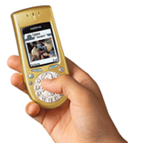
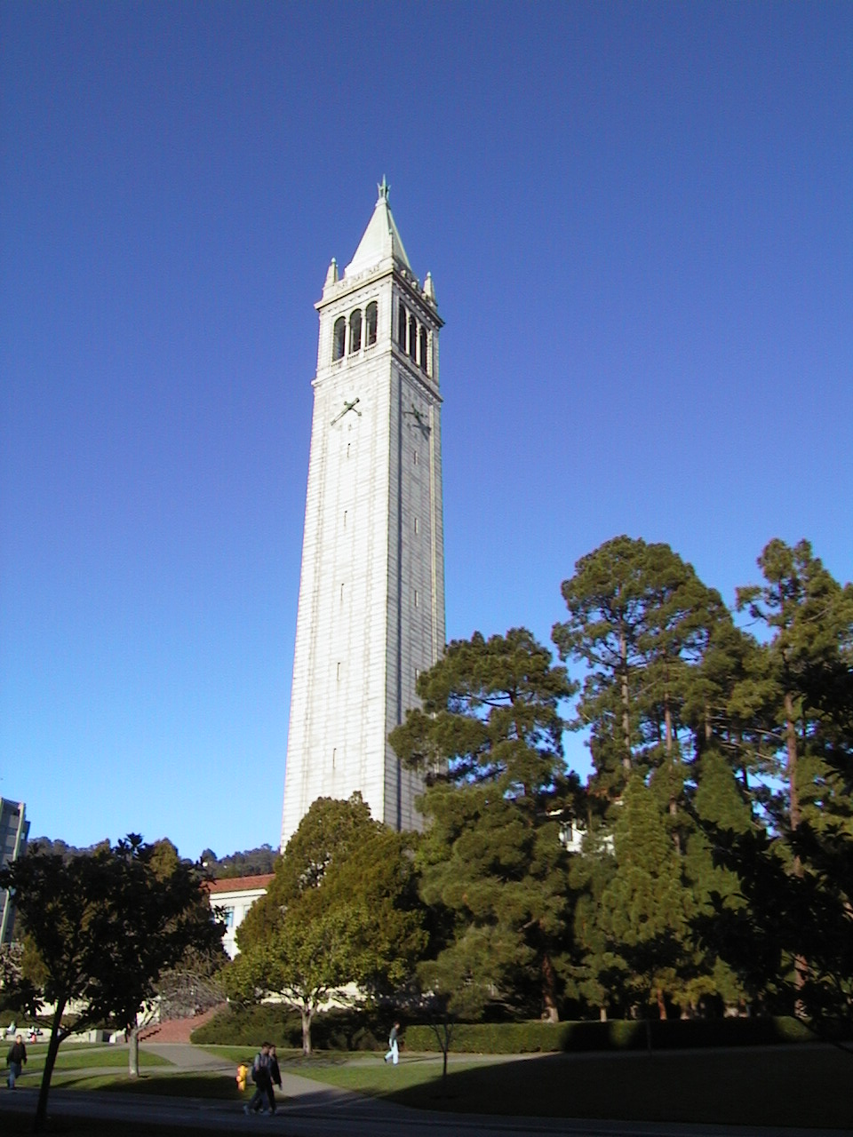
Signal-to-Symbol Problems
Semantic Gap
Gap between low-level signal analysis and high-level semantic descriptions
“Vertical off-white rectangular blob on blue background” does not equal “Campanile at UC Berkeley”

Slide 82
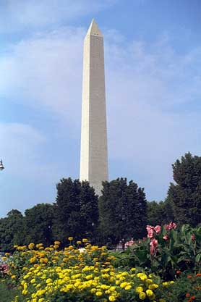
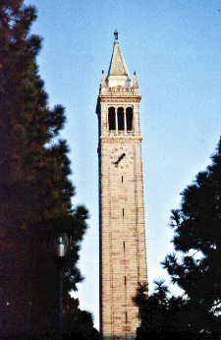
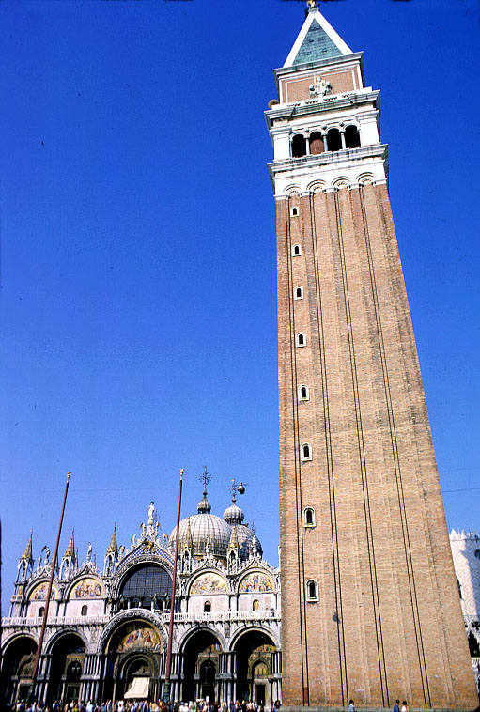
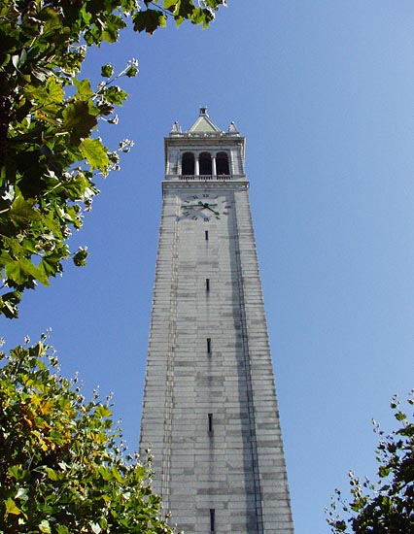
Signal-to-Symbol Problems
Sensory Gap
Gap between how an object appears and what it is
Different images of same object can appear dissimilar
Images of different objects can appear similar

Slide 83
Traditional Media Production Chain
METADATA
Metadata-Centric Production Chain
M E T A D A T A
PRE-PRODUCTION
PRODUCTION
POST-PRODUCTION
DISTRIBUTION

Slide 84
The Media Metadata Opportunity
Vastly more media will be produced
Without ways to manage it (metadata creation and use) we lose the advantages of digital media
Most current approaches are insufficient and perhaps misguided
Great opportunity for innovation and invention
Need interdisciplinary approaches to the problem

Slide 85
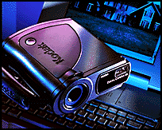
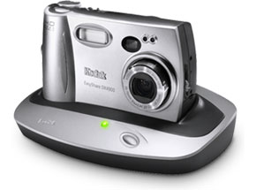
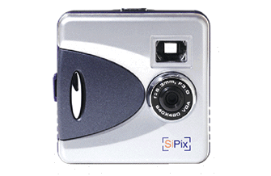
Moore’s Law for Cameras
2000
2002
$400
Kodak DC40
Kodak DX4900
$ 40
Nintendo GameBoy Camera
SiPix StyleCam Blink

Slide 86
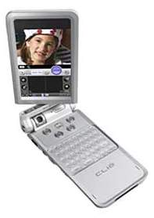
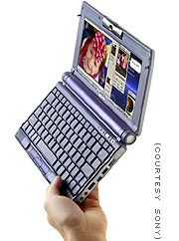
Capture+Processing+Interaction+Network

Slide 87
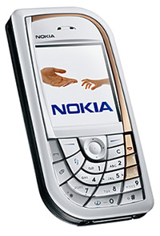
Camera Phones as Platform
Media capture (images, video, audio)
Programmable processing using open standard operating systems, programming languages, and APIs
Wireless networking
Personal information management functions
Rich user interaction modalities
Time, location, and user contextual metadata

Slide 88
Camera Phones as Platform
In the first half of 2003, more camera phones were sold worldwide than digital cameras
By 2008, the average camera phone is predicted to have 5 megapixel resolution
Last month Casio and Samsung introduced 3.2 megapixel camera phones with optical zoom and photo flash
There are more cell phone users in China than people in the United States (300 million)
For 90% of the world their “computer” is their cell phone

Slide 89
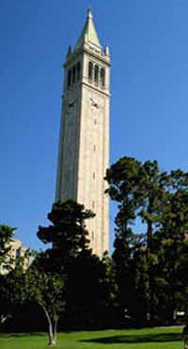
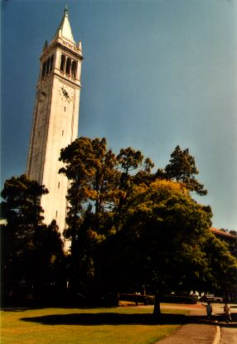
Campanile Inspiration

Slide 90
Mobile Media Metadata Idea
Leverage the spatio-temporal context and social community of media capture in mobile devices
Gather all automatically available information at the point of capture (time, spatial location, phone user, etc.)
Use metadata similarity and media analysis algorithms to find similar media that has been annotated before
Take advantage of this previously annotated media to make educated guesses about the content of the newly captured media
Interact in a simple and intuitive way with the phone user to confirm and augment system-supplied metadata for captured media

Slide 91
MMM Demo Video

Slide 92
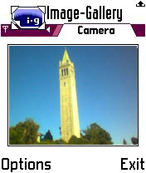
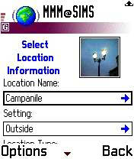
Campanile Scenario
Verified Information:
Location Name: Campanile (100%)
Setting: Outside (100%)
Image
Capture
Gathering
of Contextual
Metadata
Metadata (and
Media) Similarity Processing
Metadata and Media Sharing and Reuse
User
Verification
Gathered Data:
Location Data
Time
Date
Username
Processing Results:
Location City: Berkeley (100%)
Day of Week: Saturday (100%)
Location Name: Campanile (62%)
Setting: Outside (82%)

Slide 93
MMM Architecture
Phone
Browser
Application Server
xhtml
Annotation
Process Handling
Dialog
Logic
Phone Gateway
Web Server
Metadata
Processing
html
Desktop
Browser
Object Factory
Flamenco
Dumper
Facade
Metadata
Service
DB
Flamenco

Slide 94
From Context to Content
Context
When
Date and time refined to qualitative semantic time periods (weekday, weekend, night, day, fall, spring, summer, winter) and recurring and special events
Where
CellID (and GPS and geocoded Bluetooth access points) refined to semantic placenames
Who
Cameraphone user
Bluetooth co-presence
Whom shared with
Context

Slide 95
From Context to Content
Context
When
Where
Who
Content
Where is the location of the subject of the photo?
Who is depicted in the photo?
What objects are depicted in the photo?
What are the depicted people doing in the photo (i.e., actions, activities, events)?

Slide 96
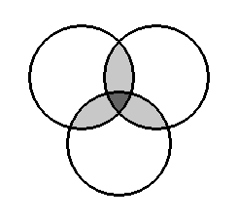
Space – Time - Community
familiar
strangers
Spatial
Temporal
spatial
cohorts
Social
temporal
cohorts

Slide 97
Space – Time – Social Space
SPATIAL
TEMPORAL
SOCIAL

Slide 98
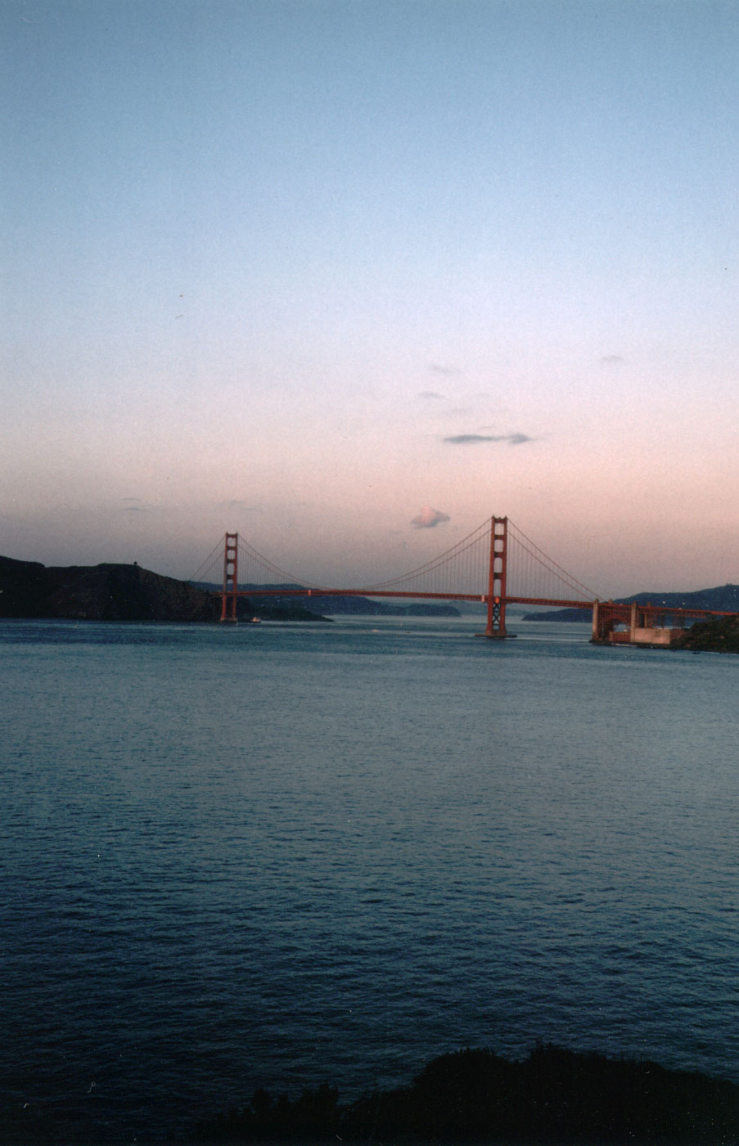
What is “Location”?

Slide 99
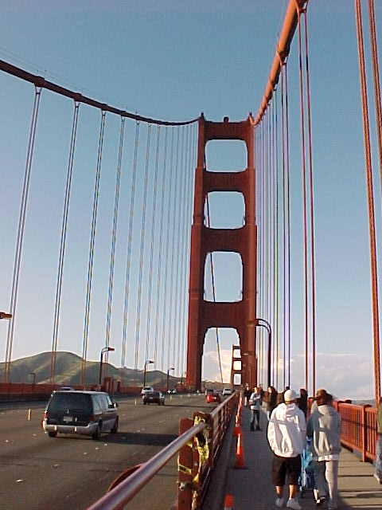
Camera Location vs. Subject Location
Camera Location = Golden Gate Bridge
Subject Location = Golden Gate Bridge
Camera Location = Albany Marina
Subject Location = Golden Gate Bridge

Slide 100
Kodak Picture Spot

Slide 101
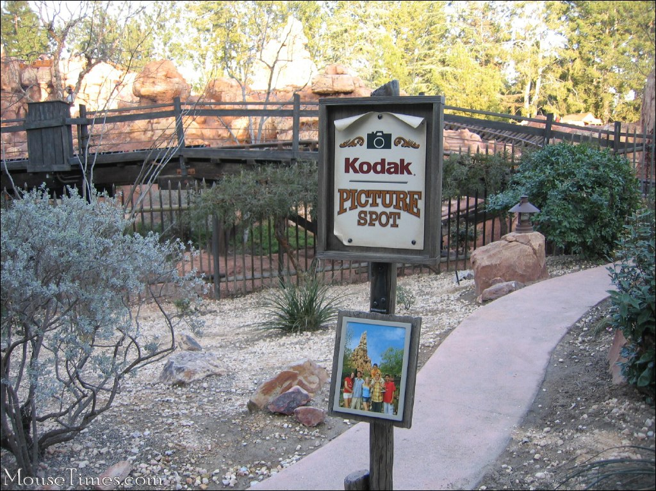
Themed Kodak Picture Spot

Slide 102
Location Guesser Concept
Calculate weighted sum of features
Most recently “visited” location
Most “visited” location by me in this CellID around this time
Most “visited” location by me in this CellID
Most “visited” location by “others” in this CellID around this time
Most “visited” location by “others” in this CellID

Slide 103
Location Guesser Performance
Exempting the occasions on which a user first enters a new location into the system, MMM guessed the correct location of the subject of the photo (out of an average of 36.8 possible locations):
100% of the time within the first four guesses
96% of the time within the first three guesses
88% of the time within the first two guesses
69% of the time as the first guess

Slide 104
Future of Mobile Imaging
Integrate media capture and analysis at the point of capture and throughout the media lifecycle
Leverage contextual metadata (spatial, temporal, social, etc.) about the capture and use of media content
Design systems that incorporate human beings as functional components and aggregate user behavior
Leveraging the spatio-temporal-social context of media capture and use can enable us to infer media content and solve key problems in mobile media management

Slide 105
MMM Revisited 2010
Technology has continued to develop and the social technologies have flourished
Many of the Yahoo! Social media services including geotagging in Flickr have been influenced by MMM (Marc was the founding director of the Yahoo! Berkeley research lab)
Many of the student MMM projects went on to become startups

Slide 106
But…
The basic concept inspired by the Campanile example has not yet been fully realized
In discussions on research collaborations with Dr. Satoshi Nakamura we have begun to define a related area combining
Photo-based GIR
Personal photo collections
Augmented reality mobile applications

Slide 107
Current Technology
High speed network connections
Built-in GPS
Time and geographic coords automatically embedded in photo metadata
Motion sensor embeds camera orientation and direction
Development platform
Thousands of applications available
Full computational capabilities
Up to 32GB local storage

Slide 108
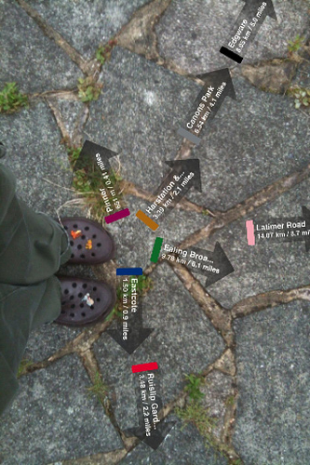
Augmented Reality
Among the many applications available we have seen the rise of several Augmented Reality apps
Basic concept
Use location information to
Give directions
Show current or historic data such as photos
Leave messages at locations for others to find

Slide 109
Augmented reality - AcrossAir

Slide 110
Augmented reality - Sekai Camera

Slide 111
Augmented Reality

Slide 112
First Steps toward MMM3
Exploring the information available in the image metadata
Based on Dr. Nakamura’s GPS located photos taken during his trip to Berkeley
Also based on my iPhone pictures since getting a GPS enabled iPhone
Using SQLite data generated by Dr. Nakamura’s lifelogviewer application
Example and Demo of GIR

Slide 113
Yosemite Falls

Slide 114
Yosemite overview

Slide 115
Demo
Not yet doing any matching with metadata sources
Many issues still to address

Slide 116
Example source for Metadata

Slide 117
Other Collections and Metadata

Slide 118
Other Collections and Metadata

Slide 119
Other Collections and Metadata

Slide 120
San Marco’s Square, Venice

Slide 121
Other Collections and Metadata
From “Mapping the World’s Photos”
David Crandall, Lars Backstrom,
Daniel Huttenlocher and Jon Kleinberg
Depar tment of Computer Science
Cornell University

Slide 122
Other Collections and Metadata
From “Mapping the World’s Photos”
David Crandall, Lars Backstrom,
Daniel Huttenlocher and Jon Kleinberg
Depar tment of Computer Science
Cornell University

Slide 123
Next-Generation MMM (MMM3?)
Continue to leverage the spatio-temporal context and social community of media capture in mobile devices
Gather all automatically available information at the point of capture (time, spatial location, phone user, other users, etc.)
Add additional automatic metadata - camera orientation, direction of photo (can we triangulate objects based on multiple camera angles or analysis like MS photosynth)
Use metadata similarity and media analysis algorithms to find similar media that has been annotated before
Exploit public resources such as Flickr, Panoramio, and Google Earth’s “points of interest”, etc.
Take advantage of this previously annotated media to make educated guesses about the content of the newly captured media
As the number of tagged photos expands, guessing becomes easier
Interact in a simple and intuitive way with the phone user to confirm and augment system-supplied metadata for captured media
Interact with other systems to support information, such as accrossair or Sekai camera
Personal library management and enhancement
Use social and image metadata to aid user in selection, presentation, etc.
Provide location memory for people

Slide 124
New Technology 2013
Google Glass
Available to developers RSN (have reserved one along with PhD student Nick Doty)
“Heads up” display
http://www.google.com/glass/start/how-it-feels/

Slide 125
Thank you.
Questions?

