Slide 1
Lecture 17: Introduction to GIR
Principles of Information Retrieval
Prof. Ray Larson
University of California, Berkeley
School of Information

Slide 2
Overview
Review
NLP and IR
Geographic Information Retrieval GIR

Slide 3
General Framework of NLP
Slides from Prof. J. Tsujii, Univ of Tokyo and Univ of Manchester

Slide 4
General Framework of NLP
John runs.
Morphological and
Lexical Processing
John run+s.
P-N V 3-pre
N plu
S
Syntactic Analysis
NP
VP
P-N
V
Semantic Analysis
Pred: RUN
Agent:John
John
run
Context processing
Interpretation
John is a student.
He runs.
Slides from Prof. J. Tsujii, Univ of Tokyo and Univ of Manchester

Slide 5
Framework of IE
IE as compromise NLP
Slides from Prof. J. Tsujii, Univ of Tokyo and Univ of Manchester

Slide 6
Difficulties of NLP
(1) Robustness:
Incomplete Knowledge
General Framework of NLP
Morphological and
Lexical Processing
Syntactic Analysis
Semantic Analysis
Predefined
Aspects of
Information
Incomplete
Domain Knowledge
Interpretation Rules
Context processing
Interpretation
Slides from Prof. J. Tsujii, Univ of Tokyo and Univ of Manchester

Slide 7
Difficulties of NLP
(1) Robustness:
Incomplete Knowledge
General Framework of NLP
Morphological and
Lexical Processing
Syntactic Analysis
Semantic Analysis
Predefined
Aspects of
Information
Incomplete
Domain Knowledge
Interpretation Rules
Context processing
Interpretation
Slides from Prof. J. Tsujii, Univ of Tokyo and Univ of Manchester

Slide 8
NLP & IR
Indexing
Use of NLP methods to identify phrases
Test weighting schemes for phrases
Use of more sophisticated morphological analysis
Searching
Use of two-stage retrieval
Statistical retrieval
Followed by more sophisticated NLP filtering

Slide 9
NPL & IR
Lewis and Sparck Jones suggest research in three areas
Examination of the words, phrases and sentences that make up a document description and express the combinatory, syntagmatic relations between single terms
The classificatory structure over document collection as a whole, indicating the paradigmatic relations between terms and permitting controlled vocabulary indexing and searching
Using NLP-based methods for searching and matching

Slide 10
NLP & IR Issues
Is natural language indexing using more NLP knowledge needed?
Or, should controlled vocabularies be used
Can NLP in its current state provide the improvements needed
How to test

Slide 11
NLP & IR
New “Question Answering” track at TREC has been exploring these areas
Usually statistical methods are used to retrieve candidate documents
NLP techniques are used to extract the likely answers from the text of the documents

Slide 12
Mark’s idle speculation
What people think is going on always
Keywords
From Mark Sanderson, University of Sheffield
NLP

Slide 13
Mark’s idle speculation
What’s usually actually going on
Keywords
NLP
From Mark Sanderson, University of Sheffield

Slide 14
What we really need is…
The reason NLP fails to help is because the machine lacks the human flexibility of interpretation and knowledge of context and content
So what about AI?
There are many debates on whether human-like AI is or is not possible
“the question of whether machines can think is no more interesting than the question of whether submarines can swim”
Edsger Dijkstra

Slide 15
The Challenge
“the open domain QA is attractive as it is one of the most challenging in the realm of computer science and artificial intelligence, requiring a synthesis of information retrieval, natural language processing, knowledge representation and reasoning, machine learning and computer-human interfaces.”
“Building Watson: An overview of the DeepQA Project”,
AI Magazine, Fall 2010

Slide 16
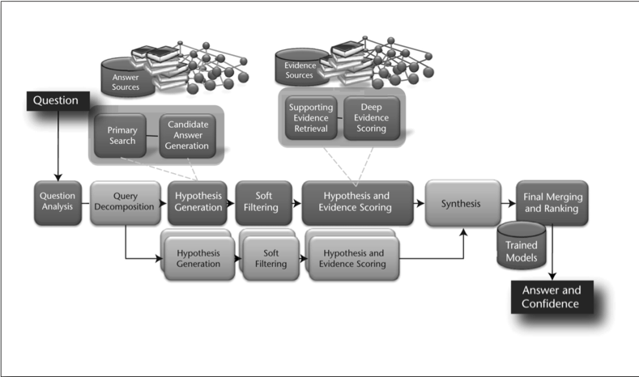
DeepQA
DeepQA High-Level Architecture from “Building Watson” AI Magazine Fall 2010

Slide 17
Question Analysis
Attempts to discover what kind of question is being asked (usually meaning the desired type of result - or LAT Lexical Answer Type)
I.e. “Who is…” needs a person, “Where is…” needs a location.
DeepQA uses a number of experts and combines the results using the confidence framework

Slide 18
Hypothesis Generation
Takes the results of Question Analysis and produces candidate answers by searching the system’s sources and extracting answer-sized snippets from the search results.
Each candidate answer plugged back into the question is considered a hypothesis
A “lightweight scoring” is performed to trim down the hypothesis set
What is the likelihood of the candidate answer being an instance of the LAT from the first stage?

Slide 19
Hypothesis and Evidence Scoring
Candidate answers that pass the lightweight scoring then undergo a rigorous evaluation process that involves gathering additional supporting evidence for each candidate answer, or hypothesis, and applying a wide variety of deep scoring analytics to evaluation the supporting evidence
This involves more retrieval and scoring (one method used involves IDF scores of common words between the hypothesis and the source passage)

Slide 20
Final Merging and Ranking
Based on the deep scoring, the hypotheses and their supporting sources are ranked and merged to select the single best-supported hypothesis
Equivalent candidate answers are merged
After merging the system must rank the hypotheses and estimate confidence based on their merged scores. (A machine-learning approach using a set of know training answers is used to build the ranking model)

Slide 21
Running DeepQA
A single question on a single processor implementation of DeepQA typically could take up to 2 hours to complete
The Watson system used a massively parallel version of the UIMA framework and Hadoop (both open source from Apache now :) that was running 2500 processors in parallel
They won the public Jeopardy Challenge (easily it seemed)

Slide 22
Geographic Information Retrieval (GIR): Algorithms and Approaches
Ray R. Larson
University of California, Berkeley
School of Information

Slide 23
Overview
What is GIR?
Spatial Approaches to GIR
A Logistic Regression Approach to GIR
Model
Testing and Results
Example using Google Earth as an interface
GIR Evaluation Tests
GeoCLEF
GikiCLEF
NTCIR GeoTime

Slide 24
Geographic Information Retrieval (GIR)
Geographic information retrieval (GIR) is concerned with spatial approaches to the retrieval of geographically referenced, or georeferenced, information objects (GIOs)
about specific regions or features on or near the surface of the Earth.
Geospatial data are a special type of GIO that encodes a specific geographic feature or set of features along with associated attributes
maps, air photos, satellite imagery, digital geographic data, photos, text documents, etc.
Source: USGS

Slide 25
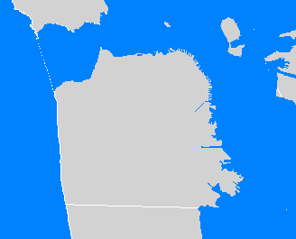
Georeferencing and GIR
Within a GIR system, e.g., a geographic digital library, information objects can be georeferenced by place names or by geographic coordinates (i.e. longitude & latitude)
San Francisco Bay Area
-122.418, 37.775

Slide 26
GIR is not GIS
GIS is concerned with spatial representations, relationships, and analysis at the level of the individual spatial object or field
GIR is concerned with the retrieval of geographic information resources (and geographic information objects at the set level) that may be relevant to a geographic query region

Slide 27
Spatial Approaches to GIR
A spatial approach to geographic information retrieval is one based on the integrated use of spatial representations, and spatial relationships.
A spatial approach to GIR can be qualitative or quantitative
Quantitative: based on the geometric spatial properties of a geographic information object
Qualitative: based on the non-geometric spatial properties.

Slide 28
Spatial Matching and Ranking
Spatial similarity can be considered as a indicator of relevance: documents whose spatial content is more similar to the spatial content of query will be considered more relevant to the information need represented by the query.
Need to consider both:
Qualitative, non-geometric spatial attributes
Quantitative, geometric spatial attributes
Topological relationships and metric details
We focus on the latter…

Slide 29
Simple Quantitative Ranking
The simplest measure to use is distance from one point to another – usually the center point of a spatial object
The “Great Circle Distance” (orthodromic)

Slide 30
Great Circle Distance
Programming simple distance calculations (in miles)
Where @Latitude, @Longitude is the start location in decimal degrees and latitude, longitude are the destination, 3959 is the radius (approx.) of the Earth in miles
The “radians” function is simply radians = degrees * π/180
Distance = 3959 * acos( cos( radians(@Latitude) ) * cos( radians( latitude ) ) * cos( radians( longitude ) - radians(@Longitude) ) + sin( radians(@Latitude) ) * sin( radians( latitude ) ) );

Slide 31
Simple Distance Problems
Distance is usually between the center of geographic objects (center point of a city or zip code, for example)
But, this is a very simple ranking method used almost everywhere for mobile apps, store locators, etc. where the geographic coordinates are known
Issues – Earth is not really a sphere
Large distances are not correct, but more complex versions of the formula can be used to correct

Slide 32
Spatial Similarity Measures and Spatial Ranking
When dealing with areas things get more interesting…
Three basic approaches to areal spatial similarity measures and ranking
Method 1: Simple Overlap
Method 2: Topological Overlap
Method 3: Degree of Overlap:

Slide 33
Method 1: Simple Overlap
Candidate geographic information objects (GIOs) that have any overlap with the query region are retrieved.
Included in the result set are any GIOs that are contained within, overlap, or contain the query region.
The spatial score for all GIOs is either relevant (1) or not relevant (0).
The result set cannot be ranked
topological relationship only, no metric refinement

Slide 34
Method 2: Topological Overlap
Spatial searches are constrained to only those candidate GIOs that either:
are completely contained within the query region,
overlap with the query region,
or, contain the query region.
Each category is exclusive and all retrieved items are considered relevant.
The result set cannot be ranked
categorized topological relationship only,
no metric refinement

Slide 35
Method 3: Degree of Overlap
Candidate geographic information objects (GIOs) that have any overlap with the query region are retrieved.
A spatial similarity score is determined based on the degree to which the candidate GIO overlaps with the query region.
The greater the overlap with respect to the query region, the higher the spatial similarity score.
This method provides a score by which the result set can be ranked
topological relationship: overlap
metric refinement: area of overlap

Slide 36
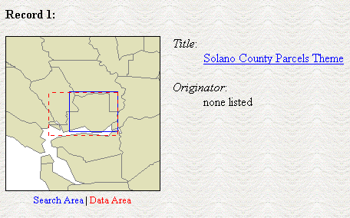
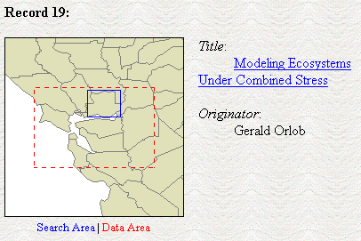
Example: Results display from CheshireGeo:
http://calsip.regis.berkeley.edu/pattyf/mapserver/cheshire2/cheshire_init.html

Slide 37
Geometric Approximations
The decomposition of spatial objects into approximate representations is a common approach to simplifying complex and often multi-part coordinate representations
Types of Geometric Approximations
Conservative: superset
Progressive: subset
Generalizing: could be either
Concave or Convex
Geometric operations on convex polygons much faster

Slide 38
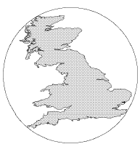
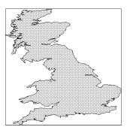
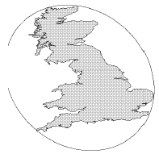
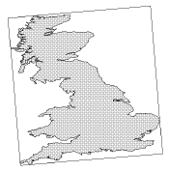
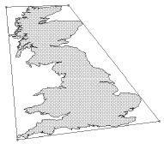
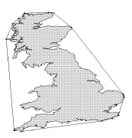
Other convex, conservative Approximations
1) Minimum Bounding Circle (3)
2) MBR: Minimum aligned Bounding rectangle (4)
3) Minimum Bounding Ellipse (5)
4) Rotated minimum bounding rectangle (5)
5) 4-corner convex polygon (8)
6) Convex hull (varies)
After Brinkhoff et al, 1993b
Presented in order of increasing quality. Number in parentheses denotes number of parameters needed to store representation

Slide 39
Our Research Questions
Spatial Ranking
How effectively can the spatial similarity between a query region and a document region be evaluated and ranked based on the overlap of the geometric approximations for these regions?
Geometric Approximations & Spatial Ranking:
How do different geometric approximations affect the rankings?
MBRs: the most popular approximation
Convex hulls: the highest quality convex approximation

Slide 40
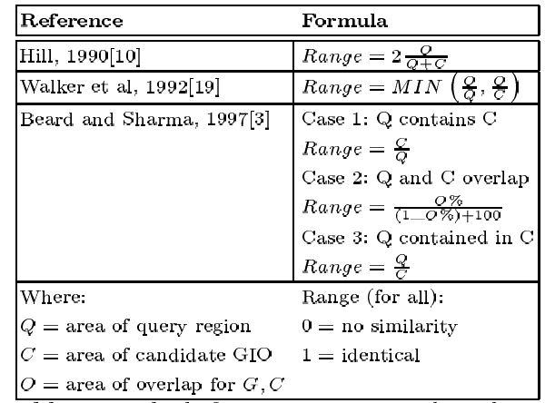
Spatial Ranking: Methods for computing spatial similarity

Slide 41
Proposed Ranking Method
Probabilistic Spatial Ranking using Logistic Inference
Probabilistic Models
Rigorous formal model attempts to predict the probability that a given document will be relevant to a given query
Ranks retrieved documents according to this probability of relevance (Probability Ranking Principle)
Rely on accurate estimates of probabilities

Slide 42
Logistic Regression
Probability of relevance is based on
Logistic regression from a sample set of documents
to determine values of the coefficients.
At retrieval the probability estimate is obtained by:
For the m X attribute measures (on the following page)

Slide 43
Probabilistic Models: Logistic Regression attributes
X₁ = area of overlap(query region, candidate GIO) / area of query region
X₂ = area of overlap(query region, candidate GIO) / area of candidate GIO
X₃ = 1 – abs(fraction of overlap region that is onshore fraction of candidate GIO that is onshore)
Where:
Range for all variables is 0 (not similar) to 1 (same)

Slide 44
Probabilistic Models
Advantages
Disadvantages
Strong theoretical basis
In principle should supply the best predictions of relevance given available information
Computationally efficient, straight- forward implementation (if based on LR)
Relevance information is required -- or is “guestimated”
Important indicators of relevance may not be captured by the model
Optimally requires on-going collection of relevance information

Slide 45
Test Collection
California Environmental Information Catalog (CEIC)
http://ceres.ca.gov/catalog.
Approximately 2500 records selected from collection (Aug 2003) of ~ 4000.

Slide 46
Test Collection Overview
2554 metadata records indexed by 322 unique geographic regions (represented as MBRs) and associated place names.
2072 records (81%) indexed by 141 unique CA place names
881 records indexed by 42 unique counties (out of a total of 46 unique counties indexed in CEIC collection)
427 records indexed by 76 cities (of 120)
179 records by 8 bioregions (of 9)
3 records by 2 national parks (of 5)
309 records by 11 national forests (of 11)
3 record by 1 regional water quality control board region (of 1)
270 records by 1 state (CA)
482 records (19%) indexed by 179 unique user defined areas (approx 240) for regions within or overlapping CA
12% represent onshore regions (within the CA mainland)
88% (158 of 179) offshore or coastal regions

Slide 47
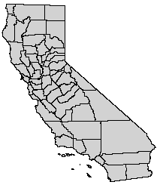
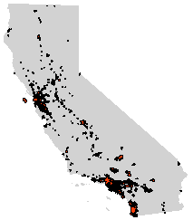
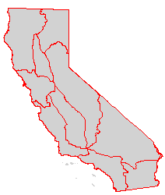
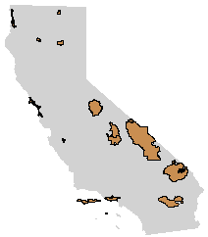
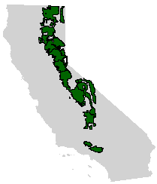
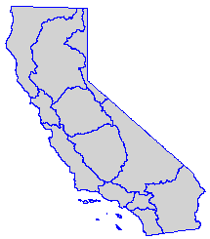
CA Named Places in the Test Collection – complex polygons
Counties
Cities
Bioregions
National
Parks
National
Forests
Water QCB
Regions

Slide 48
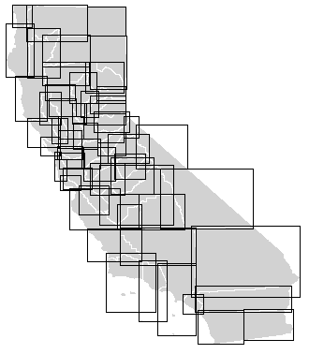
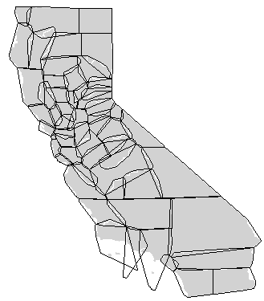
CA Counties – Geometric Approximations
MBRs
Convex Hulls
Ave. False Area of Approximation:
MBRs: 94.61% Convex Hulls: 26.73%

Slide 49
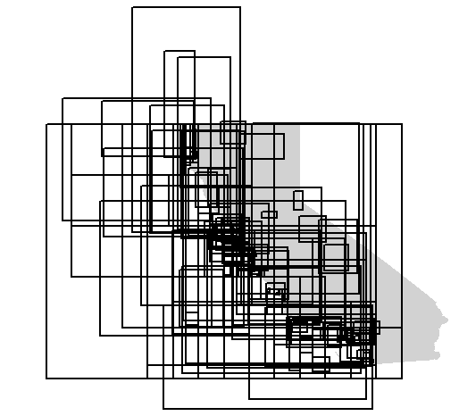
CA User Defined Areas (UDAs) in the Test Collection

Slide 50
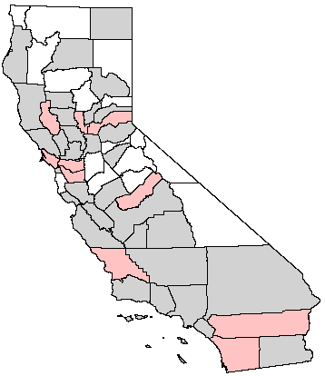
Test Collection Query Regions: CA Counties
42 of 58 counties referenced in the test collection metadata
10 counties randomly selected as query regions to train LR model
32 counties used as query regions to test model

Slide 51
Test Collection Relevance Judgements
Determine the reference set of candidate GIO regions relevant to each county query region:
Complex polygon data was used to select all CA place named regions (i.e. counties, cities, bioregions, national parks, national forests, and state regional water quality control boards) that overlap each county query region.
All overlapping regions were reviewed (semi-automatically) to remove sliver matches, i.e. those regions that only overlap due to differences in the resolution of the 6 data sets.
Automated review: overlaps where overlap area/GIO area > .00025 considered relevant, else not relevant.
Cases manually reviewed: overlap area/query area < .001 and overlap area/GIO area < .02
The MBRs and metadata for all information objects referenced by UDAs (user-defined areas) were manually reviewed to determine their relevance to each query region. This process could not be automated because, unlike the CA place named regions, there are no complex polygon representations that delineate the UDAs.
This process resulted in a master file of CA place named regions and UDAs relevant to each of the 42 CA county query regions.

Slide 52
LR model
X₁ = area of overlap(query region, candidate GIO) / area of query region
X₂ = area of overlap(query region, candidate GIO) / area of candidate GIO
Where:
Range for all variables is 0 (not similar) to 1 (same)

Slide 53
Some of our Results
Mean Average Query Precision: the average precision values after each new relevant document is observed in a ranked list.
For metadata indexed by CA named place regions:
These results suggest:
Convex Hulls perform better than MBRs
Expected result given that the CH is a higher quality approximation
A probabilistic ranking based on MBRs can perform as well if not better than a non-probabiliistic ranking method based on Convex Hulls
Interesting
Since any approximation other than the MBR requires great expense, this suggests that the exploration of new ranking methods based on the MBR are a good way to go.
For all metadata in the test collection:

Slide 54
Some of our Results
Mean Average Query Precision: the average precision values after each new relevant document is observed in a ranked list.
For metadata indexed by CA named place regions:
BUT:
The inclusion of UDA indexed metadata reduces precision.
This is because coarse approximations of onshore or coastal geographic regions will necessarily include much irrelevant offshore area, and vice versa
For all metadata in the test collection:

Slide 55
Results for MBR - Named data
Precision
Recall

Slide 56
Results for Convex Hulls -Named
Precision
Recall

Slide 57
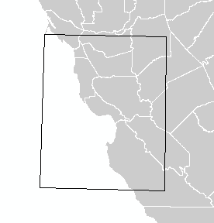
Offshore / Coastal Problem
California EEZ Sonar Imagery Map – GLORIA Quad 13
PROBLEM: the MBR for GLORIA Quad 13 overlaps with several counties that area completely inland.

Slide 58
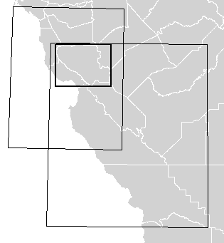
Adding Shorefactor Feature Variable
Shorefactor = 1 – abs(fraction of query region approximation that is onshore
– fraction of candidate GIO approximation that is onshore)
Onshore Areas
Candidate GIO MBRs
A) GLORIA Quad 13: fraction onshore = .55
B) WATER Project Area: fraction onshore = .74
Query Region MBR
Q) Santa Clara County: fraction onshore = .95
Q
A
Computing Shorefactor:
Q – A Shorefactor: 1 – abs(.95 - .55) = .60
Q – B Shorefactor: 1 – abs(.95 - .74) = .79
B
Even though A & B have the same area of overlap with the query region, B has a higher shorefactor, which would weight this GIO’s similarity score higher than A’s.
Note: geographic content of A is completely offshore, that of B is completely onshore.

Slide 59
About the Shorefactor Variable
Characterizes the relationship between the query and candidate GIO regions based on the extent to which their approximations overlap with onshore areas (or offshore areas).
Assumption: a candidate region is more likely to be relevant to the query region if the extent to which its approximation is onshore (or offshore) is similar to that of the query region’s approximation.

Slide 60
About the Shorefactor Variable
The use of the shorefactor variable is presented as an example of how geographic context can be integrated into the spatial ranking process.
Performance: Onshore fraction for each GIO approximation can be pre-indexed. Thus, for each query only the onshore fraction of the query region needs to be calculated using a geometric operation. The computational complexity of this type of operation is dependent on the complexity of the coordinate representations of the query region (we used the MBR and Convex hull approximations) and the onshore region (we used a very generalized concave polygon w/ only 154 pts).

Slide 61
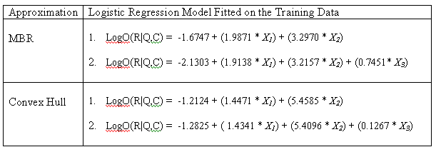
Shorefactor Model
X1 = area of overlap(query region, candidate GIO) / area of query region
X2 = area of overlap(query region, candidate GIO) / area of candidate GIO
X3 = 1 – abs(fraction of query region approximation that is onshore – fraction of candidate GIO approximation that is onshore)
Where: Range for all variables is 0 (not similar) to 1 (same)

Slide 62
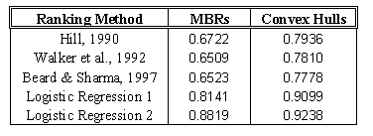
Some of our Results, with Shorefactor
For all metadata in the test collection:
Mean Average Query Precision:
the average precision values after each new relevant document is observed in a ranked list.
These results suggest:
Addition of Shorefactor variable improves the model (LR 2), especially for MBRs
Improvement not so dramatic for convex hull approximations – b/c the problem that shorefactor addresses is not that significant when areas are represented by convex hulls.

Slide 63
Results for All Data - MBRs
Precision
Recall

Slide 64
Results for All Data - Convex Hull
Precision
Recall

Slide 65
GIR Examples
The following screen captures are from a GIR application using the algorithms (2 variable logistic regression model) and data (the CIEC database data)
Uses a Google Earth network link to provide a GIR search interface

Slide 66
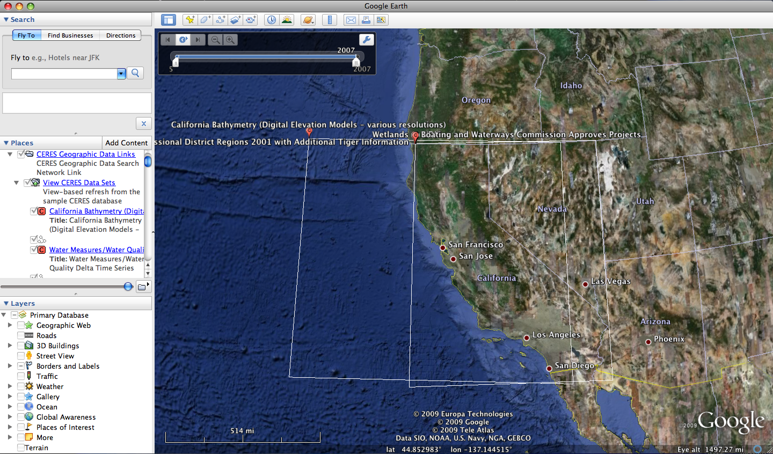

Slide 67
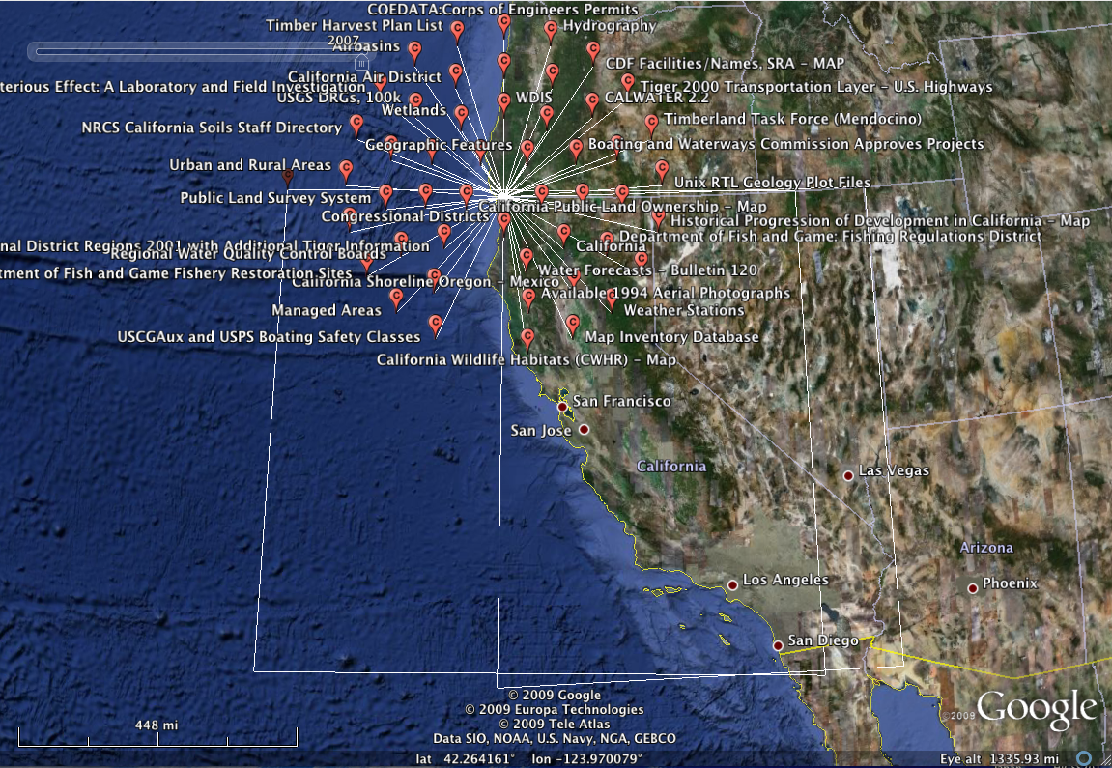

Slide 68
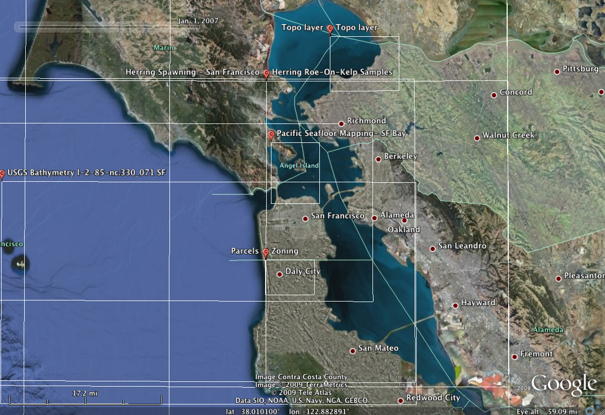

Slide 69
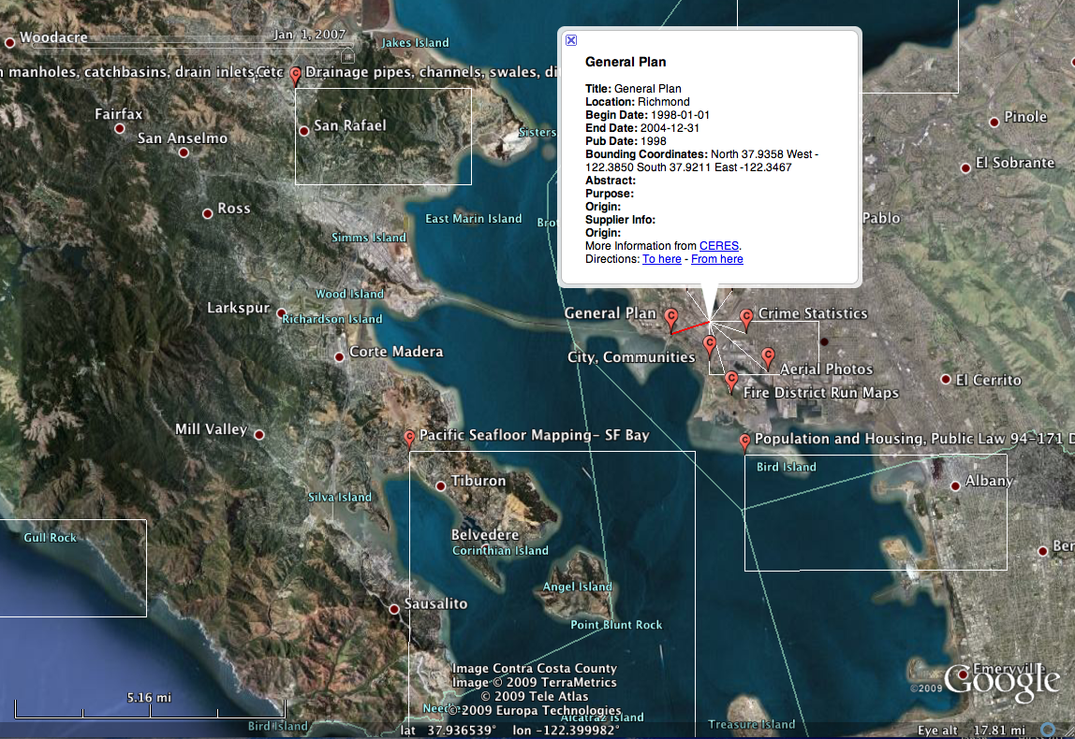

Slide 70
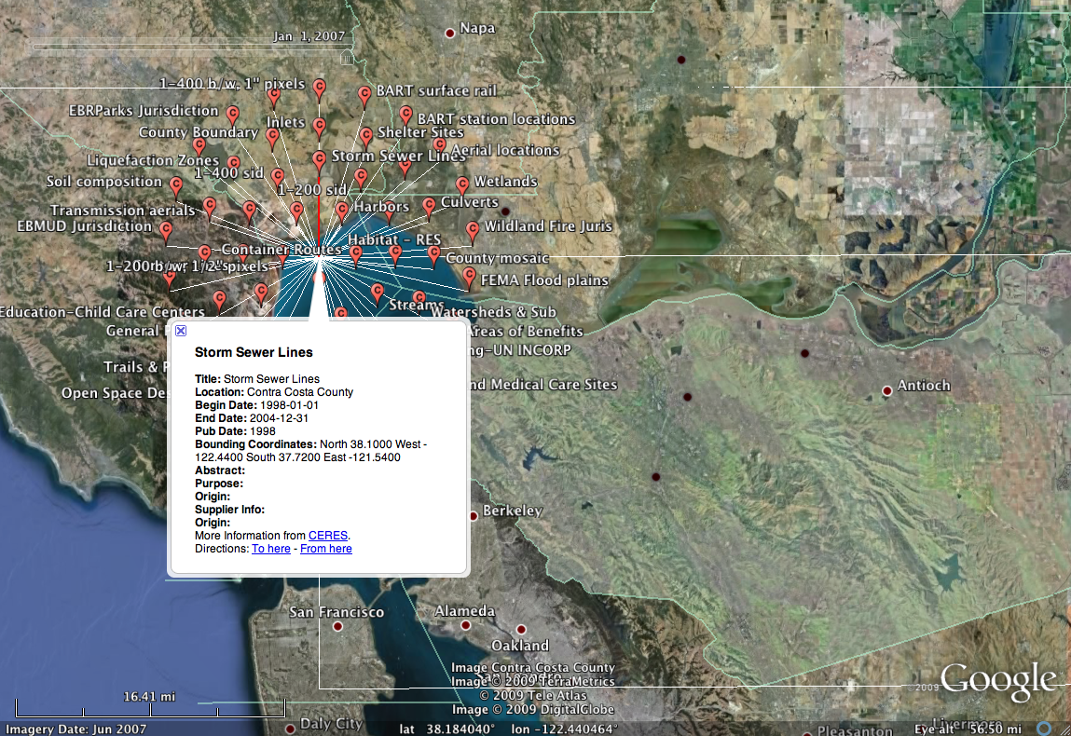

Slide 71
