Slide 1
Lecture 15: Web Search & MapReduce
Principles of Information Retrieval
Prof. Ray Larson
University of California, Berkeley
School of Information

Slide 2
Today
Web Crawling and Search Issues
Web Crawling
Web Search Engines and Algorithms
MapReduce and Hadoop
Credit for some of the slides in this lecture goes to
Marti Hearst, Doug Cutting and Dan Weld

Slide 3
Today
Web Crawling and Search Issues
Web Crawling
Web Search Engines and Algorithms
MapReduce and Hadoop
Credit for some of the slides in this lecture goes to
Marti Hearst, Doug Cutting and Dan Weld

Slide 4
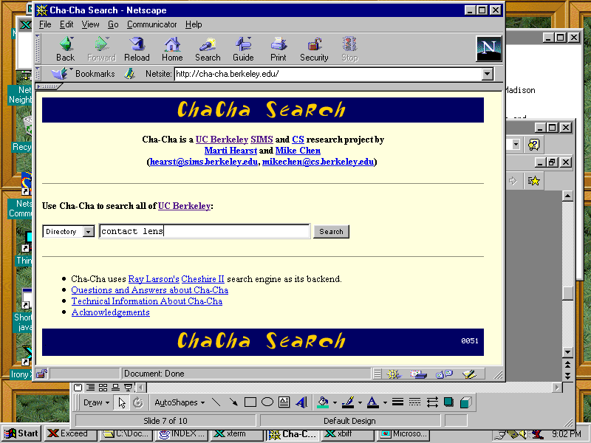
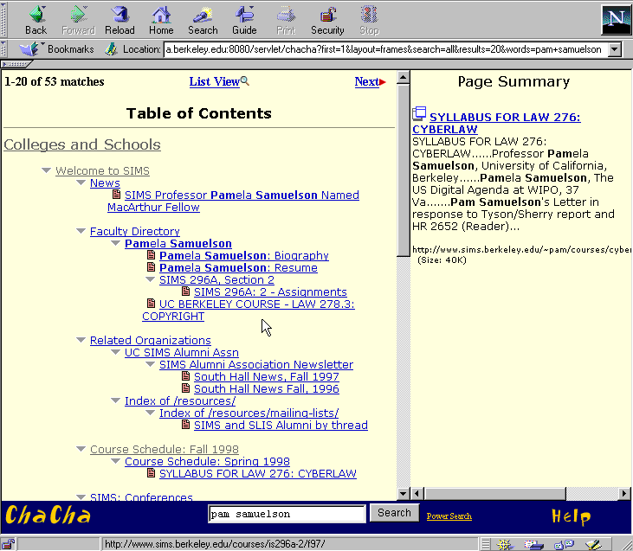
Standard Web Search Engine Architecture
Check for duplicates,
store the
documents
DocIds
crawl the
web
user
query
create an
inverted
index
Inverted
index
Search
engine
servers
Show results
To user

Slide 5
Standard Web Search Engine Architecture
Check for duplicates,
store the
documents
DocIds
crawl the
web
user
query
create an
inverted
index
Inverted
index
Search
engine
servers
Show results
To user

Slide 6
Web Crawling
How do the web search engines get all of the items they index?
Main idea:
Start with known sites
Record information for these sites
Follow the links from each site
Record information found at new sites
Repeat

Slide 7
Web Crawlers
How do the web search engines get all of the items they index?
More precisely:
Put a set of known sites on a queue
Repeat the following until the queue is empty:
Take the first page off of the queue
If this page has not yet been processed:
Record the information found on this page
Positions of words, links going out, etc
Add each link on the current page to the queue
Record that this page has been processed
In what order should the links be followed?

Slide 8
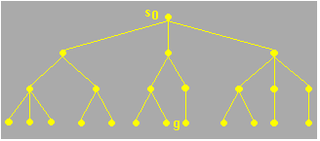
Page Visit Order
Animated examples of breadth-first vs depth-first search on trees:
http://www.rci.rutgers.edu/~cfs/472_html/AI_SEARCH/ExhaustiveSearch.html
Structure to be traversed

Slide 9
Page Visit Order
Animated examples of breadth-first vs depth-first search on trees:
http://www.rci.rutgers.edu/~cfs/472_html/AI_SEARCH/ExhaustiveSearch.html
Breadth-first search
(must be in presentation mode to see this animation)

Slide 10
Page Visit Order
Animated examples of breadth-first vs depth-first search on trees:
http://www.rci.rutgers.edu/~cfs/472_html/AI_SEARCH/ExhaustiveSearch.html
Depth-first search
(must be in presentation mode to see this animation)

Slide 11
Page Visit Order
Animated examples of breadth-first vs depth-first search on trees:
http://www.rci.rutgers.edu/~cfs/472_html/AI_SEARCH/ExhaustiveSearch.html

Slide 12
Sites Are Complex Graphs, Not Just Trees
Page 1
Page 1
Site 1
Site 2
Page 3
Page 2
Page 3
Page 2
Page 5
Page 1
Page 4
Page 1
Site 5
Page 6
Page 1
Page 2
Site 6
Site 3

Slide 13
Web Crawling Issues
Keep out signs
A file called robots.txt tells the crawler which directories are off limits
Freshness
Figure out which pages change often
Recrawl these often
Duplicates, virtual hosts, etc
Convert page contents with a hash function
Compare new pages to the hash table
Lots of problems
Server unavailable
Incorrect html
Missing links
Infinite loops
Web crawling is difficult to do robustly!

Slide 14
Today
Web Crawling and Search Issues
Web Crawling
Web Search Engines and Algorithms
MapReduce and Hadoop
Credit for some of the slides in this lecture goes to
Marti Hearst, Doug Cutting and Dan Weld

Slide 15
Searching the Web
Web Directories versus Search Engines
Some statistics about Web searching
Challenges for Web Searching
Search Engines
Crawling
Indexing
Querying
Note: This is full of old data. The search companies are less forthcoming with exact numbers than they were a few years ago.

Slide 16
Directories vs. Search Engines
Directories
Hand-selected sites
Search over the contents of the descriptions of the pages
Organized in advance into categories
Search Engines
All pages in all sites
Search over the contents of the pages themselves
Organized after the query by relevance rankings or other scores

Slide 17
Search Engines vs. Internal Engines
In the late 1990’s HotBot, GoTo, Yahoo and Microsoft were all powered by Inktomi
Today Google is the search engine behind many other search services

Slide 18
Statistics from Inktomi
Statistics from Inktomi, August 2000, for one client, one week
Total # queries: 1315040
Number of repeated queries: 771085
Number of queries with repeated words: 12301
Average words/ query: 2.39
Query type: All words: 0.3036; Any words: 0.6886; Some words:0.0078
Boolean: 0.0015 (0.9777 AND / 0.0252 OR / 0.0054 NOT)
Phrase searches: 0.198
URL searches: 0.066
URL searches w/http: 0.000
email searches: 0.001
Wildcards: 0.0011 (0.7042 '?'s )
frac '?' at end of query: 0.6753
interrogatives when '?' at end: 0.8456
composed of:
who: 0.0783 what: 0.2835 when: 0.0139 why: 0.0052 how: 0.2174 where 0.1826 where-MIS 0.0000 can,etc.: 0.0139 do(es)/did: 0.0

Slide 19
What Do People Search for on the Web?
Topics
Genealogy/Public Figure: 12%
Computer related: 12%
Business: 12%
Entertainment: 8%
Medical: 8%
Politics & Government 7%
News 7%
Hobbies 6%
General info/surfing 6%
Science 6%
Travel 5%
Arts/education/shopping/images 14%
(from Spink et al. 98 study)

Slide 20
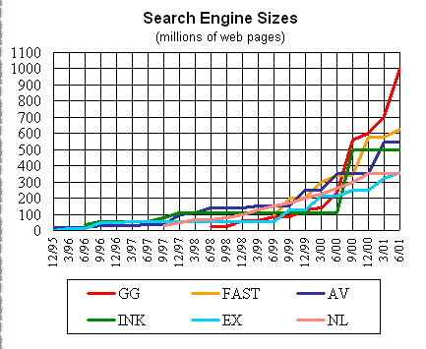

Slide 21
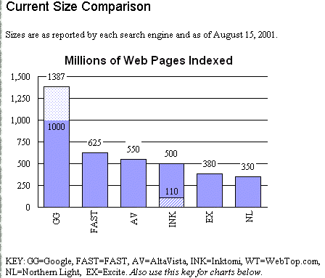

Slide 22
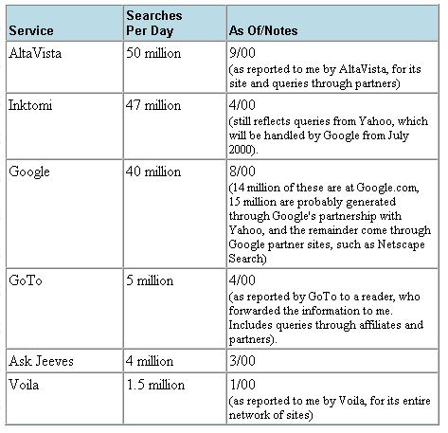
Searches Per Day (2000)

Slide 23
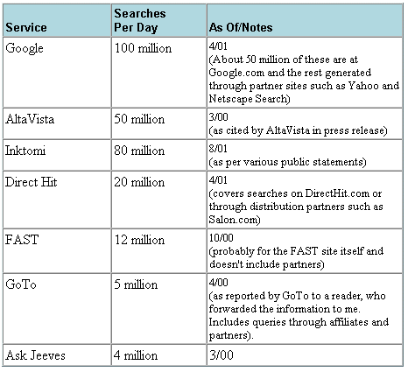
Searches Per Day (2001)

Slide 24
Searches per day (current)
Don’t have exact numbers for Google, but they have stated in their “press” section that they handle 200 Million searches per day
They index over 8 Billion web pages
http://www.google.com/press/funfacts.html
Now just says “Billions” - maybe they have stopped counting…

Slide 25
Challenges for Web Searching: Data
Distributed data
Volatile data/”Freshness”: 40% of the web changes every month
Exponential growth
Unstructured and redundant data: 30% of web pages are near duplicates
Unedited data
Multiple formats
Commercial biases
Hidden data

Slide 26
Challenges for Web Searching: Users
Users unfamiliar with search engine interfaces (e.g., Does the query “apples oranges” mean the same thing on all of the search engines?)
Users unfamiliar with the logical view of the data (e.g., Is a search for “Oranges” the same things as a search for “oranges”?)
Many different kinds of users

Slide 27
Web Search Queries
Web search queries are SHORT
~2.4 words on average (Aug 2000)
Has increased, was 1.7 (~1997)
User Expectations
Many say “the first item shown should be what I want to see”!
This works if the user has the most popular/common notion in mind

Slide 28
Search Engines
Crawling
Indexing
Querying

Slide 29
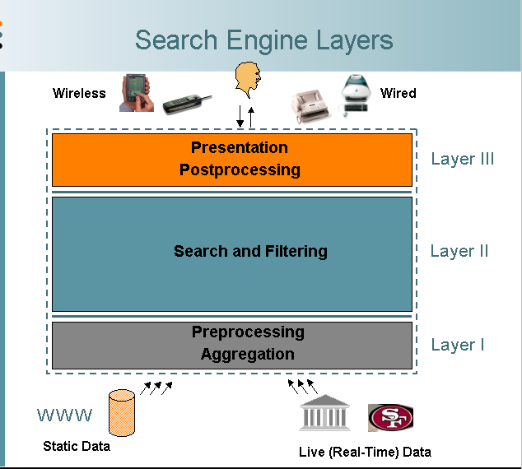
Web Search Engine Layers
From description of the FAST search engine, by Knut Risvik http://www.infonortics.com/searchengines/sh00/risvik_files/frame.htm

Slide 30
Standard Web Search Engine Architecture
Check for duplicates,
store the
documents
DocIds
crawl the
web
user
query
create an
inverted
index
Inverted
index
Search
engine
servers
Show results
To user

Slide 31
More detailed architecture, from Brin & Page 98. Only covers the preprocessing in detail, not the query serving.

Slide 32
Indexes for Web Search Engines
Inverted indexes are still used, even though the web is so huge
Most current web search systems partition the indexes across different machines
Each machine handles different parts of the data (Google uses thousands of PC-class processors and keeps most things in main memory)
Other systems duplicate the data across many machines
Queries are distributed among the machines
Most do a combination of these

Slide 33
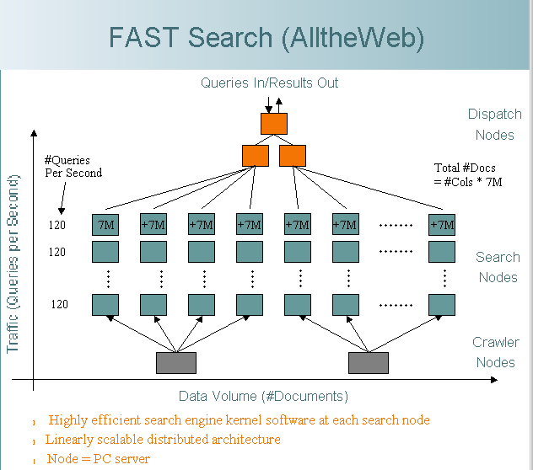
Search Engine Querying
In this example, the data for the pages is partitioned across machines. Additionally, each partition is allocated multiple machines to handle the queries.
Each row can handle 120 queries per second
Each column can handle 7M pages
To handle more queries, add another row.
From description of the FAST search engine, by Knut Risvik http://www.infonortics.com/searchengines/sh00/risvik_files/frame.htm

Slide 34
Querying: Cascading Allocation of CPUs
A variation on this that produces a cost-savings:
Put high-quality/common pages on many machines
Put lower quality/less common pages on fewer machines
Query goes to high quality machines first
If no hits found there, go to other machines

Slide 35
Google
Google maintains (probably) the worlds largest Linux cluster (over 15,000 servers)
These are partitioned between index servers and page servers
Index servers resolve the queries (massively parallel processing)
Page servers deliver the results of the queries
Over 8 Billion web pages are indexed and served by Google

Slide 36
Search Engine Indexes
Starting Points for Users include
Manually compiled lists
Directories
Page “popularity”
Frequently visited pages (in general)
Frequently visited pages as a result of a query
Link “co-citation”
Which sites are linked to by other sites?

Slide 37
Starting Points: What is Really Being Used?
Todays search engines combine these methods in various ways
Integration of Directories
Today most web search engines integrate categories into the results listings
Lycos, MSN, Google
Link analysis
Google uses it; others are also using it
Words on the links seems to be especially useful
Page popularity
Many use DirectHit’s popularity rankings

Slide 38
Web Page Ranking
Varies by search engine
Pretty messy in many cases
Details usually proprietary and fluctuating
Combining subsets of:
Term frequencies
Term proximities
Term position (title, top of page, etc)
Term characteristics (boldface, capitalized, etc)
Link analysis information
Category information
Popularity information

Slide 39
Ranking: Hearst ‘96
Proximity search can help get high-precision results if >1 term
Combine Boolean and passage-level proximity
Proves significant improvements when retrieving top 5, 10, 20, 30 documents
Results reproduced by Mitra et al. 98
Google uses something similar

Slide 40
Ranking: Link Analysis
Assumptions:
If the pages pointing to this page are good, then this is also a good page
The words on the links pointing to this page are useful indicators of what this page is about
References: Page et al. 98, Kleinberg 98

Slide 41
Ranking: Link Analysis
Why does this work?
The official Toyota site will be linked to by lots of other official (or high-quality) sites
The best Toyota fan-club site probably also has many links pointing to it
Less high-quality sites do not have as many high-quality sites linking to them

Slide 42
Ranking: PageRank
Google uses the PageRank for ranking docs:
We assume page p_{i} has pages p_{j}...p_{N} which point to it (i.e., are citations). The parameter d is a damping factor which can be set between 0 and 1. d is usually set to 0.85. L(p_{i}) is defined as the number of links going out of page p_{i}. The PageRank (PR) of a page p_{i} is given as follows:
Note that the PageRanks form a probability distribution over web pages, so the sum of all web pages' PageRanks will be one

Slide 43
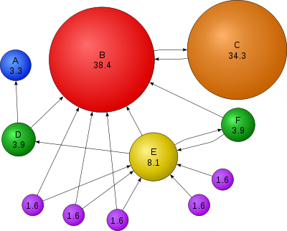
PageRank (from Wikipedia)

Slide 44
PageRank
Similar to calculations used in scientific citation analysis (e.g., Garfield et al.) and social network analysis (e.g., Waserman et al.)
Similar to other work on ranking (e.g., the hubs and authorities of Kleinberg et al.)
How is Amazon similar to Google in terms of the basic insights and techniques of PageRank?
How could PageRank be applied to other problems and domains?

Slide 45
Today
Web Crawling and Search Issues
Web Crawling
Web Search Engines and Algorithms
MapReduce and Hadoop
Credit for some of the slides in this lecture goes to
Marti Hearst, Doug Cutting and Dan Weld

Slide 46
MapReduce and Hadoop
MapReduce developed at Google
MapReduce implemented in Nutch
Doug Cutting at Yahoo!
Became Hadoop (named for Doug’s child’s stuffed elephant toy)

Slide 47
Motivation
Large-Scale Data Processing
Want to use 1000s of CPUs
But don’t want hassle of managing things
MapReduce provides
Automatic parallelization & distribution
Fault tolerance
I/O scheduling
Monitoring & status updates
From “MapReduce…” by Dan Weld

Slide 48
Map/Reduce
Map/Reduce
Programming model from Lisp
(and other functional languages)
Many problems can be phrased this way
Easy to distribute across nodes
Nice retry/failure semantics
From “MapReduce…” by Dan Weld

Slide 49
Map in Lisp (Scheme)
(map f list [list₂ list₃ …])
(map square ‘(1 2 3 4))
(1 4 9 16)
(reduce + ‘(1 4 9 16))
(+ 16 (+ 9 (+ 4 1) ) )
30
(reduce + (map square (map – l₁ l₂))))
Unary operator
Binary operator
From “MapReduce…” by Dan Weld

Slide 50
Map/Reduce ala Google
map(key, val) is run on each item in set
emits new-key / new-val pairs
reduce(key, vals) is run for each unique key emitted by map()
emits final output
From “MapReduce…” by Dan Weld

Slide 51
count words in docs
Input consists of (url, contents) pairs
map(key=url, val=contents):
For each word w in contents, emit (w, “1”)
reduce(key=word, values=uniq_counts):
Sum all “1”s in values list
Emit result “(word, sum)”
From “MapReduce…” by Dan Weld

Slide 52
Count, Illustrated
map(key=url, val=contents):
For each word w in contents, emit (w, “1”)
reduce(key=word, values=uniq_counts):
Sum all “1”s in values list
Emit result “(word, sum)”
see 1
bob 1
run 1
see 1
spot 1
throw 1
bob 1
run 1
see 2
spot 1
throw 1
see bob throw
see spot run
From “MapReduce…” by Dan Weld

Slide 53
Grep
Input consists of (url+offset, single line)
map(key=url+offset, val=line):
If contents matches regexp, emit (line, “1”)
reduce(key=line, values=uniq_counts):
Don’t do anything; just emit line
From “MapReduce…” by Dan Weld

Slide 54
Reverse Web-Link Graph
Map
For each URL linking to target, …
Output <target, source> pairs
Reduce
Concatenate list of all source URLs
Outputs: <target, list (source)> pairs
From “MapReduce…” by Dan Weld

Slide 55
MapReduce Diagram
From “MapReduce in Nutch”, Doug Cutting 20 July 2005

Slide 56
Programming model
Input & Output: each a set of key/value pairs
Programmer specifies two functions:
map (in_key, in_value) -> list(out_key, intermediate_value)
Processes input key/value pair
Produces set of intermediate pairs
reduce (out_key, list(intermediate_value)) -> list(out_value)
Combines all intermediate values for a particular key
Produces a set of merged output values (usually just one)
From “MapReduce: Simplified data Processing… ”, Jeffrey Dean and Sanjay Ghemawat

Slide 57
Example
Page 1: the weather is good
Page 2: today is good
Page 3: good weather is good.
From “MapReduce: Simplified data Processing… ”, Jeffrey Dean and Sanjay Ghemawat

Slide 58
Map output
Worker 1:
(the 1), (weather 1), (is 1), (good 1).
Worker 2:
(today 1), (is 1), (good 1).
Worker 3:
(good 1), (weather 1), (is 1), (good 1).
From “MapReduce: Simplified data Processing… ”, Jeffrey Dean and Sanjay Ghemawat

Slide 59
Reduce Input
Worker 1:
(the 1)
Worker 2:
(is 1), (is 1), (is 1)
Worker 3:
(weather 1), (weather 1)
Worker 4:
(today 1)
Worker 5:
(good 1), (good 1), (good 1), (good 1)
From “MapReduce: Simplified data Processing… ”, Jeffrey Dean and Sanjay Ghemawat

Slide 60
Reduce Output
Worker 1:
(the 1)
Worker 2:
(is 3)
Worker 3:
(weather 2)
Worker 4:
(today 1)
Worker 5:
(good 4)
From “MapReduce: Simplified data Processing… ”, Jeffrey Dean and Sanjay Ghemawat

Slide 61
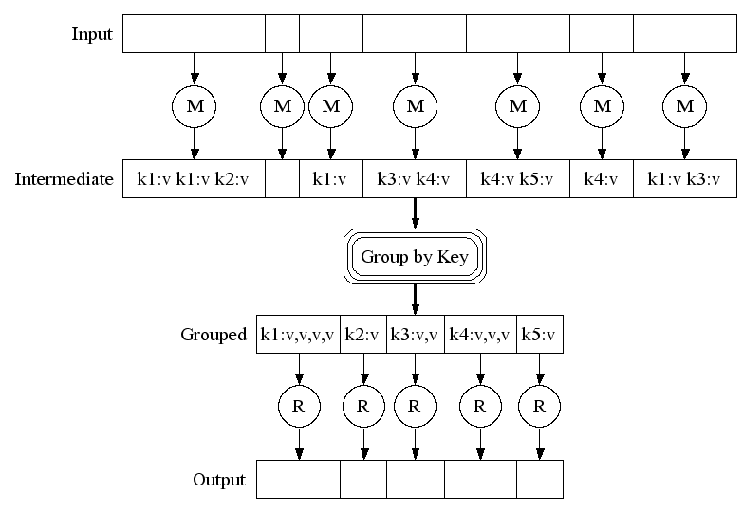
From “MapReduce: Simplified data Processing… ”, Jeffrey Dean and Sanjay Ghemawat

Slide 62
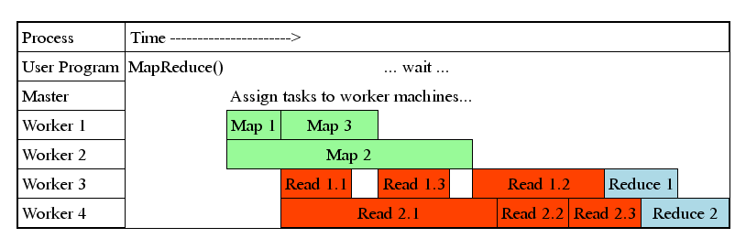
Task Granularity & Pipelining
Fine granularity tasks: map tasks >> machines
Minimizes time for fault recovery
Can pipeline shuffling with map execution
Better dynamic load balancing
Often use 200,000 map & 5000 reduce tasks
Running on 2000 machines

Slide 63
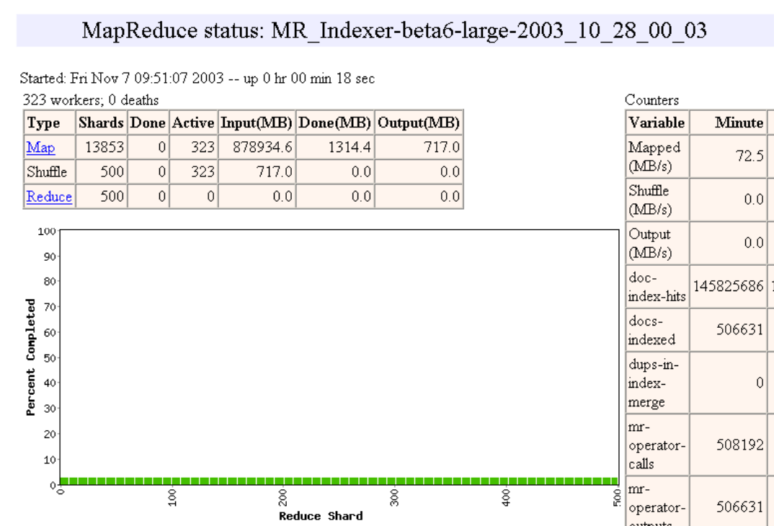

Slide 64
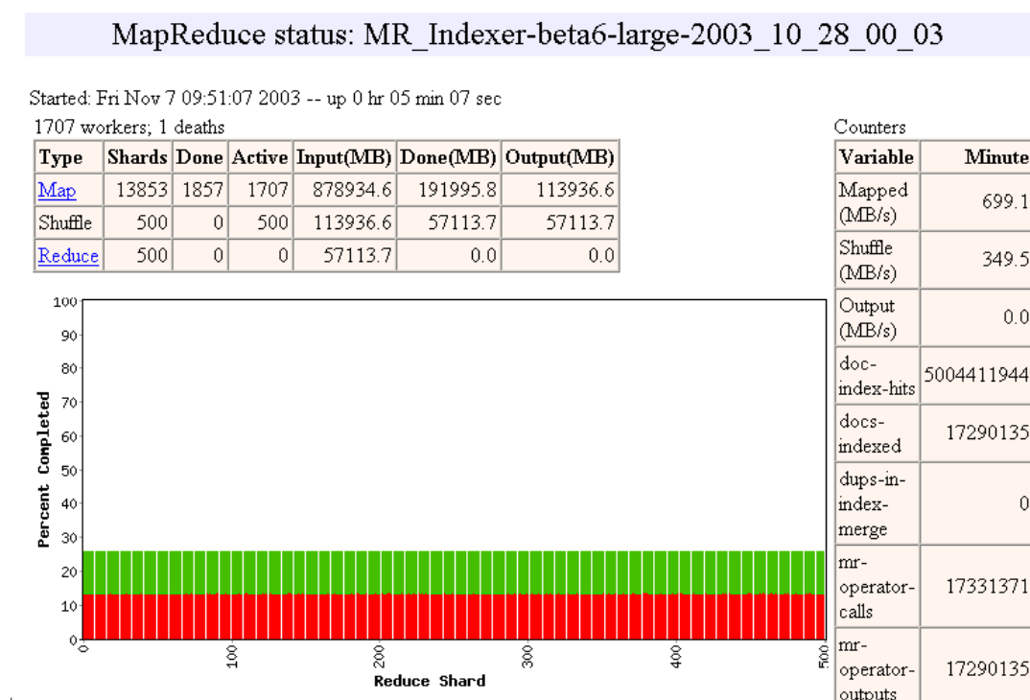

Slide 65
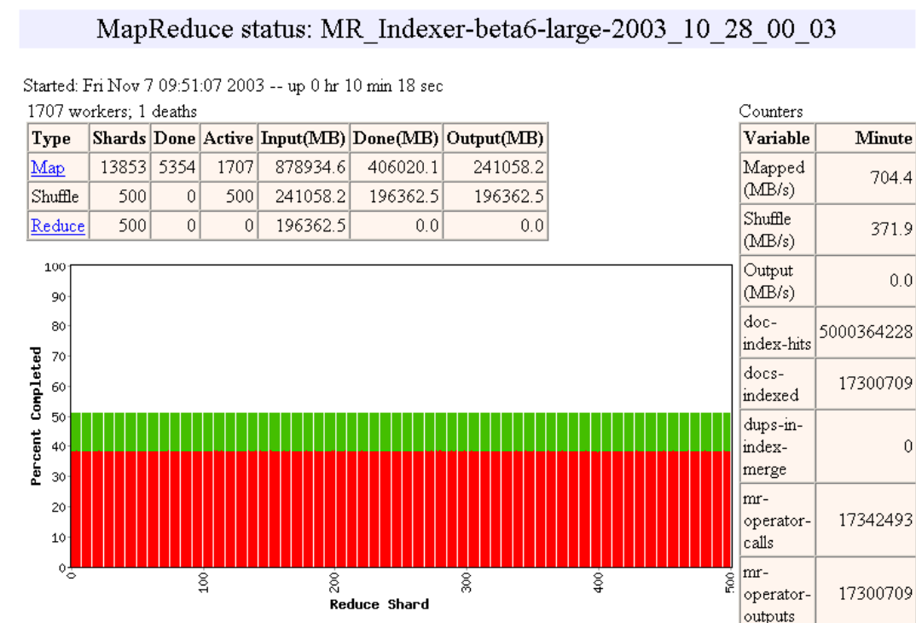

Slide 66
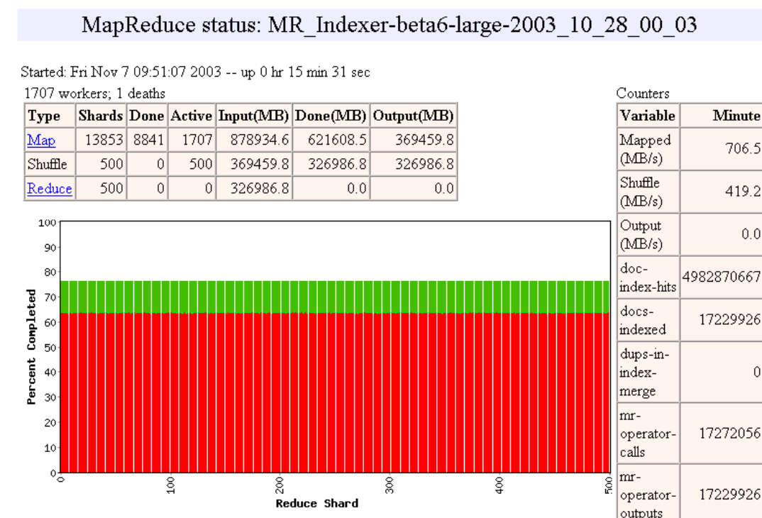

Slide 67
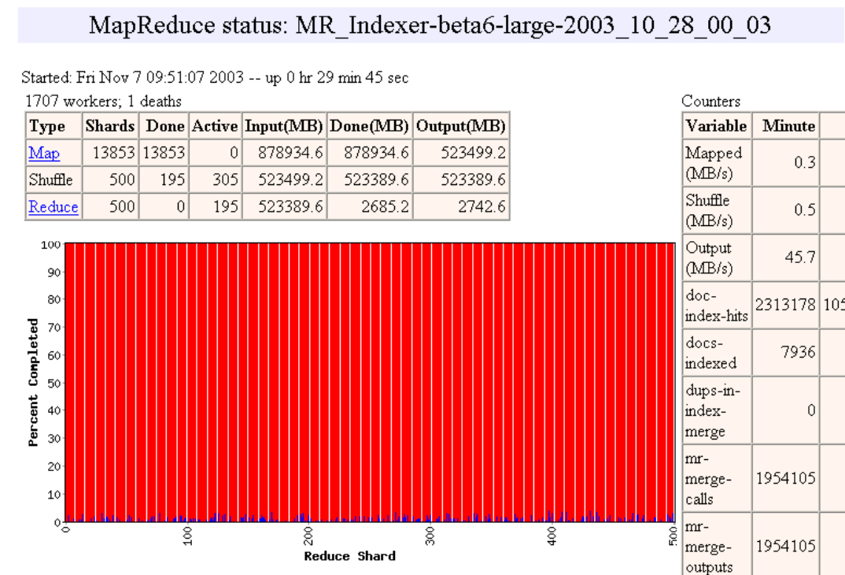

Slide 74
Fault tolerance
On worker failure:
Detect failure via periodic heartbeats
Re-execute completed and in-progress map tasks
Re-execute in progress reduce tasks
Task completion committed through master
Master failure:
Could handle, but don't yet (master failure unlikely)
From “MapReduce: Simplified data Processing… ”, Jeffrey Dean and Sanjay Ghemawat

Slide 75
Refinement
Different partitioning functions.
Combiner function.
Different input/output types.
Skipping bad records.
Local execution.
Status info.
Counters.
From “MapReduce: Simplified data Processing… ”, Jeffrey Dean and Sanjay Ghemawat

Slide 76
Performance
Scan 10^10 100-byte records to extract records matching a rare pattern (92K matching records) : 150 seconds.
Sort 10^10 100-byte records (modeled after TeraSort benchmark) : normal 839 seconds.
From “MapReduce: Simplified data Processing… ”, Jeffrey Dean and Sanjay Ghemawat

Slide 77
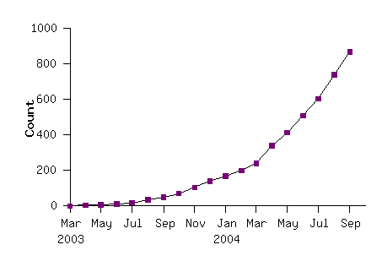
More and more mapreduce
From “MapReduce: Simplified data Processing… ”, Jeffrey Dean and Sanjay Ghemawat

Slide 78
Conclusion
MapReduce has proven to be a useful abstraction
Greatly simplifies large-scale computations at Google
Fun to use: focus on problem, let library deal w/ messy details
From “MapReduce: Simplified data Processing… ”, Jeffrey Dean and Sanjay Ghemawat

Slide 79
Word Count over a Given Set of Web Pages
see 1
bob 1
throw 1
see 1
spot 1
run 1
bob 1
run 1
see 2
spot 1
throw 1
see bob throw
see spot run
Can we do word count in parallel?
From “Intro to Mapreduce and Hadoop” by Shivnath Babu

Slide 80
The MapReduce Framework (pioneered by Google)

Slide 81
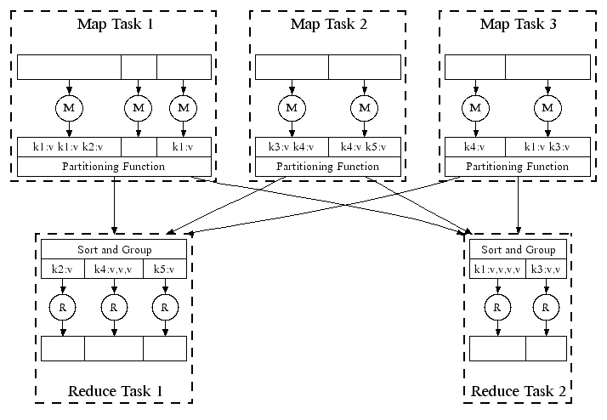
Automatic Parallel Execution in MapReduce (Google)
Handles failures automatically, e.g., restarts tasks if a node fails; runs multiples copies of the same task to avoid a slow task slowing down the whole job

Slide 82
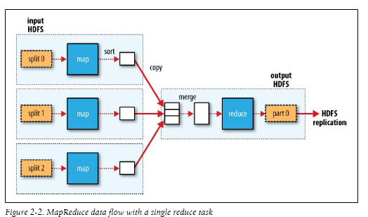
MapReduce in Hadoop (1)

Slide 83
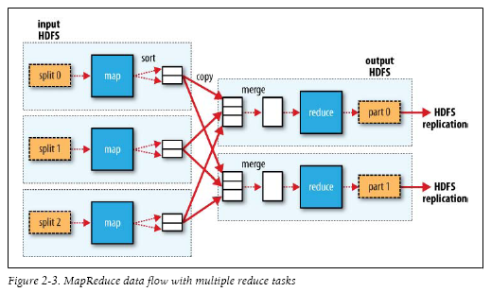
MapReduce in Hadoop (2)

Slide 84
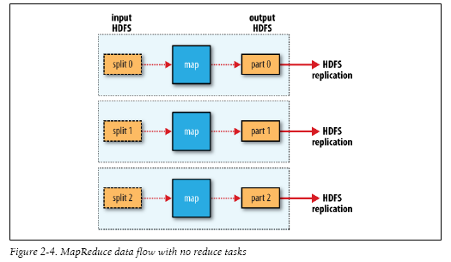
MapReduce in Hadoop (3)

Slide 85
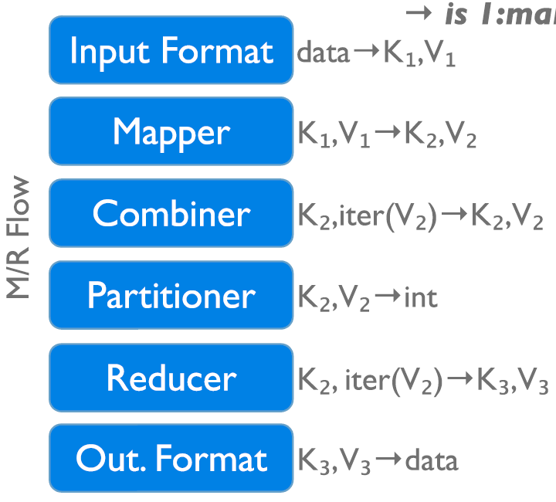
Data Flow in a MapReduce Program in Hadoop
→ 1:many
InputFormat
Map function
Partitioner
Sorting & Merging
Combiner
Shuffling
Merging
Reduce function
OutputFormat

Slide 86
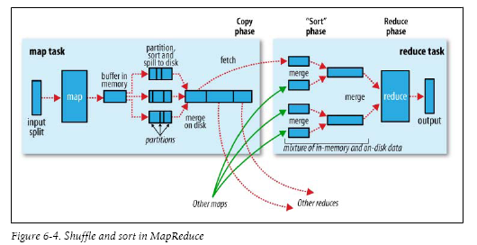

Slide 87
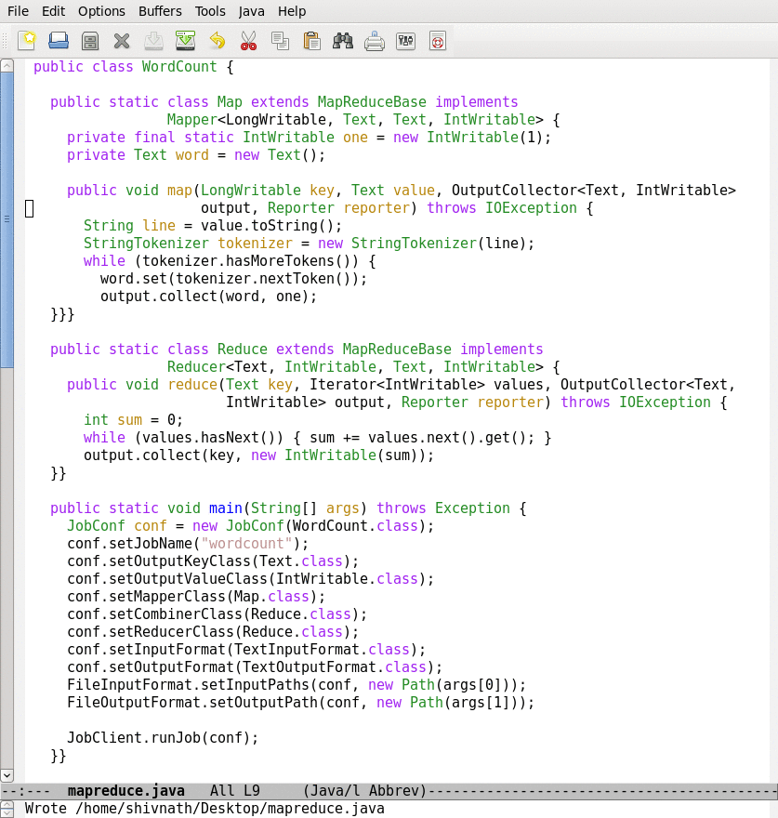
Lifecycle of a MapReduce Job
Map function
Reduce function
Run this program as a
MapReduce job

Slide 88
Lifecycle of a MapReduce Job
Map function
Reduce function
Run this program as a
MapReduce job

Slide 89
Lifecycle of a MapReduce Job
Time
Input
Splits
Map
Wave 1
Map
Wave 2
Reduce
Wave 1
Reduce
Wave 2
How are the number of splits, number of map and reduce
tasks, memory allocation to tasks, etc., determined?
Notes:
Industry wide it is recognized that to manage the complexity of today’s systems, we need to make systems self-managing. IBM’s autonomic computing, Microsoft’s DSI, and Intel’s proactive computing are some of the major efforts in this direction.
89

Slide 90
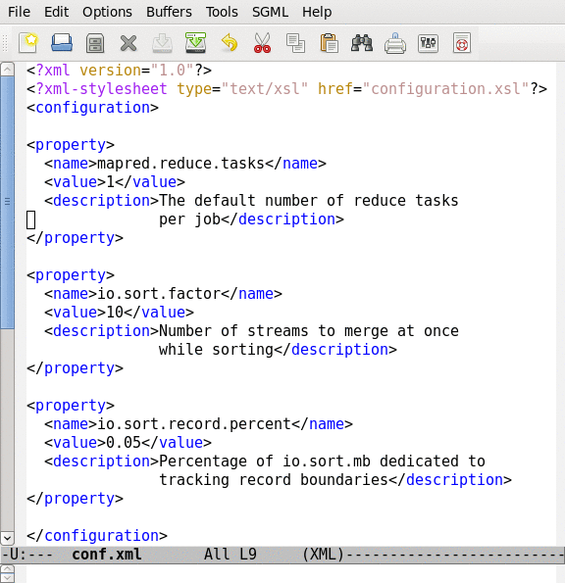
Job Configuration Parameters
190+ parameters in Hadoop
Set manually or defaults are used

