Slide 1
Lecture 14: Latent Semantic Indexing +
Principles of Information Retrieval
Prof. Ray Larson
University of California, Berkeley
School of Information

Slide 2
Overview
Review
Relevance Feedback
More of Relevance Feedback
Latent Semantic Indexing (LSI)

Slide 3
Relevance Feedback in an IR System
Interest profiles
& Queries
Documents
& data
Storage
Line
Information Storage and Retrieval System
Rules of the game =
Rules for subject indexing +
Thesaurus (which consists of
Lead-In
Vocabulary
and
Indexing
Language
Formulating query in
terms of
descriptors
Indexing
(Descriptive and
Subject)
Storage of
profiles
Storage of
Documents
Store1: Profiles/
Search requests
Comparison/
Matching
Store2: Document
representations
Potentially
Relevant
Documents
Selected relevant docs

Slide 4
Query Modification
Changing or Expanding a query can lead to better results
Problem: how to reformulate the query?
Thesaurus expansion:
Suggest terms similar to query terms
Relevance feedback:
Suggest terms (and documents) similar to retrieved documents that have been judged to be relevant

Slide 5
Relevance Feedback
Main Idea:
Modify existing query based on relevance judgements
Extract terms from relevant documents and add them to the query
and/or re-weight the terms already in the query
Two main approaches:
Automatic (psuedo-relevance feedback)
Users select relevant documents
Users/system select terms from an automatically-generated list

Slide 6
Rocchio Method

Slide 7
Rocchio/Vector Illustration
Information
1.0
Q₀ = retrieval of information = (0.7,0.3)
D₁ = information science = (0.2,0.8)
D₂ = retrieval systems = (0.9,0.1)
Q’ = ½*Q₀+ ½ * D₁ = (0.45,0.55)
Q” = ½*Q₀+ ½ * D₂ = (0.80,0.20)
D₁
Q’
0.5
Q₀
Q”
D₂
0
0.5
1.0
Retrieval

Slide 8
Example Rocchio Calculation
Relevant
docs
Non-rel doc
Original Query
Constants
Rocchio Calculation
Resulting feedback query

Slide 9
Rocchio Method
Rocchio automatically
re-weights terms
adds in new terms (from relevant docs)
have to be careful when using negative terms
Rocchio is not a machine learning algorithm
Most methods perform similarly
results heavily dependent on test collection
Machine learning methods are proving to work better than standard IR approaches like Rocchio

Slide 10
Probabilistic Relevance Feedback
Given a query term t
Document Relevance
+ -
+ r n-r n
- R-r N-n-R+r N-n
R N-R N
Document
indexing
Where N is the number of documents seen
Robertson & Sparck Jones

Slide 11
Robertson-Spark Jones Weights
Retrospective formulation --

Slide 12
Robertson-Sparck Jones Weights
Predictive formulation

Slide 13
Koenemann and Belkin
Test of user interaction in relevance feedback

Slide 14
Relevance Feedback Summary
Iterative query modification can improve precision and recall for a standing query
In at least one study, users were able to make good choices by seeing which terms were suggested for R.F. and selecting among them
So … “more like this” can be useful!

Slide 15
Alternative Notions of Relevance Feedback
Find people whose taste is “similar” to yours. Will you like what they like?
Follow a users’ actions in the background. Can this be used to predict what the user will want to see next?
Track what lots of people are doing. Does this implicitly indicate what they think is good and not good?

Slide 16
Alternative Notions of Relevance Feedback
Several different criteria to consider:
Implicit vs. Explicit judgements
Individual vs. Group judgements
Standing vs. Dynamic topics
Similarity of the items being judged vs. similarity of the judges themselves

Slide 17
Collaborative Filtering (social filtering)
If Pam liked the paper, I’ll like the paper
If you liked Star Wars, you’ll like Independence Day
Rating based on ratings of similar people
Ignores the text, so works on text, sound, pictures etc.
But: Initial users can bias ratings of future users

Slide 18
Ringo Collaborative Filtering (Shardanand & Maes 95)
Users rate musical artists from like to dislike
1 = detest 7 = can’t live without 4 = ambivalent
There is a normal distribution around 4
However, what matters are the extremes
Nearest Neighbors Strategy: Find similar users and predicted (weighted) average of user ratings
Pearson r algorithm: weight by degree of correlation between user U and user J
1 means very similar, 0 means no correlation, -1 dissimilar
Works better to compare against the ambivalent rating (4), rather than the individual’s average score

Slide 19
Social Filtering
Ignores the content, only looks at who judges things similarly
Works well on data relating to “taste”
something that people are good at predicting about each other too
Does it work for topic?
GroupLens results suggest otherwise (preliminary)
Perhaps for quality assessments
What about for assessing if a document is about a topic?

Slide 20
Learning interface agents
Add agents in the UI, delegate tasks to them
Use machine learning to improve performance
learn user behavior, preferences
Useful when:
1) past behavior is a useful predictor of the future
2) wide variety of behaviors amongst users
Examples:
mail clerk: sort incoming messages in right mailboxes
calendar manager: automatically schedule meeting times?

Slide 21
Advantages
Less work for user and application writer
compare w/ other agent approaches
no user programming
significant a priori domain-specific and user knowledge not required
Adaptive behavior
agent learns user behavior, preferences over time
Model built gradually

Slide 22
Consequences of passiveness
Weak heuristics
click through multiple uninteresting pages en route to interestingness
user browses to uninteresting page, heads to nefeli for a coffee
hierarchies tend to get more hits near root
No ability to fine-tune profile or express interest without visiting “appropriate” pages

Slide 23
Open issues
How far can passive observation get you?
for what types of applications is passiveness sufficient?
Profiles are maintained internally and used only by the application. some possibilities:
expose to the user (e.g. fine tune profile) ?
expose to other applications (e.g. reinforce belief)?
expose to other users/agents (e.g. collaborative filtering)?
expose to web server (e.g. cnn.com custom news)?
Personalization vs. closed applications
Others?

Slide 24
Relevance Feedback on Non-Textual Information
Image Retrieval
Time-series Patterns

Slide 25
MARS (Riu et al. 97)
Relevance feedback based on image similarity

Slide 26
BlobWorld (Carson, et al.)

Slide 27
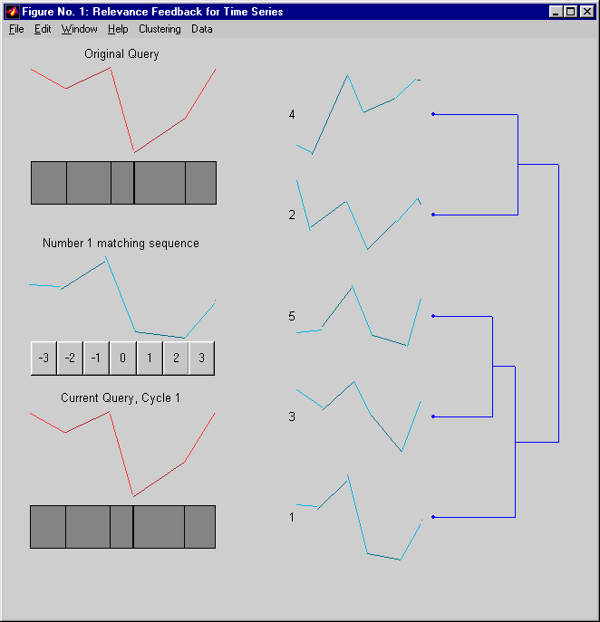
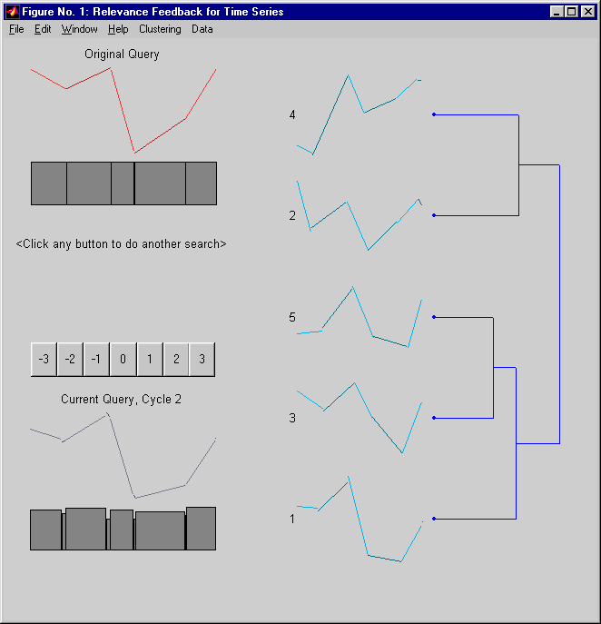
Time Series R.F. (Keogh & Pazzani 98)

Slide 28
Using Relevance Feedback
Known to improve results
in TREC-like conditions (no user involved)
So-called “Blind Relevance Feedback” typically uses the Rocchio algorithm with the assumption that the top N documents in an initial retrieval are relevant

Slide 29
Blind Feedback
Top 10 new terms taken from top 10 documents
Term selection is based on the classic Robertson/Sparck Jones probabilistic model

Slide 30
Blind Feedback in Cheshire II
Perform initial search (using TREC2 Probabilistic Algorithm) next slide

Slide 31
TREC2 Algorithm
|Q_{c}| is the number of terms in common between the query and the component
qtf is the query term frequency
ql is the query length (number of tokens)
tf_{i} is the term frequency in the component/document
cl is the number of terms in the component/document
ctf_{i} is the collection term frequency (number of occurrences in collection)
N_{t} is the number of terms in the entire collection

Slide 32
Blind Feedback in Cheshire II
Take top N documents and get the term vectors for those documents
Calculate the Robertson/Sparck Jones weights for each term in the vectors
Note that collection stats are used for non-rel documents (i.e. n, n-m, etc)

Slide 33
Blind Feedback in Cheshire II
Rank the terms by w_{t} and take the top M terms (ignoring those that occur in less than 3 of the top ranked docs)
For the new query:
Use original freq weight * 0.5 as the weight for old terms
Add w_{t} to the new query length for old terms
Use 0.5 as the weight for new terms and add 0.5 to the query length for each term.
Perform the TREC2 ranking again using the new query with the new weights and length

Slide 34
Summary
Relevance feedback is an effective means for user-directed query modification.
Modification can be done with either direct or indirect user input
Modification can be done based on an individual’s or a group’s past input.

Slide 35
Today
LSI – Latent Semantic Indexing

Slide 36
LSI Rationale
The words that searchers use to describe the their information needs are often not the same words used by authors to describe the same information.
I.e., index terms and user search terms often do NOT match
Synonymy
Polysemy
Following examples from Deerwester, et al. Indexing by Latent Semantic Analysis. JASIS 41(6), pp. 391-407, 1990

Slide 37
LSI Rationale
Access Document Retrieval Information Theory Database Indexing Computer REL M
D1 x x x x x R
D2 x* x x* M
D3 x x* x * R M
Query: IDF in computer-based information lookup
Only matching words are “information” and “computer”
D1 is relevant, but has no words in the query…

Slide 38
LSI Rationale
Problems of synonyms
If not specified by the user, will miss synonymous terms
Is automatic expansion from a thesaurus useful?
Are the semantics of the terms taken into account?
Is there an underlying semantic model of terms and their usage in the database?

Slide 39
LSI Rationale
Statistical techniques such as Factor Analysis have been developed to derive underlying meanings/models from larger collections of observed data
A notion of semantic similarity between terms and documents is central for modelling the patterns of term usage across documents
Researchers began looking at these methods that focus on the proximity of items within a space (as in the vector model)

Slide 40
LSI Rationale
Researchers (Deerwester, Dumais, Furnas, Landauer and Harshman) considered models using the following criteria
Adjustable representational richness
Explicit representation of both terms and documents
Computational tractability for large databases

Slide 41
LSI Rationale
The only method that satisfied all three criteria was Two-Mode Factor Analysis
This is a generalization of factor analysis based on Singular Value Decomposition (SVD)
Represents both terms and documents as vectors in a space of “choosable dimensionality”
Dot product or cosine between points in the space gives their similarity
An available program could fit the model in O(N²*k³)

Slide 42
How LSI Works
Start with a matrix of terms by documents
Analyze the matrix using SVD to derive a particular “latent semantic structure model”
Two-Mode factor analysis, unlike conventional factor analysis, permits an arbitrary rectangular matrix with different entities on the rows and columns
Such as Terms and Documents

Slide 43
How LSI Works
The rectangular matrix is decomposed into three other matices of a special form by SVD
The resulting matrices contain “singular vectors” and “singular values”
The matrices show a breakdown of the original relationships into linearly independent components or factors
Many of these components are very small and can be ignored – leading to an approximate model that contains many fewer dimensions

Slide 44
How LSI Works
In the reduced model all of the term-term, document-document and term-document similiarities are now approximated by values on the smaller number of dimensions
The result can still be represented geometrically by a spatial configuration in which the dot product or cosine between vectors representing two objects corresponds to their estimated similarity
Typically the original term-document matrix is approximated using 50-100 factors

Slide 45
How LSI Works
Titles
C1: Human machine interface for LAB ABC computer applications
C2: A survey of user opinion of computer system response time
C3: The EPS user interface management system
C4: System and human system engineering testing of EPS
C5: Relation of user-percieved response time to error measurement
M1: The generation of random, binary, unordered trees
M2: the intersection graph of paths in trees
M3: Graph minors IV: Widths of trees and well-quasi-ordering
M4: Graph minors: A survey
Italicized words occur and multiple docs and are indexed

Slide 46
How LSI Works
Terms Documents
c1 c2 c3 c4 c5 m1 m2 m3 m4
Human 1 0 0 1 0 0 0 0 0
Interface 1 0 1 0 0 0 0 0 0
Computer 1 1 0 0 0 0 0 0 0
User 0 1 1 0 1 0 0 0 0
System 0 1 1 2 0 0 0 0 0
Response 0 1 0 0 1 0 0 0 0
Time 0 1 0 0 1 0 0 0 0
EPS 0 0 1 1 0 0 0 0 0
Survey 0 1 0 0 0 0 0 0 0
Trees 0 0 0 0 0 1 1 1 0
Graph 0 0 0 0 0 0 1 1 1
Minors 0 0 0 0 0 0 0 1 1

Slide 47
How LSI Works
11graph
M2(10,11,12)
M4(9,11,12)
10 Tree
12 minor
M2(10,11)
9 survey
C2(3,4,5,6,7,9)
Dimension 2
M1(10)
7 time
C5(4,6,7)
6 response
4 user
SVD to 2 dimensions
3 computer
Q(1,3)
C1(1,2,3)
Blue dots are terms
Documents are red squares
Blue square is a query
Dotted cone is cosine .9 from
Query “Human Computer Interaction”
-- even docs with no terms in common
(c3 and c5) lie within cone.
2 interface
1 human
C3(2,4,5,8)
5 system
C4(1,5,8)
Dimension 1

Slide 48
How LSI Works
docs
X
T₀
=
S₀
D_{0’}
terms
txd txm mxm mxd
X = T₀S₀D_{0’}
T₀ has orthogonal, unit-length columns (T_{0’} T₀ = 1)
D₀ has orthogonal, unit-length columns (D_{0’} D₀ = 1)
S₀ is the diagonal matrix of singular values
t is the number of rows in X
d is the number of columns in X
m is the rank of X (<= min(t,d)

Slide 49
How LSI Works
docs
X
T
^
=
S
D’
terms
txd txk mxk kxd
^
X = TSD’
T has orthogonal, unit-length columns (T’T = 1)
D has orthogonal, unit-length columns (D’ D = 1)
S₀ is the diagonal matrix of singular values
t is the number of rows in X
d is the number of columns in X
m is the rank of X (<= min(t,d)
k is the chosen number of dimensions in the reduced model (k <= m)

Slide 50
Comparisons in LSI
Comparing two terms
Comparing two documents
Comparing a term and a document

Slide 51
Comparisons in LSI
In the original matrix these amount to:
Comparing two rows
Comparing two columns
Examining a single cell in the table

Slide 52
Comparing Two Terms
Dot product between the row vectors of X(hat) reflects the extent to which two terms have a similar pattern of occurrence across the set of documents

Slide 53
Comparing Two Documents
The dot product between two column vectors of the matrix X(hat) which tells the extent to which two documents have a similar profile of terms

Slide 54
Comparing a term and a document
Treat the query as a pseudo-document and calculate the cosine between the pseudo-document and the other documents

Slide 55
Use of LSI
LSI has been tested and found to be “modestly effective” with traditional test collections.
Permits compact storage/representation (vectors are typically 50-150 elements instead of thousands)

