Slide 1
Lecture 13: Evaluation Cont.
Principles of Information Retrieval
Prof. Ray Larson
University of California, Berkeley
School of Information

Slide 2
Overview
Review
Calculating Recall and Precision
The trec_eval program
Limits of retrieval performance – Relationship of Recall and Precision
More on Evaluation (Alternatives to R/P)
Expected Search Length
Precison/Recall with scales of relevance
Cumulative Gain (revisited)

Slide 3
How Test Runs are Evaluated
R_{q}={d₃,d₅,d₉,d₂₅,d₃₉,d₄₄,d₅₆,d₇₁,d₈₉,d₁₂₃} : 10 Relevant
d_{123*}
d₈₄
d₅₆*
d₆
d₈
d₉*
d₅₁₁
d₁₂₉
First ranked doc is relevant, which is 10% of the total relevant. Therefore Precision at the 10% Recall level is 100%
Next Relevant gives us 66% Precision at 20% recall level
Etc….
d₁₈₇
d₂₅*
d₃₈
d₄₈
d₂₅₀
d₁₁₃
d₃*
Examples from Chapter 3 in Baeza-Yates

Slide 4
Graphing for a Single Query
100
90
80
70
60
50
40
30
20
10
0
P
R
E
C
I
S
I
O
N
0 10 20 30 40 50 60 70 80 90 100
RECALL

Slide 5
Averaging Multiple Queries

Slide 6
Interpolation
R_{q}={d₃,d₅₆,d₁₂₉}
First relevant doc is 56, which is gives recall and precision of 33.3%
Next Relevant (129) gives us 66% recall at 25% precision
Next (3) gives us 100% recall with 20% precision
How do we figure out the precision at the 11 standard recall levels?
d_{123*}
d₈₄
d₅₆*
d₆
d₈
d₉*
d₅₁₁
d₁₂₉
d₁₈₇
d₂₅*
d₃₈
d₄₈
d₂₅₀
d₁₁₃
d₃*

Slide 7
Interpolation

Slide 8
Interpolation
So, at recall levels 0%, 10%, 20%, and 30% the interpolated precision is 33.3%
At recall levels 40%, 50%, and 60% interpolated precision is 25%
And at recall levels 70%, 80%, 90% and 100%, interpolated precision is 20%
Giving graph…

Slide 9
Interpolation
100
90
80
70
60
50
40
30
20
10
0
P
R
E
C
I
S
I
O
N
0 10 20 30 40 50 60 70 80 90 100
RECALL

Slide 10
TREC_EVAL Output
Number of Queries
From QRELS
Relevant and Retrieved
Average Precision at
Fixed Recall Levels
From individual queries
Queryid (Num): 49
Total number of documents over all queries
Retrieved: 49000
Relevant: 1670
Rel_ret: 1258
Interpolated Recall - Precision Averages:
at 0.00 0.6880
at 0.10 0.5439
at 0.20 0.4773
at 0.30 0.4115
at 0.40 0.3741
at 0.50 0.3174
at 0.60 0.2405
at 0.70 0.1972
at 0.80 0.1721
at 0.90 0.1337
at 1.00 0.1113
Average precision (non-interpolated) for all rel docs(averaged over queries)
0.3160

Slide 11
TREC_EVAL Output
Precision:
At 5 docs: 0.3837
At 10 docs: 0.3408
At 15 docs: 0.3102
At 20 docs: 0.2806
At 30 docs: 0.2422
At 100 docs: 0.1365
At 200 docs: 0.0883
At 500 docs: 0.0446
At 1000 docs: 0.0257
R-Precision (precision after R (= num_rel for a query) docs retrieved):
Exact: 0.3068
Average Precision at
Fixed Number of
Documents
Precision after R
Documents retrieved

Slide 12
Problems with Precision/Recall
Can’t know true recall value
except in small collections
Precision/Recall are related
A combined measure sometimes more appropriate
Assumes batch mode
Interactive IR is important and has different criteria for successful searches
We will touch on this in the UI section
Assumes a strict rank ordering matters

Slide 13
Relationship between Precision and Recall
 | Doc is Relevant | Doc is NOT relevant
Doc is retrieved
Doc is NOT retrieved
Buckland & Gey, JASIS: Jan 1994

Slide 14
Recall Under various retrieval assumptions
Buckland & Gey, JASIS: Jan 1994
1.0
0.9
0.8
0.7
0.6
0.5
0.4
0.3
0.2
0.1
0.0
Perfect
Tangent
Parabolic
Recall
R
E
C
A
L
L
Parabolic
Recall
1000 Documents
100 Relevant
Random
Perverse
0.0 0.1 0.2 0.3 0.4 0.5 0.6 0.7 0.8 0.9 1.0
Proportion of documents retrieved

Slide 15
Precision under various assumptions
1.0
0.9
0.8
0.7
0.6
0.5
0.4
0.3
0.2
0.1
0.0
Perfect
P
R
E
C
I
S
I
O
N
Tangent
Parabolic
Recall
1000 Documents
100 Relevant
Parabolic
Recall
Random
Perverse
0.0 0.1 0.2 0.3 0.4 0.5 0.6 0.7 0.8 0.9 1.0
Proportion of documents retrieved

Slide 16
Recall-Precision
Perfect
1.0
0.9
0.8
0.7
0.6
0.5
0.4
0.3
0.2
0.1
0.0
P
R
E
C
I
S
I
O
N
Tangent
Parabolic
Recall
1000 Documents
100 Relevant
Parabolic Recall
Random
Perverse
0.0 0.1 0.2 0.3 0.4 0.5 0.6 0.7 0.8 0.9 1.0
RECALL

Slide 17
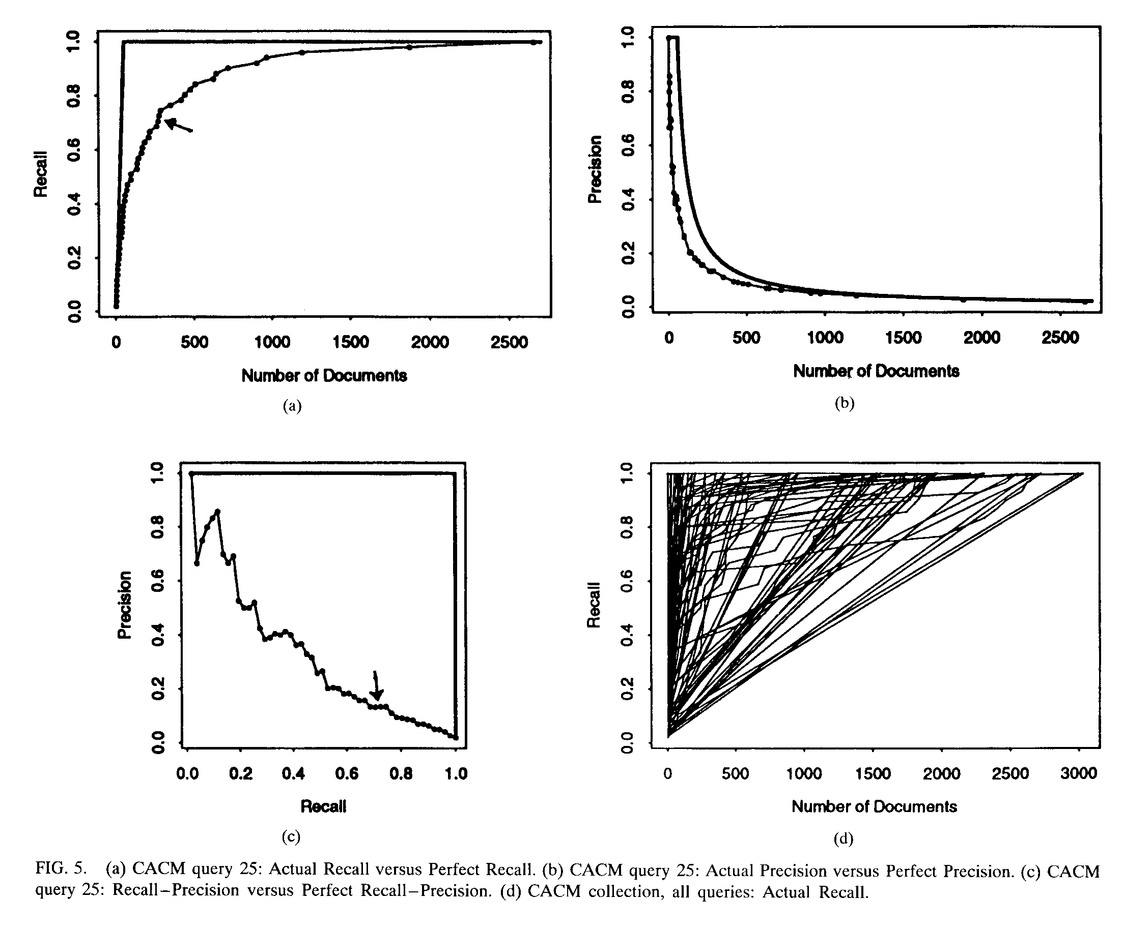
CACM Query 25

Slide 18
Relationship of Precision and Recall

Slide 19
Today
More on Evaluation (Alternatives to R/P)
Expected Search Length
Non-Binary Relevance and Evaluation

Slide 20
Other Relationships
RELEVANT NON-RELEVANT
RETRIEVED
NOT RETRIEVED
From van Rijsbergen Information Retrieval (2nd Ed.)

Slide 21
Other Relationships

Slide 22
Other Relationships
All of the previous measures are related by this equation
P=Precision, R=Recall, F=Fallout, G=Generality

Slide 23
MiniTREC 2000
Collection: Financial Times (FT) ~600 Mb
50 Topics (#401-450) from TREC 8
22516 FT QRELs from TREC8
Four Groups, 12 runs
Cheshire 1 – 4 runs
Cheshire 2 – 5 runs
MG -- 3 runs
SMART -- Still working…(not really)
Total of 598000 ranked documents submitted

Slide 24
Precision/Recall for all MiniTREC runs

Slide 25
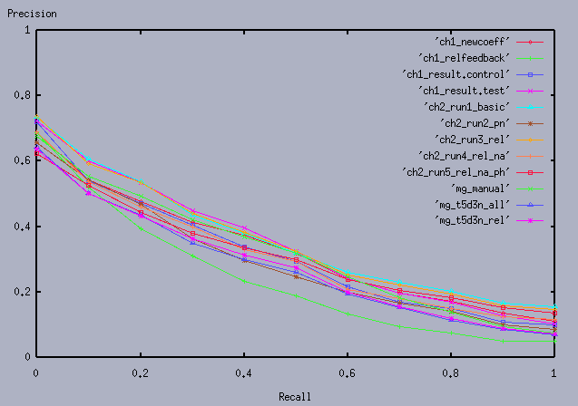
Revised Precision/Recall

Slide 26
Further Analysis
Analysis of Variance (ANOVA)
Uses the ret_rel, total relevant and average precision for each topic
Not a perfectly balanced design…
Looked at the simple models:
Recall = Runid
Precision = Runid

Slide 27
ANOVA results: Recall
Waller-Duncan K-ratio t Test for recall
NOTE: This test minimizes the Bayes risk under additive loss and
certain other assumptions.
Kratio 100
Error Degrees of Freedom 572
Error Mean Square 0.065999
F Value 4.65
Critical Value of t 1.95638
Minimum Significant Difference 0.1019
Harmonic Mean of Cell Sizes 48.63971
NOTE: Cell sizes are not equal.

Slide 28
ANOVA Results: Mean Recall
Means with the same letter are not significantly different.
Waller Grouping Mean N runid
A 0.82235 49 mg_manua
B A 0.79772 49 ch1_test
B A 0.79422 49 ch1_newc
B A 0.75550 49 ch2_run2
B A 0.75385 49 ch2_run1
B A 0.74771 49 mg_t5_al
B A 0.74707 49 ch2_run3
B A 0.74647 49 mg_t5_re
B A 0.73035 49 ch1_cont
B 0.71279 45 ch2_run5
B 0.71167 49 ch2_run4
C 0.50788 49 ch1_relf

Slide 29
ANOVA Recall - Revised
Means with the same letter are not significantly different.
Waller Grouping Mean N runid
A 0.79772 49 ch1_test
A 0.79684 49 mg_manua
A 0.79422 49 ch1_newc
A 0.75550 49 ch2_run2
A 0.75385 49 ch2_run1
A 0.74771 49 mg_t5_al
A 0.74707 49 ch2_run3
A 0.74647 49 mg_t5_re
A 0.73035 49 ch1_cont
A 0.71279 45 ch2_run5
A 0.71167 49 ch2_run4
B 0.50788 49 ch1_relf

Slide 30
ANOVA Results: Avg Precision
Waller-Duncan K-ratio t Test for avgprec
NOTE: This test minimizes the Bayes risk under additive loss and
certain other assumptions.
Kratio 100
Error Degrees of Freedom 572
Error Mean Square 0.078327
F Value 0.78
Critical Value of t 3.73250
Minimum Significant Difference 0.2118
Harmonic Mean of Cell Sizes 48.63971
NOTE: Cell sizes are not equal.

Slide 31
ANOVA Results: Avg Precision
Means with the same letter are not significantly different.
Waller Grouping Mean N runid
A 0.34839 49 ch2_run1
A 0.34501 49 ch2_run3
A 0.33617 49 ch1_test
A 0.31596 49 ch1_newc
A 0.30947 49 mg_manua
A 0.30513 45 ch2_run5
A 0.30128 49 ch1_cont
A 0.29694 49 ch2_run4
A 0.28137 49 ch2_run2
A 0.27040 49 mg_t5_re
A 0.26591 49 mg_t5_al
A 0.22718 49 ch1_relf

Slide 32
ANOVA – Avg Precision Revised
Means with the same letter are not significantly different.
Waller Grouping Mean N runid
A 0.34839 49 ch2_run1
A 0.34501 49 ch2_run3
A 0.33617 49 ch1_test
A 0.31596 49 ch1_newc
A 0.30890 49 mg_manua
A 0.30513 45 ch2_run5
A 0.30128 49 ch1_cont
A 0.29694 49 ch2_run4
A 0.28137 49 ch2_run2
A 0.27040 49 mg_t5_re
A 0.26591 49 mg_t5_al
A 0.22718 49 ch1_relf

Slide 33
What to Evaluate?
Effectiveness
Difficult to measure
Recall and Precision are only one way
What might be others?

Slide 34
Other Ways of Evaluating
“The primary function of a retrieval system is conceived to be that of saving its users to as great an extent as possible, the labor of perusing and discarding irrelevant documents, in their search for relevant ones”
William S. Cooper (1968) “Expected Search Length: A
Single measure of Retrieval Effectiveness Based on the
Weak Ordering Action of Retrieval Systems” American
Documentation, 19(1).

Slide 35
Other Ways of Evaluating
If the purpose of retrieval system is to rank the documents in descending order of their probability of relevance for the user, then maybe the sequence is important and can be used as a way of evaluating systems.
How to do it?

Slide 36
Query Types
Only one relevant document is wanted
Some arbitrary number n is wanted
All relevant documents are wanted
Some proportion of the relevant documents is wanted
No documents are wanted? (Special case)

Slide 37
Search Length and Expected Search Length
Work by William Cooper in the late ’60s
Issues with IR Measures:
Usually not a single measure
Assume “retrieved” and “not retrieved” sets without considering more than two classes
No built-in way to compare to purely random retrieval
Don’t take into account how much relevant material the user actually needs (or wants)

Slide 38
Weak Ordering in IR Systems
The assumption that there are two sets of “Retrieved” and “Not Retrieved” is not really accurate.
IR Systems usually rank into many sets of equal retrieval weights
Consider Coordinate-Level ranking…

Slide 39
Weak Ordering

Slide 40
Search Length
Rank
Relevant
1 | 2 | 3 | 4 | 5 | 6 | 7 | 8 | 9 | 10 | 11 | 12 | 13 | 14 | 15 | 16 | 17 | 18 | 19 | 20
n | y | n | y | y | y | y | n | y | n | n | n | n | y | n | y | n | n | n | n
Search Length = The number of NON-RELEVANT documents that
a user must examine before finding the number of documents that
they want (n)
If n=2 then search length is 2
If n=6 then search length is 3

Slide 41
Weak Ordering Search Length
Rank
Relevant
1 | 1 | 1 | 2 | 2 | 2 | 2 | 2 | 3 | 3 | 3 | 3 | 3 | 4 | 4 | 4 | 4 | 4 | 4 | 4
n | n | y | y | n | y | y | y | n | y | y | n | n | n | n | n | n | n | y | n
If we assume order within ranks is random…
If n=6 then we must go to level 3 of the ranking, but the
POSSIBLE search lengths are 3, 4, 5, or 6.
To compute Expected Search Length we need to know the
probability of each possible search length. to get this we need
to consider the number of different ways in which document
may be distributed in the ranks…

Slide 42
Expected Search Length
Rank
Relevant
1 | 1 | 1 | 2 | 2 | 2 | 2 | 2 | 3 | 3 | 3 | 3 | 3 | 4 | 4 | 4 | 4 | 4 | 4 | 4
n | n | y | y | n | y | y | y | n | y | y | n | n | n | n | n | n | n | y | n

Slide 43
Expected Search Length

Slide 44
Expected Search Length

Slide 45
Expected search length advantages
Instead of assuming that high recall is something that everyone wants, it lets the user determine what is wanted in terms of numbers relevant items retrieved
There are other measures that have been used recently that have something of the same idea
“Extended Cumulated Gain” used in INEX

Slide 46
Criteria for Evaluation Measures
Basic Principle: Should be able to distinguish, or rank systems by how effectively they can perform retrieval
Efficiency vs. Effectiveness (when does each matter?)
Is relevance really a binary judgement?

Slide 47
Non-Binary Relevance Judgements
TREC has been accused of having a fairly low threshold of relevance
Is a document that just mentions the query topic in passing really equally relevant compared to one that is devoted to an in-depth discussion of the topic?
What kind of criteria might be used for scales of relevance?
INEX is one evaluation forum that has been attempting to use these graded definitions of relevance in evaluating XML retrieval

Slide 48
Scales of relevance
Sormunen (2002) studied TREC judgements and re-judged on a 4 point scale. The re-judgements agreed on 95% of the items, but found for the relevant:
Highly Relevant (15%)
Fairly Relevant (33%)
Marginally Relevant (51%)
Not Relevant (~1% i.e. disagreed with TREC)
also 3% of items TREC judged non-relevant were considered to be relevant in the re-judgement

Slide 49
What kind of measures
Can’t get away from relevance, but instead of binary, we can consider a scale (i.e., typically ordinal or categorical scale values)
Kekäläinen and Järvelin explored several ways of dealing with scales of relevance
Tradition Precision as function of Recall
Precision and Recall by degree of document relevance
Generalized Precision and Recall by level of Document relevance

Slide 50
Traditional P at R averages
The first approach is just the traditional way of calculating average precision at particular recall levels.
This involves adopting some quantisation function to transform scales of relevance into the usual binary value

Slide 51
INEX 2002 metric #1
Quantization:
strict
generalized

Slide 52
P & R by degree of doc relevance
Consider each “degree” or value of relevance separately, i.e. given the example scale above:
Highly Relevant = 3
Fairly Relevant = 2
Marginally Relevant = 1
Not Relevant = 0
Documents judged at each degree are treated separately and P/R curves and averages done for each

Slide 53
Generalized P & R
Instead of the ordinal scale above, the measures are mapped to a continuous scale between 0 and 1
R is the set of retrieved documents from database D = {d₁,d₂,…,d_{N}} for some query
the documents have some relevance score r(d_{i}), which is a real number ranging from 0.0 to 1.0, with any number of intermediate points (i.e. 4 points in the previous examples)
Then…

Slide 54
Generalized P & R
Generalized recall, gR,and generalized precision, gP can be computed as:

Slide 55
Measures for Large-Scale Eval
Typical user behavior in web search systems has shown a preference for high precision
Also graded scales of relevance seem more useful than just “yes/no”
Measures have been devised to help evaluate situations taking these into account

Slide 56
Cumulative Gain Measures
Because real systems tend to overload users with result, and because users usually have some scale of relevance, then the most relevant item should be retrieved first
Järvelin and Kekäläinen developed measures that attempt to estimate the cumulative relevance gain that the user receives by examining the retrieval results up to a given rank (TOIS 20(4), Oct 2002)

Slide 57
Cumulative Gain measures
If we assume that highly relevant documents are more useful when appearing earlier in a result list (are ranked higher)
And, highly relevant documents are more useful than marginally relevant documents, which are in turn more useful than non-relevant documents
Then measures that take these factors into account would better reflect user needs

Slide 58
Simple CG
Cumulative Gain is simply the sum of all the graded relevance values the items in a ranked search result list
The CG at a particular rank p is
Where i is the rank and rel_{i} is the relevance score

Slide 59
Discounted Cumulative Gain
DCG measures the gain (usefulness) of a document based on its position in the result list
The gain is accumulated (like simple CG) with the gain of each result discounted at lower ranks
The idea is that highly relevant docs appearing lower in the search result should be penalized proportion to their position in the results

Slide 60
Discounted Cumulative Gain
The DCG is reduced logarithmically proportional to the position (p) in the ranking
Why logs? No real reason except smooth reduction. Another formulation is:
Puts a stronger emphasis on high ranks

Slide 61
Normalized DCG
Because search results lists vary in size depending on the query, comparing results across queries doesn’t work with DCG alone
To do this DCG is normalized across the query set:
First create an “ideal” result by sorting the result list by relevance score
Use that ideal value to create a normalized DCG

Slide 62
Normalized DCG
Using the ideal DCG at a given position and the observed DCG at the same position
The nDCG values for all test queries can then be averaged to give a measure of the average performance of the system
If a system does perfect ranking, the IDCG and DCG will be the same, so nDCG will be 1 for each rank (nDCG_{p} ranges from 0-1)

Slide 63
XCG
XCG was developed for the INEX XML retrieval evaluation
XCG uses graded relevance scoring instead of binary
For XML retrieval it also takes into account “near misses” (like neighboring paragraphs, or paragraphs in a section when the section is considered relevant)

Slide 64
xCG
xCG is defined as a vector of accumulated gain in relevance scores. Given a ranked list of document components where the element IDs are replaced with their relevance scores, the cumulated gain at rank i, denoted as xCG[i], is computed as the sum of the relevance scores up to that rank:

Slide 65
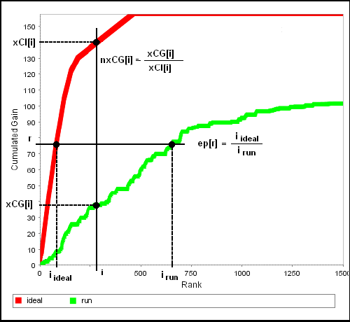
xCG used like a normalized DCG

Slide 66
Next Time
IR Components: Relevance Feedback

