Slide 1
Lecture 11: Evaluation Cont.
Principles of Information Retrieval
Prof. Ray Larson
University of California, Berkeley
School of Information

Slide 2
Mini-TREC
Proposed Schedule
February 11 – Database and previous Queries
March 4 – report on system acquisition and setup
March 6, New Queries for testing…
April 22, Results due
April 24, Results and system rankings
April 29 Group reports and discussion

Slide 3
Overview
Evaluation of IR Systems
Review
Blair and Maron
Calculating Precision vs. Recall
Using TREC_eval
Theoretical limits of precision and recall
Measures for very large-scale systems

Slide 4
Overview
Evaluation of IR Systems
Review
Blair and Maron
Calculating Precision vs. Recall
Using TREC_eval
Theoretical limits of precision and recall

Slide 5
What to Evaluate?
What can be measured that reflects users’ ability to use system? (Cleverdon 66)
Coverage of Information
Form of Presentation
Effort required/Ease of Use
Time and Space Efficiency
Recall
proportion of relevant material actually retrieved
Precision
proportion of retrieved material actually relevant
effectiveness

Slide 6
Relevant vs. Retrieved
All docs
Retrieved
Relevant

Slide 7
Precision vs. Recall
All docs
Retrieved
Relevant

Slide 8
Relation to Contingency Table
 | Doc is Relevant | Doc is NOT relevant
Doc is retrieved | a | b
Doc is NOT retrieved | c | d
Accuracy: (a+d) / (a+b+c+d)
Precision: a/(a+b)
Recall: ?
Why don’t we use Accuracy for IR?
(Assuming a large collection)
Most docs aren’t relevant
Most docs aren’t retrieved
Inflates the accuracy value

Slide 9
The F-Measure
Another single measure that combines precision and recall:
Where:
and
“Balanced” when:

Slide 10
TREC
Text REtrieval Conference/Competition
Run by NIST (National Institute of Standards & Technology)
2000 was the 9th year - 10th TREC in November
Collection: 5 Gigabytes (5 CRDOMs), >1.5 Million Docs
Newswire & full text news (AP, WSJ, Ziff, FT, San Jose Mercury, LA Times)
Government documents (federal register, Congressional Record)
FBIS (Foreign Broadcast Information Service)
US Patents

Slide 11
Sample TREC queries (topics)
<num> Number: 168
<title> Topic: Financing AMTRAK
<desc> Description:
A document will address the role of the Federal Government in financing the operation of the National Railroad Transportation Corporation (AMTRAK)
<narr> Narrative: A relevant document must provide information on the government’s responsibility to make AMTRAK an economically viable entity. It could also discuss the privatization of AMTRAK as an alternative to continuing government subsidies. Documents comparing government subsidies given to air and bus transportation with those provided to aMTRAK would also be relevant.

Slide 13
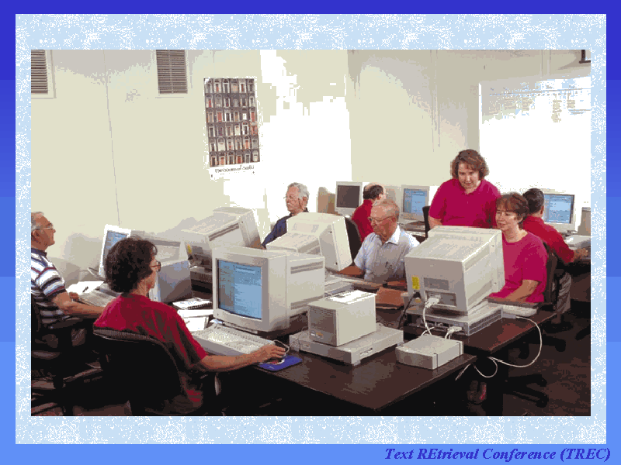

Slide 19
TREC Results
Differ each year
For the main (ad hoc) track:
Best systems not statistically significantly different
Small differences sometimes have big effects
how good was the hyphenation model
how was document length taken into account
Systems were optimized for longer queries and all performed worse for shorter, more realistic queries
Ad hoc track suspended in TREC 9

Slide 20
Overview
Evaluation of IR Systems
Review
Blair and Maron
Calculating Precision vs. Recall
Using TREC_eval
Theoretical limits of precision and recall

Slide 21
Blair and Maron 1985
A classic study of retrieval effectiveness
earlier studies were on unrealistically small collections
Studied an archive of documents for a legal suit
~350,000 pages of text
40 queries
focus on high recall
Used IBM’s STAIRS full-text system
Main Result:
The system retrieved less than 20% of the relevant documents for a particular information need; lawyers thought they had 75%
But many queries had very high precision

Slide 22
Blair and Maron, cont.
How they estimated recall
generated partially random samples of unseen documents
had users (unaware these were random) judge them for relevance
Other results:
two lawyers searches had similar performance
lawyers recall was not much different from paralegal’s

Slide 23
Blair and Maron, cont.
Why recall was low
users can’t foresee exact words and phrases that will indicate relevant documents
“accident” referred to by those responsible as:
“event,” “incident,” “situation,” “problem,” …
differing technical terminology
slang, misspellings
Perhaps the value of higher recall decreases as the number of relevant documents grows, so more detailed queries were not attempted once the users were satisfied

Slide 24
Overview
Evaluation of IR Systems
Review
Blair and Maron
Calculating Precision vs. Recall
Using TREC_eval
Theoretical limits of precision and recall

Slide 25
How Test Runs are Evaluated
First ranked doc is relevant, which is 10% of the total relevant. Therefore Precision at the 10% Recall level is 100%
Next Relevant gives us 66% Precision at 20% recall level
Etc….
R_{q}={d₃,d₅,d₉,d₂₅,d₃₉,d₄₄,d₅₆,d₇₁,d₈₉,d₁₂₃} :
10 Relevant
d_{123*}
d₈₄
d₅₆*
d₆
d₈
d₉*
d₅₁₁
d₁₂₉
d₁₈₇
d₂₅*
d₃₈
d₄₈
d₂₅₀
d₁₁₃
d₃*
Examples from Chapter 3 in Baeza-Yates

Slide 26
Graphing for a Single Query
100
90
80
70
60
50
40
30
20
10
0
P
R
E
C
I
S
I
O
N
0 10 20 30 40 50 60 70 80 90 100
RECALL

Slide 27
Averaging Multiple Queries

Slide 28
Interpolation
R_{q}={d₃,d₅₆,d₁₂₉}
First relevant doc is 56, which is gives recall and precision of 33.3%
Next Relevant (129) gives us 66% recall at 25% precision
Next (3) gives us 100% recall with 20% precision
How do we figure out the precision at the 11 standard recall levels?
d_{123*}
d₈₄
d₅₆*
d₆
d₈
d₉*
d₅₁₁
d₁₂₉
d₁₈₇
d₂₅*
d₃₈
d₄₈
d₂₅₀
d₁₁₃
d₃*

Slide 29
Interpolation

Slide 30
Interpolation
So, at recall levels 0%, 10%, 20%, and 30% the interpolated precision is 33.3%
At recall levels 40%, 50%, and 60% interpolated precision is 25%
And at recall levels 70%, 80%, 90% and 100%, interpolated precision is 20%
Giving graph…

Slide 31
Interpolation
100
90
80
70
60
50
40
30
20
10
0
P
R
E
C
I
S
I
O
N
0 10 20 30 40 50 60 70 80 90 100
RECALL

Slide 32
Overview
Evaluation of IR Systems
Review
Blair and Maron
Calculating Precision vs. Recall
Using TREC_eval
Theoretical limits of precision and recall

Slide 33
Using TREC_EVAL
Developed from SMART evaluation programs for use in TREC
trec_eval [-q] [-a] [-o] trec_qrel_file top_ranked_file
NOTE: Many other options in current version
Uses:
List of top-ranked documents
QID iter docno rank sim runid
030 Q0 ZF08-175-870 0 4238 prise1
QRELS file for collection
QID docno rel
251 0 FT911-1003 1
251 0 FT911-101 1
251 0 FT911-1300 0

Slide 34
Running TREC_EVAL
Options
-q gives evaluation for each query
-a gives additional (non-TREC) measures
-d gives the average document precision measure
-o gives the “old style” display shown here

Slide 35
Running TREC_EVAL
Output:
Retrieved: number retrieved for query
Relevant: number relevant in qrels file
Rel_ret: Relevant items that were retrieved

Slide 36
Running TREC_EVAL - Output
Total number of documents over all queries
Retrieved: 44000
Relevant: 1583
Rel_ret: 635
Interpolated Recall - Precision Averages:
at 0.00 0.4587
at 0.10 0.3275
at 0.20 0.2381
at 0.30 0.1828
at 0.40 0.1342
at 0.50 0.1197
at 0.60 0.0635
at 0.70 0.0493
at 0.80 0.0350
at 0.90 0.0221
at 1.00 0.0150
Average precision (non-interpolated) for all rel docs(averaged over queries)
0.1311

Slide 37
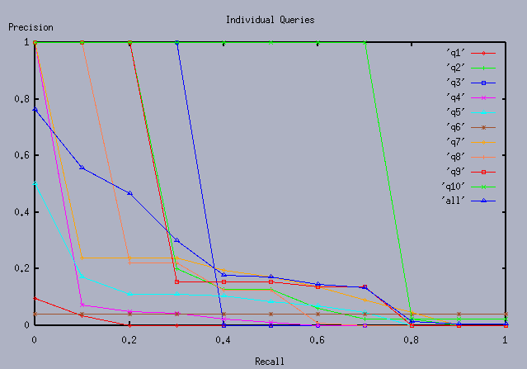
Plotting Output (using Gnuplot)

Slide 38
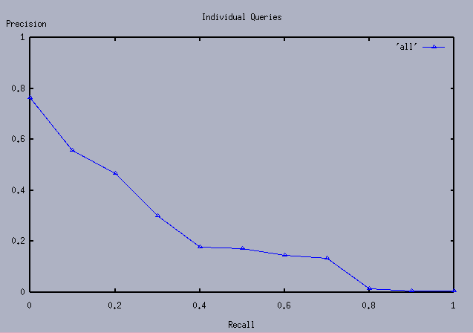
Plotting Output (using Gnuplot)

Slide 39
Gnuplot code
trec_top_file_1.txt.dat
set title "Individual Queries"
set ylabel "Precision"
set xlabel "Recall"
set xrange [0:1]
set yrange [0:1]
set xtics 0,.5,1
set ytics 0,.2,1
set grid
plot 'Group1/trec_top_file_1.txt.dat' title "Group1 trec_top_file_1" with lines 1
pause -1 "hit return"
0.00 0.4587
0.10 0.3275
0.20 0.2381
0.30 0.1828
0.40 0.1342
0.50 0.1197
0.60 0.0635
0.70 0.0493
0.80 0.0350
0.90 0.0221
1.00 0.0150

Slide 40
Overview
Evaluation of IR Systems
Review
Blair and Maron
Calculating Precision vs. Recall
Using TREC_eval
Theoretical limits of precision and recall

Slide 41
Problems with Precision/Recall
Can’t know true recall value
except in small collections
Precision/Recall are related
A combined measure sometimes more appropriate (like F or MAP)
Assumes batch mode
Interactive IR is important and has different criteria for successful searches
We will touch on this in the UI section
Assumes a strict rank ordering matters

Slide 42
Relationship between Precision and Recall
 | Doc is Relevant | Doc is NOT relevant
Doc is retrieved
Doc is NOT retrieved
Buckland & Gey, JASIS: Jan 1994

Slide 43
Recall Under various retrieval assumptions
Buckland & Gey, JASIS: Jan 1994
1.0
0.9
0.8
0.7
0.6
0.5
0.4
0.3
0.2
0.1
0.0
Perfect
Tangent
Parabolic
Recall
R
E
C
A
L
L
Parabolic
Recall
1000 Documents
100 Relevant
Random
Perverse
0.0 0.1 0.2 0.3 0.4 0.5 0.6 0.7 0.8 0.9 1.0
Proportion of documents retrieved

Slide 44
Precision under various assumptions
1.0
0.9
0.8
0.7
0.6
0.5
0.4
0.3
0.2
0.1
0.0
Perfect
P
R
E
C
I
S
I
O
N
Tangent
Parabolic
Recall
1000 Documents
100 Relevant
Parabolic
Recall
Random
Perverse
0.0 0.1 0.2 0.3 0.4 0.5 0.6 0.7 0.8 0.9 1.0
Proportion of documents retrieved

Slide 45
Recall-Precision
Perfect
1.0
0.9
0.8
0.7
0.6
0.5
0.4
0.3
0.2
0.1
0.0
P
R
E
C
I
S
I
O
N
Tangent
Parabolic
Recall
1000 Documents
100 Relevant
Parabolic Recall
Random
Perverse
0.0 0.1 0.2 0.3 0.4 0.5 0.6 0.7 0.8 0.9 1.0
RECALL

Slide 46
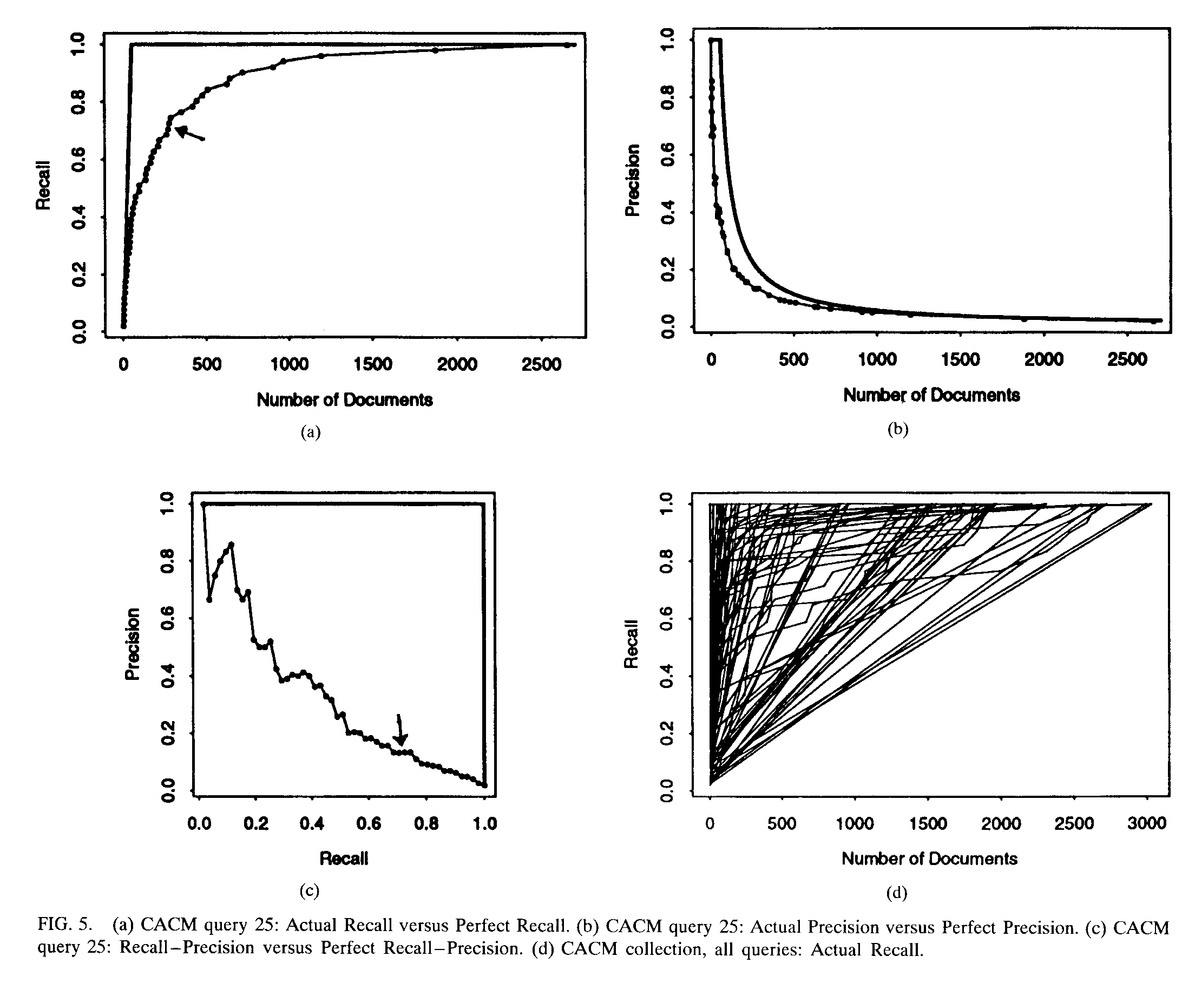
CACM Query 25

Slide 47
Relationship of Precision and Recall

Slide 48
Measures for Large-Scale Eval
Typical user behavior in web search systems has shown a preference for high precision
Also graded scales of relevance seem more useful than just “yes/no”
Measures have been devised to help evaluate situations taking these into account

Slide 49
Cumulative Gain measures
If we assume that highly relevant documents are more useful when appearing earlier in a result list (are ranked higher)
And, highly relevant documents are more useful than marginally relevant documents, which are in turn more useful than non-relevant documents
Then measures that take these factors into account would better reflect user needs

Slide 50
Simple CG
Cumulative Gain is simply the sum of all the graded relevance values the items in a ranked search result list
The CG at a particular rank p is
Where i is the rank and rel_{i} is the relevance score

Slide 51
Discounted Cumulative Gain
DCG measures the gain (usefulness) of a document based on its position in the result list
The gain is accumulated (like simple CG) with the gain of each result discounted at lower ranks
The idea is that highly relevant docs appearing lower in the search result should be penalized proportion to their position in the results

Slide 52
Discounted Cumulative Gain
The DCG is reduced logarithmically proportional to the position (p) in the ranking
Why logs? No real reason except smooth reduction. Another formulation is:
Puts a stronger emphasis on high ranks

Slide 53
Normalized DCG
Because search results lists vary in size depending on the query, comparing results across queries doesn’t work with DCG alone
To do this DCG is normalized across the query set:
First create an “ideal” result by sorting the result list by relevance score
Use that ideal value to create a normalized DCG

Slide 54
Normalized DCG
Using the ideal DCG at a given position and the observed DCG at the same position
The nDCG values for all test queries can then be averaged to give a measure of the average performance of the system
If a system does perfect ranking, the IDCG and DCG will be the same, so nDCG will be 1 for each rank (nDCG_{p} ranges from 0-1)

Slide 55
Next time
Issues in Evaluation
Has there been improvement in systems?

