Slide 1
Lecture 10: Evaluation Intro
Principles of Information Retrieval
Prof. Ray Larson
University of California, Berkeley
School of Information

Slide 2
Mini-TREC
Proposed Schedule
  February 11 – Database and previous Queries
  March 4 – report on system acquisition and setup
  March 6, New Queries for testing…
  April 22, Results due
  April 24, Results and system rankings
  April 29 Group reports and discussion

Slide 3
Today
Evaluation of IR Systems
  Precision vs. Recall
  Cutoff Points
  Test Collections/TREC
  Blair & Maron Study

Slide 4
Evaluation
Why Evaluate?
What to Evaluate?
How to Evaluate?

Slide 5
Why Evaluate?
Determine if the system is desirable
Make comparative assessments
Test and improve IR algorithms

Slide 6
What to Evaluate?
How much of the information need is satisfied.
How much was learned about a topic.
Incidental learning:
  How much was learned about the collection.
  How much was learned about other topics.
How inviting the system is.

Slide 7
Relevance
In what ways can a document be relevant to a query?
  Answer precise question precisely.
  Partially answer question.
  Suggest a source for more information.
  Give background information.
  Remind the user of other knowledge.
  Others ...

Slide 8
Relevance
How relevant is the document
  for this user for this information need.
Subjective, but
Measurable to some extent
  How often do people agree a document is relevant to a query
How well does it answer the question?
  Complete answer? Partial?
  Background Information?
  Hints for further exploration?

Slide 9
What to Evaluate?
What can be measured that reflects users’ ability to use system? (Cleverdon 66)
  Coverage of Information
  Form of Presentation
  Effort required/Ease of Use
  Time and Space Efficiency
  Recall
    proportion of relevant material actually retrieved
  Precision
    proportion of retrieved material actually relevant
effectiveness

Slide 10
Relevant vs. Retrieved
All docs
Retrieved
Relevant

Slide 11
Precision vs. Recall
All docs
Retrieved
Relevant

Slide 12
Why Precision and Recall?
Get as much good stuff while at the same time getting as little junk as possible.

Slide 13
Retrieved vs. Relevant Documents
Very high precision, very low recall
Relevant

Slide 14
Retrieved vs. Relevant Documents
Very low precision, very low recall (0 in fact)
Relevant

Slide 15
Retrieved vs. Relevant Documents
High recall, but low precision
Relevant

Slide 16
Retrieved vs. Relevant Documents
High precision, high recall (at last!)
Relevant

Slide 17
Precision/Recall Curves
There is a tradeoff between Precision and Recall
So measure Precision at different levels of Recall
Note: this is an AVERAGE over MANY queries
precision
x
x
x
x
recall

Slide 18
Precision/Recall Curves
Difficult to determine which of these two hypothetical results is better:
precision
x
x
x
x
recall

Slide 19
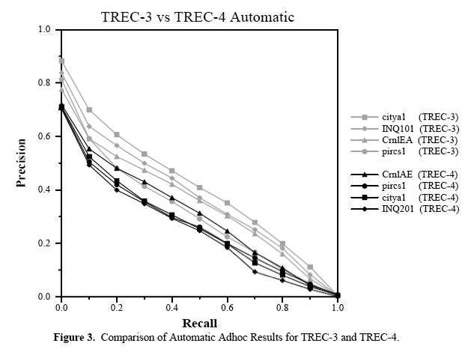
Precision/Recall Curves

Slide 20
Document Cutoff Levels
Another way to evaluate:
  Fix the number of relevant documents retrieved at several levels:
    top 5
    top 10
    top 20
    top 50
    top 100
    top 500
  Measure precision at each of these levels
  Take (weighted) average over results
This is sometimes done with just number of docs
This is a way to focus on how well the system ranks the first k documents.

Slide 21
Problems with Precision/Recall
Can’t know true recall value
  except in small collections
Precision/Recall are related
  A combined measure sometimes more appropriate
Assumes batch mode
  Interactive IR is important and has different criteria for successful searches
  We will touch on this in the UI section
Assumes a strict rank ordering matters.

Slide 22
Relation to Contingency Table
 | Doc is Relevant | Doc is NOT relevant
Doc is retrieved | a | b
Doc is NOT retrieved | c | d
Accuracy: (a+d) / (a+b+c+d)
Precision: a/(a+b)
Recall: ?
Why don’t we use Accuracy for IR?
  (Assuming a large collection)
  Most docs aren’t relevant
  Most docs aren’t retrieved
  Inflates the accuracy value

Slide 23
The F-Measure
Combine Precision and Recall into one number as the harmonic mean:
Where and therefore
Balanced PR is

Slide 24
Old Test Collections
Used 5 test collections
  CACM (3204)
  CISI (1460)
  CRAN (1397)
  INSPEC (12684)
  MED (1033)

Slide 25
TREC
Text REtrieval Conference/Competition
  Run by NIST (National Institute of Standards & Technology)
  2001 was the 10th year - 11th TREC in November
Collection: 5 Gigabytes (5 CRDOMs), >1.5 Million Docs
  Newswire & full text news (AP, WSJ, Ziff, FT, San Jose Mercury, LA Times)
  Government documents (federal register, Congressional Record)
  FBIS (Foreign Broadcast Information Service)
  US Patents

Slide 26
TREC (cont.)
Queries + Relevance Judgments
  Queries devised and judged by “Information Specialists”
  Relevance judgments done only for those documents retrieved -- not entire collection!
Competition
  Various research and commercial groups compete (TREC 6 had 51, TREC 7 had 56, TREC 8 had 66)
  Results judged on precision and recall, going up to a recall level of 1000 documents
Following slides from TREC overviews by Ellen Voorhees of NIST.

Slide 27
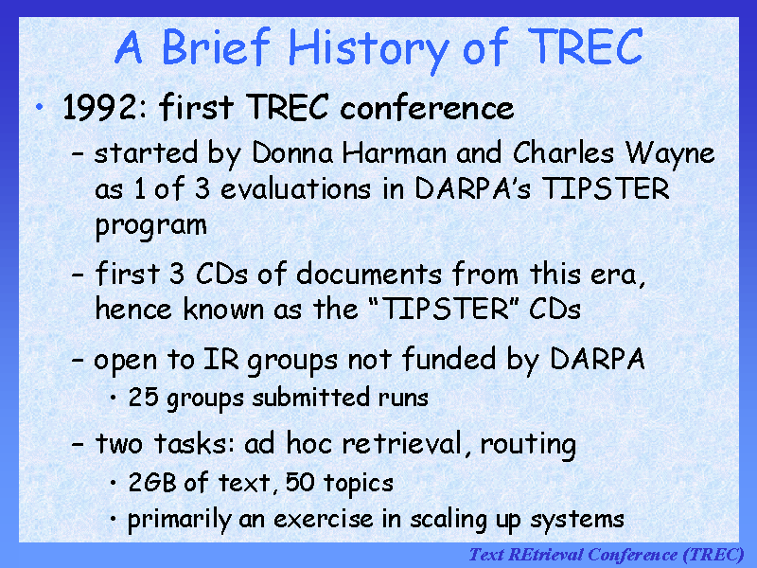

Slide 28
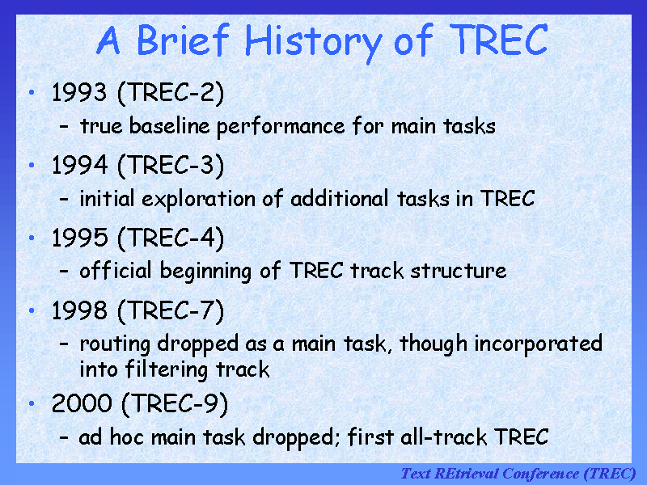

Slide 29
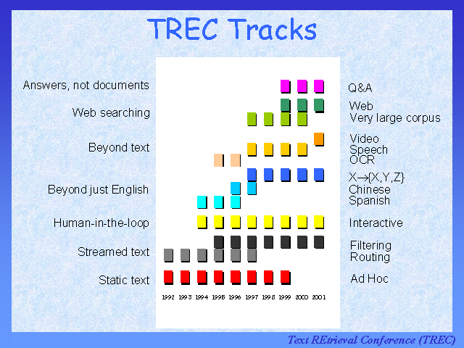

Slide 30
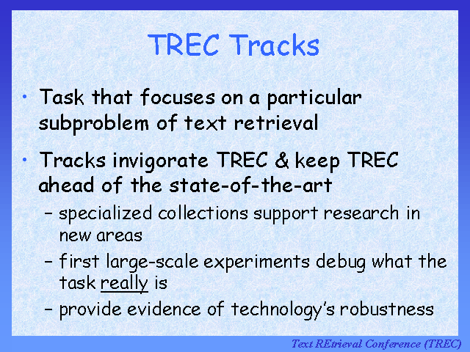

Slide 31
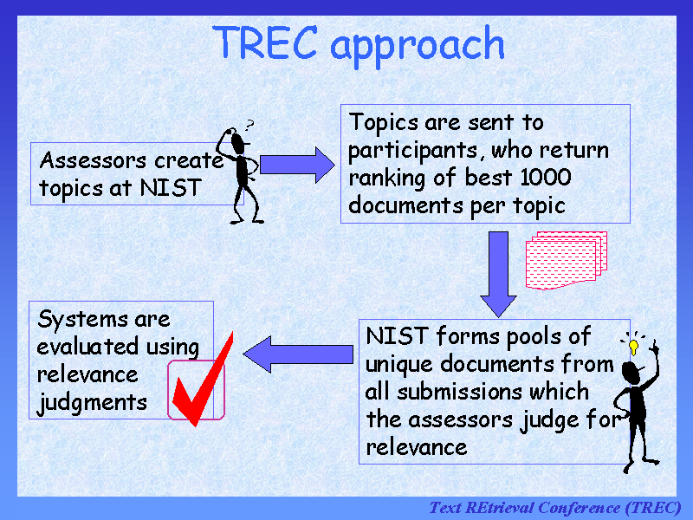

Slide 32
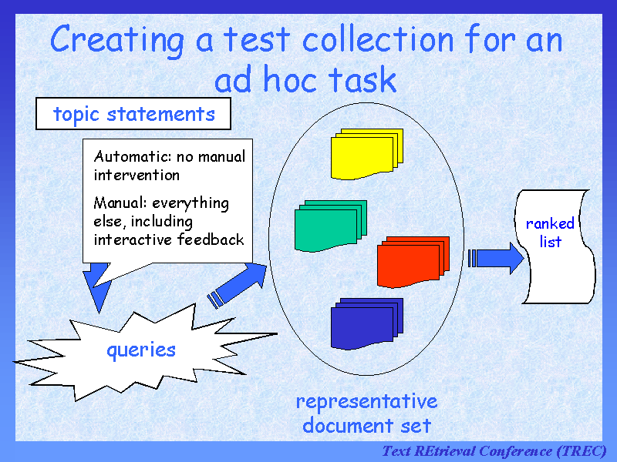

Slide 33
Sample TREC queries (topics)
<num> Number: 168
<title> Topic: Financing AMTRAK
<desc> Description:
A document will address the role of the Federal Government in financing the operation of the National Railroad Transportation Corporation (AMTRAK)
<narr> Narrative: A relevant document must provide information on the government’s responsibility to make AMTRAK an economically viable entity. It could also discuss the privatization of AMTRAK as an alternative to continuing government subsidies. Documents comparing government subsidies given to air and bus transportation with those provided to aMTRAK would also be relevant.

Slide 34
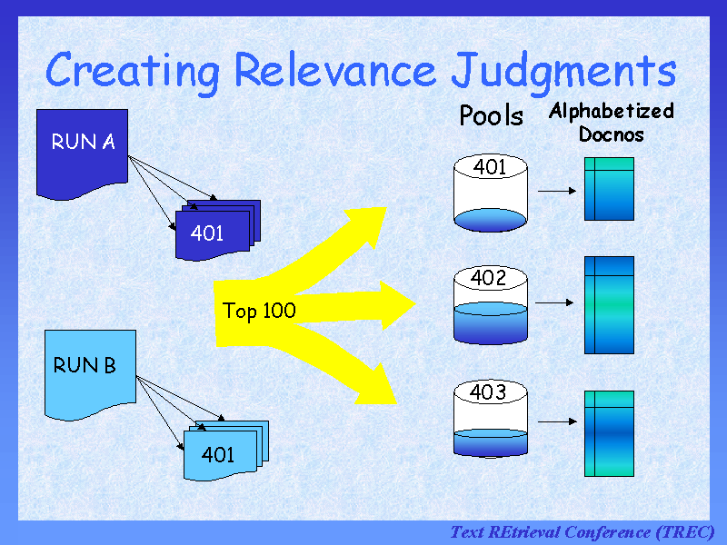

Slide 35
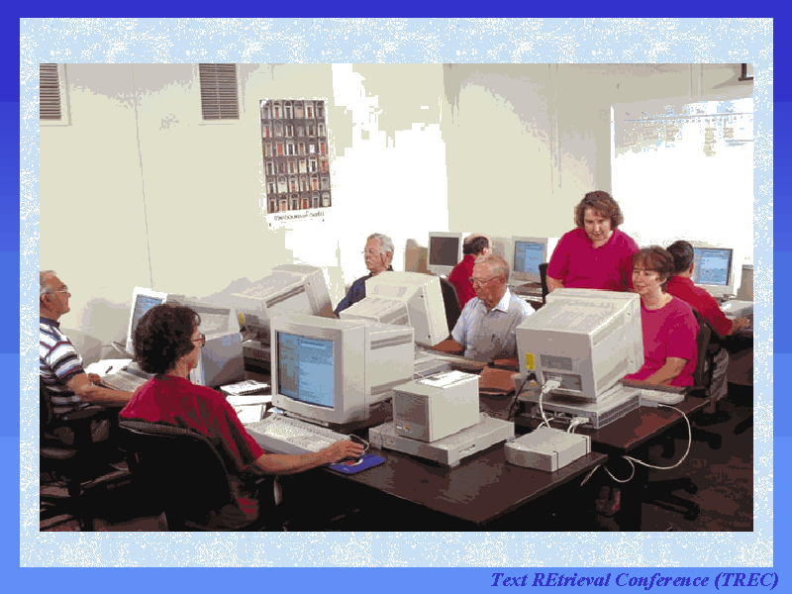

Slide 36
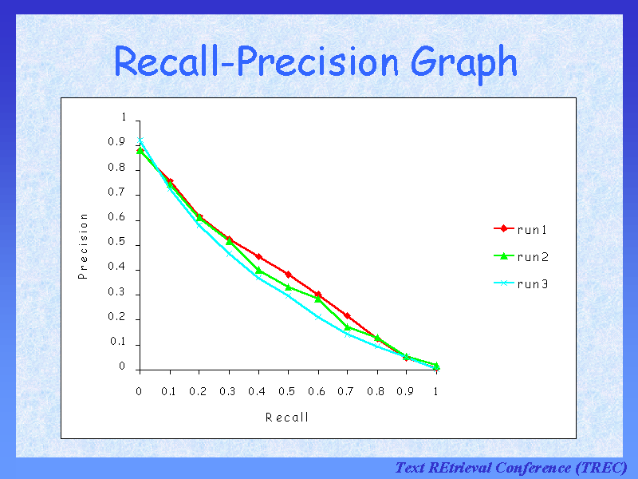

Slide 37
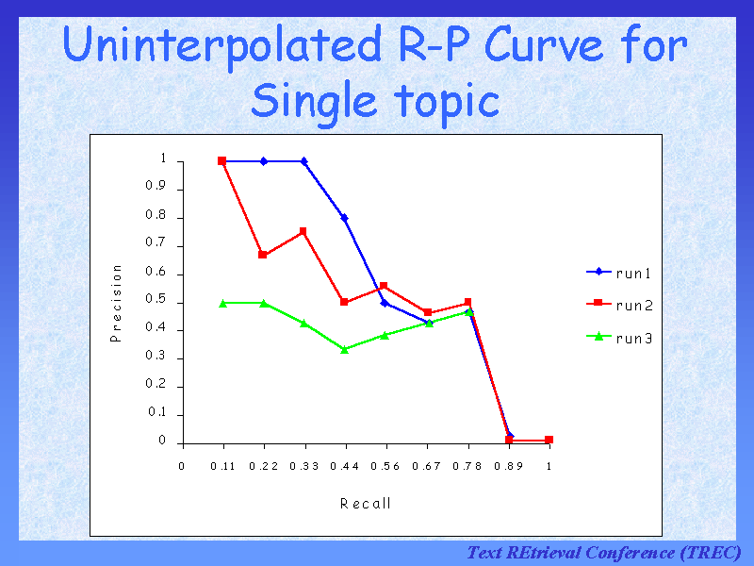

Slide 38
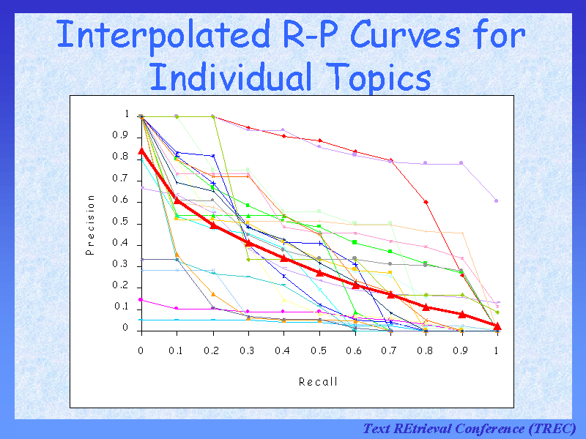

Slide 39
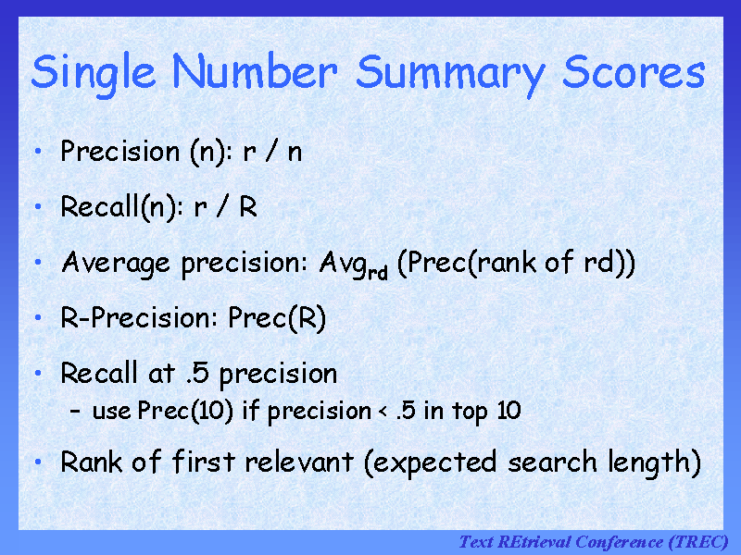

Slide 40
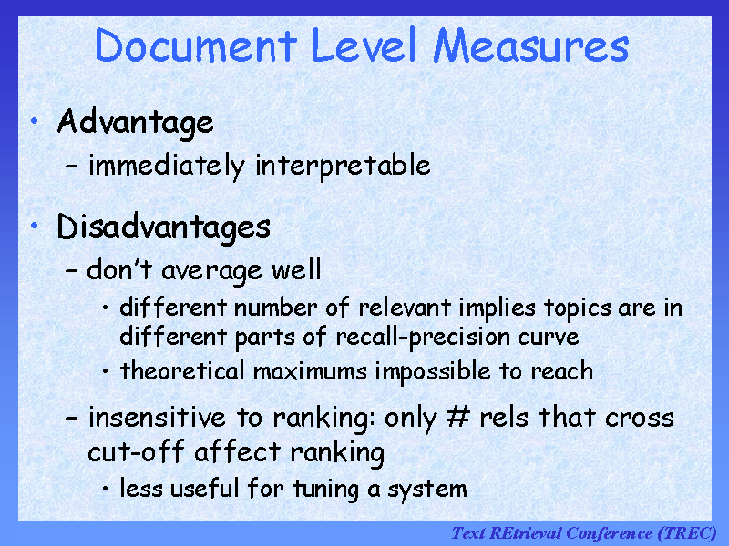

Slide 41
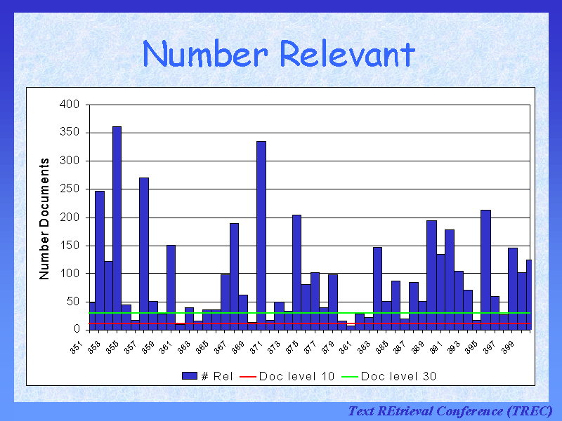

Slide 42
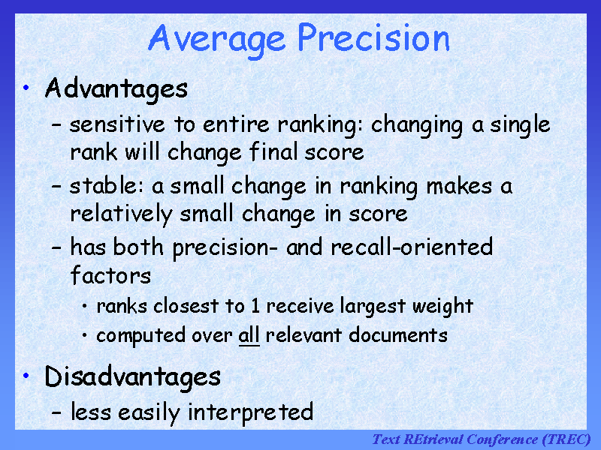

Slide 43
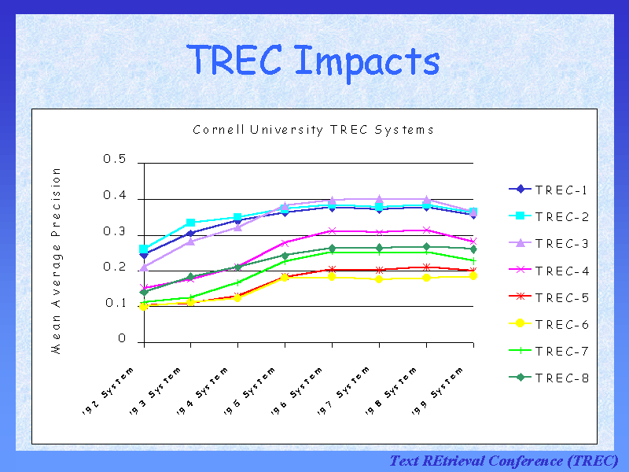

Slide 44
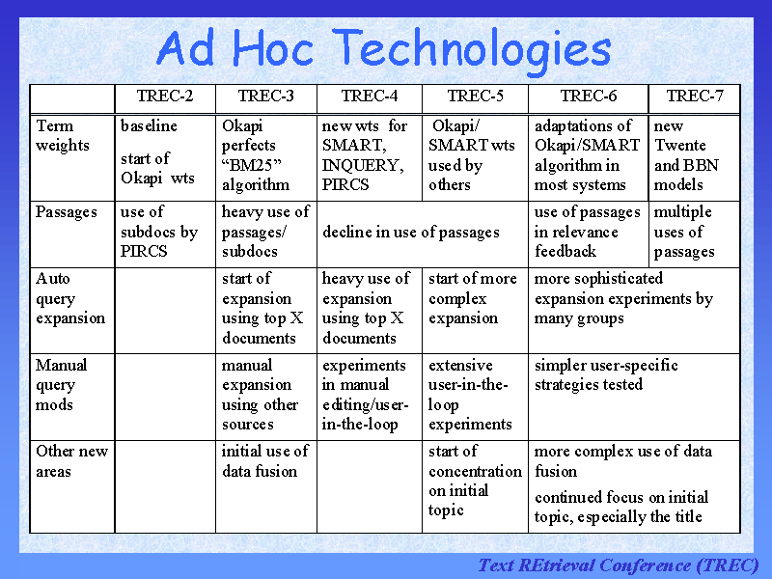

Slide 45
TREC
Benefits:
  made research systems scale to large collections (pre-WWW)
  allows for somewhat controlled comparisons
Drawbacks:
  emphasis on high recall, which may be unrealistic for what most users want
  very long queries, also unrealistic
  comparisons still difficult to make, because systems are quite different on many dimensions
  focus on batch ranking rather than interaction
    There is an interactive track.

Slide 46
TREC has changed
Ad hoc track suspended in TREC 9
Emphasis now on specialized “tracks”
  Interactive track
  Natural Language Processing (NLP) track
  Multilingual tracks (Chinese, Spanish)
  Legal Discovery Searching
  Patent Searching
  High-Precision
  High-Performance
http://trec.nist.gov/

Slide 47
TREC Results
Differ each year
For the main adhoc track:
  Best systems not statistically significantly different
  Small differences sometimes have big effects
    how good was the hyphenation model
    how was document length taken into account
  Systems were optimized for longer queries and all performed worse for shorter, more realistic queries

Slide 48
The TREC_EVAL Program
Takes a “qrels” file in the form…
  qid iter docno rel
Takes a “top-ranked” file in the form…
  qid iter docno rank sim run_id
  030 Q0 ZF08-175-870 0 4238 prise1
Produces a large number of evaluation measures. For the basic ones in a readable format use “-o”
Demo…

Slide 49
Blair and Maron 1985
A classic study of retrieval effectiveness
  earlier studies were on unrealistically small collections
Studied an archive of documents for a legal suit
  ~350,000 pages of text
  40 queries
  focus on high recall
  Used IBM’s STAIRS full-text system
Main Result:
  The system retrieved less than 20% of the relevant documents for a particular information need; lawyers thought they had 75%
But many queries had very high precision

Slide 50
Blair and Maron, cont.
How they estimated recall
  generated partially random samples of unseen documents
  had users (unaware these were random) judge them for relevance
Other results:
  two lawyers searches had similar performance
  lawyers recall was not much different from paralegal’s

Slide 51
Blair and Maron, cont.
Why recall was low
  users can’t foresee exact words and phrases that will indicate relevant documents
    “accident” referred to by those responsible as:
    “event,” “incident,” “situation,” “problem,” …
    differing technical terminology
    slang, misspellings
  Perhaps the value of higher recall decreases as the number of relevant documents grows, so more detailed queries were not attempted once the users were satisfied

Slide 52
What to Evaluate?
Effectiveness
  Difficult to measure
  Recall and Precision are one way
  What might be others?

Slide 53
Next Time
Next time
  Calculating standard IR measures
    and more on trec_eval
  Theoretical limits of Precision and Recall
  Intro to Alternative evaluation metrics
  Improvements that don’t add up?

