Slide 1
Lecture 7: Vector (cont.)
Principles of Information Retrieval
Prof. Ray Larson
University of California, Berkeley
School of Information

Slide 2
Mini-TREC
Need to make groups
Today – Give me a note with group members (names and login names)
Systems
SMART (not recommended…)
ftp://ftp.cs.cornell.edu/pub/smart
MG (from down under - ANZ)
http://www.mds.rmit.edu.au/mg/welcome.html
Cheshire II & 3
II = ftp://cheshire.berkeley.edu/pub/cheshire & http://cheshire.berkeley.edu
3 = http://cheshire3.sourceforge.org
IRF (new Java-based IR framework from NIST)
http://www.itl.nist.gov/iaui/894.02/projects/irf/irf.html
Terrier (from the IR research group at U. of Glasgow)
http://terrier.org/
Lemur (from J. Callan’s group at CMU)
http://www-2.cs.cmu.edu/~lemur
Lucene/SOLR (Apache Java-based Text search engine)
http://lucene.apache.org/
Galago (Also Java-based)
http://www.galagosearch.org
Others?? (See http://searchtools.com )

Slide 3
Mini-TREC
Proposed Schedule
February 11 – Database and previous Queries
March 4 – report on system acquisition and setup
March 6, New Queries for testing…
April 22, Results due
April 24, Results and system rankings
April 29 Group reports and discussion

Slide 4
Review
IR Models
Vector Space Continued
Clustering

Slide 5
IR Models
Set Theoretic Models
Boolean
Fuzzy
Extended Boolean
Vector Models (Algebraic)
Probabilistic Models (probabilistic)

Slide 6
Vector Space Model
Documents are represented as vectors in term space
Terms are usually stems
Documents represented by binary or weighted vectors of terms
Queries represented the same as documents
Query and Document weights are based on length and direction of their vector
A vector distance measure between the query and documents is used to rank retrieved documents

Slide 7
Document Vectors + Frequency
“Nova” occurs 10 times in text A
“Galaxy” occurs 5 times in text A
“Heat” occurs 3 times in text A
(Blank means 0 occurrences.)

Slide 8
We Can Plot the Vectors
Star
Doc about movie stars
Doc about astronomy
Doc about mammal behavior
Diet

Slide 9
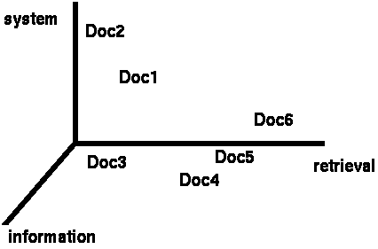
Documents in 3D Space
Primary assumption of the Vector Space Model:
Documents that are “close together” in space
are similar in meaning

Slide 10
Document Space has High Dimensionality
What happens beyond 2 or 3 dimensions?
Similarity still has to do with how many tokens are shared in common.
More terms -> harder to understand which subsets of words are shared among similar documents.
We will look in detail at ranking methods
Approaches to handling high dimensionality: Clustering and LSI (later)

Slide 11
Assigning Weights to Terms
Binary Weights
Raw term frequency
tf*idf
Recall the Zipf distribution
Want to weight terms highly if they are
Frequent in relevant documents … BUT
Infrequent in the collection as a whole
Automatically derived thesaurus terms

Slide 12
Binary Weights
Only the presence (1) or absence (0) of a term is included in the vector

Slide 13
Raw Term Weights
The frequency of occurrence for the term in each document is included in the vector

Slide 14
Assigning Weights
tf*idf measure:
Term frequency (tf)
Inverse document frequency (idf)
A way to deal with some of the problems of the Zipf distribution
Goal: Assign a tf*idf weight to each term in each document

Slide 15
Simple tf*idf

Slide 16
Inverse Document Frequency
IDF provides high values for rare words and low values for common words
For a collection
of 10000 documents
(N = 10000)

Slide 17
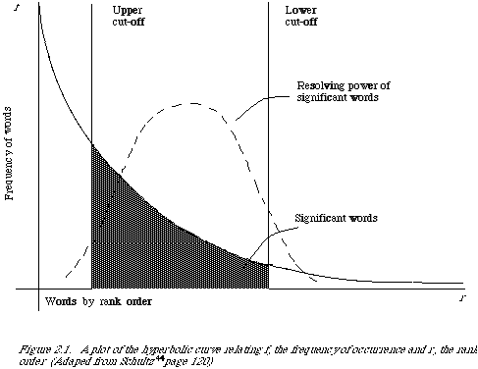
Word Frequency vs. Resolving Power
The most frequent words are not the most descriptive.
(from van Rijsbergen 79)

Slide 18
Non-Boolean IR
Need to measure some similarity between the query and the document
The basic notion is that documents that are somehow similar to a query, are likely to be relevant responses for that query
We will revisit this notion again and see how the Language Modelling approach to IR has taken it to a new level

Slide 19
Non-Boolean?
To measure similarity we…
Need to consider the characteristics of the document and the query
Make the assumption that similarity of language use between the query and the document implies similarity of topic and hence, potential relevance.

Slide 20
Similarity Measures (Set-based)
Assuming that Q and D are the sets of terms associated with a Query and Document:
Simple matching (coordination level match)
Dice’s Coefficient
Jaccard’s Coefficient
Cosine Coefficient
Overlap Coefficient

Slide 21
tf x idf normalization
Normalize the term weights (so longer documents are not unfairly given more weight)
normalize usually means force all values to fall within a certain range, usually between 0 and 1, inclusive.

Slide 22
Vector space similarity
Use the weights to compare the documents

Slide 23
Vector Space Similarity Measure
combine tf x idf into a measure

Slide 24
Weighting schemes
We have seen something of
Binary
Raw term weights
TF*IDF
There are many other possibilities
IDF alone
Normalized term frequency

Slide 25
Term Weights in SMART
SMART is an experimental IR system developed by Gerard Salton (and continued by Chris Buckley) at Cornell.
Designed for laboratory experiments in IR
Easy to mix and match different weighting methods
Really terrible user interface
Intended for use by code hackers

Slide 26
Term Weights in SMART
In SMART weights are decomposed into three factors:

Slide 27
SMART Freq Components
Binary
maxnorm
augmented
log

Slide 28
Collection Weighting in SMART
Inverse
squared
probabilistic
frequency

Slide 29
Term Normalization in SMART
sum
cosine
fourth
max

Slide 30
Lucene Algorithm
The open-source Lucene system is a vector based system that differs from SMART-like systems in the ways the TF*IDF measures are normalized

Slide 31
Lucene
The basic Lucene algorithm is:
Where is the length normalized query
and norm_{d,t} is the term normalization (square root of the number of tokens in the same document field as t)
overlap(q,d) is the proportion of query terms matched in the document
boost_{t} is a user specified term weight enhancement

Slide 32
How To Process a Vector Query
Assume that the database contains an inverted file like the one we discussed earlier…
Why an inverted file?
Why not a REAL vector file?
What information should be stored about each document/term pair?
As we have seen SMART gives you choices about this…

Slide 33
Simple Example System
Collection frequency is stored in the dictionary
Raw term frequency is stored in the inverted file postings list
Formula for term ranking

Slide 34
Processing a Query
For each term in the query
Count number of times the term occurs – this is the tf for the query term
Find the term in the inverted dictionary file and get:
n_{k} : the number of documents in the collection with this term
Loc : the location of the postings list in the inverted file
Calculate Query Weight: w_{qk}
Retrieve n_{k} entries starting at Loc in the postings file

Slide 35
Processing a Query
Alternative strategies…
First retrieve all of the dictionary entries before getting any postings information
Why?
Just process each term in sequence
How can we tell how many results there will be?
It is possible to put a limitation on the number of items returned
How might this be done?

Slide 36
Processing a Query
Like Hashed Boolean OR:
Put each document ID from each postings list into hash table
If match increment counter (optional)
If first doc, set a WeightSUM variable to 0
Calculate Document weight w_{ik} for the current term
Multiply Query weight and Document weight and add it to WeightSUM
Scan hash table contents and add to new list – including document ID and WeightSUM
Sort by WeightSUM and present in sorted order

Slide 37
Today
More on Cosine Similarity

Slide 38
Computing Cosine Similarity Scores
1.0
0.8
0.6
0.4
0.2
0.2
0.4
0.6
0.8
1.0

Slide 39
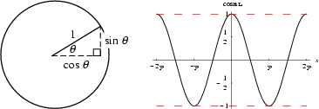
What’s Cosine anyway?
One of the basic trigonometric functions encountered in trigonometry.
Let theta be an angle measured counterclockwise from the x-axis along the
arc of the unit circle. Then cos(theta) is the horizontal coordinate of the arc
endpoint. As a result of this definition, the cosine function is periodic
with period 2pi.
From http://mathworld.wolfram.com/Cosine.html

Slide 40
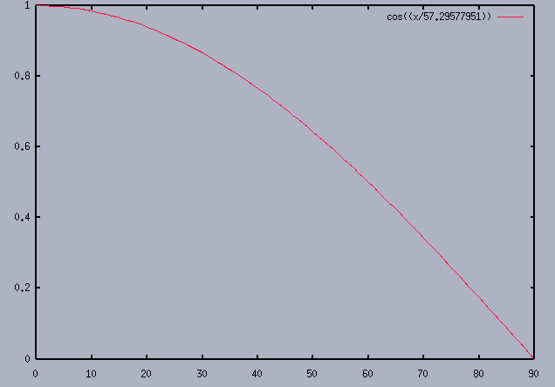
Cosine Detail (degrees)

Slide 41
Computing a similarity score

Slide 42
Vector Space with Term Weights and Cosine Matching
D_{i}=(d_{i1},w_{di1};d_{i2}, w_{di2};…;d_{it}, w_{dit})
Q =(q_{i1},w_{qi1};q_{i2}, w_{qi2};…;q_{it}, w_{qit})
Term B
1.0
Q = (0.4,0.8)
D1=(0.8,0.3)
D2=(0.2,0.7)
D₂
Q
0.8
0.6
0.4
D₁
0.2
0
0.2
0.4
0.6
0.8
1.0
Term A

Slide 43
Problems with Vector Space
There is no real theoretical basis for the assumption of a term space
it is more for visualization that having any real basis
most similarity measures work about the same regardless of model
Terms are not really orthogonal dimensions
Terms are not independent of all other terms

Slide 44
Vector Space Refinements
As we saw earlier, the SMART system included a variety of weighting methods that could be combined into a single vector model algorithm
Vector space has proven very effective in most IR evaluations (or used to be)
Salton in a short article in SIGIR Forum (Fall 1981) outlined a “Blueprint” for automatic indexing and retrieval using vector space that has been, to a large extent, followed by everyone doing vector IR

Slide 45
Vector Space Refinements
Amit Singhal (one of Salton’s students) found that the normalization of document length usually performed in the “standard tfidf” tended to overemphasize short documents
He and Chris Buckley came up with the idea of adjusting the normalization document length to better correspond to observed relevance patterns
The “Pivoted Document Length Normalization” provided a valuable enhancement to the performance of vector space systems

Slide 46
Pivoted Normalization
Probability of
Retrieval
Probability
Probability of
Relevance
Pivot
Document Length

Slide 47
Pivoted Normalization
New
Normalization
Final Normalization Factor
Old
Normalization
Pivot
Old Normalization Factor

Slide 48
Pivoted Normalization
Using pivoted normalization the new tfidf weight for a document can be written as:

Slide 49
Pivoted Normalization
Training from past relevance data, and assuming that the slope is going to be consistent with new results, we can adjust to better fit the relevance curve for document size normalization

Slide 50
Today
Clustering
Automatic Classification
Cluster-enhanced search

Slide 51
Overview
Introduction to Automatic Classification and Clustering
Classification of Classification Methods
Classification Clusters and Information Retrieval in Cheshire II
DARPA Unfamiliar Metadata Project

Slide 52
Classification
The grouping together of items (including documents or their representations) which are then treated as a unit. The groupings may be predefined or generated algorithmically. The process itself may be manual or automated.
In document classification the items are grouped together because they are likely to be wanted together
For example, items about the same topic.

Slide 53
Automatic Indexing and Classification
Automatic indexing is typically the simple deriving of keywords from a document and providing access to all of those words.
More complex Automatic Indexing Systems attempt to select controlled vocabulary terms based on terms in the document.
Automatic classification attempts to automatically group similar documents using either:
A fully automatic clustering method.
An established classification scheme and set of documents already indexed by that scheme.

Slide 54
Background and Origins
Early suggestion by Fairthorne
“The Mathematics of Classification”
Early experiments by Maron (1961) and Borko and Bernick(1963)
Work in Numerical Taxonomy and its application to Information retrieval Jardine, Sibson, van Rijsbergen, Salton (1970’s).
Early IR clustering work more concerned with efficiency issues than semantic issues.

Slide 55
Document Space has High Dimensionality
What happens beyond three dimensions?
Similarity still has to do with how many tokens are shared in common.
More terms -> harder to understand which subsets of words are shared among similar documents.
One approach to handling high dimensionality: Clustering

Slide 56
Vector Space Visualization

Slide 57
Cluster Hypothesis
The basic notion behind the use of classification and clustering methods:
“Closely associated documents tend to be relevant to the same requests.”
C.J. van Rijsbergen

Slide 58
Classification of Classification Methods
Class Structure
Intellectually Formulated
Manual assignment (e.g. Library classification)
Automatic assignment (e.g. Cheshire Classification Mapping)
Automatically derived from collection of items
Hierarchic Clustering Methods (e.g. Single Link)
Agglomerative Clustering Methods (e.g. Dattola)
Hybrid Methods (e.g. Query Clustering)

Slide 59
Classification of Classification Methods
Relationship between properties and classes
monothetic
polythetic
Relation between objects and classes
exclusive
overlapping
Relation between classes and classes
ordered
unordered
Adapted from Sparck Jones

Slide 60
Properties and Classes
Monothetic
Class defined by a set of properties that are both necessary and sufficient for membership in the class
Polythetic
Class defined by a set of properties such that to be a member of the class some individual must have some number (usually large) of those properties, and that a large number of individuals in the class possess some of those properties, and no individual possesses all of the properties.

Slide 61
Monothetic vs. Polythetic
A B C D E F G H
1 + + +
2 + + +
3 + + +
4 + + +
5 + + +
6 + + +
7 + + +
8 + + +
Polythetic
Monothetic
Adapted from van Rijsbergen, ‘79

Slide 62
Exclusive Vs. Overlapping
Item can either belong exclusively to a single class
Items can belong to many classes, sometimes with a “membership weight”

Slide 63
Ordered Vs. Unordered
Ordered classes have some sort of structure imposed on them
Hierarchies are typical of ordered classes
Unordered classes have no imposed precedence or structure and each class is considered on the same “level”
Typical in agglomerative methods

Slide 64
Text Clustering
Clustering is
“The art of finding groups in data.”
-- Kaufmann and Rousseeu
Term 1
Term 2

Slide 65
Text Clustering
Clustering is
“The art of finding groups in data.”
-- Kaufmann and Rousseeu
Term 1
Term 2

Slide 66
Text Clustering
Finds overall similarities among groups of documents
Finds overall similarities among groups of tokens
Picks out some themes, ignores others

Slide 67
Coefficients of Association
Simple
Dice’s coefficient
Jaccard’s coefficient
Cosine coefficient
Overlap coefficient

Slide 68
Pair-wise Document Similarity
How to compute document similarity?

Slide 69
Pair-wise Document Similarity (no normalization for simplicity)

Slide 70
Pair-wise Document Similarity
cosine normalization

Slide 71
Document/Document Matrix

Slide 72
Clustering Methods
Hierarchical
Agglomerative
Hybrid
Automatic Class Assignment

Slide 73
Hierarchic Agglomerative Clustering
Basic method:
1) Calculate all of the interdocument similarity coefficients
2) Assign each document to its own cluster
3) Fuse the most similar pair of current clusters
4) Update the similarity matrix by deleting the rows for the fused clusters and calculating entries for the row and column representing the new cluster (centroid)
5) Return to step 3 if there is more than one cluster left

Slide 74
Hierarchic Agglomerative Clustering
A B C D E F G H I

Slide 75
Hierarchic Agglomerative Clustering
A B C D E F G H I

Slide 76
Hierarchic Agglomerative Clustering
A B C D E F G H I

Slide 77
Next Time
Probabilistic Models of IR
Guest Lecturer – Fred Gey
No class next Monday (Presidents Day)
Probabilistic Continued on Wednesday
Guest Lecturer – Fred Gey

