Slide 1
Lecture 3: IR System Elements (cont)
Principles of Information Retrieval
Prof. Ray Larson
University of California, Berkeley
School of Information

Slide 2
Review
Review
Central Concepts in IR
Documents
Queries
Collections
Evaluation
Relevance
Elements of IR Systems

Slide 3
Collection
A collection is some physical or logical aggregation of documents
A database
A Library
A index?
Others?

Slide 4
Queries
A query is some expression of a user’s information needs
Can take many forms
Natural language description of need
Formal query in a query language
Queries may not be accurate expressions of the information need
Differences between conversation with a person and formal query expression

Slide 5
What to Evaluate?
What can be measured that reflects users’ ability to use system? (Cleverdon 66)
Coverage of Information
Form of Presentation
Effort required/Ease of Use
Time and Space Efficiency
Recall
proportion of relevant material actually retrieved
Precision
proportion of retrieved material actually relevant
effectiveness

Slide 6
Relevance
In what ways can a document be relevant to a query?
Answer precise question precisely.
Partially answer question.
Suggest a source for more information.
Give background information.
Remind the user of other knowledge.
Others ...

Slide 7
Relevance
“Intuitively, we understand quite well what relevance means. It is a primitive “y’ know” concept, as is information for which we hardly need a definition. … if and when any productive contact [in communication] is desired, consciously or not, we involve and use this intuitive notion or relevance.”
Saracevic, 1975 p. 324

Slide 8
Relevance
How relevant is the document
for this user, for this information need.
Subjective, but
Measurable to some extent
How often do people agree a document is relevant to a query?
How well does it answer the question?
Complete answer? Partial?
Background Information?
Hints for further exploration?

Slide 9
Relevance Research and Thought
Review to 1975 by Saracevic
Reconsideration of user-centered relevance by Schamber, Eisenberg and Nilan, 1990
Special Issue of JASIS on relevance (April 1994, 45(3))

Slide 10
Saracevic
Relevance is considered as a measure of effectiveness of the contact between a source and a destination in a communications process
Systems view
Destinations view
Subject Literature view
Subject Knowledge view
Pertinence
Pragmatic view

Slide 11
Define your own relevance
Relevance is the (A) gage of relevance of an (B) aspect of relevance existing between an (C) object judged and a (D) frame of reference as judged by an (E) assessor
Where…
From Saracevic, 1975 and Schamber 1990

Slide 12
A. Gages
Measure
Degree
Extent
Judgement
Estimate
Appraisal
Relation

Slide 13
B. Aspect
Utility
Matching
Informativeness
Satisfaction
Appropriateness
Usefulness
Correspondence

Slide 14
C. Object judged
Document
Document representation
Reference
Textual form
Information provided
Fact
Article

Slide 15
D. Frame of reference
Question
Question representation
Research stage
Information need
Information used
Point of view
request

Slide 16
E. Assessor
Requester
Intermediary
Expert
User
Person
Judge
Information specialist

Slide 17
Schamber, Eisenberg and Nilan
“Relevance is the measure of retrieval performance in all information systems, including full-text, multimedia, question-answering, database management and knowledge-based systems.”
Systems-oriented relevance: Topicality
User-Oriented relevance
Relevance as a multi-dimensional concept

Slide 18
Schamber, et al. Conclusions
“Relevance is a multidimensional concept whose meaning is largely dependent on users’ perceptions of information and their own information need situations
Relevance is a dynamic concept that depends on users’ judgements of the quality of the relationship between information and information need at a certain point in time.
Relevance is a complex but systematic and measureable concept if approached conceptually and operationally from the user’s perspective.”

Slide 19
Froelich
Centrality and inadequacy of Topicality as the basis for relevance
Suggestions for a synthesis of views

Slide 20
Janes’ View
Satisfaction
Topicality
Relevance
Utility
Pertinence

Slide 21
Operational Definition of Relevance
From the point of view of IR evaluation (as typified in TREC and other IR evaluation efforts)
Relevance is a term used for the relationship between a users information need and the contents of a document where the user determines whether or not the contents are responsive to his or her information need

Slide 22
IR Systems
Elements of IR Systems
Overview – we will examine each of these in further detail later in the course

Slide 23
What is Needed?
What software components are needed to construct an IR system?
One way to approach this question is to look at the information and data, and see what needs to be done to allow us to do IR

Slide 24
What, again, is the goal?
Goal of IR is to retrieve all and only the “relevant” documents in a collection for a particular user with a particular need for information
Relevance is a central concept in IR theory
OR
The goal is to search large document collections (millions of documents) to retrieve small subsets relevant to the user’s information need

Slide 25
Collections of Documents…
Documents
A document is a representation of some aggregation of information, treated as a unit.
Collection
A collection is some physical or logical aggregation of documents
Let’s take the simplest case, and say we are dealing with a computer file of plain ASCII text, where each line represents the “UNIT” or document.

Slide 26
How to search that collection?
Manually?
Cat, more
Scan for strings?
Grep
Extract individual words to search???
“tokenize” (a unix pipeline)
tr -sc ‘:alnum:’ ’\n*’ < TEXTFILE | sort | uniq –c | sort -k 1,1nr
See “Unix for Poets” by Ken Church
Put it in a DBMS and use pattern matching there…
assuming the lines are smaller than the text size limits for the DBMS

Slide 27
What about VERY big files?
Scanning becomes a problem
The nature of the problem starts to change as the scale of the collection increases
A variant of Parkinson’s Law that applies to databases is:
Data expands to fill the space available to store it
Currently this problem takes a new approach – use MapReduce (like Hadoop)

Slide 28
The IR Approach
Extract the words (or tokens) along with references to the record they come from
I.e. build an inverted file of words or tokens – more later…
Is this enough?

Slide 29
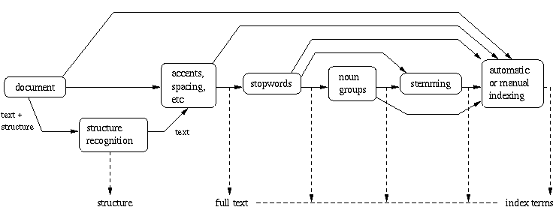
Document Processing Steps

Slide 30
What about …
The structure information, POS info, etc.?
Where and how to store this information?
DBMS?
XML structured documents (e.g.: RDF triples)?
Special file structures
DBMS File types (ISAM, VSAM, B-Tree, etc.)
PAT trees
Hashed files (Minimal, Perfect and Both)
Inverted files
How to get it back out of the storage
And how to map to the original document location?

Slide 31
Structure of an IR System
Search
Line
Interest profiles
& Queries
Documents
& data
Storage
Line
Information Storage and Retrieval System
Rules of the game =
Rules for subject indexing +
Thesaurus (which consists of
Lead-In
Vocabulary
and
Indexing
Language
Formulating query in
terms of
descriptors
Indexing
(Descriptive and
Subject)
Storage of
profiles
Storage of
Documents
Store1: Profiles/
Search requests
Comparison/
Matching
Store2: Document
representations
Potentially
Relevant
Documents
Adapted from Soergel, p. 19

Slide 32
What next?
User queries
How do we handle them?
What sort of interface do we need?
What processing steps once a query is submitted?
Matching
How (and what) do we match?

Slide 33
From Baeza-Yates: Modern IR…
User Interface
Text operations
Query
operations
DB Man.
indexing
Searching
index
Text
Db
Ranking

Slide 34
Query Processing
In order to correctly match queries and documents they must go through the same text processing steps as the documents did when they were stored
In effect, the query is treated like it was a document
Exceptions (of course) include things like structured query languages that must be parsed to extract the search terms and requested operations from the query
The search terms must still go through the same text processing steps as the document…

Slide 35
Steps in Query processing
Parsing and analysis of the query text (same as done for the document text)
Morphological Analysis
Statistical Analysis of text

Slide 36
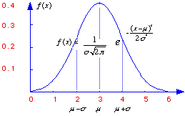
Statistical Properties of Text
Token occurrences in text are not uniformly distributed
They are also not normally distributed
They do exhibit a Zipf distribution

Slide 37
Plotting Word Frequency by Rank
Main idea: count
How many tokens occur 1 time
How many tokens occur 2 times
How many tokens occur 3 times …
Now rank these according to how often they occur. This is called the rank.

Slide 38
Plotting Word Frequency by Rank
Say for a text with 100 tokens
Count
How many tokens occur 1 time (50)
How many tokens occur 2 times (20) …
How many tokens occur 7 times (10) …
How many tokens occur 12 times (1)
How many tokens occur 14 times (1)
So things that occur the most often share the highest rank (rank 1).
Things that occur the fewest times have the lowest rank (rank n).

Slide 39
Many similar distributions…
Words in a text collection
Library book checkout patterns
Bradford’s and Lotka’s laws.
Incoming Web Page Requests (Nielsen)
Outgoing Web Page Requests (Cunha & Crovella)
Document Size on Web (Cunha & Crovella)

Slide 40
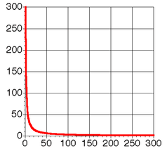
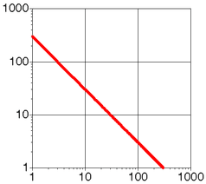
Zipf Distribution (linear and log scale)

Slide 41
Zipf Distribution
The product of the frequency of words (f) and their rank (r) is approximately constant
Rank = order of words’ frequency of occurrence
Another way to state this is with an approximately correct rule of thumb:
Say the most common term occurs C times
The second most common occurs C/2 times
The third most common occurs C/3 times
…

Slide 42
Zipf Distribution
The Important Points:
a few elements occur very frequently
a medium number of elements have medium frequency
many elements occur very infrequently

Slide 43
Most and Least Frequent Terms
Rank Freq Term 1 37 system 2 32 knowledg 3 24 base 4 20 problem 5 18 abstract 6 15 model 7 15 languag 8 15 implem 9 13 reason 10 13 inform 11 11 expert 12 11 analysi 13 10 rule 14 10 program 15 10 oper 16 10 evalu 17 10 comput 18 10 case 19 9 gener 20 9 form
150 2 enhanc
151 2 energi
152 2 emphasi
153 2 detect
154 2 desir
155 2 date
156 2 critic
157 2 content
158 2 consider
159 2 concern
160 2 compon
161 2 compar
162 2 commerci
163 2 clause
164 2 aspect
165 2 area
166 2 aim
167 2 affect

Slide 44
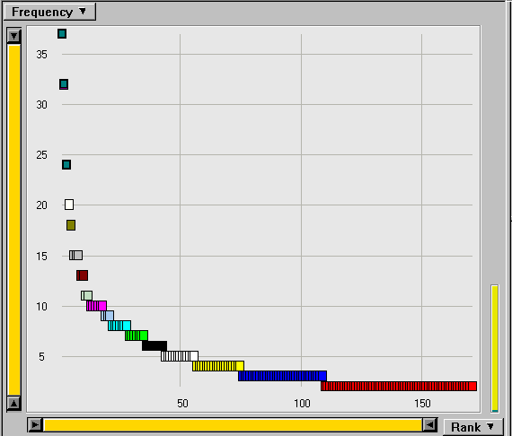
Rank Freq 1 37 system 2 32 knowledg 3 24 base 4 20 problem 5 18 abstract 6 15 model 7 15 languag 8 15 implem 9 13 reason 10 13 inform 11 11 expert 12 11 analysi 13 10 rule 14 10 program 15 10 oper 16 10 evalu 17 10 comput 18 10 case 19 9 gener 20 9 form
The Corresponding Zipf Curve

Slide 45
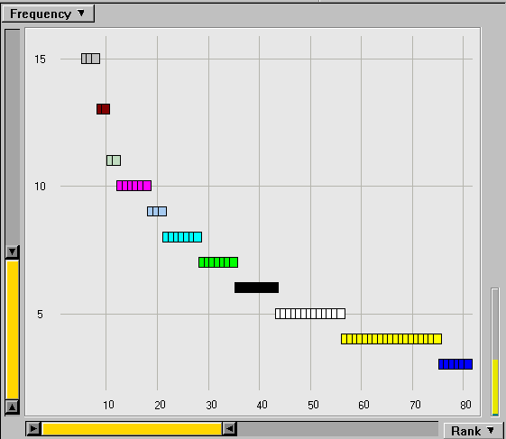
43 6 approach 44 5 work 45 5 variabl 46 5 theori 47 5 specif 48 5 softwar 49 5 requir 50 5 potenti 51 5 method 52 5 mean 53 5 inher 54 5 data 55 5 commit 56 5 applic 57 4 tool 58 4 technolog 59 4 techniqu
Zoom in on the Knee of the Curve

Slide 46
A Standard Collection
Government documents, 157734 tokens, 32259 unique
8164 the
4771 of
4005 to
2834 a
2827 and
2802 in
1592 The
1370 for
1326 is
1324 s
1194 that
973 by
969 on
915 FT
883 Mr
860 was
855 be
849 Pounds
798 TEXT
798 PUB
798 PROFILE
798 PAGE
798 HEADLINE
798 DOCNO
1 ABC
1 ABFT
1 ABOUT
1 ACFT
1 ACI
1 ACQUI
1 ACQUISITIONS
1 ACSIS
1 ADFT
1 ADVISERS
1 AE
Note: No normalization or stop words

Slide 47
Housing Listing Frequency Data
6208 tokens,
1318 unique (very small collection)

Slide 48
Very frequent word stems (Cha-Cha Web Index of berkeley.edu domain)

Slide 49
Words that occur few times (Cha-Cha Web Index)

Slide 50
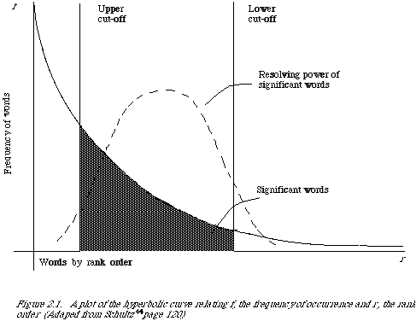
Resolving Power (van Rijsbergen 79)
The most frequent words are not the most descriptive.

Slide 51
Other Models
Poisson distribution
2-Poisson Model
Negative Binomial
Katz K-mixture
See Church (SIGIR 1995)

Slide 52
Stemming and Morphological Analysis
Goal: “normalize” similar words
Morphology (“form” of words)
Inflectional Morphology
E.g,. inflect verb endings and noun number
Never change grammatical class
dog, dogs
tengo, tienes, tiene, tenemos, tienen
Derivational Morphology
Derive one word from another,
Often change grammatical class
build, building; health, healthy

Slide 53
Simple “S” stemming
IF a word ends in “ies”, but not “eies” or “aies”
THEN “ies” → “y”
IF a word ends in “es”, but not “aes”, “ees”, or “oes”
THEN “es”→ “e”
IF a word ends in “s”, but not “us” or “ss”
THEN “s” → NULL
Harman, JASIS Jan. 1991

Slide 54
Stemmer Examples
The SMART stemmer | The Porter stemmer | The IAGO! stemmer
% tstem ate ate % tstem apples appl % tstem formulae formul % tstem appendices appendix % tstem implementation imple % tstem glasses glass | % pstem ate at % pstem apples appl % pstem formulae formula % pstem appendices appendic % pstem implementation implement % pstem glasses glass | % stem ate|2 eat|2 apples|1 apple|1 formulae|1 formula|1 appendices|1 appendix|1 implementation|1 implementation|1 glasses|1 glasses|1

Slide 55
Errors Generated by Porter Stemmer (Krovetz 93)
Too Aggressive | Too Timid
organization/organ policy/police execute/executive arm/army | european/europe cylinder/cylindrical create/creation search/searcher

Slide 56
Automated Methods
Stemmers:
Very dumb rules work well (for English)
Porter Stemmer: Iteratively remove suffixes
Improvement: pass results through a lexicon
Newer stemmers are configurable (Snowball)
Demo…
Powerful multilingual tools exist for morphological analysis
PCKimmo, Xerox Lexical technology
Require a grammar and dictionary
Use “two-level” automata
Wordnet “morpher”

Slide 57
Wordnet
Type “wn word” on a machine where wordnet is installed…
Or use it online
Large exception dictionary:
Demo
aardwolves aardwolf
abaci abacus
abacuses abacus
abbacies abbacy
abhenries abhenry
abilities ability
abkhaz abkhaz
abnormalities abnormality
aboideaus aboideau
aboideaux aboideau
aboiteaus aboiteau
aboiteaux aboiteau
abos abo
abscissae abscissa
abscissas abscissa
absurdities absurdity
…

Slide 58
Using NLP
Strzalkowski (in Reader)
Text
NLP
repres
Dbase
search
TAGGER
PARSER
TERMS
NLP:

Slide 59
Using NLP
INPUT SENTENCE
The former Soviet President has been a local hero ever since
a Russian tank invaded Wisconsin.
TAGGED SENTENCE
The/dt former/jj Soviet/jj President/nn has/vbz been/vbn a/dt
local/jj hero/nn ever/rb since/in a/dt Russian/jj tank/nn
invaded/vbd Wisconsin/np ./per

Slide 60
Using NLP
TAGGED & STEMMED SENTENCE
the/dt former/jj soviet/jj president/nn have/vbz be/vbn a/dt
local/jj hero/nn ever/rb since/in a/dt russian/jj tank/nn
invade/vbd wisconsin/np ./per

Slide 61
Using NLP
PARSED SENTENCE
[assert
[[perf [have]][[verb[BE]]
[subject [np[n PRESIDENT][t_pos THE]
[adj[FORMER]][adj[SOVIET]]]]
[adv EVER]
[sub_ord[SINCE [[verb[INVADE]]
[subject [np [n TANK][t_pos A]
[adj [RUSSIAN]]]]
[object [np [name [WISCONSIN]]]]]]]]]

Slide 62
Using NLP
EXTRACTED TERMS & WEIGHTS
President 2.623519 soviet 5.416102
President+soviet 11.556747 president+former 14.594883
Hero 7.896426 hero+local 14.314775
Invade 8.435012 tank 6.848128
Tank+invade 17.402237 tank+russian 16.030809
Russian 7.383342 wisconsin 7.785689

Slide 63
Same Sentence, different sys
Enju Parser
ROOT ROOT ROOT ROOT -1 ROOT been be VBN VB 5
been be VBN VB 5 ARG1 President president NNP NNP 3
been be VBN VB 5 ARG2 hero hero NN NN 8
a a DT DT 6 ARG1 hero hero NN NN 8
a a DT DT 11 ARG1 tank tank NN NN 13
local local JJ JJ 7 ARG1 hero hero NN NN 8
The the DT DT 0 ARG1 President president NNP NNP 3
former former JJ JJ 1 ARG1 President president NNP NNP 3
Russian russian JJ JJ 12 ARG1 tank tank NN NN 13
Soviet soviet NNP NNP 2 MOD President president NNP NNP 3
invaded invade VBD VB 14 ARG1 tank tank NN NN 13
invaded invade VBD VB 14 ARG2 Wisconsin wisconsin NNP NNP 15
has have VBZ VB 4 ARG1 President president NNP NNP 3
has have VBZ VB 4 ARG2 been be VBN VB 5
since since IN IN 10 MOD been be VBN VB 5
since since IN IN 10 ARG1 invaded invade VBD VB 14
ever ever RB RB 9 ARG1 since since IN IN 10

Slide 64
Other Considerations
Church (SIGIR 1995) looked at correlations between forms of words in texts

Slide 65
Assumptions in IR
Statistical independence of terms
Dependence approximations

Slide 66
Statistical Independence
Two events x and y are statistically independent if the product of their probability of their happening individually equals their probability of happening together.

Slide 67
Statistical Independence and Dependence
What are examples of things that are statistically independent?
What are examples of things that are statistically dependent?

Slide 68
Statistical Independence vs. Statistical Dependence
How likely is a red car to drive by given we’ve seen a black one?
How likely is the word “ambulence” to appear, given that we’ve seen “car accident”?
Color of cars driving by are independent (although more frequent colors are more likely)
Words in text are not independent (although again more frequent words are more likely)

Slide 69
Lexical Associations
Subjects write first word that comes to mind
doctor/nurse; black/white (Palermo & Jenkins 64)
Text Corpora yield similar associations
One measure: Mutual Information (Church and Hanks 89)
If word occurrences were independent, the numerator and denominator would be equal (if measured across a large collection)

Slide 70
Interesting Associations with “Doctor”
(AP Corpus, N=15 million, Church & Hanks 89)
I(x,y) | f(x,y) | f(x) | x | f(y) | y
11.3 11.3 10.7 9.4 9.0 8.9 8.7 | 12 8 30 8 6 11 25 | 111 1105 1105 1105 275 1105 621 | honorary doctors doctors doctors examined doctors doctor | 621 44 241 154 621 317 1407 | doctor dentists nurses treating doctor treat bills

Slide 71
Un-Interesting Associations with “Doctor”
I(x,y) | f(x,y) | f(x) | x | f(y) | y
0.96 0.95 0.93 | 6 41 12 | 621 284690 84716 | doctor a is | 73785 1105 1105 | with doctors doctors
These associations were likely to happen because
the non-doctor words shown here are very common
and therefore likely to co-occur with any noun.

Slide 72
Query Processing
Once the text is in a form to match to the indexes then the fun begins
What approach to use?
Boolean?
Extended Boolean?
Ranked
Fuzzy sets?
Vector?
Probabilistic?
Language Models?
Neural nets?
Most of the next few weeks will be looking at these different approaches

Slide 73
Display and formatting
Have to present the the results to the user
Lots of different options here, mostly governed by
How the actual document is stored
And whether the full document or just the metadata about it is presented

