Slide 1
Lecture 1: Introduction and History
Principles of Information Retrieval
Prof. Ray Larson
University of California, Berkeley
School of Information
http://courses.sims.berkeley.edu/i240/s13/

Slide 2
Lecture Overview
Introduction to the Course
(re)Introduction to Information Retrieval
The Information Seeking Process
Information Retrieval History and Developments
Discussion
Credit for some of the slides in this lecture goes to Marti Hearst and Fred Gey

Slide 3
Lecture Overview
Introduction to the Course
(re)Introduction to Information Retrieval
The Information Seeking Process
Information Retrieval History and Developments
Discussion
Credit for some of the slides in this lecture goes to Marti Hearst and Fred Gey

Slide 4
Introduction to Course
Course Contents
Assignments
Readings and Discussion
Hands-On use of IR systems
Participation in Mini-TREC IR Evaluation
Term paper
Grading
Readings
Web Site: http://courses.ischool.berkeley.edu/i240/s13/

Slide 5
Purposes of the Course
To impart a basic theoretical understanding of IR models
Boolean
Vector Space
Probabilistic (including Language Models)
To examine major application areas of IR including:
Web Search
Text categorization and clustering
Cross language retrieval
Text summarization
Geographic and location-based search
Digital Libraries
To understand how IR performance is measured:
Recall/Precision and other measures
Statistical significance
Gain hands-on experience with IR systems

Slide 6
Lecture Overview
Introduction to the Course
(re)Introduction to Information Retrieval
The Information Seeking Process
Information Retrieval History and Developments
Discussion
Credit for some of the slides in this lecture goes to Marti Hearst and Fred Gey

Slide 7
Introduction
Goal of IR is to retrieve all and only the “relevant” documents in a collection for a particular user with a particular need for information
Relevance is a central concept in IR theory
How does an IR system work when the “collection” is all documents available on the Web?
Web search engines have been stress-testing the traditional IR models (and inventing new ways of ranking)

Slide 8
Information Retrieval
The goal is to search large document collections (millions of documents) to retrieve small subsets relevant to the user’s information need
Examples are:
Internet search engines (Google, Yahoo! web search, etc.)
Digital library catalogues (MELVYL, GLADYS)
Some application areas within IR
Cross language retrieval
Speech/broadcast retrieval
Text categorization
Text summarization
Structured Document Element retrieval (XML)
Geographic Information Retrieval (GIR)
Subject to objective testing and evaluation
hundreds of queries
millions of documents (the TREC set and conference)

Slide 9
Origins - Information Theory
Better called “Technical Communication Theory”
Communication may be over time and space
Problems with transmission of meaning
Conduit metaphor vs. Toolmakers Paradigm
Message
Message
Source
Encoding
Decoding
Destination
Channel
Noise

Slide 10
Human Communication Theory?
Message
Message
Source
Encoding
Decoding
Destination
Channel
Noise

Slide 11
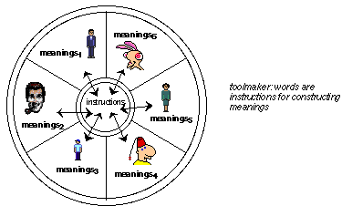
Toolmakers’ Paradigm

Slide 12
Origins - Information Theory
Communication may be over time and space
Message
Message
Source
Encoding
Decoding
Destination
Channel
Noise
Message
Message
Source
Encoding
(Writing/
Indexing)
Storage
Decoding
(Retrieval/
Reading)
Destination

Slide 13
Structure of an IR System
Search
Line
Interest profiles
& Queries
Documents
& data
Storage
Line
Information Storage and Retrieval System
Rules of the game =
Rules for subject indexing +
Thesaurus (which consists of
Lead-In
Vocabulary
and
Indexing
Language
Formulating query in
terms of
descriptors
Indexing
(Descriptive and
Subject)
Storage of
profiles
Storage of
Documents
Store1: Profiles/
Search requests
Comparison/
Matching
Store2: Document
representations
Potentially
Relevant
Documents
Adapted from Soergel, p. 19

Slide 14
Components of an IR System
Documents
Index Records
and
Document Surrogates
Indexing
Process
Authoritative
Indexing Rules
severe information loss
User’s
Information
Need
Query
Specification
Process
Retrieval
Rules
Query
Retrieval
Process
List of Documents
Relevant to User’s
Information Need
Fredric C. Gey
9

Slide 15
Conceptual View of Routing Retrieval
Detection
Engine
Document Stream

Slide 16
Conceptual View of Ad-Hoc Retrieval
Q₁
Q₂
Q₃
Q_{n}
Q.
Q₄
Collection
Q.
Q.
Q₅
Q₆
Q.
Q₉
Q₇
Q₈
‘Fixed’ collection size, can be instrumented

Slide 17
Review: Information Overload
“The world's total yearly production of print, film, optical, and magnetic content would require roughly 1.5 billion gigabytes of storage. This is the equivalent of 250 megabytes per person for each man, woman, and child on earth.” (Varian & Lyman)
“The greatest problem of today is how to teach people to ignore the irrelevant, how to refuse to know things, before they are suffocated. For too many facts are as bad as none at all.” (W.H. Auden)
“So much has already been written about everything that you can’t find anything about it.” (James Thurber, 1961)

Slide 18
IR Topics from (old) 202
The Search Process
Information Retrieval Models
Boolean, Vector, and Probabilistic
Content Analysis/Zipf Distributions
Evaluation of IR Systems
Precision/Recall
Relevance
User Studies
Web-Specific Issues
XML Retrieval Issues
User Interface Issues
Special Kinds of Search

Slide 19
Lecture Overview
Introduction to the Course
(re)Introduction to Information Retrieval
The Information Seeking Process
Information Retrieval History and Developments
Discussion
Credit for some of the slides in this lecture goes to Marti Hearst and Fred Gey

Slide 20
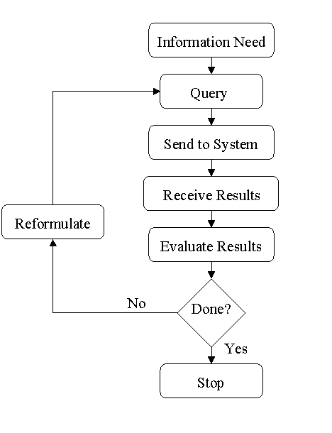
The Standard Retrieval Interaction Model

Slide 21
Standard Model of IR
Assumptions:
The goal is maximizing precision and recall simultaneously
The information need remains static
The value is in the resulting document set

Slide 22
Problems with Standard Model
Users learn during the search process:
Scanning titles of retrieved documents
Reading retrieved documents
Viewing lists of related topics/thesaurus terms
Navigating hyperlinks
Some users don’t like long (apparently) disorganized lists of documents

Slide 23
IR is an Iterative Process
Goals
Repositories
Workspace

Slide 24
IR is a Dialog
The exchange doesn’t end with first answer
Users can recognize elements of a useful answer, even when incomplete
Questions and understanding changes as the process continues

Slide 25
Bates’ “Berry-Picking” Model
Standard IR model
Assumes the information need remains the same throughout the search process
Berry-picking model
Interesting information is scattered like berries among bushes
The query is continually shifting

Slide 26
Berry-Picking Model
A sketch of a searcher… “moving through many actions towards a general goal of satisfactory completion of research related to an information need.” (after Bates 89)
Q2
Q4
Q3
Q1
Q5
Q0

Slide 27
Berry-Picking Model (cont.)
The query is continually shifting
New information may yield new ideas and new directions
The information need
Is not satisfied by a single, final retrieved set
Is satisfied by a series of selections and bits of information found along the way

Slide 28
Restricted Form of the IR Problem
The system has available only pre-existing, “canned” text passages
Its response is limited to selecting from these passages and presenting them to the user
It must select, say, 10 or 20 passages out of millions or billions!

Slide 29
Information Retrieval
Revised Task Statement:
Build a system that retrieves documents that users are likely to find relevant to their queries
This set of assumptions underlies the field of Information Retrieval

Slide 30
Lecture Overview
Introduction to the Course
(re)Introduction to Information Retrieval
The Information Seeking Process
Information Retrieval History and Developments
Discussion
Credit for some of the slides in this lecture goes to Marti Hearst and Fred Gey

Slide 31
IR History Overview
Information Retrieval History
Origins and Early “IR”
Modern Roots in the scientific “Information Explosion” following WWII
Non-Computer IR (mid 1950’s)
Interest in computer-based IR from mid 1950’s
Modern IR – Large-scale evaluations, Web-based search and Search Engines -- 1990’s

Slide 32
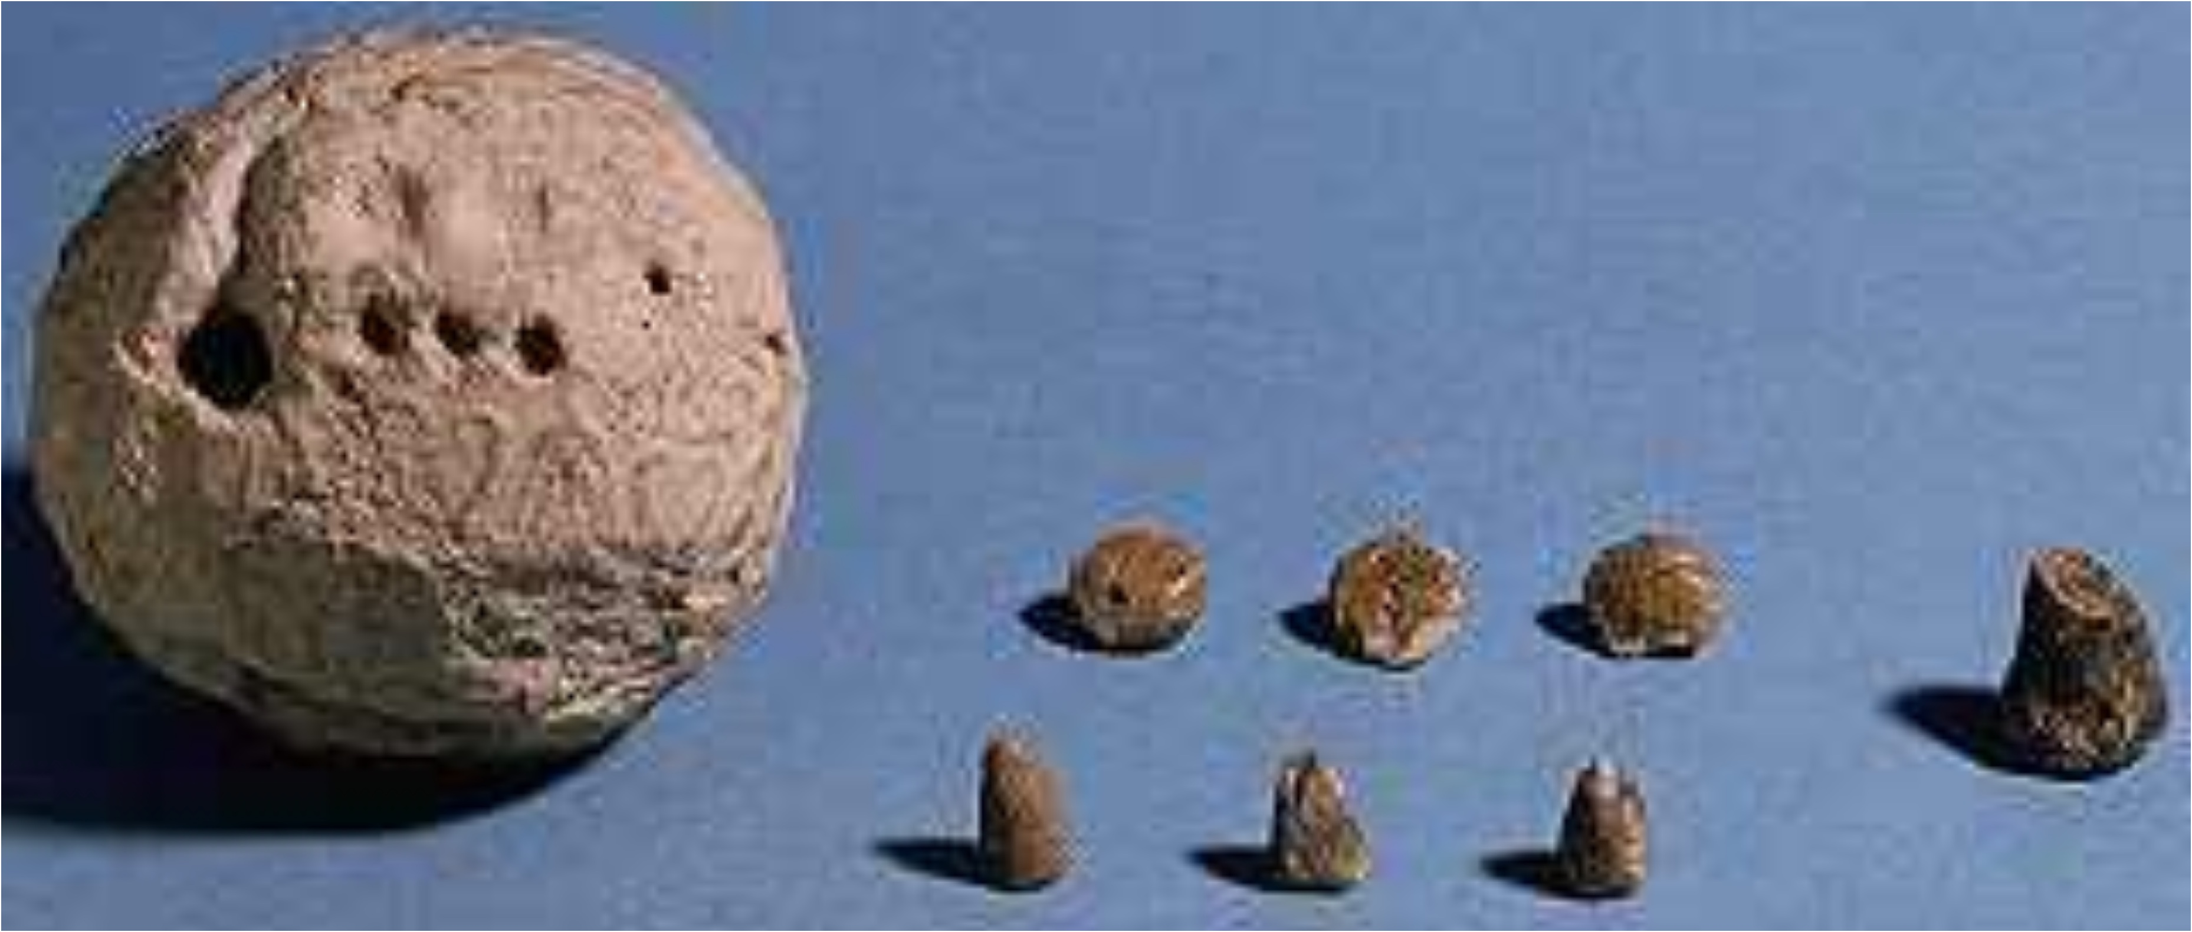
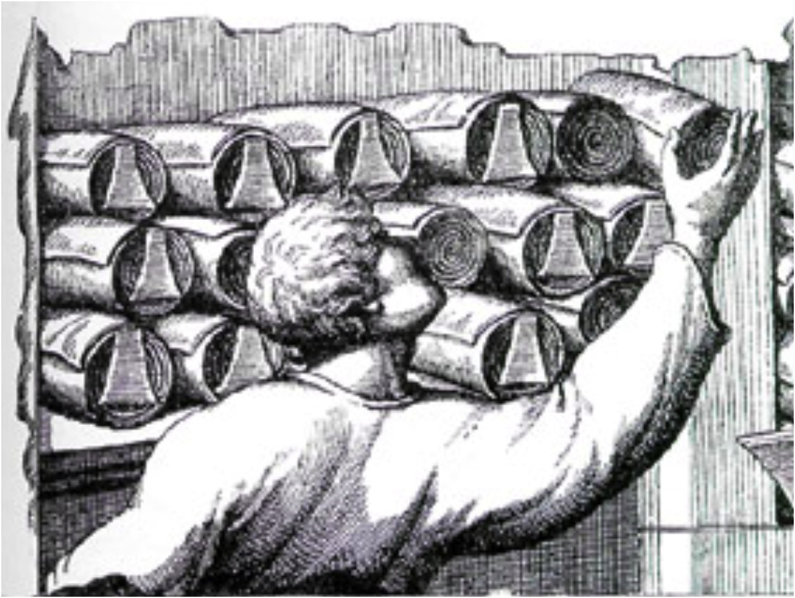
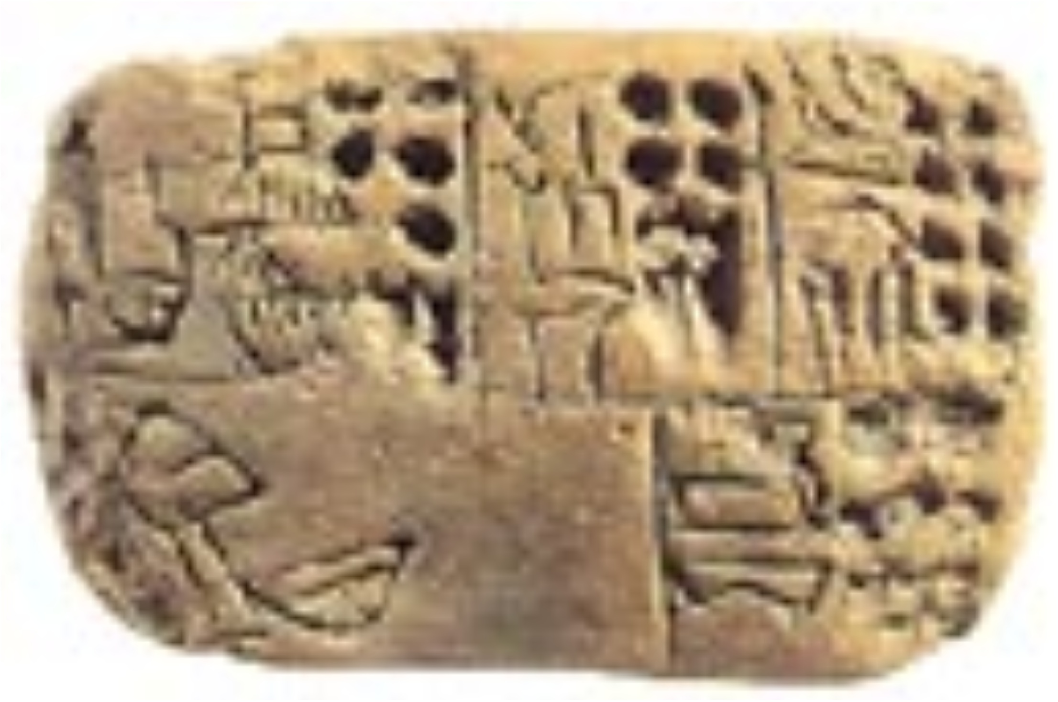
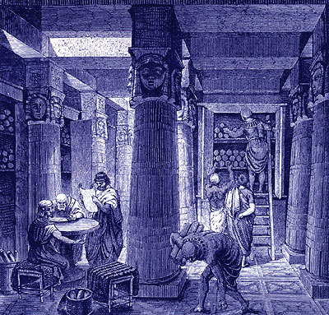
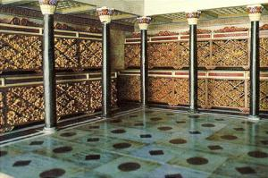
Origins
Very early history of content representation
Sumerian tokens and “envelopes”
Alexandria - pinakes
Indices

Slide 33
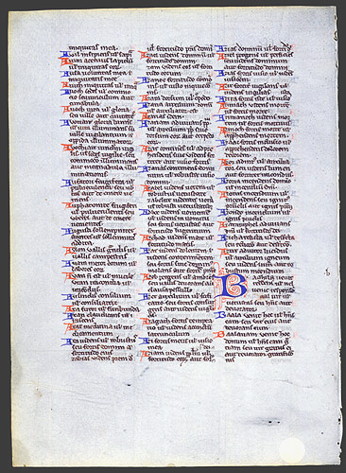
Origins
Biblical Indexes and Concordances
1247 – Hugo de St. Caro – employed 500 Monks to create keyword concordance to the Bible
Journal Indexes (Royal Society, 1600’s)
“Information Explosion” following WWII
Cranfield Studies of indexing languages and information retrieval

Slide 34
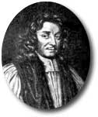
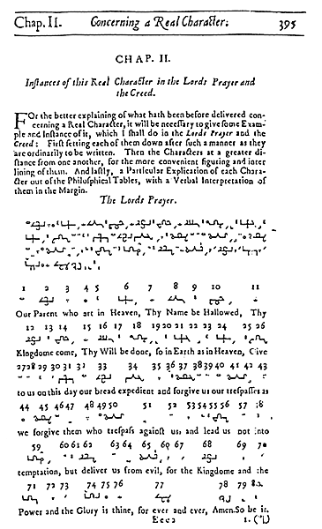
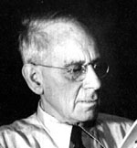
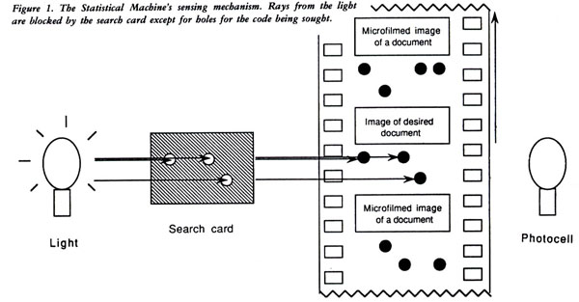
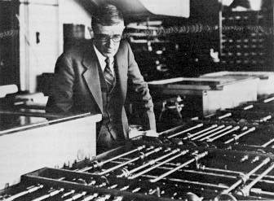
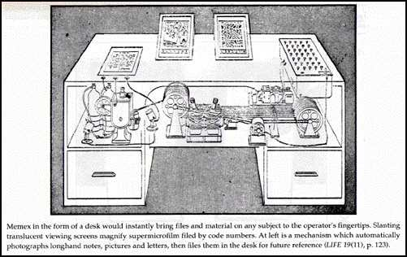
Visions of IR Systems
Rev. John Wilkins, 1600’s : The Philosophical Language and tables
Wilhelm Ostwald and Paul Otlet, 1910’s: The “monographic principle” and Universal Classification
Emanuel Goldberg, 1920’s - 1940’s
H.G. Wells, “World Brain: The idea of a permanent World Encyclopedia.” (Introduction to the Encyclopédie Française, 1937)
Vannevar Bush, “As we may think.” Atlantic Monthly, 1945.
Term “Information Retrieval” coined by Calvin Mooers. 1952

Slide 35
Card-Based IR Systems
Uniterm (Casey, Perry, Berry, Kent: 1958)
Developed and used from mid 1940’s)
EXCURSION 43821
90 241 52 63 34 25 66 17 58 49
130 281 92 83 44 75 86 57 88 119
640 122 93 104 115 146 97 158 139
870 342 157 178 199
207 248 269
298
LUNAR 12457
110 181 12 73 44 15 46 7 28 39
430 241 42 113 74 85 76 17 78 79
820 761 602 233 134 95 136 37 118 109
901 982 194 165 127 198 179
377 288
407

Slide 36
Card Systems
Batten Optical Coincidence Cards (“Peek-a-Boo Cards”), 1948
Excursion
Lunar

Slide 37
Card Systems
Zatocode (edge-notched cards) Mooers, 1951
Document 1
Title: lksd ksdj sjd sjsjfkl
Author: Smith, J.
Abstract: lksf uejm jshy
ksd jh uyw hhy jha jsyhe
Document 34
Title: lksd ksdj sjd Lunar
Author: Smith, J.
Abstract: lksf uejm jshy
ksd jh uyw hhy jha jsyhe
Document 200
Title: Xksd Lunar sjd sjsjfkl
Author: Jones, R.
Abstract: Lunar uejm jshy
ksd jh uyw hhy jha jsyhe

Slide 38
Computer-Based Systems
Bagley’s 1951 MS thesis from MIT suggested that searching 50 million item records, each containing 30 index terms would take approximately 41,700 hours
Due to the need to move and shift the text in core memory while carrying out the comparisons
1957 – Desk Set with Katharine Hepburn and Spencer Tracy – EMERAC

Slide 39
Development of Bibliographic Databases
Chemical Abstracts Service first produced “Chemical Titles” by computer in 1961.
Index Medicus from the National Library of Medicine soon followed with the creation of the MEDLARS database in 1961.
By 1970 Most secondary publications (indexes, abstract journals, etc) were produced by machine

Slide 40
Boolean IR Systems
Synthex at SDC, 1960
Project MAC at MIT, 1963 (interactive)
BOLD at SDC, 1964 (Harold Borko)
1964 New York World’s Fair – Becker and Hayes produced system to answer questions (based on airline reservation equipment)
SDC began production for a commercial service in 1967 – ORBIT
NASA-RECON (1966) becomes DIALOG
1972 Data Central/Mead introduced LEXIS – Full text of legal information
Online catalogs – late 1970’s and 1980’s

Slide 41
Experimental IR systems
Probabilistic indexing – Maron and Kuhns, 1960
SMART – Gerard Salton at Cornell – Vector space model, 1970’s
SIRE at Syracuse
I3R – Croft
Cheshire I (1990)
TREC – 1992
Inquery
Cheshire II (1994)
MG (1995?)
Lemur (2000?)

Slide 42
The Internet and the WWW
Gopher, Archie, Veronica, WAIS
Tim Berners-Lee, 1991 creates WWW at CERN – originally hypertext only
Web-crawler
Lycos
Alta Vista
Inktomi
Google
(and many others)

Slide 43
Historical Milestones in IR Research
1958 Statistical Language Properties (Luhn)
1960 Probabilistic Indexing (Maron & Kuhns)
1961 Term association and clustering (Doyle)
1965 Vector Space Model (Salton)
1968 Query expansion (Roccio, Salton)
1972 Statistical Weighting (Sparck-Jones)
1975 2-Poisson Model (Harter, Bookstein, Swanson)
1976 Relevance Weighting (Robertson, Sparck-Jones)
1980 Fuzzy sets (Bookstein)
1981 Probability without training (Croft)

Slide 44
Historical Milestones in IR Research (cont.)
1983 Linear Regression (Fox)
1983 Probabilistic Dependence (Salton, Yu)
1985 Generalized Vector Space Model (Wong, Rhagavan)
1987 Fuzzy logic and RUBRIC/TOPIC (Tong, et al.)
1990 Latent Semantic Indexing (Dumais, Deerwester)
1991 Polynomial & Logistic Regression (Cooper, Gey, Fuhr)
1992 TREC (Harman)
1992 Inference networks (Turtle, Croft)
1994 Neural networks (Kwok)
1998 Language Models (Ponte, Croft)

Slide 45
Information Retrieval – Historical View
Research
Industry
Boolean model, statistics of language (1950’s)
Vector space model, probablistic indexing, relevance feedback (1960’s)
Probabilistic querying (1970’s)
Fuzzy set/logic, evidential reasoning (1980’s)
Regression, neural nets, inference networks, latent semantic indexing, TREC (1990’s)
DIALOG, Lexus-Nexus,
STAIRS (Boolean based)
Information industry (O($B))
Verity TOPIC (fuzzy logic)
Internet search engines (O($100B?)) (vector space, probabilistic)

Slide 46
Research Sources in Information Retrieval
ACM Transactions on Information Systems
Am. Society for Information Science Journal
Document Analysis and IR Proceedings (Las Vegas)
Information Processing and Management (Pergammon)
Journal of Documentation
SIGIR Conference Proceedings
TREC Conference Proceedings
Much of this literature is now available online

Slide 47
Research Systems Software
INQUERY (Croft)
OKAPI (Robertson)
PRISE (Harman)
http://potomac.ncsl.nist.gov/prise
SMART (Buckley)
MG (Witten, Moffat)
CHESHIRE (Larson)
http://cheshire.berkeley.edu
LEMUR toolkit (Callan)
Lucene (Pedersen)
Terrier (Ounis)
Many Others

Slide 48
Lecture Overview
Introduction to the Course
(re)Introduction to Information Retrieval
The Information Seeking Process
Information Retrieval History and Developments
Discussion
Credit for some of the slides in this lecture goes to Marti Hearst and Fred Gey

Slide 49
Next Time
Basic Concepts in IR
Readings
Joyce & Needham “The Thesaurus Approach to Information Retrieval” (in Readings)
Luhn “The Automatic Derivation of Information Retrieval Encodements from Machine-Readable Texts” (in Readings)
Doyle “Indexing and Abstracting by Association, Pt I” (in Readings)
H.G. Wells “World Brain”

