Slide 1
Administrative
Final Paper Assignment Sheet Posted on Tue:
3300-5000 words (that is the full range no + or – on the word count)
Word count is without bibliography but including in-line citations
Go ahead and get started with whatever you proposed and outlined for your final paper in part II of assignment 3.

Slide 2
Session 25
Culture (continued)…
Culture and Mobile Phone Appropriation
Cross-Cultural Technology Design

Slide 3
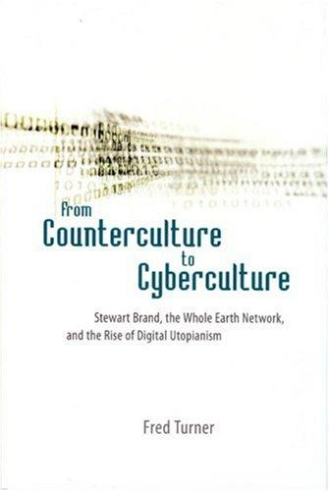
Are online cultures rooted in aspects of American culture? Or particular American subcultures?
Notes:
See also “Cyberspace as American Culture” (2002) by Phil Agre

Slide 4
Outline
Review of “culture” with an emphasis on its connection to information systems and technology (design and use)
Mobile Phone Use as Cultural
Cross-Cultural Design
Cross-Cultural Encounters
Call Center Workers in India

Slide 5
Culture: What it is
Ways of Life (the everyday) … as expressed in practices, habits
Values, Beliefs, Meanings, Attitudes
Shared (rather than unique to the individual)
Often something commonsensical to members, not actively thought about, internalized, socialized into from childhood
Dynamic and changing, but grounded in history (not exclusively the ‘traditional’)
Culture is (still) a useful concept for thinking about irreducible difference and diversity between social groups
Notes:
What is a “particular way of life” composed of?
Special events as well as the everyday
Moving from a sense of culture as being distinguishable by sharp boundaries, best found in communities “isolated” from western influence

Slide 6
Culture – 2 one-sentence definitions
Geertz – “an historically transmitted pattern of meanings embodied in symbols, a system of inherited conceptions expressed in symbolic forms by means of which men communicate, perpetuate, and develop their knowledge about and their attitudes toward life”
Tylor (1871) – “that complex whole which includes knowledge, belief, art, law, morals, custom, and any other capabilities and habits acquired by man as a member of society.”
Notes:
It is habit
It is not just behavior, but the meaning attached to those behaviors, their significance
It is shared (not idiosyncratic)
It is learned, trained into members (not instinctual)
It is whole way of life (not isolated variables, but complex interrelationship)

Slide 7
Culture: What it is not
(1) pure behavior apart from the shared meanings attached to it
(2) idiosyncratic meanings and activities of an individual (that are not shared)
(3) what is instinctual rather than learned, biological functioning
(4) any universal traits of the human species
Notes:
These are conceptual distinctions…so it is not as if a humans “psychology” or “biology” is hermetically sealed and uninfluenced by socialization, the cultural, etc.

Slide 8
Culture + Technology
In Design; In Use
Notes:
If we are studying digital technologies or information systems, how is culture relevant to our concerns?
That people from different cultural contexts may not respond in the same way to the same systems, artifacts – we may need to market to them differently, may develop products with different features or options.
The cultural prohibition against earning interest on invested money in Islam – leads to Islamic banking.
In design and in use. To harness and be more aware of

Slide 9
Values in Design (Nissenbaum)
In the design of a particular artifact or system:
Locus of control centralized or decentralized?
Workings transparent or opaque?
Support balanced terms of information exchange
Unfairly discriminate against specific sectors of potential users?
Enhance or diminish the possibility of trust?
Notes:
Ethics
Keeping in mind that notions and practices of morality as culturally variant. Being explicit about questions of values and criteria (beyond the technical) in the design of things.
Nissenbaum reading…introducing ethics. Lack of criteria for evaluating technology on social, political, ethical criteria (only technical…and economic).
Ties to tech and development or tech and poverty movement
A second key feature of VID work is its pragmatism. It is not enough to demonstrate that values are expressed through design decisions. Thinking about values should be included among the set of aspirations that guide and constrain the designs of all technology. If we accept that technology can embody values, let those who design and produce systems take values into consideration as they engineer these system components. The VID framework therefore places ethical and political values on the same plane of importance alongside technical and functional specifications and constraints.
Ethics:
Locus of control centralized or decentralized?
Workings transparent or opaque?
Support balanced terms of information exchange
Unfairly discriminate against specific sectors of potential users?
Enhance or diminish the possibility of trust?

Slide 10
Mobile Phone Use as Cultural
Location | Practice | What is ‘Cultural’ | Feature Usability
Jamaica | ‘Link-up’ – very short, frequent phone calls with long list of contacts | Beliefs and practices in relating to kin (and beyond kin) especially pronounced in low-income population | Address books not long enough
Japan | ‘Kawaii’ – customizing phone with cute figures | Buddhist reverence for animals, gift exchange practices – across ages and genders | Providing suitable customization content
Notes:
Culture not something existing outside of the material world, technology, but expressed in ways of engaging with features.
Culture materializes technology in a particular way through forms of use.

Slide 11
Mobile Phone Use as Cultural
US | Slang/Informal texting – short msgs with limited set of same individuals | Friendship as emotional support, identity work, especially among women | Accessibility of exclamation point
China | Highly formal texting with friends at a distance – very long msgs sharing life events | Friendship “appears indifferent but is pure like water” – reserved warmth, reasonable distance | Constraints on message length
Ghana/Uganda | Flashing/Beeping - ring phone but hang up before answering | Norms of reciprocity, generosity, general conditions of scarcity | Free txt msg templates with standard content “call me”

Slide 12
Cross-Cultural Design

Slide 13
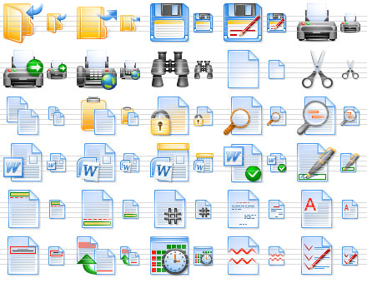
Sun (2012)
Internationalization – “isolating and extracting all cultural context from a product”
Localization – respecifying a product (software) for different markets
Language
Currencies
Icons/symbols
Colors

Slide 14
Cultural usability?
As opposed to usability that ignores sociocultural context surrounding a product, treats usability as an isolated property
Levels of context: (1) immediate, (2) sociocultural – a) subcultural and b) higher level / national
Awareness of localization as part of a ‘cultural circuit’ – developer localization, but also user localization
Notes:
Certainly we’ve discussed all throughout the semester ways in which users take up technologies and figure out how to adapt them,

Slide 15
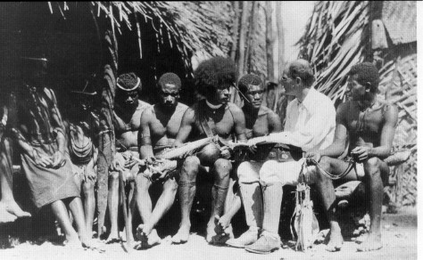
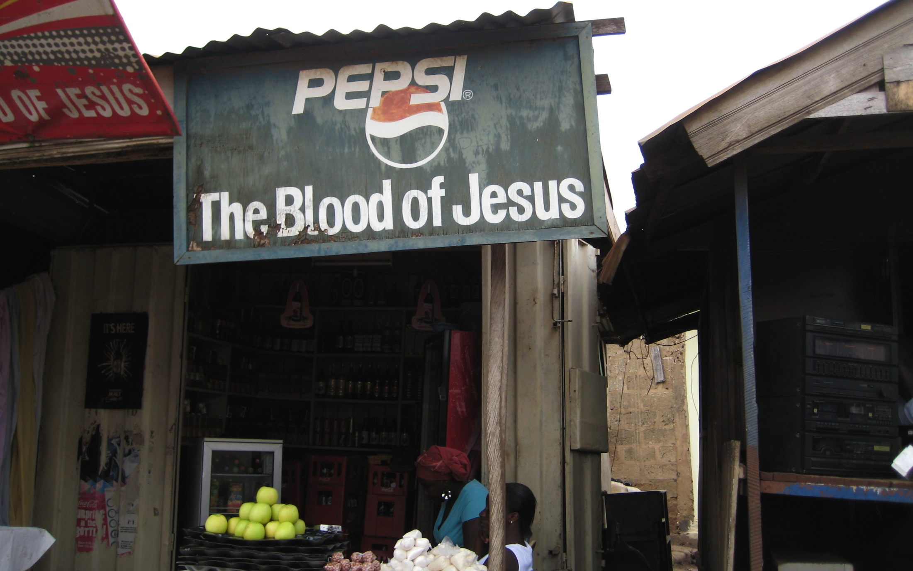
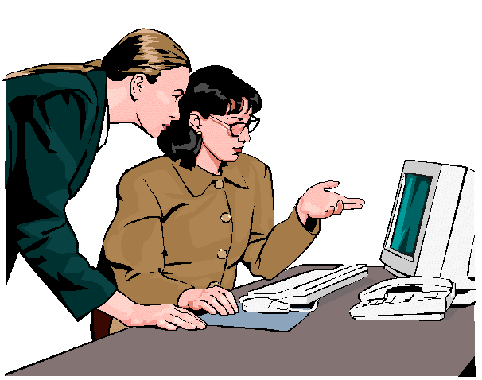
In the End…
What method to incorporate or account for cultural influences in design?
Go Talk to People - “structured fieldwork methods”
Big data is no substitute (action + meaning)
No pre-established set of ‘cultural dimensions’ offers much utility, predictive power
No handbook
Notes:
In the end…because this is the last lecture.
No real shortcuts.
Talk to people, listen, and understand from their point of view… ‘structured fieldwork methods’

