Slide 1
Session 23
Scarcity and Poverty

Slide 2
Outline – Scarcity and Poverty
Digital Inequality – A Global View
Ethics of Online Labor
Amazon Mechanical Turk
Design for Development
Interfaces for Self-Help Groups (India)
Repair and Maintenance
Designing for the full technology life-cycle
Show and Tell from Ghana
Notes:
Continuing from the discussion of inequality online, the “Digital Divide”
A more global outlook

Slide 3
Digital inequalitY vs. The Digital Divide
A Global View

Slide 4
The Global Divide
More dramatic differences between rural and urban
Skills and relevance: Language issues a central focus
Comparison between countries: political economic context, infrastructure, telecomm policy, gov filtering
Overall North America represents declining share of Internet users globally
Notes:
The Google interface for the Akan language

Slide 5
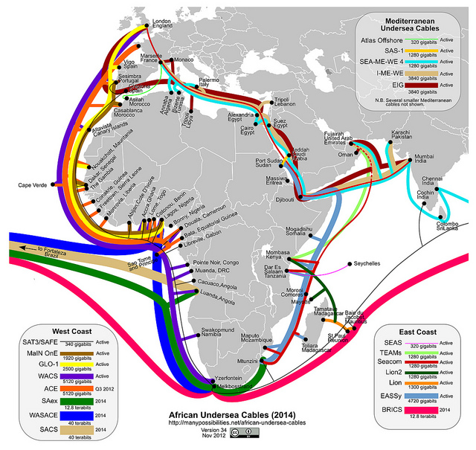
Digital Inequalities in a Globally Connected Network
Are we all on the same Internet? The View from Ghana:
E-commerce vs. cash-based economies
‘Cloud computing’ and web services
Advertising and network bandwidth
Online subcultures (increasingly exclusionary)
Notes:
http://blogs.berkeley.edu/2012/10/08/is-the-digital-divide-a-defunct-framework/
What it’s like to connect from the margins of the global economy?

Slide 6
Ethics of Online Labor

Slide 7
- Google’s 2004 founders letter

Slide 8
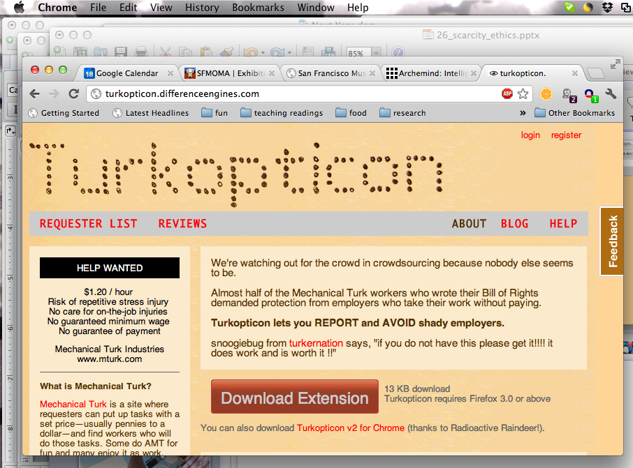
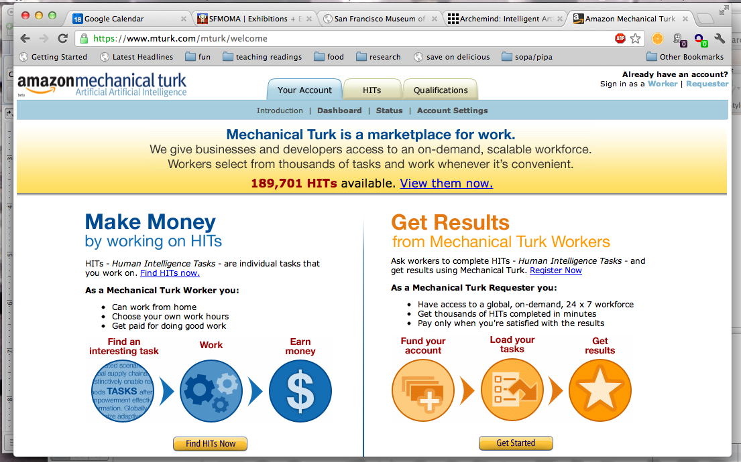
Ethics of Online Labor
Crowdsourced Work Platforms
Unethical Behavior in online employment / contracting situation
Why is interaction on AMT anonymous?
How do Turkers seek recourse?
How might Amazon design the Mechanical Turk platform differently?
Notes:
Requestors have unchecked power to reject work -- weighted towards the requestors NOT the Turkers. But in a trial found a huge number of cheated responses (on a Chinese language task). 3174 responses out of 8498 wre fraudulent
Anticipating values in design approach … design guidelines around ethical practice (not conventional usability terms)

Slide 10
Design for Development
(1) Interfaces for (Self-Help) Groups (in India)

Slide 11
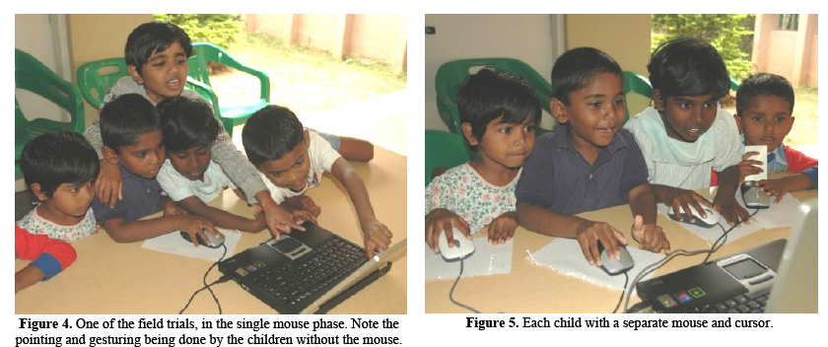
Special Design Challenges
Limited infrastructure (electricity, Internet connectivity)
Shared access models and designing for groups, collectives (rather than individuals)
Low-literacy populations
How did T. Parikh address and resolve each of these challenges?

Slide 13
Scarcity and repair

Slide 14
Repair or Replace?
What was the last electronic item you replaced? Was it because it was non-functioning? Or for other reasons?
What did you do with the replaced item?
What are your own personal ‘rules of thumb’ for deciding whether to repair or replace?
Obsolescence – ifixit.com (movement against waste, obsolescence, alienation from our gadgets and their inner-workings)

Slide 15
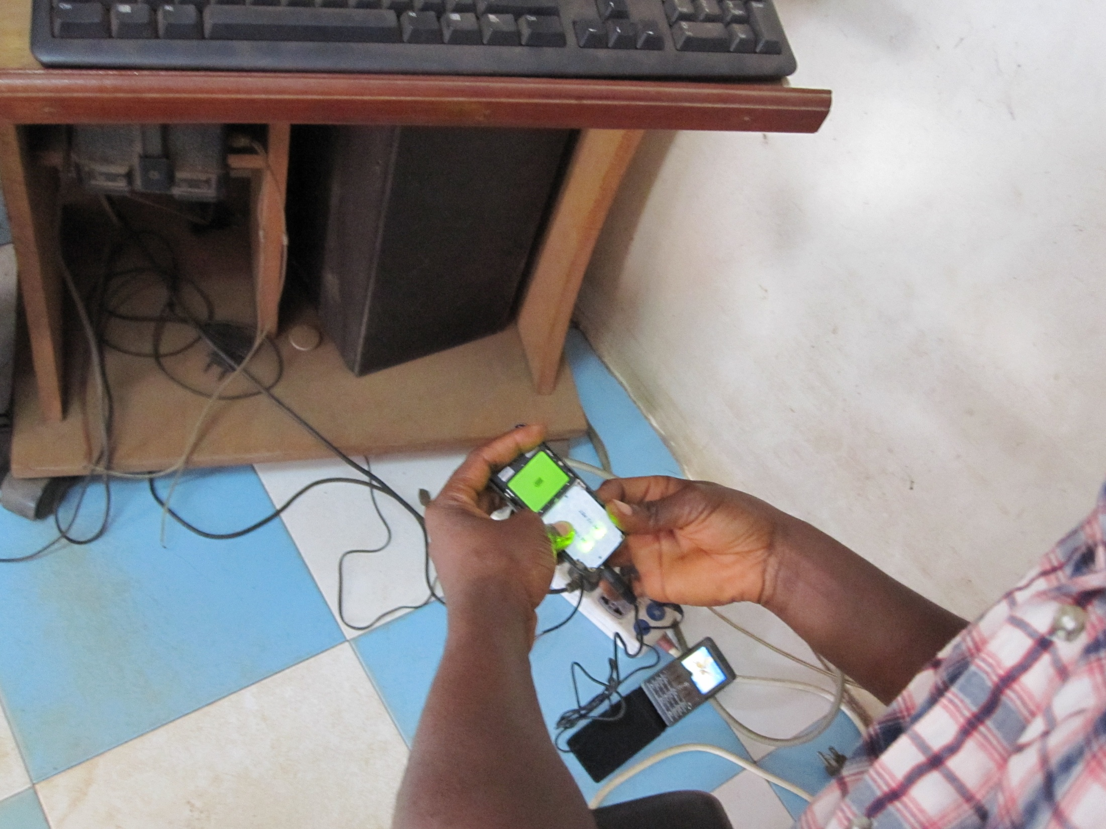
Cultures of Repair & Reuse (Ghana)
Notes:
As a way to more closely incorporate the material and the cultural.
How culture is materially instantiated. How culture must be “materialized” in some form or another.

Slide 16
Design for the Full Life Cycle?
Distribution
Use
Maintenance
Disposal
cost
suppliers
markets
buyers
theft
usability and skill
user needs and values
training
spare parts
planned vs. breakdowns
repair skills
obsolescence
waste

Slide 17
Consumer Culture Shaped By
Breakdowns as ordinary, everyday occurrence (from electricity outages to equipment failure)
Limited consumer protections, no warranties, high risk
High proportion of durable goods are purchased second-hand
Shortened life span from environmental wear and tear
Scarcity
Frugality
Unreliability
Backup/ Redundancy
Environmental Exposure

Slide 18
Reuse and the Trade in Second-Hand Electronic Goods

Slide 19
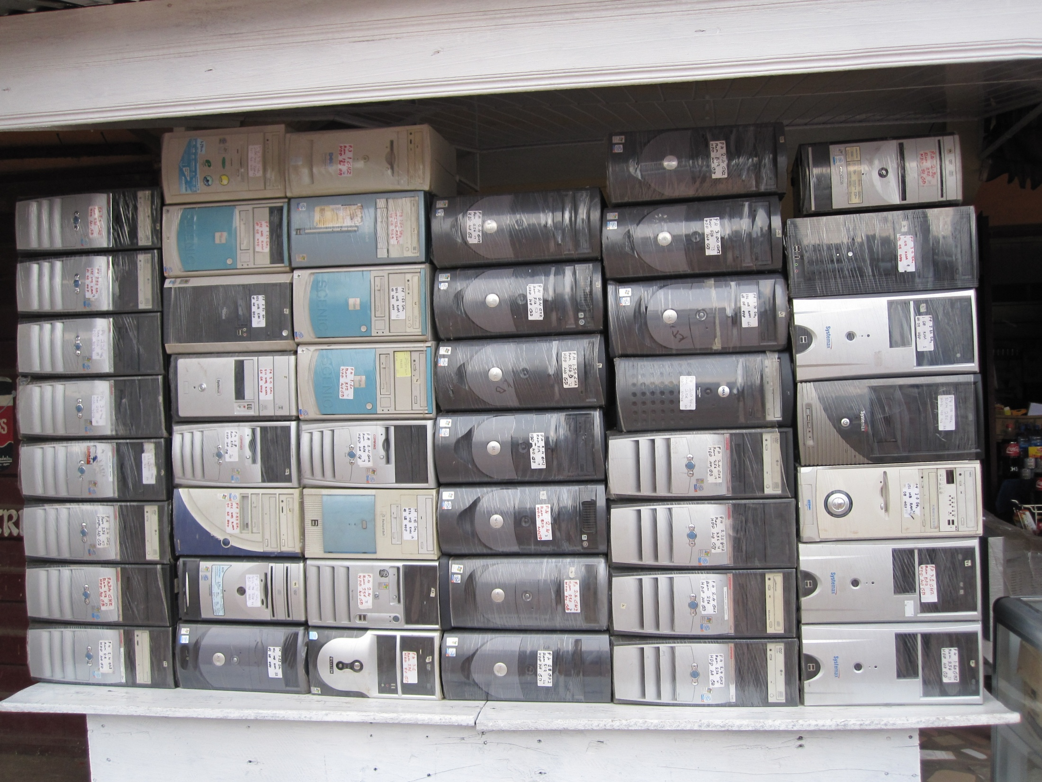
Attitudes Towards Buying Used

Slide 20
Infrastructure workarounds

Slide 21
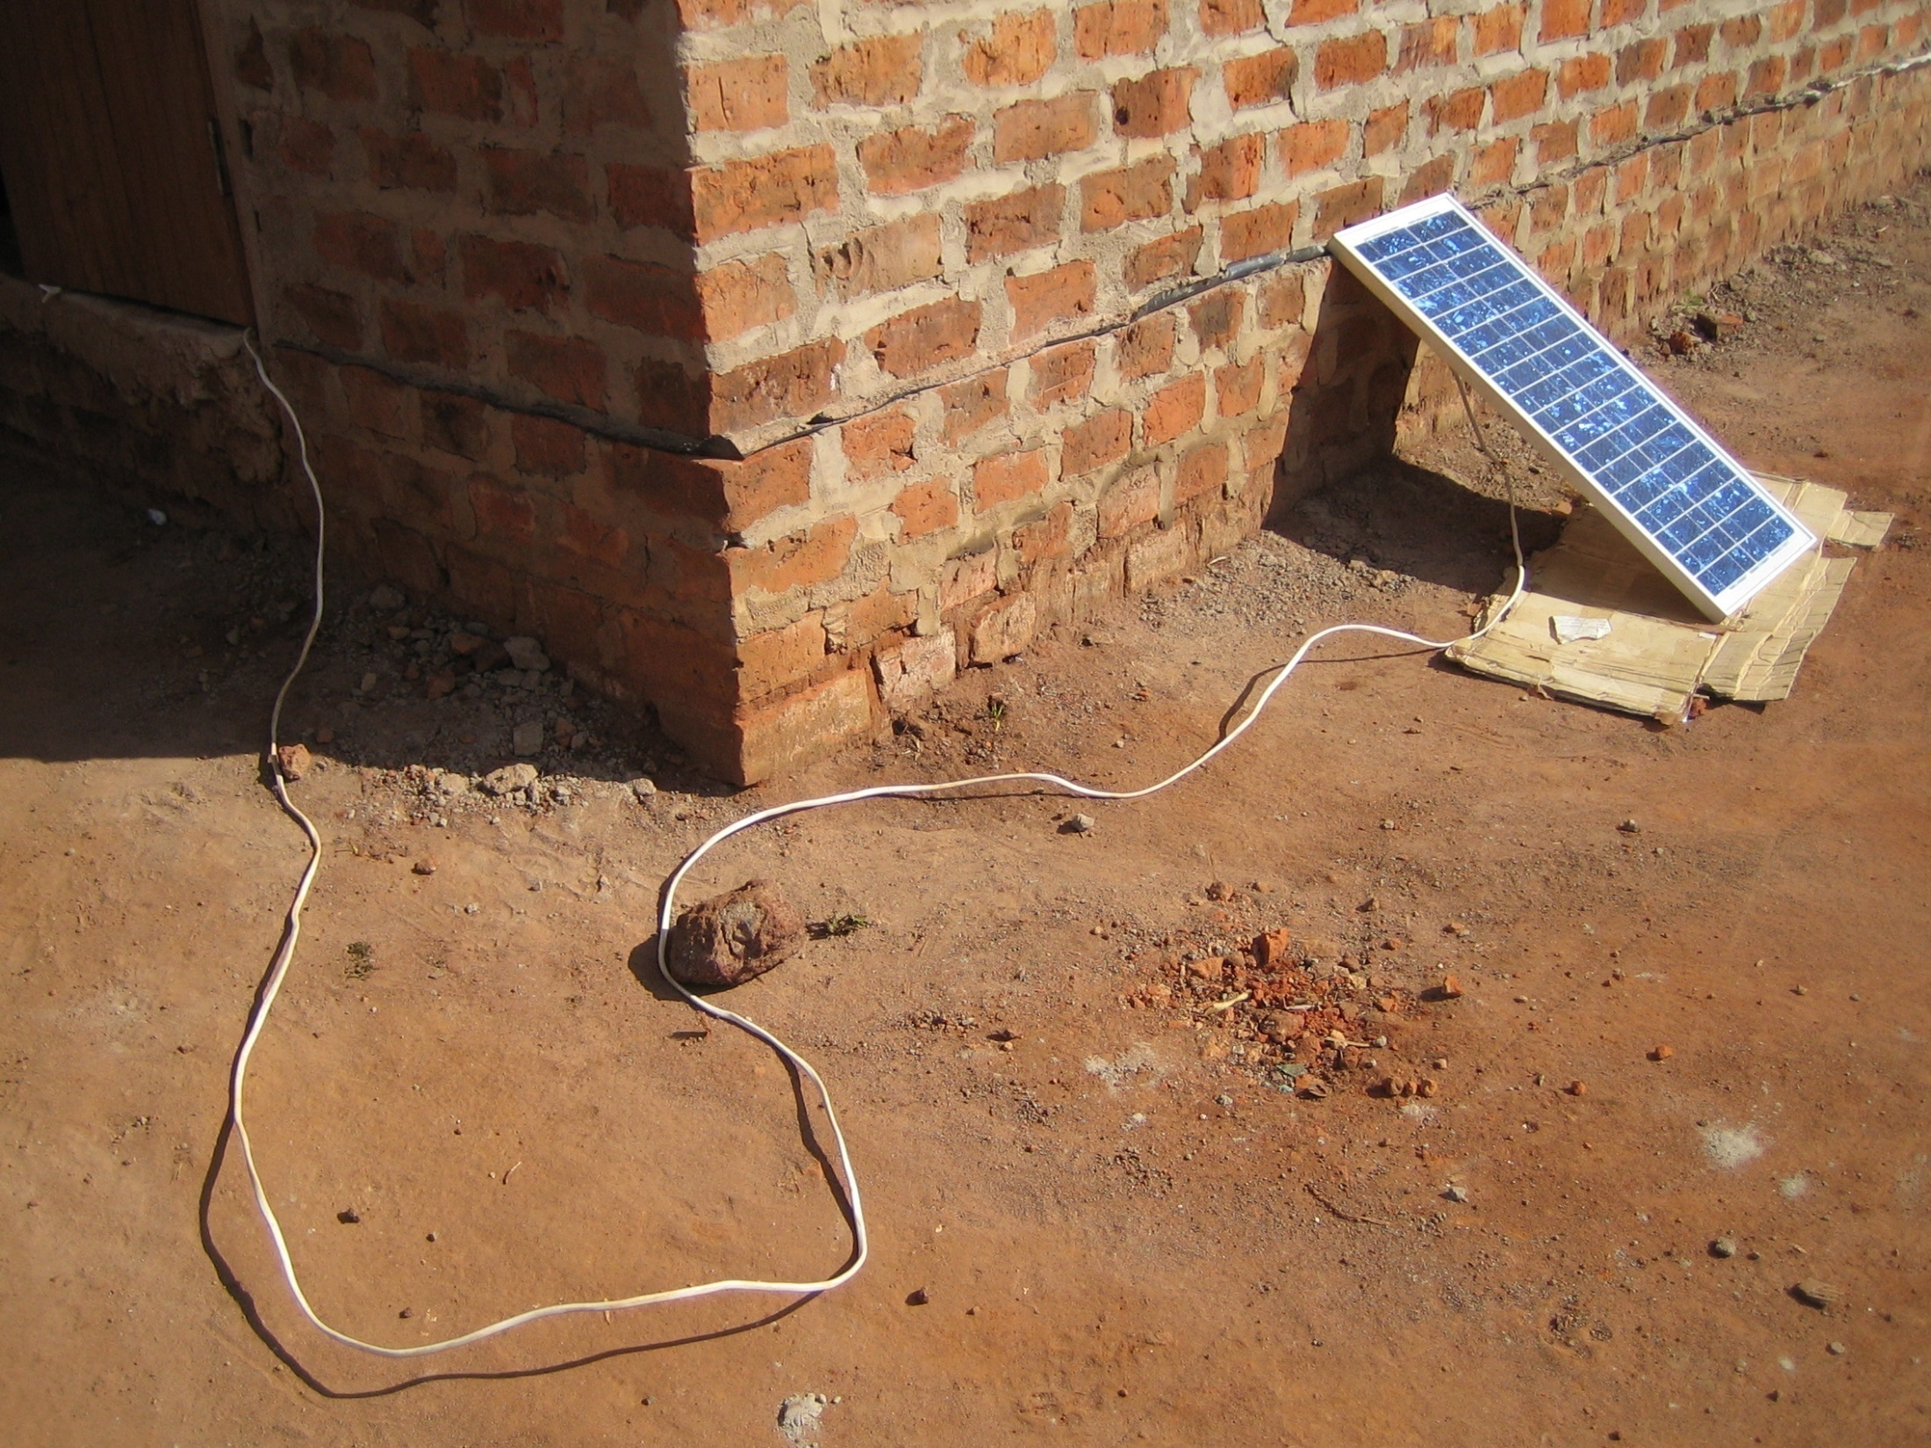
Notes:
Phone charging in a non-electrified village (Uganda)

Slide 22
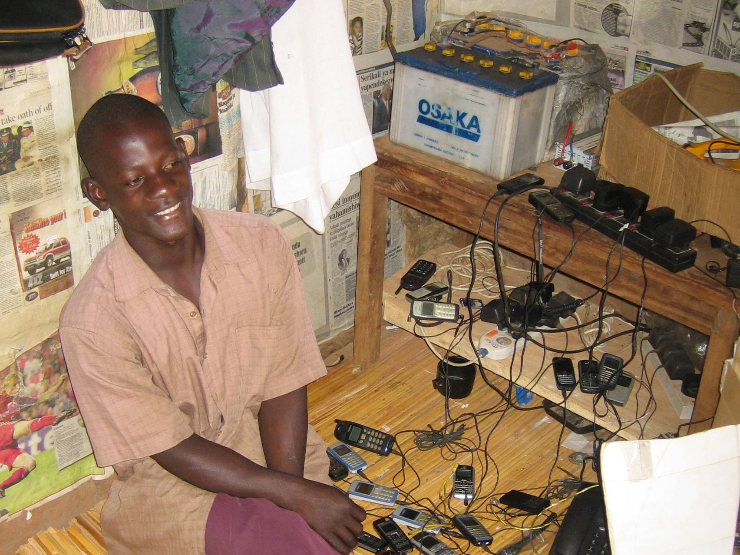
Notes:
Phone charging in a non-electrified village – note the car battery (Uganda)

Slide 23
The ‘Rules’ of Repair

Slide 24
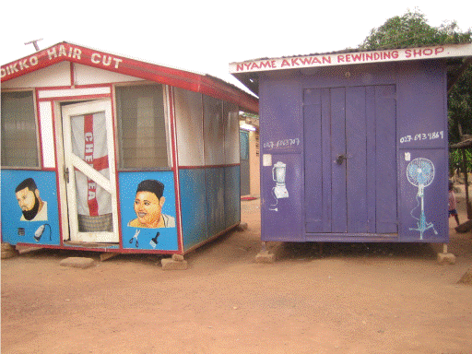
Repairable vs. Disposable

Slide 25
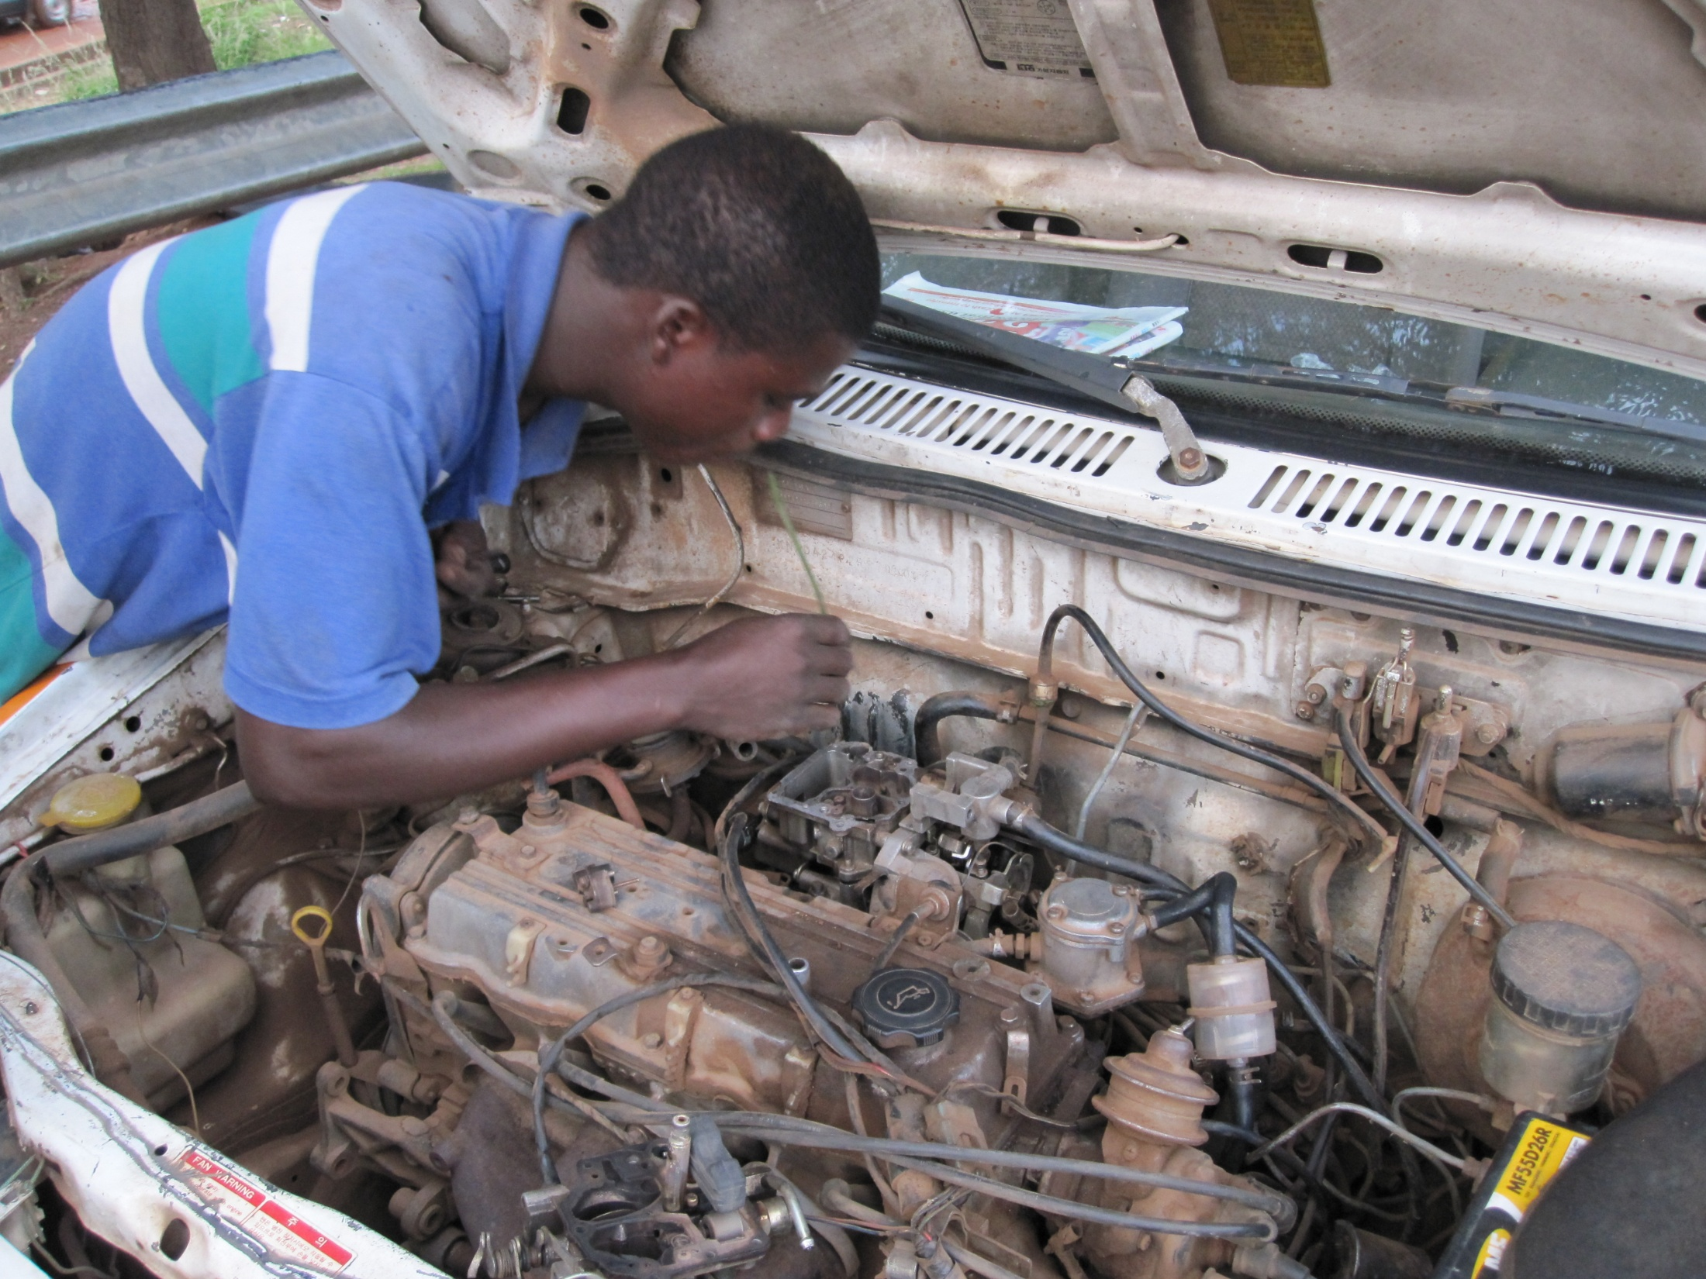
Frequency of Repair; Tools
Notes:
Repair without tools, the body as a tool.

Slide 26
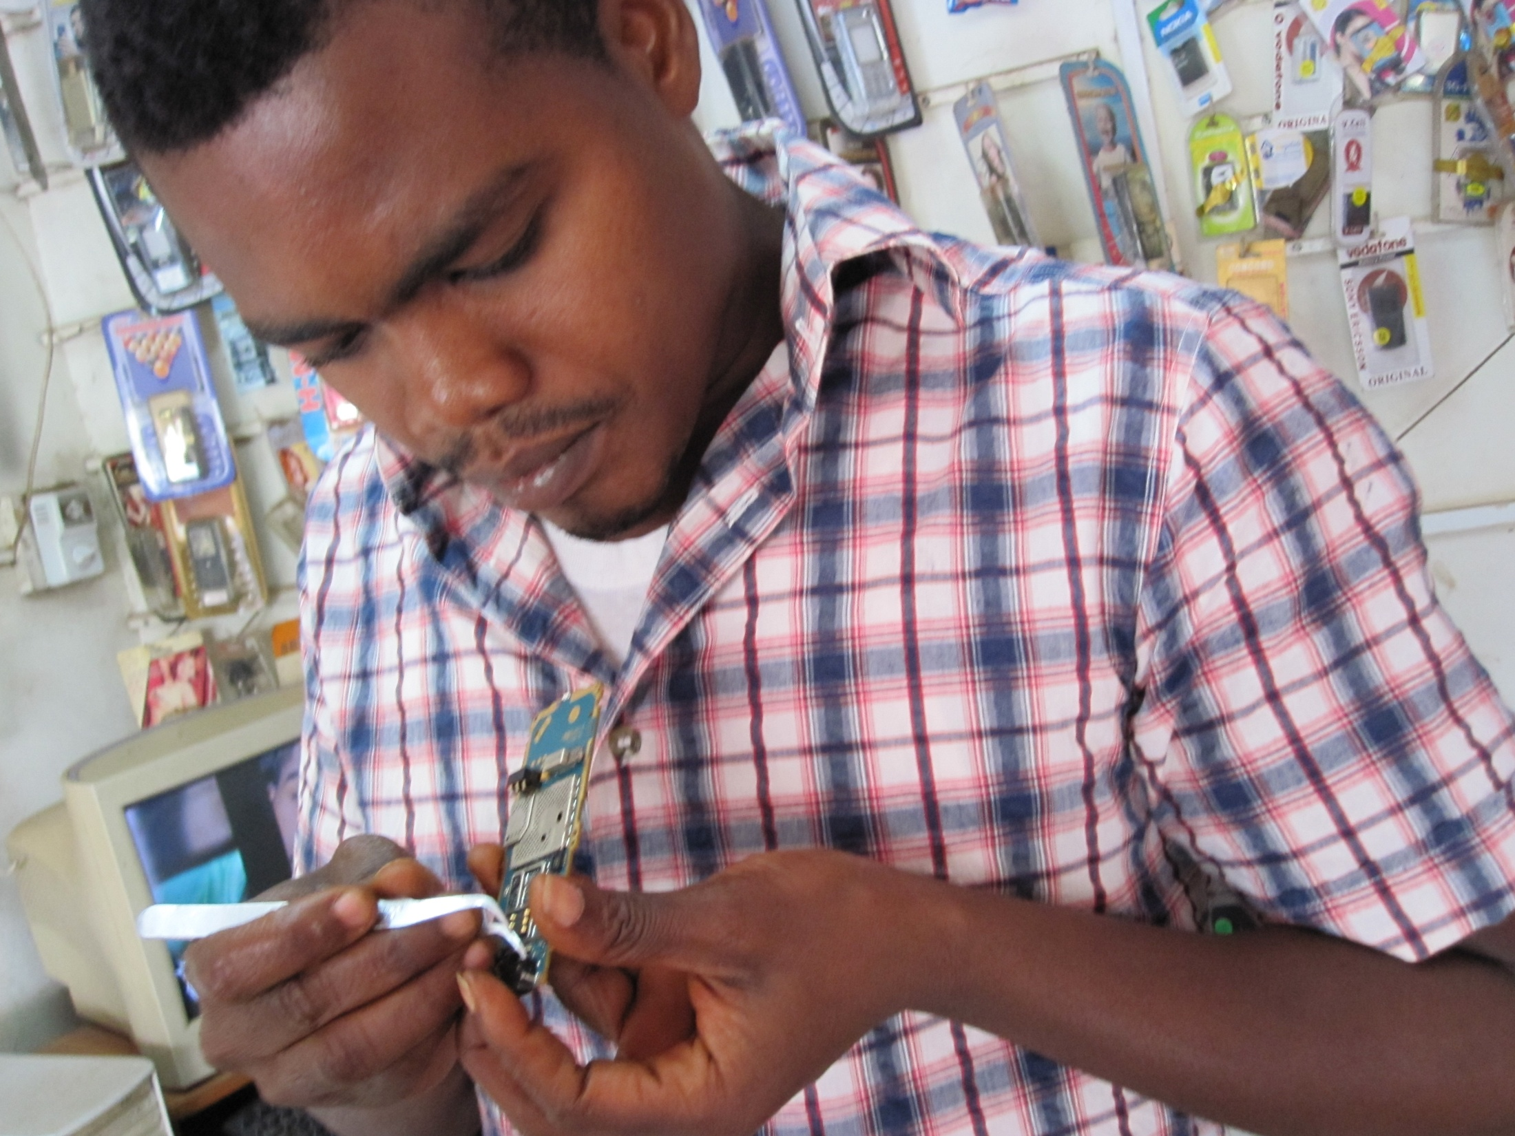
Replacement Parts

Slide 27
Disposal

Slide 28
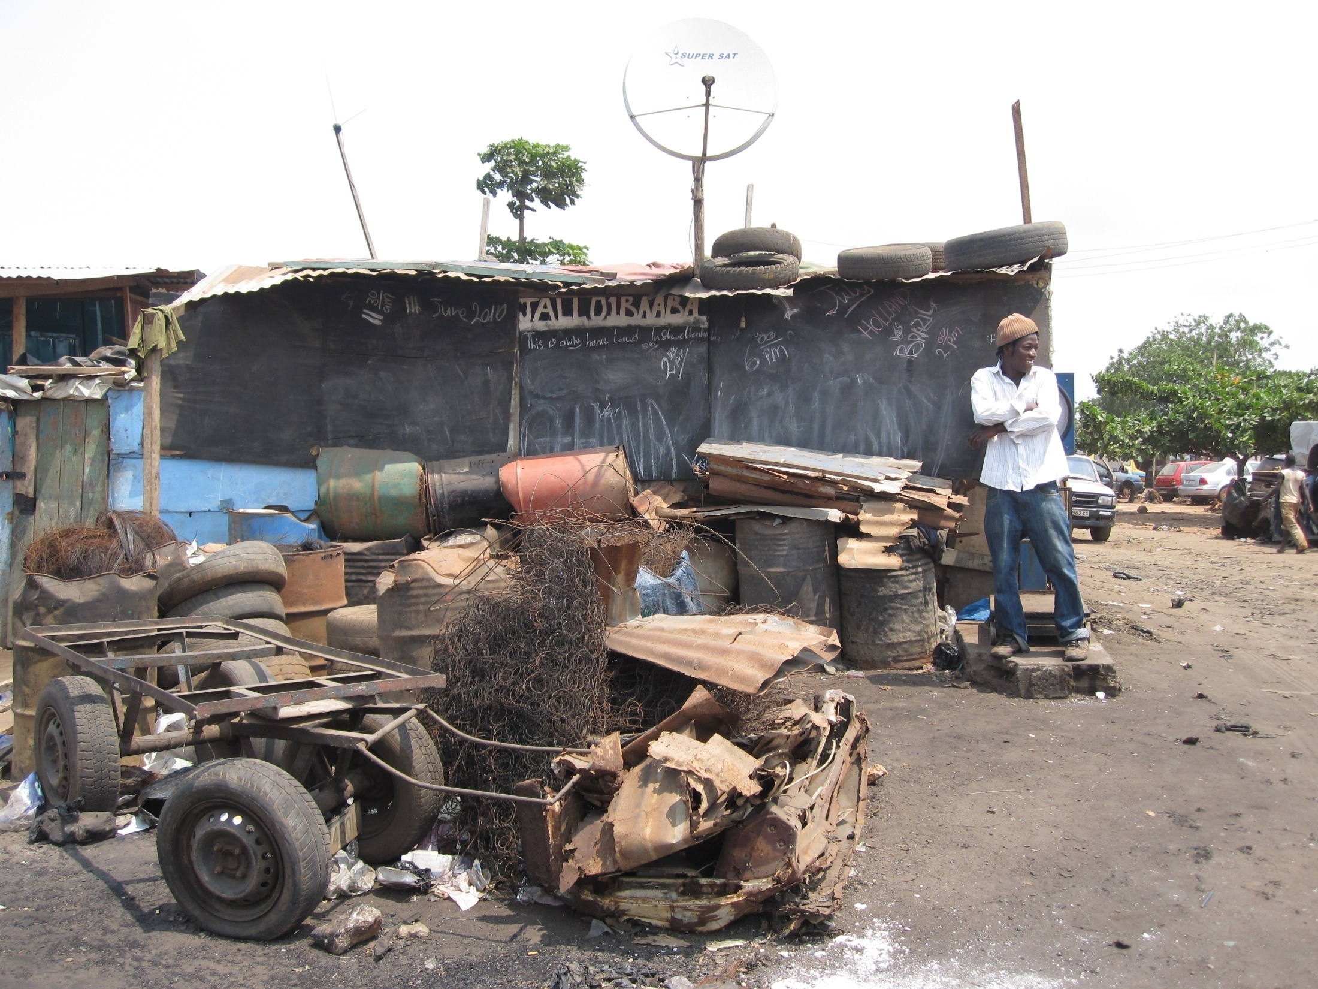
Metal Scrap Dealers

